Slide 1
JAVA PROGRAMMING · CHAPTER 04
Java 程序设计
Java Programming
第 4 章 · 类与对象
Chapter 4 · Classes and Objects
中国石油大学（北京）克拉玛依校区
China University of Petroleum (Beijing) Karamay Campus
授课教师：潘啸晨
Instructor: Pan Xiaochen

Slide 2
第 4 章 · 类与对象
Chapter 4 · Classes and Objects
04
类与对象
Classes and Objects
面向对象编程核心章：类是创建对象的模板，掌握类、对象、封装、复用、包与访问权限，是写出易维护、易扩展、易复用 Java 程序的基础。
Core Chapter of Object-Oriented Programming: Classes are templates for creating objects. Mastering classes, objects, encapsulation, reuse, packages and access permissions is the basis for writing Java programs that are easy to maintain, expand and reuse.
2 / 151

Slide 3
第 4 章 · 类与对象
Chapter 4 · Classes and Objects
导读
Introduction
本章导览
Chapter overview
主要内容
Main content
重点
focus
难点
difficulty
类
kind
Java 类的语法规则
Syntax rules for Java classes
对象的创建过程
Object creation process
构造方法与对象的创建
Constructors and object creation
类变量和实例变量
Class variables and instance variables
对象引用与实体的关系
The relationship between object reference and entity
类与对象是面向对象编程的核心：用类创建对象、操作对象的变量与方法，并掌握封装、复用、包与访问权限。
Classes and objects are the core of object-oriented programming: use classes to create objects, manipulate variables and methods of objects, and master encapsulation, reuse, packages, and access permissions.
类与程序的基本结构
Basic structure of classes and programs
import 语句
import statement
访问权限的理解
Understanding access rights
参数传值
Parameter value passing
对象的组合
combination of objects
实例成员与类成员
Instance members and class members
方法重载
Method overloading
this 关键字
this keyword
包
Bag
import 语句
import statement
对象数组
object array
3 / 151

Slide 4
第 4 章 · 类与对象
Chapter 4 · Classes and Objects
§4.1
编程语言的几个发展阶段
Several stages of development of programming languages
4.1.1 面向机器语言：用机器指令（如 0101 1100）编程，必须面向机器编写代码
4.1.1 Machine language-oriented: programming with machine instructions (such as 0101 1100), the code must be written for the machine
编程语言随着计算机硬件与软件思想的发展，经历了从面向机器到面向过程、再到面向对象的演进。
With the development of computer hardware and software ideas, programming languages ​​have evolved from machine-oriented to process-oriented to object-oriented.
4.1.2 面向过程语言（如 C）：把代码组成过程或函数块，不必关心机器指令细节
4.1.2 Process-oriented languages ​​(such as C): organize the code into procedures or function blocks, without caring about the details of machine instructions
4.1.3 面向对象语言：基于对象编程，更符合人的思维模式，鼓励创造性设计
4.1.3 Object-oriented language: Object-based programming is more in line with human thinking patterns and encourages creative design
面向对象三大特性：封装性、继承、多态
Three major characteristics of object-oriented: encapsulation, inheritance, polymorphism
4 / 151

Slide 5
第 4 章 · 类与对象
Chapter 4 · Classes and Objects
§4.1.3
面向过程 vs 面向对象
Process Oriented vs Object Oriented
面向过程语言（如 C）
Procedure-oriented language (such as C)
面向对象语言（如 Java）
Object-oriented languages ​​(such as Java)
· 以函数/过程为程序基本执行单位
· Use function/procedure as the basic execution unit of the program
· 以“对象”为核心，一切围绕对象
· With "object" as the core, everything revolves around the object
· 行为缺少“主体”，谁执行行为并不明确（说话没主语）
· The behavior lacks a "subject" and it is not clear who performs the behavior (the speech has no subject)
· 方法必须指定主体，如“奔驰车刹车了”（说话有主语）
· The method must specify the subject, such as "The Mercedes-Benz brakes" (the speech has a subject)
· 关注“做什么、怎么做”的步骤
· Focus on the “what to do and how to do it” steps
· 更符合人的思维模式，易维护、易扩展、易复用
· More in line with human thinking mode, easy to maintain, easy to expand and easy to reuse
核心理念的区别在于“行为是否有主体”。
The difference in the core concept is "whether the behavior has a subject."
· 数据与操作相分离
· Separation of data and operations
· 封装、继承、多态三大特性
· Three major features: encapsulation, inheritance, and polymorphism
5 / 151

Slide 6
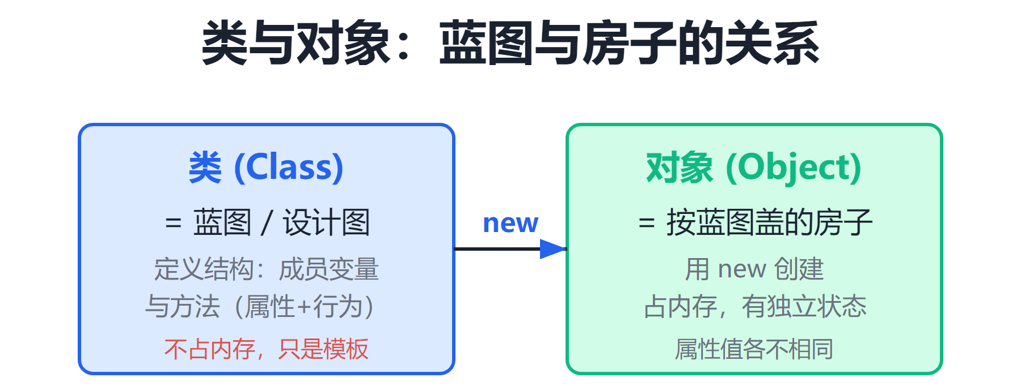
第 4 章 · 类与对象
Chapter 4 · Classes and Objects
§4.2
类
kind
类的实现包括两部分：类声明和类体；基本格式：class 类名 { 类体的内容 }
class 是关键字；类名必须是合法的 Java 标识符
class is a keyword; the class name must be a legal Java identifier
类是 Java 语言中最重要的“数据类型”；类声明的变量被称作对象，类是用来创建对象的模板。源程序由若干个类组成，源文件是扩展名为 .java 的文本文件。
Classes are the most important "data types" in the Java; variables declared by classes are called objects, and classes are templates used to create objects. The source program consists of several classes, and the source file is a text file with the extension .java.
两个大括号及其间的内容是类体
The two curly braces and the content between them are the class body
类比：类好比“蓝图”，对象好比按蓝图建造的“房子”（见示意图）
Analogy: A class is like a "blueprint", and an object is like a "house" built according to the blueprint (see diagram)
6 / 151

Slide 7
第 4 章 · 类与对象
Chapter 4 · Classes and Objects
§4.2.1
类声明
class declaration
类声明：class 类名（如 class People、class 植物）
Class declaration: class class name (such as class People, class Plant)
写类的目的是为了描述一类事物共有的属性和功能。类声明的基本形式：class 类名。
The purpose of writing a class is to describe the common attributes and functions of a class of things. The basic form of class declaration: class class name.
“class People”和“class 植物”称作类声明；People、植物分别是类名
"Class People" and "class Plant" are called class declarations; People and Plant are class names respectively.
命名风格（非语法要求，但应遵守）：
Naming style (not a syntax requirement, but should be followed):
① 类名首字母使用大写字母
① Use capital letters for the first letter of the class name
② 类名见名知意；多个单词复合时每个单词首字母大写
② The meaning of the class name is obvious; when multiple words are combined, the first letter of each word is capitalized
7 / 151

Slide 8
第 4 章 · 类与对象
Chapter 4 · Classes and Objects
§4.2.2
类体
class body
类声明之后的一对大括号及其中内容称为类体；内容分两部分：变量声明（刻画属性）与方法定义（刻画行为）。
The pair of curly brackets after the class declaration and the content inside are called the class body; the content is divided into two parts: variable declaration (characterizing attributes) and method definition (characterizing behavior).
类声明之后的一对大括号及其中内容称为类体
The pair of curly braces after the class declaration and the contents inside are called the class body
类体内容 = 变量声明（刻画属性）＋ 方法定义（刻画行为）
Class body content = variable declaration (characterizing attributes) + method definition (characterizing behavior)
成员变量与方法的声明顺序可任意（见下页 Ladder 完整代码）
Member variables and methods can be declared in any order (see the complete code of Ladder on the next page)
8 / 151

Slide 9
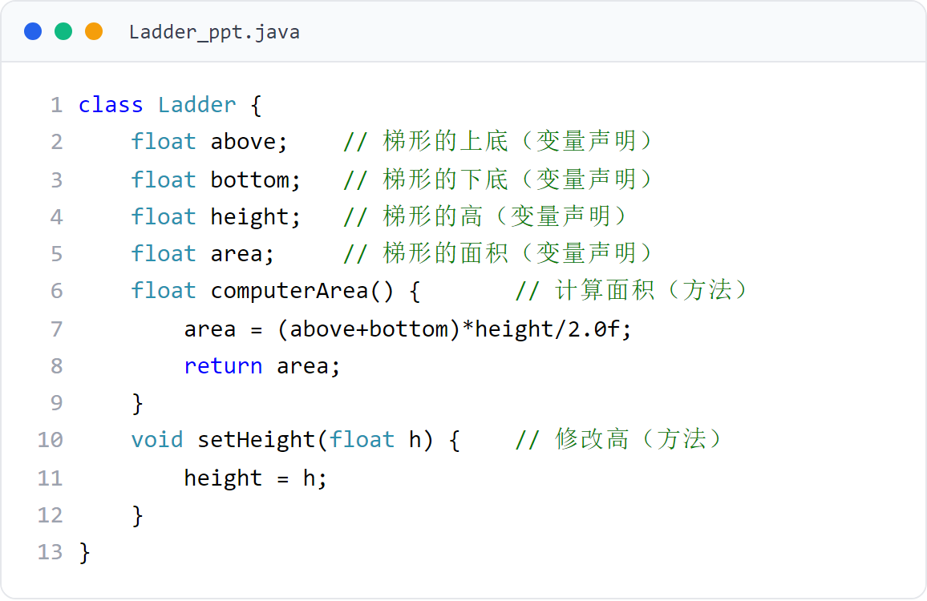
第 4 章 · 类与对象
Chapter 4 · Classes and Objects
§4.2.2
类体示例：Ladder 类
Class body example: Ladder class
Ladder 类体包含 4 个成员变量与 2 个方法，演示类体的完整结构。
The Ladder class body contains 4 member variables and 2 methods, demonstrating the complete structure of the class body.
9 / 151
Notes:
[课堂运行示例 / Classroom Demo]
课堂运行：课堂示例代码/第4章/ClassObjectDemo.java
创建两个 Rectangle 对象，修改各自的长宽，比较独立的成员变量。
[Sources]
Source concepts: user-provided chapter deck. Demo code: original instructional material.

Slide 10
第 4 章 · 类与对象
Chapter 4 · Classes and Objects
§4.2.3
成员变量
member variables
① 类型可以是任意 Java 数据类型：基本类型（整型、浮点、字符、逻辑）或引用类型（数组、对象、接口）
① The type can be any Java data type: basic type (integer, floating point, character, logical) or reference type (array, object, interface)
类体中变量声明部分所声明的变量称为成员变量或域变量。
The variables declared in the variable declaration part of the class body are called member variables or fields.
② 在整个类内的所有方法中都有效，与在类体中出现的位置无关
② Valid in all methods within the entire class, regardless of where it appears in the class body
③ 声明时未指定初值，编译器会为其指定默认值
③ If no initial value is specified when declaring, the compiler will assign a default value.
④ 若某变量初值依赖于另一变量，则被依赖者应先于它声明
④ If the initial value of a variable depends on another variable, the dependent one should be declared before it
10 / 151

Slide 11
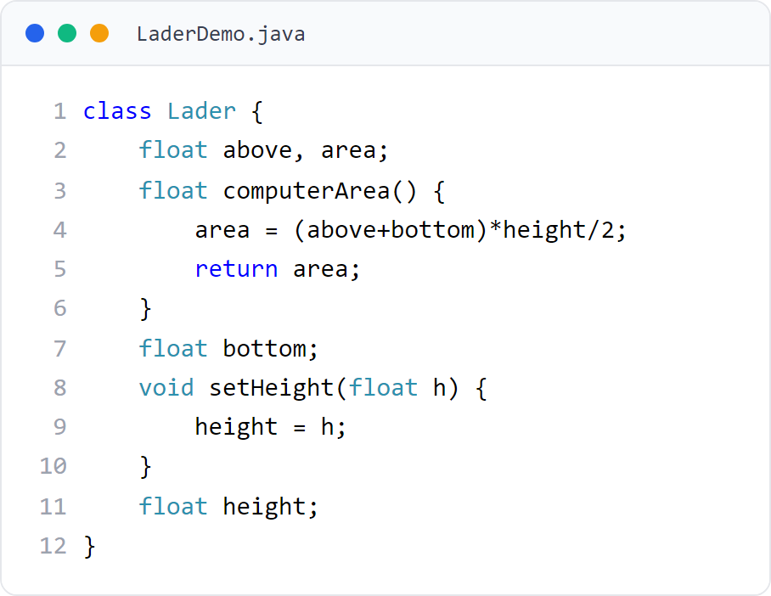
第 4 章 · 类与对象
Chapter 4 · Classes and Objects
例题
example
定义梯形类
Define ladder class
成员变量可在类体任意位置声明——成员变量在整个类内所有方法中都有效，与声明位置无关（§4.2.3②）。
Member variables can be declared anywhere in the class body - member variables are valid in all methods within the entire class, regardless of the declaration position (§4.2.3②).
11 / 151

Slide 12
第 4 章 · 类与对象
Chapter 4 · Classes and Objects
§4.2.4
方法（一）：方法声明（方法头）
Method (1): Method declaration (method header)
方法头：方法的类型、名称、小括号及参数列表
Method header: method type, name, parentheses and parameter list
方法返回类型可以是 Java 中任何数据类型；不需返回数据时必须是 void
The method return type can be any data type in Java; it must be void when no data needs to be returned.
方法头由方法的类型、名称、小括号及参数列表构成。
The method header consists of the method's type, name, parentheses, and parameter list.
int speak() { return 23; }
int add(int x, int y, int z) {
return x + y + z;
}
12 / 151

Slide 13
第 4 章 · 类与对象
Chapter 4 · Classes and Objects
§4.2.4
方法（二）：方法体
Method (2): Method body
方法体：局部变量声明 ＋ Java 语句
Method body: local variable declaration + Java statement
局部变量只在方法内有效，且与其声明位置有关
Local variables are only valid within a method and are related to the location where they are declared.
方法声明之后的一对大括号及其中内容称为方法体，包括局部变量的声明和 Java 语句。
The pair of curly brackets after the method declaration and the content inside are called the method body, including the declaration of local variables and Java statements.
int getSum(int n) {
int sum = 0;
for (int i = 1; i <= n; i++) sum += i;
return sum;
}
13 / 151

Slide 14
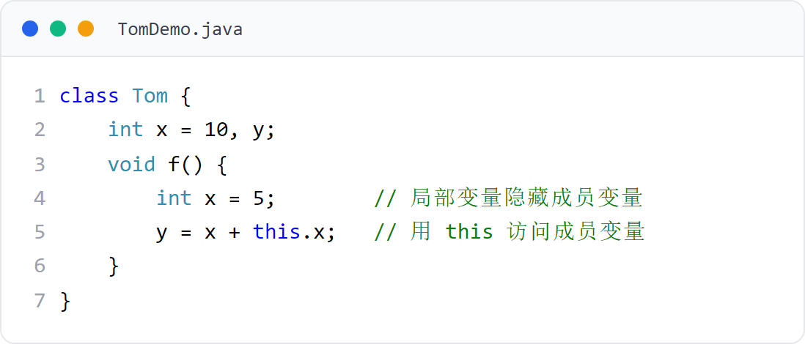
第 4 章 · 类与对象
Chapter 4 · Classes and Objects
§4.2.4
区分成员变量和局部变量
Distinguish between member variables and local variables
局部变量与成员变量同名时，成员变量被隐藏（该方法内暂时失效）；用 this 访问被隐藏的成员变量（§4.9 详讲）。
When a local variable has the same name as a member variable, the member variable is hidden (temporarily invalid in this method); use this to access the hidden member variable (details in §4.9).
14 / 151

Slide 15
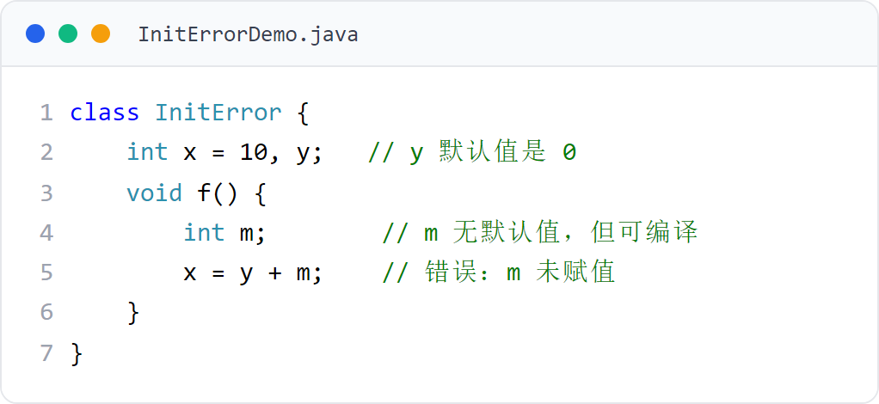
第 4 章 · 类与对象
Chapter 4 · Classes and Objects
§4.2.4
局部变量没有默认值
Local variables have no default value
成员变量有默认值（见 §4.2.3），但局部变量没有默认值，使用前必须赋值。
Member variables have default values ​​(see §4.2.3), but local variables do not have default values ​​and must be assigned a value before use.
15 / 151

Slide 16
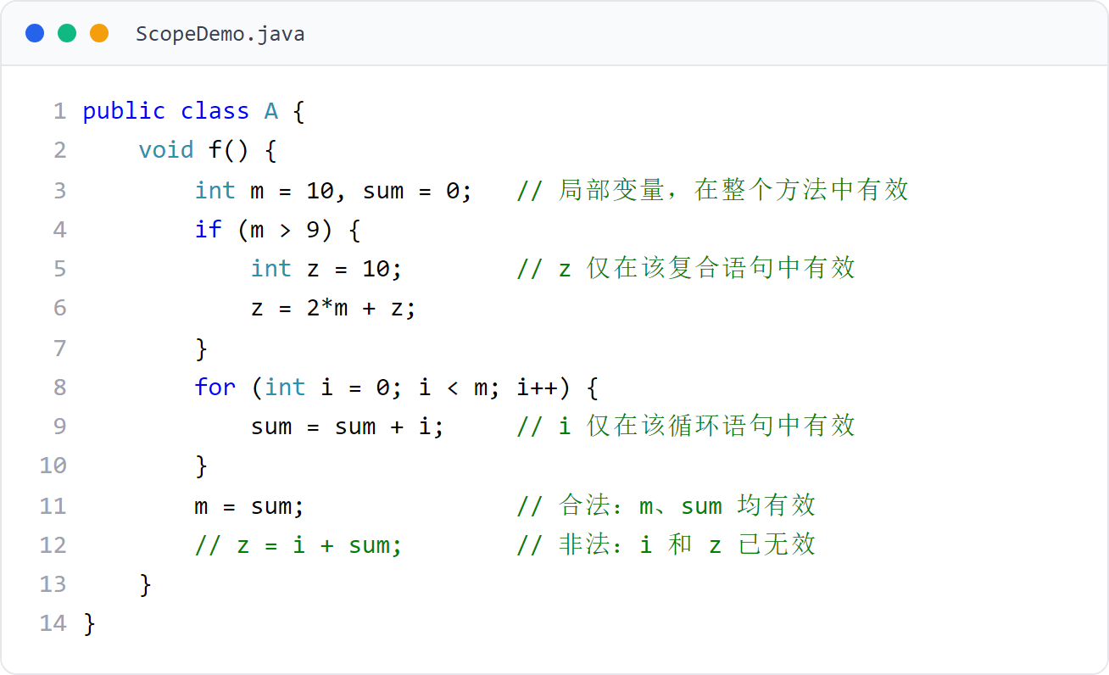
第 4 章 · 类与对象
Chapter 4 · Classes and Objects
例题
example
局部变量的作用域
scope of local variables
局部变量从声明位置之后开始有效；复合语句/循环中的局部变量仅在该语句块内有效。
Local variables are valid from the declaration position; local variables in compound statements/loops are only valid within the statement block.
16 / 151

Slide 17
第 4 章 · 类与对象
Chapter 4 · Classes and Objects
§4.2.5
需要注意的问题
Issues that need attention
对成员变量的操作只能放在方法中
Operations on member variables can only be placed in methods
声明成员变量时可同时赋初值，但类体中不可有单独赋值语句
When declaring member variables, initial values ​​can be assigned at the same time, but there cannot be separate assignment statements in the class body.
定义类时注意：对成员变量的操作只能放在方法中；类体内不能有单独的赋值语句。
Note when defining a class: operations on member variables can only be placed in methods; there cannot be a separate assignment statement within the class body.
局部变量必须赋初值，成员变量有默认值
Local variables must be assigned initial values, and member variables have default values.
class A {
int a = 12; // 声明成员变量并指定初值 12
int b; // 声明成员变量，默认初值 0
b = 12; // 错误！类体内不能有单独的赋值语句
}
17 / 151

Slide 18
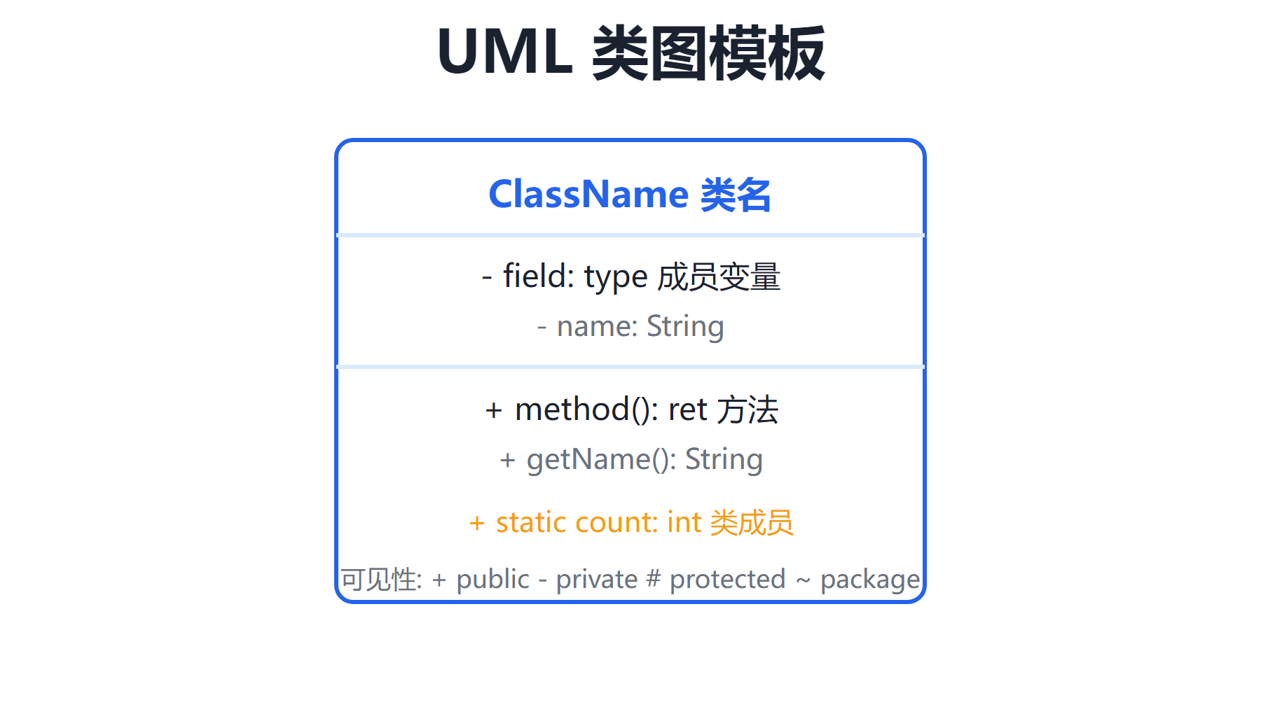
第 4 章 · 类与对象
Chapter 4 · Classes and Objects
§4.2.6
第 1 层：名字层（类名）
Layer 1: Name layer (class name)
类的 UML 图
UML diagram of class
第 2 层：变量层（属性层），如 above: float
Layer 2: variable layer (attribute layer), such as above: float
第 3 层：方法层（操作层），如 computerArea(): float
Layer 3: Method layer (operation layer), such as computerArea(): float
UML 用于描述系统静态结构。类的 UML 图用长方形垂直分为三层。
UML is used to describe the static structure of the system. The UML diagram of a class is divided vertically into three layers using rectangles.
对比：UML 属性/方法签名 ↔ Java 类声明（见模板示意）
Comparison: UML attribute/method signature ↔ Java class declaration (see template diagram)
18 / 151

Slide 19
第 4 章 · 类与对象
Chapter 4 · Classes and Objects
§4.3
构造方法与对象的创建
Constructors and object creation
类是面向对象中最重要的数据类型，用来声明变量
Class is the most important data type in object-oriented and is used to declare variables
用类声明的变量称作对象；创建对象即为对象分配变量，也称给出类的一个实例。没有类就没有对象，构造方法与对象创建密切相关。
Variables declared with a class are called objects; creating an object is assigning variables to the object, which is also called giving an instance of the class. There is no object without a class, and constructors are closely related to object creation.
用类声明的变量称作对象，但还需创建对象（分配变量）
Variables declared with a class are called objects, but the object must also be created (variable assigned)
通俗地说：类是创建对象的“模板”（如蓝图造房子）
In layman's terms: a class is a "template" for creating objects (such as a blueprint for building a house)
构造方法用于初始化对象的成员变量
The constructor is used to initialize the member variables of the object
19 / 151

Slide 20
第 4 章 · 类与对象
Chapter 4 · Classes and Objects
§4.3.1
构造方法
Constructor
名字必须与所在类的名字完全相同，且没有类型
The name must be exactly the same as the name of the class, and there is no type
构造方法是一种特殊方法，用于创建对象时初始化成员变量。
A constructor is a special method used to initialize member variables when creating an object.
一个类可写多个构造方法，但参数必须不同（个数或类型不同）
A class can write multiple constructors, but the parameters must be different (different number or type)
若未编写构造方法，系统提供无参、方法体为空的默认构造方法
If no constructor is written, the system provides a default constructor with no parameters and an empty method body.
若定义了一个或多个构造方法，Java 不再提供默认构造方法
If one or more constructors are defined, Java no longer provides a default constructor
特别注意：构造方法没有类型
Special note: the constructor has no type
20 / 151

Slide 21
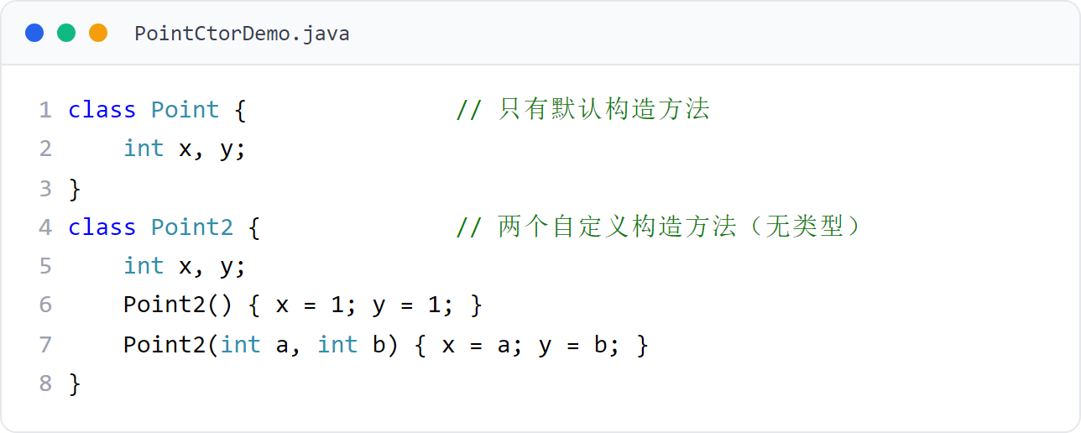
第 4 章 · 类与对象
Chapter 4 · Classes and Objects
构造函数例题
Constructor function example
默认 vs 自定义构造方法
Default vs custom constructor
演示默认构造方法与自定义构造方法的区别，强调“构造方法没有类型”。
Demonstrate the difference between the default constructor and the custom constructor, emphasizing that "constructors have no type".
21 / 151
Notes:
[课堂运行示例 / Classroom Demo]
课堂运行：课堂示例代码/第4章/ConstructorDemo.java
分别调用无参和有参构造方法，观察对象初始化结果。
[Sources]
Source concepts: user-provided chapter deck. Demo code: original instructional material.

Slide 22
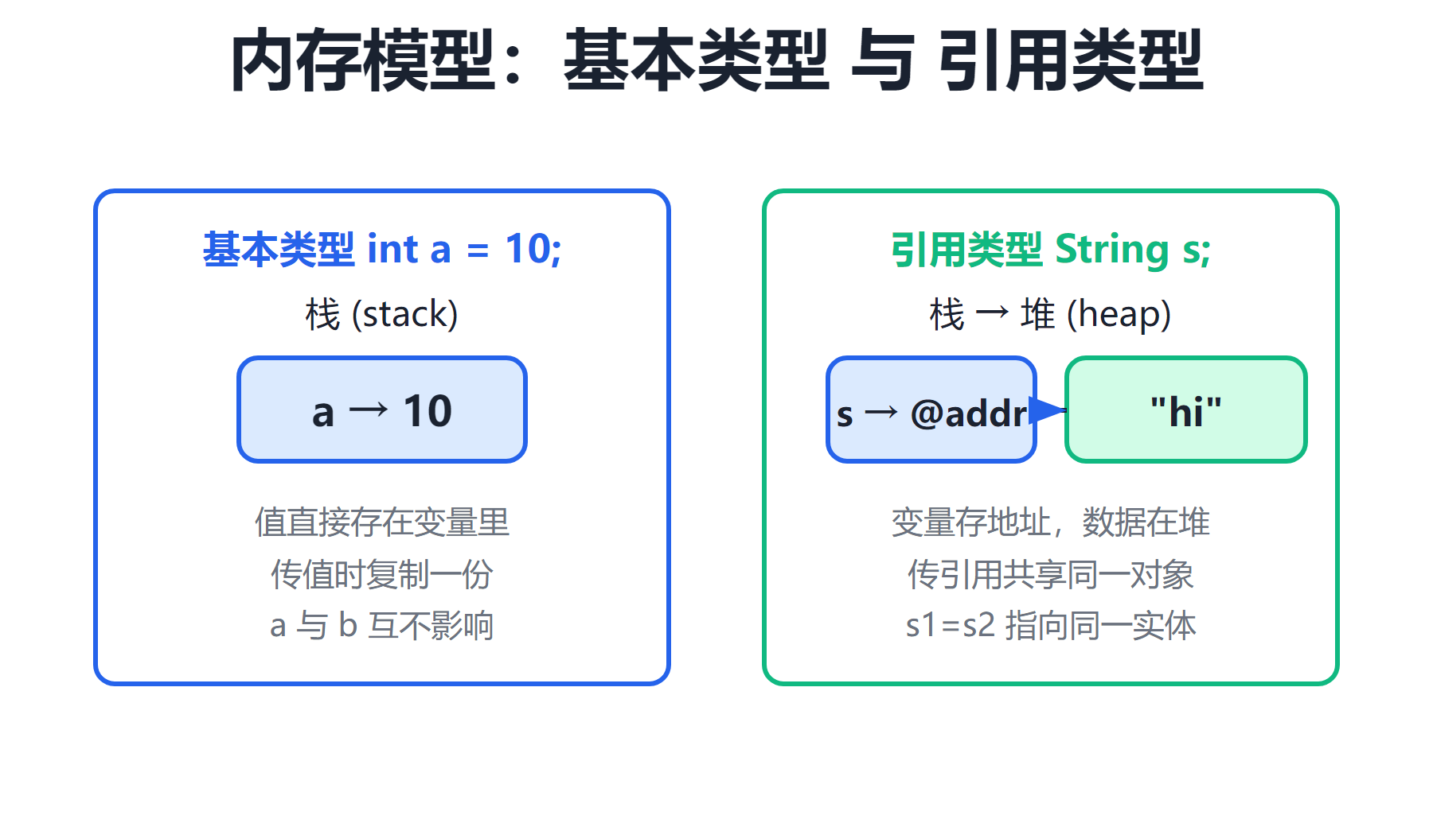
第 4 章 · 类与对象
Chapter 4 · Classes and Objects
§4.3.2
① 声明：类的名字 对象名字;（如 XiyoujiRenwu zhubajie;）
① Statement: class name object name; (such as XiyoujiRenwu zhubajie;)
创建对象
Create object
② 分配变量：用 new 与构造方法分配变量，返回引用值给对象名
② Assign variables: Use new and constructor methods to allocate variables and return the reference value to the object name
如 zhubajie = new XiyoujiRenwu();
创建一个对象包括“对象的声明”和“为对象分配变量”两个步骤。
Creating an object includes two steps: "declaration of the object" and "assigning variables to the object".
对象中存放引用值；成员变量被分配的内存空间称作对象的实体
Reference values ​​are stored in objects; the memory space allocated to member variables is called the entity of the object.
22 / 151

Slide 23
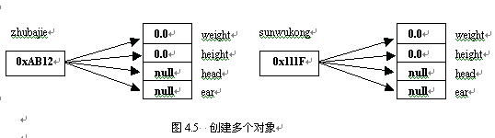
第 4 章 · 类与对象
Chapter 4 · Classes and Objects
§4.3.2
图 4.5：创建多个对象
Figure 4.5: Creating multiple objects
同一个类可以创建多个对象，每个对象拥有独立的实体，引用值互不相同。
The same class can create multiple objects, each object has independent entities and different reference values.
23 / 151

Slide 24
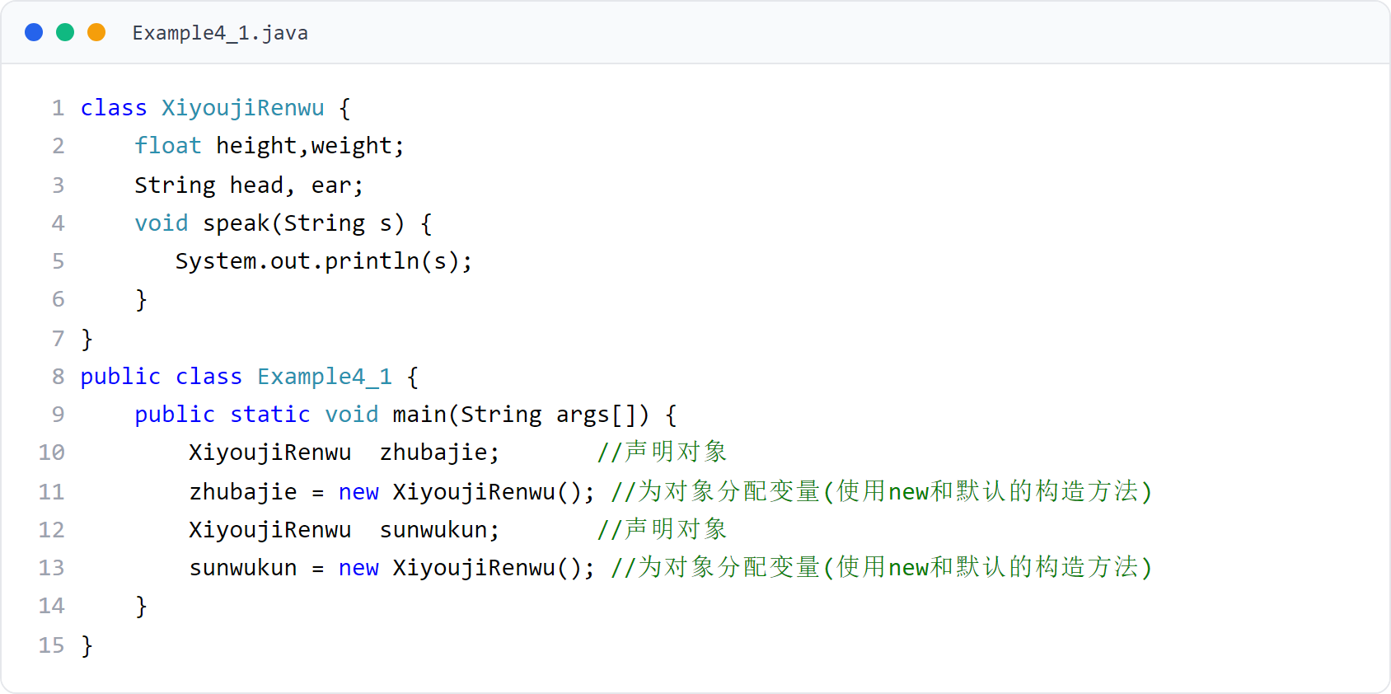
第 4 章 · 类与对象
Chapter 4 · Classes and Objects
例子1
Example 1
创建对象示例（一）
Example of creating an object (1)
用类声明对象并调用 new 创建对象。
Declare an object with a class and call new to create the object.
24 / 151

Slide 25
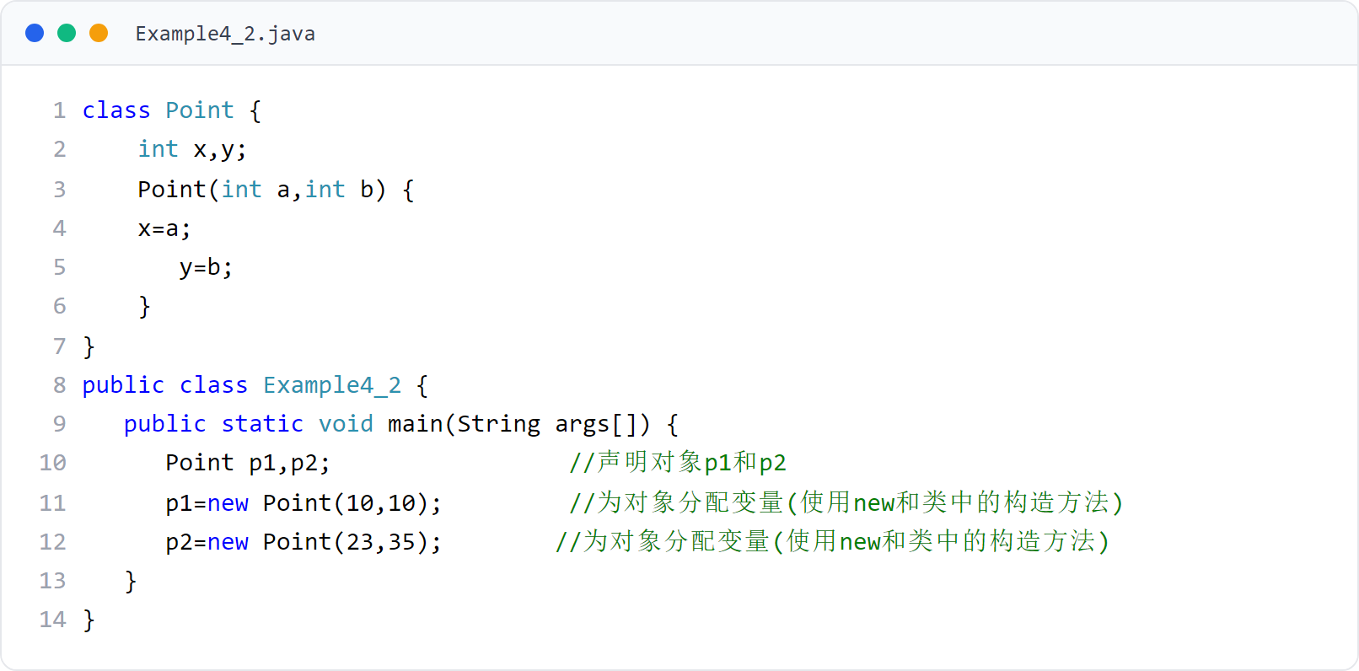
第 4 章 · 类与对象
Chapter 4 · Classes and Objects
例子2
Example 2
创建对象示例（二）
Example of creating an object (2)
创建两个对象，各自拥有独立的实体空间。
Create two objects, each with independent physical space.
25 / 151

Slide 26
第 4 章 · 类与对象
Chapter 4 · Classes and Objects
§4.3.3
使用对象
Use objects
对象创建成功后，可用点运算符“.”操作自己的变量、调用类中的方法。
After the object is successfully created, you can use the dot operator "." to operate your own variables and call methods in the class.
1．对象操作自己的变量（体现属性）：对象.变量
1. The object operates its own variables (embodied attributes): object.variable
2．对象调用类中的方法（体现行为）：对象.方法()
2. The object calls a method in the class (reflecting behavior): object.method()
对象调用变量/方法时，指的都是分配给该对象自己的成员
When an object calls variables/methods, it refers to its own members assigned to the object.
例子3 中创建 zhubajie、sunwukong 两个对象，运行效果见图
In Example 3, two objects zhubajie and sunwukong are created. The running effect is shown in the figure.
26 / 151

Slide 27
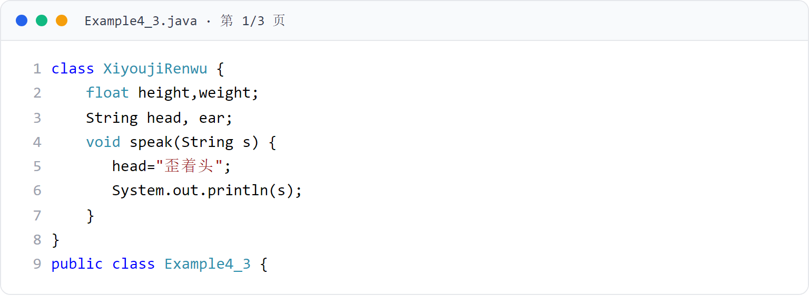
第 4 章 · 类与对象
Chapter 4 · Classes and Objects
例子3
Example 3
使用对象示例（1/3）
Example of using objects (1/3)
定义类并创建两个对象，操作其成员变量与方法。
Define the class and create two objects, and operate their member variables and methods.
27 / 151

Slide 28
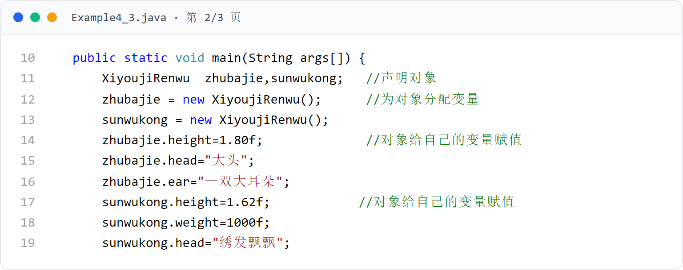
第 4 章 · 类与对象
Chapter 4 · Classes and Objects
例子3（续）
Example 3 (continued)
使用对象示例（2/3）
Using object examples (2/3)
第 2 页代码卡（共 3 页）
Page 2 Code Cards (3 pages total)
28 / 151

Slide 29
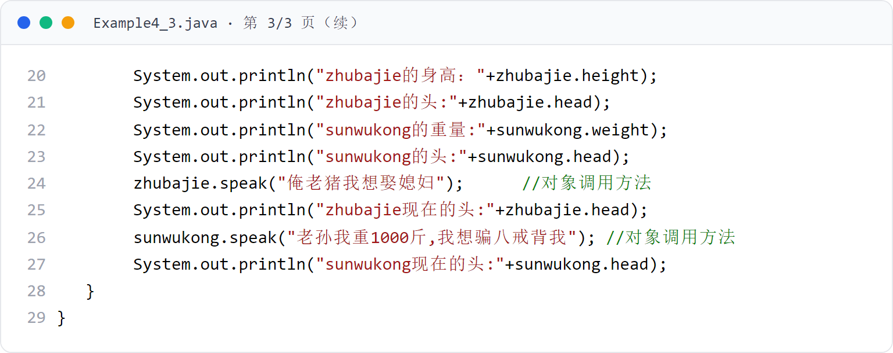
第 4 章 · 类与对象
Chapter 4 · Classes and Objects
例子3（续）
Example 3 (continued)
使用对象示例（3/3）
Example of using objects (3/3)
第 3 页代码卡（共 3 页）
Page 3 Code Cards (3 pages total)
29 / 151

Slide 30
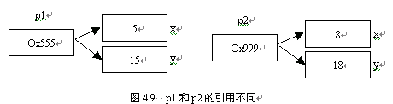
第 4 章 · 类与对象
Chapter 4 · Classes and Objects
§4.3.4
对象存放引用值，成员变量所占空间称为实体
Objects store reference values, and the space occupied by member variables is called an entity.
对象的引用和实体
Object references and entities
用 new 创建对象时，系统为成员变量分配内存并返回引用值
When using new to create an object, the system allocates memory for member variables and returns reference values.
引用与实体关系类比：遥控器 ↔ 电视（见关系图）
Reference and entity relationship analogy: remote control ↔ TV (see relationship diagram)
一个类创建的两个对象若具有相同的引用，就具有完全相同的实体。
Two objects created by a class have identical entities if they have the same reference.
class Point {
double x, y;
Point(double x, double y) { this.x = x; this.y = y; }
}
30 / 151

Slide 31
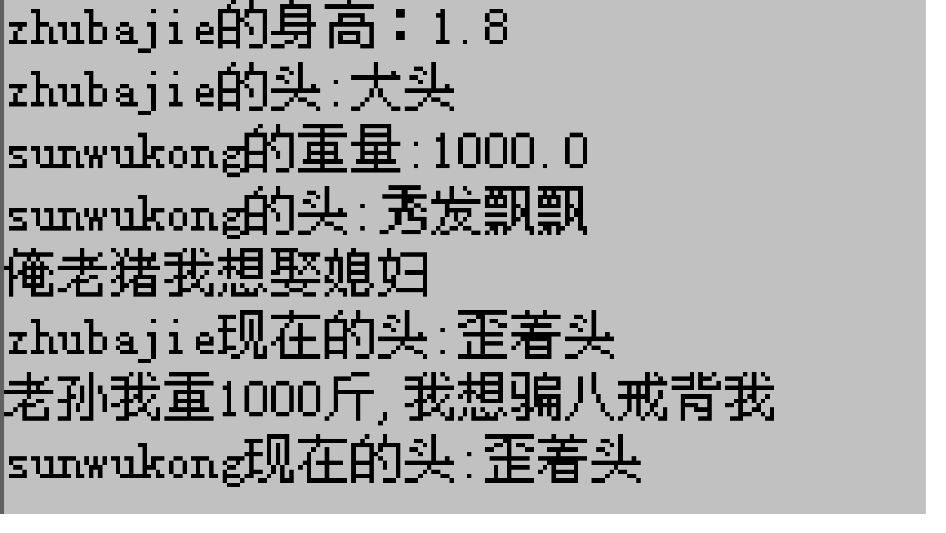
第 4 章 · 类与对象
Chapter 4 · Classes and Objects
§4.3.3 运行效果
§4.3.3 Operation effect
例子3 运行效果
Example 3 Operation effect
创建两个对象 zhubajie、sunwukong，分别调用各自的方法
Create two objects zhubajie and sunwukong and call their respective methods respectively.
主类的 main 方法中使用 XiyoujiRenwu 创建两个对象 zhubajie、sunwukong，运行效果如图。
In the main method of the main class, XiyoujiRenwu is used to create two objects zhubajie and sunwukong. The running effect is as shown in the figure.
31 / 151

Slide 32

第 4 章 · 类与对象
Chapter 4 · Classes and Objects
§4.3.4
图 4.3：未分配变量的对象
Figure 4.3: Object without assigned variables
声明对象后若未使用 new 分配变量，对象中没有任何引用值，不指向任何实体。
If you do not use new to assign variables after declaring an object, there will be no reference value in the object and it will not point to any entity.
32 / 151

Slide 33
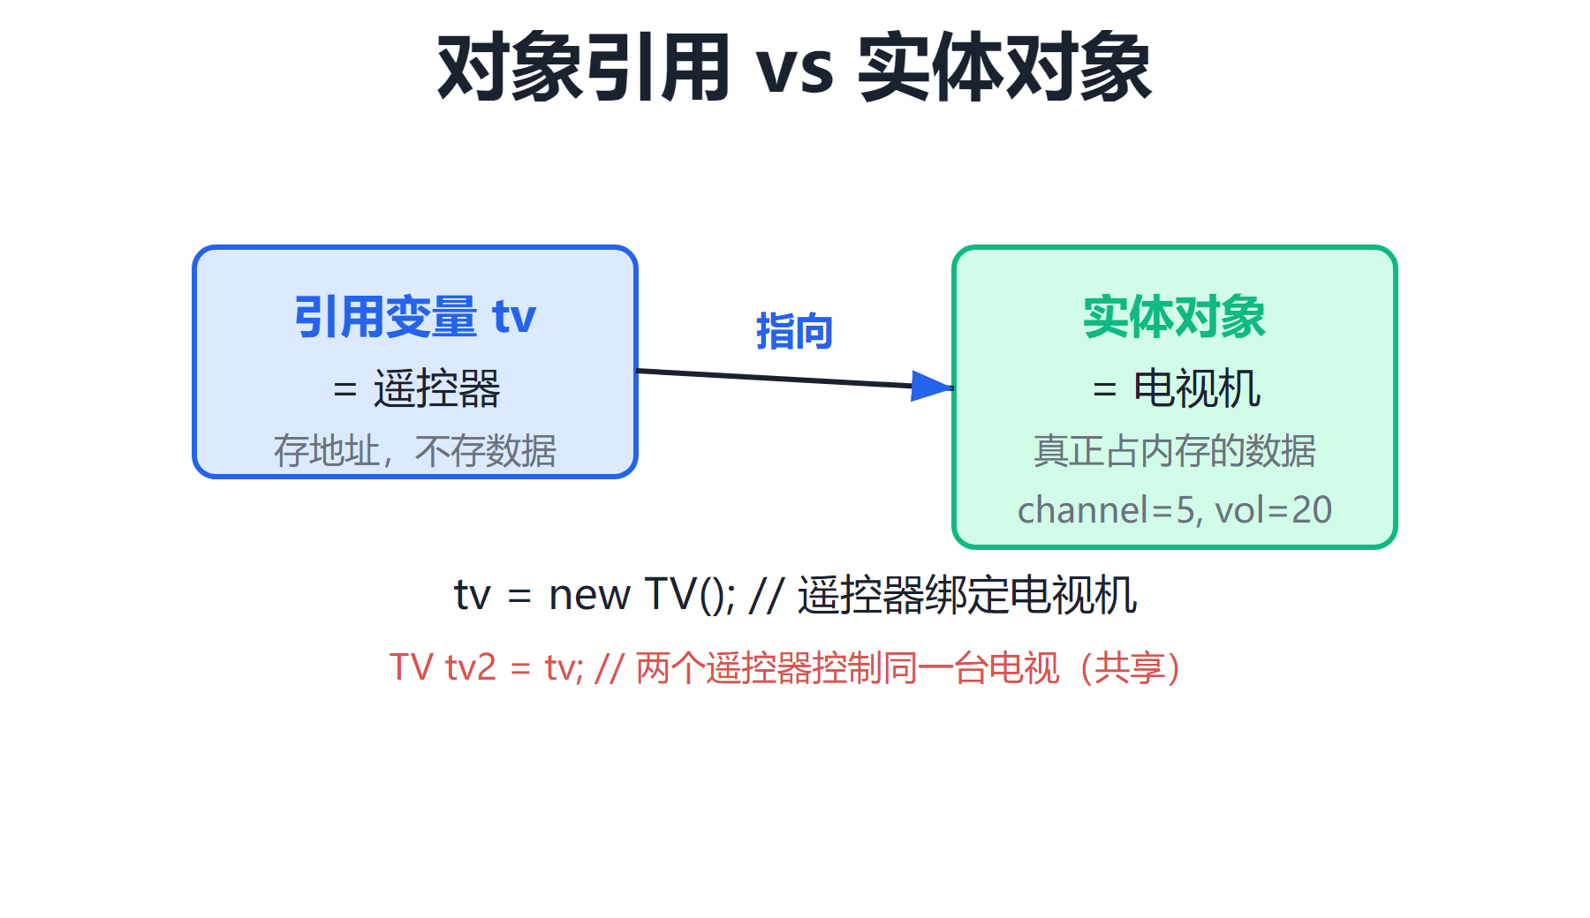
第 4 章 · 类与对象
Chapter 4 · Classes and Objects
§4.3.4 关系图
§4.3.4 Relationship diagram
对象变量 = 遥控器（持有引用）
Object variable = remote control (holds a reference)
引用与实体关系（类比）
Reference and entity relationships (analogy)
实体 = 电视（真实数据空间）
entity = tv (real data space)
多个对象引用相同 → 指向同一实体（见 §4.3.4 赋值）
Multiple objects reference the same → point to the same entity (see §4.3.4 Assignment)
遥控器持有电视的“引用”，可操控同一台电视；多个遥控器指向同一台电视即共享实体。
The remote control holds a "reference" to the TV and can control the same TV; multiple remote controls pointing to the same TV are shared entities.
33 / 151

Slide 34
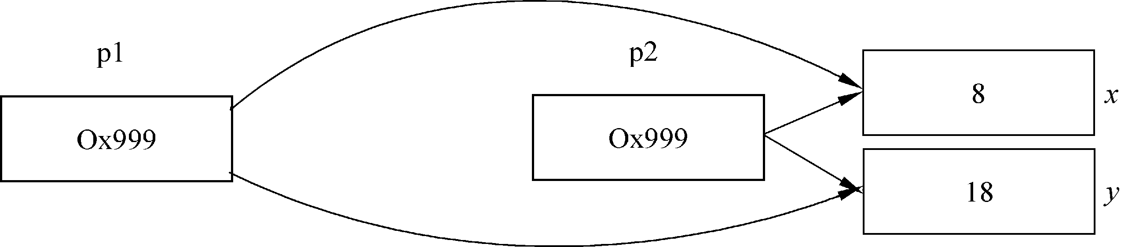
第 4 章 · 类与对象
Chapter 4 · Classes and Objects
§4.3.4
相同引用 → 相同实体
same reference → same entity
p1 = p2; 让 p1、p2 指向同一实体（变量）
p1 = p2; let p1 and p2 point to the same entity (variable)
一个类创建的两个对象若引用相同，则实体完全相同
If two objects created by a class have the same reference, the entities are exactly the same.
若执行 p1 = p2，则把 p2 的引用赋给 p1，p1 与 p2 本质相同，具有完全相同的实体。
If p1 = p2 is executed, the reference of p2 is assigned to p1. p1 and p2 are essentially the same and have exactly the same entity.
内存模型由图 4.9 变为图 4.10 所示
The memory model changes from Figure 4.9 to Figure 4.10
34 / 151

Slide 35
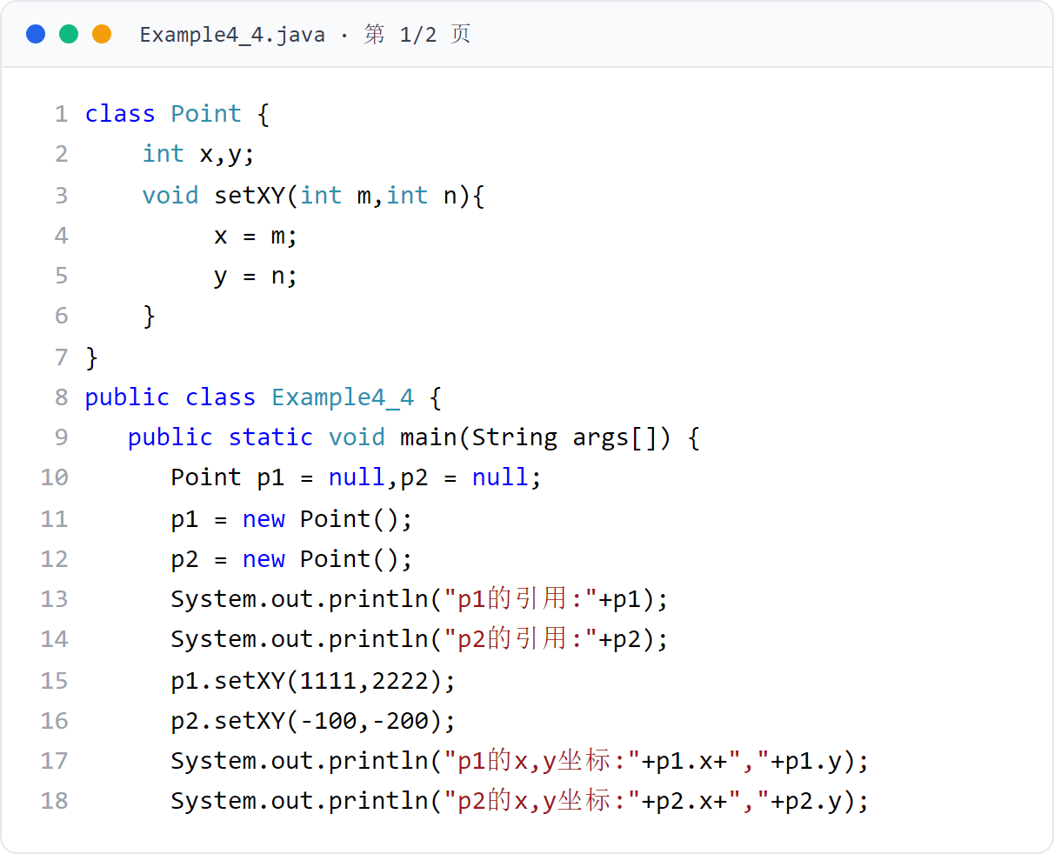
第 4 章 · 类与对象
Chapter 4 · Classes and Objects
例子4
Example 4
对象引用赋值示例（上） （1/2）
Object reference assignment example (Part 1) (1/2)
将 p2 的引用赋给 p1，使二者共享同一实体。
Assign the reference of p2 to p1 so that both share the same entity.
35 / 151
Notes:
[课堂运行示例 / Classroom Demo]
课堂运行：课堂示例代码/第4章/ReferenceDemo.java
执行 second = first 前后分别修改对象，观察两个引用是否指向同一实体。
[Sources]
Source concepts: user-provided chapter deck. Demo code: original instructional material.

Slide 36
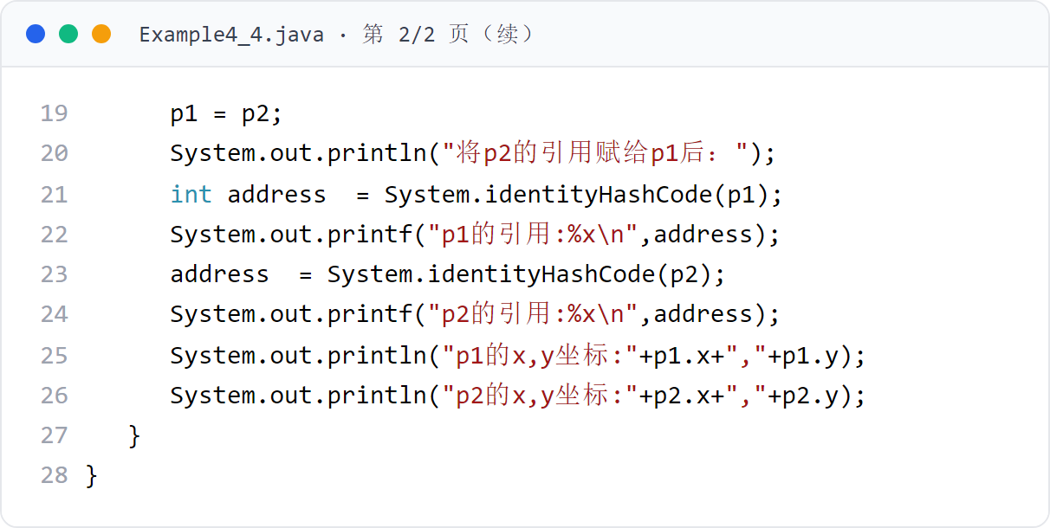
第 4 章 · 类与对象
Chapter 4 · Classes and Objects
例子4（续）
Example 4 (continued)
对象引用赋值示例（上） （2/2）
Object reference assignment example (Part 1) (2/2)
第 2 页代码卡（共 2 页）
Page 2 Code Cards (2 pages total)
36 / 151

Slide 37
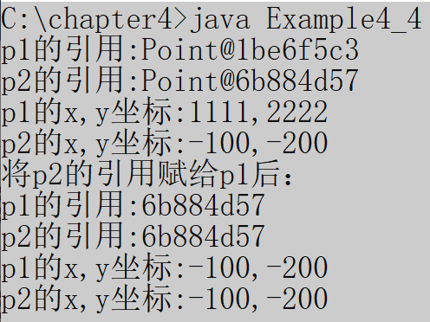
第 4 章 · 类与对象
Chapter 4 · Classes and Objects
§4.3.4 运行效果
§4.3.4 Operation effect
例子4 运行效果
Example 4 Operation effect
用 System.out.println(object) 输出引用值，Java 会加“类名@”前缀
Use System.out.println(object) to output the reference value, Java will add the "class name @" prefix
可用 System.identityHashCode(Object) 返回对象引用
Available System.identityHashCode(Object) returns an object reference
例子4 将 p2 的引用赋给 p1，输出对象引用值（类名@+前缀信息）。
Example 4 assigns the reference of p2 to p1 and outputs the object reference value (class name @+prefix information).
int address = System.identityHashCode(object);
37 / 151

Slide 38
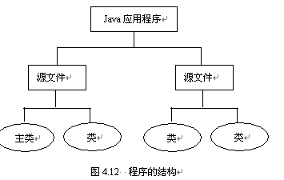
第 4 章 · 类与对象
Chapter 4 · Classes and Objects
§4.4
Java 应用程序从主类的 main 方法开始执行
Java application execution starts from the main method of the main class
类与程序的基本结构
Basic structure of classes and programs
每个源文件编译后产生一个类的字节码文件
Each source file is compiled to produce a class bytecode file
一个工程可由多个 .java 源文件组成（见图 4.12）
A project can be composed of multiple .java source files (see Figure 4.12)
一个 Java 应用程序由若干个类构成，这些类可在一个源文件中，也可分布在若干源文件中。
A Java application consists of several classes, which can be in one source file or distributed among several source files.
38 / 151

Slide 39
第 4 章 · 类与对象
Chapter 4 · Classes and Objects
§4.4 例题
§4.4 Example questions
例子5：多源文件程序
Example 5: Multi-source file program
例子5 含三个源文件（Example4_5.java、Rect.java、Ladder.java），其中 Example4_5.java 是含主类的源文件。
Example 5 contains three source files (Example4_5.java, Rect.java, Ladder.java), among which Example4_5.java is the source file containing the main class.
运行主类，输出：矩形的面积:2766.5266；梯形的面积:1517.07888
Run the main class, output: area of ​​rectangle: 2766.5266; area of ​​trapezoid: 1517.07888
编写 Java 应用程序时可分多个源文件，分别编译
When writing a Java application, you can divide it into multiple source files and compile them separately.
39 / 151

Slide 40
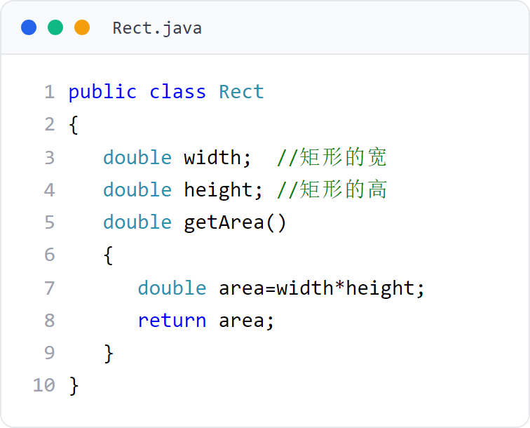
第 4 章 · 类与对象
Chapter 4 · Classes and Objects
例子5
Example 5
Rect 类：矩形
Rect class: Rectangle
Rect.java 辅助类代码
Rect.java auxiliary class code
40 / 151

Slide 41
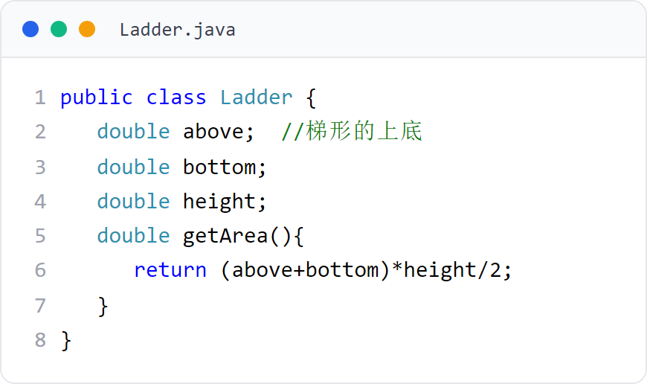
第 4 章 · 类与对象
Chapter 4 · Classes and Objects
例子5
Example 5
Ladder 类：梯形
Ladder class: trapezoid
Ladder.java 辅助类代码
Ladder.java auxiliary class code
41 / 151

Slide 42
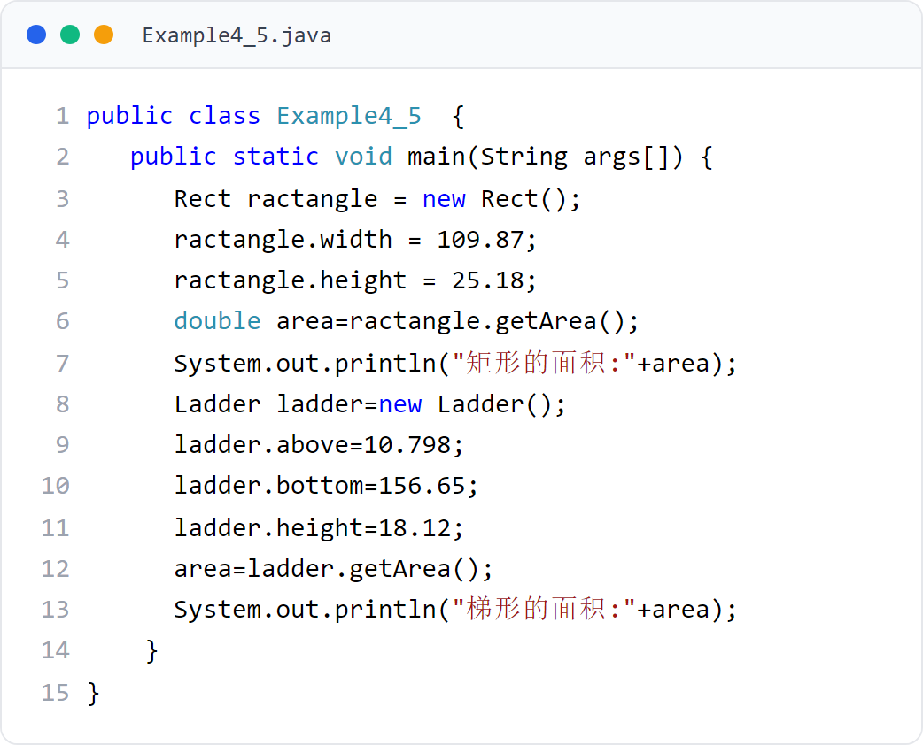
第 4 章 · 类与对象
Chapter 4 · Classes and Objects
例子5
Example 5
多源文件程序示例（上）
Multi-source file program example (Part 1)
Rect.java 与 Ladder.java 提供类，Example4_5 含主类。
Rect.java and Ladder.java provide classes, and Example4_5 contains the main class.
42 / 151

Slide 43
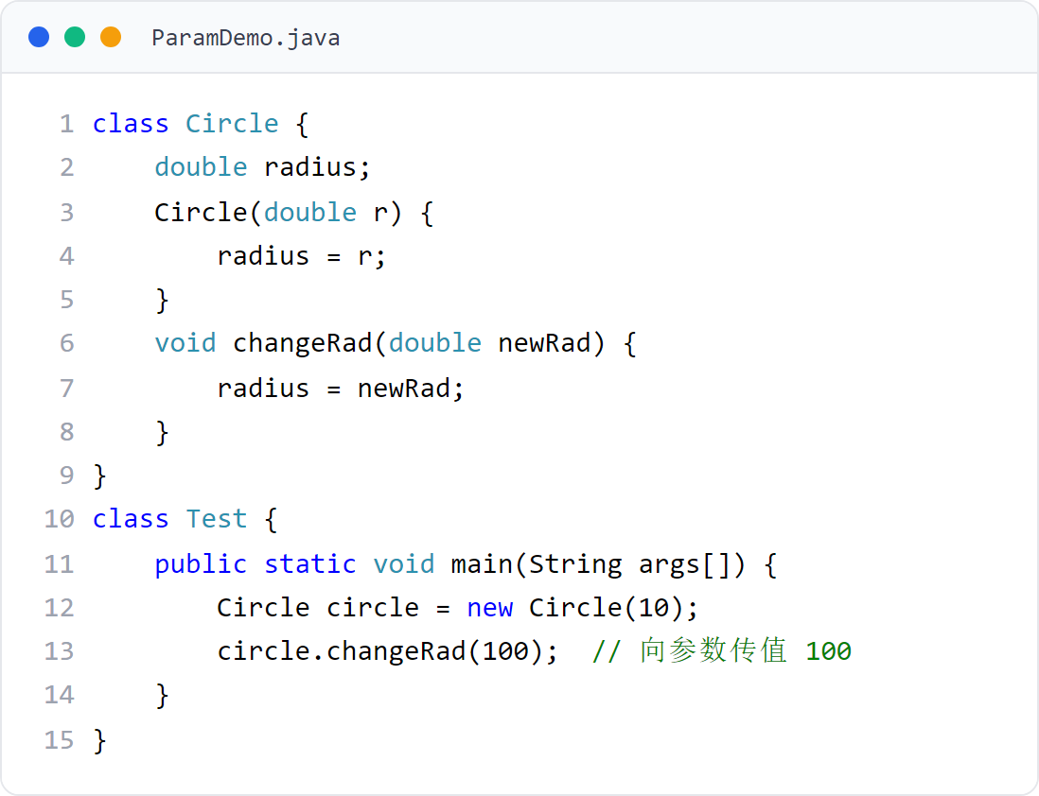
第 4 章 · 类与对象
Chapter 4 · Classes and Objects
§4.5
参数传值
Parameter value passing
方法中参数属于局部变量；对象调用方法时参数被分配内存，并要求调用者向参数传递值。
The parameters in the method are local variables; when the object calls the method, the parameters are allocated memory, and the caller is required to pass values ​​to the parameters.
43 / 151

Slide 44
第 4 章 · 类与对象
Chapter 4 · Classes and Objects
§4.5.1
基本类型传值 vs 引用类型传值
Basic type pass by value vs reference type pass by value
基本数据类型参数
Basic data type parameters
引用类型参数
Reference type parameters
· 向参数“传值”传递的是值的拷贝
· Passing by value to a parameter is a copy of the value
· 传递的是变量中存放的“引用”（地址）的拷贝
· What is passed is a copy of the "reference" (address) stored in the variable
· 参数得到的值与实参互不干扰
· The value obtained by the parameter does not interfere with the actual parameter.
· 传值级别不可高于参数的级别
· The value level cannot be higher than the parameter level
· 实参与形参指向同一个实体
· Actual and formal parameters point to the same entity
· 如 int x 得到实参 int 值的副本
· If int x gets a copy of the int value of the actual parameter
· 修改形参引用所指向的实体会影响实参
· Modifying the entity pointed to by the formal parameter reference will affect the actual parameters
Java 中方法的所有参数都是“传值”——参数是调用者所给值的拷贝。
All parameters of methods in Java are "pass by value" - the parameters are copies of the values ​​given by the caller.
· 引用类型包括对象、数组和接口
· Reference types include objects, arrays and interfaces
44 / 151

Slide 45
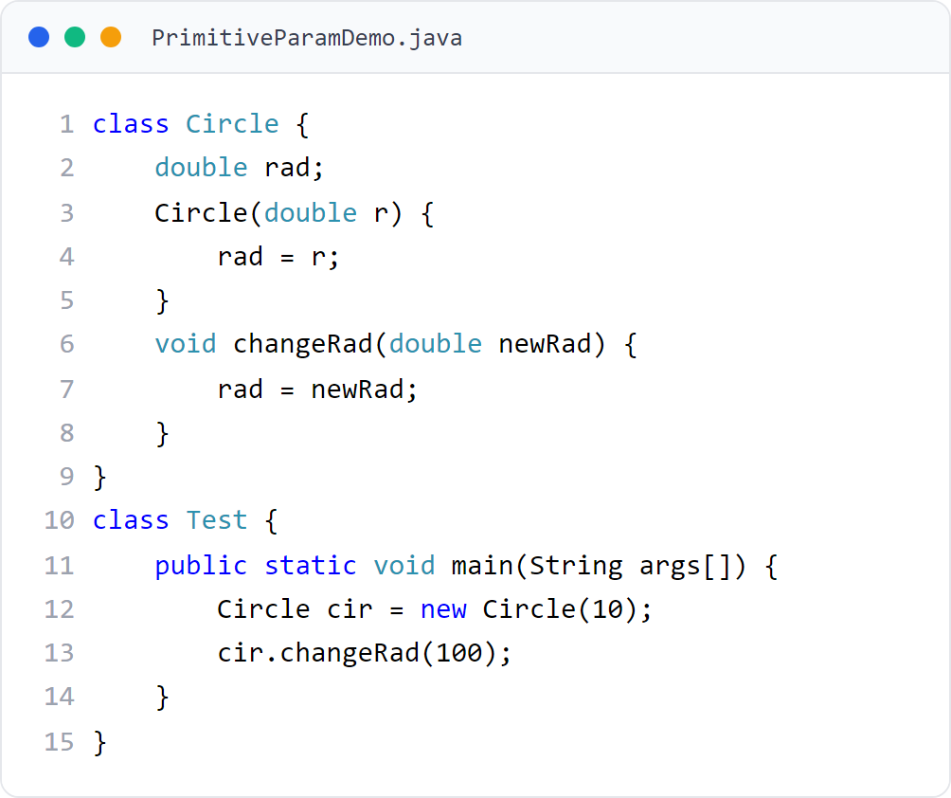
第 4 章 · 类与对象
Chapter 4 · Classes and Objects
§4.5.2
基本数据类型参数的传值
Passing values ​​of basic data type parameters
对于基本数据类型参数，传递的是值的拷贝，且传值级别不可高于参数级别。
For basic data type parameters, a copy of the value is passed, and the value level cannot be higher than the parameter level.
45 / 151

Slide 46
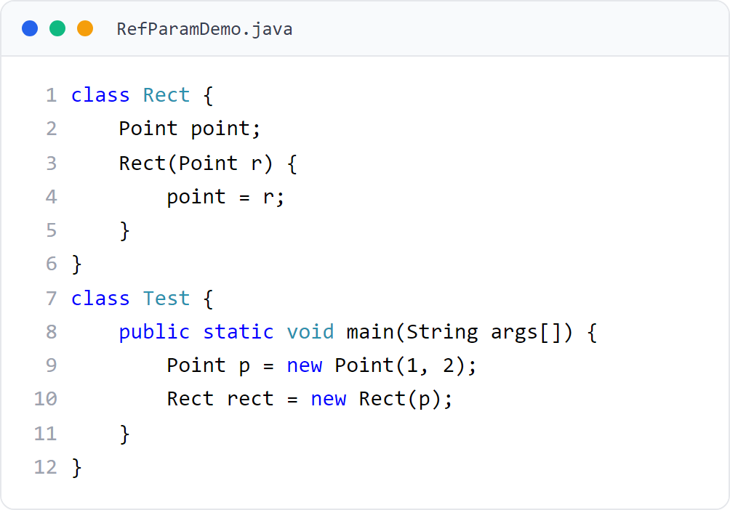
第 4 章 · 类与对象
Chapter 4 · Classes and Objects
§4.5.3
引用类型参数的传值
Pass-by-value of reference type parameters
当参数是引用类型时，传递的是变量中存放的“引用”，而不是所引用的实体。
When the parameter is a reference type, what is passed is the "reference" stored in the variable, not the referenced entity.
46 / 151

Slide 47
第 4 章 · 类与对象
Chapter 4 · Classes and Objects
§4.5.3 例题
§4.5.3 Example questions
例子7：收音机使用电池
Example 7: Radio uses batteries
Radio 类（Radio.java）创建“收音机”对象
Radio class (Radio.java) creates a "radio" object
Radio 对象调用 openRadio(Battery battery) 时，将 Battery 对象 nanfu 传给参数 battery；打开收音机消耗电池储电量，nanfu 的储电量随之变化。
When the Radio object calls openRadio(Battery battery), the Battery object nanfu is passed to the parameter battery; turning on the radio consumes battery storage, and the storage capacity of nanfu changes accordingly.
Battery 类（Battery.java）创建“电池”对象
Battery class (Battery.java) creates a "battery" object
主类 Example4_7.java 将 nanfu 传给 openRadio，消耗其储电量
The main class Example4_7.java passes nanfu to openRadio to consume its power reserve.
47 / 151

Slide 48
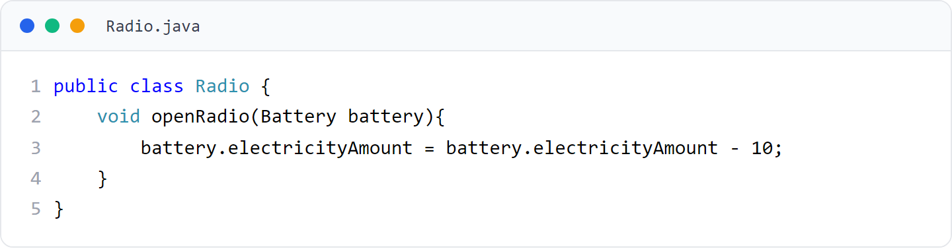
第 4 章 · 类与对象
Chapter 4 · Classes and Objects
例子7
Example 7
Radio 类：收音机
Radio class: radio
Radio.java 辅助类代码
Radio.java auxiliary class code
48 / 151

Slide 49
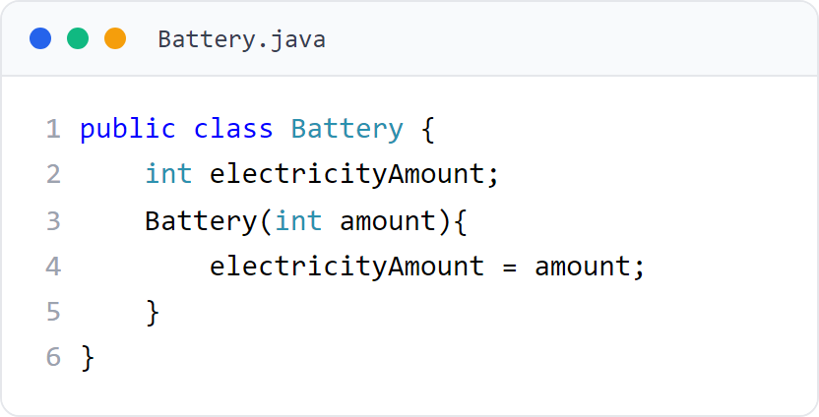
第 4 章 · 类与对象
Chapter 4 · Classes and Objects
例子7
Example 7
Battery 类：电池
Battery class: battery
Battery.java 辅助类代码
Battery.java auxiliary class code
49 / 151

Slide 50
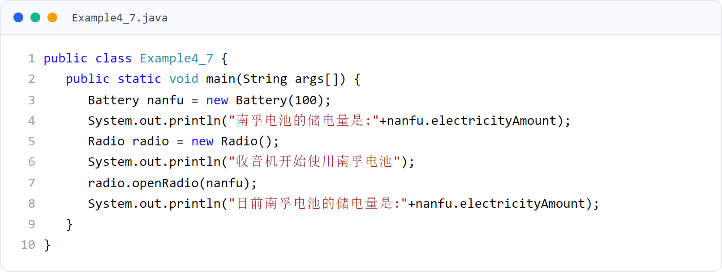
第 4 章 · 类与对象
Chapter 4 · Classes and Objects
例子7
Example 7
收音机使用电池示例（上）
Radio battery example (Part 1)
Radio 与 Battery 类，演示引用类型参数传值。
Radio and Battery classes demonstrate reference type parameter passing by value.
50 / 151

Slide 51


第 4 章 · 类与对象
Chapter 4 · Classes and Objects
§4.x 运行效果
§4.x Operation effect
示意图与运行效果如图4.14（a）（b）
The schematic diagram and operation effect are shown in Figure 4.14 (a) (b)
例子7 运行效果（图4.14）
Example 7 Operation effect (Figure 4.14)
图4.14(a) 收音机使用电池示意；(b) 运行结果：储电量从 100 变为 90。
Figure 4.14(a) Schematic of using a battery for a radio; (b) Operation result: The stored power changes from 100 to 90.
51 / 151

Slide 52
第 4 章 · 类与对象
Chapter 4 · Classes and Objects
§4.5.4
可变参数
Variable parameters
用“…”表示若干个类型相同的参数；参数代表必须是参数列表最后一项
Use "..." to represent several parameters of the same type; the parameter representative must be the last item in the parameter list
通过下标运算 x[0]、x[1]… 表示具体参数
Represent specific parameters through subscript operations x[0], x[1]…
可变参数（variable arguments）允许在声明方法时不给出某几项参数的名字与个数，但这些参数类型必须相同。
Variable arguments allow you not to give the names and numbers of certain parameters when declaring a method, but the types of these parameters must be the same.
getSum(203,178,56,2098) 返回四数之和；getSum(1,2,3) 返回 6
getSum(203,178,56,2098) returns the sum of four numbers; getSum(1,2,3) returns 6
int getSum(int... x) {
int sum = 0;
for (int i = 0; i < x.length; i++) sum += x[i];
return sum;
}
52 / 151

Slide 53
第 4 章 · 类与对象
Chapter 4 · Classes and Objects
§4.6
对象的组合
combination of objects
一个类可以把对象作为自己的成员变量，从而该对象由其他对象组合而成。
A class can use objects as its own member variables, so that the object is composed of other objects.
对象 a 组合对象 b，则 a 可委托 b 调用其方法（复用 b 的方法）
Object a combines object b, then a can delegate b to call its method (reuse b's method)
“黑盒”复用：当前对象对所含对象的方法细节一无所知
"Black box" reuse: the current object knows nothing about the method details of the contained object
对象与所含对象属于弱耦合关系，可随时更换所含对象
The object and the contained objects are weakly coupled, and the contained objects can be replaced at any time.
53 / 151

Slide 54
第 4 章 · 类与对象
Chapter 4 · Classes and Objects
§4.6 例题
§4.6 Example questions
例子8：圆锥与圆组合
Example 8: Combination of cone and circle
圆锥有一个圆形的底（Circle 对象）
A cone has a circular base (Circle object)
圆锥对象组合一个 Circle 对象 bottom 作底，计算体积时委托 bottom 调用 getArea() 求底面积。
The cone object is combined with a Circle object bottom as the base. When calculating the volume, bottom is entrusted to call getArea() to find the bottom area.
圆锥对象委托所含 Circle 对象调用 getArea()，对其算法细节不知情
The Circle object contained in the Cone object delegate calls getArea() without knowing the details of its algorithm
涉及类：Circle.java、Circular.java、Example4_8.java
Involved classes: Circle.java, Circular.java, Example4_8.java
54 / 151
Notes:
[课堂运行示例 / Classroom Demo]
课堂运行：课堂示例代码/第4章/CompositionDemo.java
让 Radio 组合 Battery，调用 play() 后观察电量变化。
[Sources]
Source concepts: user-provided chapter deck. Demo code: original instructional material.

Slide 55
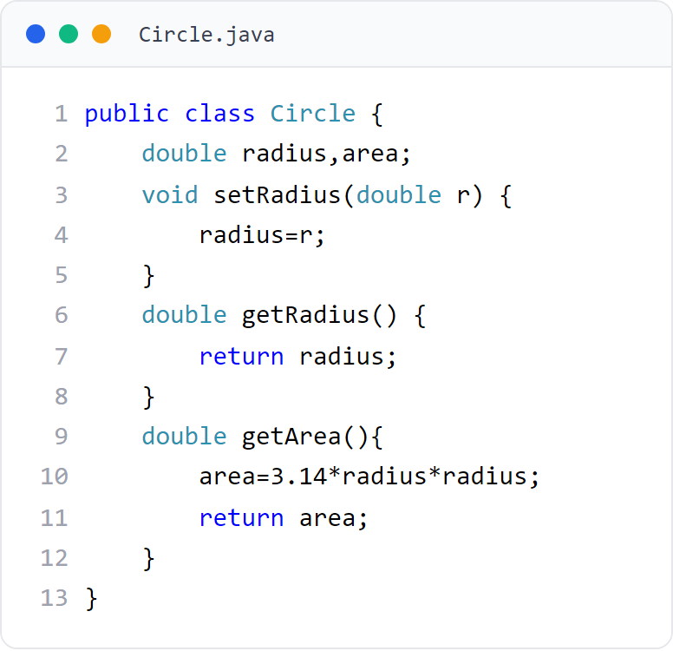
第 4 章 · 类与对象
Chapter 4 · Classes and Objects
例子8
Example 8
Circle 类：圆
Circle class: circle
Circle.java 辅助类代码
Circle.java auxiliary class code
55 / 151

Slide 56
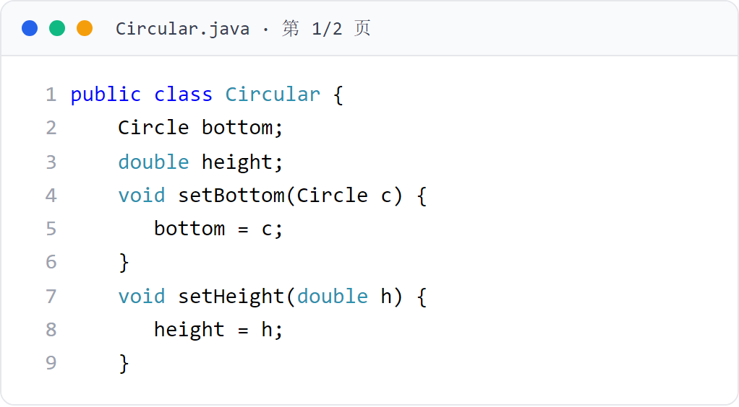
第 4 章 · 类与对象
Chapter 4 · Classes and Objects
例子8
Example 8
Circular 类：圆锥（1/2）
Circular class: Cone (1/2)
Circular.java 辅助类代码
Circular.java auxiliary class code
56 / 151

Slide 57
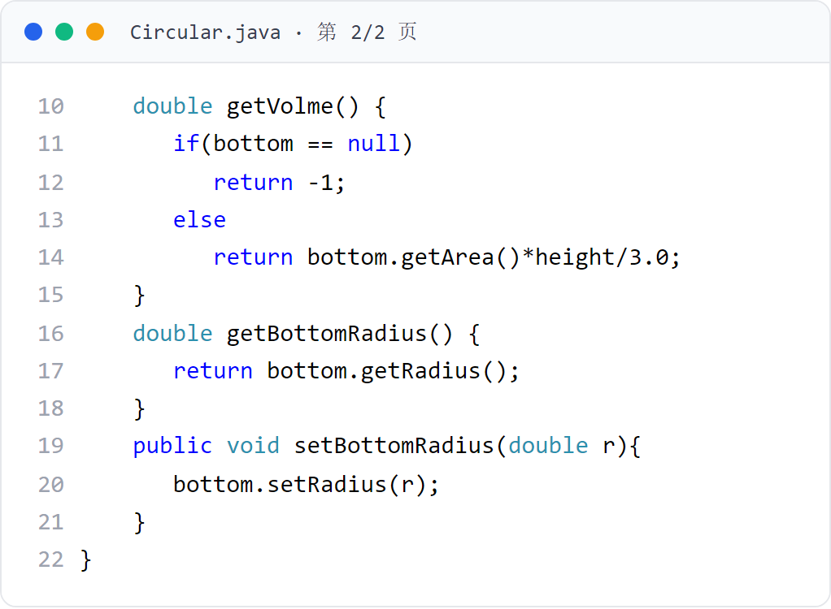
第 4 章 · 类与对象
Chapter 4 · Classes and Objects
例子8
Example 8
Circular 类：圆锥（2/2）
Circular Class: Cone (2/2)
Circular.java 辅助类代码
Circular.java auxiliary class code
57 / 151

Slide 58
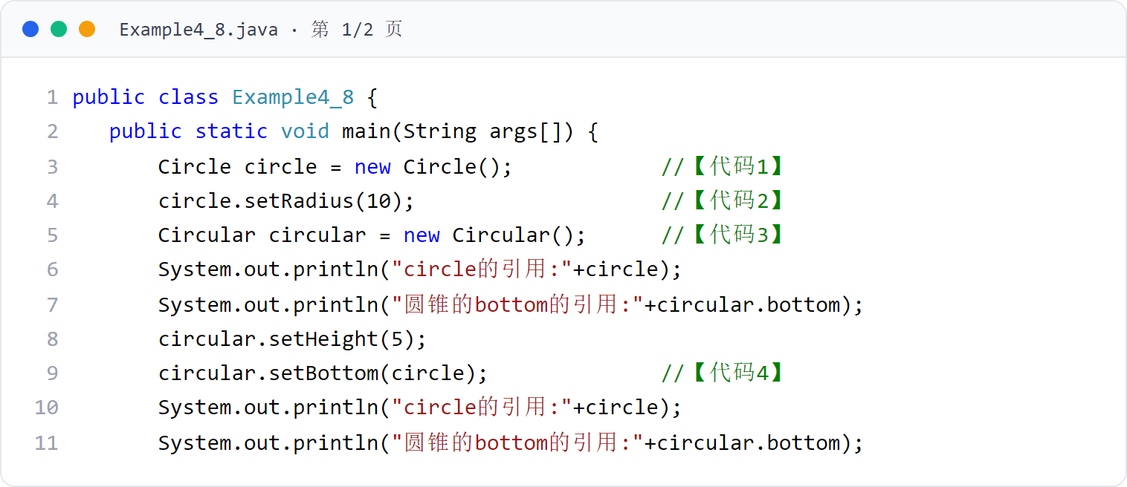
第 4 章 · 类与对象
Chapter 4 · Classes and Objects
例子8
Example 8
圆锥与圆组合示例（一） （1/2）
Example of combination of cone and circle (1) (1/2)
Circle 类与 Circular 类，演示对象的组合复用。
Circle class and Circular class demonstrate the combination and reuse of objects.
58 / 151

Slide 59
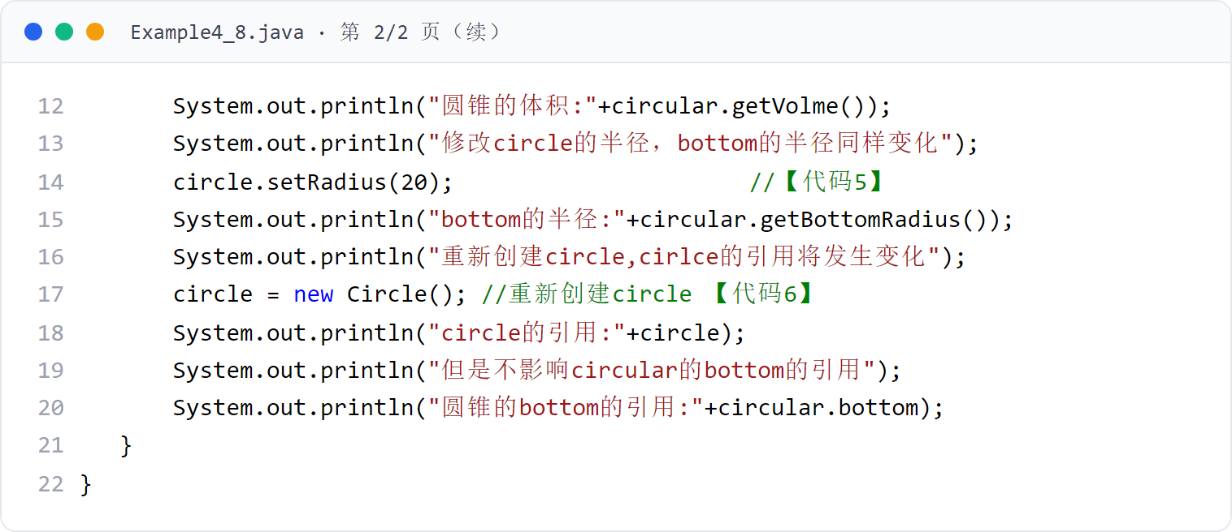
第 4 章 · 类与对象
Chapter 4 · Classes and Objects
例子8（续）
Example 8 (continued)
圆锥与圆组合示例（一） （2/2）
Example of combination of cone and circle (1) (2/2)
第 2 页代码卡（共 2 页）
Page 2 Code Cards (2 pages total)
59 / 151

Slide 60
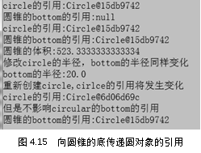
第 4 章 · 类与对象
Chapter 4 · Classes and Objects
§4.6 运行效果
§4.6 Operation effect
例子8 运行效果
Example 8 Operation effect
例子8 模拟圆锥用圆作为底，运行效果如图 4.15。
Example 8 simulates a cone using a circle as its base, and the running effect is as shown in Figure 4.15.
60 / 151

Slide 61
第 4 章 · 类与对象
Chapter 4 · Classes and Objects
§4.6.1
组合与复用
Combination and reuse
对象 a 组合对象 b，即可委托 b 调用其方法，以组合方式复用 b 的方法。
Object a combines object b, that is, delegates b to call its methods, and reuses b's methods in a combined manner.
例子9 模拟手机与 SIM 卡的组合关系
Example 9 Simulate the combination relationship between mobile phone and SIM card
MobileTelephone 对象组合一个 SIM 卡，可用 setSIM(SIM card) 更换 SIM 卡
The MobileTelephone object combines a SIM card. You can use setSIM(SIM card) to replace the SIM card.
涉及类：SIM.java、MobileTelephone.java、Example4_9.java
Involved classes: SIM.java, MobileTelephone.java, Example4_9.java
运行效果如图 4.20
The running effect is shown in Figure 4.20
61 / 151

Slide 62
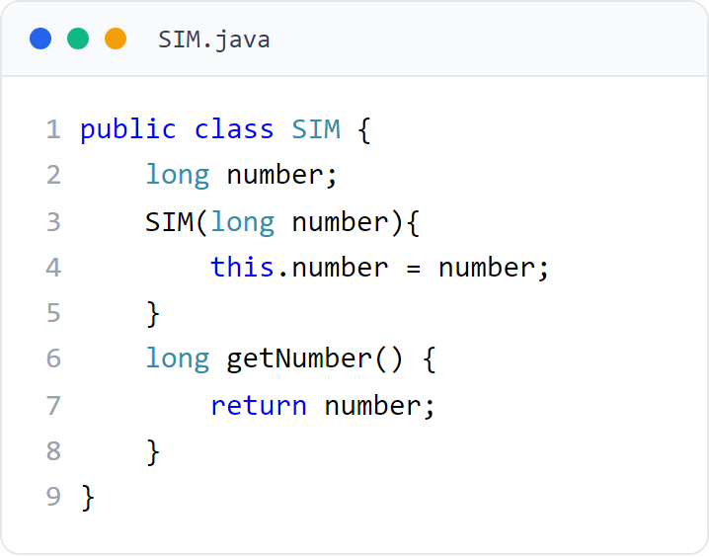
第 4 章 · 类与对象
Chapter 4 · Classes and Objects
例子9
Example 9
SIM 类：SIM 卡
SIM type: SIM card
SIM.java 辅助类代码
SIM.java auxiliary class code
62 / 151

Slide 63
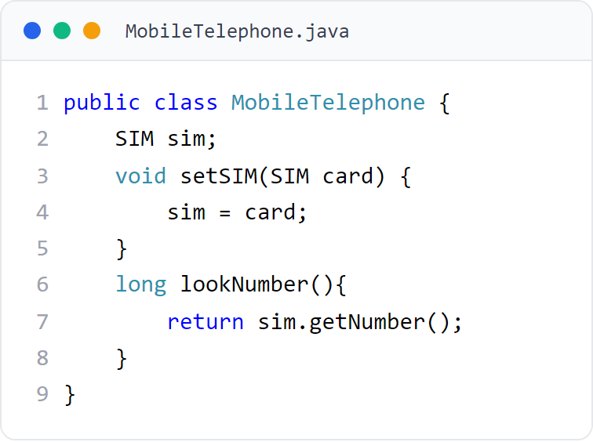
第 4 章 · 类与对象
Chapter 4 · Classes and Objects
例子9
Example 9
MobileTelephone 类：手机
MobileTelephone class: mobile phone
MobileTelephone.java 辅助类代码
MobileTelephone.java auxiliary class code
63 / 151

Slide 64
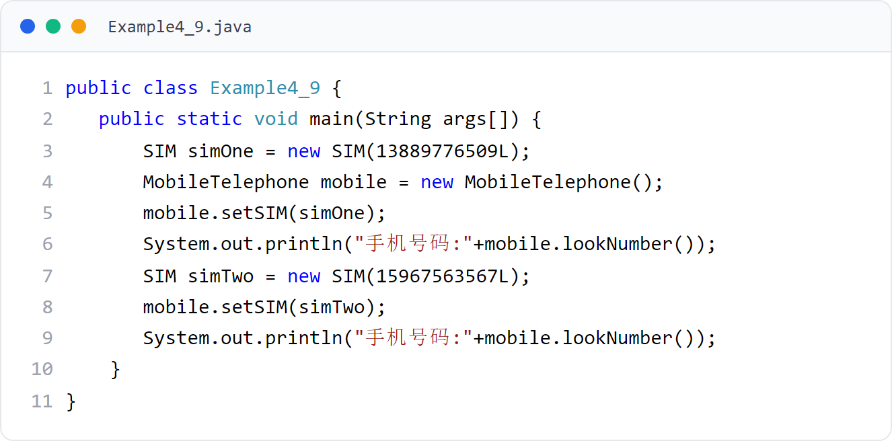
第 4 章 · 类与对象
Chapter 4 · Classes and Objects
例子9
Example 9
手机与 SIM 卡组合示例（上）
Example of mobile phone and SIM card combination (Part 1)
SIM 与 MobileTelephone 类，演示组合复用。
SIM and MobileTelephone classes demonstrate combination and reuse.
64 / 151

Slide 65
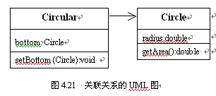
第 4 章 · 类与对象
Chapter 4 · Classes and Objects
§4.6.2
关联关系（UML 图）
Association relationships (UML diagram)
关联：一个类“知道”另一个类，并持有其对象引用
Association: One class "knows" another class and holds references to its objects
如 MobileTelephone 组合/关联一个 SIM 对象
For example, MobileTelephone combines/associates a SIM object
UML 中用实线（可带 multiplicity）表示
Represented by solid lines (can be multiplicity) in UML
关联关系表示类之间的结构联系，常用实线连接相关类。
Association relationships represent structural connections between classes, and solid lines are often used to connect related classes.
65 / 151

Slide 66

第 4 章 · 类与对象
Chapter 4 · Classes and Objects
§4.6.1 运行效果
§4.6.1 Operation effect
例子9 运行效果
Example 9 Operation effect
例子9 模拟手机使用 SIM 卡，运行效果如图 4.20。
Example 9 simulates the use of a SIM card on a mobile phone, and the running effect is as shown in Figure 4.20.
66 / 151

Slide 67
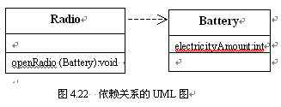
第 4 章 · 类与对象
Chapter 4 · Classes and Objects
§4.6.2
依赖关系（UML 图）
Dependencies (UML diagram)
依赖：一个类的方法局部使用另一个类的对象（参数/局部变量）
Dependency: A method of one class locally uses objects (parameters/local variables) of another class
如 Radio 的 openRadio(Battery) 依赖 Battery
For example, Radio's openRadio(Battery) depends on Battery
UML 中用带箭头的虚线表示
Represented by a dashed line with an arrow in UML
依赖关系表示一个类在方法实现中“使用”另一个类，是比关联更弱的关系。
A dependency relationship means that one class "uses" another class in method implementation and is a weaker relationship than an association.
关联 vs 依赖 区别对照（见对照图）
Difference comparison of association vs. dependence (see comparison chart)
67 / 151

Slide 68
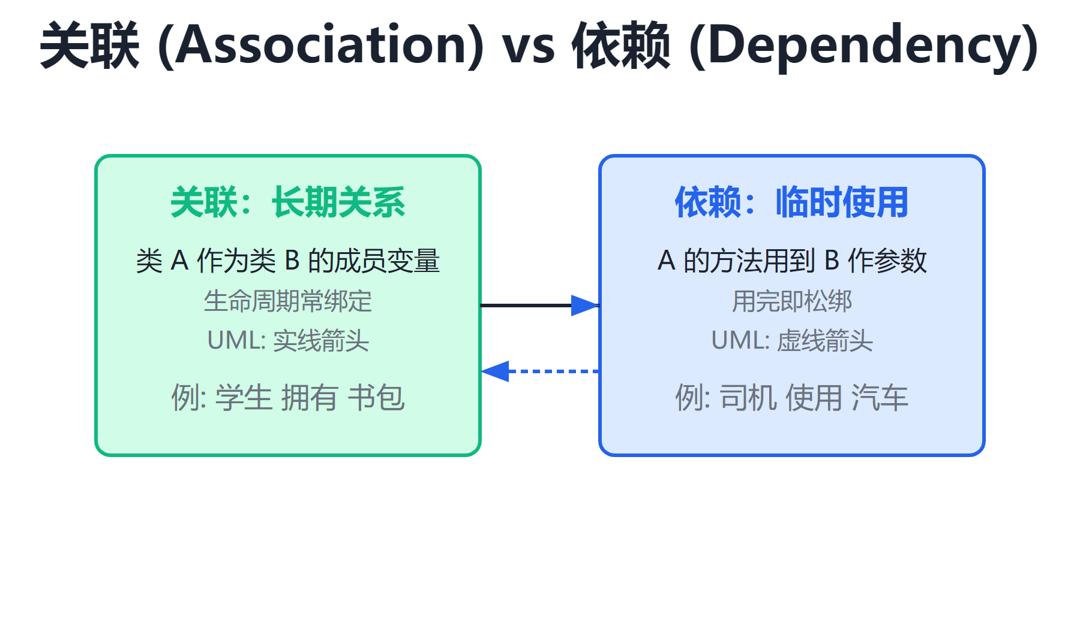
第 4 章 · 类与对象
Chapter 4 · Classes and Objects
§4.6.2 对照
§4.6.2 Comparison
关联：成员变量级别的引用（实线）
Association: Reference at the member variable level (solid line)
关联 vs 依赖 区别
Association vs Dependency Difference
依赖：方法参数/局部变量级别的使用（虚线箭头）
Dependency: Usage at method parameter/local variable level (dashed arrow)
关联耦合强于依赖
Associative coupling is stronger than dependence
关联是“长期持有”，依赖是“临时使用”；二者在 UML 中的画法不同。
Associations are "long-term held" and dependencies are "temporarily used"; they are drawn differently in UML.
68 / 151

Slide 69
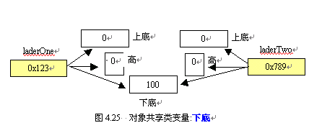
第 4 章 · 类与对象
Chapter 4 · Classes and Objects
§4.7
实例成员与类成员
Instance members and class members
1 声明：static 修饰的是类变量，否则是实例变量（静态变量）
1 Statement: static modifies class variables, otherwise it is instance variables (static variables)
2 区别：不同对象的实例变量互不相同；所有对象共享类变量
2 Differences: Instance variables of different objects are different from each other; all objects share class variables
用 static 修饰的成员变量是类变量，否则是实例变量；二者在共享性上不同。
Member variables modified with static are class variables, otherwise they are instance variables; the two are different in sharing.
3 可通过类名直接访问类变量
3 Class variables can be accessed directly through the class name
例子10 中 Ladder 创建的梯形对象共享一个下底（见图 4.23）
The trapezoidal objects created by Ladder in Example 10 share a lower base (see Figure 4.23)
69 / 151

Slide 70
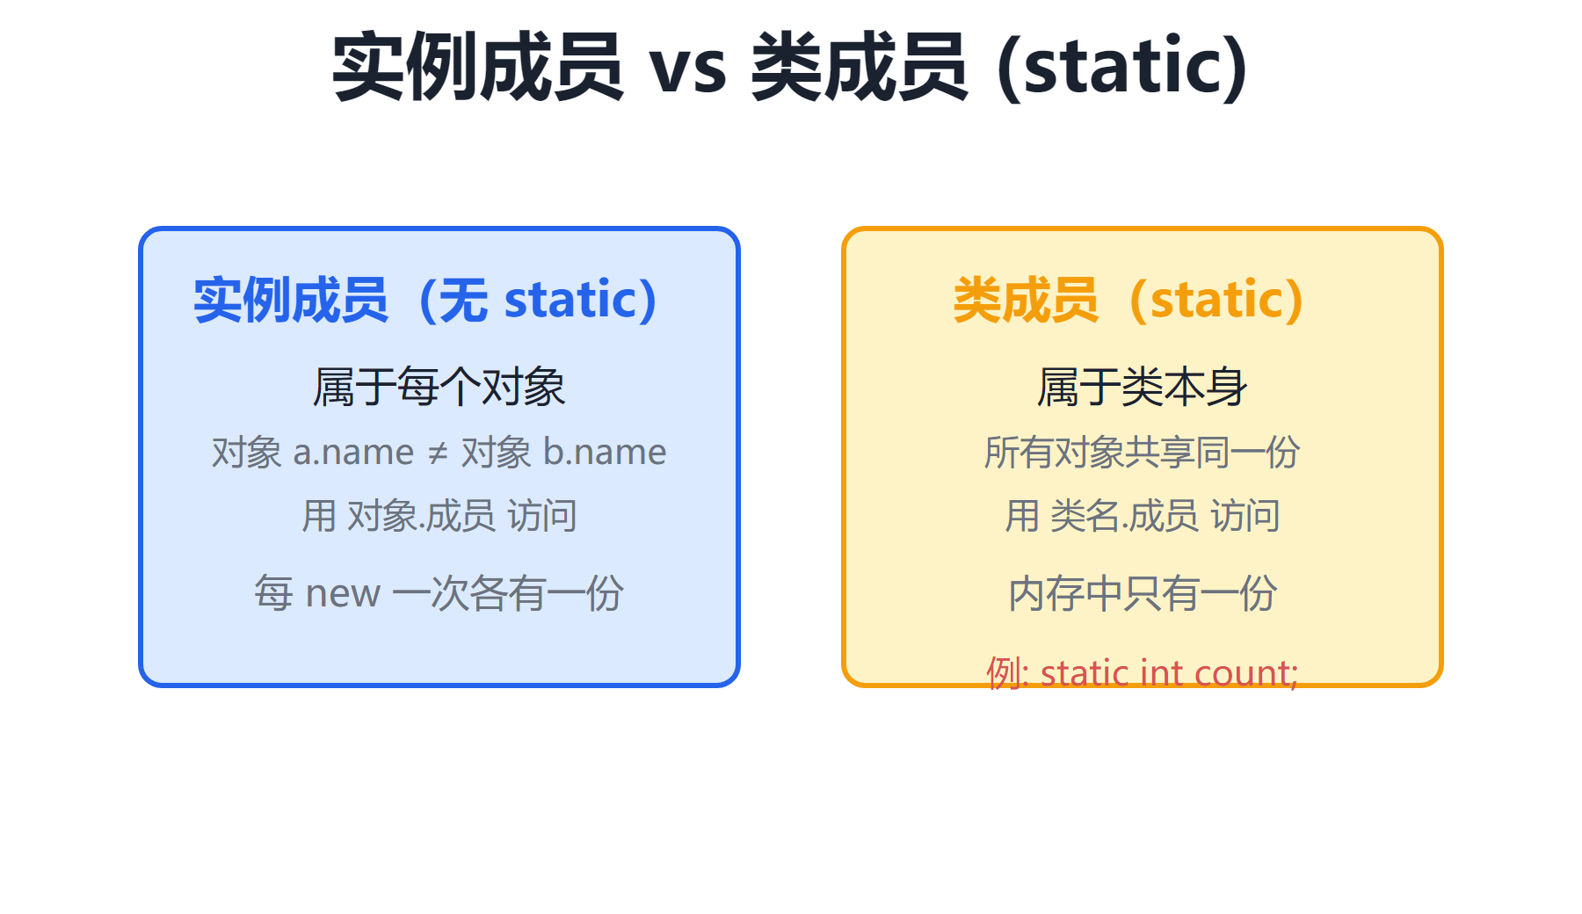
第 4 章 · 类与对象
Chapter 4 · Classes and Objects
§4.7 对照
§4.7 Comparison
实例变量/方法：每个对象各有一份，互不相同
Instance variables/methods: each object has one copy, which is different from each other
实例成员 vs 类成员（static）
Instance members vs class members (static)
类变量/方法（static）：全类只有一份，所有对象共享
Class variables/methods (static): There is only one copy for the whole class, shared by all objects
类方法不能操作实例变量（对象尚未创建时无实例内存）
Class methods cannot operate instance variables (there is no instance memory when the object has not been created)
类方法可直接通过类名调用
Class methods can be called directly through the class name
实例成员属于单个对象，类成员属于整个类，被所有对象共享。
Instance members belong to a single object, and class members belong to the entire class and are shared by all objects.
70 / 151

Slide 71
第 4 章 · 类与对象
Chapter 4 · Classes and Objects
§4.7
实例方法和类方法
Instance methods and class methods
方法声明时类型前加 static 是类方法，否则是实例方法。
When a method is declared with static before the type, it is a class method, otherwise it is an instance method.
3 定义：不加 static 为实例方法，加 static 为类方法（静态方法）
3 Definition: If static is not added, it is an instance method, and if static is added, it is a class method (static method)
4 区别：对象调用实例方法时可操作实例变量与类变量
4 Difference: When an object calls instance methods, instance variables and class variables can be manipulated
类名调用类方法；类方法不能操作实例变量、不能调用实例方法
The class name calls the class method; the class method cannot operate instance variables or call instance methods.
类方法在对象创建前即可通过类名执行
Class methods can be executed through the class name before the object is created.
71 / 151

Slide 72
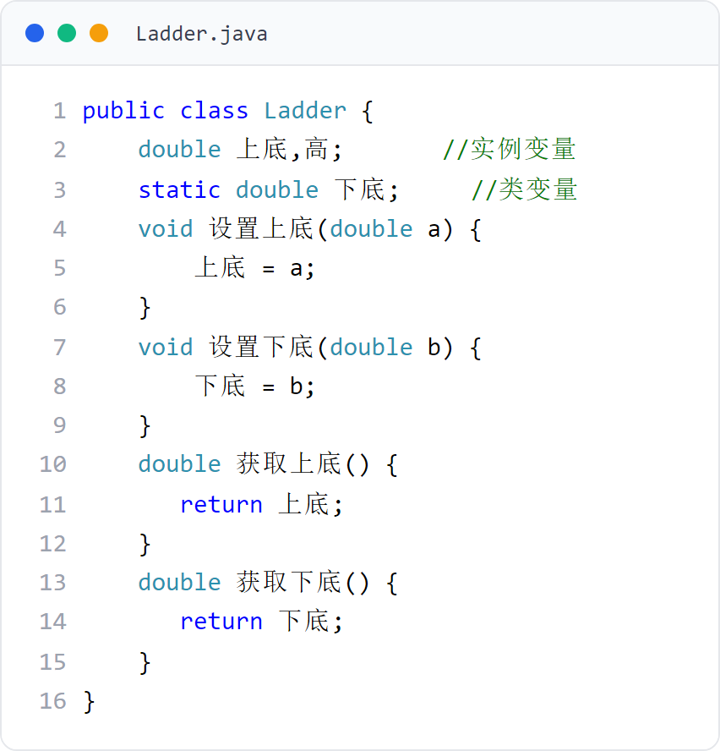
第 4 章 · 类与对象
Chapter 4 · Classes and Objects
例子10
Example 10
Ladder 类：梯形（共享下底）
Ladder class: trapezoid (shared bottom)
Ladder.java 辅助类代码
Ladder.java auxiliary class code
72 / 151

Slide 73
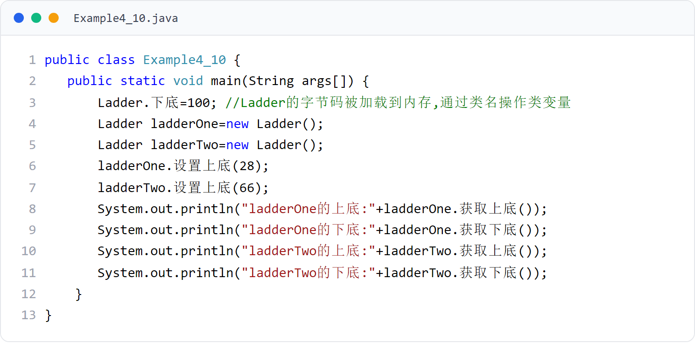
第 4 章 · 类与对象
Chapter 4 · Classes and Objects
例子10
Example 10
梯形共享下底示例（上）
Example of trapezoid sharing bottom (Part 1)
Lader 类用 static 修饰共享下底，所有梯形对象共享该变量。
The Lader class uses static to modify the shared bottom, and all ladder objects share this variable.
73 / 151

Slide 74
第 4 章 · 类与对象
Chapter 4 · Classes and Objects
§4.8
方法重载与多态
Method overloading and polymorphism
方法重载指同一类中有多个同名方法，但参数必须不同；是两种多态之一。
Method overloading means that there are multiple methods with the same name in the same class, but the parameters must be different; it is one of the two types of polymorphism.
重载条件：方法名相同，参数个数或类型不同
Overloading conditions: The method name is the same, but the number or type of parameters is different.
Java 两种多态：重载（Overload）与重写（Override，第 5 章）
Two types of polymorphism in Java: Overload and Override (Chapter 5)
构造方法也可重载，但不参与与非构造方法的重载比较
Constructors can also be overloaded, but they do not participate in overload comparisons with non-constructor methods.
74 / 151

Slide 75

第 4 章 · 类与对象
Chapter 4 · Classes and Objects
§4.8 例题
§4.8 Example questions
例子12：方法重载
Example 12: Method overloading
hello 方法以不同参数列表重载
The hello method is overloaded with a different parameter list
例子12 的 People 类中的 hello 方法是重载方法。
The hello method in the People class in Example 12 is an overloaded method.
对象调用 hello 时按参数匹配对应方法
When the object calls hello, the corresponding method is matched according to the parameters.
重载示例见图
See the figure for overloading example
75 / 151
Notes:
[课堂运行示例 / Classroom Demo]
课堂运行：课堂示例代码/第4章/OverloadDemo.java
调用三个同名 area 方法，比较编译器如何按参数列表选择方法。
[Sources]
Source concepts: user-provided chapter deck. Demo code: original instructional material.

Slide 76
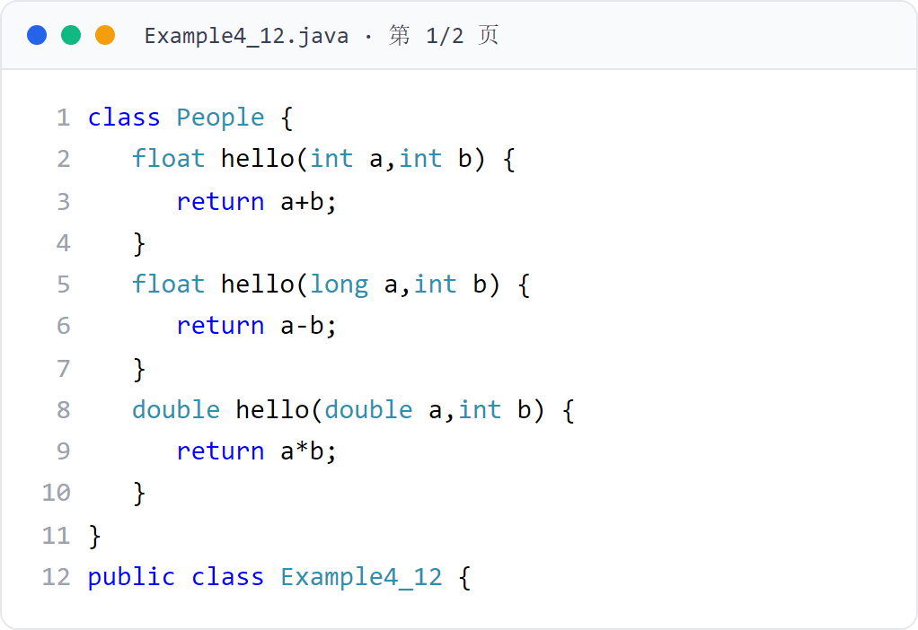
第 4 章 · 类与对象
Chapter 4 · Classes and Objects
例子12
Example 12
方法重载示例（上） （1/2）
Method overloading example (Part 1) (1/2)
People 类的多个 hello 重载方法。
Multiple hello overloaded methods for the People class.
76 / 151

Slide 77
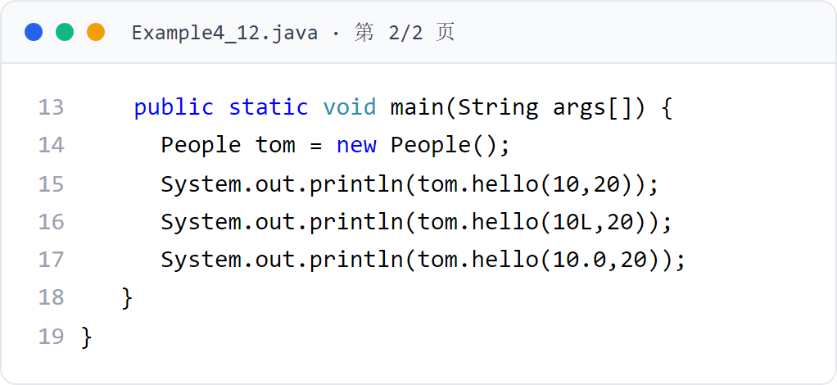
第 4 章 · 类与对象
Chapter 4 · Classes and Objects
例子12（续）
Example 12 (continued)
方法重载示例（上） （2/2）
Method overloading example (Part 1) (2/2)
第 2 页代码卡（共 2 页）
Page 2 Code Cards (2 pages total)
77 / 151

Slide 78
第 4 章 · 类与对象
Chapter 4 · Classes and Objects
§4.8 例题
§4.8 Example questions
例子13：方法重载
Example 13: Method overloading
例子13 的 Student 类（Student.java、Circle.java、Tixing.java、Example4_13.java）中的 computerArea 方法是重载方法。
The computerArea method in the Student class (Student.java, Circle.java, Tixing.java, Example4_13.java) in Example 13 is an overloaded method.
computerArea 针对不同图形重载
computerArea overloaded for different graphics
程序运行效果如图 4.27
The running effect of the program is shown in Figure 4.27
78 / 151

Slide 79

第 4 章 · 类与对象
Chapter 4 · Classes and Objects
例子13
Example 13
Circle 类：圆
Circle class: circle
Circle.java 辅助类代码
Circle.java auxiliary class code
79 / 151

Slide 80

第 4 章 · 类与对象
Chapter 4 · Classes and Objects
例子13
Example 13
Student 类：学生
Student class: student
Student.java 辅助类代码
Student.java auxiliary class code
80 / 151

Slide 81

第 4 章 · 类与对象
Chapter 4 · Classes and Objects
例子13
Example 13
Tixing 类：梯形
Tixing class: trapezoid
Tixing.java 辅助类代码
Tixing.java auxiliary class code
81 / 151

Slide 82

第 4 章 · 类与对象
Chapter 4 · Classes and Objects
例子13
Example 13
方法重载示例（一）
Method overloading example (1)
Student 类中 computerArea 重载。
computerArea overloaded in Student class.
82 / 151

Slide 83

第 4 章 · 类与对象
Chapter 4 · Classes and Objects
§4.x 运行效果
§4.x Operation effect
例子13 运行效果（图4.27）
Example 13 Operation effect (Figure 4.27)
运行效果图
Operation renderings
83 / 151

Slide 84
第 4 章 · 类与对象
Chapter 4 · Classes and Objects
§4.9
this 关键字
this keyword
this 是 Java 的关键字，表示“某个对象”，类似于自然语言中的代词。
this is a keyword in Java that means "some object", similar to pronouns in natural language.
自然语言用代词（他/它/This）在上下文中指代具体对象
Natural language uses pronouns (he/it/this) to refer to specific objects in context
Java 也用关键字 this 在上下文中指代当前对象
Java also uses the keyword this to refer to the current object in the context
this 可以出现在实例方法和构造方法中，不可出现在类方法中
this can appear in instance methods and constructors, but cannot appear in class methods
84 / 151

Slide 85
第 4 章 · 类与对象
Chapter 4 · Classes and Objects
§4.9
this 的使用
use of this
this 在构造方法中代表所创建的对象；在实例方法中代表正在调用该方法的当前对象。
This represents the created object in the constructor; in the instance method it represents the current object on which the method is being called.
this 出现在构造方法中：代表用该构造方法创建的对象
this appears in the constructor: represents the object created with this constructor
this 出现在实例方法中：代表正在调用方法的当前对象
this appears in instance methods: represents the current object on which the method is being called
实例方法中 this.成员变量 默认格式调用成员变量
This. member variable in instance method calls member variable in default format
static 成员变量默认用 类名.成员变量；实例方法只能由对象调用
By default, static member variables use classname.member variable; instance methods can only be called by objects.
85 / 151

Slide 86

第 4 章 · 类与对象
Chapter 4 · Classes and Objects
例子14
Example 14
this 关键字示例
this keyword example
People 类的构造方法中使用 this 指代所创建的对象。
The constructor of the People class uses this to refer to the object being created.
86 / 151

Slide 87
第 4 章 · 类与对象
Chapter 4 · Classes and Objects
§4.10
包
Bag
包是 Java 有效管理类的机制，用以区分名字相同的类。
Packages are Java's mechanism for efficiently managing classes to distinguish classes with the same name.
包名目的是有效区分名字相同的类
The purpose of package names is to effectively distinguish classes with the same name.
不同源文件中两个同名类可通过隶属不同的包来相互区分
Two classes with the same name in different source files can be distinguished from each other by belonging to different packages.
87 / 151

Slide 88
第 4 章 · 类与对象
Chapter 4 · Classes and Objects
§4.10.1
包语句
package statement
通过 package 关键字声明包语句，为源文件中的类指定包名。
Use the package keyword to declare a package statement and specify the package name for the class in the source file.
格式：package 包名;
必须是 Java 源文件的第一条语句；源程序中最多一个包语句
Must be the first statement in the Java source file; there can be at most one package statement in the source program
省略 package 则类属于无名包（同目录即同包，但无包名）
If package is omitted, the class belongs to an unnamed package (the same directory means the same package, but no package name)
包名可为合法标识符，或由若干标识符加“.”分隔
The package name can be a legal identifier, or it can be composed of several identifiers separated by "."
88 / 151

Slide 89
第 4 章 · 类与对象
Chapter 4 · Classes and Objects
§4.10.2
有包名的类的存储目录
Storage directory for classes with package names
如 package tom.jiafei; 对应目录 …\tom\jiafei
使用包语句后，存储文件的目录结构必须包含与包名对应的层级。
After using the package statement, the directory structure in which the files are stored must contain a level corresponding to the package name.
字节码文件须保存在该目录中（源文件可任意存放）
The bytecode files must be saved in this directory (the source files can be stored arbitrarily)
编译：C:\1000> javac tom\jiafei\源文件（字节码默认存入对应目录）
Compile: C:\1000> javac tom\jiafei\source file (the bytecode is stored in the corresponding directory by default)
89 / 151

Slide 90

第 4 章 · 类与对象
Chapter 4 · Classes and Objects
§4.10.3
运行有包名的主类
Run the main class with the package name
若主类包名是 tom.jiafei，字节码在 …\tom\jiafei 中
If the main class package name is tom.jiafei, the bytecode is in ...\tom\jiafei
运行须到 tom 的父目录（如 1000）执行
The operation must be executed in the parent directory of tom (such as 1000)
运行有包名的主类时，必须到包名父目录中去运行。
When running the main class with a package name, you must run it in the parent directory of the package name.
C:\1000> java tom.jiafei.主类名
C:\1000>java tom.jiafei.main class name
例子15 的 Student.java、Example4_15.java 使用了包语句
Student.java and Example4_15.java in Example 15 use the package statement
90 / 151

Slide 91

第 4 章 · 类与对象
Chapter 4 · Classes and Objects
例子15
Example 15
带包名的主类示例
Main class example with package name
Student 与 Example4_15 使用 package 语句按子目录存放。
Student and Example4_15 use the package statement to store them in subdirectories.
91 / 151

Slide 92

第 4 章 · 类与对象
Chapter 4 · Classes and Objects
例子15
Example 15
Student 类（tom/jiafei 子目录）
Student class (tom/jiafei subdirectory)
Student.java 辅助类代码
Student.java auxiliary class code
92 / 151

Slide 93

第 4 章 · 类与对象
Chapter 4 · Classes and Objects
§4.11
import 语句
import statement
同一包中的类可直接使用，无需 import
Classes in the same package can be used directly without import
不同包中的类需用 import 引入
Classes in different packages need to be introduced using import
需要使用的类若在另一个包中，用 import 语句引入。
If the class you need to use is in another package, use the import statement to introduce it.
如 import java.util.Date; 引入 Date 类；import java.util.*; 引入包中所有类
93 / 151

Slide 94
第 4 章 · 类与对象
Chapter 4 · Classes and Objects
§4.11.1
引入类库中的类
Import classes from the class library
用户编写的类与类库中的类不在同一包，需用 import 引入。
The classes written by users are not in the same package as the classes in the class library and need to be introduced using import.
使用已存在的类，避免一切从头做起，是 OOP 的重要方面
Using existing classes to avoid having to reinvent the wheel is an important aspect of OOP
例子16 的 Example4_16.java 用 import 引入 java.util 的 Date 与 Arrays
Example 16 Example4_16.java uses import to introduce Date and Arrays of java.util
Arrays.sort 可将数组排序；Arrays.toString 返回全部元素字符序列
Arrays.sort sorts the array; Arrays.toString returns all element character sequences
94 / 151

Slide 95

第 4 章 · 类与对象
Chapter 4 · Classes and Objects
例子16
Example 16
引入类库 Date/Arrays 示例
Introducing the class library Date/Arrays example
用 import 引入 java.util 中的 Date 与 Arrays 类。
Use import to introduce the Date and Arrays classes in java.util.
95 / 151

Slide 96
第 4 章 · 类与对象
Chapter 4 · Classes and Objects
§4.11.2
引入自定义包中的类
Import classes from custom packages
如 import tom.jiafei.*;
用户程序也可 import 引入非类库、有包名的自定义类。
User programs can also import non-class libraries and custom classes with package names.
在用户程序目录下建立与包对应的子目录结构（如 C:\ch4\tom\jiafei）
Create a subdirectory structure corresponding to the package in the user program directory (such as C:\ch4\tom\jiafei)
“包名路径左对齐”：源文件包名路径与待引入类的包名路径父目录相同
"Package name path left aligned": The source file package name path is the same as the parent directory of the package name path of the class to be introduced.
例子17、例子18 演示引入自定义包
Example 17 and Example 18 demonstrate the introduction of custom packages
96 / 151

Slide 97

第 4 章 · 类与对象
Chapter 4 · Classes and Objects
例子17
Example 17
引入自定义包示例（一）
Example of introducing a custom package (1)
按子目录 tom/jiafei 组织并使用 import 引入。
Organize by subdirectory tom/jiafei and use import to introduce.
97 / 151

Slide 98

第 4 章 · 类与对象
Chapter 4 · Classes and Objects
例子18
Example 18
引入自定义包示例（二）
Example of introducing a custom package (2)
主类（无包名）import 引入 sohu.com 包中的 Triangle 类。
The main class (no package name) import introduces the Triangle class in the sohu.com package.
98 / 151

Slide 99
第 4 章 · 类与对象
Chapter 4 · Classes and Objects
§4.12
访问权限
Access rights
对象能否用“.”操作自己的变量、使用方法受访问权限限制。
Whether an object can use "." to operate its own variables and how to use it are subject to access permission restrictions.
访问权限指对象能否通过“.”操作自己的变量或方法
Access rights refer to whether an object can operate its own variables or methods through "."
访问限制修饰符：private、protected、public
Access restriction modifiers: private, protected, public
它们用来修饰成员变量或方法
They are used to modify member variables or methods
99 / 151

Slide 100

第 4 章 · 类与对象
Chapter 4 · Classes and Objects
§4.12.2
只有在本类中创建该类的对象时，才能访问其私有成员
Only when an object of this class is created within this class, its private members can be accessed
私有变量和私有方法
Private variables and private methods
其他类中创建的对象不能用“.”直接操作私有变量/方法
Objects created in other classes cannot use "." to directly operate private variables/methods
提倡通过类提供的方法来改变属性，使数据操作更合理
It is advocated to change attributes through the methods provided by classes to make data operations more reasonable.
用 private 修饰的成员变量和方法称为私有成员，仅在本类中创建的对象可访问。
Member variables and methods modified with private are called private members and can only be accessed by objects created in this class.
100 / 151

Slide 101

第 4 章 · 类与对象
Chapter 4 · Classes and Objects
例子19
Example 19
访问权限示例（一）
Access permission example (1)
Student 类将部分成员变量设为 private，类外无法直接访问。
The Student class sets some member variables as private and cannot be accessed directly outside the class.
101 / 151

Slide 102

第 4 章 · 类与对象
Chapter 4 · Classes and Objects
例子19
Example 19
Student 类：学生
Student class: student
Student.java 辅助类代码
Student.java auxiliary class code
102 / 151

Slide 103
第 4 章 · 类与对象
Chapter 4 · Classes and Objects
§4.12.3
共有变量和共有方法
Shared variables and shared methods
用 public 修饰的成员变量和方法称为共有成员。
Member variables and methods modified with public are called public members.
在任何类中创建对象后，该对象能访问自己的 public 变量与方法
After creating an object in any class, the object can access its own public variables and methods
也可通过类名访问 public 的 static 成员变量与方法
Public static member variables and methods can also be accessed through the class name.
103 / 151

Slide 104
第 4 章 · 类与对象
Chapter 4 · Classes and Objects
§4.12.4
友好变量和友好方法
Friendly variables and friendly methods
不加修饰符的成员是友好成员，仅在同包内可访问。
Unmodified members are friendly members and are only accessible within the same package.
若另一类与 Tom 类在同一包中，其对象能访问友好变量/方法
If another class is in the same package as the Tom class, its objects can access friendly variables/methods
同包中也可通过 Tom 类名访问其 static 友好成员
Its static friendly members can also be accessed through the Tom class name in the same package.
104 / 151

Slide 105

第 4 章 · 类与对象
Chapter 4 · Classes and Objects
§4.12.5
受保护的成员变量和方法
Protected member variables and methods
介于友好与 public 之间，与继承相关（详见第 5 章）
Between friendly and public, related to inheritance (see Chapter 5 for details)
同一包内及子类中可访问
Accessible within the same package and subclasses
用 protected 修饰的成员称为受保护成员。
Members modified with protected are called protected members.
105 / 151

Slide 106
第 4 章 · 类与对象
Chapter 4 · Classes and Objects
§4.12.6
public 类与友好类
public classes and friendly classes
类声明前加 public 的是 public 类，否则是友好类。
The class declaration preceded by public is a public class, otherwise it is a friendly class.
public 类：可在任何其他类中用其创建对象
public class: can be used to create objects in any other class
友好类：使用友好类创建对象时须保证在同一包中
Friendly classes: When using friendly classes to create objects, they must be in the same package.
106 / 151

Slide 107
第 4 章 · 类与对象
Chapter 4 · Classes and Objects
§4.13
基本类型的类封装
Class encapsulation of basic types
Java 为基本数据类型提供了对应的包装类，位于 java.lang 包。
Java provides corresponding wrapper classes for basic data types, located in the java.lang package.
基本类型：byte、short、int、long、float、double、char
Basic types: byte, short, int, long, float, double, char
对应包装类：Byte、Short、Integer、Long、Float、Double、Character
Corresponding packaging classes: Byte, Short, Integer, Long, Float, Double, Character
这些类实现了对基本数据类型的封装
These classes implement encapsulation of basic data types
107 / 151

Slide 108
第 4 章 · 类与对象
Chapter 4 · Classes and Objects
§4.13.1
Double 和 Float 类
Double and Float classes
JDK 9 起构造方法过时，改用静态方法 Double.valueOf(double)、Float.valueOf(float)
The constructor method is obsolete starting from JDK 9. Use static methods Double.valueOf(double) and Float.valueOf(float) instead.
Double、Float 类封装 double、float 基本型数据。
Double and Float classes encapsulate double and float basic data.
Double 对象调用 doubleValue() 返回其中的 double 数据
Calling doubleValue() on a Double object returns the double data therein
Float 对象调用 floatValue() 返回其中的 float 数据
The Float object calls floatValue() to return the float data therein
108 / 151

Slide 109
第 4 章 · 类与对象
Chapter 4 · Classes and Objects
§4.13.2
Byte、Short、Integer、Long 类
Byte, Short, Integer, Long classes
改用 Byte.valueOf(byte)、Short.valueOf(short)、Integer.valueOf(int)、Long.valueOf(long)
Use Byte.valueOf(byte), Short.valueOf(short), Integer.valueOf(int), Long.valueOf(long) instead
这些类封装对应的整数基本型数据，构造方法同样已过时。
These classes encapsulate the corresponding integer primitive data, and the constructor methods are also obsolete.
分别调用 byteValue()、shortValue()、intValue()、longValue() 返回基本型数据
Call byteValue(), shortValue(), intValue(), longValue() respectively to return basic data
109 / 151

Slide 110
第 4 章 · 类与对象
Chapter 4 · Classes and Objects
§4.13.3
Character 类
Character class
Character 类封装 char 基本型数据，提供一些常用类方法。
The Character class encapsulates char basic type data and provides some common class methods.
静态方法 valueOf(char c) 返回 Character 对象
Static method valueOf(char c) returns Character object
isDigit(char ch)：ch 是数字字符返回 true
isDigit(char ch): ch is a numeric character and returns true
isLetter(char ch)：ch 是字母返回 true
isLetter(char ch): ch is a letter and returns true
例子20 将字符数组中的小写变大写、大写变小写
Example 20 Change the lowercase characters in the character array to uppercase, and the uppercase characters to lowercase
110 / 151

Slide 111

第 4 章 · 类与对象
Chapter 4 · Classes and Objects
例子20
Example 20
Character 类示例
Character class example
用 Character 类方法交换字符的大小写。
Swap the case of characters using the Character class methods.
111 / 151

Slide 112
第 4 章 · 类与对象
Chapter 4 · Classes and Objects
§4.14
var 局部变量
var local variable
不可在类体中声明成员变量；只能在方法体内用 var 声明局部变量
Member variables cannot be declared in the class body; local variables can only be declared with var in the method body.
可用 var 声明局部变量，类型由编译器推断（仅限于方法体内）。
Local variables can be declared with var, and the type is inferred by the compiler (only within method bodies).
声明时必须同时指定初值（初值不可以是 null）
The initial value must be specified when declaring (the initial value cannot be null)
var 不是动态变量，类型在编译阶段即确定
var is not a dynamic variable, the type is determined at the compilation stage
方法的参数与返回类型不可用 var 声明
The parameter and return type of the method are not available var declaration
例子21 的 Tom 类方法 f 中用 var 声明局部变量
Use var to declare local variables in the Tom class method f in Example 21
112 / 151

Slide 113

第 4 章 · 类与对象
Chapter 4 · Classes and Objects
例子21
Example 21
var 局部变量示例
var local variable example
方法体内用 var 声明局部变量，由初值推断类型。
Use var to declare local variables in the method body, and infer the type from the initial value.
113 / 151

Slide 114
第 4 章 · 类与对象
Chapter 4 · Classes and Objects
§4.15
对象数组
object array
数组元素可以是对象；使用对象数组前须创建数组所包含的对象。
Array elements can be objects; before using an object array, you must create the objects contained in the array.
不当做法：逐个声明 Student stu1…stu10
Improper practice: Declare Student stu1…stu10 one by one
正确做法：Student[] stu; stu = new Student[10];
new 仅创建数组，元素仍是空对象，须用 stu[0] = new Student(); 创建
例子22 中使用了对象数组
Example 22 uses an array of objects
114 / 151

Slide 115

第 4 章 · 类与对象
Chapter 4 · Classes and Objects
例子22
Example 22
对象数组示例（上）
Object array example (top)
声明并创建对象数组，逐个实例化元素。
Declare and create an array of objects, instantiating elements one by one.
115 / 151

Slide 116
第 4 章 · 类与对象
Chapter 4 · Classes and Objects
§4.16
jar 文件
jar file
jar 文件用于将多个类的字节码打包，便于分发与复用。
jar files are used to package the bytecode of multiple classes for easy distribution and reuse.
用清单文件（如 qingdan.mf）描述 jar 内容
Use a manifest file (such as qingdan.mf) to describe the contents of the jar
用 jar 命令生成 jar 文件
Use jar command to generate jar file
jar 文件可分为文档性质 jar 与可运行 jar
Jar files can be divided into document jars and runnable jars
116 / 151

Slide 117
第 4 章 · 类与对象
Chapter 4 · Classes and Objects
§4.16.1
文档性质的 jar 文件
Documentation jar file
例子23：TestOne（包 sohu.com）、TestTwo（包 sun.hello.moon）
Example 23: TestOne (includes sohu.com), TestTwo (includes sun.hello.moon)
将若干类的字节码打包为文档性质 jar，供其他程序通过 import 引入。
Package the bytecode of several classes into document jars for other programs to introduce through import.
源文件分别存于 C:\ch4\sohu\com 与 C:\ch4\sun\hello\moon
The source files are stored in C:\ch4\sohu\com and C:\ch4\sun\hello\moon respectively.
C:\ch4> jar cfm Jerry.jar qingdan.mf sohu\com\*.class sun\hello\moon\*.class
117 / 151

Slide 118

第 4 章 · 类与对象
Chapter 4 · Classes and Objects
例子23
Example 23
文档性质 jar 示例
Document nature jar example
打包 sohu.com 与 sun.hello.moon 中的类为 Jerry.jar。
The classes in sohu.com and sun.hello.moon are packaged as Jerry.jar.
118 / 151

Slide 119

第 4 章 · 类与对象
Chapter 4 · Classes and Objects
例子23
Example 23
TestTwo 类（sun/hello/moon 子目录）
TestTwo class (sun/hello/moon subdirectory)
TestTwo.java 辅助类代码
TestTwo.java auxiliary class code
119 / 151

Slide 120
第 4 章 · 类与对象
Chapter 4 · Classes and Objects
§4.16.1
使用 jar 文件中的类
Using classes from jar files
例子24（包 tom.jiafei）用 import 引入例子23 生成的 Jerry.jar 中的类
Example 24 (package tom.jiafei) uses import to introduce the classes in Jerry.jar generated in Example 23
其他程序可用 import 引入 jar 文件中的类，编译/运行时用 -cp 指定 jar。
Other programs can use import to introduce classes in jar files, and use -cp to specify jar when compiling/running.
编译：C:\ch4> javac -cp .;Jerry.jar tom\jiafei\Example4_24.java
Compile: C:\ch4> javac -cp .;Jerry.jar tom\jiafei\Example4_24.java
运行：C:\ch4> java -cp Jerry.jar tom.jiafei.Example4_24
Run: C:\ch4> java -cp Jerry.jar tom.jiafei.Example4_24
120 / 151

Slide 121

第 4 章 · 类与对象
Chapter 4 · Classes and Objects
例子24
Example 24
使用 jar 中类示例
Example using classes in jar
编译/运行主类时通过 -cp 加载 Jerry.jar。
Jerry.jar is loaded via -cp when compiling/running the main class.
121 / 151

Slide 122
第 4 章 · 类与对象
Chapter 4 · Classes and Objects
§4.16.2
可运行的 jar 文件
Runnable jar file
将整个 Java 应用打包为可运行 jar，用 java -jar 直接运行。
Package the entire Java application into a runnable jar and run it directly with java -jar.
例子25 含三个源文件：Circle.java、Circular.java、Example4_25.java
Example 25 contains three source files: Circle.java, Circular.java, Example4_25.java
分别存于 C:\ch4\data\one、data\two、my\app
Stored in C:\ch4\data\one, data\two, my\app respectively
制作：jar -cfm App.jar moon.mf data/one/*.class data/two/*.class my/app/*.class
Make: jar -cfm App.jar moon.mf data/one/*.class data/two/*.class my/app/*.class
执行：java -jar App.jar
Execution: java -jar App.jar
122 / 151

Slide 123

第 4 章 · 类与对象
Chapter 4 · Classes and Objects
例子25
Example 25
可运行 jar 示例
Runnable jar example
以 moon.mf 为主清单制作并运行 App.jar。
Make and run App.jar using moon.mf as the main manifest.
123 / 151

Slide 124

第 4 章 · 类与对象
Chapter 4 · Classes and Objects
例子25
Example 25
Circular 类（data/two 子目录）
Circular class (data/two subdirectory)
Circular.java 辅助类代码
Circular.java auxiliary class code
124 / 151

Slide 125

第 4 章 · 类与对象
Chapter 4 · Classes and Objects
例子25
Example 25
Circle 类（data/one 子目录）
Circle class (data/one subdirectory)
Circle.java 辅助类代码
Circle.java auxiliary class code
125 / 151

Slide 126
第 4 章 · 类与对象
Chapter 4 · Classes and Objects
§4.17
文档生成器
Document generator
使用 JDK 的 javadoc.exe 可生成源文件类结构的 HTML 文档。
Use the JDK's javadoc.exe to generate HTML documentation of the source file's class structure.
在源文件目录执行：javadoc Example.java
Execute in the source file directory: javadoc Example.java
生成若干 HTML 文档，描述类的组成结构（方法、成员变量）
Generate several HTML documents to describe the structure of the class (methods, member variables)
便于阅读与维护 API 文档
Easy to read and maintain API documentation
126 / 151

Slide 127

第 4 章 · 类与对象
Chapter 4 · Classes and Objects
§4.18
应用举例：有理数的类封装
Application example: Class encapsulation of rational numbers
Rational 类封装分子与分母，并提供四则运算方法
The Rational class encapsulates the numerator and denominator and provides four arithmetic operations methods
Rational 类的 UML 图如图 4.31 所示
The UML diagram of the Rational class is shown in Figure 4.31
例子26 给出 Rational 类的代码
Example 26 gives the code for the Rational class
有理数有分子、分母两个重要成员及四则运算，用 Rational 类对其进行封装。
Rational numbers have two important members, numerator and denominator, and four arithmetic operations, which are encapsulated by the Rational class.
127 / 151

Slide 128

第 4 章 · 类与对象
Chapter 4 · Classes and Objects
例子26
Example 26
有理数类封装示例（一） （1/7）
Rational number class encapsulation example (1) (1/7)
Rational 类的成员变量与构造方法。
Member variables and constructors of the Rational class.
128 / 151

Slide 129

第 4 章 · 类与对象
Chapter 4 · Classes and Objects
例子26（续）
Example 26 (continued)
有理数类封装示例（一） （2/7）
Rational number class encapsulation example (1) (2/7)
第 2 页代码卡（共 7 页）
Page 2 Code Cards (7 pages total)
129 / 151

Slide 130

第 4 章 · 类与对象
Chapter 4 · Classes and Objects
例子26（续）
Example 26 (continued)
有理数类封装示例（一） （3/7）
Rational number class encapsulation example (1) (3/7)
第 3 页代码卡（共 7 页）
Page 3 Code Cards (7 pages total)
130 / 151

Slide 131

第 4 章 · 类与对象
Chapter 4 · Classes and Objects
例子26（续）
Example 26 (continued)
有理数类封装示例（一） （4/7）
Rational number class encapsulation example (1) (4/7)
第 4 页代码卡（共 7 页）
Page 4 of 7 code cards
131 / 151

Slide 132

第 4 章 · 类与对象
Chapter 4 · Classes and Objects
例子26（续）
Example 26 (continued)
有理数类封装示例（一） （5/7）
Rational number class encapsulation example (1) (5/7)
第 5 页代码卡（共 7 页）
Page 5 of 7 code cards
132 / 151

Slide 133

第 4 章 · 类与对象
Chapter 4 · Classes and Objects
例子26（续）
Example 26 (continued)
有理数类封装示例（一） （6/7）
Rational number class encapsulation example (1) (6/7)
第 6 页代码卡（共 7 页）
Page 6 of 7 code cards
133 / 151

Slide 134

第 4 章 · 类与对象
Chapter 4 · Classes and Objects
例子26（续）
Example 26 (continued)
有理数类封装示例（一） （7/7）
Rational number class encapsulation example (1) (7/7)
第 7 页代码卡（共 7 页）
Page 7 Code Cards (7 pages total)
134 / 151

Slide 135
第 4 章 · 类与对象
Chapter 4 · Classes and Objects
§4.18
应用举例：分数四则运算
Application examples: four arithmetic operations on fractions
1/5+3/2 = 17/10；1/5-3/2 = -13/10
例子27 的主类使用 Rational 对象计算两个分数的四则运算，并求 2/1+3/2+5/3… 前 10 项和。
The main class of Example 27 uses Rational objects to calculate the four arithmetic operations of two fractions and finds the sum of the first 10 terms of 2/1+3/2+5/3….
1/5×3/2 = 3/10；1/5÷3/2 = 2/15
前 10 项和：分数 998361233/60580520；小数 16.479905306194137
Sum of the first 10 terms: fraction 998361233/60580520; decimal 16.479905306194137
135 / 151

Slide 136

第 4 章 · 类与对象
Chapter 4 · Classes and Objects
例子27
Example 27
有理数四则运算示例（一） （1/3）
Examples of four arithmetic operations on rational numbers (1) (1/3)
Example4_27 主类使用 Rational 计算分数运算与前 10 项和。
Example4_27 The main class uses Rational to calculate fraction operations and the sum of the first 10 terms.
136 / 151

Slide 137

第 4 章 · 类与对象
Chapter 4 · Classes and Objects
例子27（续）
Example 27 (continued)
有理数四则运算示例（一） （2/3）
Examples of four arithmetic operations on rational numbers (1) (2/3)
第 2 页代码卡（共 3 页）
Page 2 Code Cards (3 pages total)
137 / 151

Slide 138

第 4 章 · 类与对象
Chapter 4 · Classes and Objects
例子27（续）
Example 27 (continued)
有理数四则运算示例（一） （3/3）
Examples of four arithmetic operations on rational numbers (1) (3/3)
第 3 页代码卡（共 3 页）
Page 3 Code Cards (3 pages total)
138 / 151

Slide 139

第 4 章 · 类与对象
Chapter 4 · Classes and Objects
§4.18.2
搭建流水线
Build an assembly line
例子28 用流水线完成分数评定
Example 28 Use assembly line to complete score evaluation
InputScore 组合 DelScore；DelScore 组合 ComputerAver
InputScore composes DelScore; DelScore composes ComputerAver
若对象 a 含 b 的引用、b 含 c 的引用，可组合 a、b、c 搭建流水线。
If object a contains a reference to b and b contains a reference to c, you can combine a, b, and c to build a pipeline.
Line 组合 InputScore、DelScore、ComputerAver 三个实例
Line combines three instances of InputScore, DelScore, and ComputerAver
运行类 SingGame 驱动整条流水线
The running class SingGame drives the entire pipeline
139 / 151

Slide 140

第 4 章 · 类与对象
Chapter 4 · Classes and Objects
例子28
Example 28
分数评定流水线示例（一）
Score assessment pipeline example (1)
InputScore、DelScore 类搭建录入与去极值流水线。
The InputScore and DelScore classes build input and extreme value removal pipelines.
140 / 151

Slide 141

第 4 章 · 类与对象
Chapter 4 · Classes and Objects
例子28
Example 28
InputScore 类：录入分数
InputScore class: input score
InputScore.java 辅助类代码
InputScore.java auxiliary class code
141 / 151

Slide 142

第 4 章 · 类与对象
Chapter 4 · Classes and Objects
例子28
Example 28
DelScore 类：去掉最高最低分
DelScore class: remove the highest and lowest scores
DelScore.java 辅助类代码
DelScore.java auxiliary class code
142 / 151

Slide 143

第 4 章 · 类与对象
Chapter 4 · Classes and Objects
例子28
Example 28
ComputerAver 类：计算平均分
ComputerAver class: Calculate the average score
ComputerAver.java 辅助类代码
ComputerAver.java auxiliary class code
143 / 151

Slide 144

第 4 章 · 类与对象
Chapter 4 · Classes and Objects
例子28
Example 28
Line 类：组合整条流水线
Line class: combines the entire pipeline
Line.java 辅助类代码
Line.java auxiliary class code
144 / 151

Slide 145
第 4 章 · 类与对象
Chapter 4 · Classes and Objects
总结
Summary
本章要点
Key points of this chapter
类与对象
Classes and Objects
类是组成 Java 源文件的基本元素，是创建对象的模板
A class is a basic element of a Java source file and a template for creating objects
类体含成员变量与方法两类成员
A class body contains two kinds of members: member variables and methods
实例与类成员
Instances and class members
成员变量分实例变量（各对象互不相同）与类变量（共享）
Member variables include instance variables, which differ by object, and shared class variables
方法分实例方法与类方法；类方法只能操作类变量
Methods include instance methods and class methods; class methods can directly operate only on class variables
封装与复用
Encapsulation and reuse
对象访问成员受访问权限（private/默认/protected/public）限制
Object access to members is controlled by private, default, protected, and public permissions
通过组合、包、import 实现复用与有效管理
Use composition, packages, and import to achieve reuse and effective management
145 / 151

Slide 146
第 4 章 · 类与对象
Chapter 4 · Classes and Objects
作业
Homework
课后练习
After-class exercises
按时完成老师布置的作业。
Complete the assigned homework on time.
教材提供题库练习系统（见前言二维码），可在线刷题自测。
The textbook provides an online question bank for practice and self-testing; see the QR code in the preface.
建议动手实现本章 28 个例子并观察运行结果，加深对类与对象的理解。
Implement the 28 examples in this chapter and observe their results to deepen your understanding of classes and objects.
146 / 151

Slide 147
第 4 章 · 类与对象
Chapter 4 · Classes and Objects
编程题 1
Programming Task 1
矩形类与对象
Rectangle class and objects
定义 Rectangle，包含 width、height 和有参构造方法。
Define Rectangle with width, height, and a parameterized constructor.
编写 area() 与 perimeter()，在 main 中创建两个对象并输出。
Add area() and perimeter(); create two objects in main and print results.
文件名：RectangleClassPractice.java
File: RectangleClassPractice.java
147 / 151
Notes:
[编程题参考答案 / Reference Solution]
class RectangleAnswer {
double width, height;
RectangleAnswer(double width, double height) { this.width = width; this.height = height; }
double area() { return width * height; }
double perimeter() { return 2 * (width + height); }
}
public class RectangleClassPracticeAnswer {
public static void main(String[] args) {
RectangleAnswer a = new RectangleAnswer(5, 3);
RectangleAnswer b = new RectangleAnswer(8, 4);
System.out.println(a.area() + ", " + a.perimeter());
System.out.println(b.area() + ", " + b.perimeter());
}
}
[Sources]
Original instructional exercise and solution.

Slide 148
第 4 章 · 类与对象
Chapter 4 · Classes and Objects
编程题 2
Programming Task 2
封装学生信息
Encapsulate student data
Student 的 name、score 使用 private，提供构造方法和 getter/setter。
Make Student name and score private; add a constructor and getters/setters.
setScore 只接受 0—100；非法值保持原成绩。
Let setScore accept only 0–100 and keep the old score for invalid values.
文件名：StudentEncapsulationPractice.java
File: StudentEncapsulationPractice.java
148 / 151
Notes:
[编程题参考答案 / Reference Solution]
class StudentAnswer {
private String name;
private int score;
StudentAnswer(String name, int score) { this.name = name; setScore(score); }
String getName() { return name; }
int getScore() { return score; }
void setScore(int score) { if (score >= 0 && score <= 100) this.score = score; }
}
public class StudentEncapsulationPracticeAnswer {
public static void main(String[] args) {
StudentAnswer s = new StudentAnswer("Li Ming", 88);
s.setScore(95);
System.out.println(s.getName() + ": " + s.getScore());
}
}
[Sources]
Original instructional exercise and solution.

Slide 149
第 4 章 · 类与对象
Chapter 4 · Classes and Objects
编程题 3
Programming Task 3
电池与收音机组合
Battery and radio composition
Battery 保存电量，Radio 把 Battery 对象作为成员变量。
Battery stores power; Radio holds a Battery object as a member variable.
每次 play() 消耗 10 电量；电量不足时不能播放。
Each play() consumes 10 units; playback stops when power is insufficient.
文件名：BatteryRadioPractice.java
File: BatteryRadioPractice.java
149 / 151
Notes:
[编程题参考答案 / Reference Solution]
class BatteryAnswer { int power; BatteryAnswer(int power) { this.power = power; } }
class RadioAnswer {
private BatteryAnswer battery;
RadioAnswer(BatteryAnswer battery) { this.battery = battery; }
void play() {
if (battery.power >= 10) { battery.power -= 10; System.out.println("播放中，电量：" + battery.power); }
else System.out.println("电量不足");
}
}
public class BatteryRadioPracticeAnswer {
public static void main(String[] args) {
RadioAnswer radio = new RadioAnswer(new BatteryAnswer(20));
radio.play(); radio.play(); radio.play();
}
}
[Sources]
Original instructional exercise and solution.

Slide 150
第 4 章 · 类与对象
Chapter 4 · Classes and Objects
编程题 4
Programming Task 4
方法重载计算面积
Overload methods to calculate area
在 AreaCalculator 中重载 area：正方形、矩形和圆。
Overload area in AreaCalculator for a square, rectangle, and circle.
参数列表必须不同；在 main 中分别调用三个方法。
Parameter lists must differ; call all three methods in main.
文件名：MethodOverloadPractice.java
File: MethodOverloadPractice.java
150 / 151
Notes:
[编程题参考答案 / Reference Solution]
class AreaCalculatorAnswer {
int area(int side) { return side * side; }
int area(int width, int height) { return width * height; }
double area(double radius) { return Math.PI * radius * radius; }
}
public class MethodOverloadPracticeAnswer {
public static void main(String[] args) {
AreaCalculatorAnswer c = new AreaCalculatorAnswer();
System.out.println(c.area(5));
System.out.println(c.area(5, 3));
System.out.println(c.area(2.5));
}
}
[Sources]
Original instructional exercise and solution.

Slide 151
Thank You !
第 4 章 · 类与对象 到此结束
End of Chapter 4 · Classes and Objects
151 / 151

