Slide 1
JAVA PROGRAMMING · CHAPTER 03
Java 程序设计
Java Programming
第 3 章 · 运算符、表达式和语句
Chapter 3 · Operators, Expressions, and Statements
中国石油大学（北京）克拉玛依校区
China University of Petroleum (Beijing) Karamay Campus
授课教师：潘啸晨
Instructor: Pan Xiaochen

Slide 2
第 3 章 · 运算符、表达式和语句
Chapter 3 · Operators, Expressions, and Statements
03
运算符、表达式和语句
Operators, expressions and statements
Java 语言的运算符、表达式及分支与循环语句
Operators, expressions, branch and loop statements of Java
2 / 57

Slide 3
第 3 章 · 运算符、表达式和语句
Chapter 3 · Operators, Expressions, and Statements
导读
Introduction
主要内容
Main content
本章导览
Chapter overview
运算符与表达式
Operators and Expressions
语句概述
Statement overview
if 条件分支语句
if conditional branch statement
Java 提供了丰富的运算符，并支持条件分支与循环控制语句。
Java provides a rich set of operators and supports conditional branches and loop control statements.
switch 开关语句
switch switch statement
循环语句（for / while / do-while）
Loop statements (for/while/do-while)
break 和 continue 语句
break and continue statements
数组与 for 语句（for-each）
Arrays and for statements (for-each)
重点
focus
运算符、表达式的使用
Use of operators and expressions
各种控制语句的语法与执行流程
Syntax and execution flow of various control statements
难点
difficulty
各种控制语句的用法（嵌套、流程图）
Usage of various control statements (nested, flow chart)
3 / 57

Slide 4
第 3 章 · 运算符、表达式和语句
Chapter 3 · Operators, Expressions, and Statements
§3.1
运算符与表达式
Operators and Expressions
算术运算符：+ - * / %
Arithmetic operators: + - * / %
关系运算符：> < >= <= == !=
Relational operators: > < >= <= == !=
Java 提供了丰富的运算符（算术、关系、逻辑、位等）。绝大多数运算符与 C 语言相同，基本语句（条件分支、循环等）也与 C 类似，本章就主要知识点给予简单介绍。
Java provides a rich set of operators (arithmetic, relational, logical, bitwise, etc.). Most operators are the same as C language, and basic statements (conditional branches, loops, etc.) are also similar to C. This chapter gives a brief introduction to the main knowledge points.
逻辑运算符：&& || !
Logical operators: && || !
位运算符：& | ~ ^ （按位运算）
Bitwise operators: & | ~ ^ (bitwise operations)
赋值运算符：=；instanceof 运算符：判断对象类型
Assignment operator: =; instanceof operator: determine object type
与 C 语言对照学习：绝大多数运算符语法一致，重点是 boolean 型条件、String 类型支持、增强 for 等差异。
Comparative learning with C language: most operator syntax is consistent, focusing on differences such as boolean conditions, String type support, enhanced for, etc.
4 / 57

Slide 5
第 3 章 · 运算符、表达式和语句
Chapter 3 · Operators, Expressions, and Statements
§3.1.1
算术运算符与算术表达式
Arithmetic operators and arithmetic expressions
加减 +、- ：二目运算符；结合方向从左到右；操作元为整型或浮点型；优先级 4 级
Addition and subtraction +, -: binary operators; the combination direction is from left to right; the operand is an integer or floating point type; priority level 4
乘除求余 *、/、% ：二目运算符；结合方向从左到右；操作元为整型或浮点型；优先级 3 级
Remainder of multiplication and division *, /, %: Binary operators; the combination direction is from left to right; the operand is an integer or floating point type; priority level 3
算术表达式：用算术符号和括号连接，符合 Java 语法的式子
Arithmetic expressions: connected by arithmetic symbols and parentheses, expressions that conform to Java syntax
x + 2*y - 30 + 3*(y+5)
5 / 57
Notes:
[课堂运行示例 / Classroom Demo]
课堂运行：课堂示例代码/第3章/OperatorDemo.java
修改 a、b，观察 / 与 %；再把 b 改成 0，讨论除零保护。
[Sources]
Source concepts: user-provided chapter deck. Demo code: original instructional material.

Slide 6
第 3 章 · 运算符、表达式和语句
Chapter 3 · Operators, Expressions, and Statements
§3.1.2
自增、自减运算符 ++ / --
Increment and decrement operators ++ / --
++x // 在使用 x 之前，先使 x 增 1
x++ // 在使用 x 之后，使 x 增 1
单目运算符，可前置或后置；操作元必须是整型或浮点型变量，作用是使变量增 1 / 减 1。
Unary operator, which can be prefixed or postfixed; the operand must be an integer or floating-point variable, and its function is to increase/decrease the variable by 1.
int f=2, m=2;
int x = (f*m++) + m; // x = 7，m 变为 3
m = 2; // 重置 m，再单独看前置 ++
int y = (f*++m) + m; // y = 9
6 / 57

Slide 7
第 3 章 · 运算符、表达式和语句
Chapter 3 · Operators, Expressions, and Statements
§3.1.4
关系运算符与关系表达式
Relational operators and relational expressions
运算符：>、<、>=、<=、==、!=
Operators: >, <, >=, <=, ==, !=
二目运算符，用来比较两个值的关系
Binary operator, used to compare the relationship between two values
运算结果是 boolean 型：关系成立为 true，否则 false
The operation result is of boolean type: the relationship is true, otherwise false
操作数是基本数据类型时，比较数据内容
When the operand is a basic data type, compare the data content
操作数是引用类型时，比较对象的引用值（是否同一对象）
When the operand is a reference type, compare the reference value of the object (whether it is the same object)
详见表 3.1 关系运算符（见下页）
See Table 3.1 Relational Operators for details (see next page)
9 / 57

Slide 8
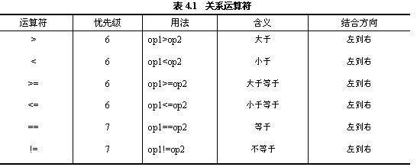
第 3 章 · 运算符、表达式和语句
Chapter 3 · Operators, Expressions, and Statements
表 3.1
Table 3.1
关系运算符
Relational operators
10 / 57

Slide 9
第 3 章 · 运算符、表达式和语句
Chapter 3 · Operators, Expressions, and Statements
§3.1.5
逻辑运算符与逻辑表达式
Logical operators and logical expressions
运算符：&&、||、!
Operators: &&, ||, !
&&、|| 为二目，实现逻辑与 / 逻辑或；! 为单目，实现逻辑非
&&, || are binary, realizing logical AND / logical OR; ! is single-order, realizing logical negation
操作元必须是 boolean 型，可用来连接关系表达式
The operand must be of type boolean and can be used to connect relational expressions
&&、|| 是短路运算符：op1=false 时 && 不再计算 op2；op1=true 时 || 不再计算 op2
&& and || are short-circuit operators: when op1=false, && no longer calculates op2; when op1=true, || no longer calculates op2.
op1 && op2 // 短路与：op1 为 false 时不计算 op2
op1 || op2 // 短路或：op1 为 true 时不计算 op2
逻辑运算规则详见表 3.2（下页）
See Table 3.2 for details of logical operation rules (next page)
11 / 57

Slide 10
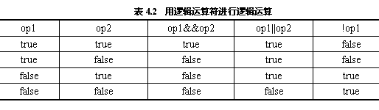
第 3 章 · 运算符、表达式和语句
Chapter 3 · Operators, Expressions, and Statements
表 3.2
Table 3.2
用逻辑运算符进行逻辑运算
Perform logical operations using logical operators
12 / 57

Slide 11
第 3 章 · 运算符、表达式和语句
Chapter 3 · Operators, Expressions, and Statements
短路例题
Short circuit example
短路运算符演示
Short circuit operator demonstration
注意 y 的值：因为 || 短路，y=20 没有被执行。
Note the value of y: y=20 is not executed because || is short-circuited.
int x = 10, y = 10;
if ( ((x=0)==0) || ((y=20)==20) ) {
System.out.println("现在 x 的值是:" + x); // x = 0
System.out.println("现在 y 的值是:" + y); // y 仍为 10（短路）
}
13 / 57
Notes:
[课堂运行示例 / Classroom Demo]
课堂运行：课堂示例代码/第3章/ShortCircuitDemo.java
先预测 y 是否变化，再运行验证 || 和 && 的短路效果。
[Sources]
Source concepts: user-provided chapter deck. Demo code: original instructional material.

Slide 12
第 3 章 · 运算符、表达式和语句
Chapter 3 · Operators, Expressions, and Statements
§3.1.6
赋值运算符与赋值表达式
Assignment operators and assignment expressions
赋值运算符：=
Assignment operator: =
二目运算符，左操作元必须是变量，不能是常量或表达式
Binary operator, the left operand must be a variable, not a constant or an expression
优先级较低（14 级），结合方向从右到左
Lower priority (level 14), binding direction from right to left
赋值表达式的值就是 = 左面变量的值
The value of the assignment expression is the value of the variable on the left of =
⚠ 不要将赋值 = 与等号逻辑 == 混淆
⚠ Do not confuse assignment = with equal sign logic ==
x = 20;
b = true;
14 / 57

Slide 13
第 3 章 · 运算符、表达式和语句
Chapter 3 · Operators, Expressions, and Statements
§3.1.8
instanceof 运算符
instanceof operator
二目运算符，左操作元是对象，右操作元是类。当左对象是右类或子类创建的对象时，结果为 true，否则 false。
Binary operator, the left operand is an object and the right operand is a class. The result is true when the left object is an object created by the right class or subclass, false otherwise.
String s = new String("abc");
if (s instanceof String)
System.out.println("s 是 String 对象");
Test b = new Test();
if (b instanceof Test)
System.out.println("b 是 Test 对象");
17 / 57

Slide 14
第 3 章 · 运算符、表达式和语句
Chapter 3 · Operators, Expressions, and Statements
§3.1.9
运算符综述
Operator overview
Java 表达式是用运算符连接起来、符合 Java 规则的式子
Java expressions are expressions that are connected using operators and conform to Java rules.
运算符的优先级决定表达式中运算执行的先后顺序
The precedence of operators determines the order in which operations in an expression are performed.
建议多用括号 () 明确运算次序，避免阅读歧义
It is recommended to use parentheses () to clarify the order of operations and avoid reading ambiguities.
运算符的结合性决定具有相同级别运算符的先后顺序
The associativity of operators determines the order of operators with the same level.
18 / 57

Slide 15
第 3 章 · 运算符、表达式和语句
Chapter 3 · Operators, Expressions, and Statements
§3.2
语句概述
Statement overview
方法调用语句：如 System.out.println("Hello");
Java 里的语句可分为以下六类。
Statements in Java can be divided into the following six categories.
表达式语句：表达式末尾加分号，如 x = 23;
Expression statement: Add a semicolon at the end of the expression, such as x = 23;
复合语句：用 { } 把若干语句括起来构成复合语句
Compound statement: Use { } to enclose several statements to form a compound statement
空语句：一个分号也是一条语句
Empty statement: a semicolon is also a statement
控制语句：条件分支语句、开关语句、循环语句（本章重点）
Control statements: conditional branch statements, switch statements, loop statements (the focus of this chapter)
package 语句和 import 语句：与类、对象有关，将在第 4 章讲解
package statement and import statement: related to classes and objects, will be explained in Chapter 4
19 / 57

Slide 16
第 3 章 · 运算符、表达式和语句
Chapter 3 · Operators, Expressions, and Statements
§3.3
if 条件分支语句（三种形式）
if conditional branch statement (three forms)
if 语句：单条件、单分支——满足条件才执行
if statement: single condition, single branch - executed only when the condition is met
按语法格式细分为三种形式，均要求条件表达式为 boolean 型。
It is subdivided into three forms according to the syntax format, all of which require the conditional expression to be of boolean type.
if-else 语句：单条件、双分支——二选一
if-else statement: single condition, double branch - choose one of the two
if-else if-...-else 语句：多条件、多分支——依次判断
if-else if-...-else statement: multiple conditions, multiple branches - judge in sequence
20 / 57

Slide 17
第 3 章 · 运算符、表达式和语句
Chapter 3 · Operators, Expressions, and Statements
§3.3.1
if 语句
if statement
单条件分支语句，根据一个条件控制程序执行流程（见图 3.2）。
A single conditional branch statement controls the program execution flow based on a condition (see Figure 3.2).
if (表达式) {
若干语句
several sentences
}
表达式的值必须是 boolean 型；不能用 0 代表 false，1 代表 true
The value of the expression must be of type boolean; 0 cannot be used to represent false or 1 to represent true.
21 / 57

Slide 18
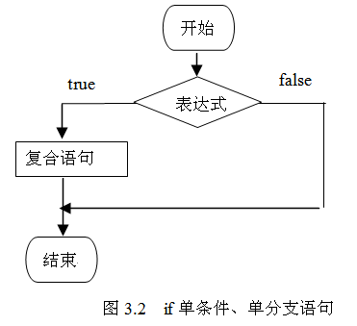
第 3 章 · 运算符、表达式和语句
Chapter 3 · Operators, Expressions, and Statements
图 3.2
Figure 3.2
if 单条件、单分支语句
if single condition, single branch statement
22 / 57

Slide 19
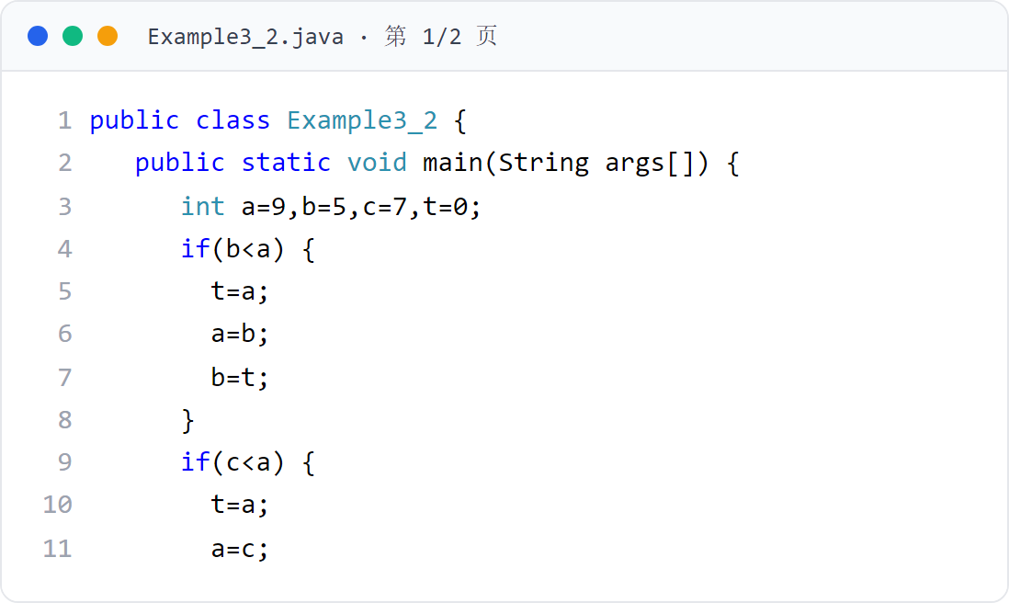
第 3 章 · 运算符、表达式和语句
Chapter 3 · Operators, Expressions, and Statements
例子2
Example 2
用 if 语句将三个数从小到大排序（上）
Use if statement to sort three numbers from small to large (Part 1)
三个 if 块依次确保 a ≤ b、a ≤ c、b ≤ c。
The three if blocks in turn ensure that a ≤ b, a ≤ c, b ≤ c.
23 / 57

Slide 20
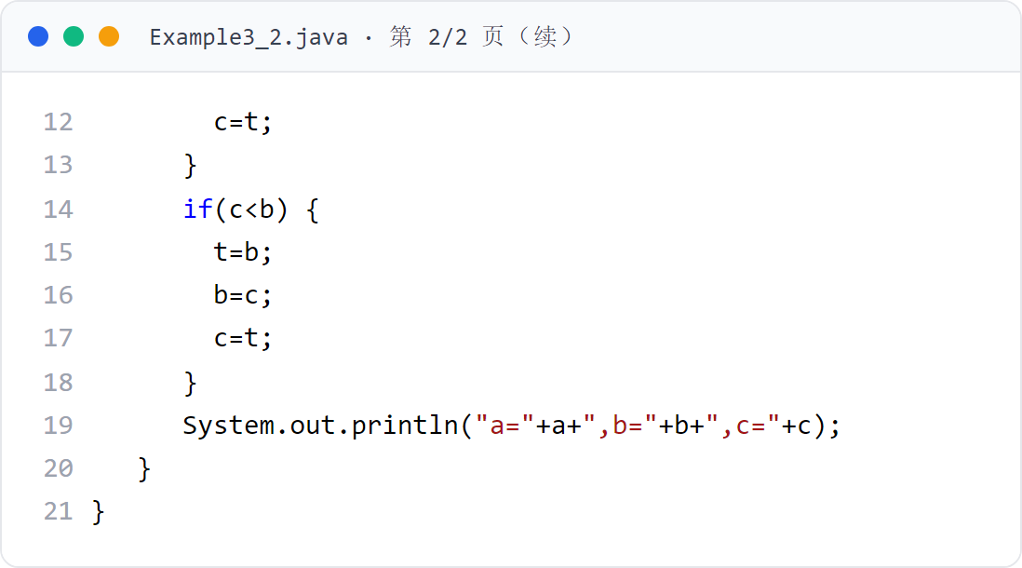
第 3 章 · 运算符、表达式和语句
Chapter 3 · Operators, Expressions, and Statements
例子2
Example 2
用 if 语句将三个数从小到大排序（下）
Use the if statement to sort three numbers from small to large (Part 2)
接上页（行号连续）。
Continued from previous page (line numbers are consecutive).
24 / 57

Slide 21
第 3 章 · 运算符、表达式和语句
Chapter 3 · Operators, Expressions, and Statements
§3.3.2
if-else 语句
if-else statement
双条件分支语句，根据一个条件选择两个分支之一（见图 3.3）。
A biconditional branch statement selects one of two branches based on a condition (see Figure 3.3).
if (表达式) {
若干语句
several sentences
}
else {
若干语句
several sentences
}
25 / 57

Slide 22
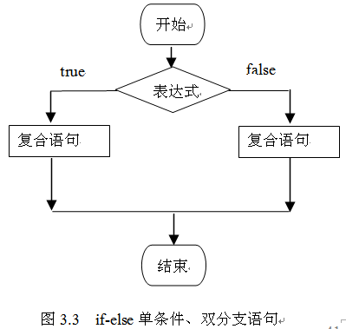
第 3 章 · 运算符、表达式和语句
Chapter 3 · Operators, Expressions, and Statements
图 3.3
Figure 3.3
if-else 单条件、双分支语句
if-else single condition, double branch statement
26 / 57

Slide 23
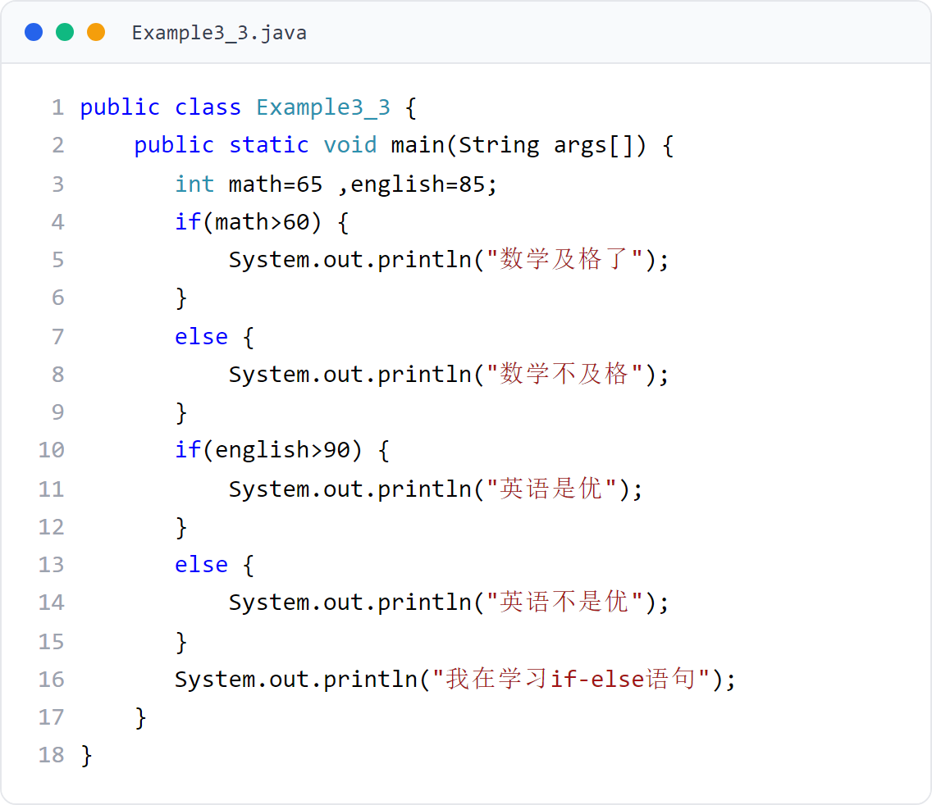
第 3 章 · 运算符、表达式和语句
Chapter 3 · Operators, Expressions, and Statements
例子3
Example 3
用 if-else 输出成绩评价
Use if-else to output performance evaluation
两条 if-else：根据数学/英语分数输出对应评价。
Two if-else: output corresponding evaluation based on math/English scores.
27 / 57
Notes:
[课堂运行示例 / Classroom Demo]
课堂运行：课堂示例代码/第3章/BranchDemo.java
依次输入 95、82、68、55 和 105，观察多分支与合法性检查。
[Sources]
Source concepts: user-provided chapter deck. Demo code: original instructional material.

Slide 24
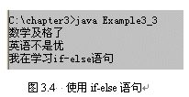
第 3 章 · 运算符、表达式和语句
Chapter 3 · Operators, Expressions, and Statements
运行效果
Run result
例子3 运行效果
Example 3 Operation effect
设定 math=65、english=85，输出两条 if-else 的判定结果。
Set math=65, english=85, and output two if-else judgment results.
28 / 57

Slide 25
第 3 章 · 运算符、表达式和语句
Chapter 3 · Operators, Expressions, and Statements
§3.3.3
if-else if-else 语句
if-else if-else statement
if (表达式1) {
若干语句
several sentences
多条件分支语句，按顺序判断多个条件（见图 3.5）。
A multi-condition branch statement evaluates multiple conditions in sequence (see Figure 3.5).
}
else if (表达式2) {
若干语句
several sentences
}
…
else {
若干语句
several sentences
}
29 / 57

Slide 26
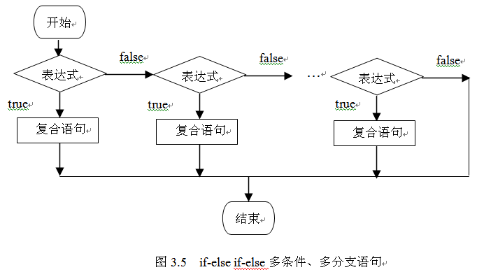
第 3 章 · 运算符、表达式和语句
Chapter 3 · Operators, Expressions, and Statements
图 3.5
Figure 3.5
if-else if-else 多条件、多分支语句
if-else if-else multi-condition, multi-branch statement
30 / 57

Slide 27
第 3 章 · 运算符、表达式和语句
Chapter 3 · Operators, Expressions, and Statements
§3.4
switch 开关语句
switch switch statement
单条件多分支开关语句，其中 break 语句可选。
Single conditional multi-branch switch statement, in which the break statement is optional.
表达式的值可以是 byte、short、int、char、String 或 enum（但不可以是 long）
The value of the expression can be byte, short, int, char, String, or enum (but not long)
case 常量必须与 switch 表达式类型相同
case constant must be of the same type as the switch expression
根据需要设置 break，否则会从匹配的 case 一直贯穿到最后（fall-through）
Set break as needed, otherwise it will run from the matching case to the end (fall-through)
default 语句可放在任意位置；不匹配任何 case 时执行
The default statement can be placed anywhere; it is executed when no case matches
31 / 57

Slide 28
第 3 章 · 运算符、表达式和语句
Chapter 3 · Operators, Expressions, and Statements
§3.4
switch (表达式) {
switch 格式定义
switch format definition
case 常量值1:
case constant value 1:
若干个语句
several statements
break;
单条件多分支的开关语句，其中 break 语句是可选的。
Single conditional multi-branch switch statement, in which the break statement is optional.
case 常量值2:
case constant value 2:
若干个语句
several statements
break;
...
case 常量值n:
case constant value n:
若干个语句
several statements
break;
default:
若干语句
several sentences
}
32 / 57

Slide 29
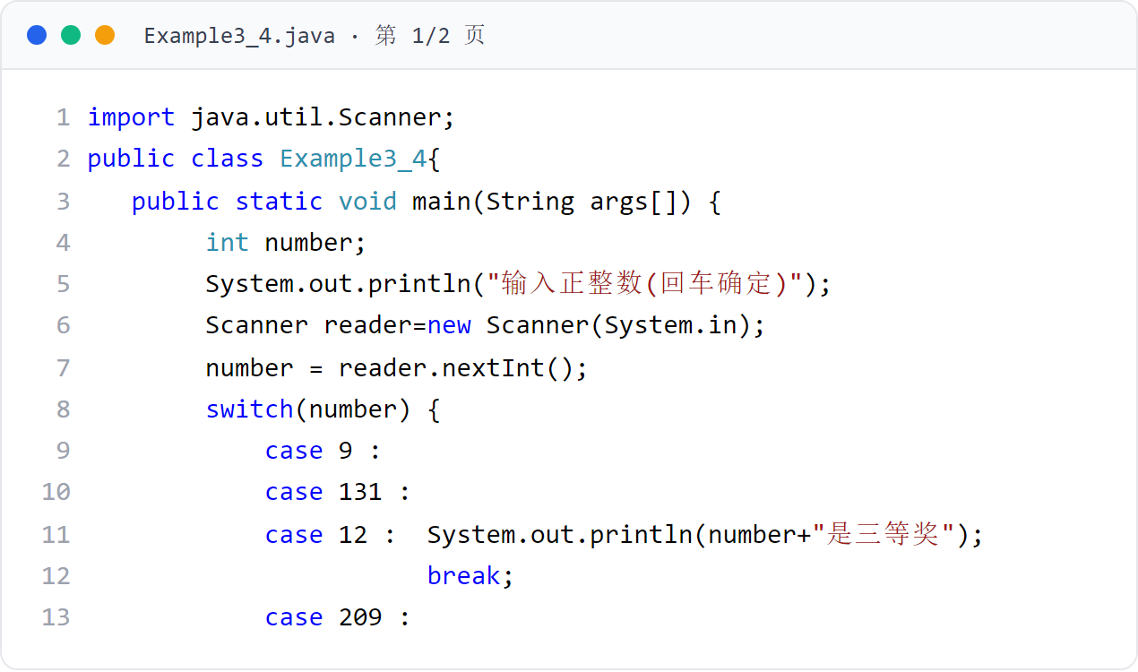
第 3 章 · 运算符、表达式和语句
Chapter 3 · Operators, Expressions, and Statements
例子4
Example 4
用 switch 判断输入是否中奖（上）
Use switch to determine whether the input is winning (Part 1)
用户从键盘输入一个正整数，程序判断奖项。
The user inputs a positive integer from the keyboard, and the program determines the award.
33 / 57

Slide 30
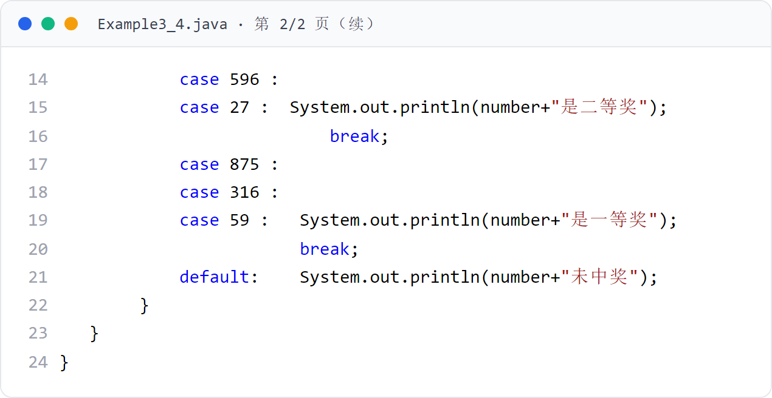
第 3 章 · 运算符、表达式和语句
Chapter 3 · Operators, Expressions, and Statements
例子4
Example 4
用 switch 判断输入是否中奖（下）
Use switch to determine whether the input is winning (Part 2)
接上页（行号连续）。
Continued from previous page (line numbers are consecutive).
34 / 57

Slide 31
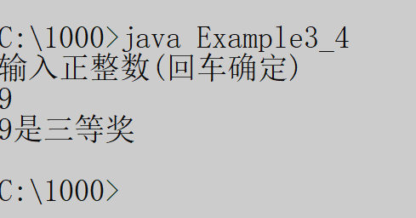
第 3 章 · 运算符、表达式和语句
Chapter 3 · Operators, Expressions, and Statements
运行效果
Run result
例子4 运行效果
Example 4 Operation effect
输入 9、131、209、875 等测试中奖号码，观察 switch 各分支输出。
Enter the test winning numbers such as 9, 131, 209, 875, etc., and observe the output of each branch of the switch.
35 / 57

Slide 32
第 3 章 · 运算符、表达式和语句
Chapter 3 · Operators, Expressions, and Statements
§3.5.1
for 循环语句
for loop statement
1. 计算表达式 1：完成必要的初始化工作
1. Calculate expression 1: Complete necessary initialization work
2. 判断表达式 2：true 则执行 3，false 则执行 4
2. Judgment expression 2: if true, execute 3, if false, execute 4
语法格式与执行规则（见图 3.6）。
Syntax format and execution rules (see Figure 3.6).
3. 执行循环体，然后计算表达式 3（改变循环条件），回到 2
3. Execute the loop body, then evaluate expression 3 (change the loop condition), and return to 2
4. 结束 for 语句
4. End the for statement
for (表达式1; 表达式2; 表达式3) {
若干语句
several sentences
}
36 / 57

Slide 33
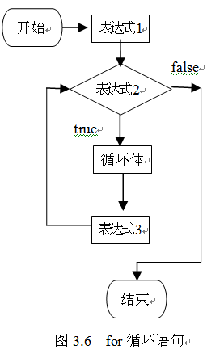
第 3 章 · 运算符、表达式和语句
Chapter 3 · Operators, Expressions, and Statements
图 3.6
Figure 3.6
for 循环语句
for loop statement
37 / 57

Slide 34
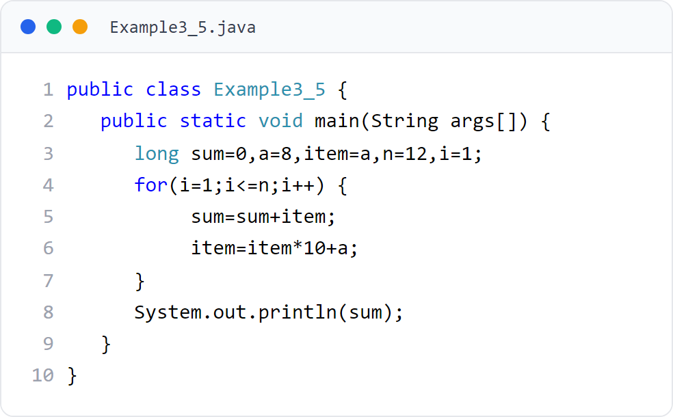
第 3 章 · 运算符、表达式和语句
Chapter 3 · Operators, Expressions, and Statements
例子5
Example 5
计算 8+88+888+8888... 前 12 项和
Calculate the sum of the first 12 terms of 8+88+888+8888...
每一项 item 自身乘 10 加 a（8）得到下一项。
Each item is multiplied by 10 and a(8) is added to get the next item.
38 / 57
Notes:
[课堂运行示例 / Classroom Demo]
课堂运行：课堂示例代码/第3章/LoopSeriesDemo.java
逐轮观察 item 与 sum，说明下一项如何由上一项生成。
[Sources]
Source concepts: user-provided chapter deck. Demo code: original instructional material.

Slide 35
第 3 章 · 运算符、表达式和语句
Chapter 3 · Operators, Expressions, and Statements
§3.5.2
while 循环
while loop
1. 计算表达式的值：true 则执行 2，false 则执行 3
1. Calculate the value of the expression: if true, execute 2; if false, execute 3
先判断后执行，循环体可能一次都不执行（见图 3.7）。
Judgment first and then execution, the loop body may not be executed at all (see Figure 3.7).
2. 执行循环体，回到 1
2. Execute the loop body and return to 1
3. 结束 while 语句
3. End the while statement
while (表达式) {
若干语句
several sentences
}
39 / 57

Slide 36
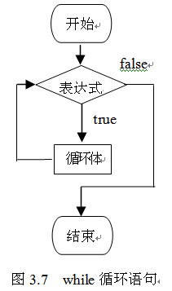
第 3 章 · 运算符、表达式和语句
Chapter 3 · Operators, Expressions, and Statements
图 3.7
Figure 3.7
while 循环语句
while loop statement
40 / 57

Slide 37
第 3 章 · 运算符、表达式和语句
Chapter 3 · Operators, Expressions, and Statements
§3.5.3
do-while 循环
do-while loop
1. 执行循环体
1. Execute the loop body
先执行后判断，循环体至少执行一次（见图 3.8）。
Execute first and then judge. The loop body is executed at least once (see Figure 3.8).
2. 计算表达式的值：true 则回到 1，false 则执行 3
2. Calculate the value of the expression: if true, return to 1; if false, execute 3
3. 结束 do-while 语句
3. End the do-while statement
do {
若干语句
several sentences
} while (表达式);
41 / 57

Slide 38
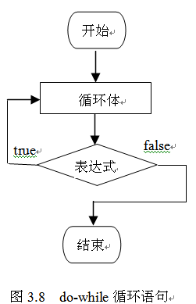
第 3 章 · 运算符、表达式和语句
Chapter 3 · Operators, Expressions, and Statements
图 3.8
Figure 3.8
do-while 循环语句
do-while loop statement
42 / 57

Slide 39
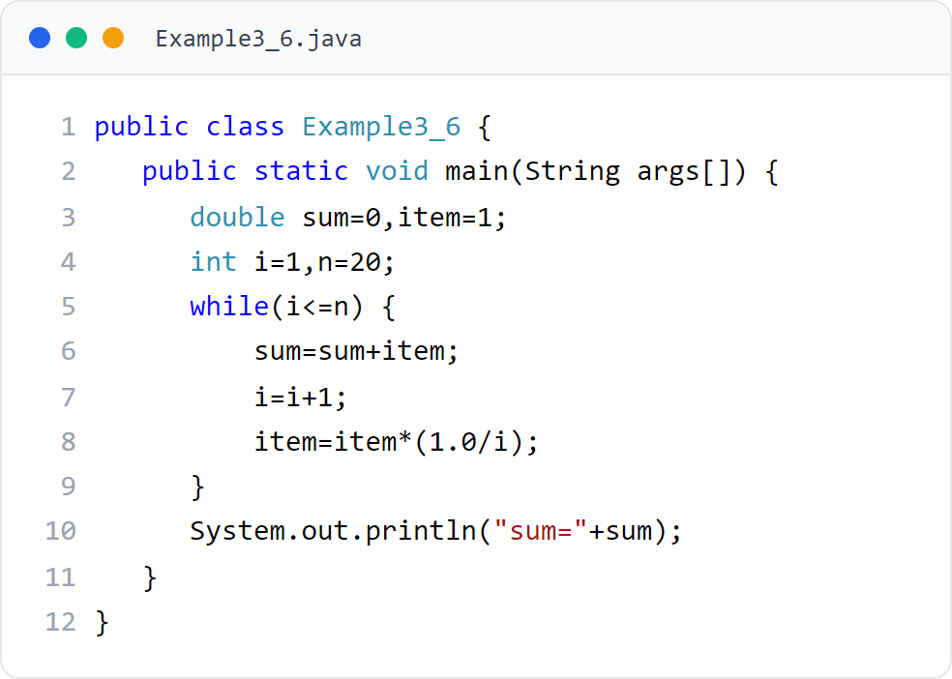
第 3 章 · 运算符、表达式和语句
Chapter 3 · Operators, Expressions, and Statements
例子6
Example 6
用 while 计算 1+1/2!+1/3!+... 前 20 项和
Use while to calculate the sum of the first 20 terms of 1+1/2!+1/3!+...
每轮 item 乘以 1.0/i 得到下一项的阶倒数。
Each round item is multiplied by 1.0/i to get the reciprocal of the order of the next item.
43 / 57

Slide 40
第 3 章 · 运算符、表达式和语句
Chapter 3 · Operators, Expressions, and Statements
§3.6
break 和 continue 语句
break and continue statements
由关键字 break 或 continue 加分号构成
It consists of the keyword break or continue followed by a semicolon
在循环体中可使用 break 和 continue
You can use break and continue in the loop body
执行 break：整个循环语句结束
Execute break: the entire loop statement ends
执行 continue：本次循环结束（continue 之后的循环体语句不再执行），转入下一次循环
Execute continue: This loop ends (the loop body statement after continue will no longer be executed) and transfers to the next loop.
44 / 57

Slide 41
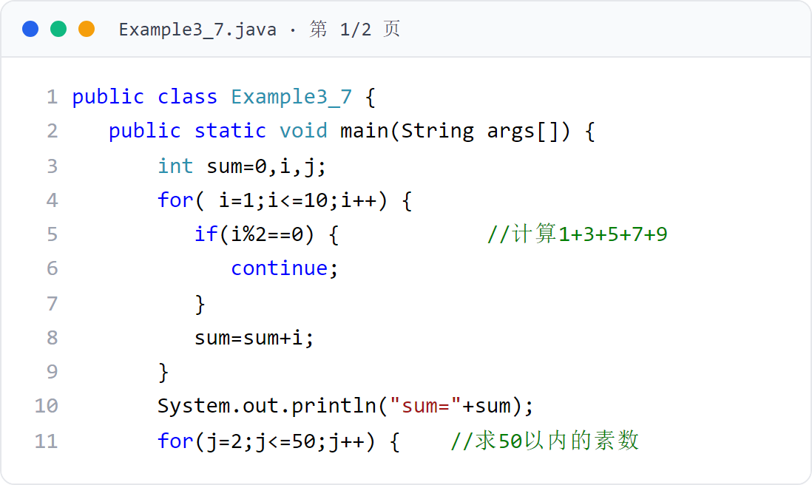
第 3 章 · 运算符、表达式和语句
Chapter 3 · Operators, Expressions, and Statements
例子7
Example 7
用 continue/break 计算 1+3+5... 与 50 以内素数（上）
Use continue/break to calculate 1+3+5... and prime numbers within 50 (Part 1)
第一个 for 演示 continue：跳过偶数累加奇数和；第二个 for 演示 break：判断 50 以内素数。
The first for demonstrates continue: skips even numbers and accumulates the sum of odd numbers; the second for demonstrates break: determines prime numbers within 50.
45 / 57

Slide 42
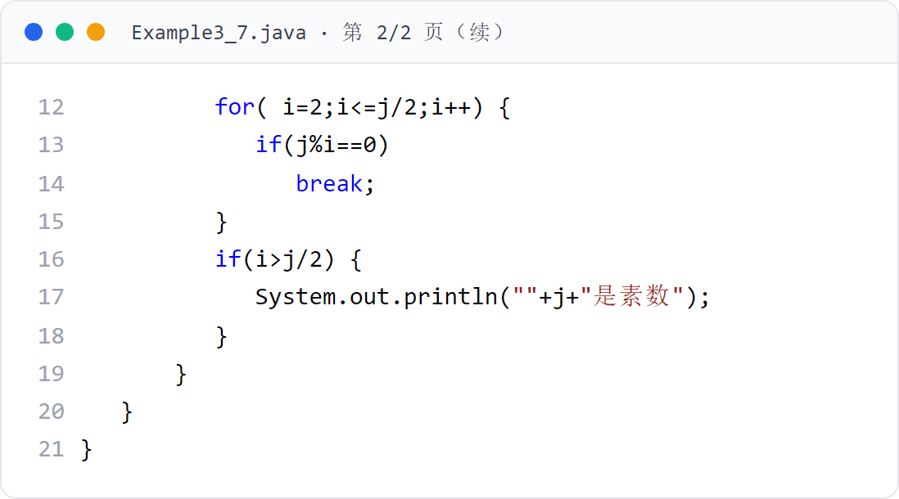
第 3 章 · 运算符、表达式和语句
Chapter 3 · Operators, Expressions, and Statements
例子7
Example 7
用 continue/break 计算 1+3+5... 与 50 以内素数（下）
Use continue/break to calculate 1+3+5... and prime numbers within 50 (Part 2)
接上页（行号连续）。
Continued from previous page (line numbers are consecutive).
46 / 57

Slide 43
第 3 章 · 运算符、表达式和语句
Chapter 3 · Operators, Expressions, and Statements
§3.7
for 语句与数组
for statement and array
循环变量依次取数组的每一个元素的值，自动遍历完整个数组
The loop variable takes the value of each element of the array in turn and automatically traverses the entire array.
比传统 for(;;) 更简洁：无需下标、无需 length
JDK 5 起对 for 语句的功能给予扩充、增强，以便更好地遍历数组。这种形式类似 "for each"。
Starting from JDK 5, the functions of the for statement have been expanded and enhanced to better traverse arrays. This form is similar to "for each".
只读遍历：无法通过循环变量修改数组元素
Read-only traversal: array elements cannot be modified through loop variables
for (声明循环变量 : 数组的名字) {
// 循环变量依次取数组的每一个元素的值
//The loop variable takes the value of each element of the array in turn
}
声明的循环变量类型必须和数组的类型相同
The type of the declared loop variable must be the same as the type of the array
47 / 57

Slide 44
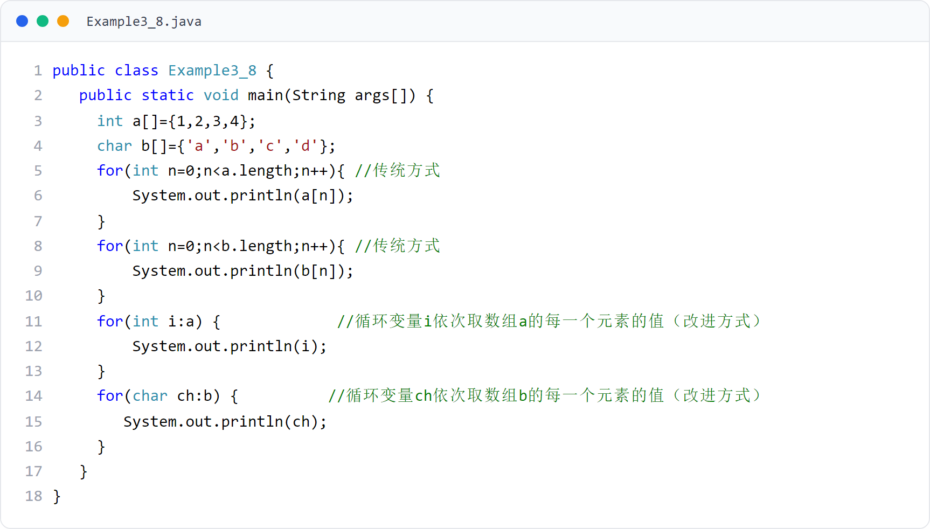
第 3 章 · 运算符、表达式和语句
Chapter 3 · Operators, Expressions, and Statements
例子8
Example 8
用传统 for 与 for-each 遍历数组
Traverse arrays using traditional for and for-each
同一数组分别用 for(;;) 和 for(:) 两种方式遍历。
48 / 57

Slide 45
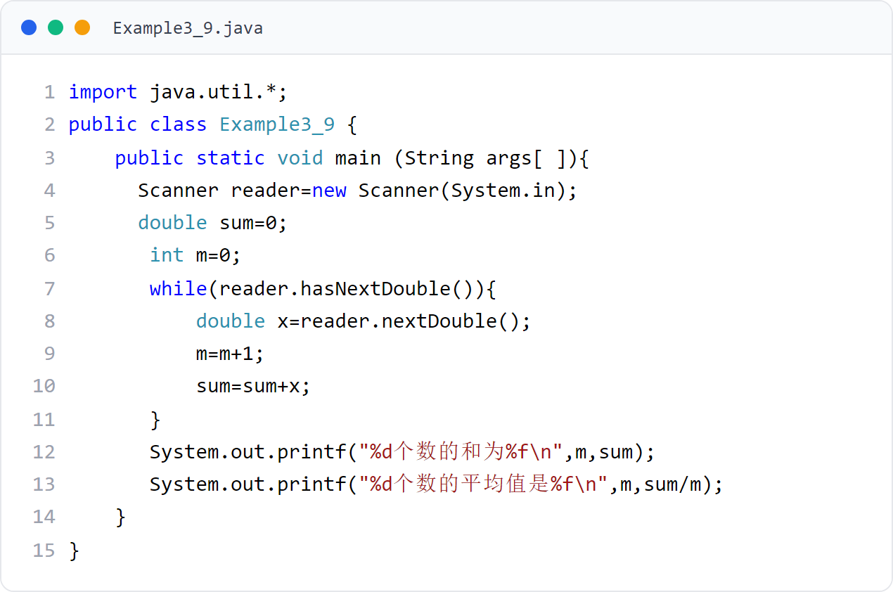
第 3 章 · 运算符、表达式和语句
Chapter 3 · Operators, Expressions, and Statements
例子9
Example 9
用 Scanner 累加键盘输入的若干数并求平均
Use Scanner to accumulate several numbers entered on the keyboard and average them
循环调用 hasNextDouble() 等待、nextDouble() 获取输入，遇到非数字字符串结束；最后用 printf 输出和与平均值。
Call hasNextDouble() in a loop to wait, nextDouble() to get input, and end when encountering a non-numeric string; finally use printf to output the sum and average.
49 / 57
Notes:
[课堂运行示例 / Classroom Demo]
课堂运行：课堂示例代码/第3章/ScannerAverageDemo.java
输入 98 129.77 865.88 end，观察计数、累加和平均值。
[Sources]
Source concepts: user-provided chapter deck. Demo code: original instructional material.

Slide 46

第 3 章 · 运算符、表达式和语句
Chapter 3 · Operators, Expressions, and Statements
运行效果
Run result
例子9 运行效果
Example 9 Operation effect
依次输入 98、129.77、865.88，最后输入非数字 end 结束，输出和与平均值。
Enter 98, 129.77, 865.88 in sequence, and finally enter a non-number end to end, and output the sum and average.
50 / 57

Slide 47
第 3 章 · 运算符、表达式和语句
Chapter 3 · Operators, Expressions, and Statements
总结
Summary
本章要点
Key points of this chapter
1
2
3
Java 提供了丰富的运算符，学会各种运算符的使用
Java provides a wealth of operators, learn how to use them
Java 控制语句分为条件控制语句（if / switch）和循环控制语句（for / while / do-while）
Java control statements are divided into conditional control statements (if / switch) and loop control statements (for / while / do-while)
Java 5 提供了 for-each 形式的增强 for 循环，便于遍历数组
Java 5 provides an enhanced for loop in the form of for-each to facilitate array traversal
51 / 57

Slide 48
第 3 章 · 运算符、表达式和语句
Chapter 3 · Operators, Expressions, and Statements
作业
Homework
课后练习
After-class exercises
按时完成老师布置的作业。
Complete the homework assigned by the teacher on time.
教材提供了题库练习系统（见前言二维码），可在线刷题自测。
The textbook provides a question bank practice system (see the QR code in the preface), and you can write questions online for self-test.
建议动手实现本章 9 个例子并观察运行结果，加深对控制语句的理解。
It is recommended to implement the 9 examples in this chapter and observe the running results to deepen your understanding of control statements.
52 / 57

Slide 49
第 3 章 · 运算符、表达式和语句
Chapter 3 · Operators, Expressions, and Statements
编程题 1
Programming Task 1
四则运算计算器
Arithmetic calculator
读入两个整数，输出 +、-、*、/ 和 % 的结果。
Read two integers and print the results of +, -, *, /, and %.
除数为 0 时，不执行除法和取余，输出提示信息。
If the divisor is 0, skip division and remainder and print a message.
文件名：ArithmeticCalculatorPractice.java
File: ArithmeticCalculatorPractice.java
53 / 57
Notes:
[编程题参考答案 / Reference Solution]
import java.util.Scanner;
public class ArithmeticCalculatorPracticeAnswer {
public static void main(String[] args) {
Scanner in = new Scanner(System.in);
int a = in.nextInt();
int b = in.nextInt();
System.out.println(a + b);
System.out.println(a - b);
System.out.println(a * b);
if (b != 0) {
System.out.println(a / b);
System.out.println(a % b);
} else {
System.out.println("除数不能为 0");
}
in.close();
}
}
[Sources]
Original instructional exercise and solution.

Slide 50
第 3 章 · 运算符、表达式和语句
Chapter 3 · Operators, Expressions, and Statements
编程题 2
Programming Task 2
成绩等级判断
Grade classifier
读入 0—100 的成绩，用 if-else if 输出 A、B、C、D 或 F。
Read a score from 0 to 100 and print A, B, C, D, or F with if-else if.
成绩超出范围时输出“输入无效”，不能进入正常分支。
Print “invalid input” when the score is outside the valid range.
文件名：GradeClassifierPractice.java
File: GradeClassifierPractice.java
54 / 57
Notes:
[编程题参考答案 / Reference Solution]
import java.util.Scanner;
public class GradeClassifierPracticeAnswer {
public static void main(String[] args) {
Scanner in = new Scanner(System.in);
int score = in.nextInt();
if (score < 0 || score > 100) System.out.println("输入无效");
else if (score >= 90) System.out.println("A");
else if (score >= 80) System.out.println("B");
else if (score >= 70) System.out.println("C");
else if (score >= 60) System.out.println("D");
else System.out.println("F");
in.close();
}
}
[Sources]
Original instructional exercise and solution.

Slide 51
第 3 章 · 运算符、表达式和语句
Chapter 3 · Operators, Expressions, and Statements
编程题 3
Programming Task 3
循环求和与阶乘
Loop sum and factorial
读入正整数 n，用 for 计算 1+2+…+n。
Read a positive integer n and use for to calculate 1+2+…+n.
再用 while 计算 n!；n 不合法时输出提示。
Then use while to calculate n!; print a message for invalid n.
文件名：LoopMathPractice.java
File: LoopMathPractice.java
55 / 57
Notes:
[编程题参考答案 / Reference Solution]
import java.util.Scanner;
public class LoopMathPracticeAnswer {
public static void main(String[] args) {
Scanner in = new Scanner(System.in);
int n = in.nextInt();
if (n < 1) { System.out.println("输入无效"); return; }
int sum = 0;
for (int i = 1; i <= n; i++) sum += i;
long factorial = 1;
int i = 1;
while (i <= n) factorial *= i++;
System.out.println("和：" + sum);
System.out.println("阶乘：" + factorial);
in.close();
}
}
[Sources]
Original instructional exercise and solution.

Slide 52
第 3 章 · 运算符、表达式和语句
Chapter 3 · Operators, Expressions, and Statements
编程题 4
Programming Task 4
输入若干数求平均
Average multiple inputs
循环读取 double，遇到非数字字符串结束。
Read doubles in a loop and stop when a non-number token is entered.
输出数量、总和和平均值；没有数字时避免除零。
Print count, sum, and average; avoid division by zero when no number is entered.
文件名：ScannerAveragePractice.java
File: ScannerAveragePractice.java
56 / 57
Notes:
[编程题参考答案 / Reference Solution]
import java.util.Scanner;
public class ScannerAveragePracticeAnswer {
public static void main(String[] args) {
Scanner in = new Scanner(System.in);
int count = 0;
double sum = 0;
while (in.hasNextDouble()) { sum += in.nextDouble(); count++; }
System.out.println("数量：" + count);
System.out.println("总和：" + sum);
if (count > 0) System.out.println("平均值：" + sum / count);
else System.out.println("没有输入数字");
in.close();
}
}
[Sources]
Original instructional exercise and solution.

Slide 53
Thank You !
第 3 章 · 运算符、表达式和语句 到此结束
Chapter 3 · Operators, Expressions, and Statements That Ends
57 / 57

