Slide 1
JAVA PROGRAMMING · CHAPTER 01
Java 程序设计
Java programming
第 1 章 · Java 入门
Chapter 1 · Getting Started with Java
中国石油大学（北京）克拉玛依校区
China University of Petroleum (Beijing) Karamay Campus

Slide 2

第 1 章 · Java 入门
Chapter 1 · Getting Started with Java
§1.2 教材
§1.2 Textbooks
本课程
使用教材
this course
Use textbooks
教材与教学环境（JDK 21）保持一致，教学与时俱进
The teaching materials and teaching environment (JDK 21) are consistent, and the teaching keeps pace with the times.
本课程 9 章结构
9 Chapter Structure of this Course
第1章 Java语言简介（2）
Chapter 1 Introduction to Java (2)
第2章 基本数据类型与数组（2）
Chapter 2 Basic Data Types and Arrays (2)
第3章 运算符、表达式和语句（2）
Chapter 3 Operators, Expressions and Statements (2)
第4章 类与对象（10）· 核心
Chapter 4 Classes and Objects (10) · Core
第5章 子类与继承（4）
Chapter 5 Subclassing and Inheritance (4)
第6章 接口与实现（2）
Chapter 6 Interface and Implementation (2)
第7章 内部类与异常类（4）
Chapter 7 Internal Classes and Exception Classes (4)
第8章 常用实用类（4）
Chapter 8 Commonly Used Utility Classes (4)
第9章 Lambda表达式与Stream API（2）
Chapter 9 Lambda Expressions and Stream API (2)
合计 32 理论 + 16 上机 = 48 学时 · 第4章占比最高（10/32）
Total 32 theory + 16 hands-on = 48 hours · Chapter 4 accounts for the highest proportion (10/32)
2 / 43

Slide 3
CHAPTER
01
第 1 章
Chapter 1
Java 入门
Getting Started with Java
先掌握命令行，再用 IDE——本课程使用IntelliJ IDEA（2025.3 起统一版：核心 Java/Kotlin 功能免费；Ultimate 高级功能师生可凭教育授权免费申请）。掌握命令行后再用 IDE 不会有困难。
Master the command line first, then use the IDE - this course uses IntelliJ IDEA (unified version starting from 2025.3: core Java/Kotlin functions are free; teachers and students can apply for Ultimate advanced functions for free with education authorization). Once you master the command line, you won't have any trouble using an IDE.

Slide 4
第 1 章 · Java 入门
Chapter 1 · Getting Started with Java
§1.3 导读
§1.3 Introduction
主要内容
Main content
本章
导读
this chapter
Introduction
· Java 的地位 · Java 诞生 · Java 的特点
· 安装 JDK 21 · 简单的 Java 应用程序
· Status of Java · Birth of Java · Characteristics of Java
· Install JDK 21 · Simple Java application
★ IntelliJ IDEA 环境配置（新增）
★ AI 编程助手简介与使用边界（新增）
★ IntelliJ IDEA environment configuration (new)
★Introduction and usage boundaries of AI programming assistant (new)
内容、重点、难点一目了然，合理分配学习投入
The content, key points, and difficulties are clear at a glance, and learning investment is allocated reasonably.
重点
focus
· Java 平台无关性
· Java 程序的结构
· Java platform independence
· Structure of Java programs
难点
difficulty
· Java 程序的开发过程
· Java program development process
4 / 43

Slide 5
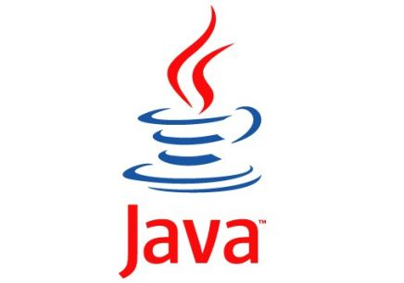
第 1 章 · Java 入门
Chapter 1 · Getting Started with Java
§1.5 诞生
§1.5 Birth
Java之父与
Java 的诞生
The father of Java and
The birth of Java
1995
6 月由 Sun 公司 发布的革命性编程语言
（2010 年 Sun 被 Oracle 收购，现由 Oracle 维护）
A revolutionary programming language released by Sun Microsystems in June
(Sun was acquired by Oracle in 2010 and is now maintained by Oracle)
1990
Sun 公司成立由 James Gosling 领导的开发小组，致力于开发可移植、跨平台的语言
Sun established a development team led by James Gosling to develop portable, cross-platform languages
Java 官方 Logo · 自 1995 年
Java Official Logo · Since 1995
命名
name
印度尼西亚盛产咖啡的岛屿 Java（爪哇），寓意"为世人端上一杯热咖啡"
Java, the island rich in coffee in Indonesia, means "bringing a cup of hot coffee to the world"
5 / 43

Slide 6
第 1 章 · Java 入门
Chapter 1 · Getting Started with Java
§1.X 概览
§1.X Overview
Java 的先导知识
与后继技术
Preliminary knowledge of Java
and successor technologies
C 语言
C language
→
Java 语言
Java
→
现代生态
modern ecology
先学 C，再学 Java；Java 之后可以继续哪些方向？
Learn C first, then learn Java; in what directions can you continue after Java?
后继方向（了解即可，不做考核要求）
Future direction (just understand it, no assessment requirements)
企业级 / Web
Enterprise/Web
移动端
Mobile terminal
数据交换
data exchange
大数据 / 云
Big Data/Cloud
AI / 服务端
AI / server
Spring Boot · Jakarta EE
Android（Kotlin） · HarmonyOS
JSON
Hadoop · Spark · Flink
Python 工具链 + Java 后端
Python toolchain + Java backend
6 / 43

Slide 7
第 1 章 · Java 入门
Chapter 1 · Getting Started with Java
§1.1 地位
§1.1 Status
1.1.1 网络地位
1.1.1 Network status
Java 的
地位
Java's
status
Java 的平台无关性让它成为编写网络应用程序的佼佼者；Java 也提供了许多以网络应用为核心的技术，特别适合网络应用软件的设计与开发。
Java's platform independence makes it a leader in writing network applications; Java also provides many technologies with network applications as the core, which is particularly suitable for the design and development of network application software.
从网络、语言、需求三个维度理解 Java 的重要性
Understand the importance of Java from the three dimensions of network, language, and requirements
1.1.2 语言地位
1.1.2 Language status
Java 是一门优秀的面向对象语言。通过学习 Java，可以掌握怎样使用对象来完成任务、理解面向对象编程的基本思想。
Java is an excellent object-oriented language. By learning Java, you can master how to use objects to complete tasks and understand the basic ideas of object-oriented programming.
1.1.3 需求地位
1.1.3 Demand status
IT 行业对 Java 人才的需求持续增长，掌握 Java 语言及其相关技术意味着较好的就业前景和工作酬金。
The demand for Java talents in the IT industry continues to grow. Mastering the Java and its related technologies means better employment prospects and work remuneration.
7 / 43

Slide 8
第 1 章 · Java 入门
Chapter 1 · Getting Started with Java
§1.2 特点（一）
§1.2 Features (1)
1.2.1 简单
1.2.1 Simple
Java 的
特点（一）
Java's
Features (1)
Java 比 C++ 简单。C++ 中许多容易混淆的概念，或者被 Java 弃之不用，或者以更清晰、更容易理解的方式实现。
Java is simpler than C++. Many confusing concepts in C++ have either been abandoned in Java or implemented in a clearer, easier-to-understand way.
简单 · 面向对象 · 平台无关
Simple·Object-oriented·Platform-independent
1.2.2 面向对象
1.2.2 Object-oriented
Java 是面向对象的编程语言。类、对象、继承、多态、接口等重要概念将在第 4、5、6 章详细讨论。
Java is an object-oriented programming language. Important concepts such as classes, objects, inheritance, polymorphism, and interfaces will be discussed in detail in Chapters 4, 5, and 6.
1.2.3 平台无关 ⭐
1.2.3 Platform independent ⭐
在一台计算机上编译得到的字节码文件，可复制到任何安装了 Java 运行环境的计算机上直接使用。JVM 负责将字节码翻译成本地机器码。
The bytecode file compiled on one computer can be copied to any computer with the Java runtime environment installed and used directly. The JVM is responsible for translating the bytecode into native machine code.
8 / 43

Slide 9
第 1 章 · Java 入门
Chapter 1 · Getting Started with Java
§1.2 平台与指令
§1.2 Platform and instructions
平台与
机器指令
Platform and
machine instructions
什么是“平台”？
What is a "platform"?
平台由 操作系统（OS） 和 处理器（CPU） 构成。 与平台无关是指软件的运行不因操作系统、处理器的变化而无法运行或出现错误。
The platform consists of an operating system (OS) and a processor (CPU). Platform-independent means that the operation of the software will not fail or cause errors due to changes in the operating system or processor.
理解 Java 平台无关性的概念铺垫
Understand the concept of Java platform independence
什么是“机器指令”？
What are "machine instructions"?
每个平台都有自己独特的机器指令：可以被该平台直接识别、执行的 0、1 序列代码。
Each platform has its own unique machine instructions: sequences of 0s and 1s that can be directly recognized and executed by that platform.
平台 A：00001111 表示加法 · 10000001 表示减法
平台 B：10101010 表示加法 · 10010011 表示减法
Platform A: 00001111 represents addition · 10000001 represents subtraction
Platform B: 10101010 means addition · 10010011 means subtraction
9 / 43

Slide 10
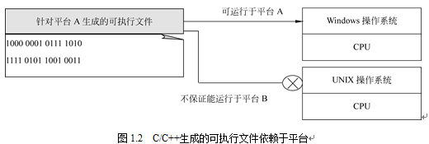
第 1 章 · Java 入门
Chapter 1 · Getting Started with Java
图 1.2
Figure 1.2
C/C++ 程序
依赖平台
C/C++ program
Dependent on platform
C/C++ 针对当前源程序所在的特定平台进行编译、链接，生成该平台的机器指令（即可执行文件）。
C/C++ compiles and links for the specific platform where the current source program is located, and generates machine instructions (ie, executable files) for that platform.
不同平台可能具有不同的机器指令，因此不能保证同一份可执行文件在所有平台上都正确运行。
Different platforms may have different machine instructions, so there is no guarantee that the same executable file will run correctly on all platforms.
10 / 43

Slide 11
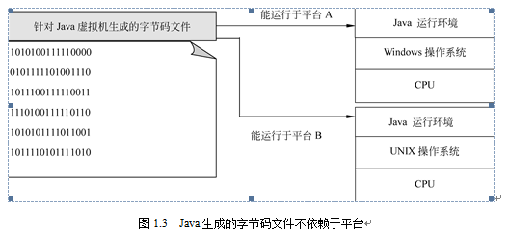
第 1 章 · Java 入门
Chapter 1 · Getting Started with Java
图 1.3
Figure 1.3
Java 虚拟机
与字节码
Java virtual machine
with bytecode
Java 编译器不针对特定 OS/CPU，而是针对 Java 虚拟机（JVM） 把源程序编译成 字节码。
The Java compiler does not target a specific OS/CPU, but compiles the source program into bytecode for the Java Virtual Machine (JVM).
不同平台的 JVM 字节码指令相同；JVM 负责把字节码翻译成当前平台的机器码并运行。
The JVM bytecode instructions of different platforms are the same; the JVM is responsible for translating the bytecode into the machine code of the current platform and running it.
11 / 43

Slide 12
第 1 章 · Java 入门
Chapter 1 · Getting Started with Java
§1.2 特点（二）
§1.2 Features (2)
Java 的
特点（二）
Java's
Features (2)
1.2.4 多线程
1.2.4 Multithreading
Java 内置对多线程的支持。多线程允许程序同时完成多个任务，例如一边下载文件一边响应用户操作。
Java has built-in support for multithreading. Multithreading allows a program to complete multiple tasks at the same time, such as downloading files while responding to user operations.
多线程 · 动态
Multi-threaded · Dynamic
1.2.5 动态
1.2.5 Dynamic
Java 程序的基本组成单元是类。类可以在运行时动态装载，既可以使用自己编写的类，也可以引入类库，便于在分布环境中动态维护程序。
The basic building block of a Java program is a class. Classes can be loaded dynamically at runtime. You can use your own classes or introduce class libraries to facilitate dynamic maintenance of programs in a distributed environment.
12 / 43

Slide 13
第 1 章 · Java 入门
Chapter 1 · Getting Started with Java
§1.3 安装
§1.3 Installation
三种平台
简介
Three platforms
Introduction
Java SE（Standard Edition，标准版）
Java SE (Standard Edition, Standard Edition)
Java 核心与基础，提供 JVM 与基础类库。本课程全程使用 Java SE 21（LTS）。
Java core and foundation, providing JVM and basic class libraries. This course uses Java SE 21 (LTS) throughout.
Jakarta EE（原 Java EE，企业版）
Jakarta EE (formerly Java EE, Enterprise Edition)
Java SE / Jakarta EE / Java ME
面向服务器端 / 分布式企业应用。2018 年起由 Oracle 移交 Eclipse 基金会并更名，包名由 javax.* 改为 jakarta.*。
For server-side/distributed enterprise applications. Since 2018, Oracle has transferred it to the Eclipse Foundation and changed its name. The package name has been changed from javax.* to jakarta.*.
Java ME（Micro Edition，微型版）
Java ME (Micro Edition, micro version)
曾面向嵌入式 / 功能机，现基本被 Android、嵌入式 Linux 取代；本课程不涉及。
It was once oriented to embedded/feature machines, but has now been basically replaced by Android and embedded Linux; this course does not cover it.
无论哪个平台，底层都是同一套 JVM 与字节码思想。
Regardless of the platform, the bottom layer is the same set of JVM and bytecode ideas.
13 / 43

Slide 14
第 1 章 · Java 入门
Chapter 1 · Getting Started with Java
§1.3.2 安装
§1.3.2 Installation
Java SE 平台是学习掌握 Java 语言的最佳平台，掌握 Java SE 又是进一步学习 Jakarta EE 和 Android 所必需的。
The Java SE platform is the best platform to learn and master the Java. Mastering Java SE is necessary for further learning Jakarta EE and Android.
安装 Java SE
平台
Install Java SE
Platform
推荐步骤
Recommended steps
1. 下载 JDK 21（LTS）：jdk-21_windows-x64_bin.zip
2. 解压到 C:\，目录名建议为 C:\jdk-21
3. 本书（第 7 版）全部代码基于 JDK 21，与课程环境一致
1. Download JDK 21 (LTS): JDK-21_windows-x64_bin.zip
2. Unzip to C:\, the directory name is recommended to be C:\JDK-21
3. All codes in this book (7th edition) are based on JDK 21, consistent with the course environment
下载 JDK 21 并解压到 C:\jdk-21
Download JDK 21 and extract to C:\JDK-21
解压后 C:\jdk-21 目录结构示意
C:\JDK-21 directory structure after decompression
C:\jdk-21
├─ bin/ ← javac.exe、java.exe 在这里
├─ conf/
├─ include/
├─ jmods/
├─ legal/
└─ lib/
C:\JDK-21
├─ bin/ ← javac.exe, java.exe are here
├─conf/
├─ include/
├─ jmods/
├─ legal/
└─lib/
14 / 43

Slide 15
第 1 章 · Java 入门
Chapter 1 · Getting Started with Java
§1.3.2 环境变量
§1.3.2 Environment variables
设置
JAVA_HOME
settings
JAVA_HOME
右键“此电脑” → 属性 → 高级系统设置 → 环境变量。
Right-click "This PC" → Properties → Advanced System Settings → Environment Variables.
添加 系统变量：
Add system variables:
给 JDK 指定一个“家庭住址”
Assign a "home address" to the JDK
JAVA_HOME = C:\jdk-21
系统变量对话框示意
System variables dialog box
变量名：
Variable name:
JAVA_HOME
变量值：
Variable value:
C:\jdk-21
15 / 43

Slide 16
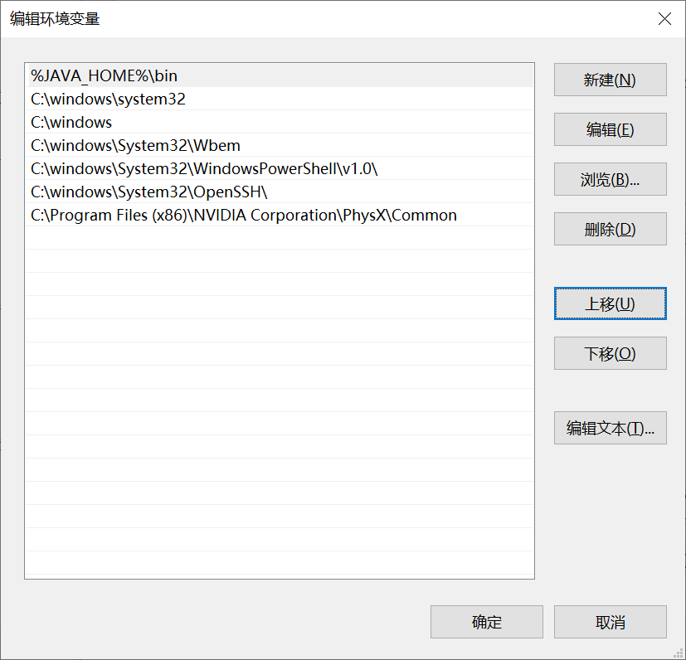
第 1 章 · Java 入门
Chapter 1 · Getting Started with Java
§1.3.2 环境变量
§1.3.2 Environment variables
设置系统
环境 path
Set up the system
environment path
在 path 中新建一项：
Create a new entry in path:
%JAVA_HOME%in
建议移到列表最上方。当计算机安装了多个 JDK 版本时，默认使用最上方的版本。
It is recommended to move it to the top of the list. When multiple JDK versions are installed on the computer, the top version is used by default.
16 / 43

Slide 17
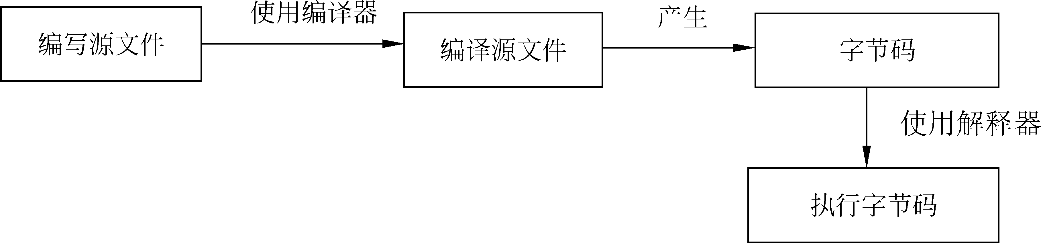
第 1 章 · Java 入门
Chapter 1 · Getting Started with Java
§1.4 开发步骤
§1.4 Development steps
Java 程序的
开发步骤
Java program
Development steps
1. 编写源文件
1. Write source files
扩展名必须是 .java
Extension must be.java
2. 编译源程序
2. Compile source program
用 javac.exe 生成字节码 .class
Use javac.exe to generate bytecode.class
3. 运行 Java 程序
3. Run the Java program
用 java.exe 解释执行字节码
Use java.exe to interpret and execute bytecode
17 / 43

Slide 18
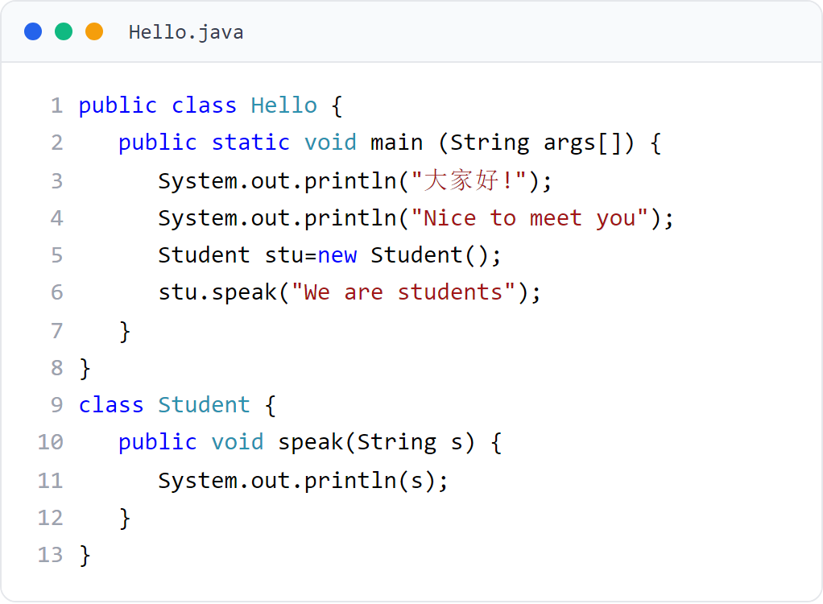
第 1 章 · Java 入门
Chapter 1 · Getting Started with Java
§1.5 应用程序
§1.5 Application
简单的 Java
应用程序
Simple Java
application
Java 源文件由若干相互独立的类组成。例子 1 由 Hello（主类，含 main）与 Student 组成。
Java source files consist of several independent classes. Example 1 consists of Hello (main class, including main) and Student.
18 / 43
Notes:
[课堂运行示例]
课堂运行：课堂示例代码/第1章/Hello.java
命令：javac -encoding UTF-8 Hello.java；java Hello
先让学生预测三行输出，再运行。强调 public 类名必须与文件名一致。

Slide 19
第 1 章 · Java 入门
Chapter 1 · Getting Started with Java
§1.5.1 保存
§1.5.1 Save
编写与保存
源文件
Write and save
source file
英文标点
English punctuation
代码中的括号、分号、引号必须是 英文状态；字符串内部可以是中文。
The brackets, semicolons, and quotation marks in the code must be in English; the inside of the string can be in Chinese.
几个新手最容易踩的坑
Some of the most common pitfalls for novices
public 类名 = 文件名
public class name = file name
多个类时只能有一个 public 类，且源文件名必须与其 完全相同。
When there are multiple classes, there can only be one public class, and the source file name must be exactly the same.
例子 1 必须保存为 Hello.java，放到 C:\chapter1。
Example 1 must be saved as Hello.java and placed in C:\chapter1.
19 / 43

Slide 20
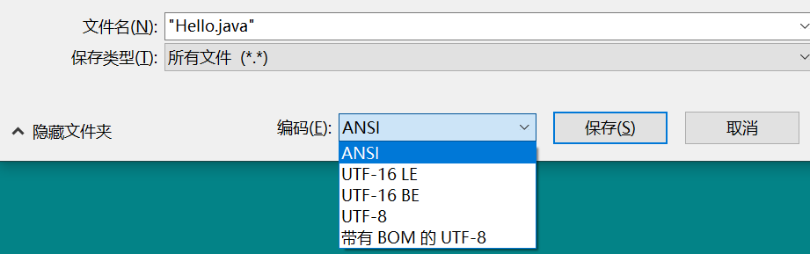
第 1 章 · Java 入门
Chapter 1 · Getting Started with Java
§1.5.1 编码
§1.5.1 Encoding
保存源文件
的编码
Save source file
encoding
· 保存类型选“所有文件”
· 编码优先选择 UTF-8（JDK 18 起 javac 默认编码为 UTF-8）
· 不要选择“带有 BOM 的 UTF-8”
· 若保存为 ANSI/GBK，编译时必须显式指定 -encoding GBK
·Select "All files" as the save type
· UTF-8 is preferred for encoding (the default encoding of javac is UTF-8 starting from JDK 18)
· Do not select "UTF-8 with BOM"
· If saved as ANSI/GBK, -encoding GBK must be explicitly specified when compiling
20 / 43

Slide 21

第 1 章 · Java 入门
Chapter 1 · Getting Started with Java
§1.5.2 编译
§1.5.2 Compilation
编译 Java
源程序
Compile Java
Source program
编译器是 javac.exe。
The compiler is javac.exe.
JDK 18 起默认编码为 UTF-8，UTF-8 源文件可直接编译：
Starting from JDK 18, the default encoding is UTF-8, and UTF-8 source files can be compiled directly:
C:\chapter1> javac Hello.java
无报错即编译成功，会生成 Hello.class 字节码文件。
If no error is reported, the compilation is successful and the Hello.class bytecode file will be generated.
21 / 43

Slide 22

第 1 章 · Java 入门
Chapter 1 · Getting Started with Java
§1.5.2 编译
§1.5.2 Compilation
显式使用
-encoding
Explicit use
-encoding
显式使用 -encoding 参数是好习惯，可以避免“不可映射字符”错误。
It is good practice to use the -encoding parameter explicitly to avoid "unmappable character" errors.
javac -encoding utf-8 Hello.java
javac -encoding GBK Hello.java
22 / 43

Slide 23

第 1 章 · Java 入门
Chapter 1 · Getting Started with Java
§1.5.3 运行
§1.5.3 Operation
运行 Java
程序
Run Java
program
主类必须含 public static void main(String args[])。
The main class must contain public static void main(String args[]).
使用 java.exe 解释执行字节码：
Use java.exe to interpret and execute bytecode:
C:\chapter1> java Hello
注意：运行的是类名 Hello，不是 Hello.class
Note: The class name Hello is run, not Hello.class
23 / 43

Slide 24
第 1 章 · Java 入门
Chapter 1 · Getting Started with Java
§1.5.4
为什么使用
IDE
Why use
IDE
命令行方式
Command line mode
优点：直观理解编译/运行原理
缺点：手动管理大量源文件、类路径、依赖时繁琐
Advantages: Intuitive understanding of compilation/operation principles
Disadvantages: Manually managing a large number of source files, class paths, and dependencies is cumbersome
命令行理解原理，IDE 提高效率
Command line understanding principles, IDE improves efficiency
IDE（集成开发环境）
IDE (Integrated Development Environment)
编辑器 + 编译器 + 调试器 + 项目管理一体化。
Editor + compiler + debugger + project management integration.
主流 Java IDE：IntelliJ IDEA、Eclipse、NetBeans。本课程统一使用 IntelliJ IDEA（2025.3 起统一版，核心功能免费）。
Mainstream Java IDEs: IntelliJ IDEA, Eclipse, NetBeans. This course uses IntelliJ IDEA uniformly (unified version starting from 2025.3, core functions are free).
24 / 43

Slide 25
第 1 章 · Java 入门
Chapter 1 · Getting Started with Java
§1.5.5
下载与安装
IntelliJ IDEA
Download and install
IntelliJ IDEA
1
访问 jetbrains.com/idea/download/
Visit jetbrains.com/idea/download/
2
2025.3 起为统一版，只有一个下载入口；核心功能免费
It will be a unified version starting from 2025.3, with only one download entrance; core functions are free
确保 IDEA 能识别 JDK 21
Make sure IDEA recognizes JDK 21
3
Windows 推荐 .exe 安装包；首次启动选 "Do not import settings"
Windows recommends.exe installation package; select "Do not import settings" when starting for the first time
4
指定 JDK：File → Project Structure → SDKs → + → Add JDK → 选择 C:\jdk-21
Specify JDK: File → Project Structure → SDKs → + → Add JDK → Select C:\JDK-21
Ultimate 高级功能师生可凭教育授权免费申请。
Teachers and students with Ultimate advanced functions can apply for free with education authorization.
25 / 43

Slide 26
第 1 章 · Java 入门
Chapter 1 · Getting Started with Java
§1.5.6
创建第一个
Java 项目
Create the first
Java project
1
File → New → Project
2
左侧选 Java；Project SDK 选 C:\jdk-21；Build system 选 IntelliJ
Select Java on the left; select C:\JDK-21 for Project SDK; select IntelliJ for Build system
使用内置 IntelliJ 构建系统
Use the built-in IntelliJ build system
3
勾选 Create project from template → Command Line App
Check Create project from template → Command Line App
4
项目名：HelloWorld；包名留空；类名：Main
Project name: HelloWorld; package name left blank; class name: Main
5
Finish，IDEA 自动生成 Main.java 与 main 方法骨架
Finish, IDEA automatically generates Main.java and main method skeleton
本课程不涉及 Maven / Gradle，统一使用 IntelliJ 自带构建系统。
This course does not involve Maven / Gradle, and uses IntelliJ's built-in build system uniformly.
26 / 43

Slide 27
第 1 章 · Java 入门
Chapter 1 · Getting Started with Java
§1.5.7
在 IDEA 中
运行 Hello
In IDEA
Run Hello
将 Hello.java 内容放入 Main.java（或新建 Hello.java），点击 main 左侧绿色三角 / 右键 Run。IDEA 自动调用 javac 编译 + java 运行，输出：大家好! / Nice to meet you / We are students。
Put the content of Hello.java into Main.java (or create a new Hello.java), click the green triangle on the left side of main/right-click Run. IDEA automatically calls javac to compile + java to run, and the output is: Hello everyone! / Nice to meet you / We are students.
27 / 43
Notes:
[课堂运行示例]
课堂运行：课堂示例代码/第1章/Hello.java
在 IntelliJ IDEA 中点击 main 左侧绿色三角运行，并对照命令行执行过程。

Slide 28
第 1 章 · Java 入门
Chapter 1 · Getting Started with Java
§1.5.8
常用调试技巧
（选讲）
Common debugging techniques
(selected lectures)
断点
breakpoint
点击代码行号左侧添加红点，然后以 Debug 模式运行。
Click to add a red dot to the left of the code line number and run in Debug mode.
单步执行
Single step execution
Step Over（F8）· Step Into（F7）
打断点、单步执行、观察变量
Breakpoints, single-step execution, observation variables
观察变量
Observed variables
Variables 面板实时显示变量值。
The Variables panel displays variable values ​​in real time.
重构
Refactor
Rename（Shift+F6）批量重命名。
Rename (Shift+F6) batch rename.
本章仅做基本演示，详细调试留到第 4 章结合实例展开。
This chapter only provides basic demonstration, leaving detailed debugging to Chapter 4 with examples.
28 / 43
Notes:
[课堂运行示例]
课堂运行：课堂示例代码/第1章/DebugDemo.java
在 total = total + i; 设置断点，演示 Step Over、Variables 和循环变量变化。

Slide 29
第 1 章 · Java 入门
Chapter 1 · Getting Started with Java
§1.5.9
IDEA 与命令行
的关系
IDEA and the command line
relationship
· IDEA 底层仍然调用 javac.exe 与 java.exe
· The bottom layer of IDEA still calls javac.exe and java.exe
· 命令行学会后，IDEA 不会带来新概念
· After learning the command line, IDEA will not bring new concepts
IDE 是命令行的图形化封装
IDE is a graphical encapsulation of the command line
· IDEA 编译输出在 out/ 目录，可手动用 java -cp 运行验证
· IDEA compilation output is in the out/ directory, and can be manually run and verified using java -cp
课堂练习建议
Classroom Practice Suggestions
先用命令行完成例子 1/2，再用 IDEA 完成相同的例子。两头都踏实。
First use the command line to complete Example 1/2, and then use IDEA to complete the same example. Both ends are solid.
29 / 43

Slide 30
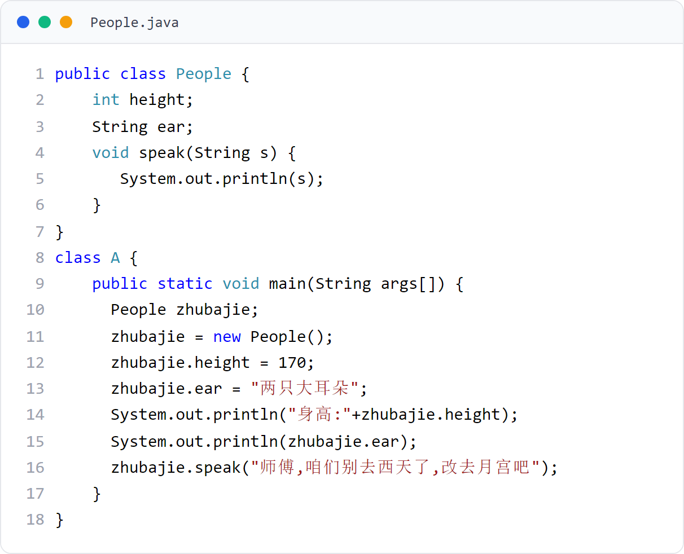
第 1 章 · Java 入门
Chapter 1 · Getting Started with Java
§1.5 例子 2
§1.5 Example 2
再看一个简单的
Java 应用程序
Let’s look at another simple one
Java application
People.java 含 People、A 两个类，主类 A 含 main。编译 javac People.java，运行 java A（注意运行的是主类 A，不是 People）。运行后输出：大家好! / Nice to meet you / We are students。
People.java contains two classes: People and A. The main class A contains main. Compile javac People.java and run java A (note that the main class A is run, not People). Output after running: Hello everyone! / Nice to meet you / We are students.
30 / 43
Notes:
[课堂运行示例]
课堂运行：课堂示例代码/第1章/PeopleDemo.java
强调一个源文件可以有多个类，但只能有一个 public 类。修改 name 与 age 后再次运行。

Slide 31
第 1 章 · Java 入门
Chapter 1 · Getting Started with Java
§1.6 反编译
§1.6 Decompile
Java 反编译
（选讲）
Java decompilation
(selected lectures)
JDK 自带反编译器 javap.exe，可以查看 .class 字节码文件的结构。
JDK comes with the decompiler javap.exe, which can view the structure of.class bytecode files.
课后了解，不强制掌握
Learn after class, no compulsion to master
C:\chapter1> javap Hello.class
C:\chapter1> javap java.util.Date
受 2 学时限制，可略讲或课后了解。
Due to the 2-hour limit, you can give a brief lecture or understand it after class.
31 / 43

Slide 32
第 1 章 · Java 入门
Chapter 1 · Getting Started with Java
§1.8.1
什么是 AI
编程助手
What is AI
Programming Assistant
AI 编程助手 = 基于大语言模型（LLM）的 IDE 插件，能提供：
AI programming assistant = IDE plug-in based on large language model (LLM), which can provide:
· 自动补全代码
· 解释代码与报错信息
· 生成测试用例
· Automatic code completion
·Explanation of code and error messages
· Generate test cases
大模型驱动的 IDE 插件，辅助但不替代思考
Large model-driven IDE plug-in, assisting but not replacing thinking
主流产品：腾讯 CodeBuddy、GitHub Copilot、通义灵码、Codeium、Cursor 等。
Mainstream products: Tencent CodeBuddy, GitHub Copilot, Tongyi Lingma, Codeium, Cursor, etc.
本课程推荐腾讯 CodeBuddy（个人免费额度满足课程需要）
Tencent CodeBuddy is recommended for this course (the personal free quota meets the needs of the course)
32 / 43

Slide 33
第 1 章 · Java 入门
Chapter 1 · Getting Started with Java
§1.8.2
在 IDEA 中
安装 CodeBuddy
In IDEA
Install CodeBuddy
1
官方教程：codebuddy.cn/setup/
Official tutorial: codebuddy.cn/setup/
插件市场搜索安装后登录即可使用
Search the plug-in market, install it and log in to use it.
2
进入 File → Settings → Plugins → Marketplace
Go to File → Settings → Plugins → Marketplace
3
搜索 Tencent Cloud CodeBuddy（发布者 Tencent Cloud），Install
Search Tencent Cloud CodeBuddy (published by Tencent Cloud), Install
4
重启 IDEA，微信扫码或手机号登录
Restart IDEA, scan the QR code with WeChat or log in with your mobile phone number
5
输入注释如 // 计算 1 到 100 的和，按 Tab 接受灰色提示
Enter a comment such as // Calculate the sum of 1 to 100, press Tab to accept the gray prompt
33 / 43

Slide 34
第 1 章 · Java 入门
Chapter 1 · Getting Started with Java
§1.8.3
使用边界
（诚信要求）
Use boundaries
(Integrity requirement)
允许
allow
· 语法提示、代码补全
· 解释报错信息、辅助调试
· 学习新 API 用法
· Grammar tips and code completion
·Explain error messages and assist in debugging
· Learn how to use new APIs
AI 是辅助，不能替你思考
AI is an assistant and cannot think for you.
禁止
prohibit
· 直接提交 AI 生成的完整代码作为作业
· 用 AI 生成代码应付实验/考试而自己不理解
· Directly submit complete AI-generated code as an assignment
· Use AI to generate code to cope with experiments/exams but you don’t understand it
诚信底线：作业必须独立完成；提交前必须能讲解每一行代码。
Bottom line of integrity: Assignments must be completed independently; each line of code must be explained before submission.
34 / 43

Slide 35
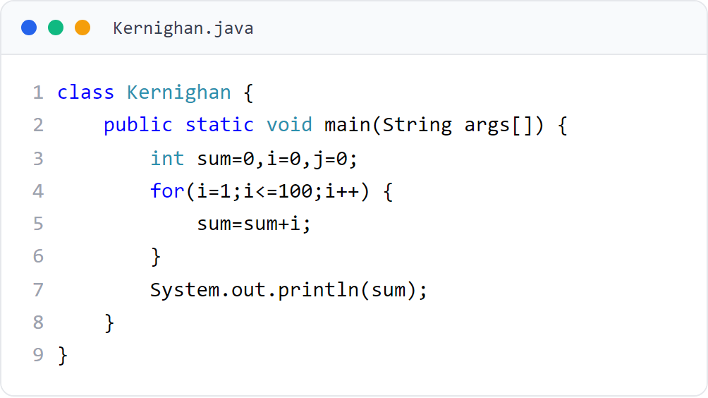
第 1 章 · Java 入门
Chapter 1 · Getting Started with Java
§1.7 编程风格
§1.7 Programming style
Kernighan
风格
Kernighan
style
Kernighan（行尾）风格：左大括号写在上一行行尾，右大括号独占一行。阿里《Java 开发手册》、Google Java Style Guide 等主流工业规范均采用此风格——本课程统一使用。
Kernighan (end-of-line) style: the opening brace is written at the end of the previous line, and the closing brace is on its own line. Alibaba's "Java Development Manual", Google Java Style Guide and other mainstream industrial specifications all adopt this style - this course uses it uniformly.
35 / 43

Slide 36
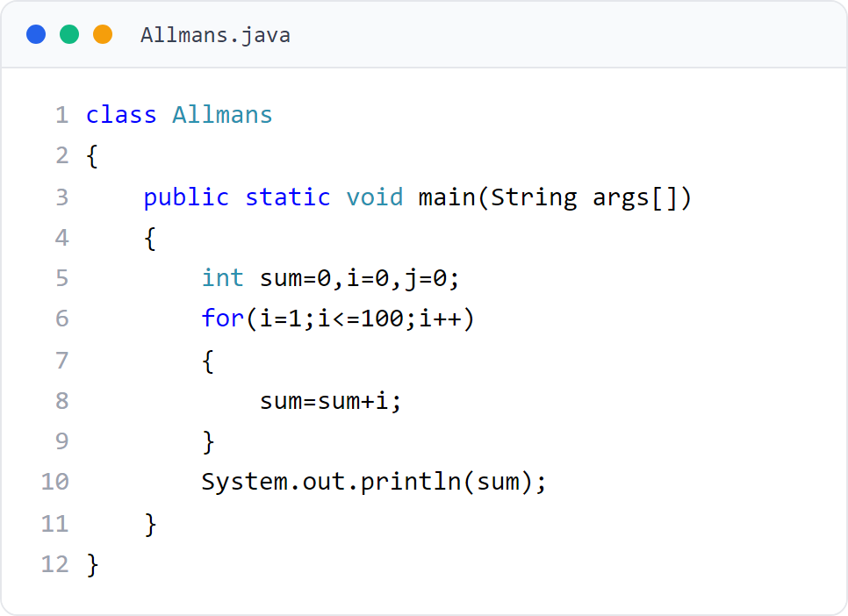
第 1 章 · Java 入门
Chapter 1 · Getting Started with Java
§1.7 编程风格
§1.7 Programming style
Allmans
风格
Allmans
style
Allmans（独行）风格：左右大括号各自独占一行。因阿里 / Google 等工业规范统一采用 Kernighan 风格，本课程以 Kernighan 为准，Allmans 仅一笔带过。
Allmans (single-line) style: left and right braces are on their own line. Because Alibaba/Google and other industrial specifications uniformly adopt the Kernighan style, this course is based on Kernighan, and Allmans only mentions it briefly.
36 / 43

Slide 37
第 1 章 · Java 入门
Chapter 1 · Getting Started with Java
§1.7.3
注释
Comment
单行注释
Single line comments
使用 // 表示单行注释开始，从 // 开始的后继内容为注释。
Use // to indicate the beginning of a single line comment, and the subsequent content starting from // is a comment.
编译器忽略注释，但代码维护离不开它
The compiler ignores comments, but code maintenance is inseparable from them
int x = 10; // 定义变量 x
int x = 10; // define variable x
多行注释
Multi-line comments
使用 /* 表示开始，*/ 表示结束。
Use /* to start and */ to end.
/* 这是
多行注释 */
/* This is
Multi-line comments */
37 / 43

Slide 38
第 1 章 · Java 入门
Chapter 1 · Getting Started with Java
1
§1.9
Java 语言是面向对象编程，编写的软件与平台无关。
Java is object-oriented programming, and the software written is platform-independent.
本章总结
Chapter summary
2
记住这四条，第 1 章就过关了
Remember these four points and you will pass Chapter 1
开发一个 Java 程序需经过三个步骤：编写源文件、编译生成字节码、加载运行字节码。
Developing a Java program requires three steps: writing source files, compiling and generating bytecode, and loading and running bytecode.
3
编写代码务必遵守行业习惯风格（本课程统一使用 Kernighan 风格）。
Be sure to follow industry conventions when writing code (Kernighan style is used uniformly in this course).
4
熟悉 IntelliJ IDEA 的基本使用流程；了解 AI 编程助手（如 CodeBuddy）的使用边界，作业必须独立完成。
Be familiar with the basic usage process of IntelliJ IDEA; understand the usage boundaries of AI programming assistants (such as CodeBuddy), and the work must be completed independently.
38 / 43

Slide 39
第 1 章 · Java 入门
Chapter 1 · Getting Started with Java
§1.10
作业
Homework
按时完成老师布置的作业
Complete the homework assigned by the teacher on time
独立完成，才能真正学到东西
Only when you complete it independently can you truly learn something.
教材题库练习
Textbook question bank exercises
教材提供题库练习系统（见前言二维码），多做练习巩固。
The textbook provides a question bank practice system (see the QR code in the preface), so you can do more exercises to consolidate.
诚信提醒
Honesty reminder
鼓励课后使用 IntelliJ IDEA 完成练习；AI 编程助手仅可用于辅助调试与思路验证，禁止直接提交 AI 生成的代码。
You are encouraged to use IntelliJ IDEA to complete exercises after class; the AI ​​programming assistant can only be used to assist debugging and idea verification, and direct submission of AI-generated code is prohibited.
39 / 43

Slide 40
第 1 章 · Java 入门
Chapter 1 · Getting Started with Java
编程题 1
Programming Task 1
个人名片程序
Personal profile program
任务：编写 PersonalCard.java
Task: Write PersonalCard.java
创建、编译并运行一个完整的 Java 程序
Create, compile, and run a complete Java program
输出要求
Output requirements
依次输出姓名、专业和一句学习目标，每项单独一行。
Print your name, major, and one learning goal, one item per line.
提交要求
Submission
包含 public class、main 和 3 条 println；提交运行截图。
Include public class, main, three println statements, and a screenshot.
40 / 43
Notes:
[编程题参考答案 / Reference Solution]
参考代码 / Reference solution:
public class PersonalCard {
public static void main(String[] args) {
System.out.println("姓名：张三");
System.out.println("专业：计算机科学与技术");
System.out.println("目标：学会独立编写 Java 程序");
}
}
课堂变化：让学生替换为自己的真实信息后再次运行。
[Sources]
No external sources. Original instructional exercise.

Slide 41
第 1 章 · Java 入门
Chapter 1 · Getting Started with Java
编程题 2
Programming Task 2
双类协作程序
Two-class program
任务：编写 StudentDemo.java
Task: Write StudentDemo.java
在一个源文件中定义两个类并完成调用
Define and use two classes in one source file
程序结构
Program structure
创建非 public 的 Student 类，含 sayHello() 方法。
Create a non-public Student class with a sayHello() method.
运行要求
Run requirement
public StudentDemo 在 main 中创建对象并调用该方法。
In main, public StudentDemo creates an object and calls the method.
41 / 43
Notes:
[编程题参考答案 / Reference Solution]
参考代码 / Reference solution:
class Student {
void sayHello() {
System.out.println("Hello, Java!");
}
}
public class StudentDemo {
public static void main(String[] args) {
Student student = new Student();
student.sayHello();
}
}
强调：文件名必须是 StudentDemo.java，一个源文件只能有一个 public 类。
[Sources]
No external sources. Original instructional exercise.

Slide 42
第 1 章 · Java 入门
Chapter 1 · Getting Started with Java
编程题 3
Programming Task 3
调试并修复程序
Debug and fix a program
任务：编写 BugFixDemo.java
Task: Write BugFixDemo.java
先制造编译错误，再使用 IDE 逐个解决
Create compile errors, then fix them with the IDE
制造错误
Create errors
写错类名大小写、漏写分号，并把 println 写成 printIn。
Change class-name case, omit a semicolon, and write printIn.
修复目标
Fixing goal
修复后输出 1 到 100 的和，并在循环中设置断点。
After fixing, print the sum from 1 to 100 and set a loop breakpoint.
42 / 43
Notes:
[编程题参考答案 / Reference Solution]
参考代码 / Reference solution:
public class BugFixDemo {
public static void main(String[] args) {
int sum = 0;
for (int i = 1; i <= 100; i++) {
sum += i;
}
System.out.println("1 到 100 的和：" + sum);
}
}
正确结果：5050。建议在 sum += i; 处设置断点。
[Sources]
No external sources. Original instructional exercise.

Slide 43
Thank You !
第 1 章 · Java 入门 到此结束
End of Chapter 1 · Getting Started with Java
43 / 43

