Slide 1
JAVA PROGRAMMING · CHAPTER 02
Java 程序设计
Java programming
第 2 章 · 基本数据类型与数组
Chapter 2 · Basic Data Types and Arrays
中国石油大学（北京）克拉玛依校区
China University of Petroleum (Beijing) Karamay Campus

Slide 2
第 2 章 · 基本数据类型与数组
Chapter 2 · Basic Data Types and Arrays
02
基本数据类型与数组
Basic data types and arrays
本章内容不多，但都是后面所有章节的「地基」——务必亲手敲一遍例子
There is not much content in this chapter, but it is the "foundation" for all subsequent chapters - be sure to type out the examples yourself
2 / 34

Slide 3
第 2 章 · 基本数据类型与数组
Chapter 2 · Basic Data Types and Arrays
导读
Introduction
本章学什么
What to learn in this chapter
主要内容
Main content
重点和难点
Key points and difficulties
标识符与关键字
Identifiers and Keywords
重点：标识符、Java 语言的数据类型、数组
Focus: Identifiers, Java data types, arrays
基本数据类型
Basic data types
难点：基本数据类型的精度与数组
Difficulty: Precision of basic data types and arrays
类型转换运算
type conversion operation
输入、输出数据
Input and output data
数组
array
3 / 34

Slide 4
第 2 章 · 基本数据类型与数组
Chapter 2 · Basic Data Types and Arrays
§2.1 标识符与关键字
§2.1 Identifiers and keywords
标识符
identifier
用来标识类名、变量名、方法名、类型名、数组名、文件名的有效字符序列
A valid character sequence used to identify class names, variable names, method names,
type names, array names, and file names.
简单说，标识符就是给代码里的东西起的一个「名字」
Simply put, an identifier is a "name" given to something in the code.
由字母、下划线、美元符号和数字组成，长度不受限制
Consists of letters, underscores, dollar signs, and numbers with no limit on length
第一个字符不能是数字字符
The first character cannot be a numeric character
不能是关键字，也不能是 true、false 和 null
Cannot be a keyword, nor true, false, or null
和 C 语言起名的习惯很像：见名知意，别用拼音缩写
It’s very similar to the naming convention in C language: Know the meaning after seeing the name, don’t use pinyin abbreviations
4 / 34

Slide 5
第 2 章 · 基本数据类型与数组
Chapter 2 · Basic Data Types and Arrays
§2.1 标识符与关键字
§2.1 Identifiers and keywords
关键字
Keywords
有特定用途的单词，不允许拿来当标识符
Words with specific uses are not allowed to be used as identifiers
关键字就是具有特定用途或被赋予特定意义的一些单词
Keywords are words that have a specific purpose or are given a specific meaning.
例如：boolean、byte、short、int、float、double、char、if、else 等
For example: boolean, byte, short, int, float, double, char, if, else, etc.
关键字都是小写的——遇到大写，肯定不是关键字，而是封装类
Keywords are all lowercase - if they are in uppercase, they are warpped class
C 语言里的 int、if、else 也是同样规则，迁移成本为零
The same rules apply to int, if, and else in C language, and the migration cost is zero.
5 / 34

Slide 6
第 2 章 · 基本数据类型与数组
Chapter 2 · Basic Data Types and Arrays
§2.2 基本数据类型
§2.2 Basic data types
8 种基本数据类型
8 basic data types
Java 语言有 8 种基本数据类型，习惯上分为四大类型
The Java has 8 basic data types, which are customarily divided into four major types
逻辑类型
logical type
整数类型
integer type
字符类型
Character type
浮点类型
floating point type
boolean：true / false
byte、short、int、long
char
float、double
6 / 34

Slide 7
第 2 章 · 基本数据类型与数组
Chapter 2 · Basic Data Types and Arrays
§2.2.1 逻辑类型
§2.2.1 Logical type
boolean
只有两个取值：真或假
There are only two values: true or false
使用关键字 boolean 声明逻辑变量，声明时也可以赋初值
Use the keyword boolean to declare logical variables. You can also assign an initial value when declaring.
常量：true、false
Constants: true, false
boolean x, ok=true, 关闭=false;
boolean x, ok=true, closed=false;
7 / 34

Slide 8
第 2 章 · 基本数据类型与数组
Chapter 2 · Basic Data Types and Arrays
§2.2.2 整数类型
§2.2.2 Integer type
int 型
int type
最常用的整数类型，4 个字节
Most commonly used integer type, 4 bytes
用关键字 int 声明 int 型变量，声明时也可赋初值
Use the keyword int to declare an int type variable, and you can also assign an initial value when declaring it.
常量四种写法：十进制 123、八进制 077、十六进制 0x3ABC、二进制 0b111
There are four ways to write constants: decimal 123, octal 077, hexadecimal 0x3ABC, binary 0b111
内存：4 个字节（byte），占 32 位
Memory: 4 bytes, 32 bits
int x = 12, 平均 = 9898, jiafei;
int x = 12, average = 9898, jiafei;
8 / 34
Notes:
[课堂运行示例]
课堂运行：课堂示例代码/第2章/IntLongCharDemo.java
先运行 int 部分：观察整数变量 students、totalScore，以及 (double) 强制转换后平均值保留小数。提问：去掉 (double) 会得到什么结果？
核心代码：int students = 45; int totalScore = 3860; double average = (double) totalScore / students;

Slide 9
第 2 章 · 基本数据类型与数组
Chapter 2 · Basic Data Types and Arrays
§2.2.2 整数类型
§2.2.2 Integer type
byte / short / long
byte：1 字节 8 位，一定范围内的 int 常量可直接赋值
byte: 1 byte 8 bits, int constants within a certain range can be assigned directly
short：2 字节 16 位，与 byte 类似
short: 2 bytes 16 bits, similar to byte
范围从小到大，占位从少到多
The range ranges from small to large, and the occupancy ranges from small to large.
long：8 字节 64 位，常量用后缀 L 表示
long: 8 bytes 64 bits, constants are represented by the suffix L
byte x = -12, tom = 28;
short x = 12, y = 1234;
long width = 12L, height = 2005L;
9 / 34
Notes:
[课堂运行示例]
课堂运行：课堂示例代码/第2章/IntLongCharDemo.java
观察 long population = 1_400_000_000L；说明较大的 long 常量末尾写 L。再讲 24L * 60 * 60 * 1000：第一个操作数写成 long，整个乘法按 long 计算。
核心代码：long millisecondsPerDay = 24L * 60 * 60 * 1000;

Slide 10
第 2 章 · 基本数据类型与数组
Chapter 2 · Basic Data Types and Arrays
§2.2.3 字符类型
§2.2.3 Character type
char 型
char type
常量：单引号括起的字符 'A'、'好' 等
Constants: characters enclosed in single quotes 'A', 'OK', etc.
一个字符占 2 个字节——因为 Java 用 Unicode
One character takes up 2 bytes - because Java uses Unicode
转义字符常量：
换行、\t 制表、\' 单引号、\\ 反斜线
Escape character constants:
Line feed, \t tab, \' single quote, \\ backslash
Java 使用 Unicode 标准字符集，最多识别 65536 个字符
Java uses the Unicode standard character set and recognizes up to 65536 characters
char ch = 'A', home = '家', handsome = '酷';
char ch = 'A', home = 'home', handsome = 'cool';
10 / 34
Notes:
[课堂运行示例]
课堂运行：课堂示例代码/第2章/IntLongCharDemo.java
运行 char 部分：分别输出 'A'、'中'、'\u2605'，再把 grade 强制转成 int 查看 Unicode 编码。最后执行 grade++，观察 A 变成 B。
核心代码：char grade = 'A'; char chinese = '中'; char star = '\u2605'; System.out.println((int) grade);

Slide 11
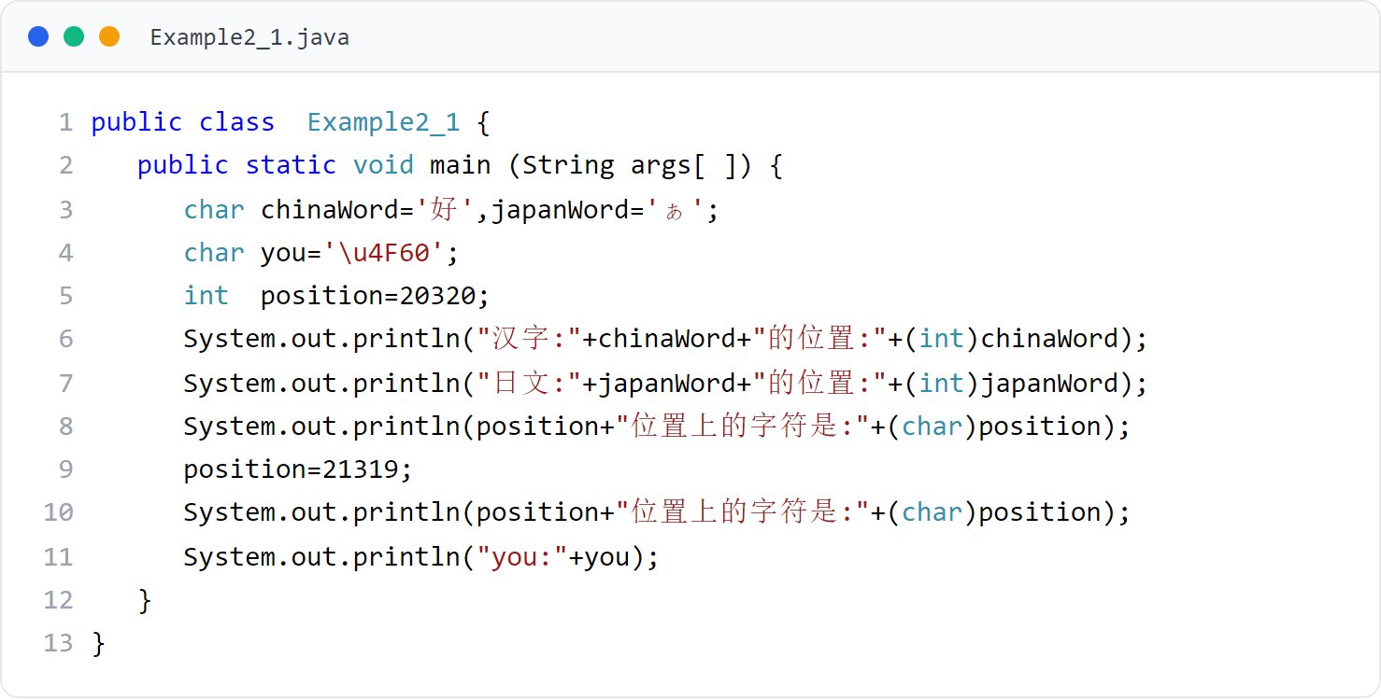
第 2 章 · 基本数据类型与数组
Chapter 2 · Basic Data Types and Arrays
例子1
Example 1
字符与 Unicode
Characters and Unicode
输出字符对应的 Unicode 位置，体会 char 就是 2 字节整数
Output the Unicode position corresponding to the character, and realize that char is a 2-byte integer
11 / 34
Notes:
[课堂运行示例]
课堂运行：课堂示例代码/第2章/UnicodeDemo.java
让学生先猜 A、好、★ 的编码，再运行；把 code 改成 67 再观察。

Slide 12
第 2 章 · 基本数据类型与数组
Chapter 2 · Basic Data Types and Arrays
§2.2.4 浮点类型
§2.2.4 Floating point type
float 型
float type
常量：453.54F（小数表示法）、2e40f（指数表示法）
Constants: 453.54F (decimal notation), 2e40f (exponential notation)
单精度浮点，4 个字节
Single precision floating point, 4 bytes
精度：存储时保留 7~8 位有效数字
Precision: 7~8 significant digits are retained when storing
内存：4 个字节，占 32 位
Memory: 4 bytes, 32 bits
float x = 22.76f, tom = 1234.987f, weight = 1e-12F;
特别注意：float 常量后面必须要有后缀 f 或 F！
Special note: there must be a suffix f or F after the float constant!
12 / 34

Slide 13
第 2 章 · 基本数据类型与数组
Chapter 2 · Basic Data Types and Arrays
§2.2.4 浮点类型
§2.2.4 Floating point type
double 型
double type
常量：238.539d、231.987、1e-90，后缀 d/D 可省略
Constants: 238.539d, 231.987, 1e-90, suffix d/D can be omitted
双精度浮点，8 个字节
Double precision floating point, 8 bytes
精度：保留 15~16 位有效数字
Precision: 15~16 significant digits retained
内存：8 个字节，占 64 位
Memory: 8 bytes, 64 bits
double height = 23.345, width = 34.56D, length = 1e12;
带小数部分的数据缺省类型是 double——所以 float 常量必须写后缀 f/F
The default type of data with a decimal part is double - so float constants must be written with the suffix f/F
13 / 34

Slide 14
第 2 章 · 基本数据类型与数组
Chapter 2 · Basic Data Types and Arrays
§2.3 类型转换运算
§2.3 Type conversion operation
类型转换：一条规则，两种方向
Type conversion: one rule, two directions
基本类型（不含逻辑型）按精度从「低」到「高」排列：byte → short → char → int → long → float → double
Basic types (excluding logical types) are arranged from "low" to "high" in precision: byte → short → char → int → long → float → double
低 → 高：把级别低的变量赋给级别高的变量，系统自动完成转换
Low → High: Assign low-level variables to high-level variables, and the system automatically completes the conversion.
高 → 低：必须使用强制类型转换运算，格式 (类型名) 表达式
High → Low: Must use cast operation, format (type name) expression
int 常量赋给 byte/short 时不能超出取值范围，否则必须强转
When assigning int constant to byte/short, it cannot exceed the value range, otherwise it must be forced
float x = 100; // int → float 自动转换
float x = 100; // int → float automatic conversion
int x = (int)34.89; // 强制转换，丢掉小数
int x = (int)34.89; // Forced conversion, discarding decimals
byte b = 128; // 错！超出 byte 取值范围
byte b = 128; // Wrong! Out of byte value range
14 / 34

Slide 15
第 2 章 · 基本数据类型与数组
Chapter 2 · Basic Data Types and Arrays
§2.3 类型转换
§2.3 Type conversion
自动 vs 强制
Automatic vs Explicit Conversion
自动转换（低→高）
Automatic conversion (low → high)
强制转换（高→低）
Forced conversion (high → low)
· 小范围存进大范围，安全
· Save in a small range and into a large range, safe
· 大范围装进小范围，可能丢精度
· Fitting a large range into a small range may cause loss of accuracy
· float x = 100; // int → float
· int x = (int)34.89; // 丢掉 .89
· int x = (int)34.89; // throw away.89
一个方向安全省心，一个方向需要显式声明
One direction is safe and automatic; the other requires an explicit cast.
· 系统自动完成，无需写代码
· The system completes it automatically, no need to write code
· 必须显式写 (类型名)，谨慎使用
· Must be written explicitly (type name), use with caution
15 / 34

Slide 16
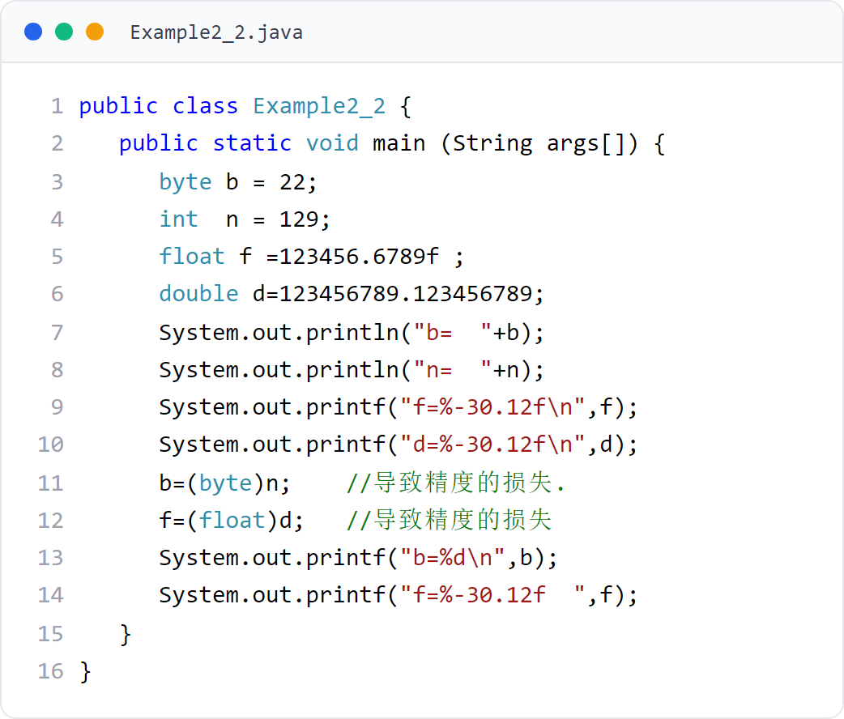
第 2 章 · 基本数据类型与数组
Chapter 2 · Basic Data Types and Arrays
例子2
Example 2
强制转换与精度损失
Casting and loss of precision
用 printf 输出强转前后的值，直观感受精度的丢失
Use printf to output the values ​​before and after the forced conversion, and intuitively feel the loss of accuracy.
16 / 34
Notes:
[课堂运行示例]
课堂运行：课堂示例代码/第2章/TypeConversionDemo.java
重点观察 34.89 转 int 后的小数丢失，以及 130 转 byte 后的溢出结果。

Slide 17
第 2 章 · 基本数据类型与数组
Chapter 2 · Basic Data Types and Arrays
§2.4.1 输入基本型数据
§2.4.1 Enter basic data
Scanner 输入
Scanner input
读取方法：nextBoolean()、nextByte()、nextInt()、nextDouble() 等
Reading methods: nextBoolean(), nextByte(), nextInt(), nextDouble(), etc.
用 Scanner 对象读取用户在命令行的输入
Use Scanner objects to read user input on the command line
方法执行时会阻塞，程序等待用户输入数据并回车确认
The method will block when executing. The program waits for the user to enter data and press Enter to confirm.
用空白做分隔标记，每次读取键盘缓冲区里的下一个「单词」
Use white space as a separation mark to read the next "word" in the keyboard buffer each time
Scanner reader = new Scanner(System.in);
使用前需要 import java.util.Scanner;
Need to import java.util.Scanner; before use
17 / 34

Slide 18
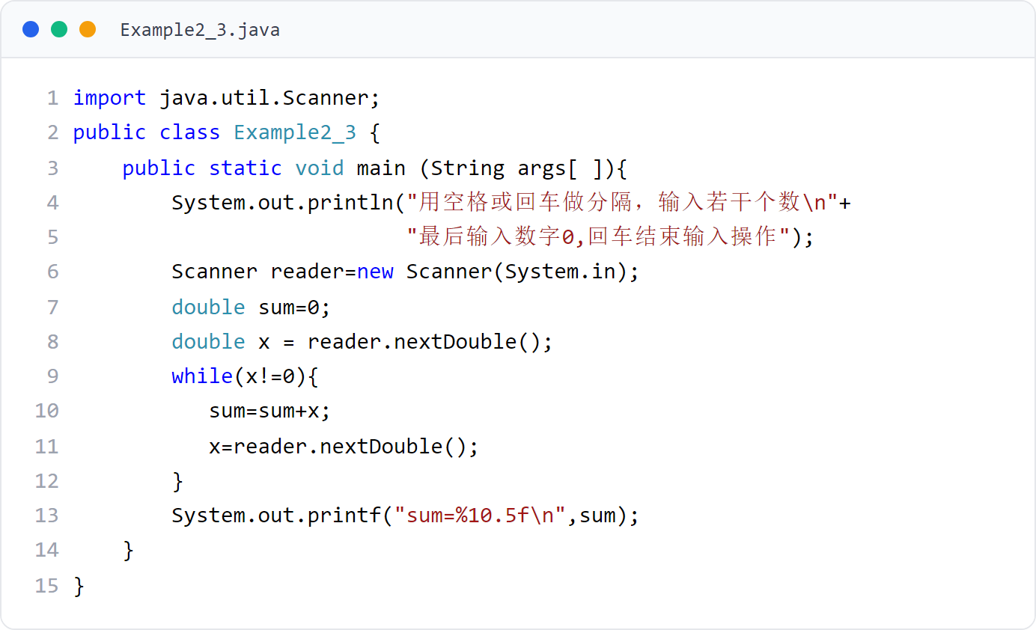
第 2 章 · 基本数据类型与数组
Chapter 2 · Basic Data Types and Arrays
例子3
Example 3
输入若干个数求和
Enter several numbers to find the sum
用户以空格或回车分隔输入，最后输入 0 结束，程序计算总和
The user separates the input with spaces or carriage returns, ends with 0, and the program calculates the sum.
18 / 34
Notes:
[课堂运行示例]
课堂运行：课堂示例代码/第2章/ScannerSumDemo.java
示例输入：10 20.5 3 0。先预测 count 与 sum，再运行验证。

Slide 19
第 2 章 · 基本数据类型与数组
Chapter 2 · Basic Data Types and Arrays
§2.4.2 输出基本型数据
§2.4.2 Output basic data
println 与 print
println and print
System.out.println()：输出数据后换行；print() 不换行
System.out.println(): Line wrap after outputting data; print() does not wrap line
用 System 类的方法输出数据
Use System class methods to output data
输出串值与表达式的值
Output string value and expression value
长字符串可用 + 并置拼接
Long strings can be concatenated with + concatenation
System.out.println("m 个数的和为" + sum);
System.out.println("The sum of m numbers is " + sum);
System.out.println("你好，" + "很高兴认识你");
System.out.println("Hello," + "Nice to meet you");
19 / 34

Slide 20
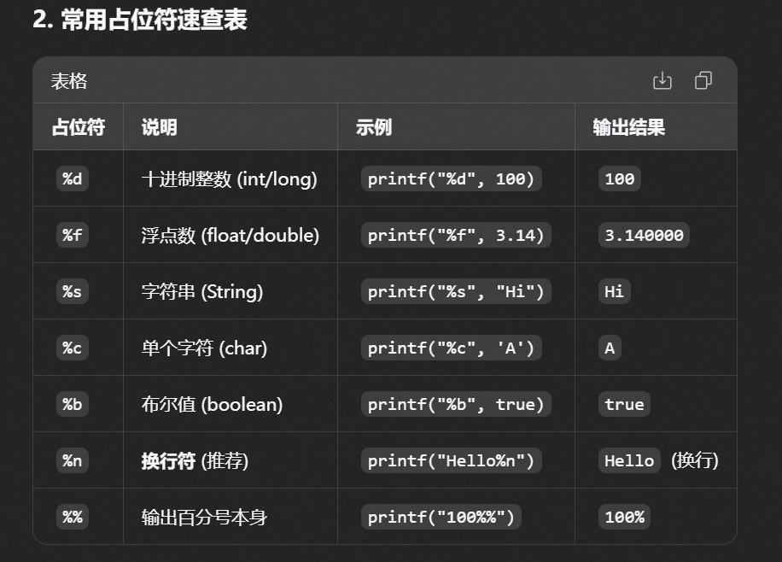
第 2 章 · 基本数据类型与数组
Chapter 2 · Basic Data Types and Arrays
§2.4.2 输出基本型数据
§2.4.2 Output basic data
printf 格式输出
printf format output
JDK 1.5 新增，和 C 语言的 printf 很像
New in JDK 1.5, it is very similar to printf in C language
%d 输出 int、%c 输出 char、%f 输出浮点（小数最多 6 位）、%s 输出字符串
%d outputs int, %c outputs char, %f outputs floating point (up to 6 decimal places), %s outputs string
%md：int 型数据占 m 列；%m.nf：浮点占 m 列、小数保留 n 位
%md: Int type data occupies m columns; %m.nf: Floating point occupies m columns, and decimals retain n digits.
System.out.printf("格式控制部分", 表达式1, 表达式2, …);
System.out.printf("Format control part", expression 1, expression 2, …);
System.out.printf("%d,%f", 12, 23.78);
20 / 34

Slide 21
第 2 章 · 基本数据类型与数组
Chapter 2 · Basic Data Types and Arrays
§2.5 数组
§2.5 Array
数组的概念与声明
The concept and declaration of arrays
数组是相同类型的数据按顺序组成的复合数据类型
An array is a composite data type composed of data of the same type in order
通过「数组名 + 下标」使用数组中的数据，下标从 0 开始
Use the data in the array through "array name + subscript", the subscript starts from 0
数组属于引用型变量：先声明，再分配元素空间
Arrays are reference variables: declare them first and then allocate element space.
float boy[]; // 或 float[] boy; 声明数组
float boy[]; // or float[] boy; declare array
21 / 34
Notes:
[课堂运行示例]
课堂运行：课堂示例代码/第2章/ArrayBasicsDemo.java
逐步演示声明、初始化、length、下标遍历和平均值计算。

Slide 22
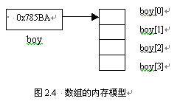
第 2 章 · 基本数据类型与数组
Chapter 2 · Basic Data Types and Arrays
2.5.2 为数组分配元素空间
2.5.2 Allocate element space for array
new 出空间
Allocate Space with new
数组变量中存放的是首元素的地址，通过名字加索引使用元素
The address of the first element is stored in the array variable. The element is used by name and index.
boy = new float[4];
数组名 = new 数组元素的类型[元素个数];
Array name = new array element type [number of elements];
float boy[] = new float[4]; // 声明+分配一步完成
float boy[] = new float[4]; // Declaration + allocation are completed in one step
22 / 34

Slide 23
第 2 章 · 基本数据类型与数组
Chapter 2 · Basic Data Types and Arrays
2.5.3 数组元素的使用
2.5.3 Use of array elements
下标从 0 开始
Subscripts start from 0
一维数组通过索引访问元素：boy[0]、boy[1]…
One-dimensional array accesses elements by index: boy[0], boy[1]…
用索引访问元素，千万别越界
Use index to access elements, never cross the boundary
数组有 4 个元素，下标到 3 为止
The array has 4 elements, indexed up to 3
越界编译可以通过，运行时抛 ArrayIndexOutOfBoundsException
Out-of-bounds compilation can pass, and ArrayIndexOutOfBoundsException is thrown at runtime.
boy[0] = 12; boy[1] = 23.908F; boy[2] = 100; boy[3] = 10.23f;
boy[4] = 384.98f; // 运行时报数组越界异常
boy[4] = 384.98f; // Array out-of-bounds exception during runtime
23 / 34

Slide 24
第 2 章 · 基本数据类型与数组
Chapter 2 · Basic Data Types and Arrays
2.5.4 length 的使用
2.5.4 Use of length
数组的 length 字段
The length field of the array
一维数组：数组名.length 的值 = 元素个数
One-dimensional array: value of array name.length = number of elements
length 告诉你数组有多大
length tells you how big the array is
二维数组：数组名.length 的值 = 含有一维数组的个数
Two-dimensional array: The value of array name.length = the number of one-dimensional arrays
float boy[] = new float[4]; // boy.length 为 4
float boy[] = new float[4]; // boy.length is 4
int a[][] = new int[3][8]; // a.length 是 3
int a[][] = new int[3][8]; // a.length is 3
// a[0].length、a[1].length、a[2].length 均为 8
// a[0].length, a[1].length, a[2].length are all 8
24 / 34

Slide 25
第 2 章 · 基本数据类型与数组
Chapter 2 · Basic Data Types and Arrays
2.5.5 数组的初始化
2.5.5 Initialization of array
创建后系统给每个元素一个默认值（float 型是 0.0）
After creation, the system gives each element a default value (float type is 0.0)
默认值、逐一赋值与整体初始化
Default value, one-by-one assignment and overall initialization
float boy[] = new float[4];
boy[0] = 12; boy[1] = 23.908F;
float boy[] = {21.3f, 23.89f, 2.0f, 23f, 778.98f};
三种给数组「填值」的方式
Three ways to "fill" an array
25 / 34

Slide 26
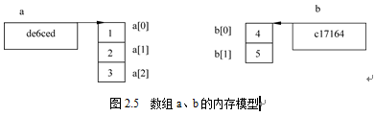
第 2 章 · 基本数据类型与数组
Chapter 2 · Basic Data Types and Arrays
2.5.6 数组的引用
2.5.6 References to arrays
两个相同类型的数组如果引用相同，就有完全相同的元素
Two arrays of the same type have exactly the same elements if they have the same reference.
引用赋值：改的是「指向」
Reference Assignment Changes What a Variable Points To
执行 a = b; 后，a 与 b 引用相同，系统释放数组 a 原有的元素
After executing a = b;, a and b have the same reference, and the system releases the original elements of array a.
int a[] = {1,2,3}, b[] = {4,5};
a = b; // 引用赋值：改的是指向，不是拷贝元素
a = b; // Reference assignment: changing the pointer, not copying the element
数组变量存的是首元素地址，不是元素本身
The array variable stores the address of the first element, not the element itself.
重要结论：引用赋值不会拷贝元素——两个变量指向同一块内存
Important conclusion: Assignment by reference does not copy elements - both variables point to the same memory
26 / 34

Slide 27
第 2 章 · 基本数据类型与数组
Chapter 2 · Basic Data Types and Arrays
§2.6 应用举例
§2.6 Application examples
折半查找
Binary Search
与数组中间的值比较：相等即找到
Compare with the value in the middle of the array: find if equal
对从小到大排序的数组，判断一个整数是否在其中
Determine whether an integer occurs in an array sorted in ascending order.
小于中间值 → 在前一半继续折半找；大于 → 在后一半继续折半找
Less than the middle value → continue to search in half in the first half; greater than → continue to search in half in the second half
每比较一次排除一半，比顺序查找快得多
Exclude half of each comparison, much faster than sequential search
mid = (low + high) / 2;
if (key < a[mid]) high = mid - 1;
else if (key > a[mid]) low = mid + 1;
27 / 34

Slide 28
第 2 章 · 基本数据类型与数组
Chapter 2 · Basic Data Types and Arrays
例子5
Example 5
折半查找：核心思路
Binary Search: Core Idea
维护查找区间 [low, high]，取中间下标 mid = (low + high) / 2
Maintain the search interval [low, high], take the middle subscript mid = (low + high) / 2
找到返回 true；区间为空（low > high）返回 false
Returns true if found; returns false if the interval is empty (low > high)
完整 44 行程序见 chapter2/例子5/Example2_5.java，课堂演示运行
See the complete 44-line program in chapter2/Example 5/Example2_5.java; it will be demonstrated in class.
mid = (low + high) / 2;
if (key == a[mid]) return true;
if (low > high) return false;
28 / 34
Notes:
[课堂运行示例]
课堂运行：课堂示例代码/第2章/BinarySearchDemo.java
逐轮观察 low、high、mid。先查找 31，再把 target 改成 30 演示未找到。

Slide 29
第 2 章 · 基本数据类型与数组
Chapter 2 · Basic Data Types and Arrays
总结
Summarize
本章要点
Key points of this chapter
标识符由字母、下划线、美元符号和数字组成，第一个字符不能是数字，关键字不能做标识符
Identifiers consist of letters, underscores, dollar signs, and numbers. The first character cannot be a number, and keywords cannot be used as identifiers.
4 句话带走本章
4 sentences to take away this chapter
Java 有 8 种基本数据类型：boolean、byte、short、char、int、long、float、double
Java has 8 basic data types: boolean, byte, short, char, int, long, float, double
数组是相同类型的数据元素按顺序组成的复合数据类型，属于引用型变量
An array is a composite data type composed of data elements of the same type in order and is a reference variable.
两个相同类型的数组如果引用相同，它们就有完全相同的元素
Two arrays of the same type have exactly the same elements if they have the same reference
29 / 34

Slide 30
第 2 章 · 基本数据类型与数组
Chapter 2 · Basic Data Types and Arrays
作业
Homework
课后练习
After class exercises
动手才是最快的掌握方式
Doing it is the fastest way to master it
完成教材配套练习与题库系统（见教材前言二维码）
Complete the textbook supporting exercises and question bank system (see the QR code in the preface of the textbook)
独立完成，禁止直接提交 AI 生成的代码
Complete independently, direct submission of AI-generated code is prohibited
30 / 34

Slide 31
第 2 章 · 基本数据类型与数组
Chapter 2 · Basic Data Types and Arrays
编程题 1
Programming Task 1
整数与字符报告
Integer and char report
使用 int、long、char 完成一次综合输出
Use int, long, and char in one program
编写 IntLongCharReport.java：定义年龄 int、人口 long、等级 char，并输出三项。
Write IntLongCharReport.java with an int age, long population, and char grade.
再输出 grade 的 Unicode 编码并执行 grade++；long 常量必须使用 L。
Print grade's Unicode value, run grade++, and use L for the long literal.
31 / 34
Notes:
[编程题参考答案 / Reference Solution]
参考代码 / Reference solution:
public class IntLongCharReport {
public static void main(String[] args) {
int age = 18;
long population = 1_400_000_000L;
char grade = 'A';
System.out.println(age);
System.out.println(population);
System.out.println(grade);
System.out.println((int) grade);
grade++;
System.out.println(grade);
}
}
[Sources]
No external sources. Original instructional exercise.

Slide 32
第 2 章 · 基本数据类型与数组
Chapter 2 · Basic Data Types and Arrays
编程题 2
Programming Task 2
输入并计算矩形
Read and calculate a rectangle
练习 Scanner、double 和强制类型转换
Practice Scanner, double, and explicit casting
读入 double 类型的长和宽，输出面积和周长；再输出强制转成 int 的面积。
Read double length and width; print area, perimeter, and the area cast to int.
用 5.5 和 3.2 测试；写注释说明整数面积为什么丢失小数。
Test with 5.5 and 3.2; comment on why the integer area loses decimals.
32 / 34
Notes:
[编程题参考答案 / Reference Solution]
参考代码 / Reference solution:
import java.util.Scanner;
public class RectangleInput {
public static void main(String[] args) {
Scanner input = new Scanner(System.in);
double length = input.nextDouble();
double width = input.nextDouble();
double area = length * width;
double perimeter = 2 * (length + width);
System.out.println("面积：" + area);
System.out.println("周长：" + perimeter);
System.out.println("整数面积：" + (int) area); // 强制转换会截掉小数部分
input.close();
}
}
输入 5.5 3.2 时：面积 17.6，周长 17.4，整数面积 17。
[Sources]
No external sources. Original instructional exercise.

Slide 33
第 2 章 · 基本数据类型与数组
Chapter 2 · Basic Data Types and Arrays
编程题 3
Programming Task 3
数组成绩统计
Array score statistics
把输入、数组、遍历和统计组合起来
Combine input, arrays, traversal, and statistics
读入 5 个 int 成绩存入数组，输出总分、平均分、最高分和最低分。
Read five int scores into an array; print total, average, maximum, and minimum.
再逆序输出数组；扩展：排序后用折半查找返回目标下标或 -1。
Print the array in reverse; extension: binary-search a sorted array for an index or -1.
33 / 34
Notes:
[编程题参考答案 / Reference Solution]
参考代码 / Reference solution:
import java.util.Scanner;
public class ScoreStatistics {
public static void main(String[] args) {
Scanner input = new Scanner(System.in);
int[] scores = new int[5];
int sum = 0;
for (int i = 0; i < scores.length; i++) {
scores[i] = input.nextInt();
sum += scores[i];
}
int max = scores[0];
int min = scores[0];
for (int score : scores) {
if (score > max) max = score;
if (score < min) min = score;
}
System.out.println("总分：" + sum);
System.out.println("平均分：" + (double) sum / scores.length);
System.out.println("最高分：" + max);
System.out.println("最低分：" + min);
for (int i = scores.length - 1; i >= 0; i--) {
System.out.print(scores[i] + " ");
}
input.close();
}
}
[Sources]
No external sources. Original instructional exercise.

Slide 34
Thank You !
第 2 章 · 基本数据类型与数组 到此结束
End of Chapter 2 · Basic Data Types and Arrays
34 / 34

