Slide 1
JAVA PROGRAMMING · CHAPTER 05
Java 程序设计
Java Programming
第 5 章 · 子类与继承
Chapter 5 · Subclasses and Inheritance
中国石油大学（北京）克拉玛依校区
China University of Petroleum (Beijing) Karamay Campus
授课教师：潘啸晨
Instructor: Pan Xiaochen

Slide 2
第 5 章 · 子类与继承
Chapter 5 · Subclasses and Inheritance
05
子类与继承
Subclasses and Inheritance
继承是面向对象编程的三大特性之一：子类复用父类的状态与行为，并通过重写、多态、抽象类与抽象方法构建易维护、易扩展的程序。
Inheritance is one of the three major characteristics of object-oriented programming: subclasses reuse the state and behavior of the parent class, and build programs that are easy to maintain and expand through rewriting, polymorphism, abstract classes, and abstract methods.
2 / 87

Slide 3
第 5 章 · 子类与继承
Chapter 5 · Subclasses and Inheritance
导读
Introduction
本章导览
Chapter overview
主要内容
Main content
重点
focus
难点
difficulty
子类与父类
Subclasses and parent classes
类的继承性
class inheritance
理解上转型对象
Understand transformation objects
子类的继承性
Inheritance from subclasses
上转型对象
Upcast object
多态技术的理解和运用
Understanding and applying polymorphic technology
继承是面向对象编程的三大特性之一：由已有的类创建新类，新类继承父类的状态和行为，并根据需要增加自己的新状态和行为。
Inheritance is one of the three major characteristics of object-oriented programming: creating a new class from an existing class, the new class inherits the state and behavior of the parent class, and adds its own new state and behavior as needed.
子类与对象
Subclasses and Objects
多态技术
polymorphic technology
成员变量的隐藏和方法重写
Hiding member variables and overriding methods
super 关键字
super keyword
final 关键字
final keyword
对象的上转型对象
upcast object
继承与多态
Inheritance and Polymorphism
abstract 类与 abstract 方法
abstract classes and abstract methods
面向抽象编程
Programming towards abstraction
开-闭原则
open-closed principle
3 / 87

Slide 4
第 5 章 · 子类与继承
Chapter 5 · Subclasses and Inheritance
§5.1
子类与父类
Subclasses and parent classes
先创建共有属性的一般类，再根据该一般类创建具有特殊属性的新类，新类继承一般类的状态和行为，并增加自己的新状态和行为
First create a general class with common attributes, and then create a new class with special attributes based on the general class. The new class inherits the status and behavior of the general class and adds its own new status and behavior.
继承是一种由已有的类创建新类的机制。
Inheritance is a mechanism for creating new classes from existing classes.
由继承而得到的类称为子类，被继承的类称为父类（超类）
The class obtained by inheritance is called a subclass, and the inherited class is called a parent class (super class).
子类与父类的关系是 “is-a” 关系：Animal 是 Dog 的父类，可以说 “狗是动物”
The relationship between the subclass and the parent class is an "is-a" relationship: Animal is the parent class of Dog. It can be said that "dog is an animal"
Java 不支持多重继承：除了 Object 类，任何子类有且只有一个父类
Java does not support multiple inheritance: except for the Object class, any subclass has only one parent class
4 / 87

Slide 5
第 5 章 · 子类与继承
Chapter 5 · Subclasses and Inheritance
§5.1.1
声明子类
Declare subclass
class 子类名 extends 父类名 {
使用关键字 extends 来定义一个类的子类。
Use the keyword extends to define subclasses of a class.
…
}
class Student extends People {
…
把 Student 类定义为 People 类的子类，People 类是 Student 类的父类。
Define the Student class as a subclass of the People class, which is the parent class of the Student class.
5 / 87

Slide 6
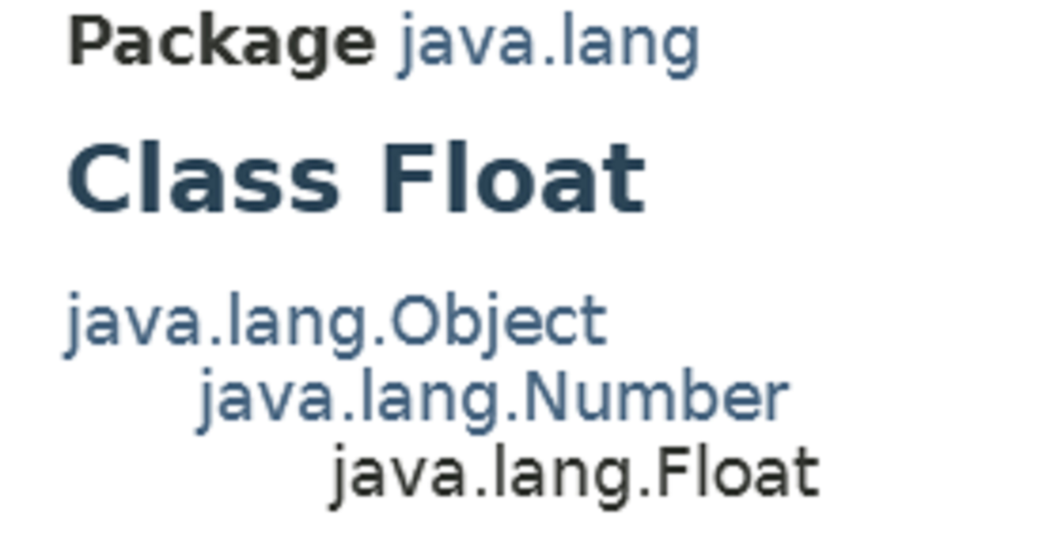
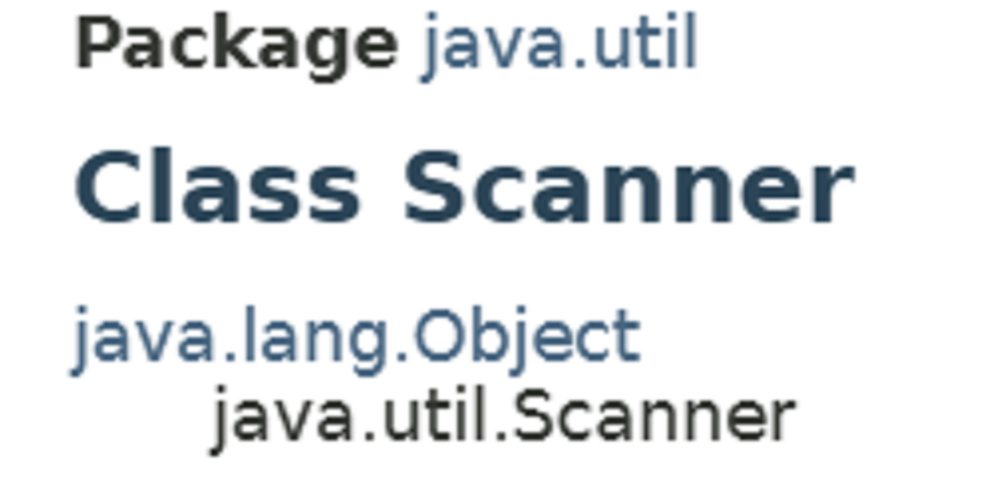
第 5 章 · 子类与继承
Chapter 5 · Subclasses and Inheritance
§5.1.2
类的树形结构
class tree structure
除了 Object 类，每个类都有且仅有一个父类；一个类可以有多个或零个子类
Except for the Object class, every class has one and only one parent class; a class can have many or zero subclasses
声明中没有使用 extends 的类，被系统默认为是 Object 的子类
Classes that do not use extends in the declaration are defaulted by the system to be subclasses of Object
Java 的类按继承关系形成树形结构，根节点是 Object 类（java.lang 包中的类），即 Object 是所有类的祖先类。
Java classes form a tree structure based on inheritance relationships. The root node is the Object class (the class in the java.lang package), that is, Object is the ancestor class of all classes.
"class A" 与 "class A extends Object" 等同。
"class A" is equivalent to "class A extends Object".
6 / 87

Slide 7
第 5 章 · 子类与继承
Chapter 5 · Subclasses and Inheritance
§5.2
子类的继承性
Inheritance from subclasses
类有两种重要成员：成员变量和方法。子类的成员中一部分是子类自己声明定义的，另一部分是从父类继承的。
Classes have two important members: member variables and methods. Some of the members of the subclass are declared and defined by the subclass itself, and some are inherited from the parent class.
继承成员变量：把继承来的变量作为自己的成员变量，好像是在子类中直接声明一样，可被子类中自己定义的任何实例方法操作
Inherited member variables: Use the inherited variables as your own member variables, as if they were declared directly in the subclass, and can be operated by any instance method defined in the subclass.
继承方法：把继承来的方法作为子类中的一个方法，好像是在子类中直接定义了一样，可被子类中自己定义的任何实例方法调用
Inherited method: Treat the inherited method as a method in the subclass, as if it were directly defined in the subclass, and can be called by any instance method defined in the subclass.
7 / 87

Slide 8
第 5 章 · 子类与继承
Chapter 5 · Subclasses and Inheritance
§5.2
继承性的类比：孩子继承父亲
Inheritance analogy: child inherits from father
父类 “动物”
Parent class "Animal"
子类 “狗”
Subcategory "dog"
方法：呼吸、睡觉
Method: breathing, sleeping
自动继承：呼吸、睡觉、五官、颜色，不用重新定义
Automatic inheritance: breathing, sleeping, facial features, color, no need to redefine
子类的继承性就好比孩子继承父亲的特征。
Inheritance of subclasses is like a child inheriting the characteristics of its father.
属性：五官、颜色
Attributes: facial features, color
按需新增：摇尾巴等独特方法
Added as needed: Unique methods such as tail wagging
通过继承性建立的类继承结构，避免了子类一切从头做起。
The class inheritance structure established through inheritance avoids the need for subclasses to start from scratch.
8 / 87

Slide 9
第 5 章 · 子类与继承
Chapter 5 · Subclasses and Inheritance
§5.2.1
子类和父类在同一包中的继承性
Inheritance between subclasses and parent classes in the same package
子类自然地继承其父类中不是 private 的成员变量作为自己的成员变量
Subclasses naturally inherit member variables that are not private in their parent class as their own member variables.
子类自然地继承父类中不是 private 的方法作为自己的方法
Subclasses naturally inherit non-private methods from the parent class as their own methods.
子类与父类同包时，继承的范围最广。
When a subclass is in the same package as its parent class, the scope of inheritance is the widest.
继承的成员变量或方法的访问权限保持不变
Access permissions for inherited member variables or methods remain unchanged
例子1 中有 4 个类：People、Student、UniverStudent 和 Example5_1（均无包名），其中 UniverStudent 是 Student 的子类，Student 是 People 的子类。
There are 4 classes in Example 1: People, Student, UniverStudent and Example5_1 (all without package names), where UniverStudent is a subclass of Student and Student is a subclass of People.
9 / 87

Slide 10
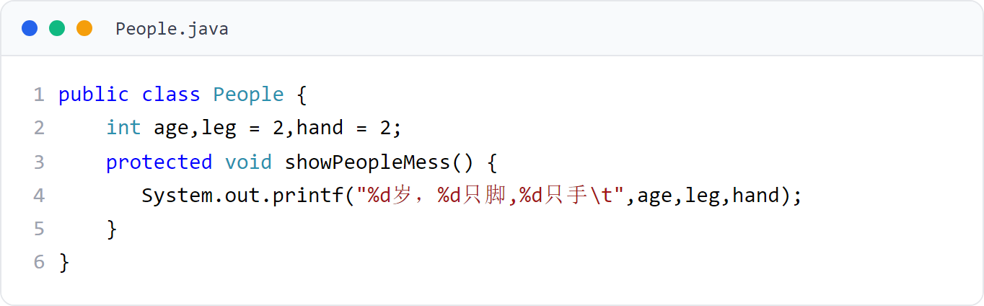
第 5 章 · 子类与继承
Chapter 5 · Subclasses and Inheritance
例子1
Example 1
People 类（父类）
People class (parent class)
声明 age、leg、hand 成员变量与 showPeopleMess() 方法。
Declare the age, leg, hand member variables and showPeopleMess() method.
10 / 87

Slide 11
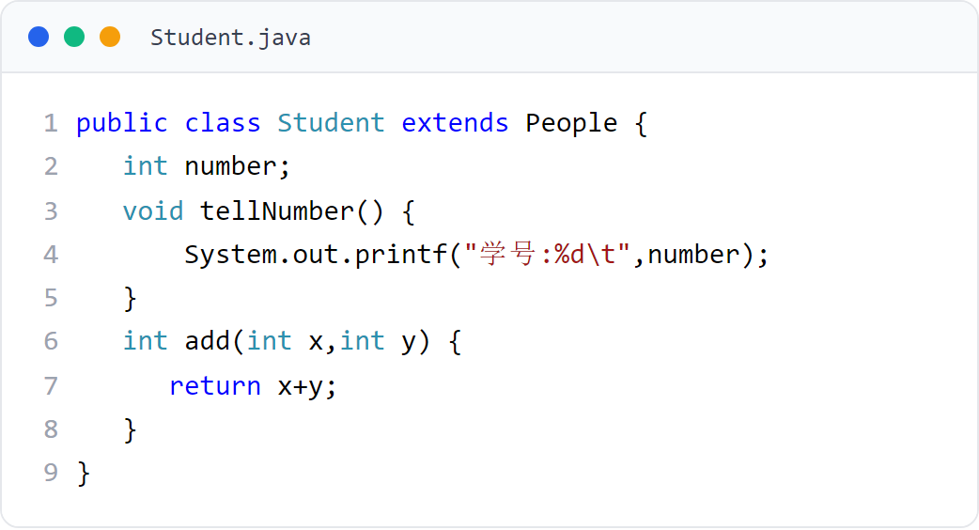
第 5 章 · 子类与继承
Chapter 5 · Subclasses and Inheritance
例子1
Example 1
Student 类（子类）
Student class (subclass)
Student 继承 People，新增 number 与 tellNumber()、add()。
Student inherits People and adds number, tellNumber(), and add().
11 / 87

Slide 12
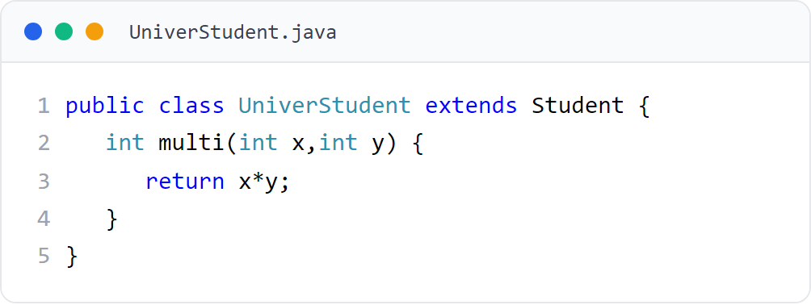
第 5 章 · 子类与继承
Chapter 5 · Subclasses and Inheritance
例子1
Example 1
UniverStudent 类（孙类）
UniverStudent class (grandchild)
UniverStudent 继承 Student，新增 multi()。
UniverStudent inherits Student and adds multi().
12 / 87

Slide 13
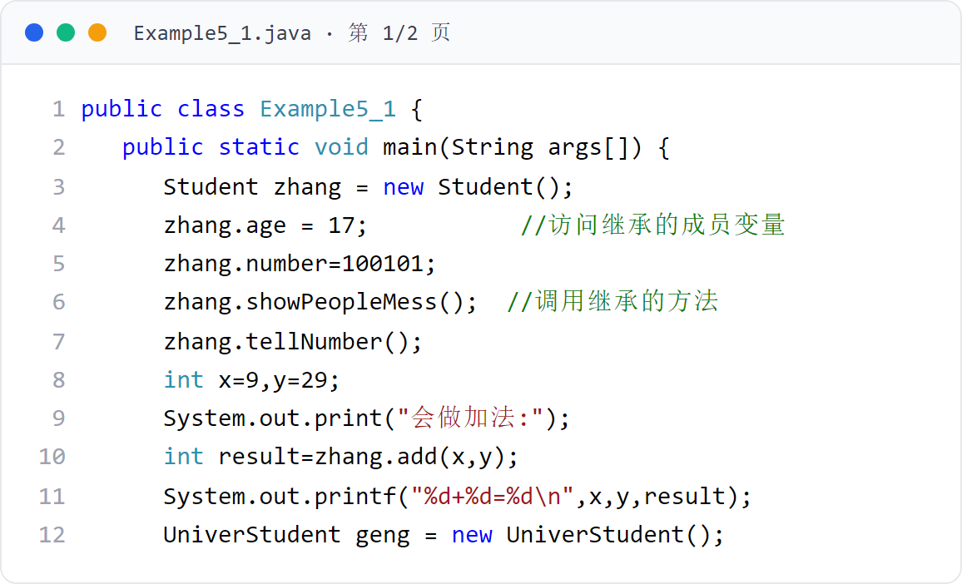
第 5 章 · 子类与继承
Chapter 5 · Subclasses and Inheritance
例子1
Example 1
Example5_1（主类，上）
Example5_1 (main class, upper)
创建 Student 与 UniverStudent 对象，访问继承的成员变量、调用继承的方法。
Create Student and UniverStudent objects, access inherited member variables, and call inherited methods.
13 / 87
Notes:
[课堂运行示例 / Classroom Demo]
课堂运行：课堂示例代码/第5章/InheritanceDemo.java
创建父类 Person 和子类 Student，观察子类继承成员并增加自己的成员。
[Sources]
Source concepts: user-provided chapter deck. Demo code: original instructional material.

Slide 14
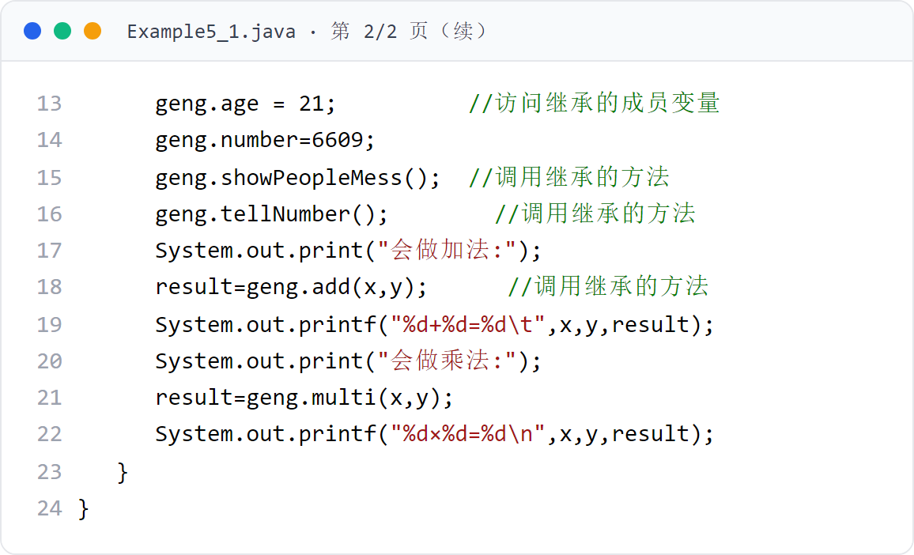
第 5 章 · 子类与继承
Chapter 5 · Subclasses and Inheritance
例子1
Example 1
Example5_1（主类，下）
Example5_1 (main class, bottom)
孙类对象 geng 同样可以访问两级继承的成员与方法。
The grandchild object geng can also access the members and methods of two-level inheritance.
14 / 87

Slide 15

第 5 章 · 子类与继承
Chapter 5 · Subclasses and Inheritance
例子1 · 运行效果
Example 1 · Operational effect
运行效果（图5.1）
Operation effect (Figure 5.1)
继承的两级传递：UniverStudent 对象可访问 People 的成员并调用继承的方法。
Two levels of inheritance: UniverStudent objects can access members of People and call inherited methods.
15 / 87

Slide 16
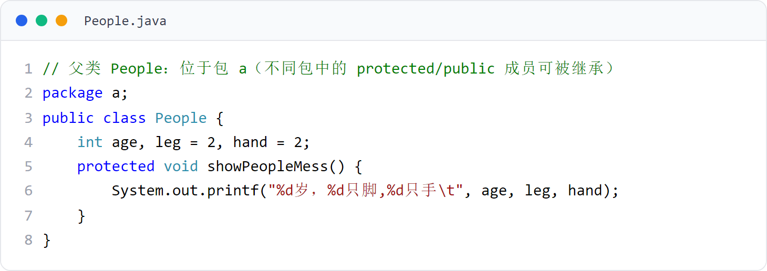
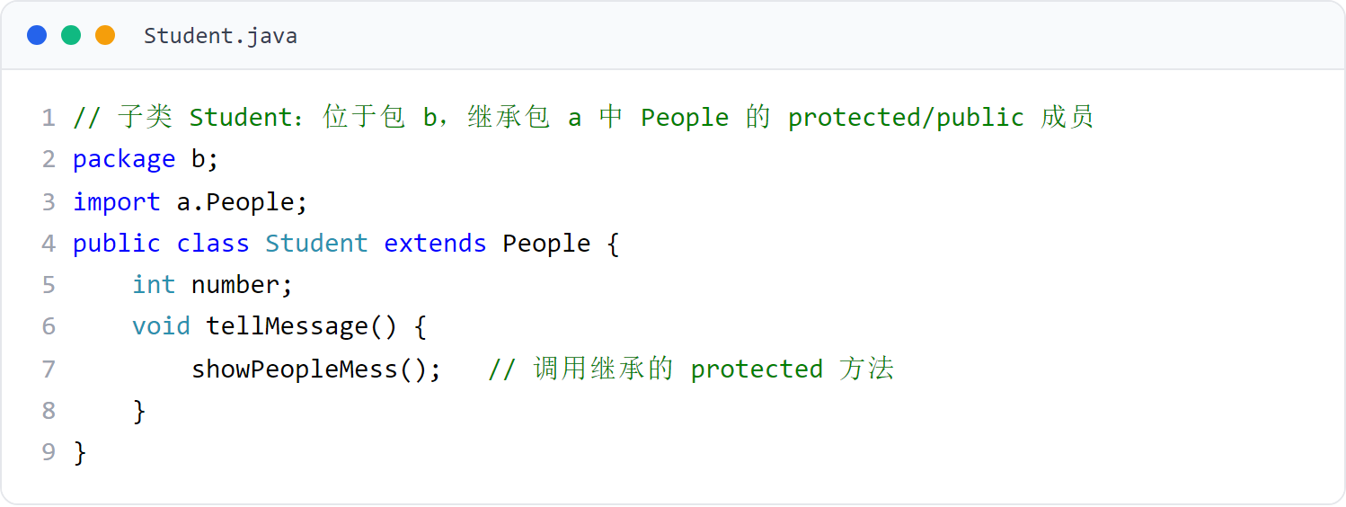
第 5 章 · 子类与继承
Chapter 5 · Subclasses and Inheritance
§5.2.2
子类和父类不在同一包中的继承性
Inheritance when subclass and parent class are not in the same package
子类只继承父类中 protected、public 的成员（本例 People 在包 a，Student 在包 b）。
The subclass only inherits the protected and public members of the parent class (in this example, People is in package a and Student is in package b).
16 / 87

Slide 17
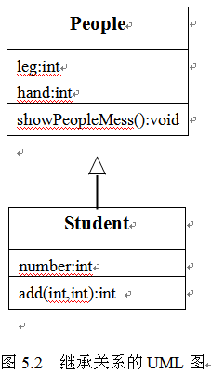
第 5 章 · 子类与继承
Chapter 5 · Subclasses and Inheritance
§5.2.3
继承关系的 UML 图
UML diagram of inheritance relationship
UML 用实线表示继承关系（Generalization），实线起始端是子类，终点端是父类，终点用空心三角形表示。
UML uses a solid line to represent the inheritance relationship (Generalization). The starting end of the solid line is the subclass, the end end is the parent class, and the end point is represented by an open triangle.
17 / 87

Slide 18
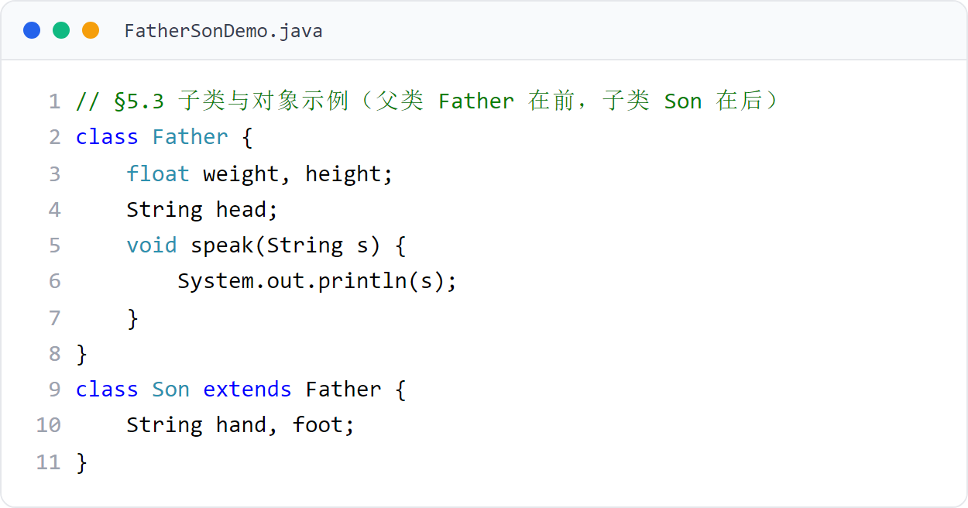
第 5 章 · 子类与继承
Chapter 5 · Subclasses and Inheritance
§5.3
子类与对象
Subclasses and Objects
子类继承父类的成员；子类创建的对象既包含继承来的成员，也包含子类新增的成员。
Subclasses inherit the members of the parent class; objects created by the subclass contain both inherited members and members added by the subclass.
父类 Father 在前，子类 Son 在后。
The parent class Father comes first, and the subclass Son comes last.
18 / 87

Slide 19

第 5 章 · 子类与继承
Chapter 5 · Subclasses and Inheritance
§5.3.1
子类创建对象时，子类的构造方法总是先调用父类的某个构造方法，完成父类部分的创建；再调用子类自己的构造方法，完成子类部分的创建
When a subclass creates an object, the constructor of the subclass always first calls a constructor of the parent class to complete the creation of the parent class part; then calls the subclass's own constructor method to complete the creation of the subclass part.
子类对象的生成
Generation of subclass objects
若子类的构造方法没有明显地指明使用父类的哪个构造方法，子类就调用父类的不带参数的构造方法
If the constructor of the subclass does not explicitly indicate which constructor of the parent class to use, the subclass calls the constructor of the parent class without parameters.
创建子类对象时，父类的成员变量也会被分配内存空间。
When creating a subclass object, the member variables of the parent class will also be allocated memory space.
子类对象不仅子类声明的成员变量被分配内存，父类的所有成员变量也分配了内存，但子类只能操作继承的那部分成员变量
For subclass objects, not only the member variables declared by the subclass are allocated memory, but also all member variables of the parent class are allocated memory. However, the subclass can only operate the inherited member variables.
子类可以通过继承的方法来操作子类未继承的变量和方法
Subclasses can use inherited methods to operate variables and methods that are not inherited by the subclass.
19 / 87

Slide 20
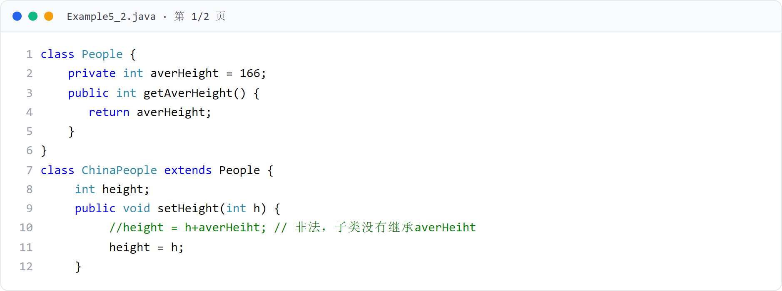
第 5 章 · 子类与继承
Chapter 5 · Subclasses and Inheritance
例子2
Example 2
Example5_2（上）
Example5_2 (top)
ChinaPeople 继承 People，People 的 averHeight 是 private，子类未继承它。
ChinaPeople inherits People. The averHeight of People is private and subclasses do not inherit it.
20 / 87

Slide 21
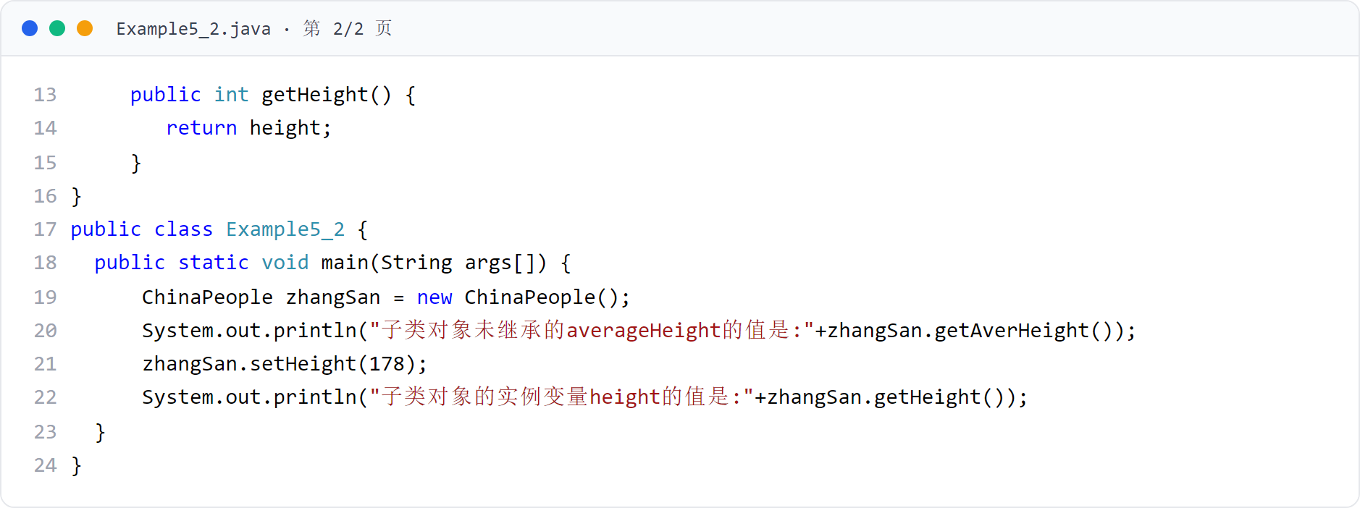
第 5 章 · 子类与继承
Chapter 5 · Subclasses and Inheritance
例子2
Example 2
Example5_2（下）
Example5_2 (Part 2)
子类对象通过继承的方法 getAverHeight() 操作未继承却分配了内存的变量。
Subclass objects use the inherited method getAverHeight() to operate variables that are not inherited but have allocated memory.
21 / 87

Slide 22
第 5 章 · 子类与继承
Chapter 5 · Subclasses and Inheritance
例子2 · 运行效果
Example 2 · Operational effect
运行效果（图5.3）
Operation effect (Figure 5.3)
private 成员变量未被子类继承，但子类对象可通过继承的方法访问它。
Private member variables are not inherited by subclasses, but subclass objects can access them through inherited methods.
22 / 87

Slide 23
第 5 章 · 子类与继承
Chapter 5 · Subclasses and Inheritance
§5.3.1
子类对象的生成：结论
Generation of subclass objects: conclusion
结论 1
Conclusion 1
结论 2
Conclusion 2
构造方法与 super 的约定。
Contract between constructor and super.
创建子类对象时，子类总是按层次结构从上到下的顺序调用所有超类的构造函数
When creating a subclass object, the subclass always calls the constructors of all superclasses in hierarchical order from top to bottom.
如果父类没有不带参数的构造方法，则必须在子类的构造方法中明确告诉调用父类的某个带参数的构造方法（通过 super 关键字）
If the parent class does not have a constructor without parameters, you must explicitly tell the constructor of the child class to call a constructor with parameters of the parent class (via the super keyword)
super 语句必须出现在构造方法的第一句
The super statement must appear in the first sentence of the constructor
23 / 87

Slide 24
第 5 章 · 子类与继承
Chapter 5 · Subclasses and Inheritance
§5.3.2
instanceof 运算符
instanceof operator
左面的操作元是对象，右面的操作元是类
The operand on the left is an object, and the operand on the right is a class.
instanceof 是 Java 独有的双目运算符，用于判断对象的类型。
instanceof is Java's unique binary operator, used to determine the type of an object.
当左面的操作元是右面的类或其子类所创建的对象时，instanceof 运算的结果是 true，否则是 false
When the operand on the left is an object created by the class on the right or its subclass, the result of the instanceof operation is true, otherwise it is false
Test t = new Test();
if (s instanceof String) {
System.out.println("YES");
}
24 / 87

Slide 25
第 5 章 · 子类与继承
Chapter 5 · Subclasses and Inheritance
§5.4.1
成员变量的隐藏
Hiding member variables
对于子类可以从父类继承的成员变量，只要子类中声明的成员变量和父类中的成员变量同名，子类就隐藏了继承的成员变量
For member variables that a subclass can inherit from the parent class, as long as the member variables declared in the subclass have the same name as the member variables in the parent class, the subclass will hide the inherited member variables.
子类声明与父类同名的成员变量时，就隐藏了继承的成员变量。
When a subclass declares a member variable with the same name as the parent class, the inherited member variable is hidden.
在子类中要操作这个与父类同名的成员变量时，子类操作的是子类重新声明的这个成员变量，而不是被隐藏掉的
When you want to operate a member variable with the same name as the parent class in a subclass, the subclass operates the member variable redeclared by the subclass instead of the hidden one.
例子3 中，Goods 类有 double 型成员变量 weight，子类 CheapGoods 重新声明了一个 int 型的同名成员变量 weight。
In Example 3, the Goods class has a double-type member variable weight, and the subclass CheapGoods redeclares an int-type member variable weight with the same name.
25 / 87

Slide 26
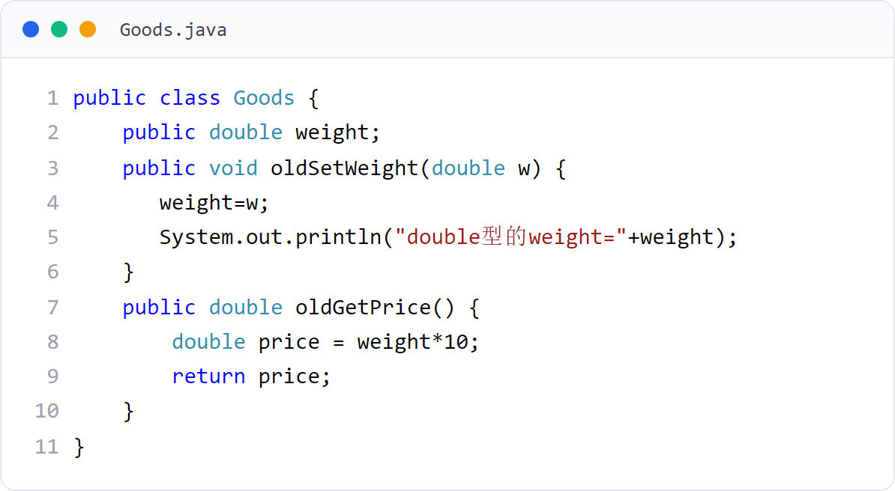
第 5 章 · 子类与继承
Chapter 5 · Subclasses and Inheritance
例子3
Example 3
Goods 类（父类）
Goods class (parent class)
声明 double 型 weight 与 oldSetWeight()、oldGetPrice()。
Declare double type weight and oldSetWeight(), oldGetPrice().
26 / 87

Slide 27
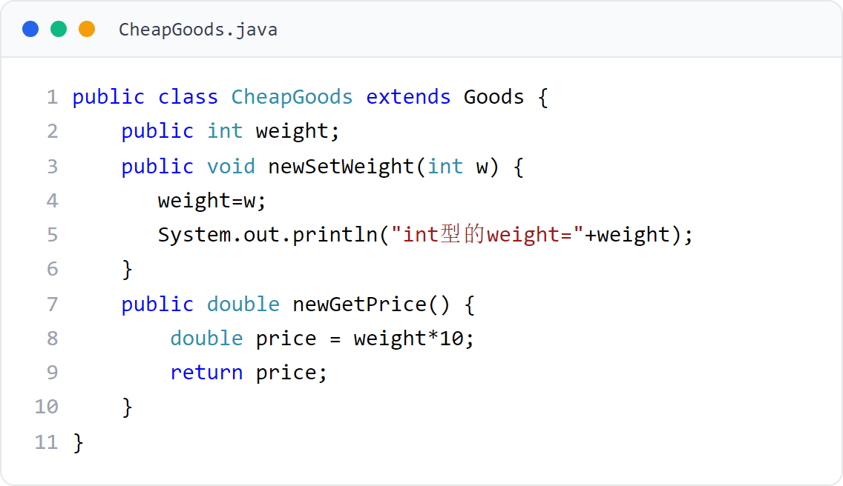
第 5 章 · 子类与继承
Chapter 5 · Subclasses and Inheritance
例子3
Example 3
CheapGoods 类（子类）
CheapGoods class (subclass)
重新声明 int 型 weight，隐藏父类的 double 型 weight。
Redeclare the int type weight and hide the double type weight of the parent class.
27 / 87

Slide 28
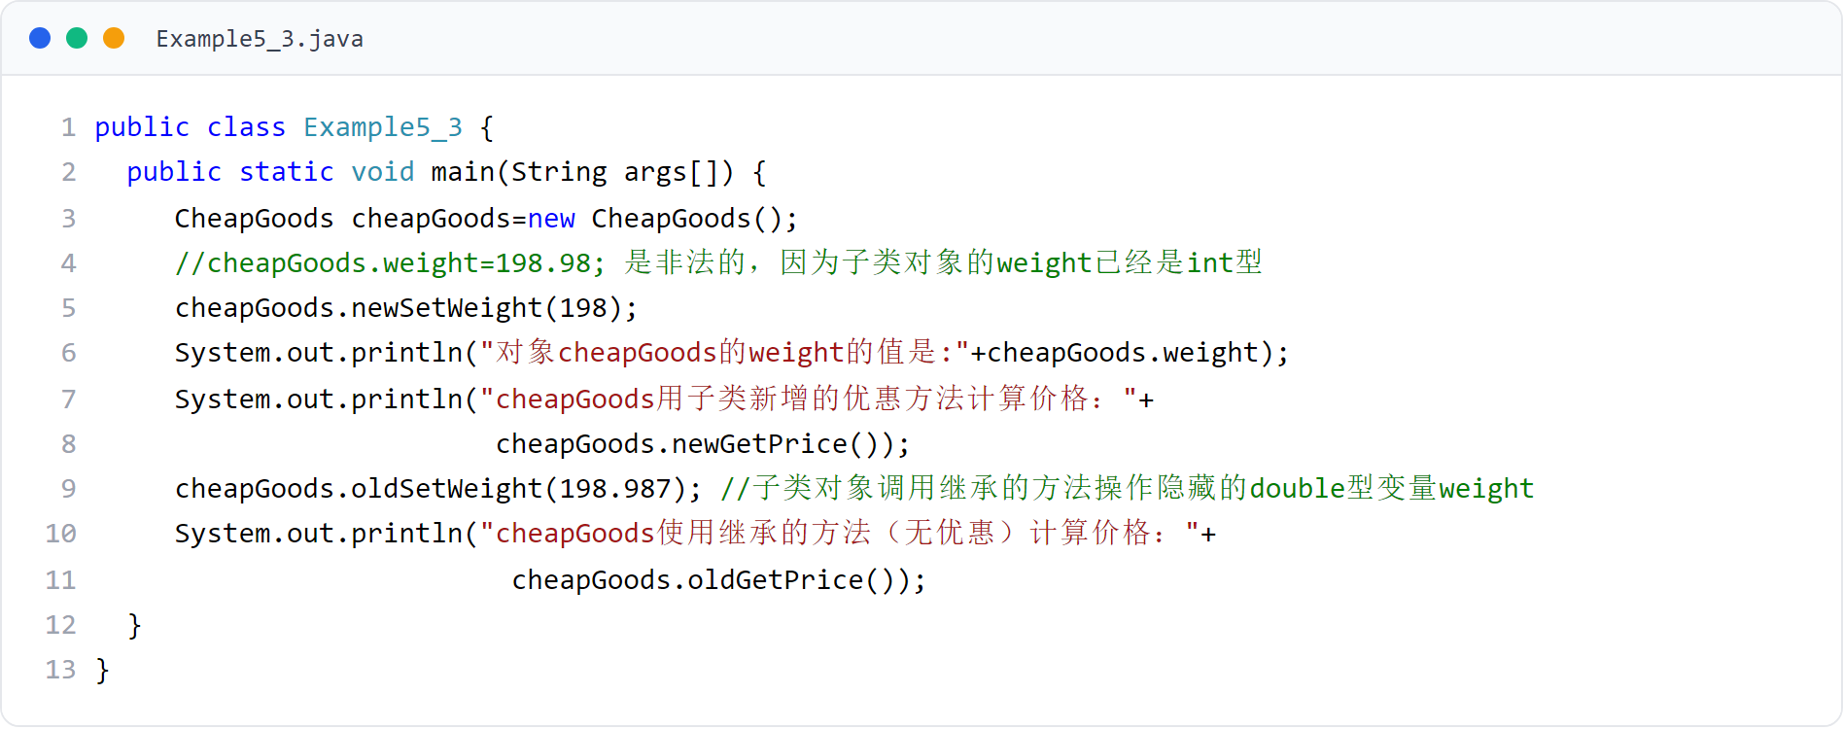
第 5 章 · 子类与继承
Chapter 5 · Subclasses and Inheritance
例子3
Example 3
Example5_3（主类）
Example5_3 (main class)
分别用父类方法操作父类的 weight、用子类方法操作子类的 weight。
Use the parent class method to operate the weight of the parent class, and use the subclass method to operate the weight of the subclass.
28 / 87

Slide 29
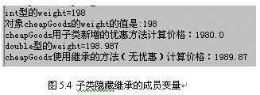
第 5 章 · 子类与继承
Chapter 5 · Subclasses and Inheritance
例子3 · 运行效果
Example 3 · Operational effect
运行效果（图5.4）
Operation effect (Figure 5.4)
同名成员变量被隐藏：子类重新声明的 int weight 隐藏父类的 double weight。
Member variables with the same name are hidden: the redeclared int weight of the subclass hides the double weight of the parent class.
29 / 87
Notes:
[课堂运行示例 / Classroom Demo]
课堂运行：课堂示例代码/第5章/OverrideDemo.java
分别用父类和子类对象调用 showInfo()，观察重写后的动态行为。
[Sources]
Source concepts: user-provided chapter deck. Demo code: original instructional material.

Slide 30
第 5 章 · 子类与继承
Chapter 5 · Subclasses and Inheritance
§5.4.2
方法重写（Override）
Method override (Override)
1．重写的语法规则
1. Rewritten syntax rules
2．重写的目的
2. Purpose of rewriting
3．重写后方法的调用
3． Calling the method after overriding
子类继承了父类的实例或静态方法（非 final 的）后，就有权利重写它
After a subclass inherits an instance or static method (non-final) of the parent class, it has the right to override it.
隐藏继承的方法
Hide inherited methods
子类重写了父类的方法 → 运行时调用子类重写的方法
The subclass overrides the method of the parent class → calls the method overridden by the subclass at runtime
把父类的状态和行为改变为自身的状态和行为
Change the state and behavior of the parent class to its own state and behavior
子类未重写父类的方法 → 运行时调用子类继承的方法
The subclass does not override the method of the parent class → calls the method inherited by the subclass at runtime
子类通过重写可以隐藏已继承的实例方法。
Subclasses can hide inherited instance methods by overriding them.
重写方法的名字、参数个数、参数的类型和父类的方法完全相同
The name, number of parameters, and parameter types of the overridden method are exactly the same as the method of the parent class.
返回类型与父类方法的类型一致，或是父类方法返回类型的子类型
The return type is consistent with the type of the parent class method, or a subtype of the return type of the parent class method
final 方法只能继承，不允许重写
Final methods can only be inherited and are not allowed to be overridden.
30 / 87

Slide 31
第 5 章 · 子类与继承
Chapter 5 · Subclasses and Inheritance
§5.4.2
重写的注意事项
Notes on rewriting
重写父类方法时的访问权限与类型约束。
Access permissions and type constraints when overriding parent class methods.
重写父类的方法时，不允许降低方法的访问权限，但可以提高访问权限
When overriding a method of a parent class, you are not allowed to lower the access rights of the method, but you can increase the access rights.
访问限制修饰符按访问权限从高到低排列：public、protected、友好的、private
Access restriction modifiers are arranged in descending order of access rights: public, protected, friendly, private
不允许把实例方法重写为静态方法，也不允许把静态方法重写为实例方法
It is not allowed to override instance methods as static methods, and it is not allowed to override static methods as instance methods.
例子4 中，ImportantUniversity 是 University 的子类，子类重写了父类的 enterRule() 方法。
In Example 4, ImportantUniversity is a subclass of University, and the subclass overrides the enterRule() method of the parent class.
31 / 87

Slide 32
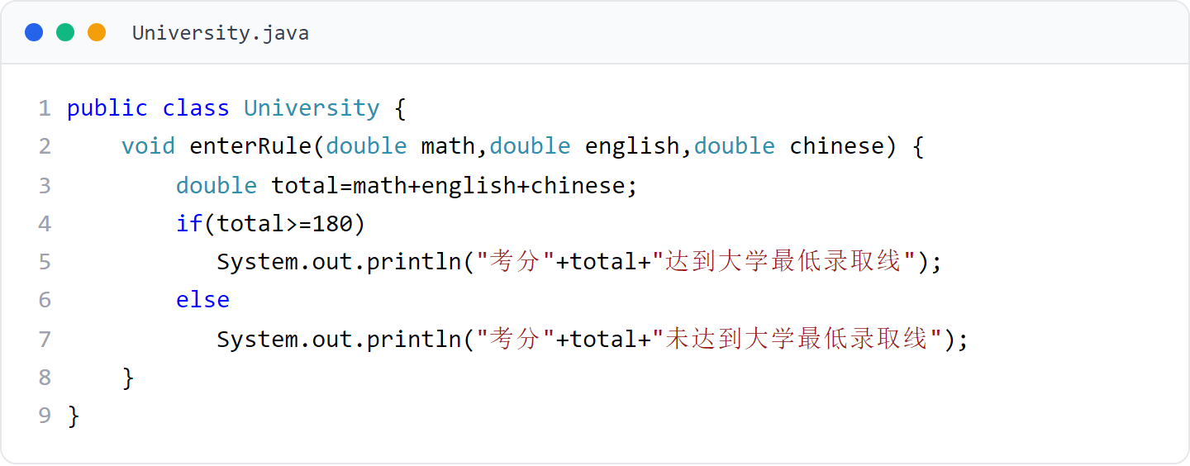
第 5 章 · 子类与继承
Chapter 5 · Subclasses and Inheritance
例子4
Example 4
University 类（父类）
University class (parent class)
enterRule() 按总分 180 判断是否达到大学最低录取线。
enterRule() uses a total score of 180 to determine whether the student has reached the minimum admission level of the university.
32 / 87

Slide 33
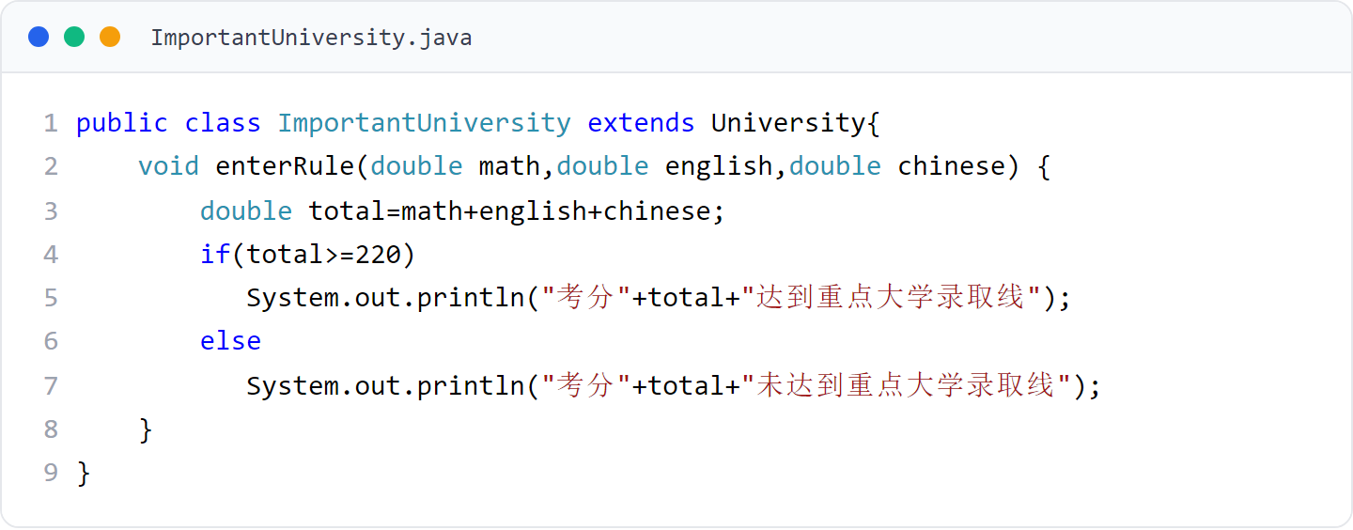
第 5 章 · 子类与继承
Chapter 5 · Subclasses and Inheritance
例子4
Example 4
ImportantUniversity 类（子类）
ImportantUniversity class (subclass)
重写 enterRule()，按总分 220 判断是否达到重点大学录取线。
Rewrite enterRule() to determine whether the admission score of key universities is reached based on the total score of 220.
33 / 87

Slide 34
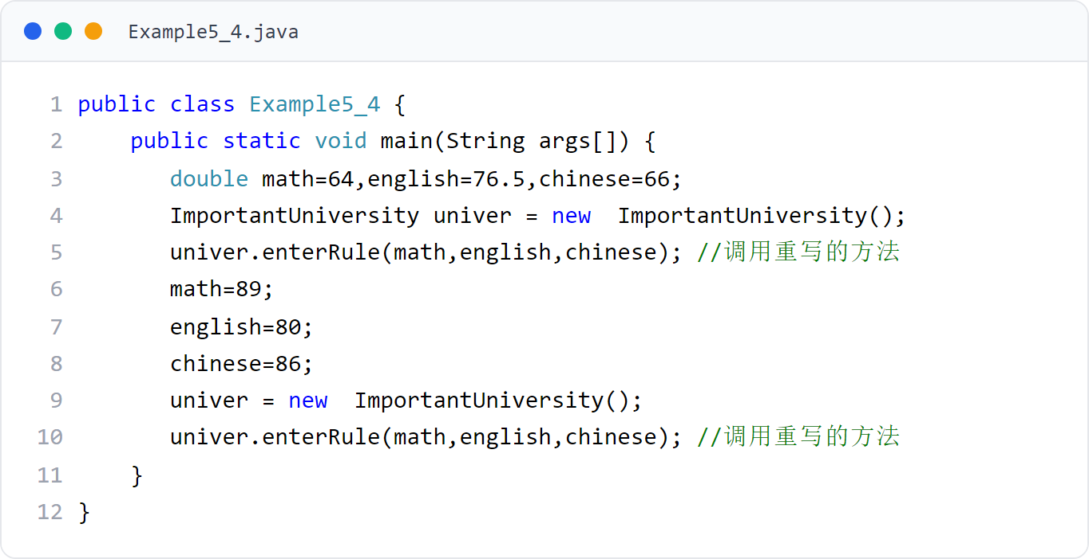
第 5 章 · 子类与继承
Chapter 5 · Subclasses and Inheritance
例子4
Example 4
Example5_4（主类）
Example5_4 (main class)
同样的方法名，子类对象调用的是子类重写后的版本。
For the same method name, the subclass object calls the rewritten version of the subclass.
34 / 87

Slide 35

第 5 章 · 子类与继承
Chapter 5 · Subclasses and Inheritance
例子4 · 运行效果
Example 4·Operation effect
运行效果（图5.5）
Operation effect (Figure 5.5)
重写后调用的是子类的方法，录取线判定不同。
After rewriting, the method of the subclass is called, and the admission line judgment is different.
35 / 87

Slide 36
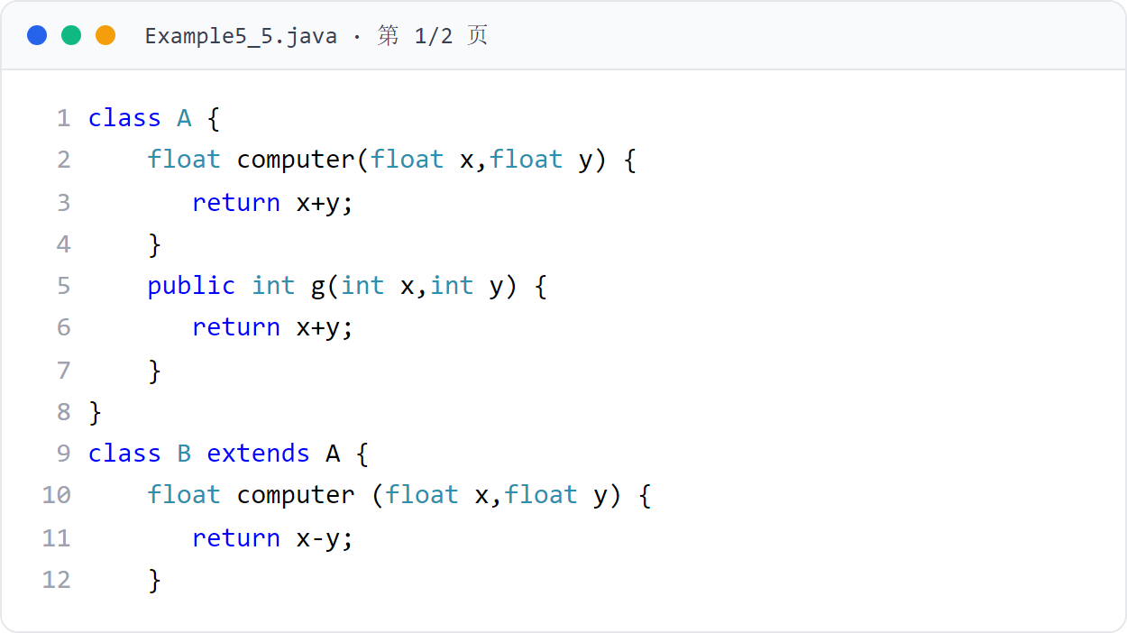
第 5 章 · 子类与继承
Chapter 5 · Subclasses and Inheritance
例子5
Example 5
Example5_5（上）
Example5_5 (Part 1)
B 类重写父类 A 的 computer() 方法，返回类型相同（float）。
Class B overrides the computer() method of parent class A, with the same return type (float).
36 / 87

Slide 37
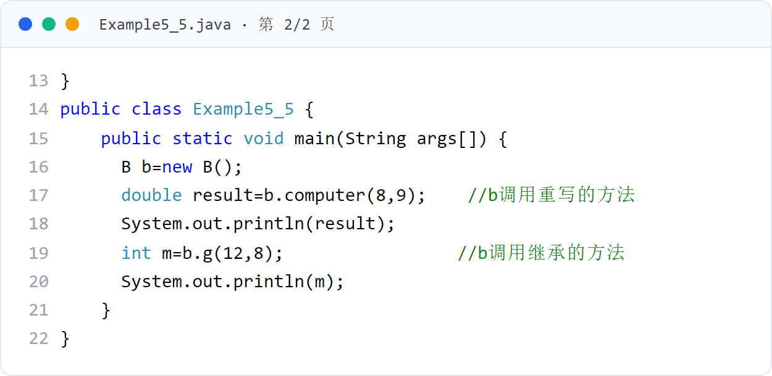
第 5 章 · 子类与继承
Chapter 5 · Subclasses and Inheritance
例子5
Example 5
Example5_5（下）
Example5_5 (Part 2)
b.computer(8,9) 调用重写的方法（8-9）；b.g(12,8) 调用继承的方法（12+8）。
b.computer(8,9) calls the overridden method (8-9); b.g(12,8) calls the inherited method (12+8).
37 / 87

Slide 38
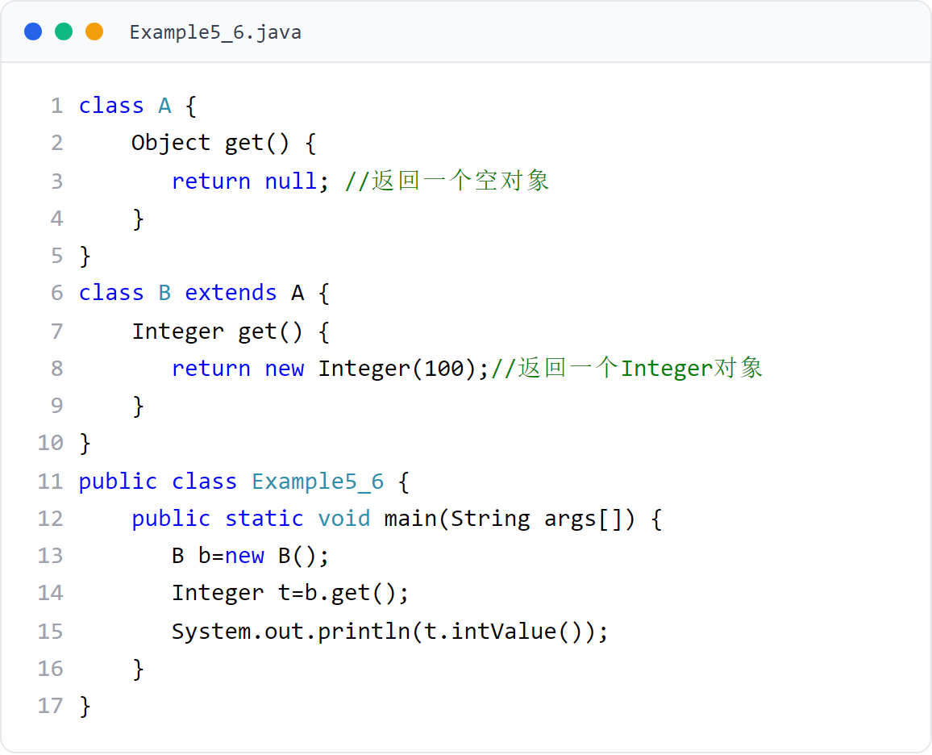
第 5 章 · 子类与继承
Chapter 5 · Subclasses and Inheritance
例子6
Example 6
Example5_6
重写方法的返回类型可以是父类方法返回类型的子类型：Object → Integer。
The return type of an overridden method can be a subtype of the parent class method's return type: Object → Integer.
38 / 87

Slide 39
第 5 章 · 子类与继承
Chapter 5 · Subclasses and Inheritance
§5.5
super 关键字（1）操作被隐藏的成员变量和方法
super keyword (1) operates hidden member variables and methods
子类可以隐藏从父类继承的成员变量和方法
Subclasses can hide member variables and methods inherited from the parent class
在子类中想使用被子类隐藏的成员变量或方法，可以使用关键字 super
If you want to use member variables or methods hidden by the subclass in a subclass, you can use the keyword super
子类可以使用 super 访问被子类隐藏的成员。
Subclasses can use super to access members hidden by the subclass.
super.x、super.play()：访问和调用被子类隐藏的成员变量 x 和方法 play()
super.x, super.play(): access and call member variables x and method play() hidden by subclasses
例子7 中，子类使用 super 访问和调用被子类隐藏的成员变量和方法。
In Example 7, the subclass uses super to access and call member variables and methods hidden by the subclass.
39 / 87

Slide 40
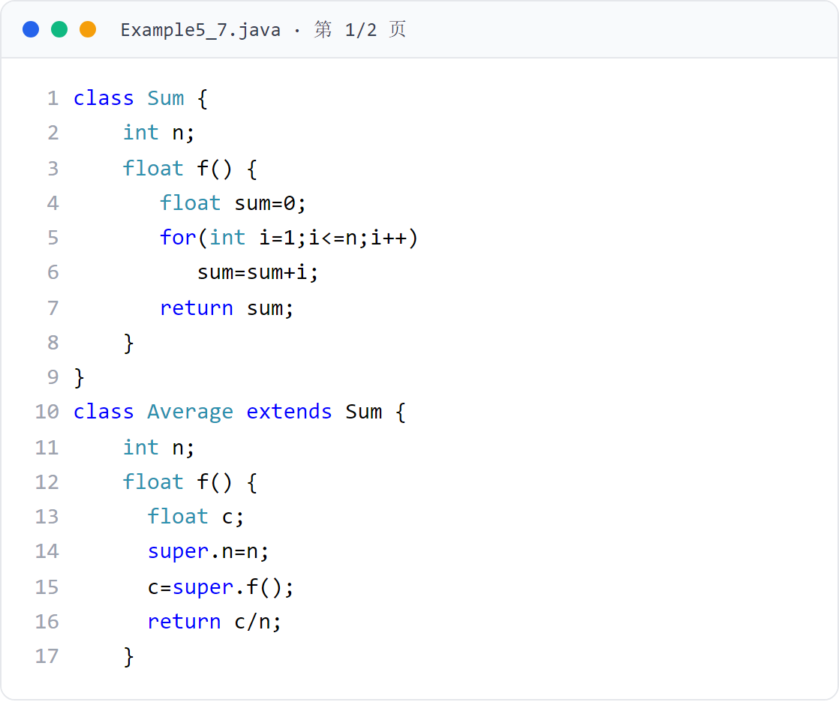
第 5 章 · 子类与继承
Chapter 5 · Subclasses and Inheritance
例子7
Example 7
Example5_7（上）
Example5_7 (Part 1)
Average 隐藏了 Sum 的 n 与 f()，通过 super.n、super.f() 访问父类成员。
Average hides n and f() of Sum, and accesses parent class members through super.n and super.f().
40 / 87

Slide 41
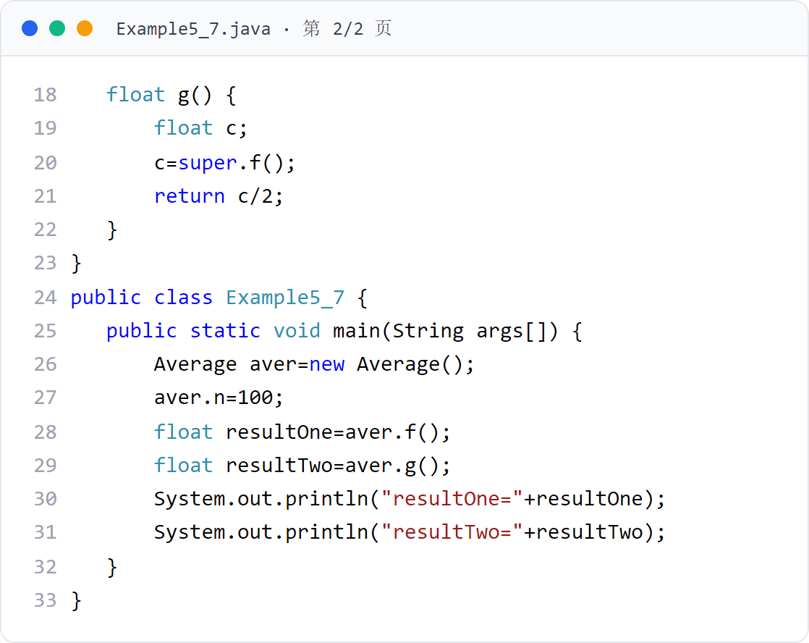
第 5 章 · 子类与继承
Chapter 5 · Subclasses and Inheritance
例子7
Example 7
Example5_7（下）
Example5_7 (Part 2)
super.f() 调用父类 Sum 的 f() 计算和，再除以 n 得平均值。
super.f() calls f() of the parent class Sum to calculate the sum, and then divides it by n to get the average value.
41 / 87
Notes:
[课堂运行示例 / Classroom Demo]
课堂运行：课堂示例代码/第5章/SuperDemo.java
通过 super 调用父类构造方法和被重写方法，观察初始化顺序。
[Sources]
Source concepts: user-provided chapter deck. Demo code: original instructional material.

Slide 42

第 5 章 · 子类与继承
Chapter 5 · Subclasses and Inheritance
例子7 · 运行效果
Example 7 · Operational effect
运行效果（图5.7）
Operation effect (Figure 5.7)
子类使用 super 访问父类被隐藏的成员变量 n 和方法 f()。
The subclass uses super to access the hidden member variable n and method f() of the parent class.
42 / 87

Slide 43
第 5 章 · 子类与继承
Chapter 5 · Subclasses and Inheritance
§5.5
super 关键字（2）调用父类的构造方法
The super keyword (2) calls the constructor of the parent class
子类如果想使用父类的构造方法，必须在子类的构造方法中使用关键字 super 表示
If a subclass wants to use the constructor of the parent class, it must use the keyword super in the constructor of the subclass.
super 必须是子类构造方法中的头一条语句
super must be the first statement in the subclass constructor
子类构造方法没有显式写出 super 时，默认第一条语句是 super()（调用父类无参构造方法）
When the subclass constructor does not explicitly write super, the default first statement is super() (calling the parent class no-argument constructor)
子类不继承父类的构造方法，如需使用必须用 super 调用。
Subclasses do not inherit the constructor of the parent class. If you need to use it, you must call it with super.
显式写出 super 后，编译器不再提供默认的 super 语句
After writing super explicitly, the compiler no longer provides a default super statement
43 / 87

Slide 44
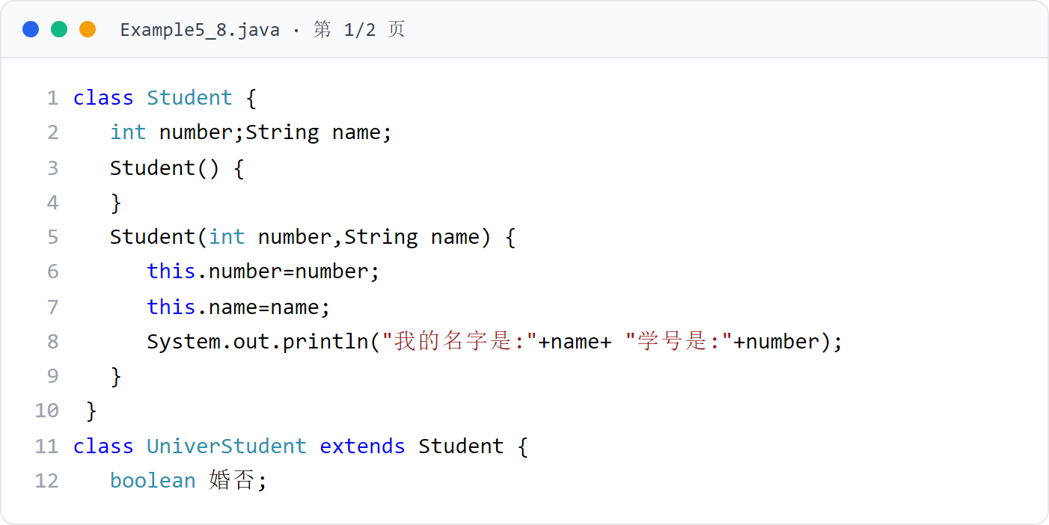
第 5 章 · 子类与继承
Chapter 5 · Subclasses and Inheritance
例子8
Example 8
Example5_8（上）
Example5_8 (Part 1)
Student 有两个构造方法：无参与带参。
Student has two construction methods: no participation and parameters.
44 / 87

Slide 45
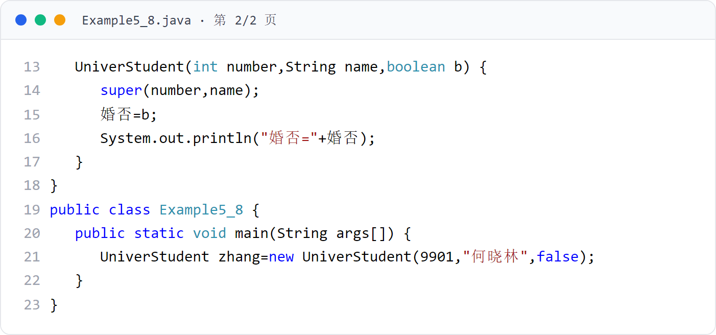
第 5 章 · 子类与继承
Chapter 5 · Subclasses and Inheritance
例子8
Example 8
Example5_8（下）
Example5_8 (Part 2)
UniverStudent 构造方法第一条语句 super(number,name) 调用父类带参构造方法。
The first statement of the UniverStudent constructor, super(number,name), calls the parent class's constructor with parameters.
45 / 87

Slide 46

第 5 章 · 子类与继承
Chapter 5 · Subclasses and Inheritance
例子8 · 运行效果
Example 8 · Operation effect
运行效果（图5.8）
Operation effect (Figure 5.8)
先执行父类构造方法，再执行子类构造方法。
The parent class construction method is executed first, and then the subclass construction method is executed.
46 / 87

Slide 47
第 5 章 · 子类与继承
Chapter 5 · Subclasses and Inheritance
§5.5
super 详解：父类构造方法的调用
Detailed explanation of super: calling the parent class constructor method
父类有带参构造方法
The parent class has a constructor with parameters
父类只有带参构造方法
The parent class only has a constructor with parameters
构造方法用于创建对象并初始化对象，子类对象的创建过程与父类密切相关。
The constructor is used to create and initialize objects. The creation process of subclass objects is closely related to the parent class.
父类拥有不带参数的构造方法 → 子类构造方法自动调用父类无参构造方法完成父类部分的初始化
The parent class has a constructor without parameters → the subclass constructor automatically calls the parent class's parameterless constructor to complete the initialization of the parent class.
子类必须显式使用 super 调用父类的某个带参数构造方法
The subclass must explicitly use super to call a parameterized constructor of the parent class.
super 语句必须放在子类构造方法的第一句
The super statement must be placed in the first sentence of the subclass constructor
好比先按默认方式组装好基础部件，再组装子类特有的部分
It's like assembling the basic components in the default way first, and then assembling the subclass-specific parts.
一个子类构造方法中只能有一条 super 语句，保证父类部分只按一种方式初始化一次
There can only be one super statement in a subclass constructor to ensure that the parent class part is only initialized once in one way.
47 / 87

Slide 48
第 5 章 · 子类与继承
Chapter 5 · Subclasses and Inheritance
§5.6
final 关键字
final keyword
final 可以修饰类、成员变量和方法中的局部变量。
final can modify local variables in classes, member variables and methods.
final 类不能被继承，即不能有子类：final class A { … }
final 修饰父类中的一个方法，这个方法不允许子类重写
final modifies a method in the parent class. This method does not allow subclasses to override it.
成员变量或局部变量被修饰为 final 的，就是常量
Member variables or local variables that are modified as final are constants.
例子9 使用了 final 关键字。
Example 9 uses the final keyword.
48 / 87

Slide 49
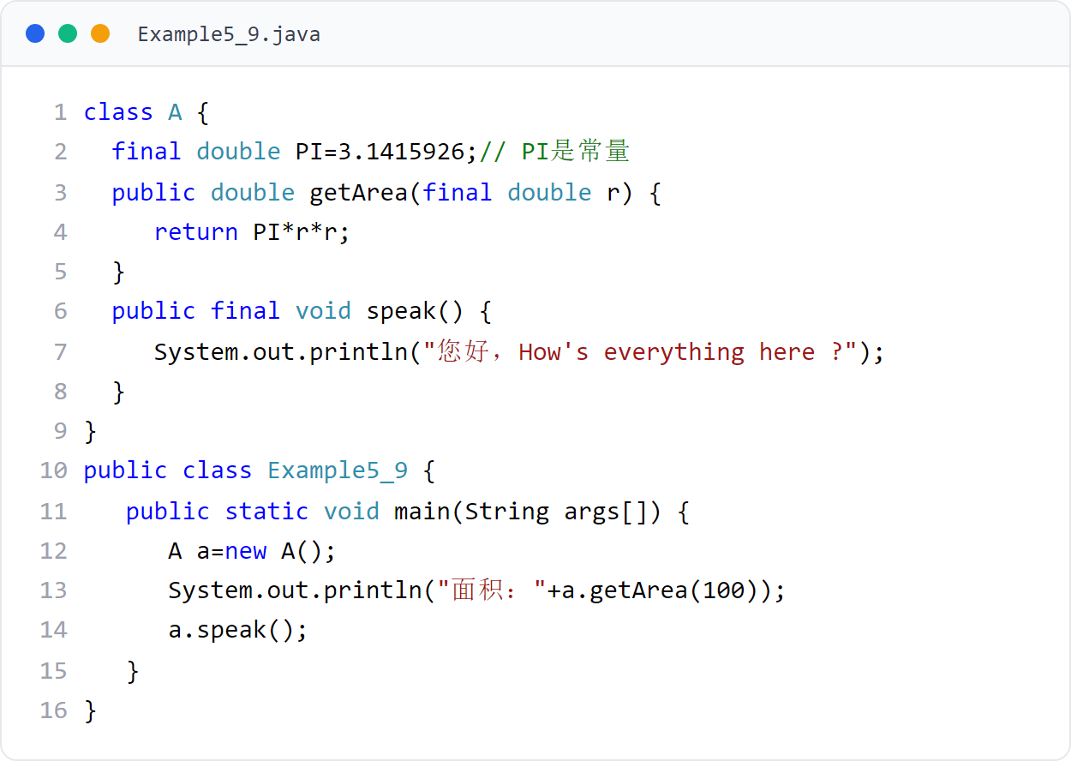
第 5 章 · 子类与继承
Chapter 5 · Subclasses and Inheritance
例子9
Example 9
Example5_9
final double PI 是常量；final 方法 speak() 不允许子类重写；final 形参 r 不可修改。
final double PI is a constant; the final method speak() does not allow subclasses to override; the final formal parameter r cannot be modified.
49 / 87

Slide 50
第 5 章 · 子类与继承
Chapter 5 · Subclasses and Inheritance
§5.7
对象的上转型对象
upcast object
人们说 “老虎是动物”“狗是动物”，当说老虎是动物时，老虎失掉了老虎独有的属性和功能，这属于上溯思维
People say "tiger is an animal" and "dog is an animal". When saying that a tiger is an animal, the tiger loses its unique attributes and functions. This is backward thinking.
把子类对象的引用放到父类的对象中，得到的对象称上转型对象。
Put the reference of the subclass object into the object of the parent class, and the resulting object is called a transformation object.
假设 A 类是 B 类的父类，用子类 B 创建一个对象，并把这个对象的引用放到父类 A 的对象 a 中，称对象 a 是对象 b 的上转型对象
Assume that class A is the parent class of class B, create an object using subclass B, and put the reference of this object into object a of parent class A, and call object a an upcast object of object b.
A a;
a = new B();
// 或
// or
B b = new B();
a = b;
50 / 87

Slide 51
第 5 章 · 子类与继承
Chapter 5 · Subclasses and Inheritance
§5.7
上转型对象的使用
Use of upcast objects
不能
cannot
可以
Can
上转型对象的使用规则（4 条）。
Rules for using upcast objects (4 items).
不能操作子类新增的成员变量
Cannot operate member variables added by subclasses
访问子类继承或隐藏的成员变量
Access inherited or hidden member variables of subclasses
不能调用子类新增的方法
Methods added by subclasses cannot be called
调用子类继承的方法或子类重写的实例方法
Call methods inherited by subclasses or instance methods overridden by subclasses
子类重写了父类的实例方法，用上转型对象调用时一定是子类重写的方法
The subclass overrides the instance method of the parent class. When called using the transformation object, it must be the method rewritten by the subclass.
子类重写了父类的静态方法，上转型对象只能调用父类的静态方法
The subclass overrides the static method of the parent class, and the up-transformed object can only call the static method of the parent class.
例子10 中，monkey 是 People 类型对象的上转型对象。
In Example 10, monkey is an upcast object of People type object.
51 / 87

Slide 52
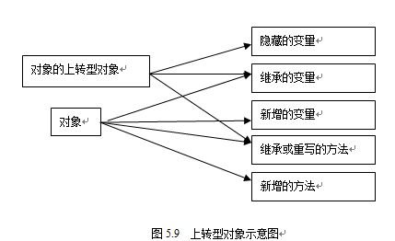
第 5 章 · 子类与继承
Chapter 5 · Subclasses and Inheritance
§5.7
上转型对象示例（图5.10）
Example of upward transformation object (Figure 5.10)
monkey 是 People 类型对象的上转型对象，调用重写方法：输出 ***I love this game ***。
monkey is an upcast object of People type object, calling the overridden method: output ***I love this game ***.
52 / 87

Slide 53
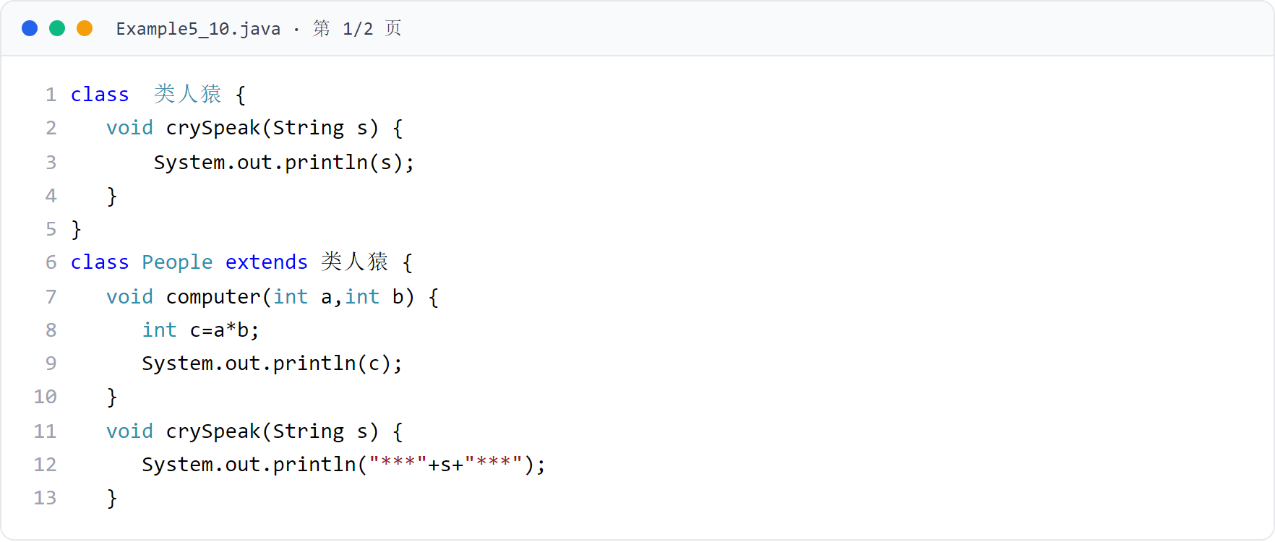
第 5 章 · 子类与继承
Chapter 5 · Subclasses and Inheritance
例子10
Example 10
Example5_10（上）
Example5_10 (Part 1)
People 继承类人猿并重写 crySpeak()，monkey 是 geng 的上转型对象。
People inherits monkey and overrides crySpeak(), monkey is the upcast object of geng.
53 / 87
Notes:
[课堂运行示例 / Classroom Demo]
课堂运行：课堂示例代码/第5章/PolymorphismDemo.java
把不同子类对象放入父类数组，循环调用同一个 speak() 方法。
[Sources]
Source concepts: user-provided chapter deck. Demo code: original instructional material.

Slide 54
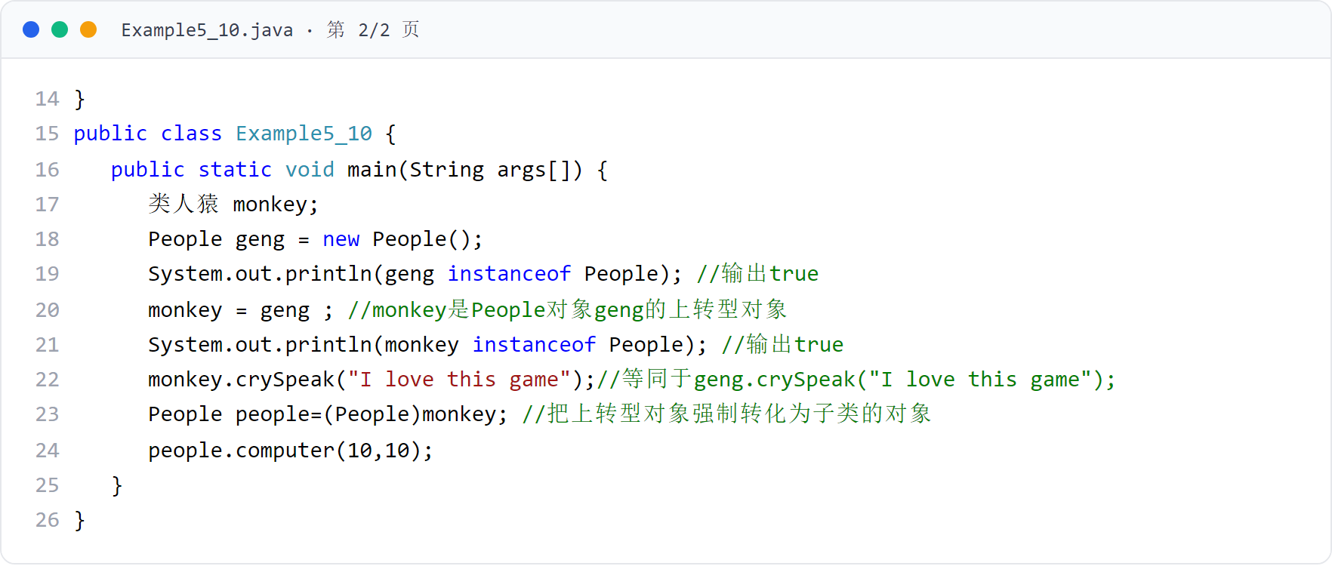
第 5 章 · 子类与继承
Chapter 5 · Subclasses and Inheritance
例子10
Example 10
Example5_10（下）
Example5_10 (Part 2)
上转型对象调用重写的实例方法；强制转化 (People)monkey 后调用子类新增方法。
Upcast the object to call the overridden instance method; call the new method of the subclass after forcing conversion to (People)monkey.
54 / 87

Slide 55
第 5 章 · 子类与继承
Chapter 5 · Subclasses and Inheritance
§5.8
继承与多态
Inheritance and Polymorphism
“哺乳动物有很多种叫声”：吼、嚎、汪汪、喵喵，这就是叫声的多态
"Mammals have many kinds of sounds": roar, howl, woof, meow, this is the polymorphism of sounds
多态性是指父类的某个方法被其子类重写时，可以各自产生自己的功能行为。
Polymorphism means that when a method of the parent class is overridden by its subclass, each can produce its own functional behavior.
一个类有很多子类，且这些子类都重写了父类中的某个实例方法
A class has many subclasses, and these subclasses all override an instance method in the parent class
把子类创建的对象的引用放到父类的对象中，得到上转型对象，它调用这个实例方法时就可能具有多种形态
Put the reference of the object created by the subclass into the object of the parent class to get the up-transformed object. It may have multiple forms when it calls this instance method.
狗类的上转型对象调用 “叫声” 产生 “汪汪”，猫类的上转型对象产生 “喵喵”
The upcast object of the dog class calls "bark" to produce "woof", and the upcast object of the cat class produces "meow".
例子11 展示了多态。
Example 11 demonstrates polymorphism.
55 / 87

Slide 56
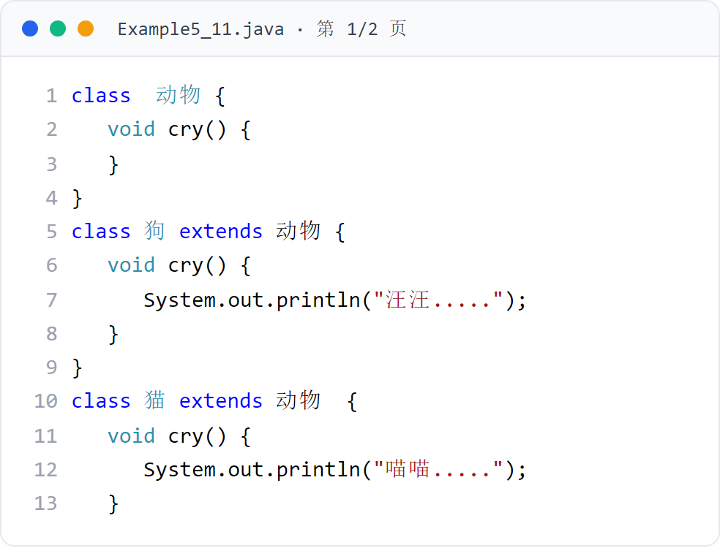
第 5 章 · 子类与继承
Chapter 5 · Subclasses and Inheritance
例子11
Example 11
Example5_11（上）
Example5_11 (Part 1)
动物、狗、猫三个类，狗和猫重写 cry()。
There are three categories: animals, dogs, and cats. Dogs and cats override cry().
56 / 87

Slide 57
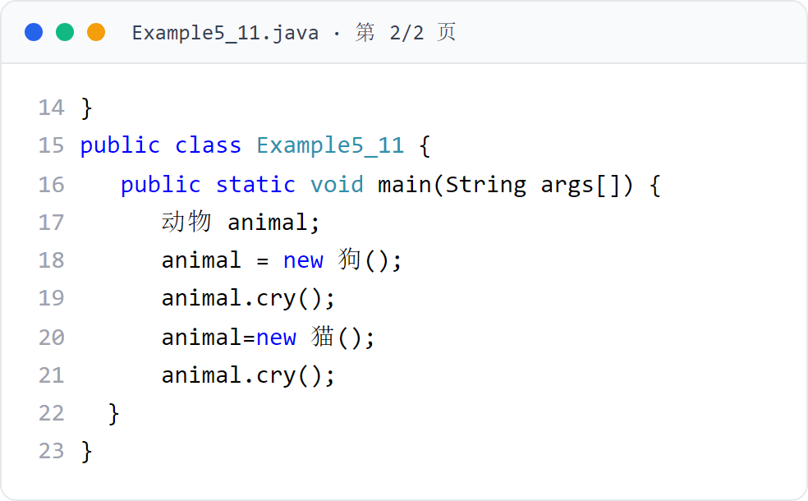
第 5 章 · 子类与继承
Chapter 5 · Subclasses and Inheritance
例子11
Example 11
Example5_11（下）
Example5_11 (Part 2)
同一上转型对象 animal，先后指向狗与猫，cry() 呈现不同行为。
The same transformed object animal points to dog and cat successively, and cry() shows different behaviors.
57 / 87

Slide 58

第 5 章 · 子类与继承
Chapter 5 · Subclasses and Inheritance
例子11 · 运行效果
Example 11 · Operation effect
运行效果（图5.11）
Operation effect (Figure 5.11)
同一上转型对象 animal 指向不同子类，调用重写方法呈现不同形态。
The same transformed object animal points to different subclasses, and the overridden method is called to take on different forms.
58 / 87

Slide 59
第 5 章 · 子类与继承
Chapter 5 · Subclasses and Inheritance
§5.9
abstract 类与 abstract 方法
abstract classes and abstract methods
abstract 类里可以有 abstract 方法，也可以没有
An abstract class may or may not have abstract methods.
abstract 方法只允许声明，不允许实现，不允许使用 final 修饰
Abstract methods are only allowed to be declared, not implemented, and final modification is not allowed.
用关键字 abstract 修饰的类称为 abstract 类（抽象类），修饰的方法称为 abstract 方法（抽象方法）。
A class modified with the keyword abstract is called an abstract class (abstract class), and the modified method is called an abstract method (abstract method).
abstract 类不能使用 new 运算符创建该类的对象，只能产生其子类，由子类创建对象
An abstract class cannot use the new operator to create objects of this class. It can only generate its subclasses and create objects from subclasses.
如果一个类是 abstract 类的子类，它必须具体实现父类的所有 abstract 方法
If a class is a subclass of an abstract class, it must concretely implement all abstract methods of the parent class
abstract class A { … }
abstract int min(int x,int y);
59 / 87

Slide 60
第 5 章 · 子类与继承
Chapter 5 · Subclasses and Inheritance
§5.9
理解抽象类
Understand abstract classes
关键点 1
Key point 1
关键点 2
Key point 2
抽象类可以抽象出重要的行为标准，该行为标准用抽象方法表示
Abstract classes can abstract important behavioral standards, which are represented by abstract methods
抽象类声明的对象可以成为其子类对象的上转型对象
Objects declared by abstract classes can become upcast objects of their subclass objects.
理解抽象类的两个关键点。
Two key points to understand abstract classes.
抽象类封装了子类必须要有的行为标准
Abstract classes encapsulate the behavioral standards that subclasses must have
调用子类重写的方法，体现子类根据抽象类里的行为标准给出的具体行为
Call the method overridden by the subclass to reflect the specific behavior given by the subclass according to the behavioral standards in the abstract class
行为标准仅仅是方法的名字、方法的类型而已：人具有 run、speak 行为，但不要说 speak 是用英语还是中文说话。抽象方法的具体实现由子类完成。
The behavioral standard is just the name of the method and the type of the method: people have the behavior of run and speak, but don't say whether speak is in English or Chinese. The specific implementation of abstract methods is completed by subclasses.
开发者可以把主要精力放在行为标准上（不用关心行为细节），节省时间，利于设计易维护、易扩展的程序（见 §5.10 节）。
Developers can focus on behavioral standards (without caring about behavioral details), save time, and help design programs that are easy to maintain and expand (see Section 5.10).
60 / 87

Slide 61
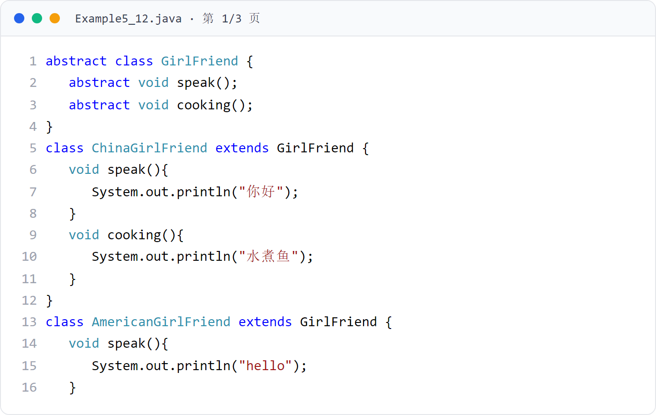
第 5 章 · 子类与继承
Chapter 5 · Subclasses and Inheritance
例子12
Example 12
Example5_12（上）
Example5_12 (Part 1)
抽象类 GirlFriend 封装两个行为标准：speak()、cooking()。
The abstract class GirlFriend encapsulates two behavioral standards: speak() and cooking().
61 / 87
Notes:
[课堂运行示例 / Classroom Demo]
课堂运行：课堂示例代码/第5章/AbstractClassDemo.java
定义抽象 Shape 与两个具体子类，比较统一接口下的面积计算。
[Sources]
Source concepts: user-provided chapter deck. Demo code: original instructional material.

Slide 62
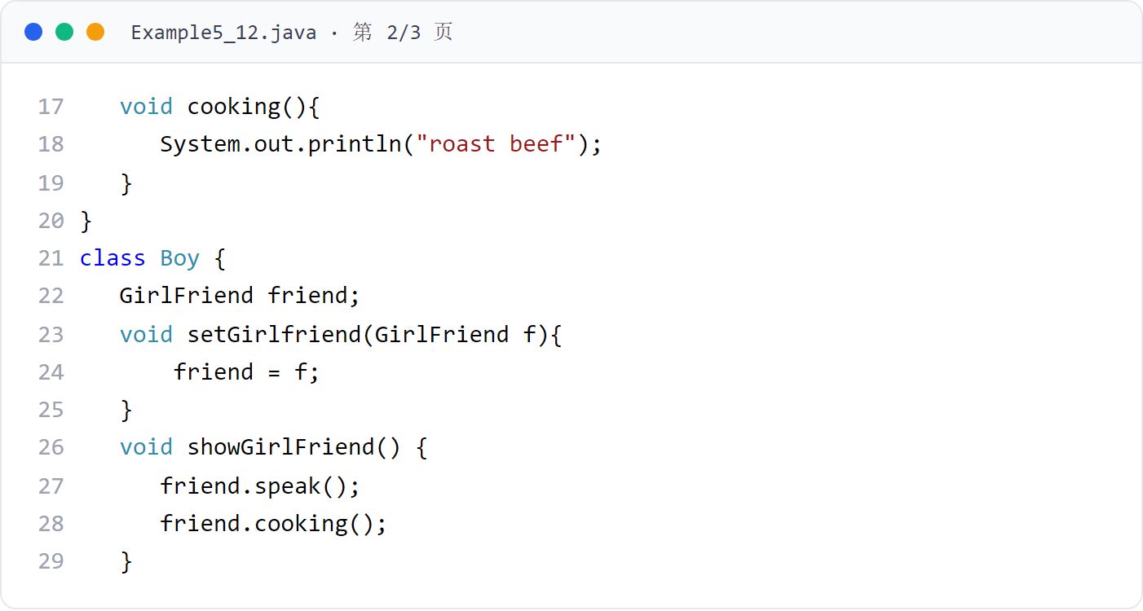
第 5 章 · 子类与继承
Chapter 5 · Subclasses and Inheritance
例子12
Example 12
Example5_12（中）
Example5_12 (middle)
ChinaGirlFriend 与 AmericanGirlFriend 具体实现行为标准。
ChinaGirlFriend and AmericanGirlFriend implement behavioral standards specifically.
62 / 87

Slide 63
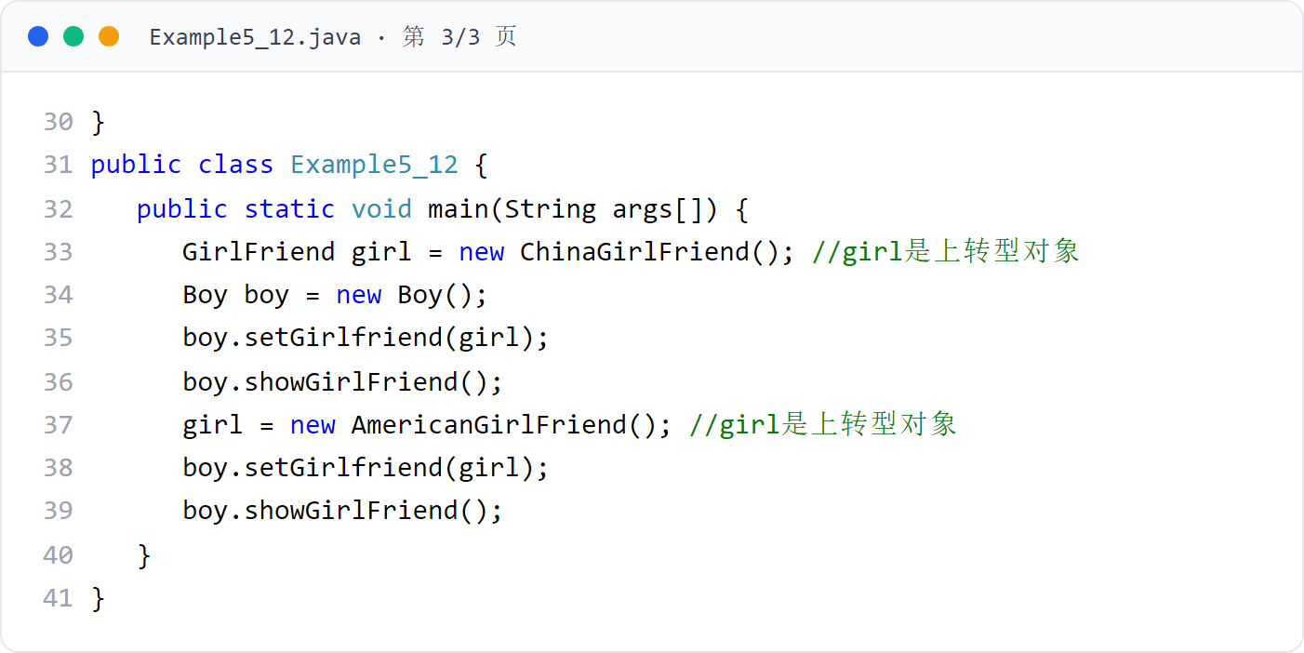
第 5 章 · 子类与继承
Chapter 5 · Subclasses and Inheritance
例子12
Example 12
Example5_12（下）
Example5_12 (Part 2)
Boy 面向抽象类 GirlFriend 编程，girl 是上转型对象。
Boy is programmed for the abstract class GirlFriend, and girl is an upcast object.
63 / 87

Slide 64
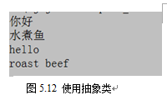
第 5 章 · 子类与继承
Chapter 5 · Subclasses and Inheritance
例子12 · 运行效果
Example 12 · Operation effect
运行效果（图5.12）
Operation effect (Figure 5.12)
同一个 girl 引用指向不同的具体类，调用行为标准产生不同实现。
The same girl reference points to different concrete classes, and calling behavioral standards produces different implementations.
64 / 87

Slide 65
第 5 章 · 子类与继承
Chapter 5 · Subclasses and Inheritance
§5.10
面向抽象编程
Programming towards abstraction
先声明一个 abstract 类，声明若干个 abstract 方法，表明这些方法在系统设计中的重要性，方法体内容细节由非 abstract 子类完成
First declare an abstract class and several abstract methods to indicate the importance of these methods in system design. The details of the method body content are completed by non-abstract subclasses.
设计重要类时，不让该类面向具体的类，而是面向抽象类。
When designing an important class, make the class not oriented toward concrete classes, but toward abstract classes.
然后利用多态实现编程：使用方法重写和上转型对象，将 abstract 类声明的对象作为其子类的上转型对象，调用子类重写的方法
Then use polymorphism to implement programming: use method rewriting and upcasting objects, use the object declared by the abstract class as the upcasting object of its subclass, and call the method rewritten by the subclass
面向抽象编程：所设计类中的重要数据是抽象类声明的对象，而不是具体类声明的对象
Abstraction-oriented programming: The important data in the designed class is the object declared by the abstract class, not the object declared by the concrete class
例题：Pillar 类面向抽象类 Geometry，Circle 和 Rectangle 都是 Geometry 的子类，Application 可以用 Pillar 创建出矩形底或圆形底的柱体。
Example: The Pillar class faces the abstract class Geometry. Circle and Rectangle are both subclasses of Geometry. Application can use Pillar to create a cylinder with a rectangular base or a circular base.
65 / 87

Slide 66
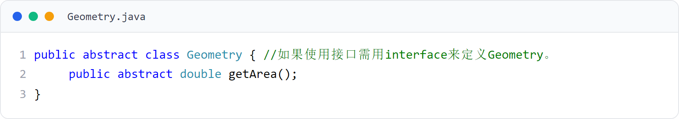
第 5 章 · 子类与继承
Chapter 5 · Subclasses and Inheritance
§5.10 例题
§5.10 Example questions
Geometry 抽象类
Geometry abstract class
声明行为标准 getArea()，不实现。
Declares behavioral standard getArea(), not implemented.
66 / 87

Slide 67
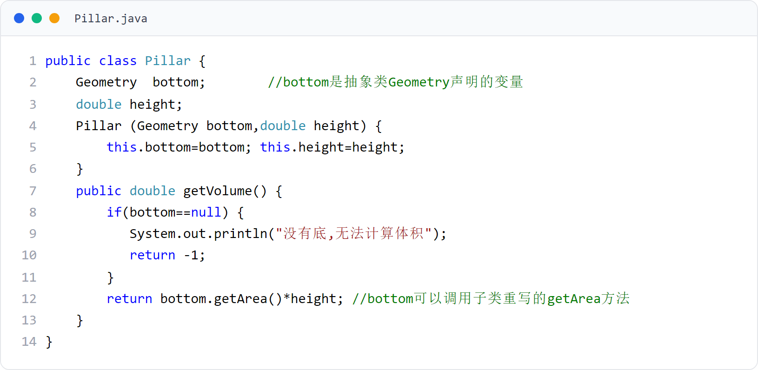
第 5 章 · 子类与继承
Chapter 5 · Subclasses and Inheritance
§5.10 例题
§5.10 Example questions
Pillar 类
Pillar class
Pillar 面向抽象类 Geometry：bottom 是抽象类声明的变量，调用 bottom.getArea()。
Pillar is oriented to the abstract class Geometry: bottom is a variable declared by the abstract class and calls bottom.getArea().
67 / 87

Slide 68
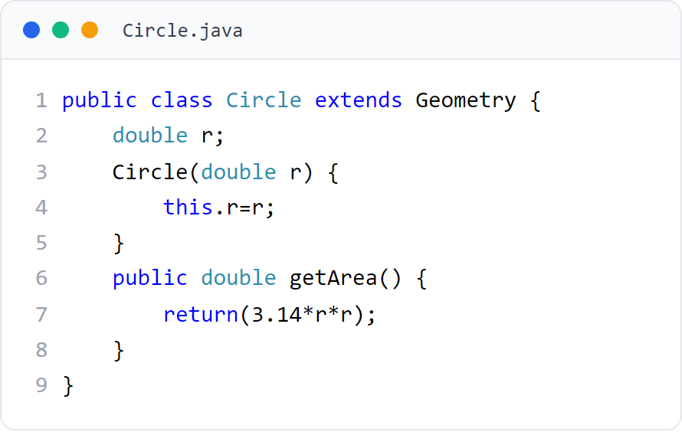
第 5 章 · 子类与继承
Chapter 5 · Subclasses and Inheritance
§5.10 例题
§5.10 Example questions
Circle 类
Circle class
Circle 是 Geometry 的子类，实现 getArea() 计算圆面积。
Circle is a subclass of Geometry that implements getArea() to calculate the area of ​​a circle.
68 / 87

Slide 69
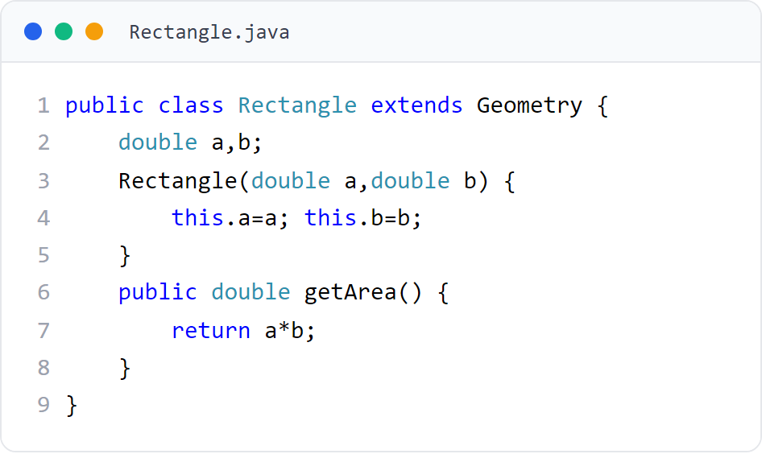
第 5 章 · 子类与继承
Chapter 5 · Subclasses and Inheritance
§5.10 例题
§5.10 Example questions
Rectangle 类
Rectangle class
Rectangle 是 Geometry 的子类，实现 getArea() 计算矩形面积。
Rectangle is a subclass of Geometry that implements getArea() to calculate the area of ​​a rectangle.
69 / 87

Slide 70
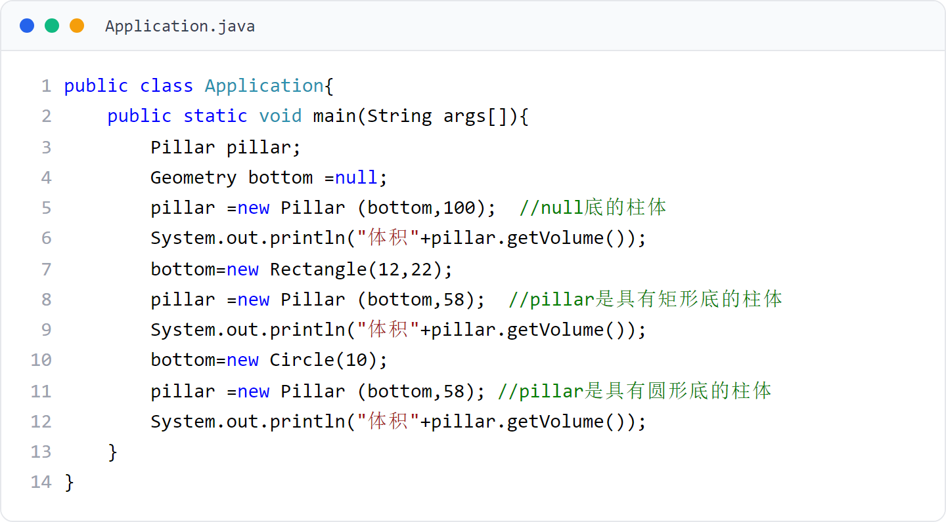
第 5 章 · 子类与继承
Chapter 5 · Subclasses and Inheritance
§5.10 例题
§5.10 Example questions
Application（主类）
Application (main class)
用 Pillar 创建 null 底、矩形底、圆形底三种柱体。
Use Pillar to create three types of cylinders: null base, rectangular base, and circular base.
70 / 87

Slide 71
第 5 章 · 子类与继承
Chapter 5 · Subclasses and Inheritance
§5.11
开-闭原则
open-closed principle
Open-Closed Principle：系统应当对扩展开放，对修改关闭。
Open-Closed Principle: The system should be open for extension and closed for modification.
在设计系统时，首先考虑用户需求的变化，将应对用户变化的部分设计为对扩展开放
When designing the system, first consider the changes in user needs, and design the parts that respond to user changes to be open to expansion.
设计的核心部分是经过精心考虑后确定下来的基本结构，这部分应当是对修改关闭的，不能因为用户需求的变化而再发生变化
The core part of the design is the basic structure determined after careful consideration. This part should be closed to modification and cannot be changed due to changes in user needs.
如果系统的设计遵守了 “开-闭原则”，系统一定易维护：增加新模块时，不必修改系统中的核心模块
If the design of the system follows the "open-close principle", the system must be easy to maintain: when adding new modules, there is no need to modify the core modules in the system
71 / 87

Slide 72
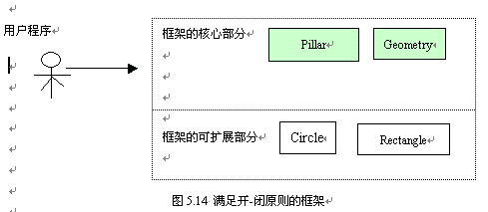
第 5 章 · 子类与继承
Chapter 5 · Subclasses and Inheritance
§5.11
框架满足 “开-闭” 原则，相对用户需求容易维护
The framework meets the "open-closed" principle and is easy to maintain relative to user needs.
结合 5.10 例题说明开-闭原则
Explain the open-closed principle with examples from 5.10
当用户程序需要使用 Pillar 创建三角形底的柱体时，只需在框架中增加一个 Geometry 的 Triangle 子类
When the user program needs to use Pillar to create a cylinder with a triangular base, it only needs to add a Triangle subclass of Geometry to the framework.
无需修改框架中的其他类
No need to modify other classes in the framework
Pillar、Geometry、Circle、Rectangle 构成一个小开发框架，Application 是使用框架的用户程序。
Pillar, Geometry, Circle, and Rectangle constitute a small development framework, and Application is the user program that uses the framework.
72 / 87

Slide 73
第 5 章 · 子类与继承
Chapter 5 · Subclasses and Inheritance
§5.12
应用举例：手机与 SIM 卡
Application examples: mobile phones and SIM cards
1．问题的分析
1. Analysis of the problem
2．设计抽象类
2. Design abstract class
3．设计手机类
3． Design mobile phones
手机不固定绑定某一家运营商，而是可以更换 SIM 卡
The mobile phone is not bound to a certain operator, but the SIM card can be changed
SIM 是抽象类，声明 setNumber()、giveNumber()、giveCorpName() 三个行为标准
SIM is an abstract class that declares three behavioral standards: setNumber(), giveNumber(), and giveCorpName()
MobileTelephone 面向抽象类 SIM 编程：card 是 SIM 类型变量
MobileTelephone is oriented to abstract class SIM programming: card is a SIM type variable
手机类面向 “SIM 卡” 这个抽象概念编程
The mobile phone class is programmed for the abstract concept of "SIM card"
用类封装手机的基本属性和功能，要求手机既可以使用移动公司的 SIM 卡，也可以使用联通公司的 SIM 卡（可以使用任何公司提供的 SIM 卡）。
Use classes to encapsulate the basic attributes and functions of mobile phones, requiring that the mobile phones can use either the SIM card of China Mobile or the SIM card of China Unicom (the SIM card provided by any company can be used).
useSIM() 更换 SIM 卡，showMess() 显示卡的信息
useSIM() replaces the SIM card, showMess() displays card information
SIMOfChinaMobile、SIMOfChinaUnicom 分别实现
SIMOfChinaMobile and SIMOfChinaUnicom are implemented respectively
例子13 中的类：MobileTelephone、SIM、SIMOfChinaMobile、SIMOfChinaUnicom、Application。
Classes in Example 13: MobileTelephone, SIM, SIMOfChinaMobile, SIMOfChinaUnicom, Application.
73 / 87

Slide 74
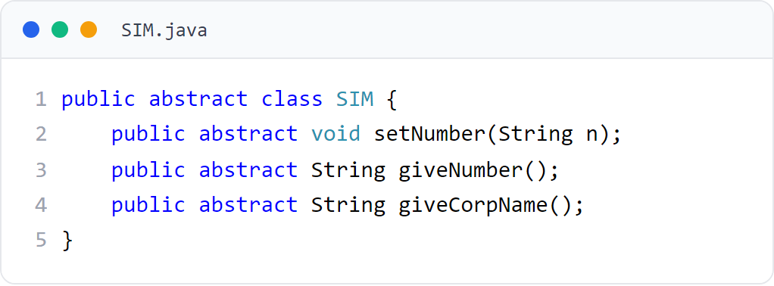
第 5 章 · 子类与继承
Chapter 5 · Subclasses and Inheritance
例子13
Example 13
SIM 抽象类
SIM abstract class
声明三个行为标准，定义 “任何公司提供的 SIM 卡”。
State three standards of conduct that define "any company-provided SIM card."
74 / 87

Slide 75
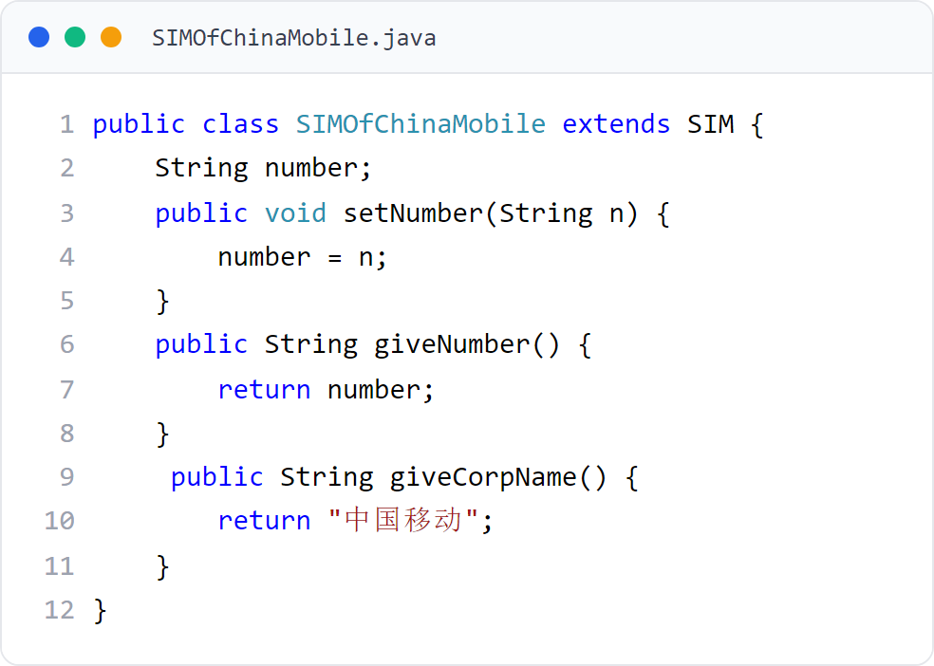
第 5 章 · 子类与继承
Chapter 5 · Subclasses and Inheritance
例子13
Example 13
SIMOfChinaMobile 类
SIMOfChinaMobile class
中国移动 SIM 卡，实现行为标准，giveCorpName() 返回 “中国移动”。
China Mobile SIM card, implements behavioral standards, giveCorpName() returns "China Mobile".
75 / 87

Slide 76
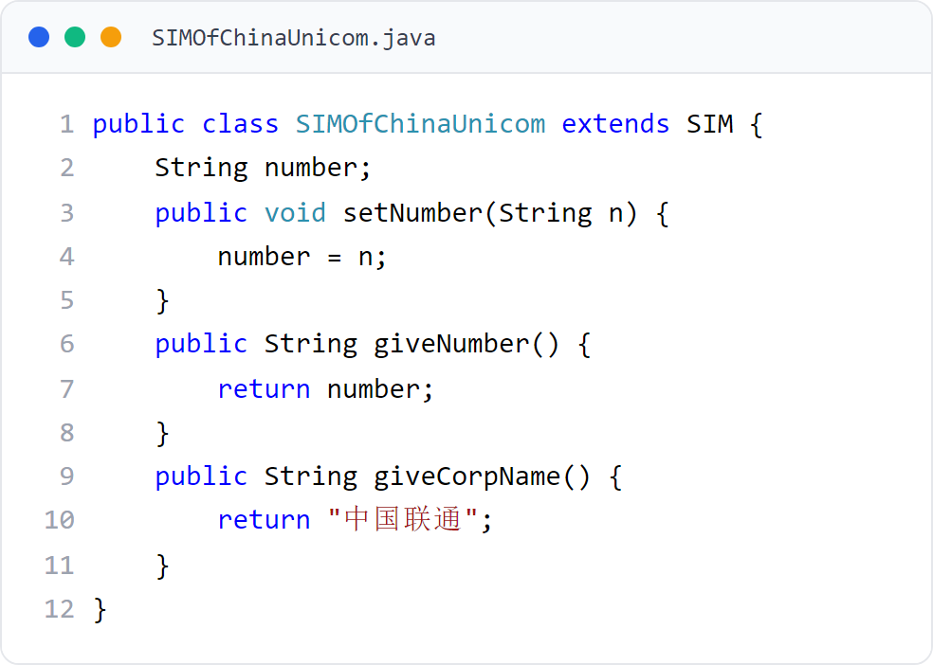
第 5 章 · 子类与继承
Chapter 5 · Subclasses and Inheritance
例子13
Example 13
SIMOfChinaUnicom 类
SIMOfChinaUnicom class
中国联通 SIM 卡，实现行为标准，giveCorpName() 返回 “中国联通”。
China Unicom SIM card, implements behavioral standards, giveCorpName() returns "China Unicom".
76 / 87

Slide 77
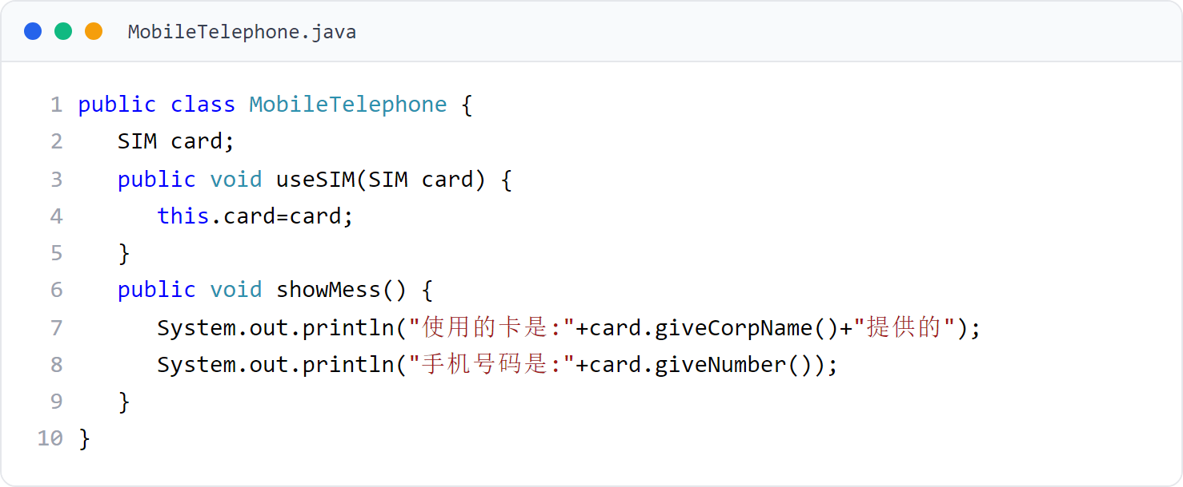
第 5 章 · 子类与继承
Chapter 5 · Subclasses and Inheritance
例子13
Example 13
MobileTelephone 类
MobileTelephone class
手机面向抽象类 SIM 编程：card 是 SIM 类型，useSIM() 换卡，showMess() 显示卡信息。
The mobile phone is programmed for the abstract class SIM: card is the SIM type, useSIM() changes the card, and showMess() displays the card information.
77 / 87

Slide 78
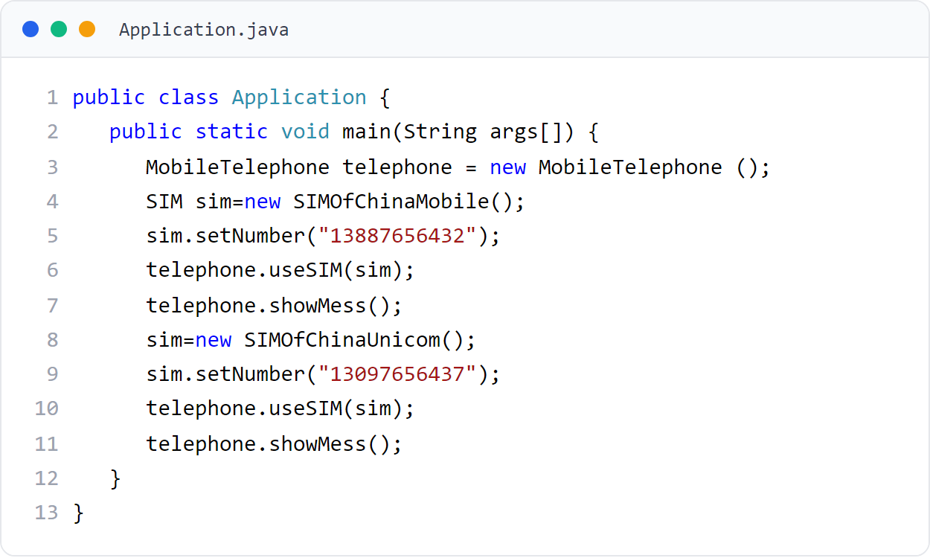
第 5 章 · 子类与继承
Chapter 5 · Subclasses and Inheritance
例子13
Example 13
Application（主类）
Application (main class)
先后插入移动卡与联通卡并显示信息。
Insert the mobile card and China Unicom card successively and display the information.
78 / 87

Slide 79
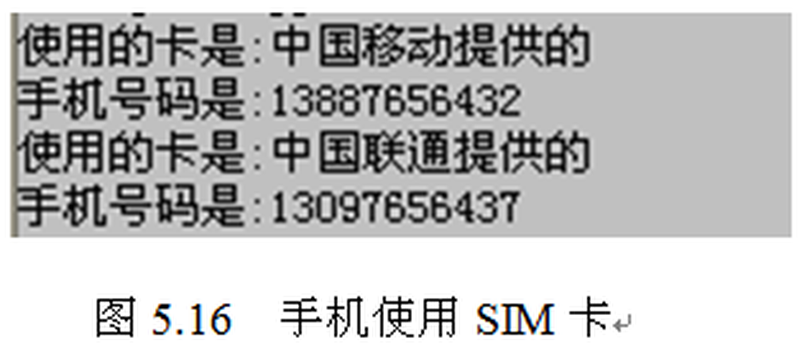
第 5 章 · 子类与继承
Chapter 5 · Subclasses and Inheritance
例子13 · 运行效果
Example 13 · Operational effect
运行效果（图5.16）
Operation effect (Figure 5.16)
同一部手机更换不同运营商的 SIM 卡，分别显示中国移动与中国联通提供的号码。
If the same mobile phone is replaced with SIM cards of different operators, the numbers provided by China Mobile and China Unicom will be displayed respectively.
79 / 87

Slide 80
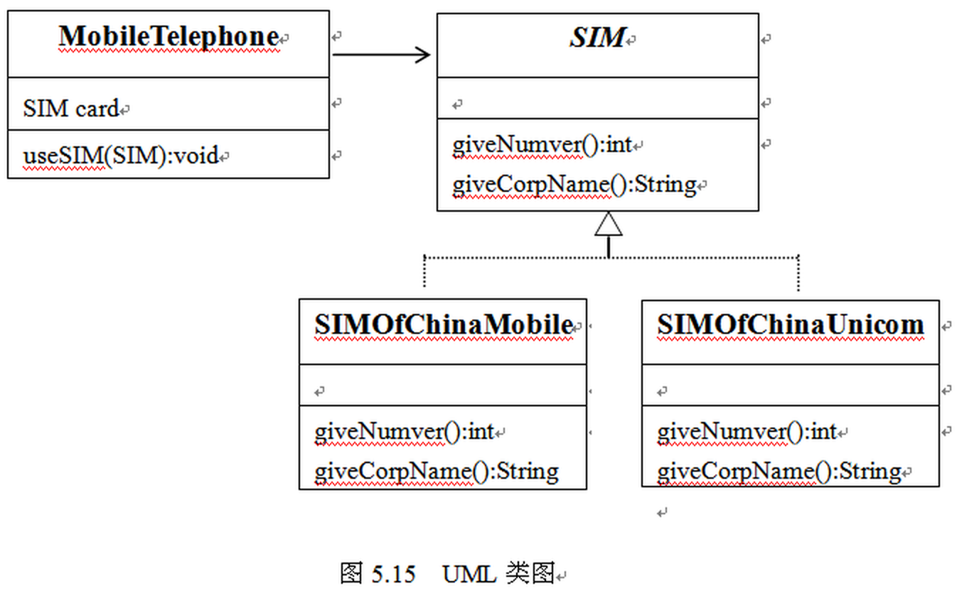
第 5 章 · 子类与继承
Chapter 5 · Subclasses and Inheritance
例子13
Example 13
例子13：UML 类图（图5.15）
Example 13: UML class diagram (Figure 5.15)
MobileTelephone 引用抽象类 SIM 作为成员；SIM 声明行为标准；SIMOfChinaMobile 与 SIMOfChinaUnicom 为具体实现。
MobileTelephone references the abstract class SIM as a member; SIM declares behavioral standards; SIMOfChinaMobile and SIMOfChinaUnicom are concrete implementations.
80 / 87

Slide 81
第 5 章 · 子类与继承
Chapter 5 · Subclasses and Inheritance
总结
Summarize
本章总结
Chapter summary
继承是一种由已有的类创建新类的机制
Inheritance is a mechanism for creating new classes from existing classes
子类继承父类的成员变量与成员方法
Subclasses inherit member variables and member methods of the parent class
继承是面向对象编程的重要特性。
Inheritance is an important feature of object-oriented programming.
子类继承过程中可以实现变量隐藏与方法重写
Variable hiding and method rewriting can be achieved during subclass inheritance.
上转型对象可以访问子类继承或隐藏的成员变量，也可以调用子类继承的方法或子类重写的实例方法
Upcast objects can access member variables inherited or hidden by subclasses, and can also call methods inherited by subclasses or instance methods overridden by subclasses.
多态：子类可以根据各自的需要重写父类的某个方法，通过方法的重写把父类的状态和行为改变为自身的状态和行为
Polymorphism: Subclasses can override a method of the parent class according to their own needs, and change the state and behavior of the parent class to their own state and behavior through method rewriting.
熟练使用上转型对象以及面向抽象编程的思想，体现程序设计所提倡的 “开-闭” 原则
Proficient in the use of upcast objects and abstract-oriented programming ideas, embodying the "open-closed" principle advocated by programming
81 / 87

Slide 82
第 5 章 · 子类与继承
Chapter 5 · Subclasses and Inheritance
作业
Homework
作业
Homework
按时完成老师布置的作业。
Complete the homework assigned by the teacher on time.
教材提供了题库练习系统（见前言二维码）
The textbook provides a question bank practice system (see the QR code in the preface)
动手实践：完成本章全部例子，体会继承、重写与多态
Hands-on practice: complete all the examples in this chapter and experience inheritance, overriding and polymorphism
82 / 87

Slide 83
第 5 章 · 子类与继承
Chapter 5 · Subclasses and Inheritance
编程题 1
Programming Task 1
学生继承父类
Student inherits from a parent class
定义 Person(name, age)，再定义 Student 继承 Person 并增加 studentId。
Define Person(name, age), then let Student extend it with studentId.
在 Student 中编写 showInfo()，输出继承字段和新增字段。
Add showInfo() in Student to print inherited and new fields.
文件名：PersonStudentInheritancePractice.java
File: PersonStudentInheritancePractice.java
83 / 87
Notes:
[编程题参考答案 / Reference Solution]
class PersonAnswer {
protected String name;
protected int age;
PersonAnswer(String name, int age) { this.name = name; this.age = age; }
}
class StudentAnswer extends PersonAnswer {
private String studentId;
StudentAnswer(String name, int age, String studentId) { super(name, age); this.studentId = studentId; }
void showInfo() { System.out.println(name + ", " + age + ", " + studentId); }
}
public class PersonStudentInheritancePracticeAnswer {
public static void main(String[] args) { new StudentAnswer("Li Ming", 19, "S1001").showInfo(); }
}
[Sources]
Original instructional exercise and solution.

Slide 84
第 5 章 · 子类与继承
Chapter 5 · Subclasses and Inheritance
编程题 2
Programming Task 2
重写工资计算方法
Override a salary calculation method
Employee 的 salary() 返回基本工资；Manager 重写后加入奖金。
Employee.salary() returns base pay; Manager overrides it to add a bonus.
分别用 Employee 和 Manager 对象调用 salary() 并比较结果。
Call salary() on Employee and Manager objects and compare results.
文件名：OverrideSalaryPractice.java
File: OverrideSalaryPractice.java
84 / 87
Notes:
[编程题参考答案 / Reference Solution]
class EmployeeAnswer {
protected double basePay;
EmployeeAnswer(double basePay) { this.basePay = basePay; }
double salary() { return basePay; }
}
class ManagerAnswer extends EmployeeAnswer {
private double bonus;
ManagerAnswer(double basePay, double bonus) { super(basePay); this.bonus = bonus; }
@Override double salary() { return super.salary() + bonus; }
}
public class OverrideSalaryPracticeAnswer {
public static void main(String[] args) {
System.out.println(new EmployeeAnswer(6000).salary());
System.out.println(new ManagerAnswer(6000, 2000).salary());
}
}
[Sources]
Original instructional exercise and solution.

Slide 85
第 5 章 · 子类与继承
Chapter 5 · Subclasses and Inheritance
编程题 3
Programming Task 3
多态动物数组
Polymorphic animal array
Animal 定义 speak()；Dog、Cat 分别重写该方法。
Animal defines speak(); Dog and Cat override it.
用 Animal[] 保存不同子类对象，并在循环中调用 speak()。
Store different subclasses in Animal[] and call speak() in a loop.
文件名：PolymorphicAnimalPractice.java
File: PolymorphicAnimalPractice.java
85 / 87
Notes:
[编程题参考答案 / Reference Solution]
class AnimalAnswer { void speak() { System.out.println("Animal sound"); } }
class DogAnswer extends AnimalAnswer { @Override void speak() { System.out.println("Woof"); } }
class CatAnswer extends AnimalAnswer { @Override void speak() { System.out.println("Meow"); } }
public class PolymorphicAnimalPracticeAnswer {
public static void main(String[] args) {
AnimalAnswer[] animals = { new DogAnswer(), new CatAnswer() };
for (AnimalAnswer animal : animals) animal.speak();
}
}
[Sources]
Original instructional exercise and solution.

Slide 86
第 5 章 · 子类与继承
Chapter 5 · Subclasses and Inheritance
编程题 4
Programming Task 4
抽象图形面积
Areas with abstract shapes
定义抽象类 Shape 和抽象方法 area()。
Define abstract class Shape with abstract method area().
Circle、Rectangle 实现 area()，用 Shape 引用统一调用。
Implement area() in Circle and Rectangle and call through Shape references.
文件名：AbstractShapePractice.java
File: AbstractShapePractice.java
86 / 87
Notes:
[编程题参考答案 / Reference Solution]
abstract class ShapeAnswer { abstract double area(); }
class CircleAnswer extends ShapeAnswer {
private double radius;
CircleAnswer(double radius) { this.radius = radius; }
@Override double area() { return Math.PI * radius * radius; }
}
class RectangleAnswer extends ShapeAnswer {
private double width, height;
RectangleAnswer(double width, double height) { this.width = width; this.height = height; }
@Override double area() { return width * height; }
}
public class AbstractShapePracticeAnswer {
public static void main(String[] args) {
ShapeAnswer[] shapes = { new CircleAnswer(2), new RectangleAnswer(3, 4) };
for (ShapeAnswer shape : shapes) System.out.println(shape.area());
}
}
[Sources]
Original instructional exercise and solution.

Slide 87
Thank You !
第 5 章 · 子类与继承 到此结束
Chapter 5 · Subclassing and Inheritance That ends here
87 / 87

