Slide 1
JAVA PROGRAMMING · CHAPTER 06
Java 程序设计
Java Programming
第 6 章 · 接口与实现
Chapter 6 · Interfaces and Implementations
中国石油大学（北京）克拉玛依校区
China University of Petroleum (Beijing) Karamay Campus
授课教师：潘啸晨
Instructor: Pan Xiaochen

Slide 2
第 6 章 · 接口与实现
Chapter 6 · Interfaces and Implementations
06
接口与实现
Interfaces and Implementations
用接口克服 Java 单继承的局限，理解接口回调与面向接口编程。
Use interfaces to overcome the limitations of Java single inheritance, and understand interface callbacks and interface-oriented programming.
2 / 56

Slide 3
第 6 章 · 接口与实现
Chapter 6 · Interfaces and Implementations
导读
Introduction
本章导览
Chapter overview
主要内容
Main content
重点
focus
难点
difficulty
Java 使用接口来弥补单继承的不足：一个类可以实现多个接口，接口可以抽象出重要的行为标准。
Java uses interfaces to make up for the shortcomings of single inheritance: a class can implement multiple interfaces, and interfaces can abstract important behavioral standards.
接口
interface
接口的理解
Understanding of interfaces
抽象类和接口的异同点
Similarities and Differences between Abstract Classes and Interfaces
实现接口
implement interface
抽象类和接口的区别
The difference between abstract class and interface
理解接口
Understand the interface
接口回调
Interface callback
函数接口与 Lambda 表达式
Function interfaces and Lambda expressions
接口与多态
Interfaces and polymorphism
接口变量做参数
Interface variables as parameters
面向接口编程
Programming to Interfaces
3 / 56

Slide 4
第 6 章 · 接口与实现
Chapter 6 · Interfaces and Implementations
接口概述
Interface overview
为什么需要接口
Why do you need an interface?
class People { private int averHeight = 166; }
Java 不支持多重继承（子类只能有一个父类），接口让一个类可以拥有多个“行为标准”。
Java does not support multiple inheritance (a subclass can only have one parent class), and interfaces allow a class to have multiple "behavior standards".
class ChinaPeople extends People {
int height;
public int getHeight() { return height; }
}
一个类只能继承一个父类；若需要多种能力，可通过实现多个接口来获得。
A class can only inherit one parent class; if multiple capabilities are needed, they can be obtained by implementing multiple interfaces.
4 / 56

Slide 5
第 6 章 · 接口与实现
Chapter 6 · Interfaces and Implementations
§6.1
接口：声明
Interface: declaration
为了克服 Java 单继承的缺点，Java 使用接口，一个类可以实现多个接口
In order to overcome the shortcomings of Java's single inheritance, Java uses interfaces. A class can implement multiple interfaces.
接口的定义与类的定义很相似，分为接口的声明和接口体。
The definition of an interface is very similar to the definition of a class and is divided into an interface declaration and an interface body.
使用关键字 interface 来定义一个接口
Use the keyword interface to define an interface
格式：interface 接口的名字 { … }（接口体）
interface Printable {
...
}
5 / 56

Slide 6
第 6 章 · 接口与实现
Chapter 6 · Interfaces and Implementations
§6.1
接口体：抽象方法和常量
Interface body: abstract methods and constants
所有抽象方法的访问权限一定都是 public（允许省略 public、abstract 修饰符）
The access rights of all abstract methods must be public (the public and abstract modifiers are allowed to be omitted)
所有 static 常量的访问权限一定都是 public（允许省略 public、final 和 static 修饰符）
All static constants must have public access permissions (the public, final and static modifiers are allowed to be omitted)
JDK8 之前接口体中只有抽象方法；接口中不会有变量。
Before JDK8, there were only abstract methods in the interface body; there were no variables in the interface.
interface Com {
int MAX = 100; // 等价：public static final int MAX = 100;
void add(); // 等价：public abstract void add();
void sum(float x, float y); // 等价：public abstract float sum(...)
}
6 / 56

Slide 7
第 6 章 · 接口与实现
Chapter 6 · Interfaces and Implementations
§6.1
接口体：default 实例方法
Interface body: default instance method
default 实例方法就是带方法体的实例方法，用关键字 default 修饰
A default instance method is an instance method with a method body, modified with the keyword default
default 实例方法的访问权限必须是 public（允许省略 public 修饰符）
The access permission of the default instance method must be public (the public modifier is allowed to be omitted)
JDK8 开始允许在接口体中定义 default 实例方法（不可以定义 default 的 static 方法）。
JDK8 begins to allow default instance methods to be defined in the interface body (default static methods cannot be defined).
interface Com {
public default int max(int a, int b) { // default 方法
return a > b ? a : b;
}
}
7 / 56

Slide 8
第 6 章 · 接口与实现
Chapter 6 · Interfaces and Implementations
§6.1
接口体：static 方法
Interface body: static method
public interface Com {
JDK8 版本开始，允许在接口体中定义 static 方法。
Starting from JDK8 version, static methods are allowed to be defined in the interface body.
public static void f() { // static 方法
System.out.println("注意是从Java SE 8开始的");
}
}
8 / 56

Slide 9
第 6 章 · 接口与实现
Chapter 6 · Interfaces and Implementations
§6.1
接口体：private 方法
Interface body: private method
目的是配合 default 实例方法：将某些算法封装在 private 方法中，供 default 实例方法调用
The purpose is to cooperate with the default instance method: encapsulate certain algorithms in private methods for the default instance method to call
JDK9 版本开始，允许在接口体中定义 private 方法，供接口中的 default 实例方法调用。
Starting from JDK9 version, private methods are allowed to be defined in the interface body for calls by the default instance method in the interface.
实现算法的复用
Implement algorithm reuse
9 / 56

Slide 10
第 6 章 · 接口与实现
Chapter 6 · Interfaces and Implementations
§6.1
接口的变量和方法的构成规则
Rules for the composition of interface variables and methods
接口中的常量自动都是 public、static、final
Constants in interfaces are automatically public, static, and final.
接口中只有常量和抽象方法，接口也产生 class 文件，但接口中没有构造函数。
There are only constants and abstract methods in the interface. The interface also generates class files, but there is no constructor in the interface.
接口中的不是 default 的实例方法默认为 public abstract
Instance methods in the interface that are not default default to public abstract
接口中的抽象方法不能被 static 和 final 修饰，因为类要重写所有接口中的抽象方法
Abstract methods in interfaces cannot be modified with static and final, because the class must override all abstract methods in the interface
接口中没有构造函数
There is no constructor in the interface
10 / 56

Slide 11
第 6 章 · 接口与实现
Chapter 6 · Interfaces and Implementations
§6.2
实现接口：类实现接口与重写方法
Implementing interfaces: Classes implementing interfaces and overriding methods
类实现了某个接口，就自然拥有了接口中的常量、default 方法（去掉 default 关键字）；也可以重写接口的 default 方法（重写时需去掉 default 关键字）
When a class implements an interface, it will naturally have the constants and default methods in the interface (remove the default keyword); it can also override the default method of the interface (remove the default keyword when rewriting)
非 abstract 类实现接口后，必须重写该接口的所有 abstract 方法，即去掉 abstract 修饰给出方法体
After a non-abstract class implements an interface, it must rewrite all abstract methods of the interface, that is, remove the abstract modification and give the method body
类在声明中使用关键字 implements 声明实现一个或多个接口（多个接口用逗号隔开）。
A class is declared to implement one or more interfaces using the keyword implements in its declaration (multiple interfaces are separated by commas).
类并不拥有接口的 static 方法和 private 方法
Classes do not have static methods and private methods of interfaces
接口中除 private 方法外，其他方法的访问权限默认都是 public 的，重写时不可省略 public
Except for private methods in the interface, the access permissions of other methods are public by default. Public cannot be omitted when rewriting.
class Dog extends Animal implements Eatable, Sleepable
11 / 56

Slide 12
第 6 章 · 接口与实现
Chapter 6 · Interfaces and Implementations
§6.2
实现接口：使用常量和 static 方法
Implementing interfaces: using constants and static methods
Com.MAX;
可以用接口名访问接口的常量、调用接口中的 static 方法。
You can use the interface name to access the constants of the interface and call the static methods in the interface.
Com.f();
例子1 中 AAA 类实现了 Com 接口。
In Example 1, the AAA class implements the Com interface.
12 / 56

Slide 13
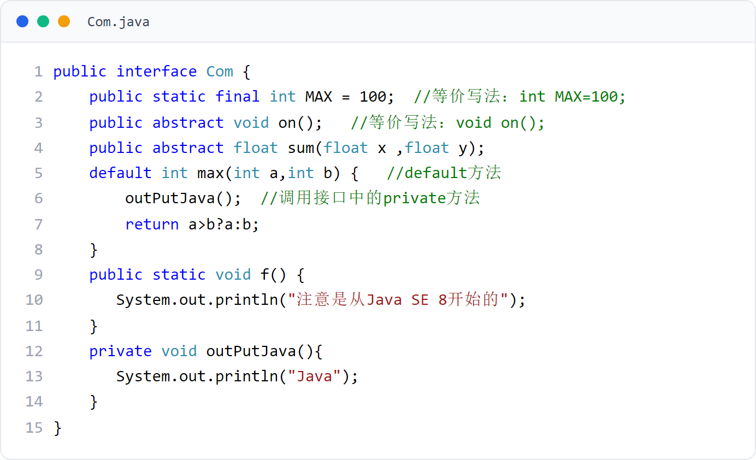
第 6 章 · 接口与实现
Chapter 6 · Interfaces and Implementations
例子1
Example 1
Com 接口
Com interface
接口中含常量、abstract 方法、default 方法与 static 方法，以及被 default 方法调用的 private 方法。
The interface contains constants, abstract methods, default methods and static methods, as well as private methods called by the default method.
13 / 56

Slide 14
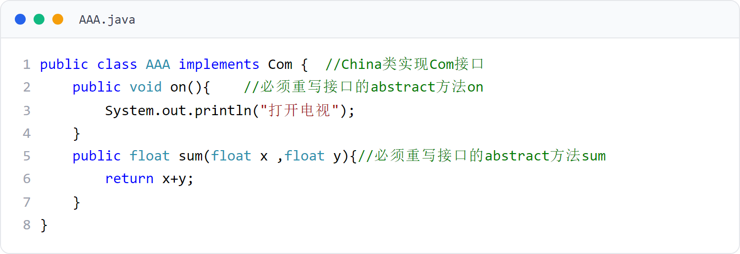
第 6 章 · 接口与实现
Chapter 6 · Interfaces and Implementations
例子1
Example 1
AAA 类（实现接口）
AAA class (implementation interface)
必须重写接口的所有 abstract 方法（on 与 sum），去掉 abstract 修饰并给出方法体。
All abstract methods of the interface (on and sum) must be rewritten, removing the abstract modification and giving the method body.
14 / 56

Slide 15
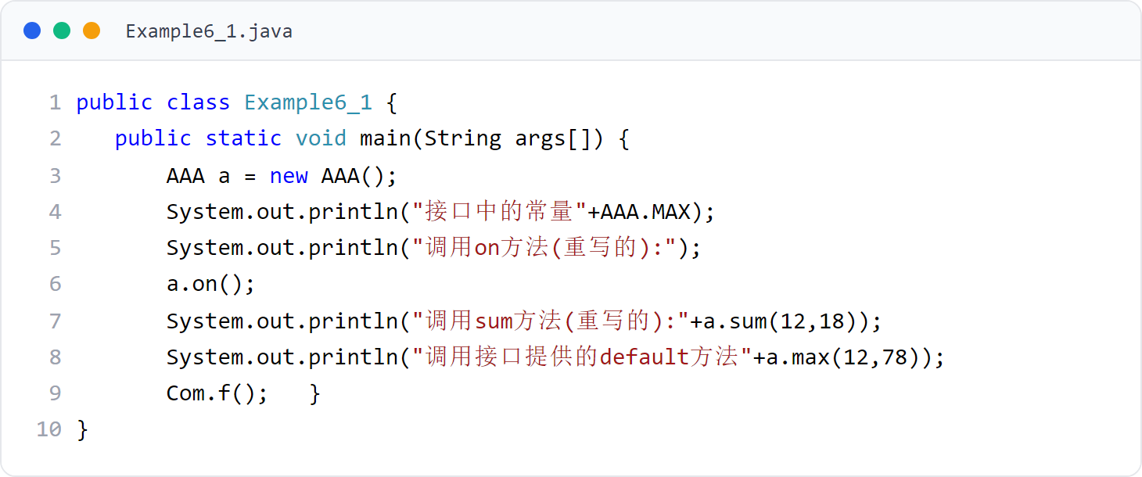
第 6 章 · 接口与实现
Chapter 6 · Interfaces and Implementations
例子1
Example 1
Example6_1（主类）
Example6_1 (main class)
通过实现类访问接口常量，调用重写的方法、default 方法，并用接口名调用 static 方法 Com.f()。
Access the interface constants by implementing the class, calling the overridden method, the default method, and calling the static method Com.f() with the interface name.
15 / 56
Notes:
[课堂运行示例 / Classroom Demo]
课堂运行：课堂示例代码/第6章/InterfaceDemo.java
让 Printer 实现 Printable，使用接口引用调用 print()。
[Sources]
Source concepts: user-provided chapter deck. Demo code: original instructional material.

Slide 16
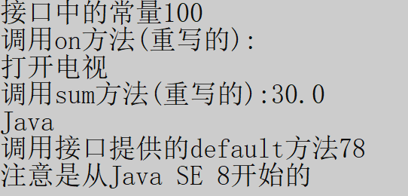
第 6 章 · 接口与实现
Chapter 6 · Interfaces and Implementations
例子1 · 运行效果
Example 1 · Operational effect
运行效果
Run result
接口中的常量、被重写的 abstract 方法、default 方法以及接口的 static 方法均可正常使用。
Constants in the interface, overridden abstract methods, default methods, and static methods of the interface can all be used normally.
16 / 56
Notes:
[课堂运行示例 / Classroom Demo]
课堂运行：课堂示例代码/第6章/DefaultStaticMethodDemo.java
分别调用接口默认方法和静态方法，比较调用语法。
[Sources]
Source concepts: user-provided chapter deck. Demo code: original instructional material.

Slide 17
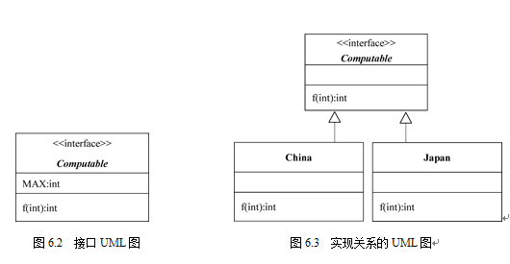
第 6 章 · 接口与实现
Chapter 6 · Interfaces and Implementations
§6.3
接口的 UML 图
UML diagram of interface
第 1 层（名字层）：接口名字必须斜体，用 <<interface>> 修饰，与名字分列两行
Layer 1 (name layer): The interface name must be in italics, decorated with <<interface>>, and placed on two lines with the name.
第 2 层（常量层）：格式“常量名字：类型”
Level 2 (constant level): Format "constant name: type"
表示接口的 UML 图与类的 UML 图类似，用长方形垂直分为三层。
The UML diagram representing the interface is similar to the UML diagram of the class, divided vertically into three layers with a rectangle.
第 3 层（方法层/操作层）：格式“方法名字（参数列表）：类型”
Layer 3 (Method Layer/Operation Layer): Format "Method Name (Parameter List): Type"
17 / 56

Slide 18
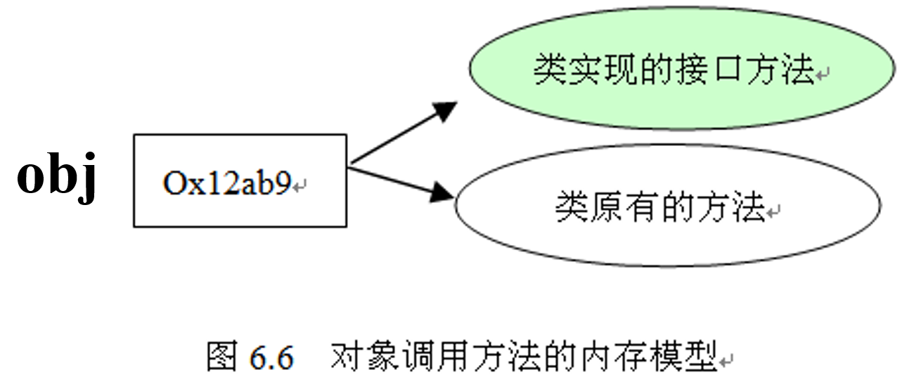
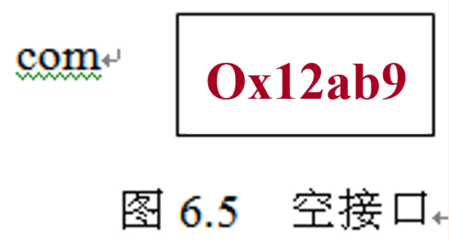
第 6 章 · 接口与实现
Chapter 6 · Interfaces and Implementations
§6.4
接口回调
Interface callback
Com com; // 声明接口变量
ImpleCom obj = new ImpleCom(); // 实现接口的类的对象
com = obj; // 接口回调
把实现某一接口的类创建的对象的引用赋给该接口声明的接口变量，接口变量就可以调用被类重写的接口方法。
Assign the reference of the object created by the class that implements an interface to the interface variable declared by the interface, and the interface variable can call the interface method overridden by the class.
图 6.5：空接口（回调前）；图 6.6：对象调用方法的内存模型（回调后）。实际上，当接口变量调用被类重写的接口方法时，就是通知相应的对象调用这个方法。例子2。
Figure 6.5: Empty interface (before callback); Figure 6.6: Memory model of object calling method (after callback). In fact, when an interface variable calls an interface method overridden by a class, the corresponding object is notified to call this method. Example 2.
18 / 56
Notes:
[课堂运行示例 / Classroom Demo]
课堂运行：课堂示例代码/第6章/InterfaceCallbackDemo.java
把不同 Greeting 实现传给 runGreeting()，观察接口回调。
[Sources]
Source concepts: user-provided chapter deck. Demo code: original instructional material.

Slide 19
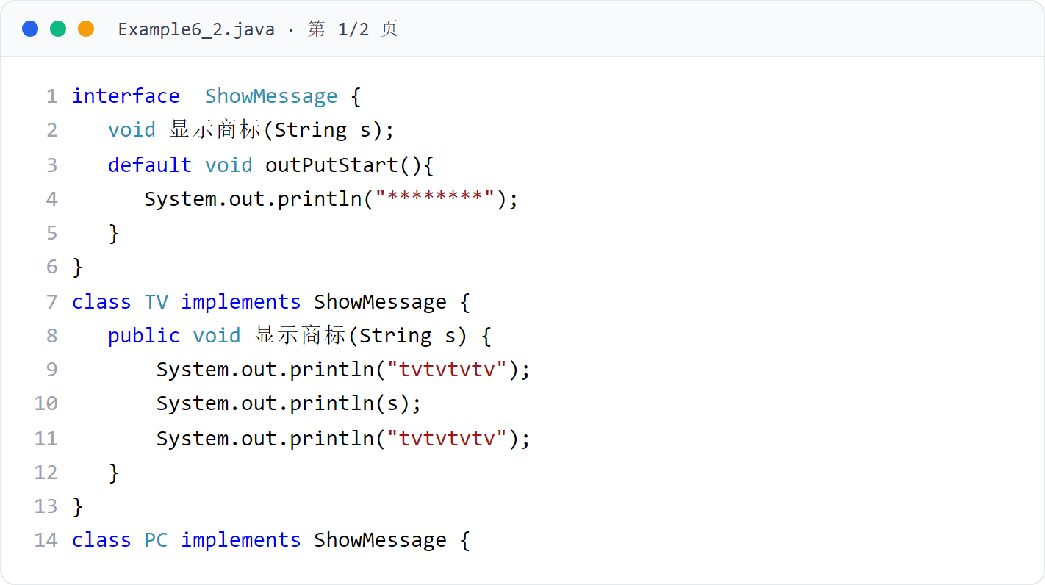
第 6 章 · 接口与实现
Chapter 6 · Interfaces and Implementations
例子2
Example 2
Example6_2（上）
Example6_2 (top)
接口 ShowMessage 含 abstract 方法显示商标与 default 方法 outPutStart。
The interface ShowMessage contains abstract method to display trademark and default method outPutStart.
19 / 56

Slide 20
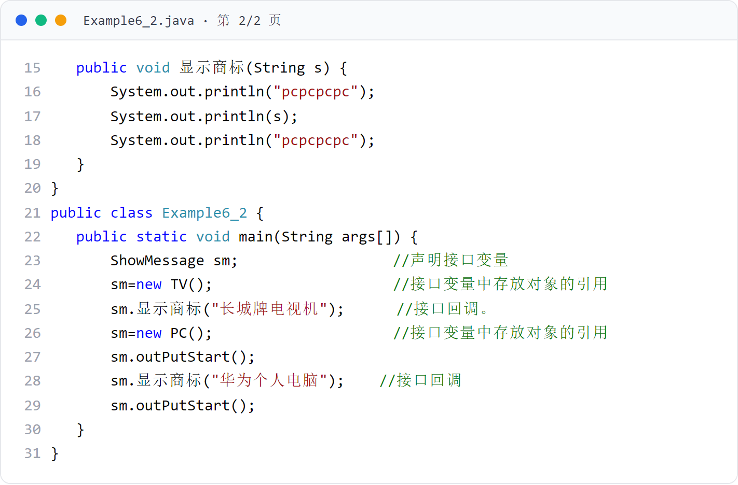
第 6 章 · 接口与实现
Chapter 6 · Interfaces and Implementations
例子2
Example 2
Example6_2（下）
Example6_2 (Part 2)
主类中接口变量存放 TV、PC 对象的引用，接口回调调用被重写的显示商标方法。
The interface variables in the main class store references to TV and PC objects, and the interface callback calls the overridden display trademark method.
20 / 56

Slide 21
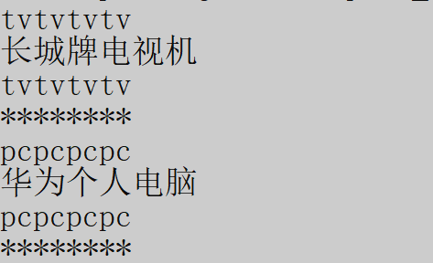
第 6 章 · 接口与实现
Chapter 6 · Interfaces and Implementations
例子2 · 运行效果
Example 2 · Operational effect
运行效果
Run result
同一接口变量先后指向 TV 与 PC 对象，接口回调输出各自的商标。
The same interface variable points to the TV and PC objects successively, and the interface callback outputs their respective trademarks.
21 / 56

Slide 22
第 6 章 · 接口与实现
Chapter 6 · Interfaces and Implementations
§6.5
函数接口与 Lambda 表达式
Function interfaces and Lambda expressions
① 函数接口：有且只有一个 abstract 方法的接口（单接口）
① Functional interface: an interface with one and only one abstract method (single interface)
有且只有一个 abstract 方法的接口称为函数接口；JDK8 之后可用 Lambda 表达式简化实现。
An interface with one and only one abstract method is called a functional interface; after JDK8, Lambda expressions can be used to simplify the implementation.
② Lambda 表达式：只写参数列表和方法体的匿名方法，参数列表与方法体之间用 ->
② Lambda expression: an anonymous method that only writes the parameter list and method body. Use -> between the parameter list and the method body.
通常方法：int computeSum(int a, int b) { return a+b; }
Lambda 表达式：(int a,int b) -> { return a+b; } 或 (a,b) -> { return a+b; }
22 / 56

Slide 23
第 6 章 · 接口与实现
Chapter 6 · Interfaces and Implementations
§6.5
Lambda 表达式的值
Lambda expression value
③ Lambda 表达式的值：就是方法的入口地址
③ The value of the Lambda expression: is the entry address of the method
由于 Lambda 表达式过于简化，必须在特殊的上下文，编译器才能推断出它到底是哪个方法，因此主要用在单接口（即函数接口）上
Since Lambda expressions are too simplified, the compiler must be in a special context to infer which method it is, so it is mainly used on single interfaces (i.e. functional interfaces)
④ 接口变量存放 Lambda 表达式的值：允许把 Lambda 表达式的值赋给接口变量，接口变量就可以调用 Lambda 表达式实现的方法——这一机制称为接口回调 Lambda 表达式实现的接口方法
④ The interface variable stores the value of the Lambda expression: the value of the Lambda expression is allowed to be assigned to the interface variable, and the interface variable can call the method implemented by the Lambda expression - this mechanism is called the interface callback. The interface method implemented by the Lambda expression
Lambda 表达式的值就是方法的入口地址，主要用在函数接口上。
The value of the Lambda expression is the entry address of the method, which is mainly used in function interfaces.
注意：不要混淆 Lambda 表达式的值（匿名方法的入口地址）和匿名方法的类型（可能是 void 型，即没有返回值）
Note: Do not confuse the value of the Lambda expression (the entry address of the anonymous method) and the type of the anonymous method (which may be void type, that is, there is no return value)
例子3 和例子2 类似，但采用 Lambda 表达式实现。
Example 3 is similar to Example 2, but implemented using Lambda expressions.
23 / 56

Slide 24
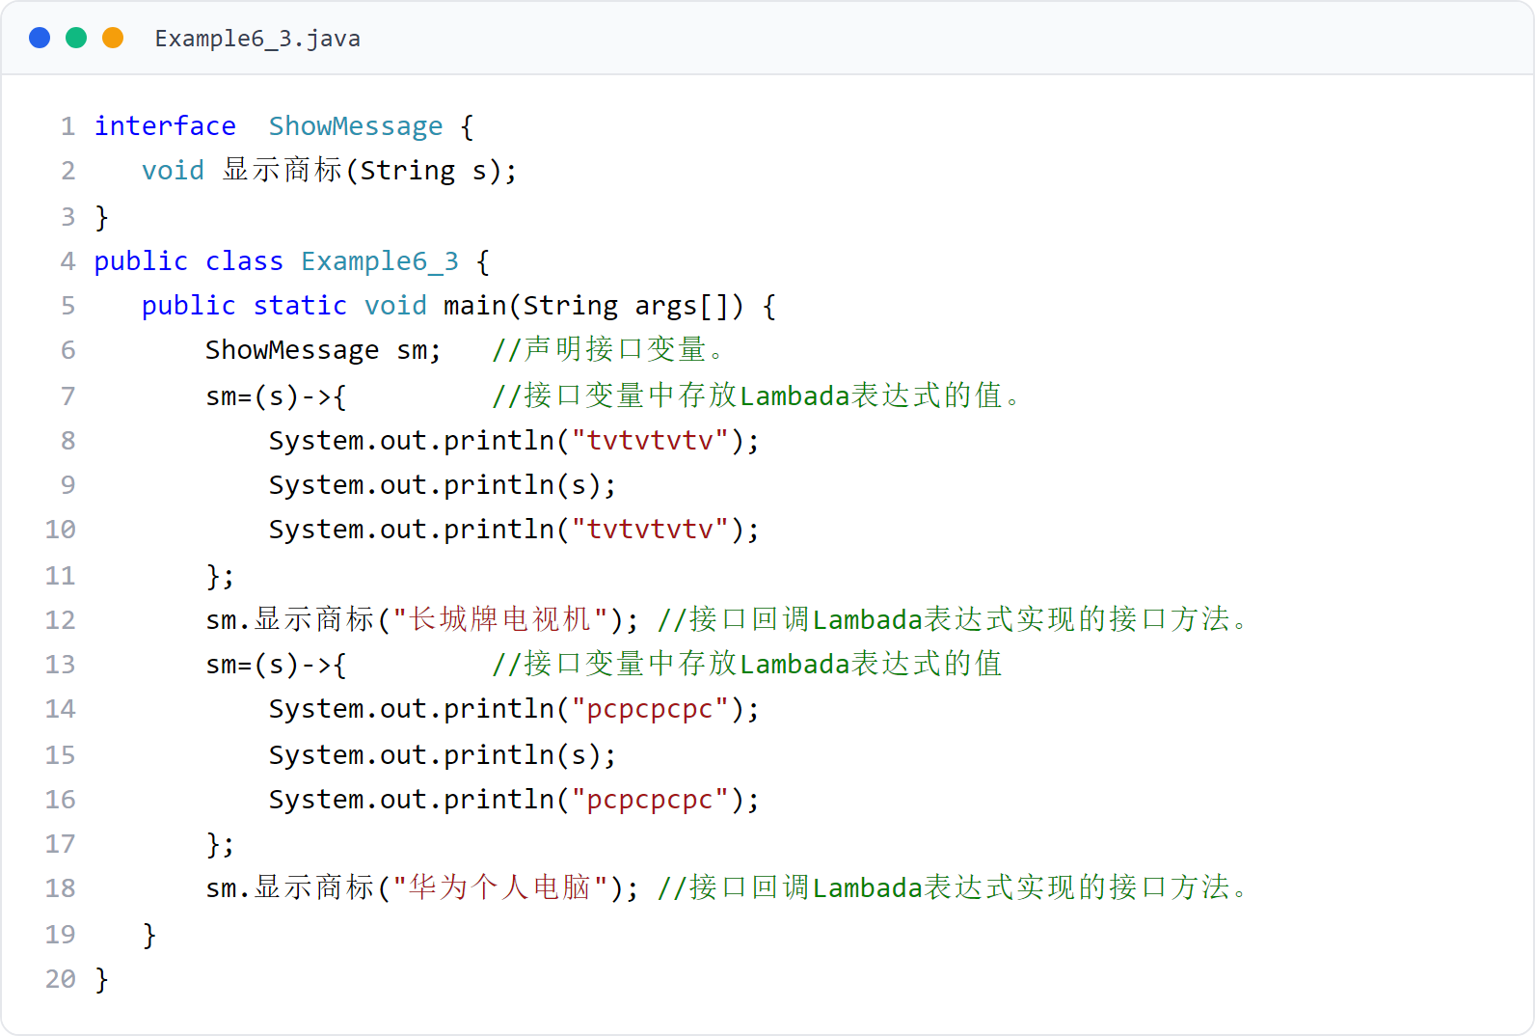
第 6 章 · 接口与实现
Chapter 6 · Interfaces and Implementations
例子3
Example 3
Example6_3（Lambda 表达式实现接口）
Example6_3 (Lambda expression implementation interface)
接口变量 sm 先后存放两个 Lambda 表达式的值，接口回调 Lambda 表达式实现的接口方法。
The interface variable sm stores the values ​​of two Lambda expressions one after another, and the interface calls back the interface method implemented by the Lambda expression.
24 / 56
Notes:
[课堂运行示例 / Classroom Demo]
课堂运行：课堂示例代码/第6章/LambdaDemo.java
用 Lambda 实现函数式接口，完成加法和乘法。
[Sources]
Source concepts: user-provided chapter deck. Demo code: original instructional material.

Slide 25
第 6 章 · 接口与实现
Chapter 6 · Interfaces and Implementations
例子3 · 运行效果
Example 3 · Operational effect
运行效果
Run result
输出与例子2 相同：接口变量回调 Lambda 表达式实现的接口方法。
The output is the same as Example 2: the interface variable calls back the interface method implemented by the Lambda expression.
25 / 56

Slide 26
第 6 章 · 接口与实现
Chapter 6 · Interfaces and Implementations
§6.6
理解接口
Understand the interface
接口的思想在于：要求某些类有相同名称的方法，但方法的具体内容可以不同。
The idea of ​​an interface is to require certain classes to have methods with the same name, but the specific content of the methods can be different.
（1）接口可以抽象出重要的行为标准，该行为标准用抽象方法来表示
(1) Interfaces can abstract important behavioral standards, which are represented by abstract methods
（2）可以把实现接口的类的对象的引用赋值给接口变量，接口变量可以调用被该类实现的接口方法，即体现该类根据接口里的行为标准给出的具体行为
(2) The reference of the object of the class that implements the interface can be assigned to the interface variable. The interface variable can call the interface method implemented by the class, that is, it embodies the specific behavior given by the class according to the behavior standards in the interface.
接口在要求一些类有相同名称的方法的同时，并不强迫这些类具有相同的父类
While interfaces require some classes to have methods with the same name, they do not force these classes to have the same parent class.
26 / 56

Slide 27
第 6 章 · 接口与实现
Chapter 6 · Interfaces and Implementations
§6.6
理解接口：例子4 场景
Understanding Interfaces: Example 4 Scenario
MotorVehicles 类（机动车）的子类 Taxi（出租车）和 Bus（公共汽车）必须有名称为 brake 的方法（有刹车功能）
Taxi and Bus subclasses of the MotorVehicles class must have a method named brake (with braking function)
额外要求 Taxi 有 controlAirTemperature 和 charge 方法（有空调和收费功能）→ Taxi 实现两个接口
Additional requirements: Taxi has controlAirTemperature and charge methods (with air conditioning and charging functions) → Taxi implements two interfaces
接口 + 继承：用接口约束“能力”，用继承约束“种类”。
Interface + inheritance: Use interface to constrain "capabilities" and use inheritance to constrain "types".
要求 Bus 有 charge 方法（有收费功能）→ Bus 只实现一个接口
Requires Bus to have a charge method (with charging function) → Bus only implements one interface
例子4：Taxi 继承 MotorVehicles 并实现 MoneyFare 与 ControlTemperature 两个接口；Bus 继承 MotorVehicles 并实现 MoneyFare 一个接口。
Example 4: Taxi inherits MotorVehicles and implements two interfaces, MoneyFare and ControlTemperature; Bus inherits MotorVehicles and implements one interface, MoneyFare.
27 / 56

Slide 28
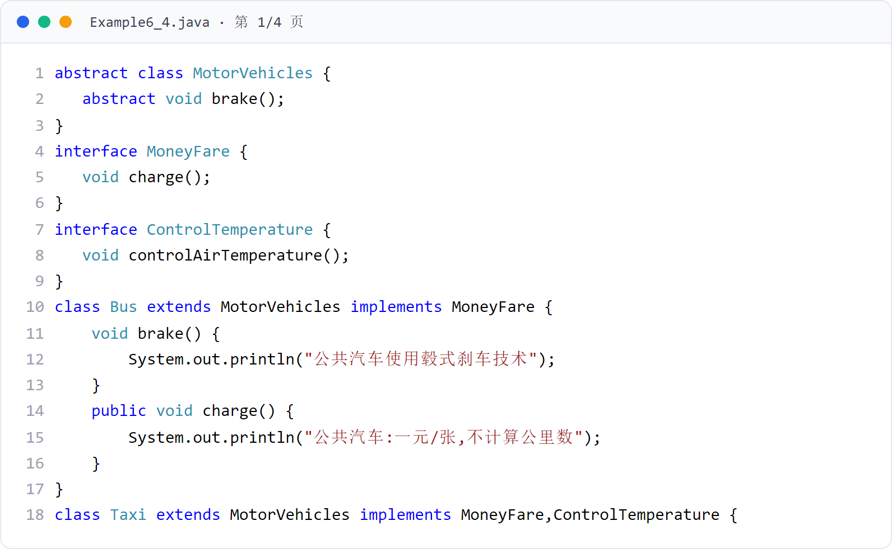
第 6 章 · 接口与实现
Chapter 6 · Interfaces and Implementations
例子4
Example 4
Example6_4（上）
Example6_4 (Part 1)
抽象类 MotorVehicles 与接口 MoneyFare、ControlTemperature 的声明；Bus、Taxi 类继承 + 实现接口并重写方法。
Declaration of abstract class MotorVehicles and interfaces MoneyFare and ControlTemperature; inheritance of Bus and Taxi classes + implementation of interfaces and overriding methods.
28 / 56

Slide 29
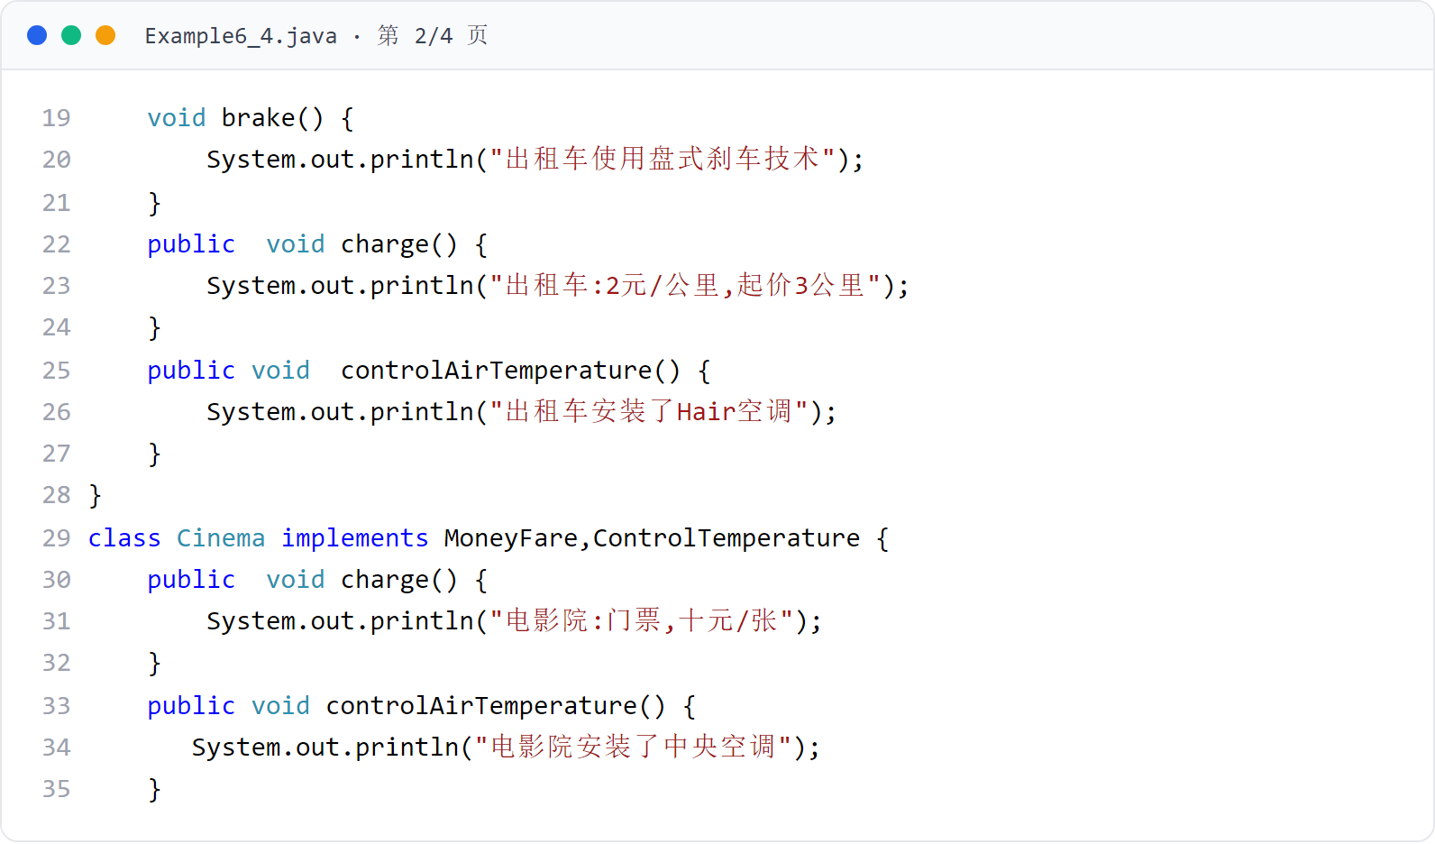
第 6 章 · 接口与实现
Chapter 6 · Interfaces and Implementations
例子4
Example 4
Example6_4（中一）
Example6_4 (Form 1)
Taxi 实现两个接口（收费、空调），Cinema 仅实现接口（不继承机动车）。
Taxi implements two interfaces (toll collection and air conditioning), while Cinema only implements the interface (does not inherit motor vehicles).
29 / 56

Slide 30
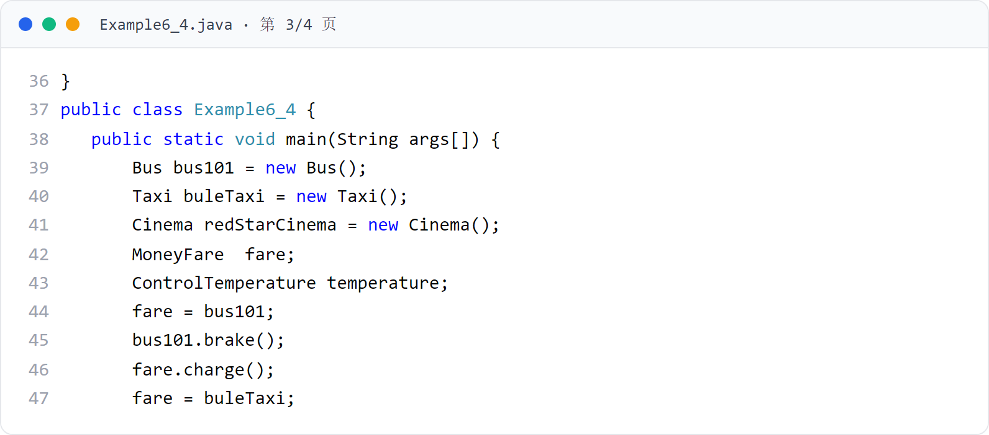
第 6 章 · 接口与实现
Chapter 6 · Interfaces and Implementations
例子4
Example 4
Example6_4（中二）
Example6_4 (Second Form 2)
Cinema 类实现 MoneyFare、ControlTemperature 两个接口。
The Cinema class implements the MoneyFare and ControlTemperature interfaces.
30 / 56

Slide 31
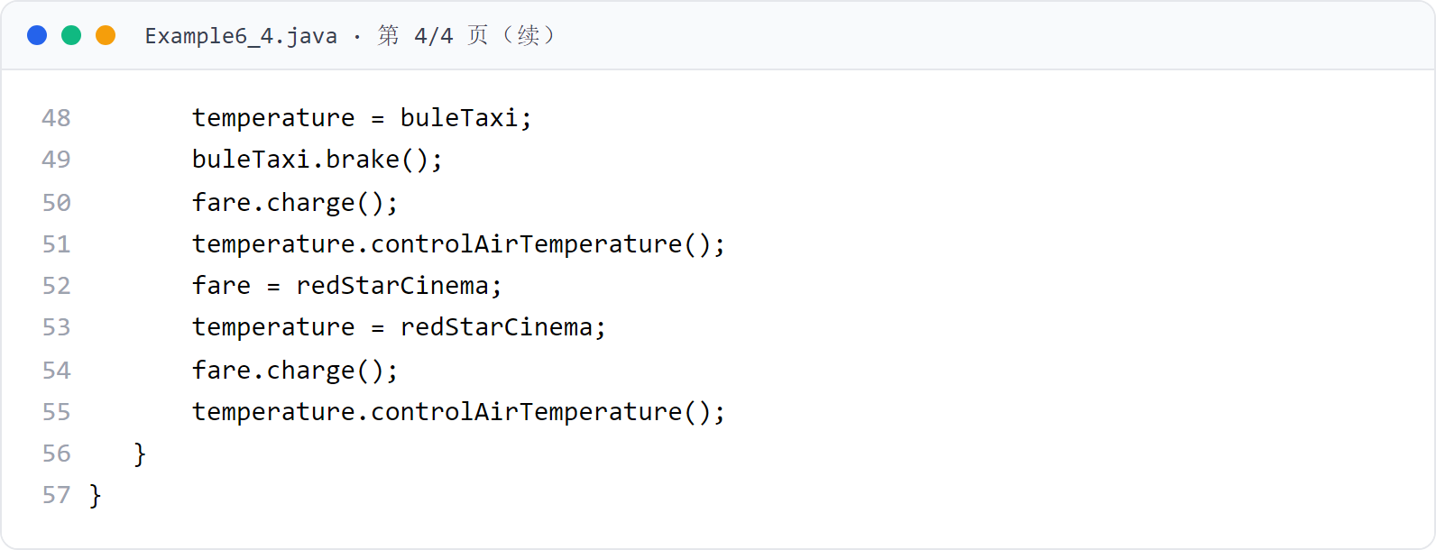
第 6 章 · 接口与实现
Chapter 6 · Interfaces and Implementations
例子4
Example 4
Example6_4（下，主类）
Example6_4 (lower, main class)
接口变量 fare 与 temperature 存放不同对象的引用，接口回调输出各自行为。
The interface variables fare and temperature store references to different objects, and the interface callbacks output their respective behaviors.
31 / 56

Slide 32

第 6 章 · 接口与实现
Chapter 6 · Interfaces and Implementations
例子4 · 运行效果
Example 4·Operation effect
运行效果
Run result
公交、出租车、电影院各自实现收费与空调行为：接口回调体现同一接口不同实现（多态）。
Buses, taxis, and movie theaters each implement charging and air-conditioning behaviors: the interface callback reflects different implementations of the same interface (polymorphism).
32 / 56
Notes:
[课堂运行示例 / Classroom Demo]
课堂运行：课堂示例代码/第6章/MultiInterfaceDemo.java
让 SmartDevice 同时实现 Chargeable 和 Connectable。
[Sources]
Source concepts: user-provided chapter deck. Demo code: original instructional material.

Slide 33
第 6 章 · 接口与实现
Chapter 6 · Interfaces and Implementations
§6.7
接口与多态
Interfaces and polymorphism
由接口产生的多态：不同的类在实现同一个接口时可能具有不同的实现方式。
Polymorphism caused by interfaces: Different classes may have different implementation methods when implementing the same interface.
可以通过在接口中声明若干个 abstract 方法，表明这些方法的重要性，方法体的内容细节由实现接口的类去完成
You can indicate the importance of these methods by declaring several abstract methods in the interface. The content details of the method body are completed by the class that implements the interface.
使用接口进行程序设计的核心思想是使用接口回调，即接口变量存放实现该接口的类的对象的引用，从而接口变量就可以回调类实现的接口方法
The core idea of ​​using interfaces for programming is to use interface callbacks, that is, interface variables store references to objects of classes that implement the interface, so that interface variables can call back interface methods implemented by the class.
例子5：接口 CompurerAverage 由类 A、B 分别实现算术平均值与几何平均值
Example 5: The interface CompurerAverage implements arithmetic mean and geometric mean by classes A and B respectively.
33 / 56

Slide 34
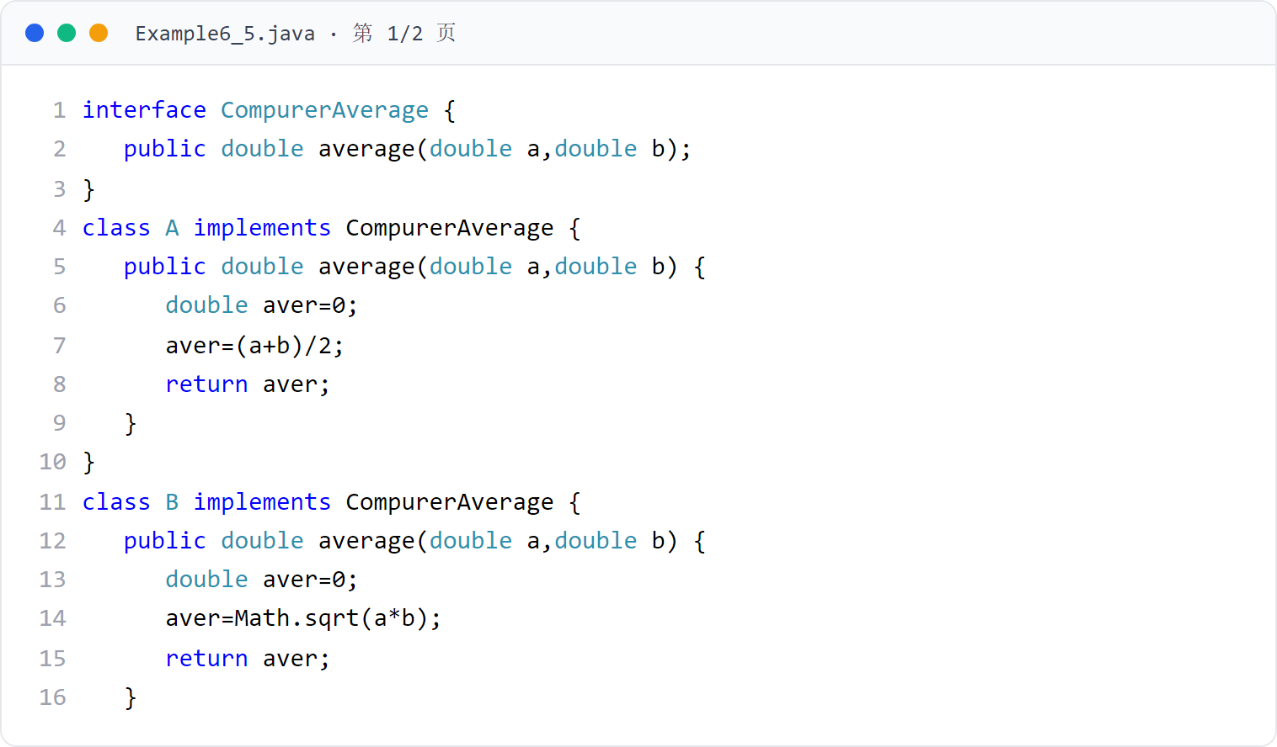
第 6 章 · 接口与实现
Chapter 6 · Interfaces and Implementations
例子5
Example 5
Example6_5（上）
Example6_5 (Part 1)
接口 CompurerAverage 与实现类 A（算术平均值）、B（几何平均值）。
Interface CompurerAverage and implementation classes A (arithmetic mean), B (geometric mean).
34 / 56

Slide 35
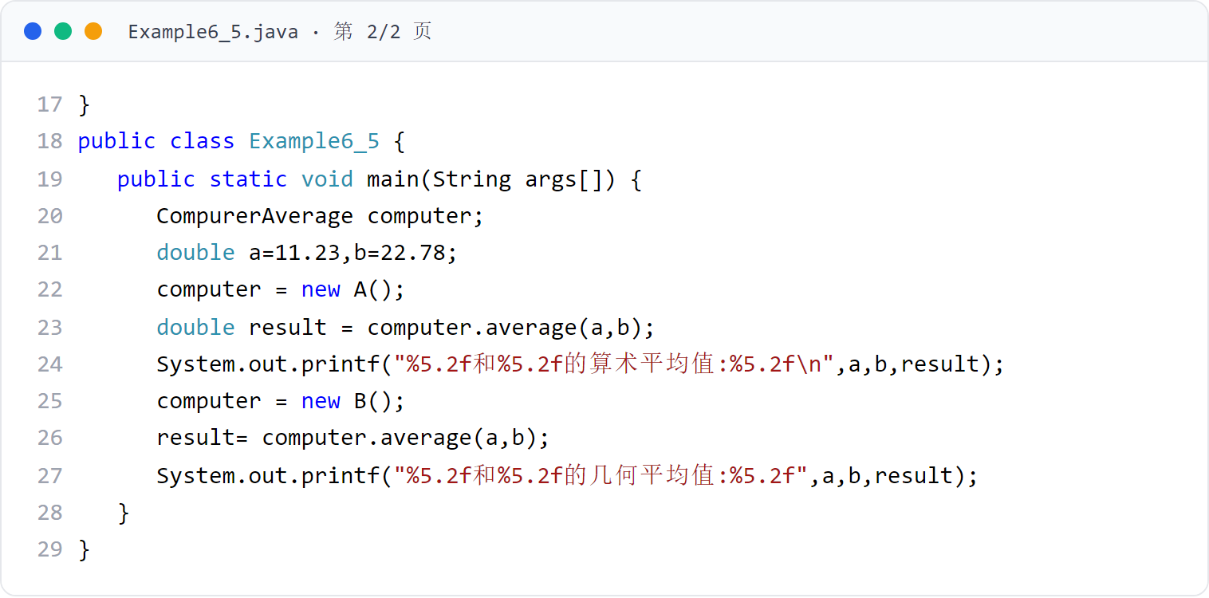
第 6 章 · 接口与实现
Chapter 6 · Interfaces and Implementations
例子5
Example 5
Example6_5（下，主类）
Example6_5 (lower, main class)
接口变量 computer 先后存放 A、B 对象的引用，接口回调得到不同的平均值。
The interface variable computer stores references to objects A and B successively, and the interface callback obtains different average values.
35 / 56

Slide 36
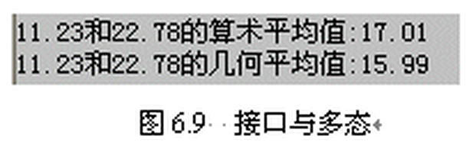
第 6 章 · 接口与实现
Chapter 6 · Interfaces and Implementations
例子5 · 运行效果
Example 5 · Operational effect
运行效果
Run result
同一接口变量回调不同实现，得到算术平均值与几何平均值。
The same interface variable callbacks different implementations to obtain the arithmetic mean and geometric mean.
36 / 56

Slide 37
第 6 章 · 接口与实现
Chapter 6 · Interfaces and Implementations
§6.8
接口参数
Interface parameters
方法的参数是接口类型时，可以将任何实现该接口的类的实例的引用传递给该接口参数。
When a method parameter is an interface type, you can pass a reference to an instance of any class that implements the interface to the interface parameter.
接口参数可以回调类实现的接口方法
Interface parameters can callback interface methods implemented by the class
例子6：KindHello 的 lookHello(SpeakHello hello) 方法以接口为参数，接口回调输出不同问候语
Example 6: KindHello’s lookHello(SpeakHello hello) method takes an interface as a parameter, and the interface callback outputs different greetings.
还可以向接口参数传递 Lambda 表达式的值
You can also pass the value of a Lambda expression to an interface parameter
37 / 56

Slide 38
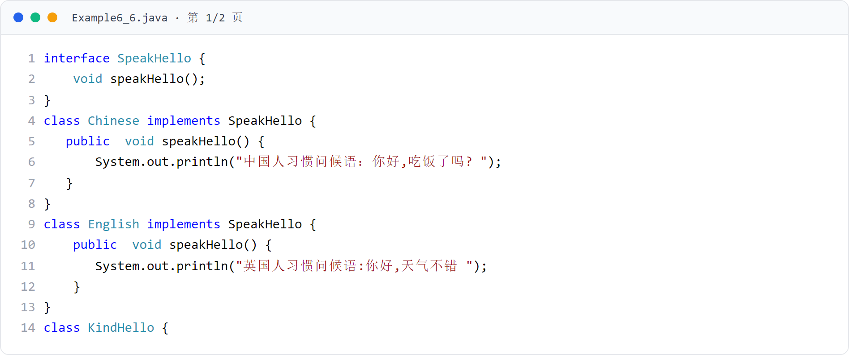
第 6 章 · 接口与实现
Chapter 6 · Interfaces and Implementations
例子6
Example 6
Example6_6（上）
Example6_6 (Part 1)
接口 SpeakHello 与实现类 Chinese、English，以及接口类型参数的方法 lookHello。
The interface SpeakHello has implementation classes Chinese, English, and the method lookHello for interface type parameters.
38 / 56

Slide 39
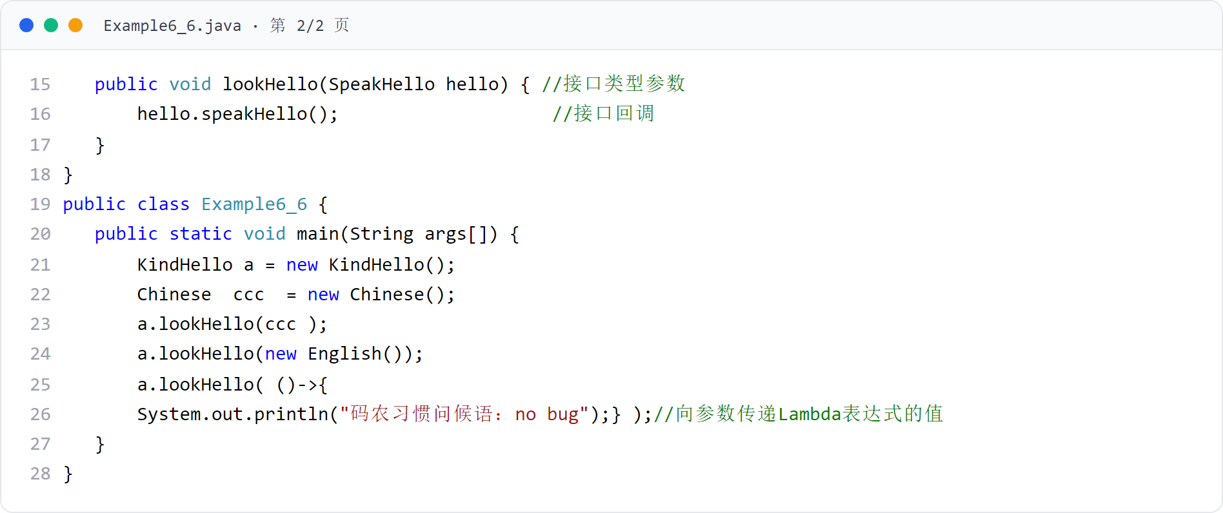
第 6 章 · 接口与实现
Chapter 6 · Interfaces and Implementations
例子6
Example 6
Example6_6（下，主类）
Example6_6 (lower, main class)
向 lookHello 依次传递 Chinese、English 对象与 Lambda 表达式，接口参数回调各自方法。
Pass Chinese, English objects and Lambda expressions to lookHello in sequence, and the interface parameters call back their respective methods.
39 / 56

Slide 40

第 6 章 · 接口与实现
Chapter 6 · Interfaces and Implementations
例子6 · 运行效果
Example 6 · Operational effect
运行效果
Run result
同一接口参数回调不同实现类与 Lambda 表达式的方法。
The same interface parameter calls back methods of different implementation classes and Lambda expressions.
40 / 56

Slide 41
第 6 章 · 接口与实现
Chapter 6 · Interfaces and Implementations
§6.9
abstract 类与接口的比较
Comparison of abstract classes and interfaces
abstract 类和接口都可以有 abstract 方法
Both abstract classes and interfaces can have abstract methods
abstract 类与接口都可以有 abstract 方法，但二者在成员构成上有区别。
Both abstract classes and interfaces can have abstract methods, but they are different in member composition.
接口中只可以有常量，不能有变量；而 abstract 类中既可以有常量也可以有变量
Interfaces can only have constants, not variables; abstract classes can have both constants and variables.
abstract 类中也可以有非 abstract 的实例方法和 static 方法；JDK8 之后，接口可以有 default 修饰的实例方法和 static 方法
Abstract classes can also have non-abstract instance methods and static methods; after JDK8, interfaces can have default-modified instance methods and static methods.
41 / 56

Slide 42
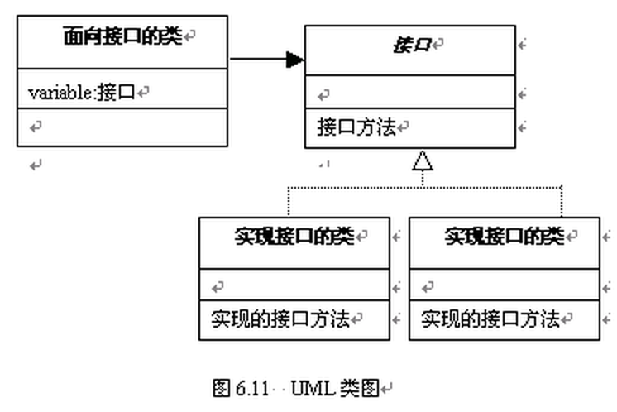
第 6 章 · 接口与实现
Chapter 6 · Interfaces and Implementations
§6.10
使用接口进行程序设计的核心思想是使用接口回调
The core idea of ​​using interfaces for programming is to use interface callbacks
面向接口编程
Programming to Interfaces
即接口变量存放实现该接口的类的对象的引用，从而接口变量就可以回调类实现的接口方法
That is, the interface variable stores a reference to the object of the class that implements the interface, so the interface variable can call back the interface method implemented by the class.
面向接口去设计程序：在接口中声明 abstract 方法表明其重要性，方法体内容细节由实现接口的类去完成。
Design the program for the interface: declaring abstract methods in the interface shows its importance, and the details of the method body content are completed by the class that implements the interface.
42 / 56

Slide 43
第 6 章 · 接口与实现
Chapter 6 · Interfaces and Implementations
§6.11
应用举例：广告牌
Application example: billboard
1．问题的分析：广告牌应面向接口设计，可替换展示不同公司的广告
1. Analysis of the problem: Billboards should be designed for interfaces and can replace advertisements from different companies.
设计一个广告牌，希望所设计的广告牌可以展示许多公司的广告词。
Design a billboard and hope that the designed billboard can display the advertising slogans of many companies.
2．设计接口：Advertisement 接口声明 showAdvertisement 与 getCorpName 抽象方法
2. Design interface: Advertisement interface declaration showAdvertisement and getCorpName abstract methods
3．设计广告牌类：AdvertisementBoard 面向接口编程，通过接口回调展示广告
3． Design billboard class: AdvertisementBoard is interface-oriented programming and displays advertisements through interface callbacks.
例子7 中除主类（Example6_7）外，还有 Advertisement 接口、实现该接口的 WhiteCloudCorp（白云公司）和 BlackLandCorp（黑土公司），以及面向接口的 AdvertisementBoard 类（广告牌），程序运行效果如图 6.12。
In Example 7, in addition to the main class (Example6_7), there is also the Advertisement interface, WhiteCloudCorp and BlackLandCorp that implement this interface, and the interface-oriented AdvertisementBoard class (billboard). The program running effect is shown in Figure 6.12.
43 / 56

Slide 44
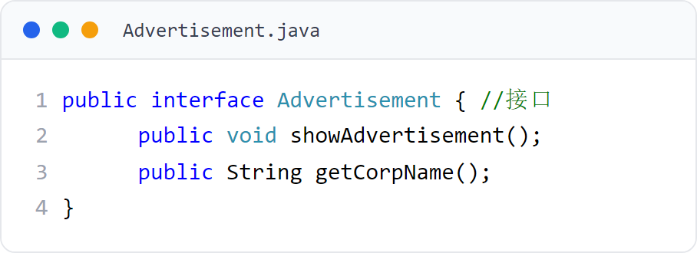
第 6 章 · 接口与实现
Chapter 6 · Interfaces and Implementations
例子7
Example 7
Advertisement 接口
Advertisement interface
广告牌依赖的接口：声明展示广告与获取公司名两个抽象方法。
The interface that the billboard relies on: declares two abstract methods for displaying advertisements and obtaining company names.
44 / 56

Slide 45
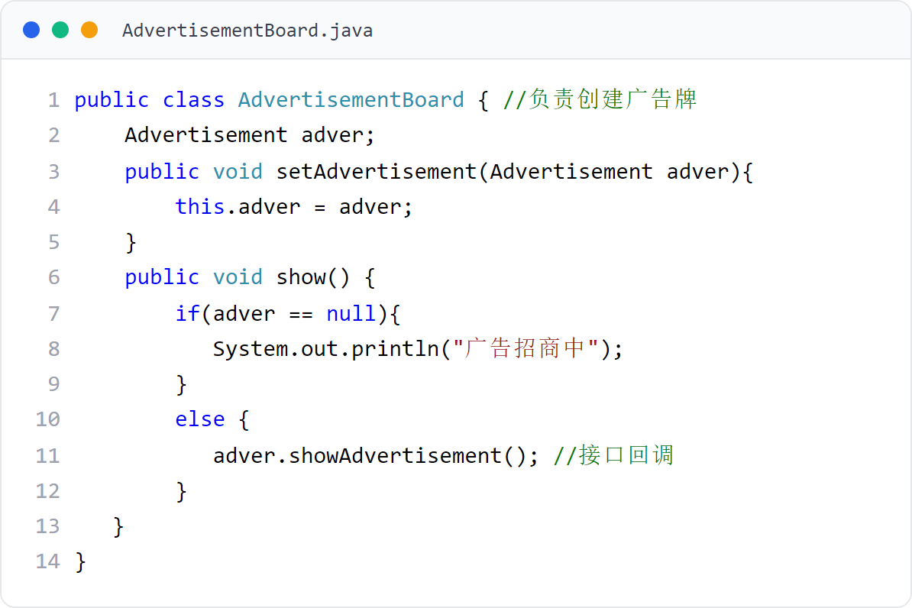
第 6 章 · 接口与实现
Chapter 6 · Interfaces and Implementations
例子7
Example 7
AdvertisementBoard 广告牌类
AdvertisementBoard billboard type
面向接口设计：setAdvertisement 接收 Advertisement 对象，show 方法接口回调展示广告。
Interface-oriented design: setAdvertisement receives the Advertisement object, and the show method interface calls back to display the advertisement.
45 / 56

Slide 46
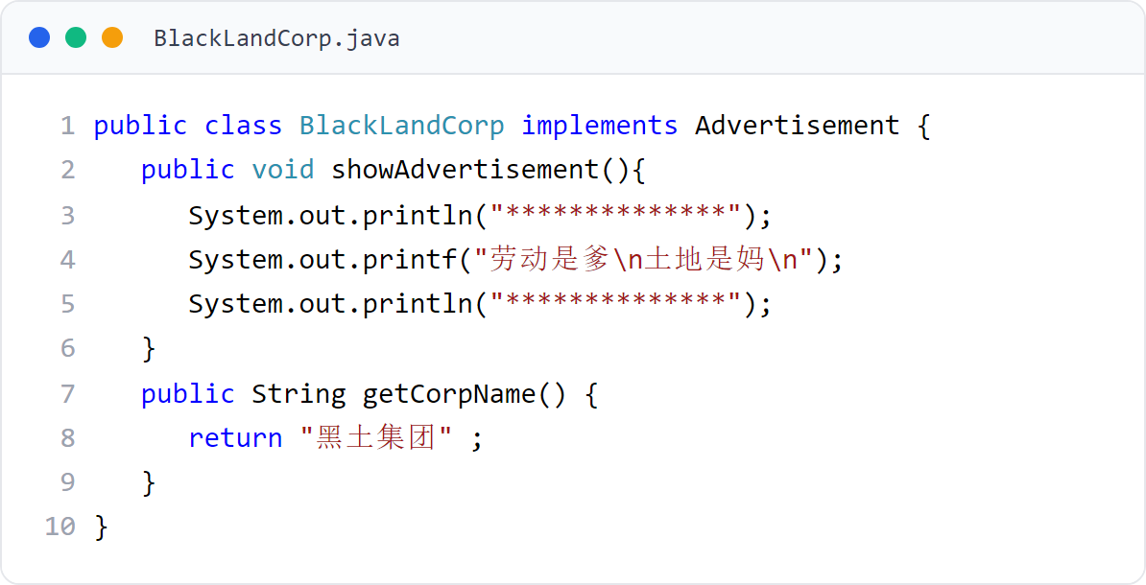
第 6 章 · 接口与实现
Chapter 6 · Interfaces and Implementations
例子7
Example 7
BlackLandCorp 类（黑土公司）
Class BlackLandCorp (BlackLandCorp)
实现 Advertisement 接口，展示黑土集团广告词。
Implement the Advertisement interface to display Black Earth Group’s advertising slogans.
46 / 56

Slide 47
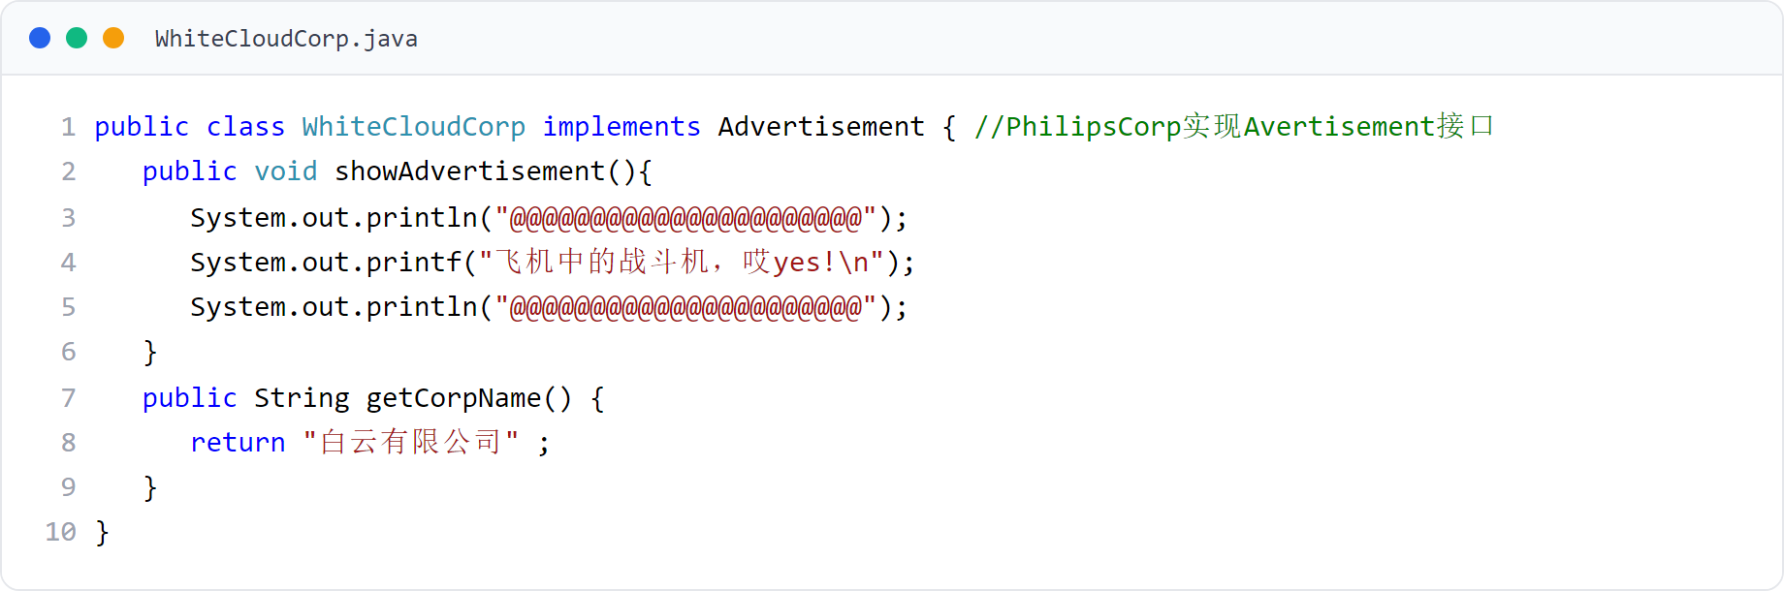
第 6 章 · 接口与实现
Chapter 6 · Interfaces and Implementations
例子7
Example 7
WhiteCloudCorp 类（白云公司）
WhiteCloudCorp class (WhiteCloudCorp)
实现 Advertisement 接口，展示白云有限公司广告词。
Implement the Advertisement interface to display the advertising words of Baiyun Co., Ltd.
47 / 56

Slide 48
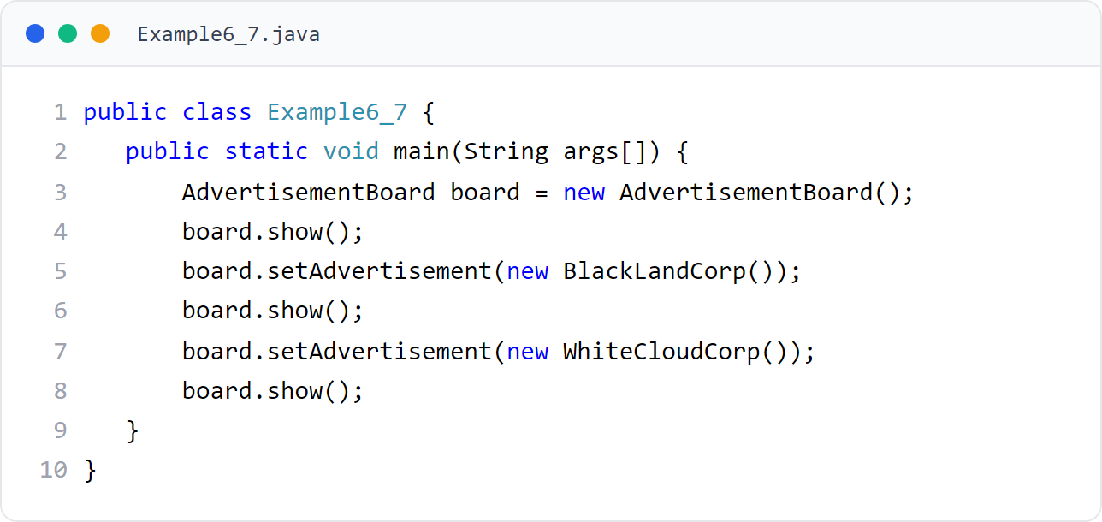
第 6 章 · 接口与实现
Chapter 6 · Interfaces and Implementations
例子7
Example 7
Example6_7（主类）
Example6_7 (main class)
广告牌依次展示黑土集团与白云公司的广告，先展示“广告招商中”。
The billboard displays the advertisements of Black Earth Group and Baiyun Company in sequence, first displaying "Advertisement Recruiting".
48 / 56

Slide 49

第 6 章 · 接口与实现
Chapter 6 · Interfaces and Implementations
例子7 · 运行效果
Example 7 · Operational effect
运行效果（图6.12）
Operation effect (Figure 6.12)
广告牌不关心具体公司，只面向接口编程：替换实现类即可更换广告（开-闭原则）。
The billboard does not care about the specific company, but is only oriented to interface programming: replacing the implementation class can replace the advertisement (open-close principle).
49 / 56

Slide 50
第 6 章 · 接口与实现
Chapter 6 · Interfaces and Implementations
总结
Summarize
本章总结
Chapter summary
接口的接口体中只可以有常量和 abstract 方法
The interface body of an interface can only have constants and abstract methods.
和类一样，接口也是 Java 中一种重要的引用型数据类型
Like classes, interfaces are also an important reference data type in Java.
接口是 Java 中一种重要的引用型数据类型。
Interface is an important reference data type in Java.
当接口变量中存放了实现接口的类的对象的引用后，接口变量就可以调用类实现的接口方法，这一过程被称为接口回调
When the interface variable stores a reference to the object of the class that implements the interface, the interface variable can call the interface method implemented by the class. This process is called an interface callback.
和子类体现多态类似，由接口产生的多态就是指不同的类在实现同一个接口时可能具有不同的实现方式
Similar to polymorphism reflected by subclasses, polymorphism caused by interfaces means that different classes may have different implementation methods when implementing the same interface.
在使用多态设计程序时，要熟练使用接口回调技术以及面向接口编程的思想，以便体现程序设计所提倡的“开-闭”原则
When using polymorphic design programs, you must be proficient in using interface callback technology and the idea of ​​​​interface-oriented programming in order to reflect the "open-close" principle advocated by program design.
50 / 56

Slide 51
第 6 章 · 接口与实现
Chapter 6 · Interfaces and Implementations
作业
Homework
作业
Homework
按时完成老师布置的作业。
Complete the homework assigned by the teacher on time.
教材提供了题库练习系统（见前言二维码）
The textbook provides a question bank practice system (see the QR code in the preface)
动手实践：完成本章全部例子，体会接口回调与面向接口编程
Hands-on practice: complete all the examples in this chapter and experience interface callbacks and interface-oriented programming
51 / 56

Slide 52
第 6 章 · 接口与实现
Chapter 6 · Interfaces and Implementations
编程题 1
Programming Task 1
实现打印接口
Implement a printable interface
定义 Printable 接口及 print()；Document 类实现该接口。
Define Printable with print(); let Document implement it.
使用 Printable 引用保存 Document，并调用 print()。
Store a Document in a Printable reference and call print().
文件名：PrintableInterfacePractice.java
File: PrintableInterfacePractice.java
52 / 56
Notes:
[编程题参考答案 / Reference Solution]
interface PrintableAnswer { void print(); }
class DocumentAnswer implements PrintableAnswer {
private String text;
DocumentAnswer(String text) { this.text = text; }
@Override public void print() { System.out.println(text); }
}
public class PrintableInterfacePracticeAnswer {
public static void main(String[] args) { PrintableAnswer item = new DocumentAnswer("Hello interface"); item.print(); }
}
[Sources]
Original instructional exercise and solution.

Slide 53
第 6 章 · 接口与实现
Chapter 6 · Interfaces and Implementations
编程题 2
Programming Task 2
接口默认与静态方法
Interface default and static methods
在 Logger 接口中定义 default log() 和 static version()。
Define default log() and static version() in Logger.
ConsoleLogger 使用默认方法；分别演示对象调用和接口名调用。
Use the default method in ConsoleLogger and call the static method by interface name.
文件名：DefaultStaticInterfacePractice.java
File: DefaultStaticInterfacePractice.java
53 / 56
Notes:
[编程题参考答案 / Reference Solution]
interface LoggerAnswer {
default void log(String message) { System.out.println("LOG: " + message); }
static String version() { return "1.0"; }
}
class ConsoleLoggerAnswer implements LoggerAnswer { }
public class DefaultStaticInterfacePracticeAnswer {
public static void main(String[] args) {
new ConsoleLoggerAnswer().log("started");
System.out.println(LoggerAnswer.version());
}
}
[Sources]
Original instructional exercise and solution.

Slide 54
第 6 章 · 接口与实现
Chapter 6 · Interfaces and Implementations
编程题 3
Programming Task 3
Lambda 计算器
Lambda calculator
定义函数式接口 Calculator，只有 calculate(a, b)。
Define functional interface Calculator with calculate(a, b).
用 Lambda 创建加法和乘法实现，并输出计算结果。
Use lambdas for addition and multiplication and print the results.
文件名：LambdaCalculatorPractice.java
File: LambdaCalculatorPractice.java
54 / 56
Notes:
[编程题参考答案 / Reference Solution]
@FunctionalInterface
interface CalculatorAnswer { int calculate(int a, int b); }
public class LambdaCalculatorPracticeAnswer {
public static void main(String[] args) {
CalculatorAnswer add = (a, b) -> a + b;
CalculatorAnswer multiply = (a, b) -> a * b;
System.out.println(add.calculate(6, 4));
System.out.println(multiply.calculate(6, 4));
}
}
[Sources]
Original instructional exercise and solution.

Slide 55
第 6 章 · 接口与实现
Chapter 6 · Interfaces and Implementations
编程题 4
Programming Task 4
实现多个接口
Implement multiple interfaces
定义 Chargeable 和 Connectable 两个接口。
Define Chargeable and Connectable interfaces.
SmartDevice 同时实现二者，在 main 中分别调用两个接口方法。
Let SmartDevice implement both and call both methods in main.
文件名：MultiInterfacePractice.java
File: MultiInterfacePractice.java
55 / 56
Notes:
[编程题参考答案 / Reference Solution]
interface ChargeableAnswer { void charge(); }
interface ConnectableAnswer { void connect(); }
class SmartDeviceAnswer implements ChargeableAnswer, ConnectableAnswer {
@Override public void charge() { System.out.println("Charging"); }
@Override public void connect() { System.out.println("Connected"); }
}
public class MultiInterfacePracticeAnswer {
public static void main(String[] args) {
SmartDeviceAnswer device = new SmartDeviceAnswer();
device.charge();
device.connect();
}
}
[Sources]
Original instructional exercise and solution.

Slide 56
Thank You !
第 6 章 · 接口与实现 到此结束
Chapter 6 · Interfaces and Implementation This is the end
56 / 56

