Slide 1
Retention time, iRT, and standards
Northeastern University
Targeted Proteomics with Skyline
Monday, May 1 - 1:30 pm session

Slide 2
Objectives
Understand from an applications framework what retention time is
Compare how retention time is calculated without prior knowledge of peptide RT versus with prior knowledge
Establish comfortability with Skyline’s retention time calculator for scheduled methods

Slide 3
Agenda
Overview of retention time
Predicting retention time with SSRCalc and iRT
Choosing RT standards
Hands on: building an iRT calculator
--break--
LC Optimization, part 1
Hands on: Effect of LC gradient on quantitative MS
LC Optimization, part 2
Hands on: Effect of scheduling on quantitative MS

Slide 4
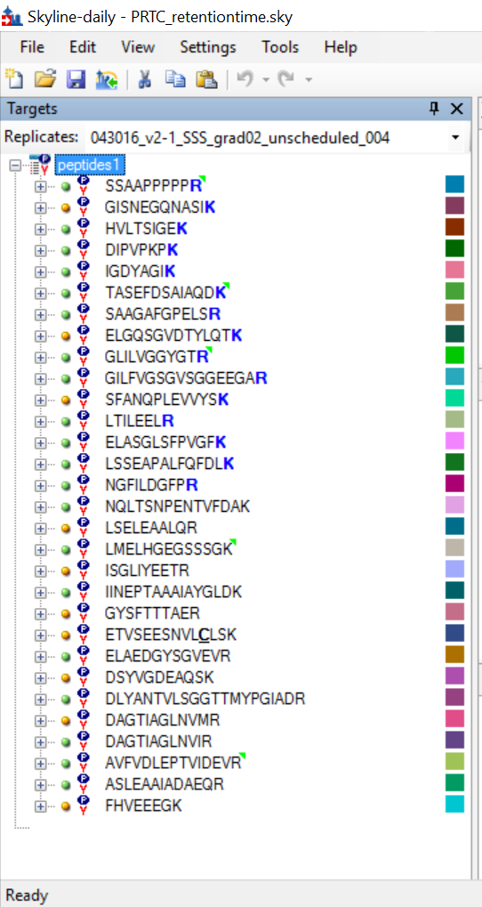
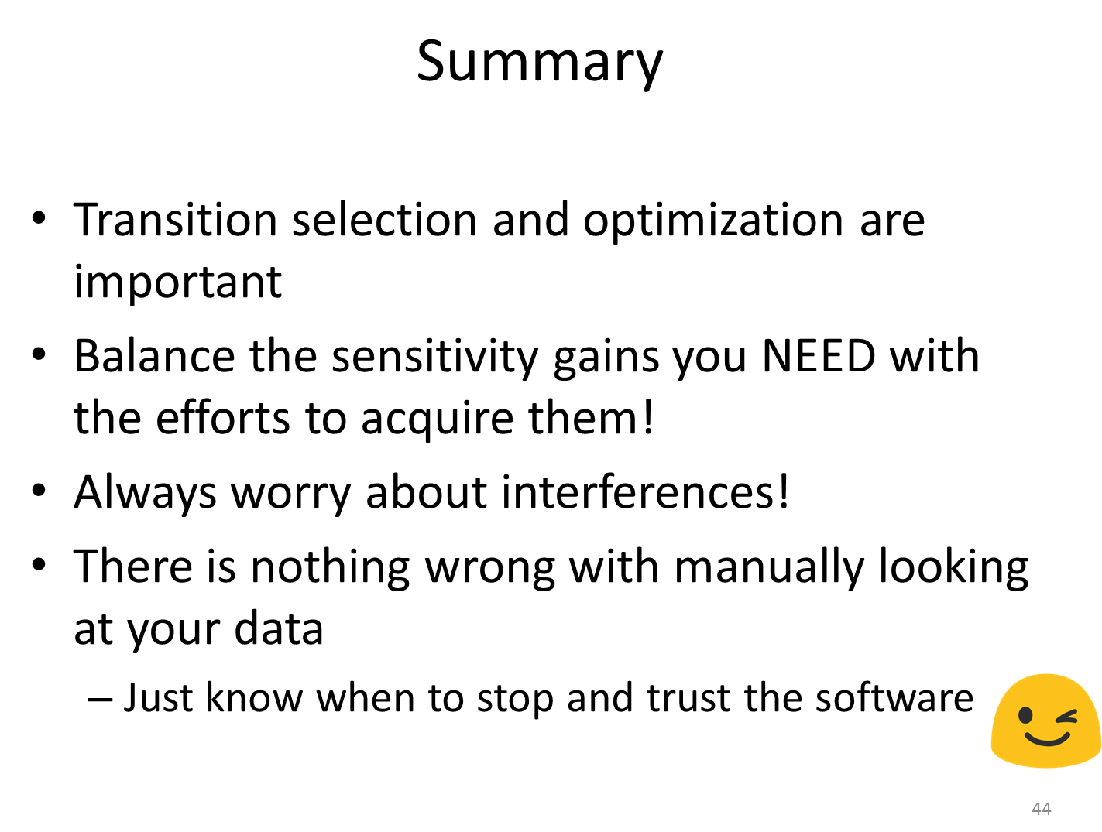
Review: Setting up a targeted MS method

Slide 5
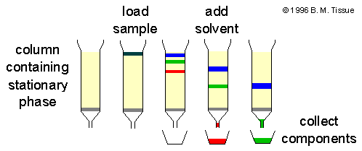
Can’t do “LC-MS” without the LC!
Liquid Chromatography (LC): Analytes dissolved in mobile phase move through the stationary phase at a speed that depends on the analyte (more details on analyte “speed” later)
Retention time (RT): timepoint in the LC gradient when a given peptide elutes

Slide 6

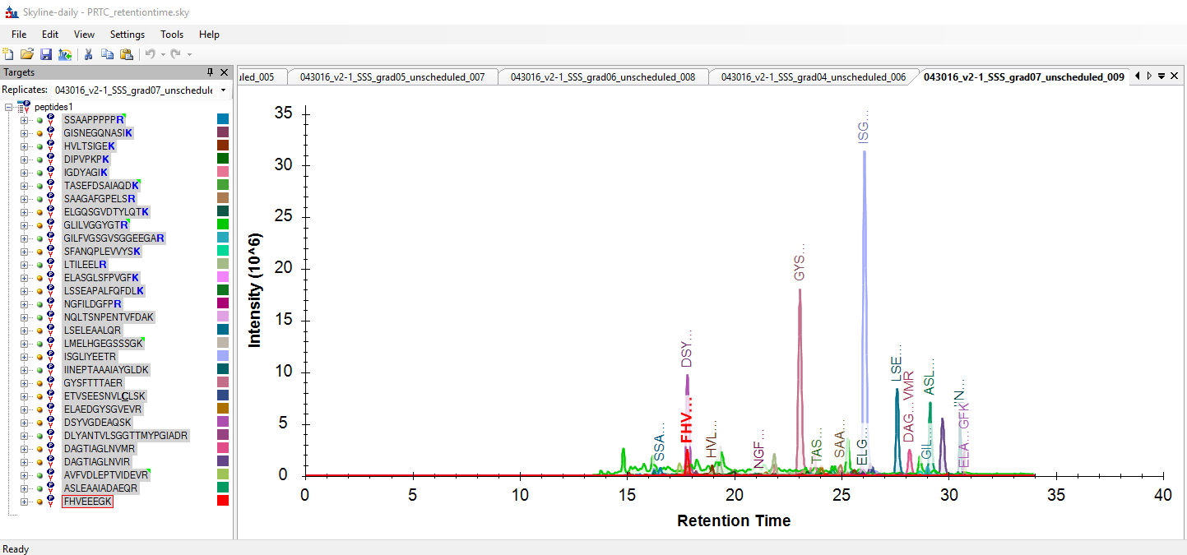
Native visualization of multiple peptides in Skyline
Tip! Hold “ctrl” + select peptides to view their chromatogram

Slide 7


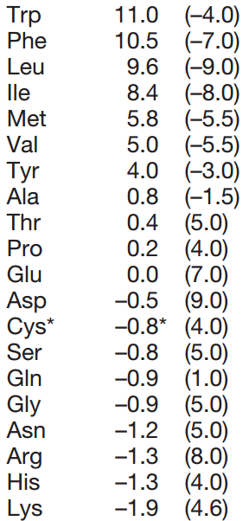
Peptide retention times can be predicted using bioinformatic algorithms (SSRCalc)
SSRCalc: Sequence-Specific Retention Calculator
sums retention coefficients of individual amino acids, plus additionally considers retention coefficients N-term amino acid
Krokhin 2004

Slide 8
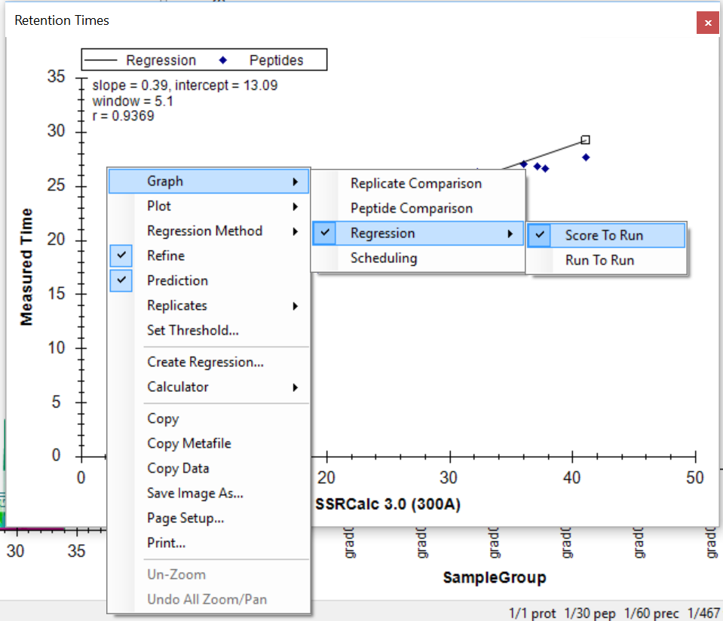
Viewing SSRCalc results in Skyline
Tip! In the Retention Time pane, right click and select “Graph” > “Regression” > “Score To Run”

Slide 9
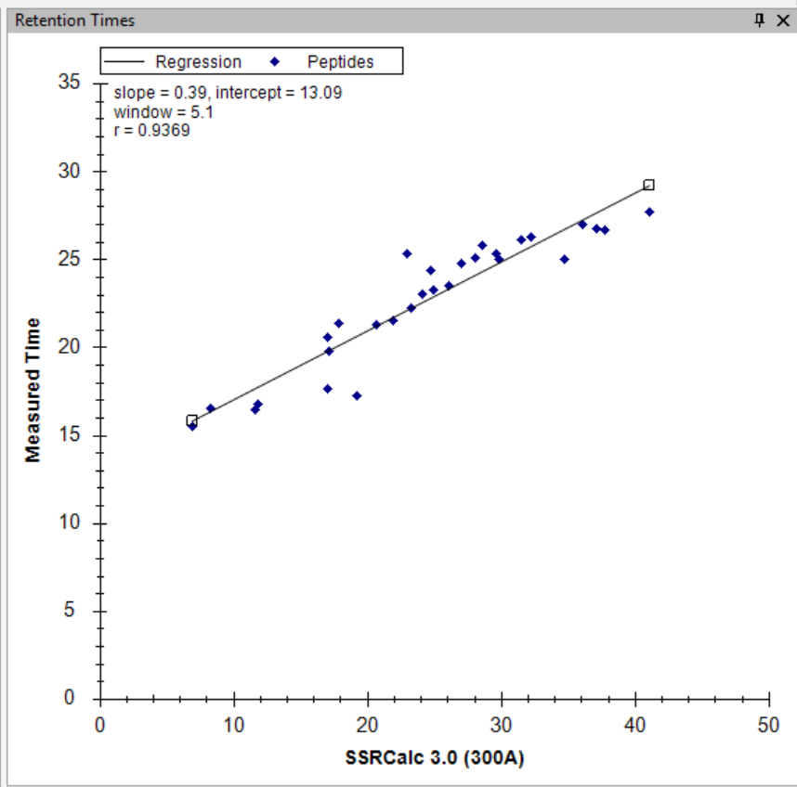
Reading a regression-view Retention Time pane with an SSRCalc calculator
“real” RT
Each point is a peptide
SSRCalc score

Slide 10
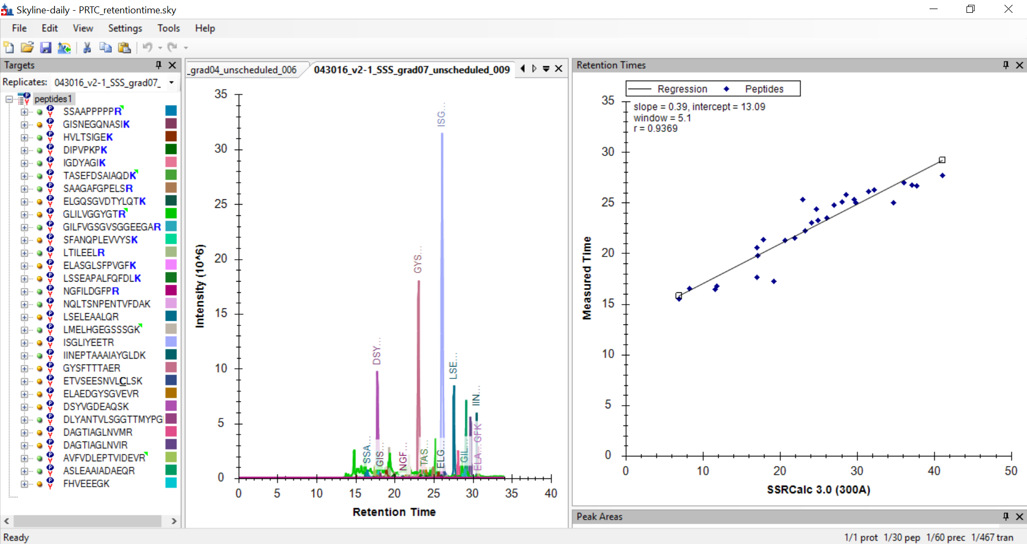

Slide 11
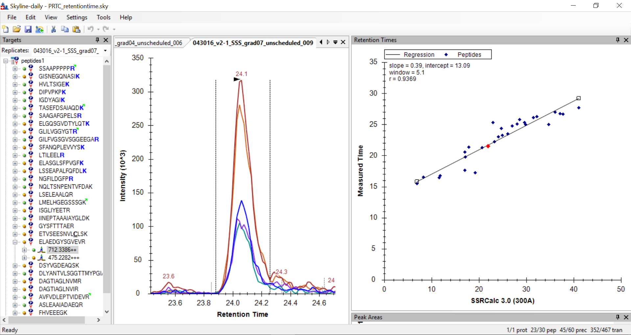

Slide 12
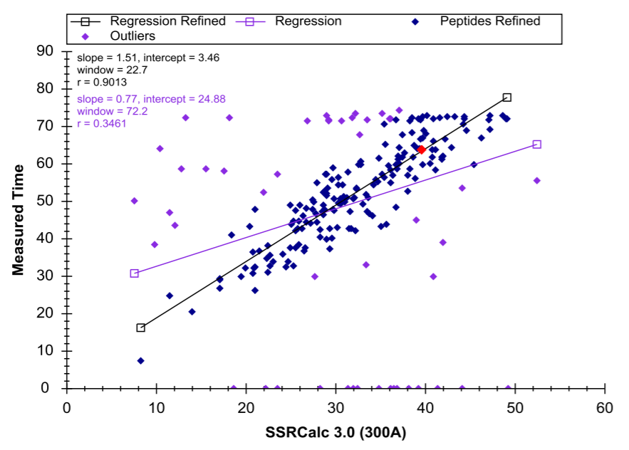

Slide 13

Outliers!

Slide 14
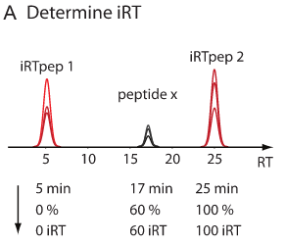
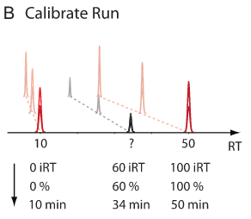
Peptide RT can be empirically determined using standards (iRT)
iRT: a technique for storing calibrated, empirically measured peptide retention times in a library for future use in retention time prediction
Escher 2012

Slide 15
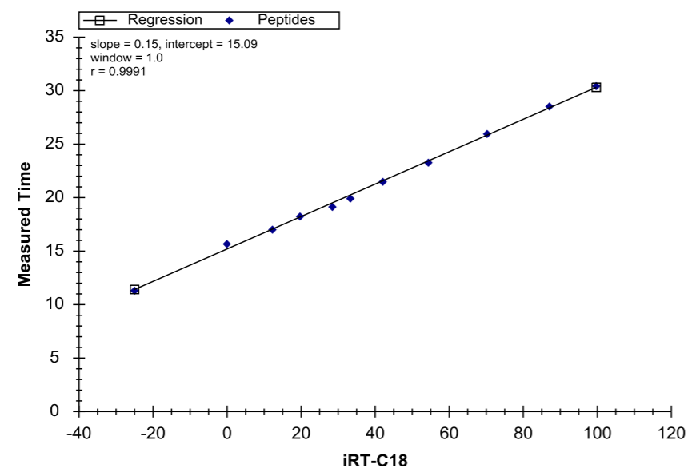
Reading a regression-view Retention Time pane with an iRT calculator

Slide 16
Regression-view Retention Time pane: SSRCalc and iRT calculator
Each point is a peptide
SSRCalc score
“real” RT
iRT value

Slide 17
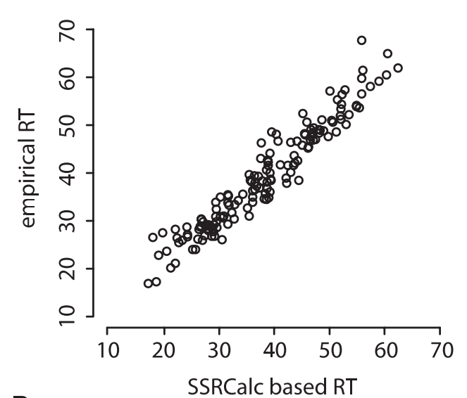
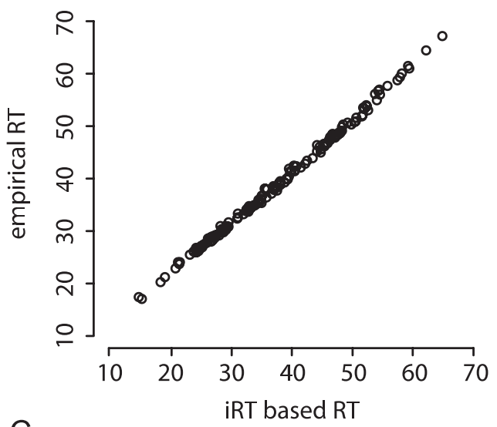
Empirically derived retention times (iRT) outperform computationally predicted RT (SSRCalc)
Escher 2012

Slide 18
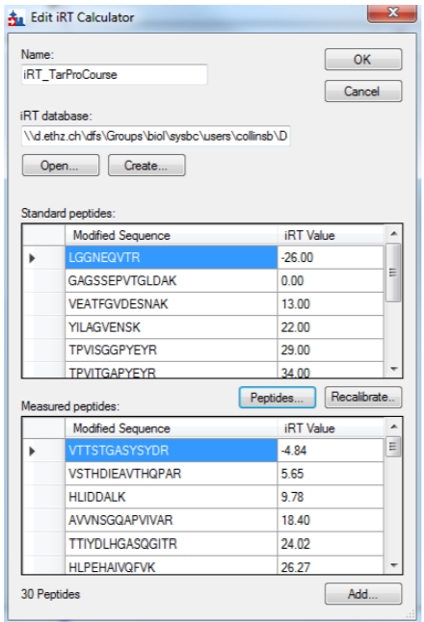
Peptide standards establish the correlation between RT prediction score and measured RT
Hands-on iRT calculators from Brendan after this!

Slide 19
Many types of RT standards to choose from
Exogenous commercial standard spike-in
Pro: reliability
Con: price
Ex: Pierce, Sigma Aldrich, Biognosys, …
Experiment-specific endogenous standards
Pro: Cheap, simple implementation
Con: Must see those peptides in every sample!
Ex: Common contaminants (human keratin), abundant system-specific peptides (albumin)

Slide 20
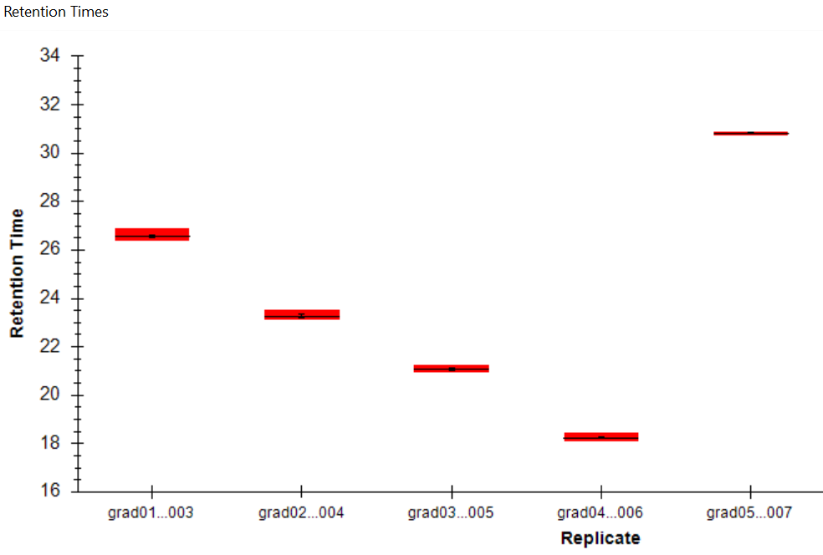
RT standards and prediction guard against RT drift
Tip! In the Retention Times pane, right click and select “Graph” > “Replicate Comparison” (you can click and drag areas to zoom, too)
Same column over time →
New column

Slide 21
Conclusions
Peptide retention time is influenced by the LC, not by the MS
SSRCalc predicts retention time with no knowledge other than the peptide sequence
iRT uses peptide standards to build a normalized peptide RT that can then be applied to unknown peptides
Skyline supports both SSRCalc- and iRT-based retention time prediction

Slide 22
For more information…
Literature
iRT:
http://onlinelibrary.wiley.com/doi/10.1002/pmic.201100463/abstract
SSRCalc:
http://www.mcponline.org/content/3/9/908.full.pdf
Skyline iRT calculator tutorials
http://dia-swath-course.ethz.ch/tutorials2015/Tutorial-5_Scheduling.pdf
https://skyline.ms/wiki/home/software/Skyline/page.view?name=tutorial_irt
Retention time in Skyline (pp 7-12)
https://skyline.ms/_webdav/home/software/Skyline/%40files/tutorials/MethodRefine-1_4.pdf

Slide 23
Hands on: Building an iRT calculator
Take home:
Create and apply an iRT calculator within a Skyline document
Interpret regression visualizations of RT

