Slide 1
LC optimization
Northeastern University
Targeted Proteomics with Skyline
Monday, May 1 - 3:30 pm session

Slide 2
Objectives
Explore how to manipulate liquid chromatography to achieve your experimental goals
Build intuition for the effects of liquid chromatography on quantitative MS data

Slide 3
Agenda
Overview of retention time
Predicting retention time with SSRCalc and iRT
Choosing RT standards
Hands on: building a retention time calculator
--break--
LC Optimization, part 1
Hands on: Effect of LC gradient on quantitative MS
LC Optimization, part 2
Hands on: Effect of scheduling on quantitative MS

Slide 4
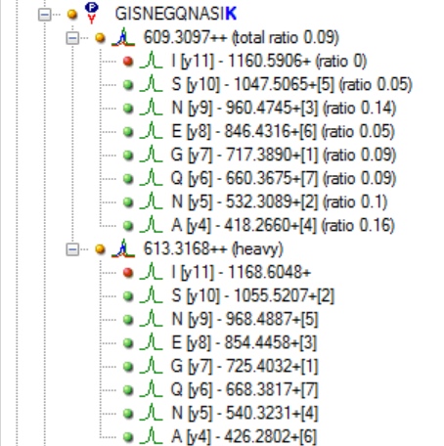
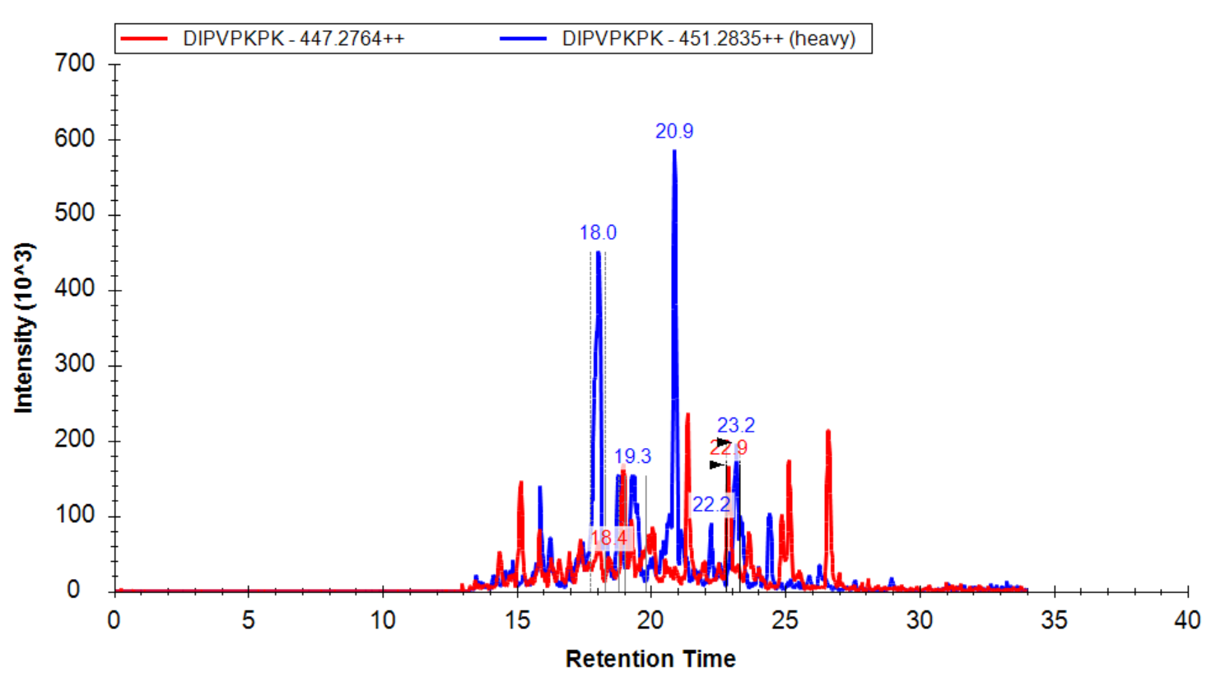
Peak picking with retention time information
Prediction of m/z good, prediction of RT not so good
Knowledge of when a peptide elutes helps the software “pick” the right peptide peak
Recall: empirically sourced RT is more accurate than predicted!

Slide 5

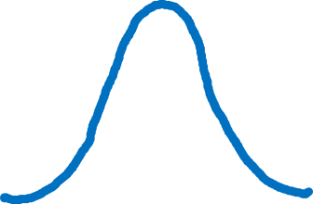
Chromatography has quantitative consequences

Slide 6
Chromatography has quantitative consequences

Slide 7
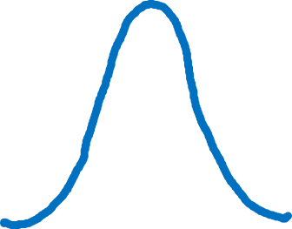
Chromatography has quantitative consequences
cycle time

Slide 8
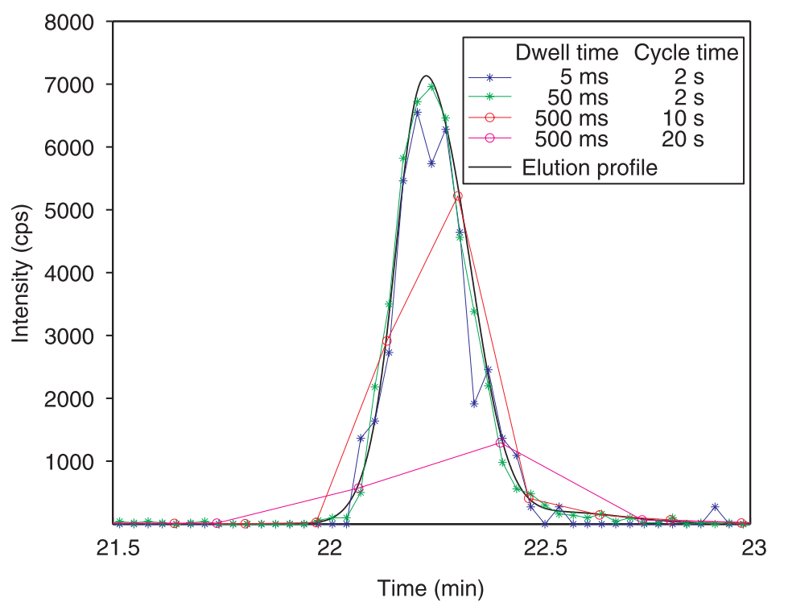
Quantitative accuracy is a function of dwell time and cycle time
Lange 2008

Slide 9
Balancing number of targets, dwell time, and acquisition time
Target list
Acquisition time
Dwell time

Slide 10
Balancing number of targets, dwell time, and acquisition time
Number of precursors/transitions
Target list
Total duration of the acquisition
Amount of time spent on each scan
Acquisition time
Dwell time

Slide 11
Balancing number of targets, dwell time, and acquisition time
Target list
# Targets * dwell time = cycle time
Acquisition time
Dwell time

Slide 12
Points-across-peak can be manipulated by number of scans or by peak width
cycle time

Slide 13

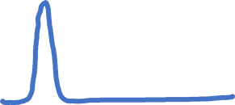

Peak width is determined by a combination of column and gradient details
Important Column Details
Length (aka bed volume)
Stationary phase (packing material)
Inner diameter (ID)

Slide 14




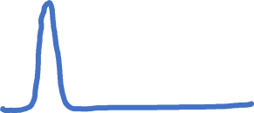




Faster separation
Greater loading capacity
Greater sensitivity

Slide 15
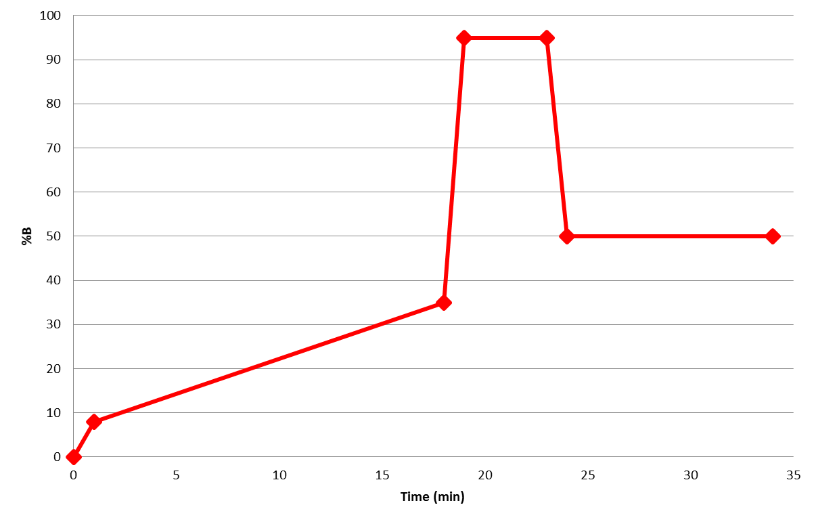
Gradient details – the separation aka analytical gradient – also affect separation
Important Gradient Details
Starting condition
Duration of separation
Start/end %B
Equally important is the “wash” and “reequilibration” step, but for now we’ll focus on just separation/analytical

Slide 16

Analytical component is specified by the duration of separation, and the starting %B and ending %B
Wash
(“clean” column)
Separating aka analytical
(when peptides elute)
Reequilibration
(prepare column to bind next sample’s peptides)
Hands on coming up

Slide 17
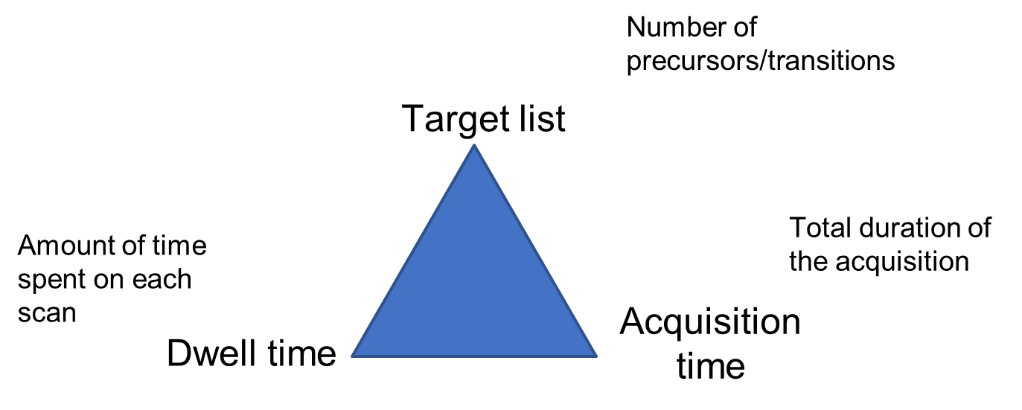
Conclusions
Components to an LC method
Column details:
Bed volume
packing material
Tubing ID
Gradient details:
Starting condition
Duration of separation
Start/end %B

Slide 18
Hands on: gradient effects on method
Take home:
Build intuition for how separation affects data
Practice utilization of Skyline Document Grid (points across peak)

Slide 19
Agenda
Overview of retention time
Predicting retention time with SSRCalc and iRT
Choosing RT standards
Hands on: building a retention time calculator
--break--
LC Optimization, part 1
Hands on: Effect of LC gradient on quantitative MS
LC Optimization, part 2
Hands on: Effect of scheduling on quantitative MS

Slide 20
Hands on: gradients differed in separation, but same wash and reequilibration

Slide 21
Separation gradients aren’t required to have one constant slope
Multi step separation
Sharp bump to elute hydrophobics
Long and shallow during “typical” peptide elution
Quick bump to 5-10%

Slide 22
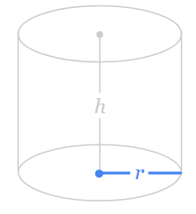
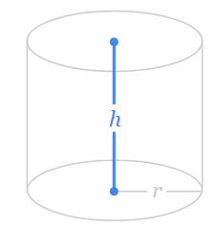
Gradient wash and reequilibration rule-of-thumbs
Column bed volume: V = π * r * 2h
Typically you know the inner diameter (ID) of the column (r) and the length of your column (h)
Step | Solvent | Volume
Separation | Range (2-60% B) | --
Wash | 70-98% B | 1x column volume
Reequilibration | Starting conditions (2-5% B) | 2-3x column volume
Notes:
100 um ID = 0.1 mm diameter = 0.05 mm radius ; 25 cm column = 250 mm height ;

Slide 23
Reequilibration practice example
Column bed volume: V = π * r * 2h
Reequilibrate with 2-3x column volume
Given:
100 um ID
25 cm bed length
Notes:
100 um ID = 0.1 mm diameter = 0.05 mm radius ; 25 cm column = 250 mm height ;

Slide 24
Reequilibration practice example
Column bed volume: V = π * r * 2h
Reequilibrate with 2-3x column volume
Given:
100 um ID
25 cm bed length
Bed volume:
1.96 ul
Wash for 10 min
Tip: Increasing flow rate can help reequilibrate faster, but be cautious of back pressure
Bed volume (1.96 ul) * 2 = 4 ul
Bed volume (1.96 ul) * 3 = 6 ul
4 – 6 ul
Reequilibration volume (4 ul) / Flow rate (0.2 ul/min) = 20 min
Reequilibration volume (6 ul) / Flow rate (0.2 ul/min) = 30 min
20 – 30 min
Notes:
100 um ID = 0.1 mm diameter = 0.05 mm radius ; 25 cm column = 250 mm height
Flow rate of 0.3 ul/min = 12 – 20 min!

Slide 25
Tips and tricks 1
Increasing flow rate can help reequilibrate faster, but be cautious of back pressure
Shorter columns generate less backpressure (can flow faster)
Bigger beads generate less backpressure
Heating increases the maximum flow rate your column can handle

Slide 26
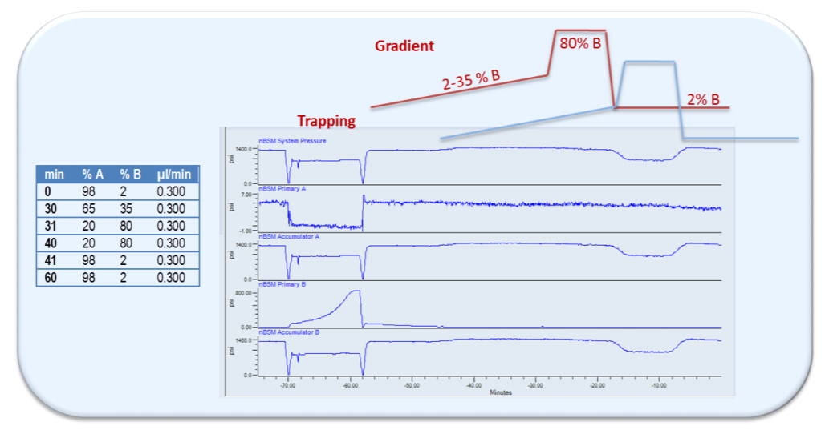
Tips and tricks 2
“Dead volume” means you have to keep pumping solvent to “see” your peptides elute
don’t just stop the method at your peptide’s elution percentage
“dead volume” can be calculated, but it’s easier to simply observe
University of Washington Proteomics Resource (UWPR)

Slide 27

Tips and tricks 3
Use of a “trap” aka “precolumn” is helpful in certain experiments
What it is: a short (2-3cm) column placed between the HPLC gradient delivery and the micro-tee
What it does: concentrates the sample bolus, washes salts from sample
What you gain: trap gets “dirty” before your analytical column does, and changing a dirty trap is less disruptive to chromatographic conditions than changing the analytical column

Slide 28
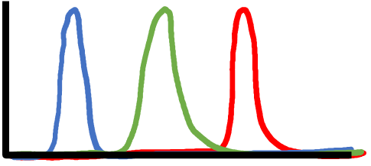
“Scheduling” targeted methods makes efficient use of MS/MS scans
MS/MS scan
Point on peak
Cycle time
Targeted acquisition of “red” m/z

Slide 29
“Scheduling” targeted methods makes efficient use of MS/MS scans
Unscheduled
Scheduled

Slide 30
Comparison of unscheduled vs scheduled
 | Unscheduled |  | Scheduled
Workflow | “Set it and forget it” |  | Requires periodic adjustment to account for peptide RT drift
Target list | Less targets (limited by minimum 3-5 points across the peak) |  | More targets
Quantitative quality | Less points-across-peak on average (fixed cycle time across gradient) |  | More points-across-the-peak on average (variable cycle times across gradient)

Slide 31
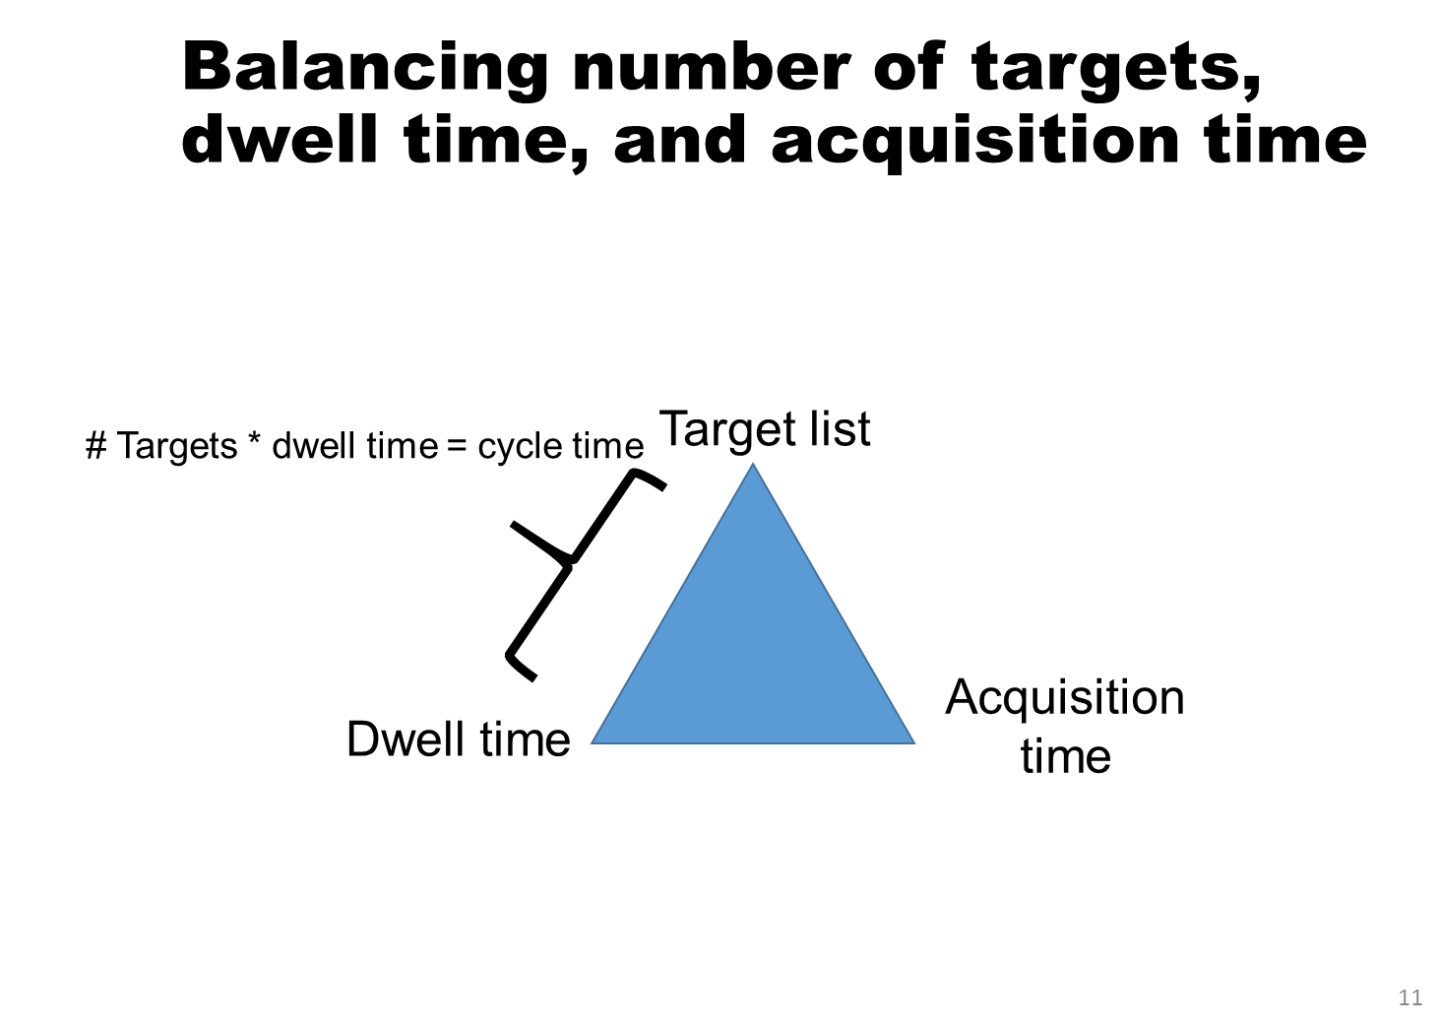
Recall: balancing number of targets with acquisition time and dwell time

Slide 32
When scheduling isn’t enough, multiple injections is a possibility

Slide 33
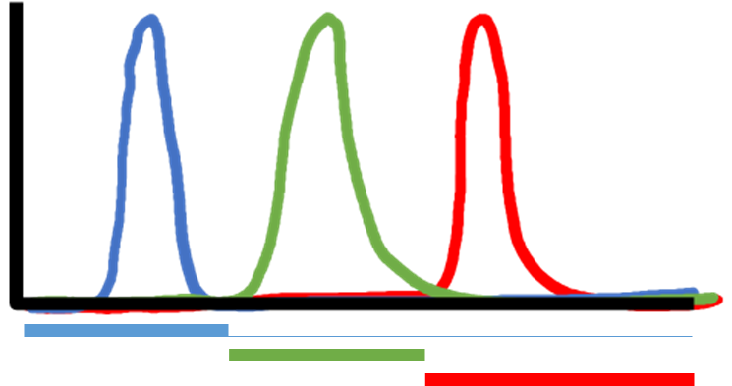

Multiple injections splits method into parts
Injection #1: blue and red
Injection #2: green

Slide 34
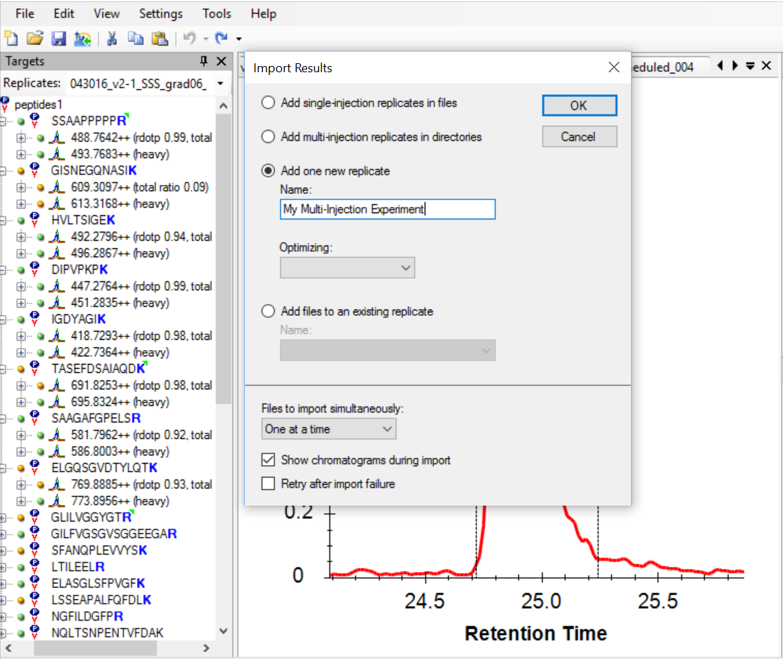

Process and visualize multiple injection experiments as single files using Skyline
Tip! Import multiple injections as a single run:
File >
Import >
Results >
Add multi-injection
Add new replicate + Add files to an existing replicate

Slide 35
Conclusions
Step | Solvent | Volume
Separation | Range (2-60% B) | --
Wash | 70-98% B | 1x column volume
Reequilibration | Starting conditions (2-5% B) | 2-3x column volume
Various “tricks” help meet experimental needs
Chromatography: flow rates, heat, trapping, …
MS: scheduling, multi-injection, …

Slide 36
For more information…
Solid HPLC Resource
http://www.ionsource.com/tutorial/chromatography/rphplc.htm
Full Skyline method refinement tutorial:
https://skyline.ms/labkey/_webdav/home/software/Skyline/%40files/tutorials/MethodRefine-1_4.pdf
Unmentioned tip: Ion pairing additives (like DMSO)
http://www.nature.com/nmeth/journal/v10/n10/abs/nmeth.2610.html

Slide 37
Hands on: Scheduled vs unscheduled
Take home:
Differentiate data analysis between scheduled vs unscheduled
Explore how peak picking is affected by scheduling
Locate and manipulate the scheduling window visualization in Skyline

