Slide 1
Study of Financial Market based on S&P 500
Changhyun Ahn
(Edward) Xi Cai
(Betti) Biwei Tao

Slide 2
Our research is trying to
We are trying to reveal effects from BAD NEWS on Index
Crises in early 2000 and in late 2000 both changed characteristics of financial markets?
Comparison between market volatilities by time series analyses
Simulations from results of the analyses
Friday Index is less than that on other weekdays because BAD NEWS usually disclosed in Friday?

Slide 3
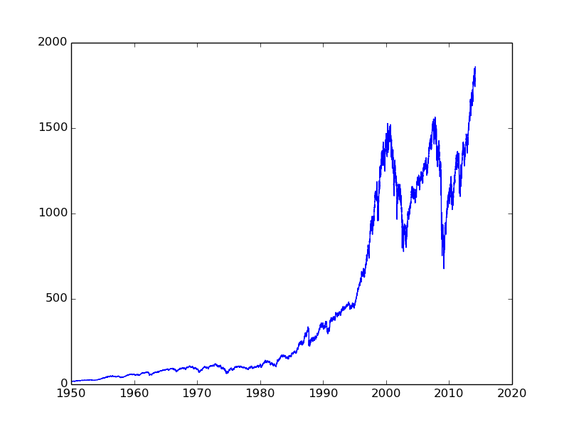
Historical DATA of S&P 500 Index

Slide 4
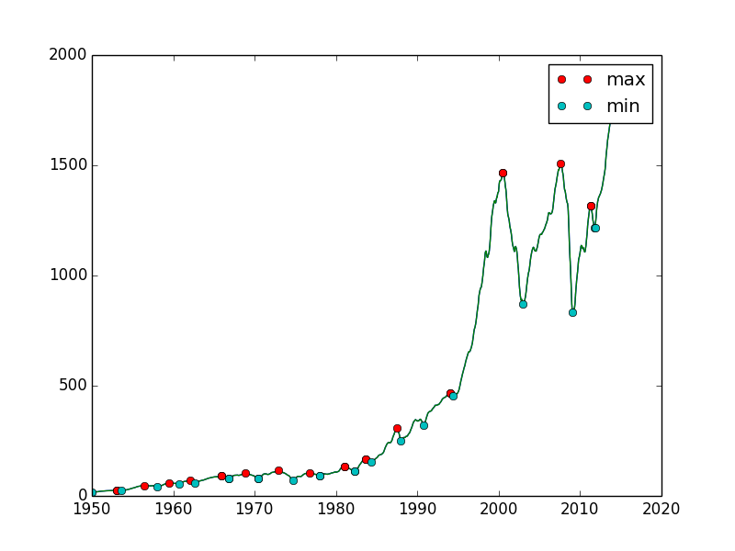
Smoothed Index and Local MAX & MIN
Notes:
Tried to find exact dates of crises
Smoothed the data by neighboring 300 days
Found local maxima, candidates of the Indices before crises began

Slide 5
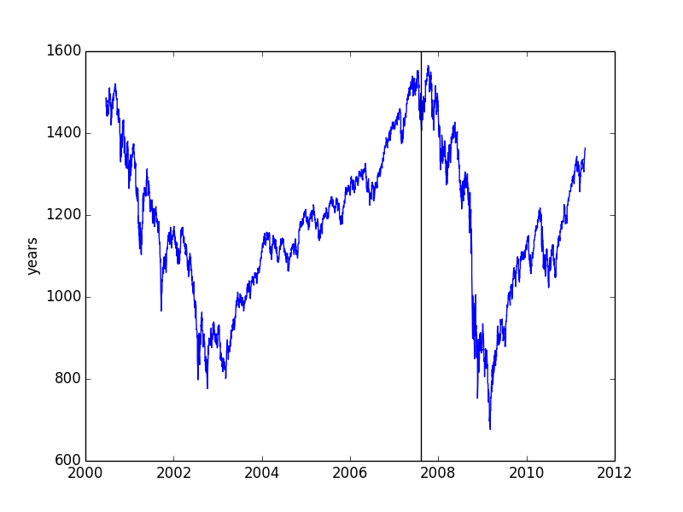
Pre-Event and Post-Event Index DATA

Slide 6

ARIMA(Autoregressive Integrated Moving Average) Model
$W_{t}=∇^{d}Y_{t}$
$W_{t}=φ_{1}Y_{t−1}+φ_{2}Y_{t−2}+⋯+φ_{p}W_{t−p}−θ_{1}e_{t−1}−θ_{2}e_{t−2}−⋯−θ_{q}e_{t−q}$

Slide 7
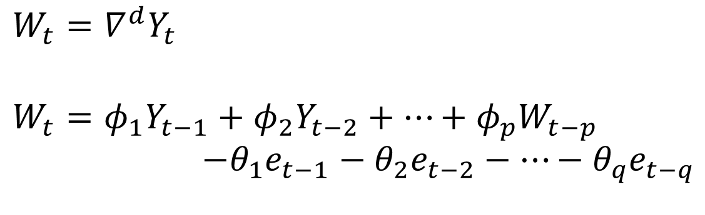
ARIMA(Autoregressive Integrated Moving Average) Model
ARIMA(p, d, q)
$$W_{t}=∇^{d}Y_{t}$$
$$W_{t}=φ_{1}Y_{t−1}+φ_{2}Y_{t−2}+⋯+φ_{p}W_{t−p}$$
$$−θ_{1}e_{t−1}−θ_{2}e_{t−2}−⋯−θ_{q}e_{t−q}$$

Slide 8
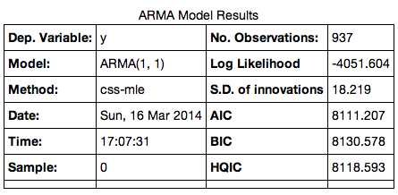
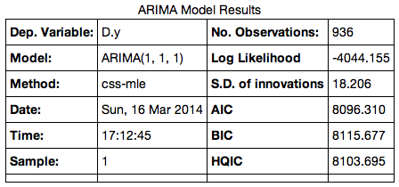
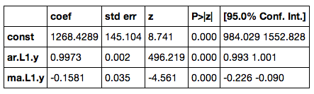
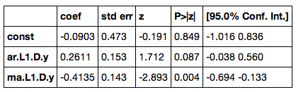
ARIMA Results from Pre and Post-Events

Slide 9
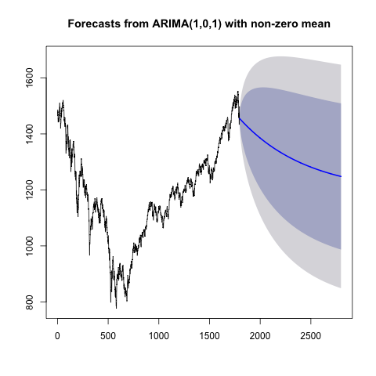
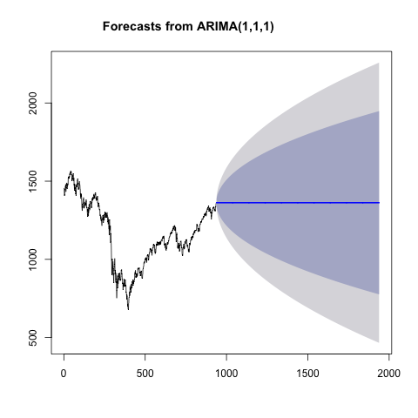
Forecasts

Slide 10
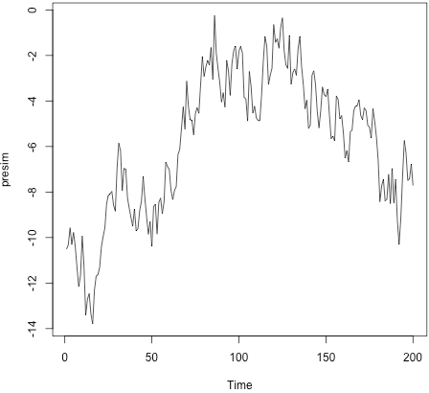
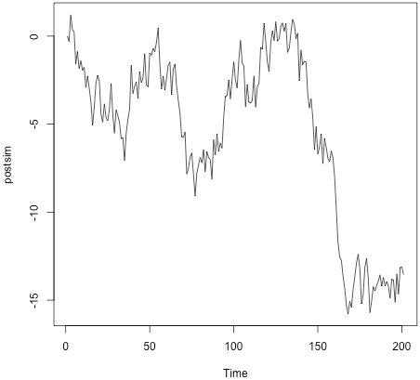
Simulations

Slide 11
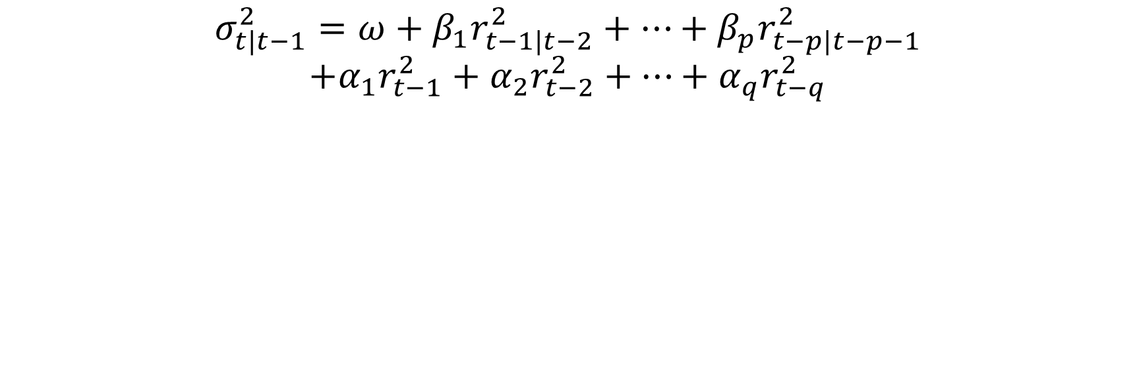
GARCH(Generalized Autoregressive Conditional Heteroscedasticity)
$$σ_{t|t−1}^{2}=ω+β_{1}r_{t−1|t−2}^{2}+⋯+β_{p}r_{t−p|t−p−1}^{2}$$
$$+α_{1}r_{t−1}^{2}+α_{2}r_{t−2}^{2}+⋯+α_{q}r_{t−q}^{2}$$

Slide 12
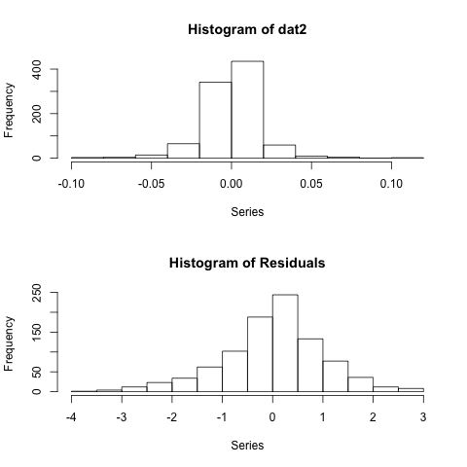
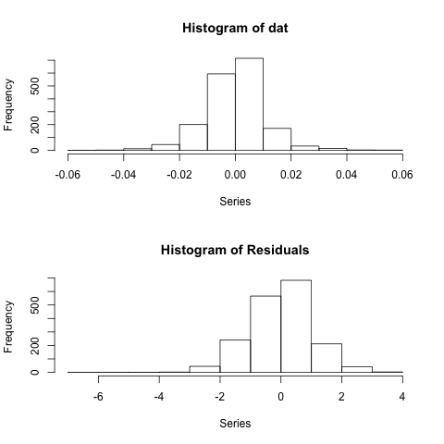
Log Returns and Residuals

Slide 13
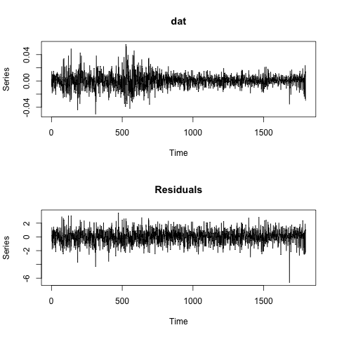
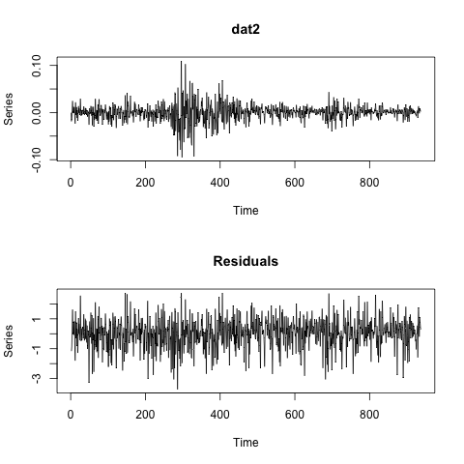
Log Returns and Residuals

Slide 14
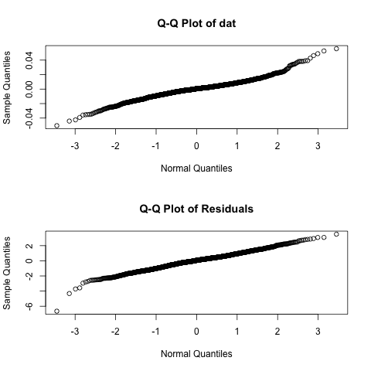
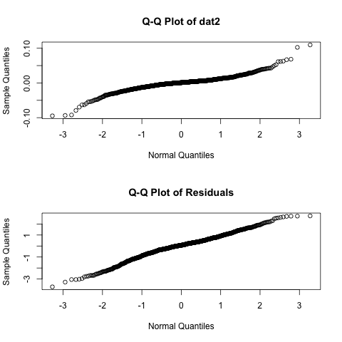
Q-Q Plots

Slide 15
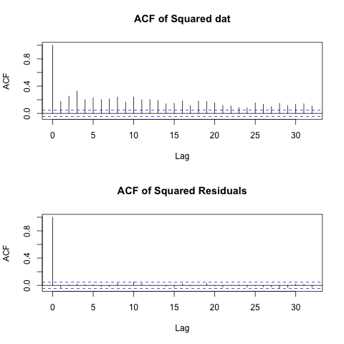
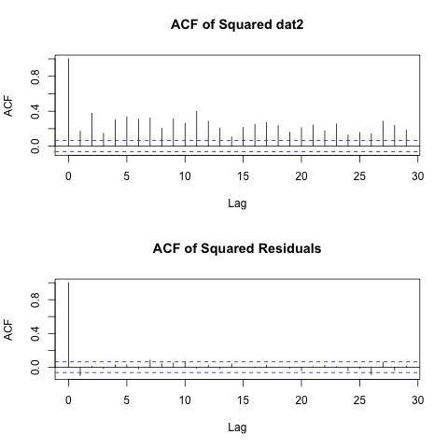
ACF(Auto-correlated Functions)

Slide 16
Investigation of “Weekend Effect”
Investopedia Definition:
A phenomenon in financial markets in which stock returns on Mondays
are often significantly lower than those of the immediately preceding Friday.
Some theories that explain the effect attribute the tendency for companies
to release bad news on Friday after the markets close to depressed stock prices
on Monday. Others state that the weekend effect might be linked to short selling,
which would affect stocks with high short interest positions.
After Hours in the U.S.:
1) 4:00 p.m. to 8:00 p.m. ET, and 2) 4:00 a.m. to 9:30 a.m. ET

Slide 17
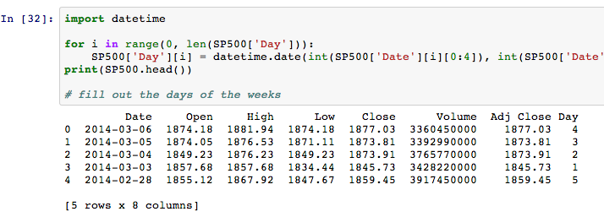
Data Cleaning by Day of the Week (1)

Slide 18
Data Cleaning by Day of the Week (2)
Rate of Return: Day Adjusted Close / Next Day Open
Monday | Tuesday | Wednesday | Thursday | Friday
1.04 | 0.98 | NaN | 1.00 | 0.98
1.01 | NaN | 1.00 | 1.01 | 1.03
… | … | … | … | …
0.94 | 1.03 |  | .98 | NaN
 | 1.01 |  |  | 1.01

Slide 19
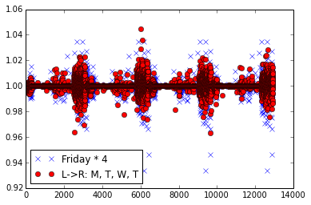
Daily Rate of Return (open / adj. close)

Slide 20
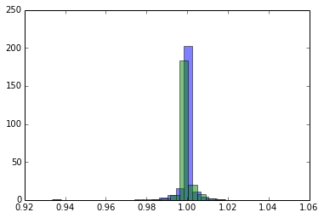
Normalized Histogram Friday vs. NonFriday

Slide 21
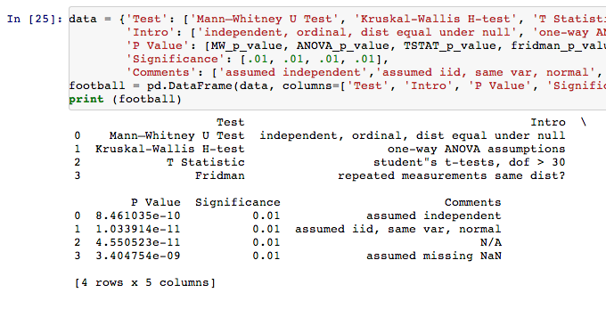

Slide 22
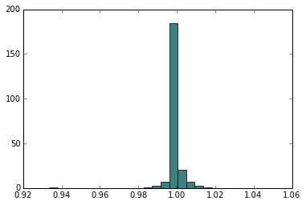
“Triweight” Kernel Estimation Bootstrapping Sample vs. Population

Slide 23
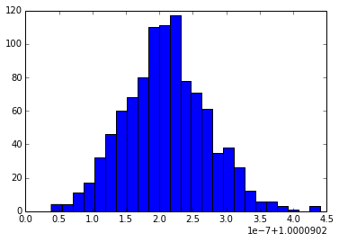
T = mean(Bootstrap Friday*)

Slide 24
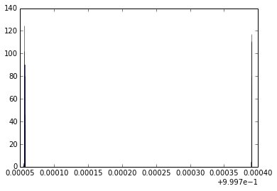
Extreme p-values… assumption failed?

