Slide 1

面向前端开发者的 V8性能优化
@justjavac
https://github.com/justjavac

Slide 2


Slide 3
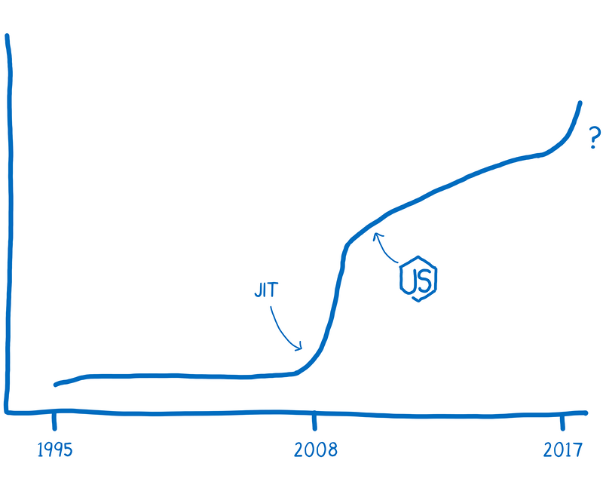

Slide 4
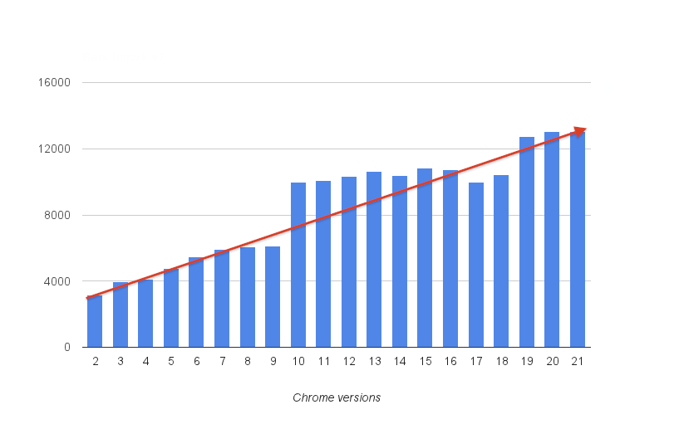
V8's Score on V8Bench (version 7)

Slide 5
动态语言如何进行快速算术

Slide 6
导读
V8中数字的表示
动态语言的算术运算为何慢
解释器、非优化编译器
类型反馈、优化编译器
去优化（Deoptimization）
截断分析
编译器的挑战
语言设计讨论
新的数字类型提案（Int64，BigNum，SIMD）

Slide 7
Encoding of numbers in V8 (x64)
小整数（Small integers） “tagged pointers”.
整数:
引用:
例如, 整数 42 编码为 0x0000002a00000000 指针 0x12345678 编码为 0x12345679
非整数数值存放在堆里
int32
0000:0000
high 63-bits of pointer
1
Heap
<number header>
1
Pointer to heap num
1
Float64 payload

Slide 8
SMI
// Tag information for Smi.
const int kSmiTag = 0;
const int kSmiTagSize = 1;
const intptr_t kSmiTagMask = (1 << kSmiTagSize) - 1;
template <size_t ptr_size> struct SmiTagging;
template<int kSmiShiftSize>
V8_INLINE internal::Object* IntToSmi(int value) {
int smi_shift_bits = kSmiTagSize + kSmiShiftSize;
uintptr_t tagged_value = (static_cast<uintptr_t>(value) << smi_shift_bits) | kSmiTag;
return reinterpret_cast<internal::Object*>(tagged_value);
}

Slide 9
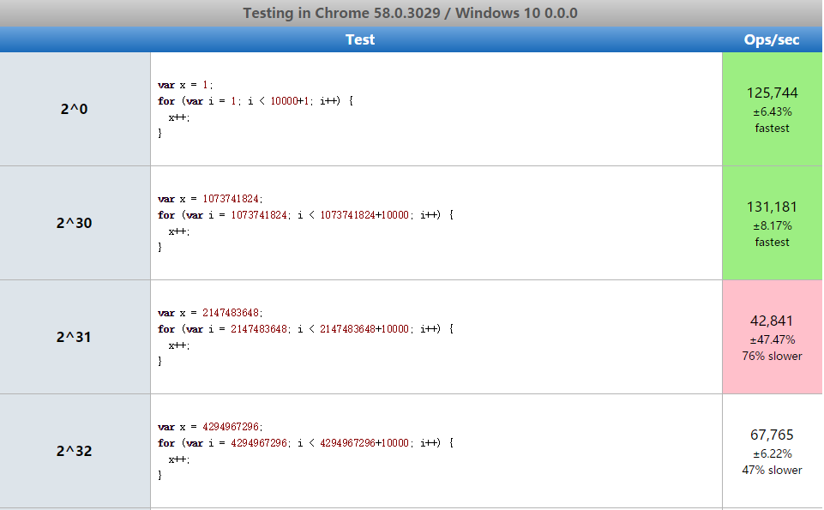
i30 or i31 or i32
// 2^30 is a smi boundary
// on arm and ia32.
var two_30 = 1 << 30;
// 2^31 is a smi boundary
// on arm64 and x64.
var two_31 = 2 * two_30;

Slide 10
i30 or i31 or i32
const SMI_MAX = (1 << 29) - 1 + (1 << 29);
const SMI_MIN = -SMI_MAX - 1;
assertEquals(1, Add1(0)); // fast case
assertEquals(1, Add1Reversed(0)); // fast case
assertEquals(SMI_MAX + ONE, Add1(SMI_MAX), "smimax + 1");
assertEquals(SMI_MAX + ONE, Add1Reversed(SMI_MAX), "1 + smimax");
assertEquals(42 + ONE, Add1(OBJ_42)); // non-smi
assertEquals(42 + ONE, Add1Reversed(OBJ_42)); // non-smi
assertEquals(SMI_MIN - ONE, Sub1(SMI_MIN)); // overflow
assertEquals(ONE - SMI_MIN, Sub1Reversed(SMI_MIN)); // overflow

Slide 11
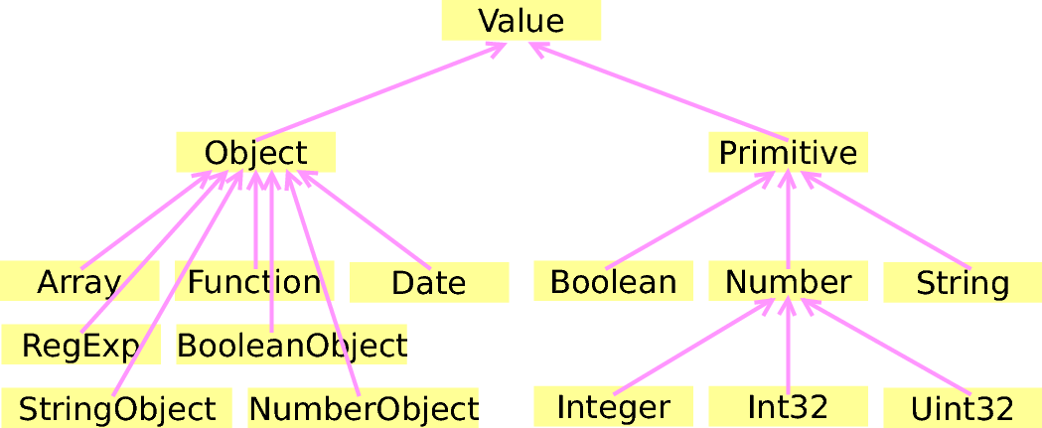
Data type in V8

Slide 12
javascript中的“加法”
为什么 ++[[]][+[]]+[+[]] = 10？
{} + {} 等于多少?
为什么 [1,2] + [3,4] 不等于 [1,2,3,4]？

Slide 13
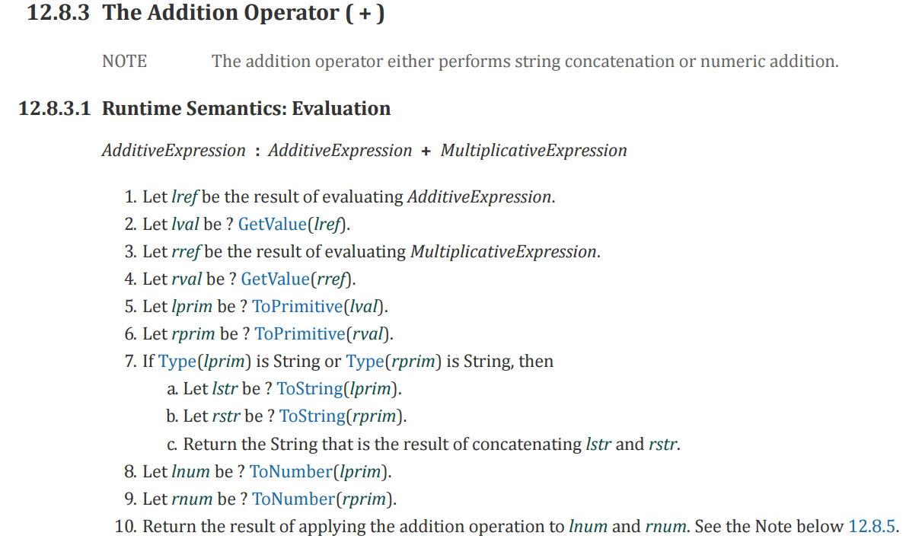
加法操作

Slide 14
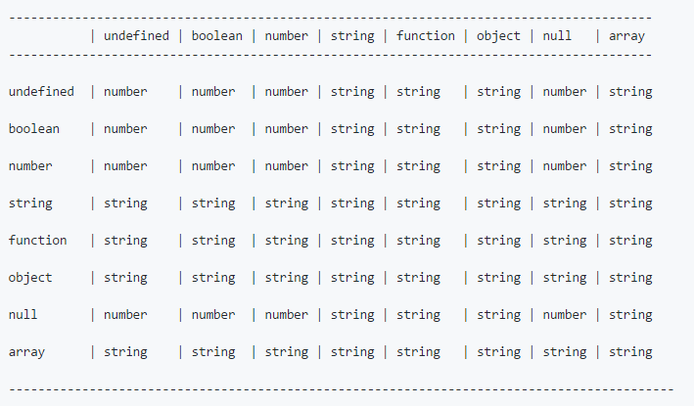
“加法”运算结果

Slide 15
V8的算数运算
快速模式：直接调用二进制代码assembly
小整数
堆区的数值
怪异类型 - undefined, null, true, false.
字符串 (字符串连接运算)
对象（object）运算使用 C++ 实现（慢）

Slide 16
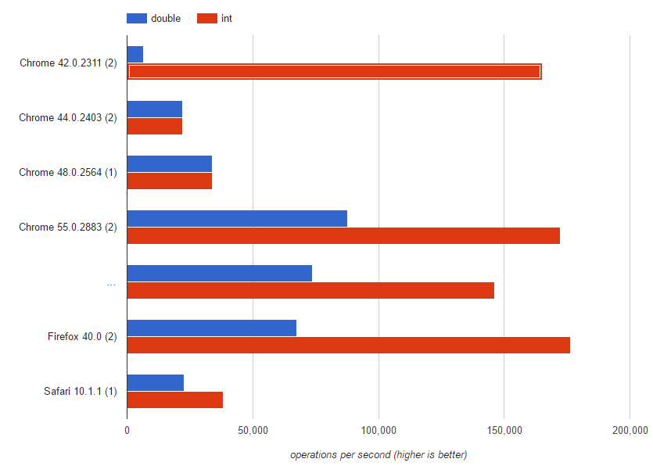
SMI vs Double

Slide 17
快速模式
代码：a + b
常规编译：
mov eax, a
mov ebx, b
call RuntimeAdd
优化编译：
mov eax, a
mov ebx, b
add eax, ebx

Slide 18
Type feedback
二元运算符可以收集函数的 type feedback 信息.
function f(a, b){ var c = a + a; return b + c;
}
函数信息
StackCheck
Ldar a0
Add a0, [2]
Star r0
Ldar r0
Add a1, [3]
Return
Feedback vector
...
...
2: unitialized
3: unitialized

Slide 19
Type feedback
二元运算符可以收集函数的 type feedback 信息.
function f(a, b){ var c = a + a; return b + c;
}
f(1, 2);
函数信息
StackCheck
Ldar a0
Add a0, [2]
Star r0
Ldar r0
Add a1, [3]
Return
Feedback vector
...
...
2: int x int -> int
3: int x int -> int

Slide 20
Type feedback
二元运算符可以收集函数的 type feedback 信息.
function f(a, b){ var c = a + a; return b + c;
}
f(1, 2);
f(1, 0.1)
函数信息
StackCheck
Ldar a0
Add a0, [2]
Star r0
Ldar r0
Add a1, [3]
Return
Feedback vector
...
...
2: int x int -> int
3: num x int -> num

Slide 21
Optimizing compiler
使用 type feedback 做动态检查
一般而言，在编译阶段提前检查
检查之后，使用该类型作为动态类型
如果检查失败，去优化（deoptimize）
去优化之后，可能会使用解释器(ignition)运行中间码

Slide 22
Compile with types
对输入进行检查、相加、返回结果。
function f(a, b){ var c = a + a; return b + c; }
f(1, 2);
f(1, 2);
Feedback vector
...
Optimized code
...
movq rax,[rbp+0x18]
test al,0x1
jnz 115
movq rbx,rax
addq rbx,rax
jo 120
movq rax,[rbp+0x10]
test al,0x1
jnz 125
addq rbx,rax
jo 130
movq rax,rbx
movq rsp,rbp
pop rbp
ret 0x18
...
...
2: int x int -> int
3: int x int -> int
StackCheck
Ldar a0
Add a0, [2]
Star r0
Ldar r0
Add a1, [3]
Return

Slide 23
Compile with types
对输入进行检查、相加、返回结果。
function f(a, b){ var c = a + a; return b + c; }
f(1, 2);
f(1, 2);
f(1, 0.1);//Deopt!
Feedback vector
...
Optimized code
...
movq rax,[rbp+0x18]
test al,0x1
jnz 115
movq rbx,rax
addq rbx,rax
jo 120
movq rax,[rbp+0x10]
test al,0x1
jnz 125
addq rbx,rax
jo 130
movq rax,rbx
movq rsp,rbp
pop rbp
ret 0x18
...
...
2: int x int -> int
3: int x int -> int
StackCheck
Ldar a0
Add a0, [2]
Star r0
Ldar r0
Add a1, [3]
Return
Deoptimizer

Slide 24
去优化Deoptimization
对输入进行检查、相加、返回结果。
function f(a, b){ var c = a + a; return b + c; }
f(1, 2);
f(1, 2);
f(1, 0.1);//Deopt!
Feedback vector
Deoptimizer
生成一个未优化的帧
...
...
2: int x int -> int
3: int x int -> int
-> StackCheck
Ldar a0
Add a0, [2]
Star r0
Ldar r0
Add a1, [3]
Return

Slide 25
去优化Deoptimization
对输入进行检查、相加、返回结果。
function f(a, b){ var c = a + a; return b + c; }
f(1, 2);
f(1, 2);
f(1, 0.1);//Deopt!
Feedback vector
Deoptimizer
生成一个未优化的帧
当运行加法运算时更新 Type feedback 信息。
...
...
2: int x int -> int
3: inum x int -> num
StackCheck
Ldar a0
Add a0, [2]
Star r0
Ldar r0
Add a1, [3]
Return

Slide 26
去优化Deoptimization
对输入进行检查、相加、返回结果。
function f(a, b){ var c = a + a; return b + c; }
f(1, 2);
f(1, 2);
f(1, 0.1);//Deopt!
Feedback vector
...
Optimized code
...
movq rax,[rbp+0x18] test al,0x1 jnz 179 (0x120096c04373) shrq rax, 32 movq rbx,rax addl rbx,rax jo 332 (0x120096c0440c) movq rax,[rbp+0x10] test al,0x1 jz 91 (0x120096c0431b) movq r10,[r13+0x50] cmpq [rax-0x1],r10 vmovsd xmm0,[rax+0x7] jnz 337 (0x120096c04411) jmp 107 (0x120096c0432b) movq r10,rax shrq r10, 32 vxorpd xmm0,xmm0,xmm0 vcvtlsi2sd xmm0,xmm0,r10 vxorpd xmm1,xmm1,xmm1 vcvtlsi2sd xmm1,xmm1,rbx vaddsd xmm0,xmm1,xmm0 movq rbx,[r13+0x7ff3f0] movq rax,rbx addq rax,0x10 cmpq rax,[r13+0x7ff3f8] ja 254 (0x120096c043be) movq [r13+0x7ff3f0],rax incq rbx movq r10,[r13+0x50] movq [rbx-0x1],r10 vmovsd [rbx+0x7],xmm0 movq rax,rbx movq rsp,rbp pop rbp ret 0x18 ...
...
2: int x int -> int
3: inum x int -> num
StackCheck
Ldar a0
Add a0, [2]
Star r0
Ldar r0
Add a1, [3]
Return
Deoptimizer

Slide 27
要避免“去优化”
去优化的消耗是很大的！
主要是因为重新优化（re-optimization）的消耗是很大的！
如果我们不恰当的使用类型反馈信息，那么我们就会陷入去优化的怪圈（deoptimization loop）:
函数不停的去优化，然后再重新优化，直到我们达到了重优化的次数限制，这时我们的函数将再也不会被V8引擎优化。

Slide 28
Deoptimization loop example
function f(x, y) { // 首次运行：x=1, y=undefined if (x) y = x + 1; // Integer feedback for + // Type feedback 猜测 y 为 integer
// 后面的代码会把 y 作为 integer // Crankshaft 会把 y 当作 int32 // 如果 y 不是 int32，那么引擎做去优化 if (x) y = y + 2; // Integer feedback for + return y; }

Slide 29
Deoptimization loop example
function f(x, y) { // 首次 x=1, 然后 x=0
if (x) y = x + 1; // Integer feedback for + // 如果 y 不是 int32，那么引擎做去优化 if (x) y = y + 2; // Integer feedback for + return y;
}
f(1, undefined); // 首先 feedback, 然后 optimize.
// Crankshaft 进行去优化，最终优化被禁止
for (var i = 0; i < 1000000; i++) {
f(0, undefined);
}

Slide 30
Can we do better?
Javascript code
var l = a[i] & 0x3fff,
h = a[i++]>>14,
m = xh*l+h*xl; l = ((m&0x3fff)<<14 …
Asm.js code
e=...|0;K=...|0; ...
S=e+K+c+b+f+E+D+m+o+g+a+C+B+A+z+y+R|0
根本不需要做范围检测，因为位运算只对低32位有效。

Slide 31
截断（Truncations）
在 (x + y)|0 运算时，我们只关心低 32 位的结果。即使 x, y 都是int52，我们也只关心 x 和 y 的低 32 位。
表达式 +a[i] 不区分 a[i] = undefined 和 a[i] = NaN。在稀疏数组中，我们会读取到 NaN! 而不是 undefined。
表达式 c ? x : y 也不需要区分 c = 1 和 c = true。

Slide 32
Example 1
var a = (x|0)+(y|0)*(z&0xff)|0
ToInt32
ToInt32
&
*
+
ToInt32

Slide 33
Example 1 (类型上限)
var a = (x|0)+(y|0)*(z&0xff)|0
ToInt32
Type: I32
Type: I32
Type: 0-255
ToInt32
ToInt32
ToInt32
&
&
*
Type: ..-547608329985
*
+
Type: ..-549755813632
ToInt32
ToInt32

Slide 34
Example 1 (截断传播)
var a = (x|0)+(y|0)*(z&0xff)|0
ToInt32
Type: I32
Type: I32
Type: 0-255
ToInt32
ToInt32
ToInt32
&
&
None
None
None
*
Type: ..-547608329985
*
None
+
Type: ..-549755813632
Word32
ToInt32
ToInt32

Slide 35
Example 1 (截断传播)
var a = (x|0)+(y|0)*(z&0xff)|0
ToInt32
Type: I32
Type: I32
Type: 0-255
ToInt32
ToInt32
ToInt32
&
&
None
None
Word32
*
Type: ..-547608329985
*
Word32
+ I32
Type: ..-549755813632
Word32
ToInt32
ToInt32

Slide 36
Example 1 (截断传播)
var a = (x|0)+(y|0)*(z&0xff)|0
ToInt32
Type: I32
Type: I32
Type: 0-255
ToInt32
ToInt32
ToInt32
&
&
Word32
Word32
Word32
*
Type: ..-547608329985
* I32
Word32
+ I32
Type: ..-549755813632
Word32
ToInt32
ToInt32
现在不需要检查范围溢出，所有的操作都是 int32!

Slide 37
Example 2
var a = (y|0)*(z&0xff); f(a); a = (x|0)+(a|0)|0
ToInt32
ToInt32
&
*
+
Call
ToInt32

Slide 38
Example 2
var a = (y|0)*(z&0xff); f(a); a = (x|0)+(a|0)|0
ToInt32
ToInt32
&
Float64
Float64
Word32
* F64
Any
Word32
I32
Call
Word32
ToInt32

Slide 39
Example 2
var a = (y|0)*(z&0xff); f(a); a = (x|0)+(a|0)|0
ToInt32
ToInt32
&
I32 -> F64
I32 -> F64
* F64
F64 -> W32
I32
Call
ToInt32

Slide 40
“截断”的其他用途
截断还可以用于其他优化:
从 double 到 integer 转换时的负零检查
乘法运算的负零检查
读取数组元素时的 undefined 检查
使引擎能更精准地表示类型
截断传播只在 V8 的 Turbofan 编译器有效。

Slide 41
面临的挑战
目前，引擎首先进行截断分析，而类型反馈不影响截断。
例如，（x + y | 0）中 x 和 y 将会被作为整型。
理想情况下，使用x和y的类型反馈，然后进行 int32加法。
然而，很多情况下，最明智的选择往往是“更差”的表示法。
例如，a + b + 0.5 应该是 float64，即使 a，b 被反馈为整型。

Slide 42
未来方向
JavaScript 可以使用任意的精确的整数
我们可以更加精准的控制V8引擎生成的代码!
也许以后会有 (U)Int64 或 BigNum 类型?
TypedArray
WebAssembly
SIMD

Slide 43
其它
V8 Binding
TurboFan 架构
Intermediate Representation
Hidden Classes
Inline Cache

Slide 44
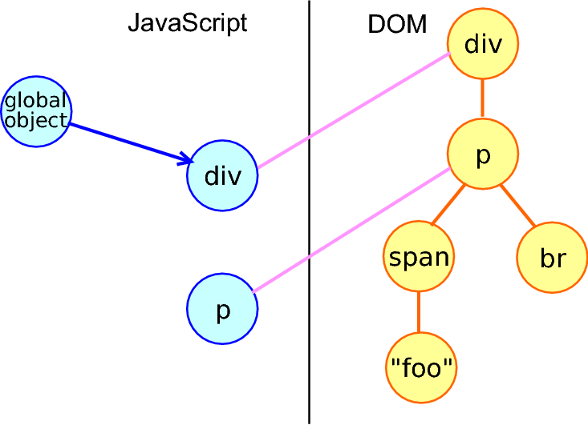
V8 Binding： JS object 和 DOM 对象
div = document.createElement("div");
div.innerHTML = "<p><span>foo</span><br></p>";
div.firstChild;

Slide 45
attribute VS property
<input id="name" disabled>
<a href="/user/list"></a>
<div id="test" class="button" foo="1"></div>
el.getAttribute('name');
el.name

Slide 46
TurboFan 架构
Wasm
Compiler
CodeStub
Assembler
Code
Assembler
Intel, ARM, MIPS,
PowerPC, etc. code
Machine
Graph
Scheduler
Schedule
Backend
Optimizer
Simplified
Graph
Inliner &
Lowerings
JavaScript
Graphs
Bytecode
GraphBuilder
Ast
GraphBuilder
Google Proprietary

Slide 47
TurboFan IR
function f(x) { return x + 1;
}
Start
FrameState
Context parameter
Parameter x
Constant 1
Checkpoint
FrameState
JSAdd
IfSuccess
Return
加法运算有可能进行去优化(deopt)
End

Slide 48
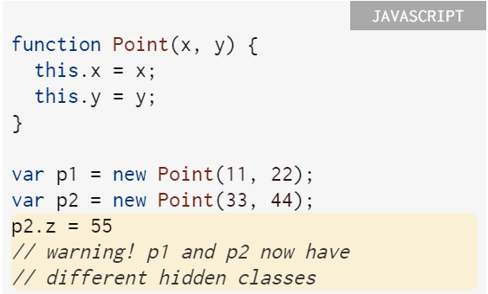
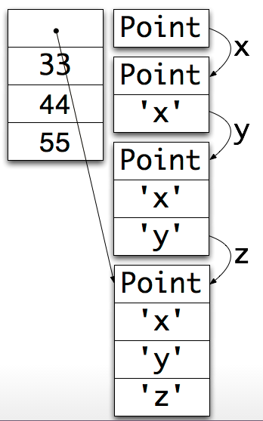
Hidden Classes
http://v8-io12.appspot.com

Slide 49
Talk is cheap. Show me the code.

Slide 50
整数相加
function add(obj) {
return obj.prop + obj.prop;
}
const length = 1000 * 1000;
const o = { prop: 1 };
for (let i = 0; i < length; i++) {
add(o);
}

Slide 51
d8 --trace-opt-verbose add-of-ints.js
[marking 030ADD65 <JS Function test (SharedFunctionInfo 03E3A99D)> for recompilation, reason: small function, ICs with typeinfo: 3/3 (100%), generic ICs: 0/3 (0%)]
[compiling method 030ADD65 <JS Function test (SharedFunctionInfo 03E3A99D)> using Crankshaft]
[optimizing 030ADD65 <JS Function test (SharedFunctionInfo 03E3A99D)> - took 0.033, 0.067, 0.537 ms]
[completed optimizing 030ADD65 <JS Function test (SharedFunctionInfo 03E3A99D)>]
[marking 030ADA75 <JS Function (SharedFunctionInfo 03E3A8E9)> for recompilation, reason: small function, ICs with typeinfo: 3/3 (100%), generic ICs: 0/3 (0%)]
Notes:
第一次优化的原因是 small function，add 函数是小函数，为了减小函数调用的开销，V8 引擎对 add 做了优化。第二次的原因是 hot and stable

Slide 52
混合相加
function test( obj ) {
return obj.prop + obj.prop;
}
let a = { prop: 'a' }, b = { prop: [] }, i = 0;
while ( i++ < 10000 ) {
test( Math.random() > 0.5 ? a : b );
}

Slide 53
d8 --trace-opt-verbose add-of-mixed.js
[marking 03F723E9 <JS Function valueOf (SharedFunctionInfo 03F32765)> for recompilation, reason: small function, ICs with typeinfo: 0/0 (100%), gener
ic ICs: 0/0 (0%)]
[marking 03F6C499 <JS Function toString (SharedFunctionInfo 03F3687D)> for recompilation, reason: small function, ICs with typeinfo: 4/5 (80%), generic ICs: 0/5 (0%)]
[compiling method 03F723E9 <JS Function valueOf (SharedFunctionInfo 03F32765)> using Crankshaft]
[compiling method 03F6C499 <JS Function toString (SharedFunctionInfo 03F3687D)> using Crankshaft]
[optimizing 03F723E9 <JS Function valueOf (SharedFunctionInfo 03F32765)> - took 0.031, 0.112, 0.037 ms]
[completed optimizing 03F723E9 <JS Function valueOf (SharedFunctionInfo 03F32765)>]
[optimizing 03F6C499 <JS Function toString (SharedFunctionInfo 03F3687D)> - took 0.073, 0.211, 0.076 ms]
[completed optimizing 03F6C499 <JS Function toString (SharedFunctionInfo 03F3687D)>]
[not yet optimizing test, not enough type info: 2/3 (66%)]
[not yet optimizing test, not enough type info: 2/3 (66%)]
[not yet optimizing test, not enough type info: 2/3 (66%)]
[not yet optimizing test, not enough type info: 2/3 (66%)]

Slide 54
[not yet optimizing test, not enough type info: 2/3 (66%)]
[not yet optimizing test, not enough type info: 2/3 (66%)]
[not yet optimizing test, not enough type info: 2/3 (66%)]
[not yet optimizing test, not enough type info: 2/3 (66%)]
[not yet optimizing test, not enough type info: 2/3 (66%)]
[not yet optimizing test, not enough type info: 2/3 (66%)]
[not yet optimizing test, not enough type info: 2/3 (66%)]
[not yet optimizing test, not enough type info: 2/3 (66%)]
[not yet optimizing test, not enough type info: 2/3 (66%)]
[not yet optimizing test, not enough type info: 2/3 (66%)]
[marking 037ADADD <JS Function (SharedFunctionInfo 0453A8F5)> for recompilation, reason: small function, ICs with typeinfo: 7/7 (100%), generic ICs:0/7 (0%)]
[not yet optimizing test, not enough type info: 2/3 (66%)]
[not yet optimizing test, not enough type info: 2/3 (66%)]
[not yet optimizing test, not enough type info: 2/3 (66%)]
[not yet optimizing test, not enough type info: 2/3 (66%)]
[not yet optimizing test, not enough type info: 2/3 (66%)]

Slide 55
--trace-deopt
function test( obj ) {
return obj.prop + obj.prop;
}
let a = { prop: 'a' }, b = { prop: [] }, i = 0;
while ( i++ < 10000 ) {
test( i !== 8000 ? a : b );
}

Slide 56
[deoptimizing (DEOPT eager): begin 035ADE39 <JS Function test (SharedFunctionInfo 0433ABA1)> (opt #0) @3, FP to SP delta: 12, caller sp: 0x00c2f548]
reading input frame test => node=4, args=2, height=1; inputs:
0: 0x035ade39 ; [fp - 8] 035ADE39 <JS Function test (SharedFunctionInfo 0433ABA1)>
1: 0x03d8a395 ; [fp + 12] 03D8A395 <JS Global Object>
2: 0x035adec1 ; ecx 035ADEC1 <an Object with map 0450DB69>
3: 0x03d6b2b9 ; [fp - 12] 03D6B2B9 <FixedArray[173]>
translating frame test => node=4, height=0
0x00c2f544: [top + 20] <- 0x03d8a395 ; 03D8A395 <JS Global Object> (input #1)
0x00c2f540: [top + 16] <- 0x035adec1 ; 035ADEC1 <an Object with map 0450DB69> (input #2)
0x00c2f53c: [top + 12] <- 0x04433dac ; caller's pc
0x00c2f538: [top + 8] <- 0x00c2f564 ; caller's fp
0x00c2f534: [top + 4] <- 0x03d6b2b9 ; context 03D6B2B9 <FixedArray[173]> (input #3)
0x00c2f530: [top + 0] <- 0x035ade39 ; function 035ADE39 <JS Function test (SharedFunctionInfo 0433ABA1)> (input #0)
[deoptimizing (eager): end 035ADE39 <JS Function test (SharedFunctionInfo 0433ABA1)> @3 => node=4, pc=0x044340e5, caller sp=0x00c2f548, state=NO_REGISTERS, took 5.152 ms]
[removing optimized code for: test]
[evicting entry from optimizing code map (notify deoptimized) for 0433ABA1 <SharedFunctionInfo test>]

Slide 57
Garbage Collection
function strToArray( str ) {
let i = 0,
len = str.length,
arr = new Uint16Array( str.length );
for ( ; i < len; ++i ) {
arr[ i ] = str.charCodeAt( i );
}
return arr;
}
let i = 0, str = 'V8 is the collest';
while ( i++ < 1e5 ) {
strToArray( str );
}

Slide 58
d8 --trace-gc gc.js
[14484:01BF4CA8] 9 ms: Scavenge 1.7 (2.5) -> 1.6 (3.5) MB, 0.7 / 0.0 ms [allocation failure].
[14484:01BF4CA8] 11 ms: Scavenge 1.7 (3.5) -> 1.7 (4.5) MB, 0.6 / 0.0 ms [allocation failure].
[14484:01BF4CA8] 131 ms: Scavenge 3.2 (7.5) -> 2.7 (9.5) MB, 1.8 / 0.0 ms [allocation failure].
[14484:01BF4CA8] 196 ms: Scavenge 4.2 (9.5) -> 2.7 (9.5) MB, 6.7 / 0.0 ms [allocation failure].
[14484:01BF4CA8] 223 ms: Scavenge 4.6 (9.5) -> 2.7 (9.5) MB, 8.0 / 0.0 ms [allocation failure].
[14484:01BF4CA8] 250 ms: Scavenge 4.6 (9.5) -> 2.7 (9.5) MB, 8.1 / 0.0 ms [allocation failure].
[14484:01BF4CA8] 275 ms: Scavenge 4.6 (9.5) -> 2.7 (9.5) MB, 8.0 / 0.0 ms [allocation failure].

Slide 59
no-gc
function strToArray( str, bufferView ) {
let i = 0,
len = str.length;
for ( ; i < len; ++i ) {
bufferView[ i ] = str.charCodeAt( i );
}
return bufferView;
}
let i = 0,
str = 'V8 is the coolest',
buffer = new ArrayBuffer( str.length * 2 ),
bufferView = new Uint16Array( buffer );
while ( i++ < 1e5 ) {
strToArray( str, bufferView );
}

Slide 60
[23052:01D277F8] 9 ms: Scavenge 1.7 (2.5) -> 1.6 (3.5) MB, 0.8 / 0.0 ms [allocation failure].
[23052:01D277F8] 10 ms: Scavenge 1.7 (3.5) -> 1.7 (4.5) MB, 0.6 / 0.0 ms [allocation failure].

Slide 61
full gc
function strToArray( str ) {
var i = 0,
len = str.length,
arr = new Uint16Array( str.length );
for ( ; i < len; ++i ) {
arr[ i ] = str.charCodeAt( i );
}
return arr;
}
var i = 0, str = 'V8 is the coolest', arr = [];
while ( i++ < 1e6 ) {
strToArray( str );
if ( i % 100000 === 0 ) {
// 数组里面存放大对象 huge object
arr.push( new Uint16Array( 100000000 ) );
// 5% 概率释放数组
Math.random() > 0.95 && ( arr.length = 0 );
}
}

Slide 62
d8 --trace-gc gc.js
[8664:01E15D10] 9 ms: Scavenge 1.7 (2.5) -> 1.6 (3.5) MB, 0.6 / 0.0 ms [allocation failure].
[8664:01E15D10] 11 ms: Scavenge 1.7 (3.5) -> 1.7 (4.5) MB, 0.7 / 0.0 ms [allocation failure].
[8664:01E15D10] 71 ms: Scavenge 3.2 (7.5) -> 2.7 (9.5) MB, 1.8 / 0.0 ms [allocation failure].
[8664:01E15D10] 94 ms: Scavenge 4.2 (9.5) -> 2.7 (9.5) MB, 6.3 / 0.0 ms [allocation failure].
[8664:01E15D10] 119 ms: Scavenge 4.6 (9.5) -> 2.7 (9.5) MB, 7.6 / 0.0 ms [allocation failure].
[8664:01E15D10] 144 ms: Scavenge 4.6 (9.5) -> 2.7 (9.5) MB, 7.4 / 0.0 ms [allocation failure].
[8664:01E15D10] 169 ms: Scavenge 4.6 (9.5) -> 2.7 (9.5) MB, 8.3 / 0.0 ms [allocation failure].
[8664:01E15D10] 193 ms: Mark-sweep 4.6 (9.5) -> 2.6 (9.5) MB, 5.0 / 0.0 ms [allocation failure] [promotion limit reached].
[8664:01E15D10] 230 ms: Scavenge 4.5 (9.5) -> 2.6 (9.5) MB, 16.9 / 0.0 ms [allocation failure].
[8664:01E15D10] 258 ms: Scavenge 4.5 (9.5) -> 2.6 (9.5) MB, 9.2 / 0.0 ms [allocation failure].
[8664:01E15D10] 282 ms: Scavenge 4.5 (9.5) -> 2.6 (9.5) MB, 7.7 / 0.0 ms [allocation failure].
[8664:01E15D10] 303 ms: Mark-sweep 4.5 (9.5) -> 2.6 (9.5) MB, 4.8 / 0.0 ms [allocation failure] [promotion limit reached].
[8664:01E15D10] 339 ms: Scavenge 4.5 (9.5) -> 2.6 (9.5) MB, 19.2 / 0.0 ms [allocation failure].
[8664:01E15D10] 365 ms: Scavenge 4.5 (9.5) -> 2.6 (9.5) MB, 8.7 / 0.0 ms [allocation failure].

Slide 63
--allow-natives-syntax
function factorial( n ) {
return n === 1 ? n : factorial( --n );
}
var i = 0;
while ( i++ < 1e8 ) {
factorial( 10 );
i % 1e7 === 0 && %CollectGarbage( null );
}

Slide 64
d8 --allow-natives-syntax --trace-gc
[21068:00294D18] 7 ms: Scavenge 1.7 (2.5) -> 1.6 (3.5) MB, 0.7 / 0.0 ms [allocation failure].
[21068:00294D18] 8 ms: Scavenge 1.7 (3.5) -> 1.7 (4.5) MB, 0.6 / 0.0 ms [allocation failure].
[21068:00294D18] 561 ms: Mark-sweep 2.8 (7.5) -> 2.6 (10.5) MB, 2.9 / 0.0 ms [%CollectGarbage] [GC in old space requested].
[21068:00294D18] 1060 ms: Mark-sweep 2.6 (10.5) -> 2.5 (9.5) MB, 3.8 / 0.0 ms [%CollectGarbage] [GC in old space requested].
[21068:00294D18] 1563 ms: Mark-sweep 2.5 (9.5) -> 2.5 (9.5) MB, 2.2 / 0.0 ms [%CollectGarbage] [GC in old space requested].
[21068:00294D18] 2063 ms: Mark-sweep 2.5 (9.5) -> 2.4 (9.5) MB, 1.9 / 0.0 ms [%CollectGarbage] [GC in old space requested].
[21068:00294D18] 2564 ms: Mark-sweep 2.4 (9.5) -> 2.4 (9.5) MB, 1.8 / 0.0 ms [%CollectGarbage] [GC in old space requested].
[21068:00294D18] 3058 ms: Mark-sweep 2.4 (9.5) -> 2.4 (6.5) MB, 1.9 / 0.0 ms [%CollectGarbage] [GC in old space requested].
[21068:00294D18] 3561 ms: Mark-sweep 2.4 (6.5) -> 2.4 (6.5) MB, 1.9 / 0.0 ms [%CollectGarbage] [GC in old space requested].

Slide 65
Hidden Classes
function Class( val ) {
this.prop = val;
}
var a = new Class('foo');
var b = new Class('bar');
print( %HaveSameMap( a, b ) );
b.prop2 = 'baz';
print( %HaveSameMap( a, b ) );

Slide 66
d8 --allow-natives-syntax
true
false

Slide 67
bluebird promise
function toFastProperties(obj) {
/*jshint -W027*/
function f() {}
f.prototype = obj;
ASSERT("%HasFastProperties", true, obj);
return f;
eval(obj);
}

Slide 68
尾调用优化
Syntactic Tail Calls (STC)
https://github.com/tc39/proposal-ptc-syntax

Slide 69
累加
function sum(x) {
if (x === 1) {
return x;
}
return x + sum(x - 1);
}

Slide 70
sum(5)
sum(5)
5 + sum(4)
5 + (4 + sum(3))
5 + (4 + (3 + sum(2)))
5 + (4 + (3 + (2 + sum(1))))
5 + (4 + (3 + (2 + 1)))
5 + (4 + (3 + 3))
5 + (4 + 6)
5 + 10
15

Slide 71
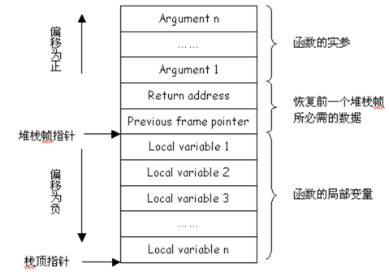

Slide 72
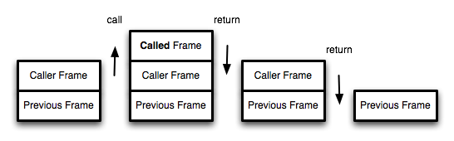
调用栈

Slide 73
存在的问题
function foo(n) {
return bar(n*2);
}
function bar() {
throw new Error();
}
try {
foo(1);
} catch(e) {
print(e.stack);
}

Slide 74
不使用PTC：
Error
at bar
at foo
at Global Code
使用PTC：
Error
at bar
at Global Code

Slide 75
解决方式：显式指定
return continue
!return
#function()

Slide 76
<questions />
by @jjc

