Slide 1
Project Presentation of CO-OP Project at Industry (Module-2) (22CS421)
On
Comparative Analysis of ML & DL Algorithms for Stock Market Prediction
Danish Awasthi, Mayank Gupta
2210990247,2210990467
Supervised By
Swati Goel
Department of Computer Science and Engineering,
Chitkara University, Punjab

Slide 2
Contents
1. Introduction ................................. 3
2. Related Work ................................. 4
3. Dataset and Feature Engineering .............. 5
4. Methodology and Model Configurations ......... 6
5. LSTM Architecture ............................ 7
6. Experimental Results — 80:20 Split ........... 8
7. Error Metrics Chart (MAE / RMSE / MAPE) ...... 9
8. R² Score Comparison Chart .............. 10
9. Multi-Split Evaluation ...................... 11
10. Multi-Split Trend Chart ..................... 12
11. Actual vs Predicted Price Chart ............. 13
12. Scalability and Complexity Analysis ......... 14
13. Feature Importance Chart .................... 15
14. Training Time Chart ......................... 16
15. Multi-Dimensional Capability Radar .......... 17
16. Conclusion .................................. 18
2

Slide 3
Introduction
Background
Stock market prediction is a challenging problem due to non-linear, volatile, and constantly changing financial time-series data.
Traditional methods (ARIMA, exponential smoothing) struggle with non-linear dependencies in stock data.
ML ensemble methods (Random Forest, Gradient Boosting) and DL models (LSTM) have emerged as powerful alternatives.
Research Gap
Most prior studies evaluate ML and DL models in isolation, with inconsistent preprocessing and evaluation metrics.
Practical deployment aspects (complexity, scalability, latency) are rarely addressed.
This Study
Unified comparison of 6 ML models + LSTM on identical dataset, features, and chronological splits.
Includes 18 engineered technical indicators and scalability/deployment analysis.
3

Slide 4
Related Work
Traditional Machine Learning
Ravikumar & Saraf (2020): Random Forest achieved highest regression accuracy among 6 ML models.
Singh et al. (2021): Gradient Boosting outperformed SVM via iterative error correction.
Vazirani et al. (2020): Hybrid Linear Regression model outperformed individual algorithms.
Deep Learning — LSTM
Hochreiter & Schmidhuber (1997): Introduced LSTM to solve the vanishing gradient problem.
Fischer & Krauss (2018): LSTM outperformed DNN, Random Forest, and LR on S&P 500 directional prediction.
Moghar & Hamiche (2020): LSTM showed lower RMSE than standard RNN for longer horizons.
Key Gap Addressed
No prior work performs a controlled ML vs. LSTM comparison with scalability analysis under identical experimental conditions.
4

Slide 5
Dataset and Feature Engineering
Dataset
Apple Inc. (AAPL) OHLCV data from Yahoo Finance: January 2015 to December 2024 (~2,515 trading days).
Target variable: Next-day closing price (one-step-ahead regression problem).
After feature engineering and NaN removal: ~2,440 usable data points.
18 Engineered Technical Indicators
Moving Averages: MA-7, MA-20, MA-50; Exponential MAs: EMA-12, EMA-26.
MACD (EMA-12 minus EMA-26), RSI (14-day), Bollinger Bands (MA-20 ± 2 std), ROC (5-day), Rolling Volatility (20-period).
Temporal features: day of week and month.
Preprocessing
Min-Max normalization to [0,1]. Time-ordered (chronological) train-test splits: 70:30, 80:20, 90:10.
Scalers fitted only on training data to prevent data leakage.
5

Slide 6
Methodology and Model Configurations
Six ML Models (scikit-learn)
Linear Regression — baseline closed-form model.
Decision Tree — max depth 10; greedy recursive splitting.
Random Forest — 200 trees, max depth 10, n_jobs=-1 (parallelised).
Gradient Boosting — 200 trees, max depth 5, learning rate 0.05 (sequential).
SVR — RBF kernel, C=100, gamma=0.1 (quadratic programming).
KNN — 7 neighbours, Euclidean distance (lazy learner).
Evaluation Metrics
MAE, RMSE, R² (R-squared), MAPE — computed on test set per chronological split.
6

Slide 7
LSTM Architecture
Network Design (TensorFlow/Keras)
Input: 60-day look-back window of normalised closing prices.
Layer 1: LSTM (128 neurons) + Dropout (rate = 0.2).
Layer 2: LSTM (64 neurons) + Dropout (rate = 0.2).
Layer 3: LSTM (32 neurons) + Dropout (rate = 0.2).
Dense hidden layer (16 neurons, ReLU) → Output layer (1 neuron).
Training Configuration
Optimiser: Adam (lr = 0.001) | Loss: Mean Squared Error (MSE).
Up to 100 epochs, batch size 32. GPU/CPU matrix operations.
Key Characteristic
Designed to capture long-term temporal dependencies, but requires significantly more compute than ML models.
7

Slide 8
Experimental Results — 80:20 Split
Performance Ranking (80:20 Train-Test Split)
1st Gradient Boosting: MAE=2.84, RMSE=4.21, R²=0.9891, MAPE=1.63%
2nd Random Forest: MAE=3.12, RMSE=4.85, R²=0.9853, MAPE=1.88%
3rd LSTM: MAE=4.67, RMSE=6.43, R²=0.9742, MAPE=2.31%
4th SVM (SVR): MAE=5.21, RMSE=7.82, R²=0.9601, MAPE=2.97%
5th Linear Regression: MAE=6.45, RMSE=9.13, R²=0.9388, MAPE=3.78%
6th KNN: MAE=7.18, RMSE=10.24, R²=0.9201, MAPE=4.21%
7th Decision Tree: MAE=9.83, RMSE=14.67, R²=0.8614, MAPE=5.89%
Key Insight
Gradient Boosting’s sequential learning (each tree corrects prior errors) drives its superior performance over LSTM.
8

Slide 9
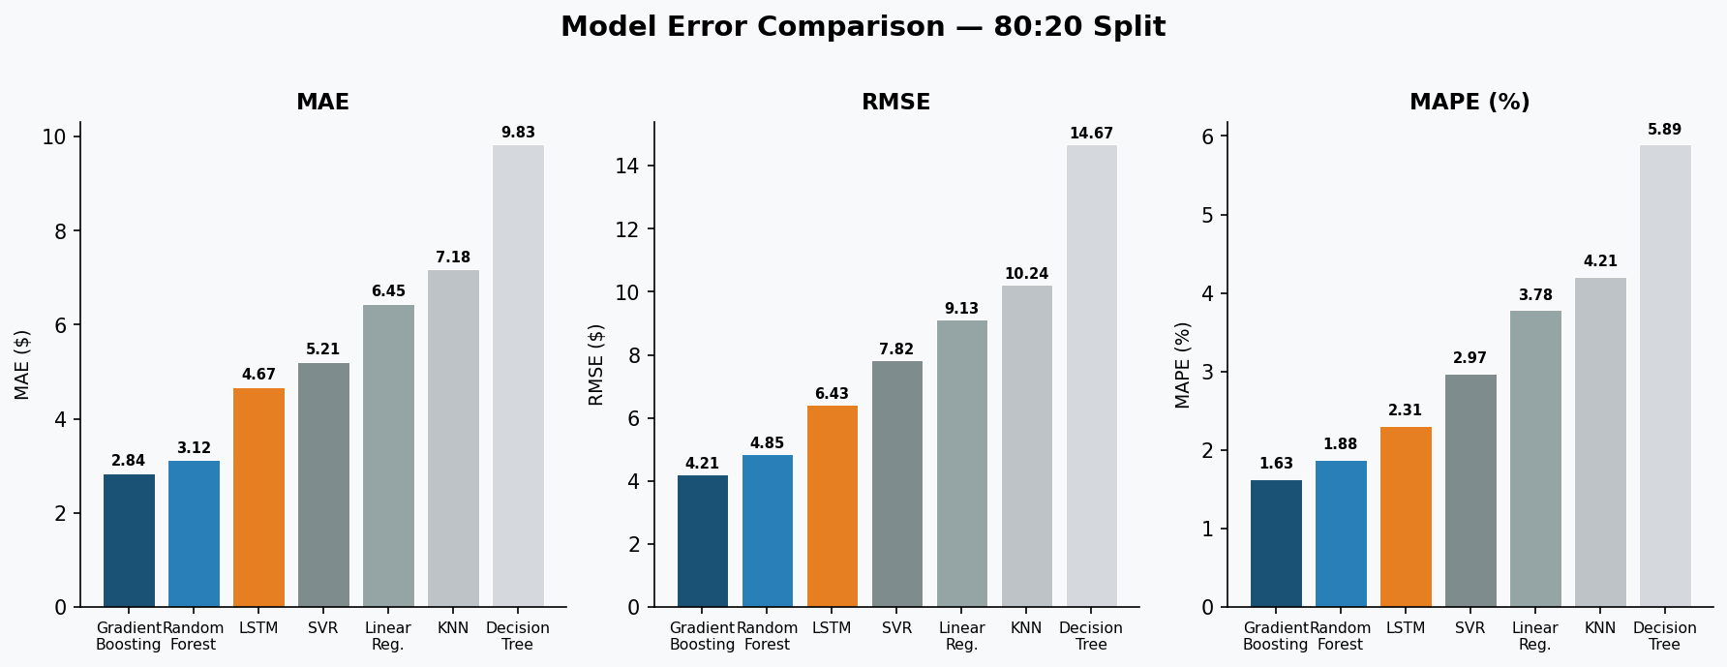
Results: Error Metrics Comparison (80:20 Split)
MAE, RMSE, and MAPE across all 7 models — lower is better
Key Insights
Gradient Boosting achieves lowest MAE (2.84), RMSE (4.21), and MAPE (1.63%) best overall.
Random Forest is a close second across all three error metrics.
Decision Tree has the worst performance with RMSE = 14.67.
LSTM ranks 3rd, outperforming SVR, Linear Regression, KNN, and Decision Tree.
9

Slide 10
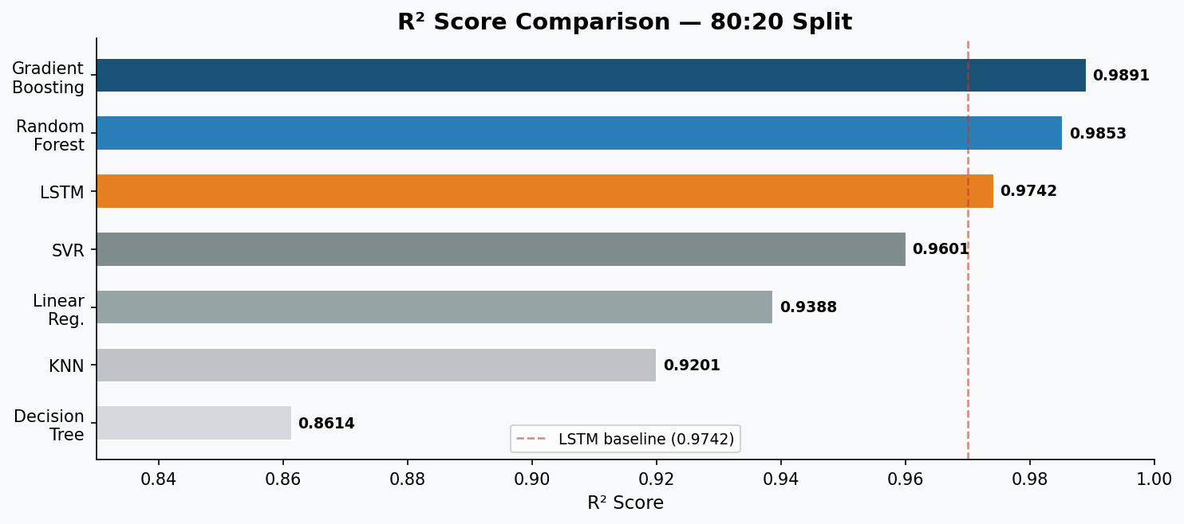
Results: R² Score Comparison (80:20 Split)
R² score measures variance explained — closer to 1.0 is better
Key Insights
Gradient Boosting (R² = 0.9891) explains ~98.9% of price variance.
All ensemble models (GB, RF) outperform the LSTM baseline of 0.9742.
Decision Tree has the lowest R² (0.8614), explaining ~14% less variance than GB.
Deep Learning (LSTM) is strong but not superior to ensemble ML on structured financial data.
10

Slide 11
Multi-Split Evaluation
Results Across 70:30, 80:20, 90:10 Splits
Gradient Boosting R²: 0.9866 (70:30) → 0.9891 (80:20) → 0.9907 (90:10)
Random Forest R²: 0.9831 (70:30) → 0.9853 (80:20) → 0.9871 (90:10)
LSTM R²: 0.9688 (70:30) → 0.9742 (80:20) → 0.9761 (90:10)
Observations
All models improve consistently as training data increases — no overfitting detected.
Gradient Boosting maintains the highest R² across all three splits.
LSTM shows a comparable improvement trend but consistently ranks 3rd.
Feature Importance (Random Forest)
Top features: Close, High, Low, Open prices + short-term indicators (MA-7, EMA-12).
RSI and MACD contribute as secondary signals; calendar features (weekday, month) contribute negligibly.
11

Slide 12
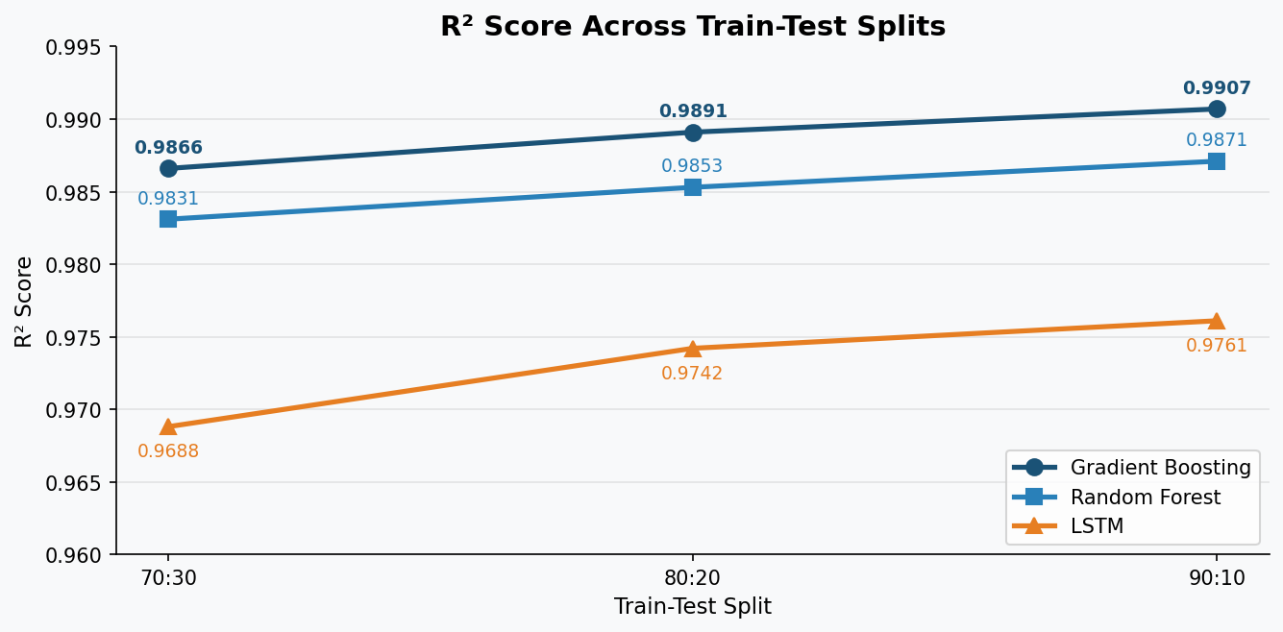
Results: Multi-Split R² Trend
Performance across 70:30, 80:20, and 90:10 chronological train-test splits
Key Insights
All three top models improve consistently as training data increases.
Gradient Boosting consistently leads: 0.9866 → 0.9891 → 0.9907.
LSTM improves from 0.9688 to 0.9761 but remains below both ensemble models.
Robust performance across all splits confirms no significant overfitting.
12

Slide 13
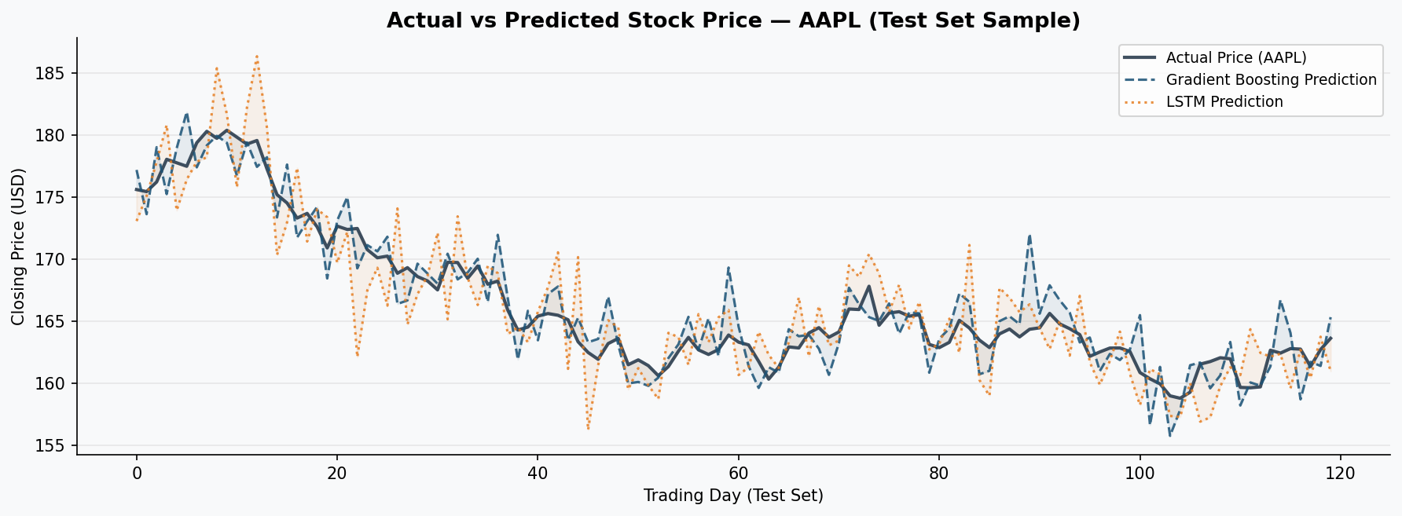
Actual vs Predicted — AAPL Stock Price
Sample test-set predictions: Gradient Boosting tracks actual price more closely than LSTM
Key Insights
Gradient Boosting predictions (dashed) stay tightly around the actual price line.
LSTM predictions (dotted) show slightly higher variance, especially during volatile swings.
Both models correctly follow the general price trend across 120 test trading days.
Lower residual spread for GB confirms its superior RMSE and MAE scores quantitatively.
13

Slide 14
Scalability and Computational Complexity
Training Time (on Intel Core i5, 16 GB RAM, ~2,000 samples)
Linear Regression: ~0.1 sec | KNN: ~0 sec (lazy) | Decision Tree: ~0.5 sec
Random Forest: ~5-8 sec (parallelised) | Gradient Boosting: ~15-20 sec (sequential)
SVR: ~20-30 sec | LSTM: ~5-10 minutes (backpropagation over 100 epochs)
Theoretical Complexity
Linear Regression: O(n×d²) | Decision Tree / RF / GB: O(T×n×d×log n)
SVR: O(n² to n³) — slow for large n | LSTM: O(epochs×batches×H²)
Multi-Stock Scalability
ML models scale linearly — 10 stocks takes ~10x time; no special hardware needed.
LSTM requires GPU cluster for multi-stock deployment; per-stock model takes 5-10 min each.
Gradient Boosting recommended for real-time production: ~0.1 sec inference, no GPU, interpretable.
14

Slide 15
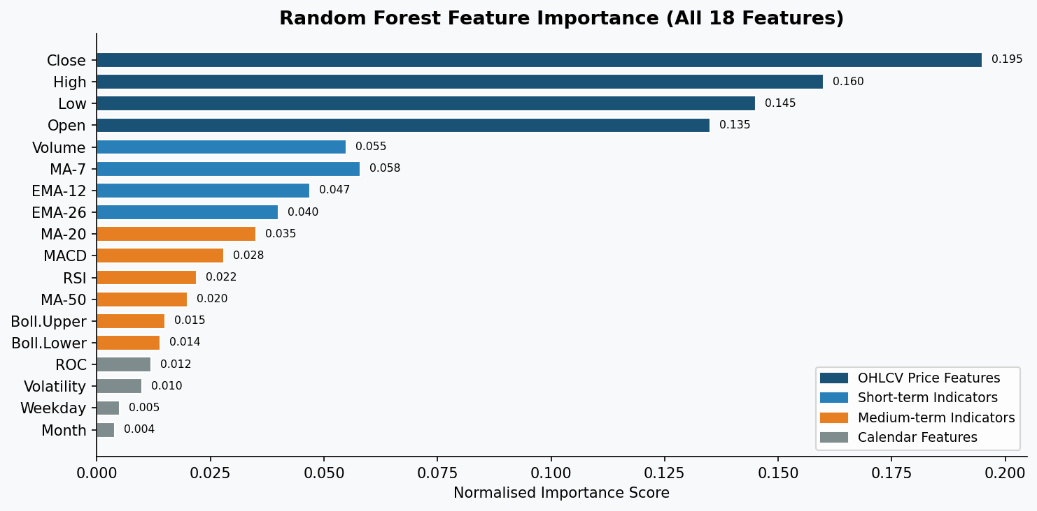
Feature Importance (Random Forest)
Normalised feature importance across all 18 engineered technical indicators
Key Insights
OHLCV price features (Close, High, Low, Open) dominate — collectively ~63% importance.
Short-term indicators MA-7 and EMA-12 are the most informative technical features.
RSI and MACD contribute as secondary momentum signals.
Calendar features (weekday, month) contribute negligibly — confirming price-driven prediction.
15

Slide 16
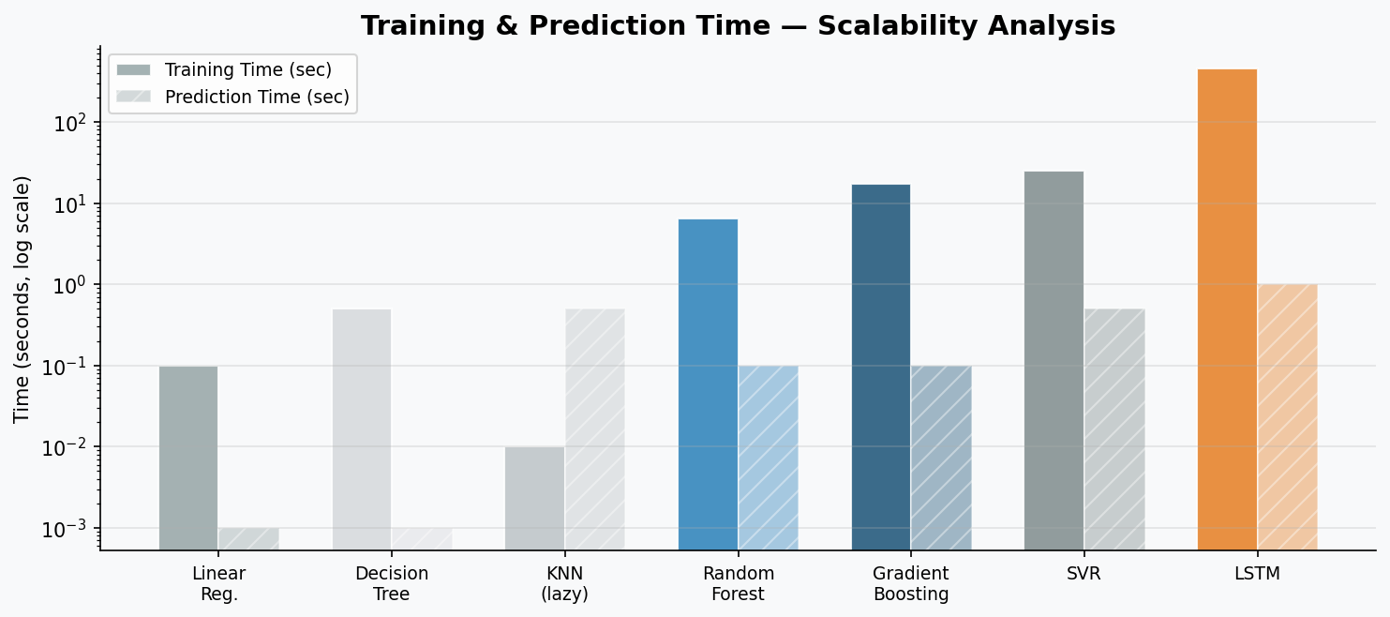
Scalability: Training and Prediction Time
Training and prediction time on Intel Core i5, 16 GB RAM with ~2,000 samples (log scale)
Key Insights
LSTM requires ~5–10 minutes to train vs. seconds for all ML models.
Gradient Boosting trains in 15–20 sec; prediction is ~0.1 sec — suitable for real-time use.
KNN has zero training time (lazy learner) but slow prediction due to exhaustive search.
Log scale highlights the ~200× training time difference between LSTM and ML models.
16

Slide 17
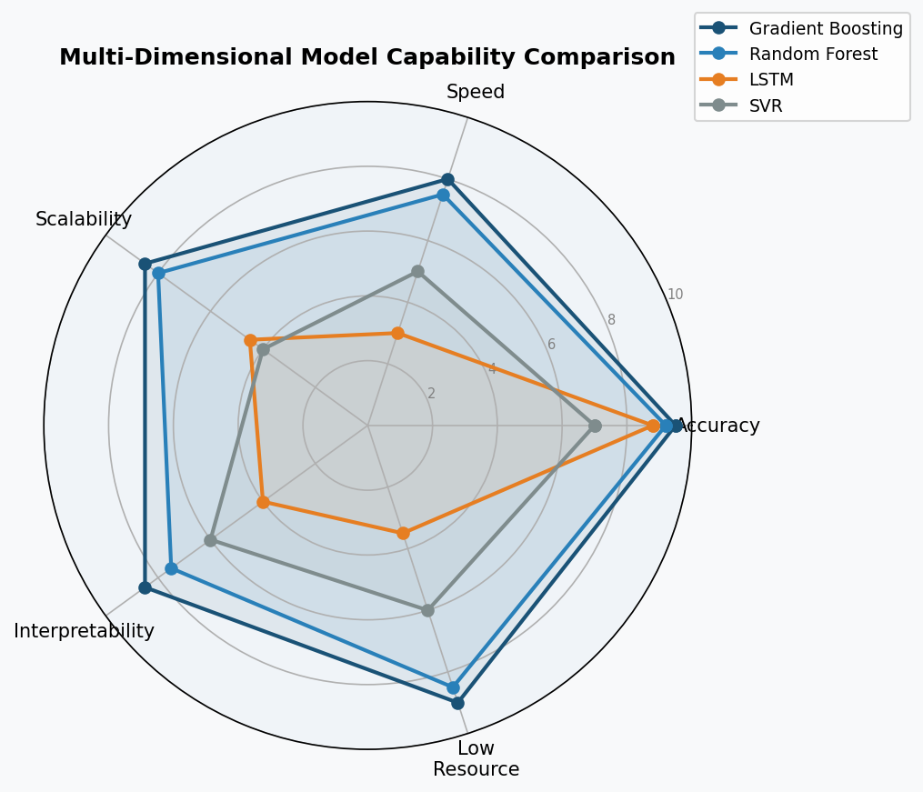
Multi-Dimensional Capability Comparison
Radar chart scoring models on Accuracy, Speed, Scalability, Interpretability, and Low Resource use
Key Insights
Gradient Boosting leads on 4 of 5 dimensions — strongest all-round production model.
Random Forest is a balanced second choice with similar capability profile.
LSTM scores high on accuracy but significantly low on Speed, Scalability, and Resources.
For production deployment, Gradient Boosting’s profile makes it the clear recommendation.
17

Slide 18
Conclusion
Deep Learning is NOT Always Superior
LSTM achieved R²=0.9742 — strong, but Gradient Boosting (0.9891) and Random Forest (0.9853) outperformed it.
DL’s edge is most evident for unstructured data (text, images); structured financial data favours ensemble ML.
Feature Engineering is Critical
18 technical indicators allow ML models to detect patterns without explicit sequence modelling.
Residuals for Gradient Boosting and Random Forest are closer to zero; LSTM shows higher variance in volatile periods (2020 crash, 2022 correction).
Practical Deployment Recommendation
Production systems: Use Gradient Boosting — fast training, low latency, interpretable, linear scalability.
Research / long-horizon / multi-asset tasks: Use LSTM or Transformer models for sequence-based learning.
18

Slide 19
Future Work
1. Implement Hybrid Architectures
Since Deep Learning excels at extracting non-linear features while Gradient Boosting handles structured data and residuals well, you can combine them:
Residual Boosting: Train the LSTM or Transformer first, and feed its predictive residuals into a Gradient Boosting model to capture what the sequence model misses.
Tree-Feature Extraction: Use a Random Forest or Gradient Boosting algorithm to extract the most critical feature interactions, then pass those selected high-importance features into your LSTM to reduce noise.
2. Advance Sequence-Based Learning
Instead of relying solely on baseline LSTMs, explore modern sequence architectures that solve the forgetting and gradient-vanishing issues you observed during volatile periods
Transformer Models: Implement multi-head self-attention mechanisms to allow the model to directly weight previous market crashes or corrections, rather than relying on sequential memory.
Temporal Convolutional Networks (TCNs): TCNs generally outperform standard RNNs/LSTMs in time-series forecasting by providing larger receptive fields and avoiding sequential dependencies.
19

