Slide 1

Online News Popularity
Huimeng Zhang

Slide 2

Data Curation
Redundant Predictors | VIF value
n_non_stop_words | 2086.212
weekday_is_monday | Inf
weekday_is_saturday | Inf
LDA_04 | 981618118
n_unique_tokens | 13681.29
rate_negative_words | 18.21274
self_reference_avg_sharess | 19.14889
kw_max_min | 11.30715

Slide 3
Classification
Model | Accuracy
Logistic Regression | 0.7076331
Linear Discriminant Analysis (LDA) | 0.7072536
Quadratic Discriminant Analysis (QDA) | 0.6837255
Random Forest (RF) | 0.7876316
Support Vector Machine (SVM) | 0.71466035
K-Nearest Neighbors (KNN) | 0.6996097

Slide 4
Prediction
Model | Test MSE
K-Nearest Neighbors (KNN) | 203394969
Smoothing spline (GAM) | 156557987
Random forest (RF) | 126437588
Ridge Regression | 206494352
LASSO | 201407596
Principal Components Regression (PCA) | 158072532
Partial Least Squares (PLS) | 255595567

Slide 5
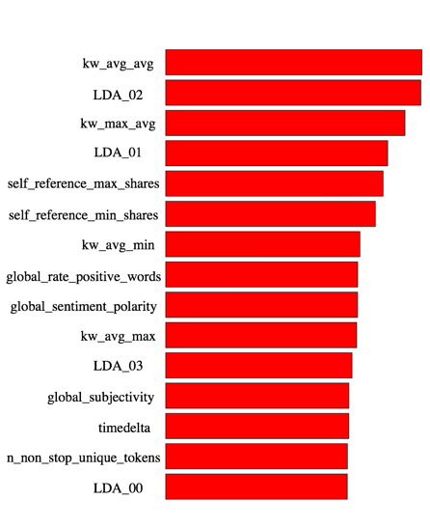
Prediction

Slide 6
Thank you.

