Slide 1
Pay Parity
Prove a job category's gender pay gap is under 5%,
without publishing a single salary.
Midnight Buildathon, Wave 2
Notes:
Pay Parity lets an employer prove pay-gap compliance for a job category and publish only the verdict. About 30 seconds on this slide.

Slide 2
Compliance needs proof, and proof needs payroll
The rule
The EU Pay Transparency Directive (2023/970) makes employers report gender pay gaps. An unexplained gap of 5% or more in a job category triggers a joint pay assessment.
Regulators and workers
want to check the gap is real and the record can't be rewritten.
The conflict
Regulators and worker representatives need evidence. Employers can't put payroll on a public ledger, and in a small category an average can point at one person.
Employers and employees
don't want individual salaries visible to anyone, including the auditor.
Notes:
The directive creates a real tension. Proof requires the data, and the data is sensitive. A spreadsheet sent to an auditor also leaves no tamper-evident record.

Slide 3
What the ledger sees, and what it doesn't
On the public ledger
Stays on the employer's machine
Verdict: under 5%, or 5% or more
Headcount in the audit
Job category and year
A commitment to the payroll
Every attempt, including failures
Every individual salary
Who earns what, by gender
The employer's secret key
The salt behind the commitment
The payroll file itself
Notes:
This is the whole idea in one slide. The right column never leaves the employer. A test in the repo checks the public state for every salary, as decimals and as the bytes the ledger stores.

Slide 4
How it works on Midnight
1
2
3
4
Private input
Circuit checks
Explicit disclosure
Append to the log
Witnesses hand the circuit up to eight pay records, the employer key and a salt. They never leave the machine.
Sums and counts per group, at least two people each, and average female pay above 95% of average male pay.
Only the verdict and headcount are marked disclose(). The compiler refuses to publish anything else.
The result, with persistentCommit(payroll, salt), is added to a public append-only map.
The commitment binds the employer to the payroll they audited. If the real payroll and salt are produced later, anyone can recompute it and check it against the ledger.
Notes:
Public ledger state is the sealed employer authority, a counter and the audits map. Private state is the key, the batch and the salt, supplied through witnesses.

Slide 5
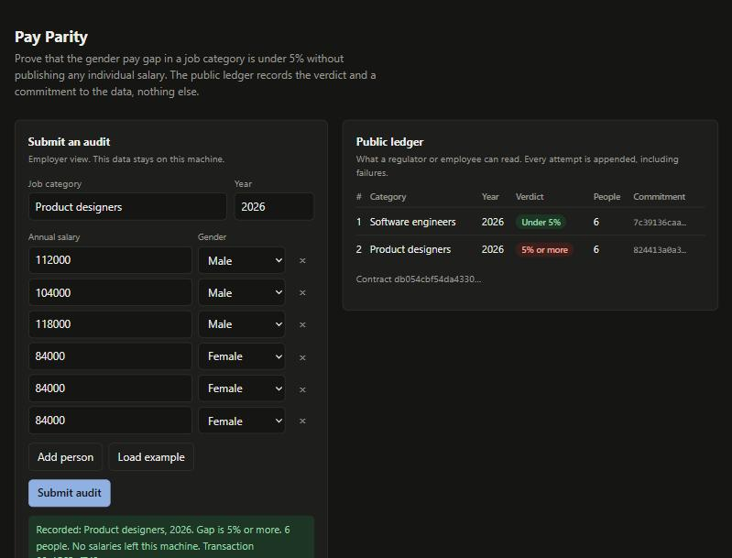
Working demo
Employer view
Enter pay data. It stays on this machine.
Public ledger
Verdict, headcount and a commitment. Failures stay on the record.
Contract rules
Groups under two people are rejected with the contract's own message, and nothing is recorded.
Notes:
Run the demo live if possible: load the example, submit, change the female salaries, submit again, then remove two women and submit to show the rejection.

Slide 6
Tested locally, on-chain and live on Preprod
31 + 8
0
5%
unit tests plus on-chain tests, all passing
salaries in public state, checked in-process and read back from the chain
boundary pinned: exactly 5% fails, one unit under passes
Rejections: a group of one, a stranger to the employer, malformed input. Each leaves the ledger untouched.
The commitment is binding and hiding: a changed payroll or a new salt changes it.
Deployed to Midnight Preprod, with two audits recorded by real proven transactions. The on-chain suite does the same on a local network. CI compiles, typechecks and tests on every push.
Preprod contract f4e684d9e05b892e8427cba2296e08a96c0086cd12fe5c618c3c53064add8d05, searchable at preprod.midnightexplorer.com
Notes:
Mention the ordering bug found while preparing screenshots: the ledger map does not iterate in insertion order, so the log is now sorted by sequence number, with a test that fails without the fix.

Slide 7
Who needs it, and how it gets adopted
Employers in the EU
HR and compliance teams that must evidence pay-gap compliance without circulating payroll.
Auditors and worker representatives
Get a tamper-evident record and a commitment they can check against payroll when it is disclosed to them.
Payroll and HR vendors
Can export a batch and sign it, which closes the gap between a proof about supplied data and the true payroll.
Adoption path: start as an add-on next to the existing payroll export, run it per category each reporting year, and extend to signed payroll sources.
Notes:
No market figures here on purpose. The audience is employers subject to the directive, and the first step is a pilot with one employer.

Slide 8
Limits today, and what comes next
Today
Wave 3
Live on Preprod, but the two audits use made-up pay data
The contract proves the supplied data meets the rule, not that it is the true payroll
Eight people per audit, whole-number salaries, female and male groups as in the directive's formula
Pilot with a real employer payroll export
Combine several batches into one verdict for large categories
Signed payroll sources checked inside the circuit
Employee self-check with a Merkle inclusion proof
github.com/56steve/pay-parity
Notes:
Be direct about the limits. They are the roadmap for Wave 3.

