Slide 1
Machine Learning Algorithms for Software Bug Prediction
Zhenjie Jia, Xinyi He
Carnegie Mellon University
Nikolaos Ploskas
University of Western Macedonia
Nick Sahinidis
Carnegie Mellon University
Notes:
Hi everyone，the topic of our presentation is Machine Learning Algorithms for software bug prediction.
This work is a joint work with Zhenjie Jia.

Slide 2
MOTIVATION
The effort in finding and fixing bugs in a software will consume near 80% of the budget of a software development
Large open-source software have many independent features which make it become a good target in machine learning
Version control tools and website like github makes it possible to extract features and form the dataset
Notes:
So, first part should the motivation, why should we want to use machine learning algorithms in software industry. The first reason is that debugging is so annoying. In fact it may take up to 80% of the budget in software development. While large-open source software are always complicated project with lots of unique features like depth of inheritance tree, number of static fields, number of attributes and ratio of public attributes and private attributes. What’s more, we have some fantastic version control tools like git and platform like github, which makes it possible to extracting features of each releasing version for some software. I think this give this study more realistic meaning.

Slide 3
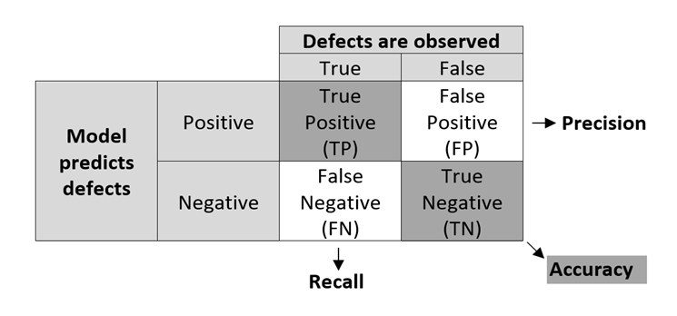
RESEARCH GOAL
Objective: find a process to classify whether a class in software has bugs or not.
Evaluation Standard：
True Positives (TP) True Negatives (TN)
False Positives (FP) False Negatives (FN)
Accuracy: (TP+TN)/(TP+FP+FN+TN)
Recall: TP/(TP+FN)
Precision：TP/(TP+FP）
F1-score： 2*(Recall * Precision) / (Recall + Precision)
Notes:
So, our goal is clear, we would like to find a good process to solve the bug-classification problem in class level. We choose 4 evaluation standards, accuracy, recall, precision, and F1-score.
To explain these evaluation, we need other 4 definitions. True positive means we predicted it as buggy and it truly has bugs. True negative means we predicted it has no bug and it truly doesn’t. False Positive and false negative respectively means the number of class which we predict wrongly that are buggy and not buggy.
So under above defination, Accuracy equals to the ratio of (number of correctly predicted class to number of total input class). Recall equals to the ratio of (number of correctly predicted buggy class to number of all buggy class). Precision equals to == (number of correctly predicted buggy class to number of predicted buggy class). F1 is the weight average of recall and precision. In our study we consider that recall score is the most import judgement and which we should optimized. Because even smallest bug can cause the system to crash. So we want to find as much bugs as possible.
Accuracy: (TP+TN)/(TP+FP+FN+TN) == (number of correctly predicted class/number of total input class)
Recall: TP/(TP+FN) == (number of correctly predicted buggy class/number of all buggy class)
Precision：TP/(TP+FP) == (number of correctly predicted buggy class/number of predicted buggy class)
F1-score： 2*(Recall * Precision) / (Recall + Precision)

Slide 4
Previous work
1. D'Ambros’s data set (D'Ambros et al., 2010)
Software: Eclipse JDT Core, Eclipse PDE UI, Equinox Framework, Lucene, Mylyn
Features: 1) change features: NR, NREF, NFIX, NAUTH, LINES…
2) code features: DIT, NOC, FanIn, FanOut,NOM,NOA...
2. Zimmermann’s data set (Zimmermann et al., 2007)
Software: Eclipse release version: 2.0, 2.1, 3.0
Features: 1) complexity metrics: FOUT, PAR, NSF, MLOC…
2) structure of abstract syntax tree(s): frequency of each of nodes
Notes:
Our work is based on previous work, we used the dataset created by previous researchers. The first is D’Ambros’s dataset. It contains 5 matrix, each related to one different software including eclipse JDT core, eclipse PDE UI, equinox framework lucene and mylyn. Every matrix contains the class name, number of bugs in this class and features that can represent the class. The features are mainly two parts. First is the changed features like number of versions, number of time the class involved in bug fixing. Number of authors who committed to the file. The other part are code features like Depth of Inheritance Tree, Number of children.
The other dataset we use is Zimmermann’s dataset. It involves 3 versions of eclipse project. Version 2.0, 2.1, 3.0. The feature of the matrix is made up by complexity metrics like number of method calls and structure of abstract syntax trees.
NR Number of revisions NREF Number of times file has been refactored NFIX Number of times file was involved in bug-fixing NAUTH Number of authors who committed the file LINES Lines added and removed (sum, max, average)
CK WMC Weighted Method Count CK DIT Depth of Inheritance Tree CK RFC Response For Class CK NOC Number Of Children
OO FanIn Number of other classes that reference the class OO FanOut Number of other classes referenced by the class OO NOA Number of attributes OO NOPA Number of public attributes OO NOPRA Number of private attributes OO NOAI Number of attributes inherited OO LOC Number of lines of code
FOUT Number of method calls (fan out)
PAR Number of parameters
NSF Number of static fields
MLOC Method lines of code

Slide 5
Previous Work
Couto et al. (2014) used multilayer perceptron with different activation functions to achieve an average recall ranging from 13% (Equinox)to 31% (Lucene). The max recall rate they got for the Eclipse JDT, Eclipse PDE UI, Equinox,and Lucene systems were 68%, 44%,31%, and 52%, respectively on D’Ambros’s dataset (D'Ambros et al., 2010).
Zimmermann et al. (2007) used logistic regression on their own dataset and achieved Accuracy ranging from 86.4% to 90% with Recall rate ranging from 17.1% to 27.7%.
Notes:
Some researchers chose the same standard as their goal and use the same dataset with us. Like couto also wants to improve the recall rate. He tried mlp with different activation functions. And the highest recall score he achieved is from 68% to 31 on Dambro’s score.
Zimmermann used test his own dataset and achieved accuracy ranging from 86.4% to 90% with recall ranging from 17.1% to 27.7%.

Slide 6
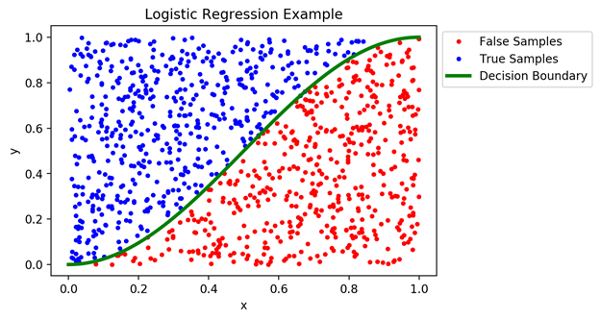
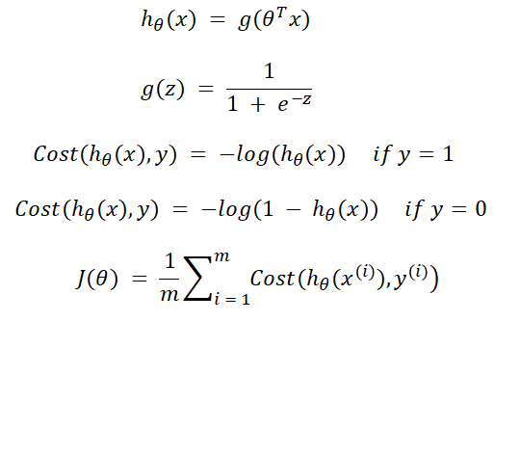
Algorithms
Logistic regression
Notes:
Now, it comes to our work. We tried many algorithms, and three of them performs much better than others. First, it is logistic regression. The gradient descent for logistic regression is the sum of(y predicted minus y true) and multiply by x. It is not senestive to the distribution of data since we can put different weighs on the loss function.

Slide 7
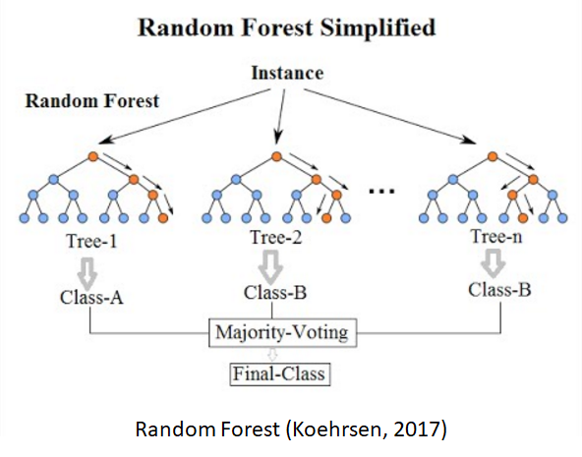
Algorithms
Random forest
Notes:
The second algorithms we chose is random forest. It is an algorithm based on bagging. You use random selected data to train many decision trees. And at each node, you randomly selected some features of all features to calculated on which feature should you split the node. At end, we use major vote of all decision trees to get the result.

Slide 8
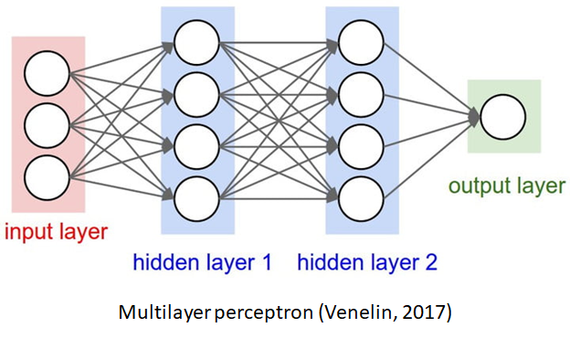
Algorithms
Multilayer perceptron (MLP)
Notes:
The last algorithms we use is multilayer perceptron. Each We didn’t use techniques like cnn or rnn. For our data is small for deep learning problems. but mlp performs good on our data since we can change the dimension of our data in hidden layer.

Slide 9
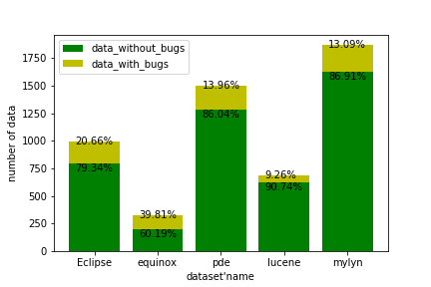
Dataset
D'Ambros’s data set (D'Ambros et al., 2010)
Distribution of D'Ambros’s dataset (D'Ambros et al., 2010)
Notes:
Ok. Then. I will talk about the dataset. We used the D‘Ambros’s data set and Zimmermann’s data set on different software projects.
The D'Ambros’s dataset contains five different software, including Eclipse JDT Core, Eclipse PDE UI, Equinox Framework, Lucene and Mylyn. For each software, We have about 40 attributes and one target, buggy or not.
This figure shows the distribution of the D'Ambros’s data set, including the number of data for each software and the percentage of the buggy classes and the non-buggy classes for each software. We can see that the largest percentage of data with bugs is about 40 percent and the smallest percentage of data with bugs is less than 10%.
Generally, the classes without bug is far more than the classes with bug. Thus, the D'Ambros’s dataset is not balanced.

Slide 10
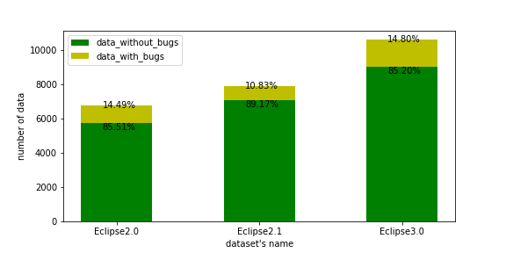
Dataset
Zimmermann’s data set (Zimmermann et al., 2007)
Distribution of Zimmermann’s data set (Zimmermann et al., 2007)
Notes:
Zimmermann’s data set contains three different versions of Eclipse software at file level, including eclipse2.0, eclipse2.1, eclipse3.0. This dataset contains about 200 attributes and one target, buggy or not.
This figure shows the distribution of the Zimmermann’s data set , including the number of data for each version of eclipse and the percentage of the buggy classes and the non-buggy classes for each version of eclipse . We can see that the largest percentage of data with bugs is about 15 percent and the smallest percentage of data with bugs is just about 10%.
As a result , the Zimmermann’s dataset is also not balanced.

Slide 11
Data Preprocessing
Over sample: Add more copies of the minority class.
Under sample: Remove some observations of the majority class.
Syn sample: Create synthetic samples.
Standardization: Let the distribution of the data follow a normal distribution.
Notes:
Because the dataset is highly imbalanced, the classifiers may tend to predict that most of the classes are not buggy since it will get a high accuracy score. Former researchers’ work is mainly focused on getting a high accuracy score while the recall rate is very low. We think it is not a good model because we cannot successfully predict the buggy classes if the recall score is low.
To solve this problem, we apply some data preprocessing methods, including over sample, under sample and syn sample to adjust the data distribution. By over sample, we just add more copies of the minority class. However, this may cause overfitting. By under sample, we just remove some majority classes. However, since the data is very valuable, this may decrease the performance of the model. Therefore, finally we choose syn sample to create synthetic samples. We use a Synthetic Minority Oversampling Technique called SMOTE. It uses a nearest neighbors' algorithm to generate new data we can use for training our model.
In addition, we also let the distribution of the data follows a normal distribution, which will improves the numerical stability of the model and speed up the training process.

Slide 12
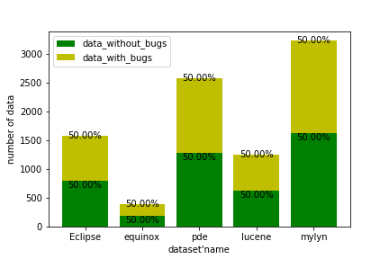
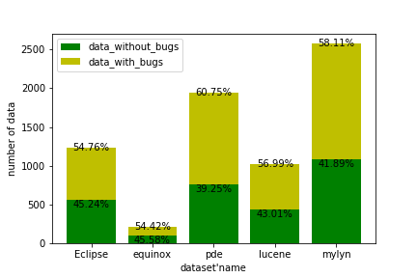
Data Preprocessing
Distribution of the dataset after Preprocessing
Distribution of D'Ambros’s dataset (D'Ambros et al., 2010) after over sampling
Distribution of D'Ambros’s dataset (D'Ambros et al., 2010) after syn sampling
Notes:
This figure shows the distribution of the the D‘Ambros’s data set after data preprocessing. We can find that after oversampling, the number of the buggy and non-buggy classes are totally the same and after syn sampling, the number of the buggy and non-buggy classes are also approximately the same.
As a result, the dataset becomes balanced after data preprocessing.

Slide 13
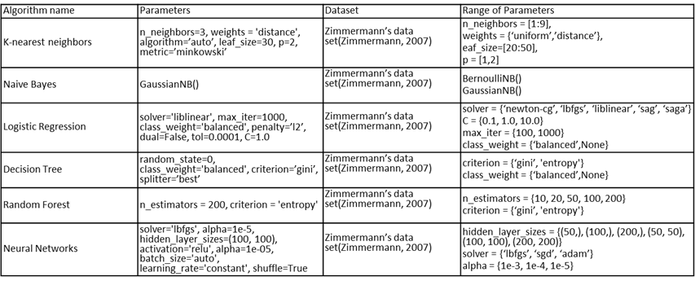
Results on Zimmermann’s dataset
1 ) training and testing on the same project
Parameters for different algorithms
Notes:
Then this is our result for training and testing on the same dataset.
I will show one example of Zimmermann’s dataset. The first column is the algorithms name. The second is the parameters we used to get our result. The last columns the grid search range.

Slide 14
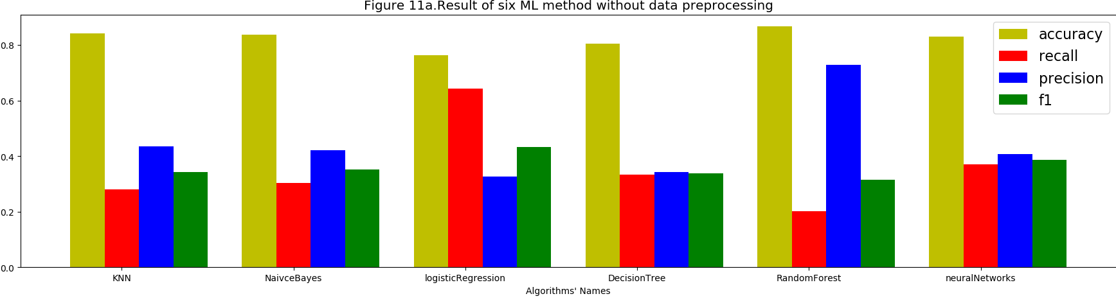
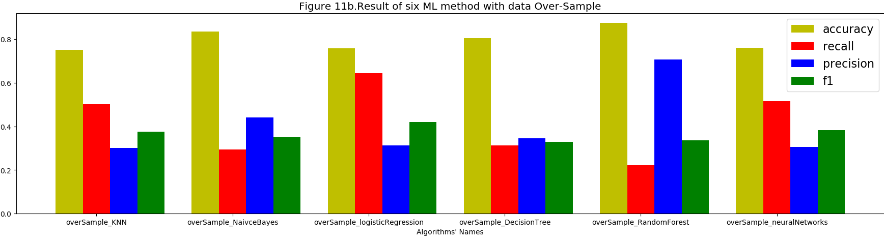
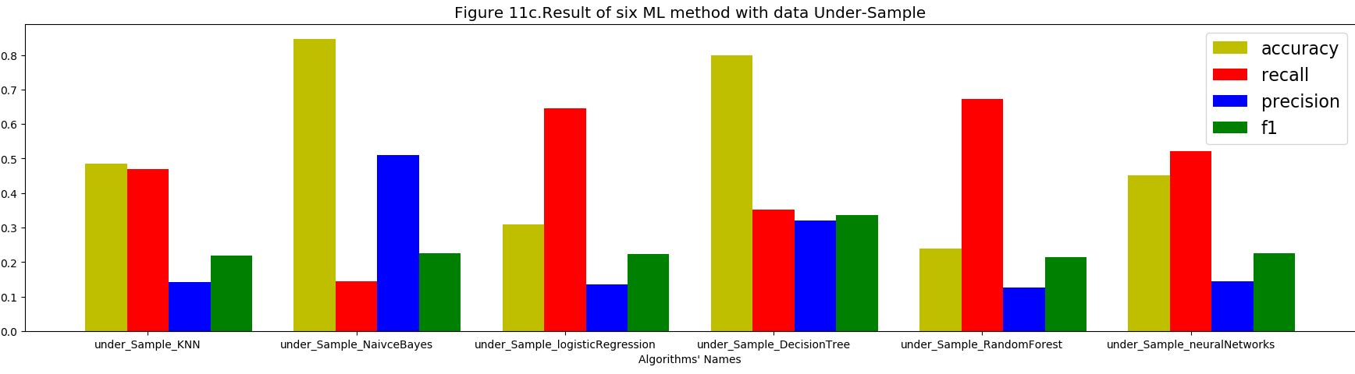
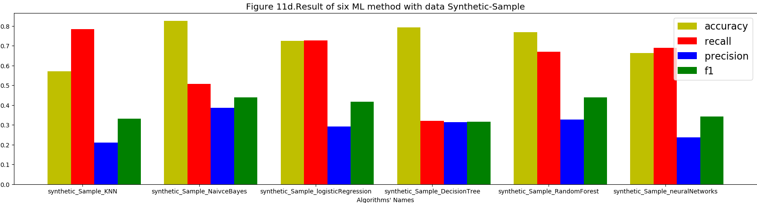
Results on D'Ambros’s dataset
1 ) training and testing on the same project: eclipse
Notes:
And this is the result without any data preprocessing. You can see the accuracy are all near 80% but the recall rate are just above 20%. Then after over sample, the recall rate slightly raise for neural network and knn, but the accuracy also decrease. Then we tried under sample, as you can see, the accuracy decrease dramatically on most algorithm. But the recall rate for random forest raise greatly to near 70%.
At last, we tried syn sample. logistic regression and random forest and neural network all showing good results: the accuracy and recall are all aroud 70%.
I think this is due to when use syn sample. We need to generate less data point. The fake points we generate to balance the dataset are more reasonable. And more close the real data. And random forest and neural network are algorithms that can tolerate variance in the input data. So it’s performance will improve because he bias is decreasing as we balance the dataset.

Slide 15
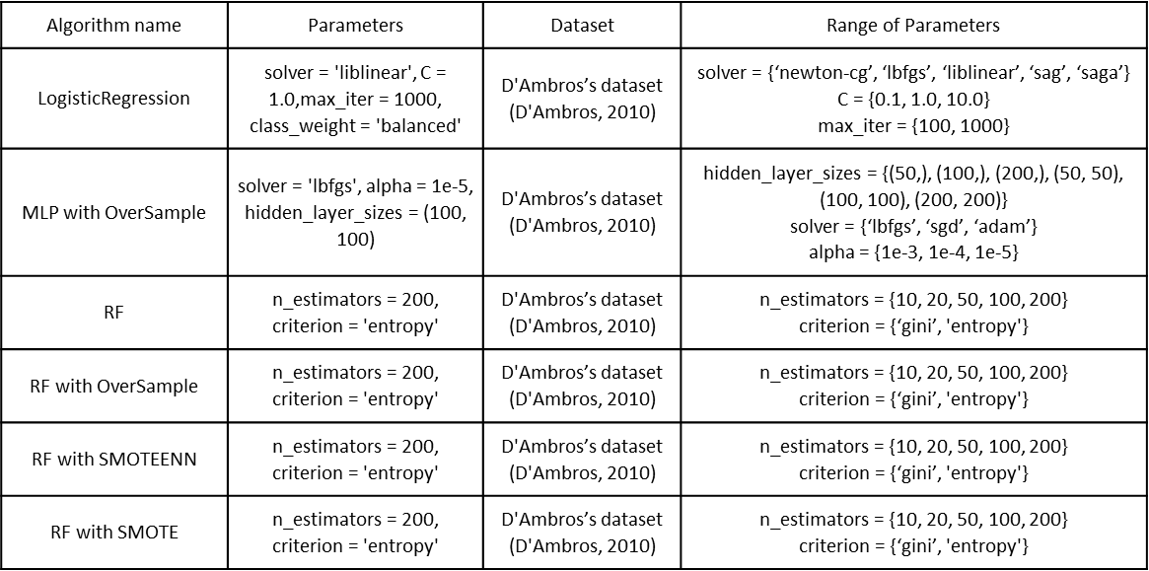
Results on D'Ambros’s dataset
2 ) training and testing on the different projects
Parameters for different algorithms
Notes:
Then, for the D'Ambros’s dataset, we also train the model on one project and test on a different project. We use different machine learning algorithms, including Naive Bayes, Logistic Regression, K-nearest Neighbors, Decision Tree, Random Forest, and Multi-layer perception. We also apply some data preprocessing methods mentioned above. Then we use grid search to tune parameters for each algorithm.
This table shows some algorithms with or without data preprocessing methods that have top performance, including logistic regression with class_weight, Multi-layer perception with Oversample, Random Forest, Random Forest with Oversample, Random Forest with SMOTEEN and Random Forest with SMOTE. It also shows the range of the parameters we use for grid search and the optimized parameters for each algorithm.

Slide 16
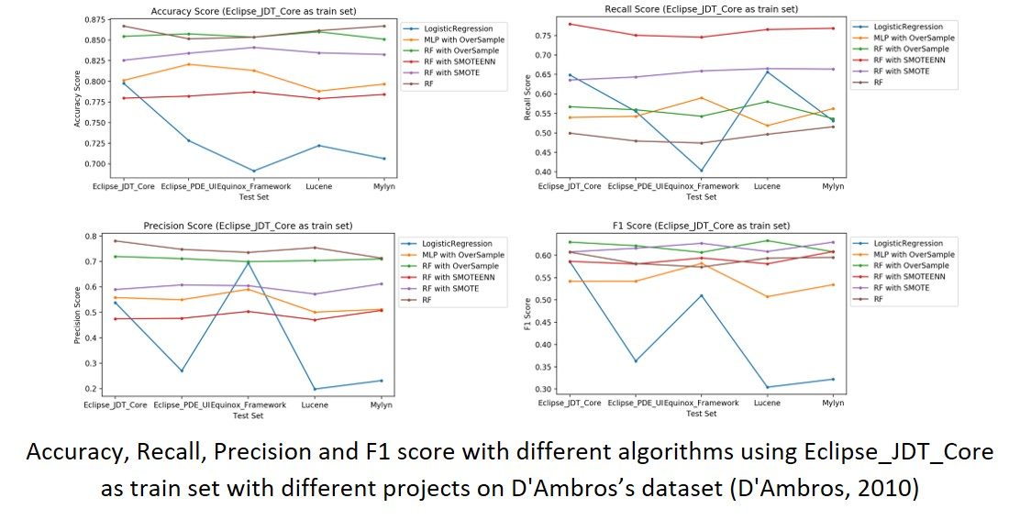
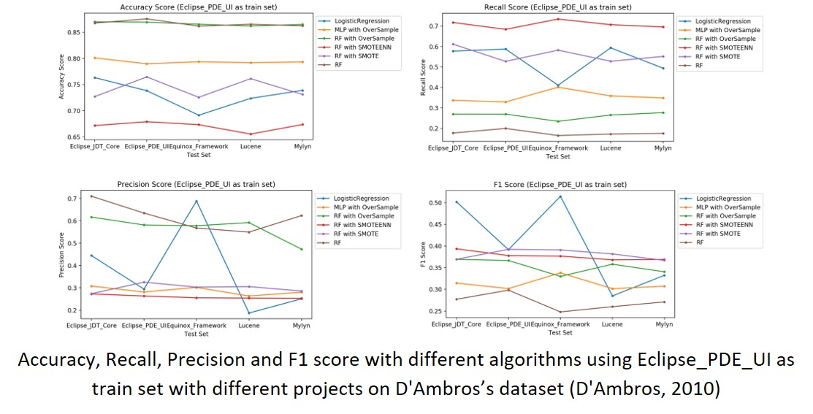
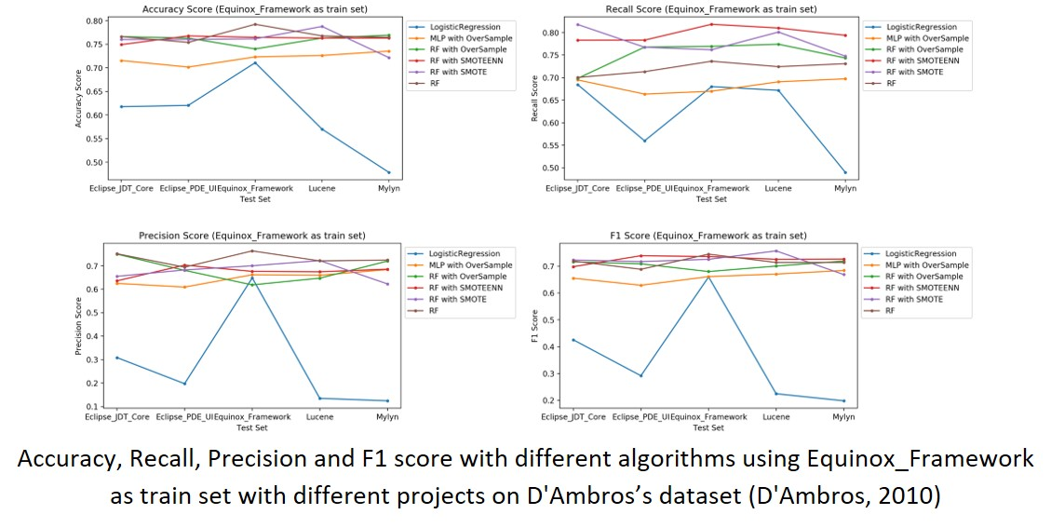
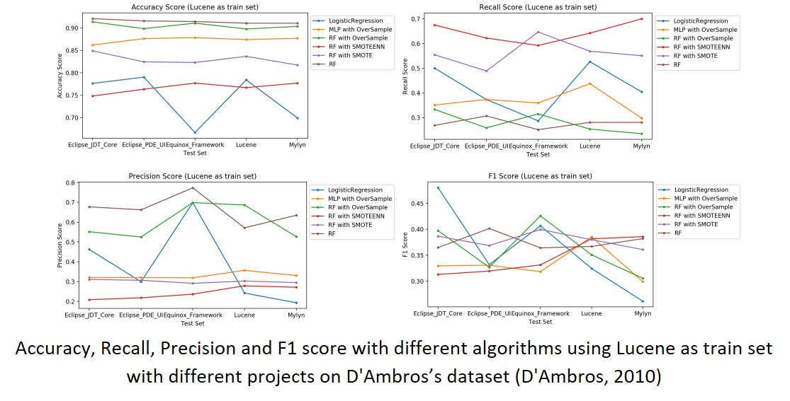
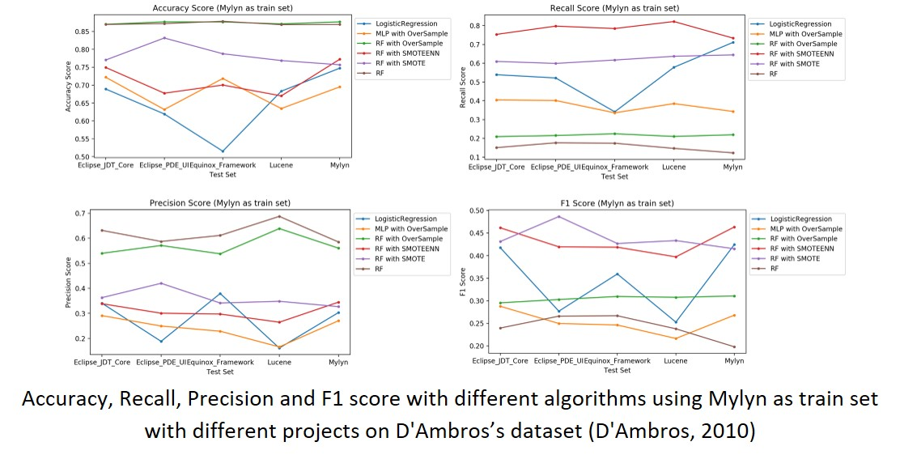
Results on D'Ambros’s dataset
2 ) training and testing on the different projects
2 ) training and testing on the different projects
Notes:
These Figures shows the results we get for training and testing cross different projects on D'Ambros’ dataset. These 5 figures apply Eclipse_JDT_Core, Eclipse_PDE_UI, Equinox_Framework, Lucene and Mylynas as train set respectively. In each figure, the four subplots show Accuracy score, Recall score, Precision score and F1 score separately. In each subplot, the x axis means the project we use as test set and different lines represent different algorithms.
we found that fandom forest and fandom forest with Oversample give us the better accuracy score, which is usually above 0.8, and random forest with smoteen gives us the better recall score, which is usually above 0.7, and fandom forest and fandom forest with overSample give us the better precision score, which is usually above 0.5, and fandom forest with smote and fandom forest with smoteen give us the better f1 score, which is sometimes above 0.5.
Generally, after applying the data preprocessing methods, the accuracy score may slightly decrease, but usually recall score and f1 score increase significantly.

Slide 17
Result on Zimmermann’s data set
Algorithm name | Parameters | Dataset | Range of Parameters
LogisticRegression | solver = 'liblinear', C = 1.0,max_iter = 1000, class_weight = {0: 0.125, 1: 0.875} | Zimmermann’s data set(Zimmermann, 2007) | solver = {‘newton-cg’, ‘lbfgs’, ‘liblinear’, ‘sag’, ‘saga’} C = {0.1, 1.0, 10.0} max_iter = {100, 1000}
Random Forest with SMOTE | n_estimators = 200, criterion = 'entropy' | Zimmermann’s data set(Zimmermann, 2007) | n_estimators = {10, 20, 50, 100, 200} criterion = {‘gini’, 'entropy'}
Random Forest with SMOTEENN | n_estimators = 200, criterion = 'entropy' | Zimmermann’s data set(Zimmermann, 2007) | n_estimators = {10, 20, 50, 100, 200} criterion = {‘gini’, 'entropy'}
Parameters for different algorithms
Notes:
Then, we also train and test the model cross different versions of eclipse on Zimmermann’s data. We also use different machine learning algorithms and apply some data preprocessing methods mentioned above. Then we also use grid search to tune parameters for each algorithm.
This table shows some algorithms with or without data preprocessing methods that have top performance, including logistic regression with class_weight, Random Forest with SMOTE and Random Forest with SMOTEEN. It also shows the range of the parameters we use for grid search and the optimized parameters for each algorithm.

Slide 18
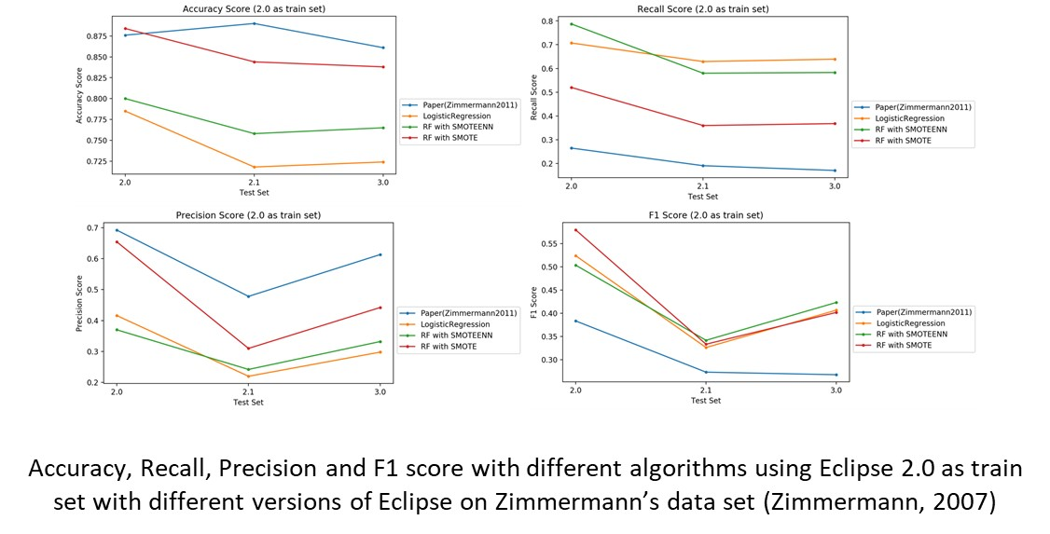
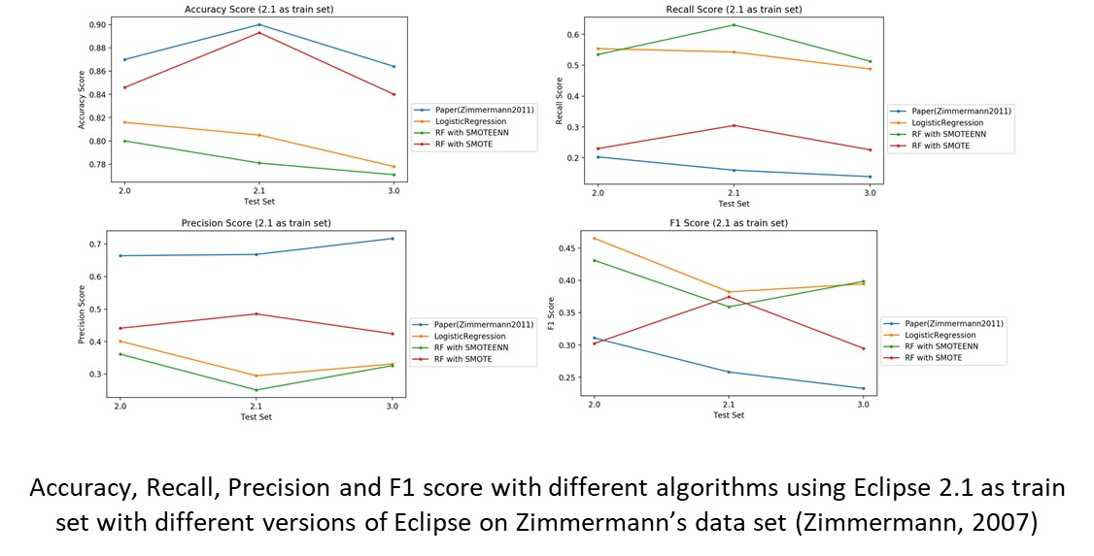
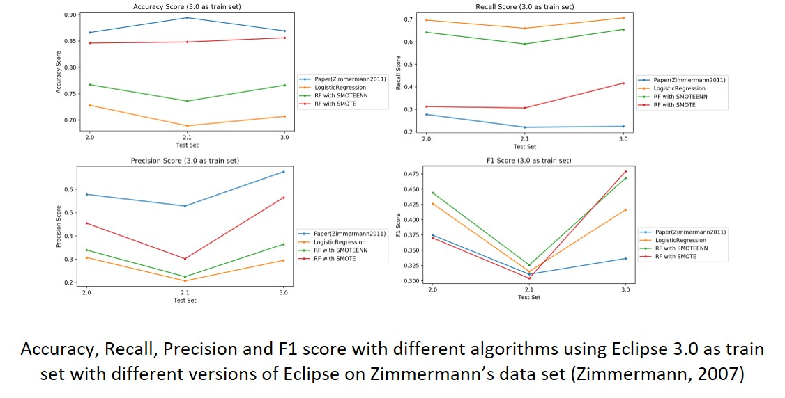
Result on Zimmermann’s data set
Notes:
These Figures shows the results we got for training and testing cross different versions of eclipse on Zimmermann’s dataset. These 3 figures apply eclipse2.0, eclipse2.1 and eclipse3.0 as train set respectively. In each figure, the four subplots show Accuracy score, Recall score, Precision score and F1 score separately. In each subplot, the x axis means the version we use as test set and different lines represent different algorithms.
we found that fandom forest with SMOTE give us the better accuracy score, which usually above 0.8, and logistic regression and random forest with smoteen gives us the better recall score, which is usually above 0.6, and fandom forest with SMOTE give us the better precision score, which is usually above 0.4, and logistic regression, fandom forest with smote and fandom forest with smoteen all give us the better f1 score, which is sometimes above 0.4.

Slide 19
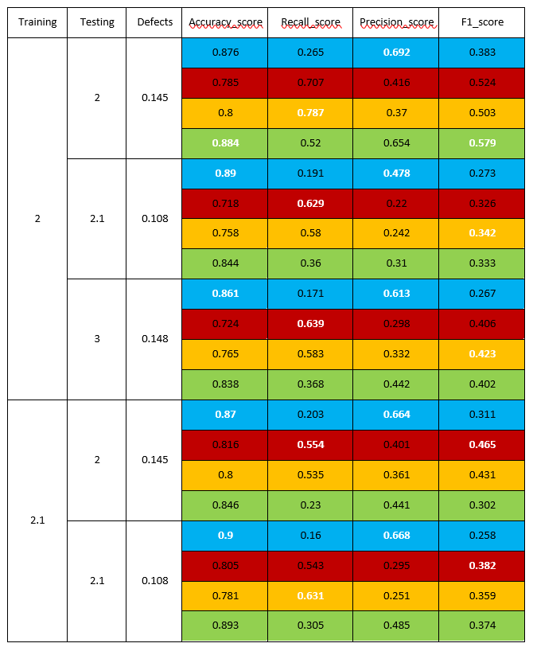
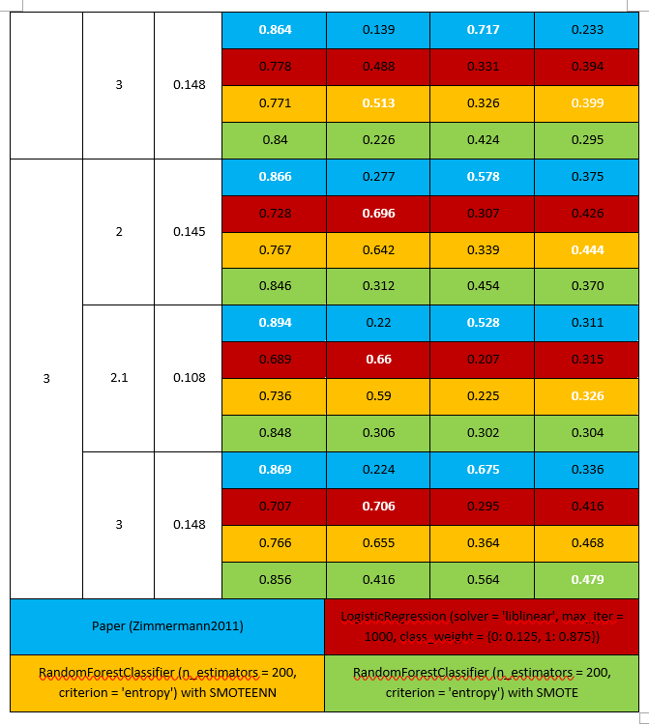
Notes:
This table shows all the results more intuitively. We could found that the recall score in Zimmermann’s paper is very low, which means the model in Zimmermann’s paper cannot predict the buggy classes well.
After applying the logistic regression with appropriate class_weight or random forest with data preprocessing methods, the accuracy score we get is a little bit lower than the paper while the recall score and f1 score are obviously higher than the paper.

Slide 20
Conclusion
All machine learning algorithms can achieve 70% - 85% accuracy score without any data preprocessing methods.
Logistic regression, random forest and neural networks behave better after syn sampling within the same open source software on D'Ambros’ dataset.
The f1 score cross the projects when using Eclipse_JDT_Core, Equinox_Framework as train set are better on D'Ambros’ dataset.
the recall score and f1 score after using random forest with data preprocessing on Zimmermann’s data are much better than Zimmermann’s result.
Notes:
Thus, for the conclusion, we found that all machine learning algorithms can achieve 70% - 85% accuracy score without any data preprocessing methods, while the recall score is only 20%-30%. Logistic regression, random forest and neural networks behave better after syn sampling within the same open source software’s on D'Ambros’ dataset, which can achieve 70% - 80% both on accuracy score and recall score. The f1 score cross the projects when using Eclipse_JDT_Core, Equinox_Framework as train set are better on D'Ambros’ dataset, which is between 50% - 70%. the recall score and f1 score after using random forest with data preprocessing on Zimmermann’s data are much better than Zimmermann’s result, which has an improvement about 20%-50%.
As a result, the data preprocessing methods such as syn sample can improve the performance of the recall rate and f1 score within the project or cross projects.

Slide 21
References
Thank you to Dr. Nick Sahinidis and Dr. Ploskas
[1] Tassey, G. (2002). The economic impacts of inadequate infrastructure for software testing. National Institute of Standards and Technology, RTI Project, 7007(011), 429-489.
[2] Akiyama, F. (1971, August). An Example of Software System Debugging. In IFIP Congress (1) (Vol. 71, pp. 353-359).
[3] Kamei, Y., & Shihab, E. (2016, March). Defect prediction: Accomplishments and future challenges. In 2016 IEEE 23rd international conference on software analysis, evolution, and reengineering (SANER) (Vol. 5, pp. 33-45). IEEE.
[4] Tantithamthavorn, C., McIntosh, S., Hassan, A. E., & Matsumoto, K. (2016, May). Automated parameter optimization of classification techniques for defect prediction models. In 2016 IEEE/ACM 38th International Conference on Software Engineering (ICSE) (pp. 321-332). IEEE.
[5] Tóth, Z., Gyimesi, P., & Ferenc, R. (2016, July). A public bug database of github projects and its application in bug prediction. In International Conference on Computational Science and Its Applications (pp. 625-638). Springer, Cham.
[6] Xia, X., Lo, D., Wang, X., Yang, X., Li, S., & Sun, J. (2013, March). A comparative study of supervised learning algorithms for re-opened bug prediction. In 2013 17th European Conference on Software Maintenance and Reengineering (pp. 331-334). IEEE.

Slide 22
References
[7] Zhang, F., Zheng, Q., Zou, Y., & Hassan, A. E. (2016, May). Cross-project defect prediction using a connectivity-based unsupervised classifier. In Proceedings of the 38th International Conference on Software Engineering (pp. 309-320). ACM.
[8] Couto, C., Pires, P., Valente, M. T., Bigonha, R. S., & Anquetil, N. (2014). Predicting software defects with causality tests. Journal of Systems and Software, 93, 24-41.
[9] Osman, H., Ghafari, M., & Nierstrasz, O. (2017, February). Hyperparameter optimization to improve bug prediction accuracy. In 2017 IEEE Workshop on Machine Learning Techniques for Software Quality Evaluation (MaLTeSQuE) (pp. 33-38). IEEE.
[10] Kamei, Y., Matsumoto, S., Monden, A., Matsumoto, K. I., Adams, B., & Hassan, A. E. (2010, September). Revisiting common bug prediction findings using effort-aware models. In 2010 IEEE International Conference on Software Maintenance (pp. 1-10). IEEE.
[11] Shivaji, S., Whitehead Jr, E. J., Akella, R., & Kim, S. (2009, November). Reducing features to improve bug prediction. In 2009 IEEE/ACM International Conference on Automated Software Engineering (pp. 600-604). IEEE.
[12] Zimmermann, T., Premraj, R., & Zeller, A. (2007, May). Predicting defects for eclipse. In Third International Workshop on Predictor Models in Software Engineering (PROMISE'07: ICSE Workshops 2007) (pp. 9-9). IEEE.
[13] Jureczko, M., & Madeyski, L. (2010, September). Towards identifying software project clusters with regard to defect prediction. In Proceedings of the 6th International Conference on Predictive Models in Software Engineering (p. 9). ACM.

Slide 23
References
[14] Kim, S., Zhang, H., Wu, R., & Gong, L. (2011, May). Dealing with noise in defect prediction. In 2011 33rd International Conference on Software Engineering (ICSE) (pp. 481-490). IEEE.
[15] Shihab, E., Ihara, A., Kamei, Y., Ibrahim, W. M., Ohira, M., Adams, B., ... & Matsumoto, K. I. (2010, October). Predicting re-opened bugs: A case study on the eclipse project. In 2010 17th Working Conference on Reverse Engineering (pp. 249-258). IEEE.
[16] Shihab, E., Ihara, A., Kamei, Y., Ibrahim, W. M., Ohira, M., Adams, B., ... & Matsumoto, K. I. (2013). Studying re-opened bugs in open source software. Empirical Software Engineering, 18(5), 1005-1042.
[17] D'Ambros, M., Lanza, M., & Robbes, R. (2010, May). An extensive comparison of bug prediction approaches. In 2010 7th IEEE Working Conference on Mining Software Repositories (MSR 2010) (pp. 31-41). IEEE.
[18] Shirabad, J. S., & Menzies, T. J. (2005). The PROMISE repository of software engineering databases. School of Information Technology and Engineering, University of Ottawa, Canada, 24.
[19] Koehrsen, W. (2017). Random Forest Simple Explanation. Published in www.medium.com. Last accessed on 10/23/2019.
[20] Venelin, V. (2017). Creating a Neural Network from Scratch — TensorFlow for Hackers (Part IV). Published in www.medium.com. Last accessed on 10/29/2019.
[21] Zohar, K., & Amir, S. (2018). Amazon SageMaker supports kNN classification and regression. Published in www.medium.com. Last accessed on 10/29/2019.

