Slide 1

FTU cooperative education, industrial training, and observation education system
1. Anuwa Chelong 571431011
2. Asree Kamah 571431024

Slide 2

CONTENT
Introduction Relate work
Problem Statement Methodology
Objective
Project scope
Significant of study

Slide 3
INTRODUCTION
FTU Cooperative education, industrial training, and observation education. is developed for Fatoni University to conducting student apprenticeship. To manage and store apprenticeship information to the same source.

Slide 4
PROBLEM STATEMENT
The university have to tracking their students who join the apprenticeship by using the old system to continue.
With the need to handle a lot of document. It also increases the difficulty of handling student information and the relevant information. The document will be damage or lost in sometime and also difficult to search any information of student and lecturer.
The training process is very complex with the number of staffs is not enough when we compared to the workload and limitations on the duration of the operation.
Fatoni University has not developed an apprenticeship system.

Slide 5
OBJECTIVE
To develop the FTU cooperative education, industrial training, and observation education system from the old system which is using the paper. The data is stored in the database, make quick of searching various information, reducing workload, and operating procedures are quick and easy to student affairs administration.
To reduce the complexity of the document.
To track and report data is fast.
To check information about apprenticeship for students with ease.
To use the information of the establishment next generation students, search information on the selection of establishments.

Slide 6
PROJECT SCOPE
This project is develop for Fatoni University to use this system to carry out the apprenticeship of students with the curriculum for 4-5 years. However, the user can be update of any information.
The most of this project, its will focus on web-based and we tried to develop more which is different from other user in form of mobile application for only student and advisor.

Slide 7
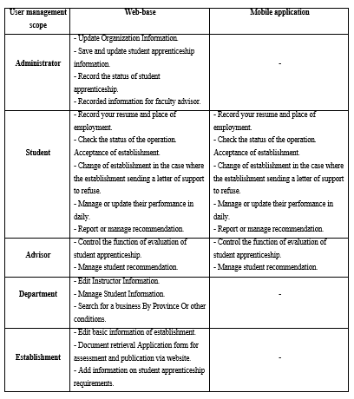
PROJECT SCOPE

Slide 8
SIGNIFICANT OF STUDY
Convenient to store and search
Convenient to manage and update.
Helps reduce errors and duplication of data.
Get effective apprenticeship management system.
Reduce the workload of the staff responsible for the internship.
The establishment can find information on the students who are interns.

Slide 9
RELATED WORK

Slide 10
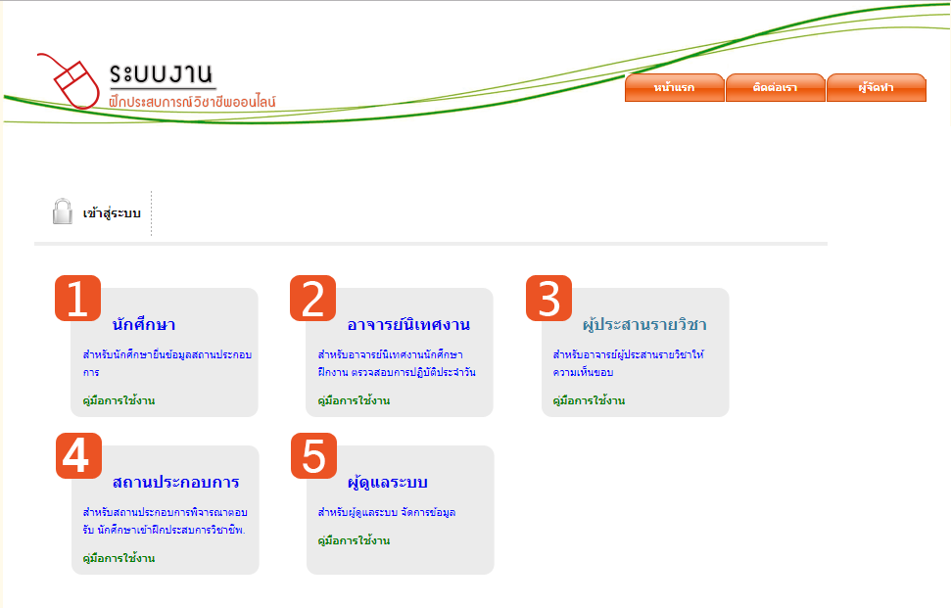

Slide 11
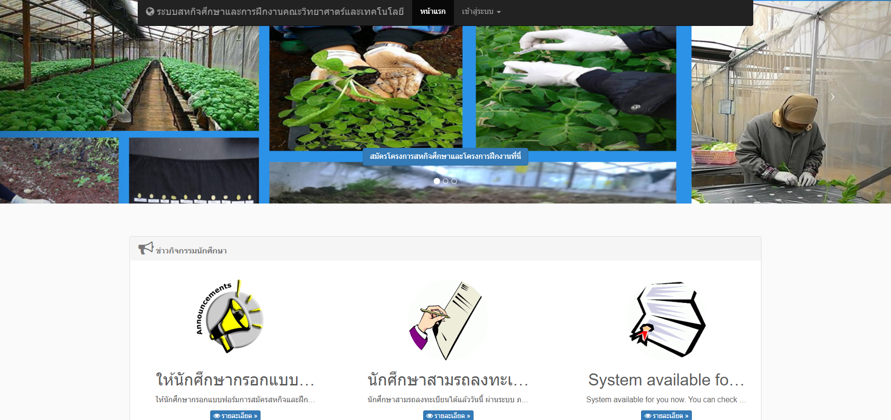

Slide 12
METHODOLOGY

Slide 13
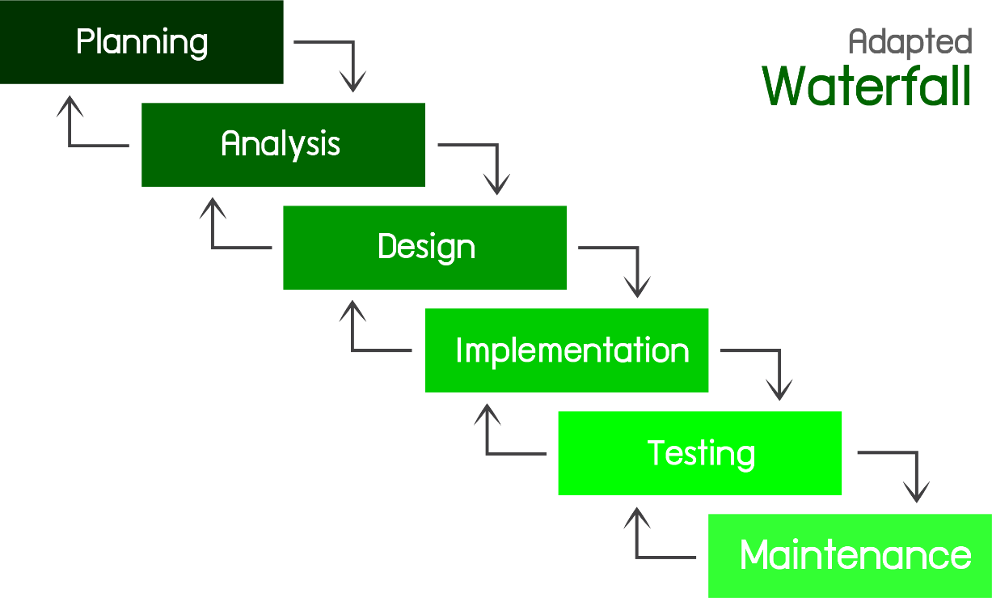
Adapted Waterfall

Slide 14
Summary
System Development for Fatoni University. The development process, including planning, analysis, design, initial stage results is the feasibility of a project or proposal. The output of the detailed procedure is a list of UML diagram requirements. The output of the construction process is the database design and coding of this project. The outcome of the change phase is the implementation of the system from development to testing, problem solving and feedback. The key point of this system. Emphasize users or students of Fatoni University who are involved in conducting the internship.

Slide 15
Jazakumullahukhoiran

