Slide 1
TOUCH
T E C H N O L O G I E S

Slide 2
TOUCH
T E C H N O L O G I E S
Touch Technologies serves IT & Telecommunication industry in Asia Pacific region. The goal is to exceed the expectations of every client by offering innovation solution, excellent services and greater value.

Slide 3
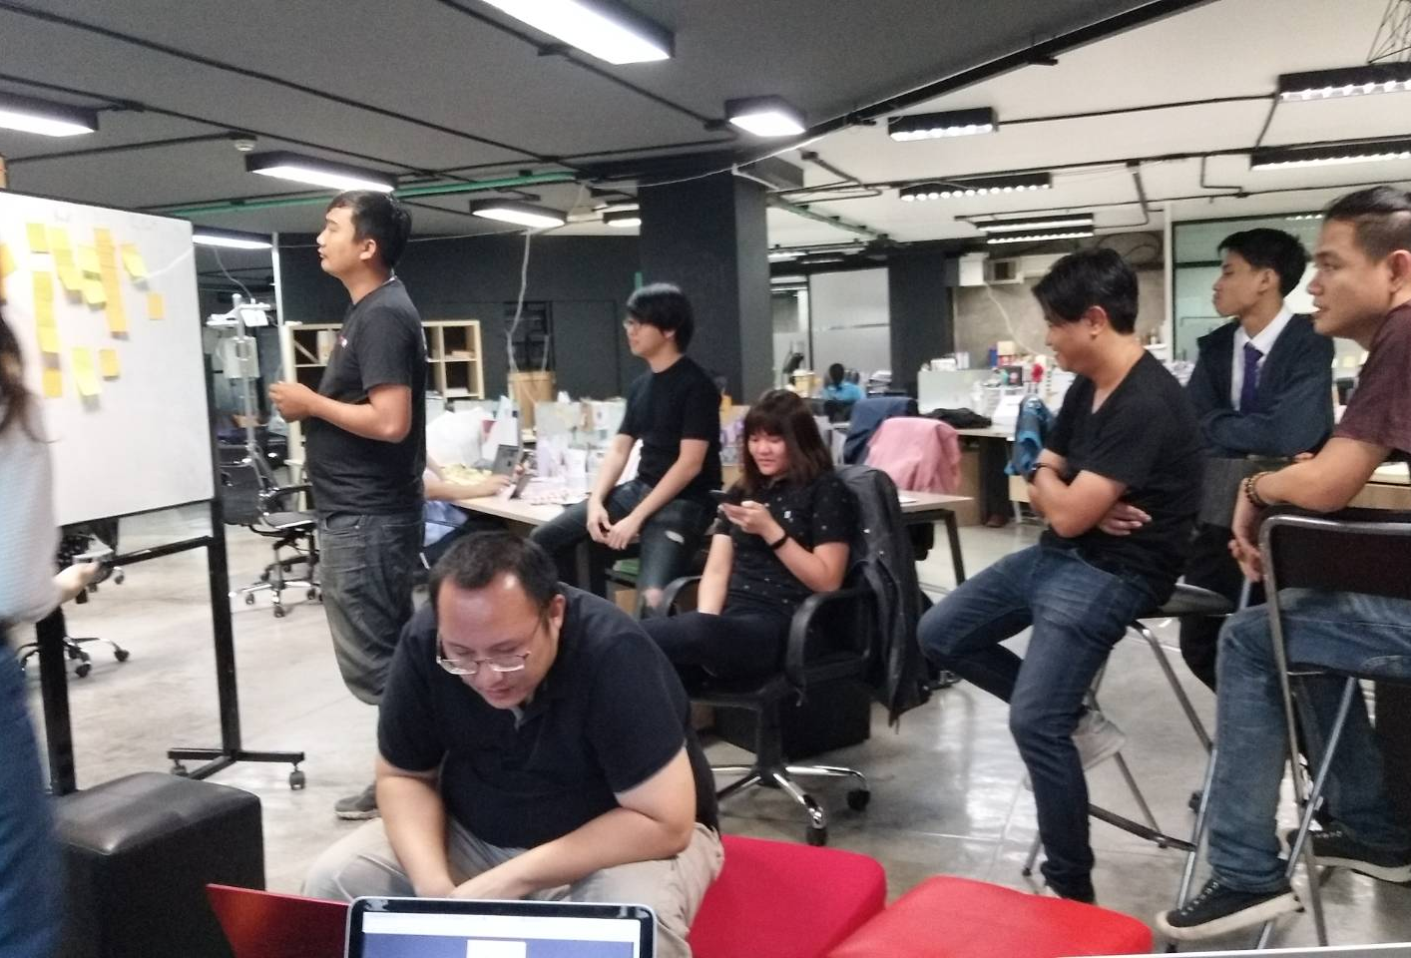
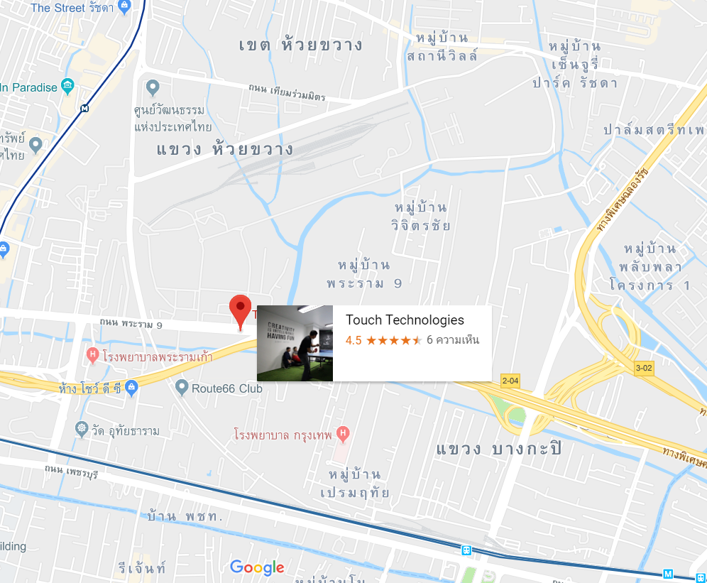
WORK PLACE
296 KSP Tower, ชั้น 3 ห้อง 3A, ถนนพระราม 9 แขวงห้วยขวาง กรุงเทพมหานคร 10310

Slide 4
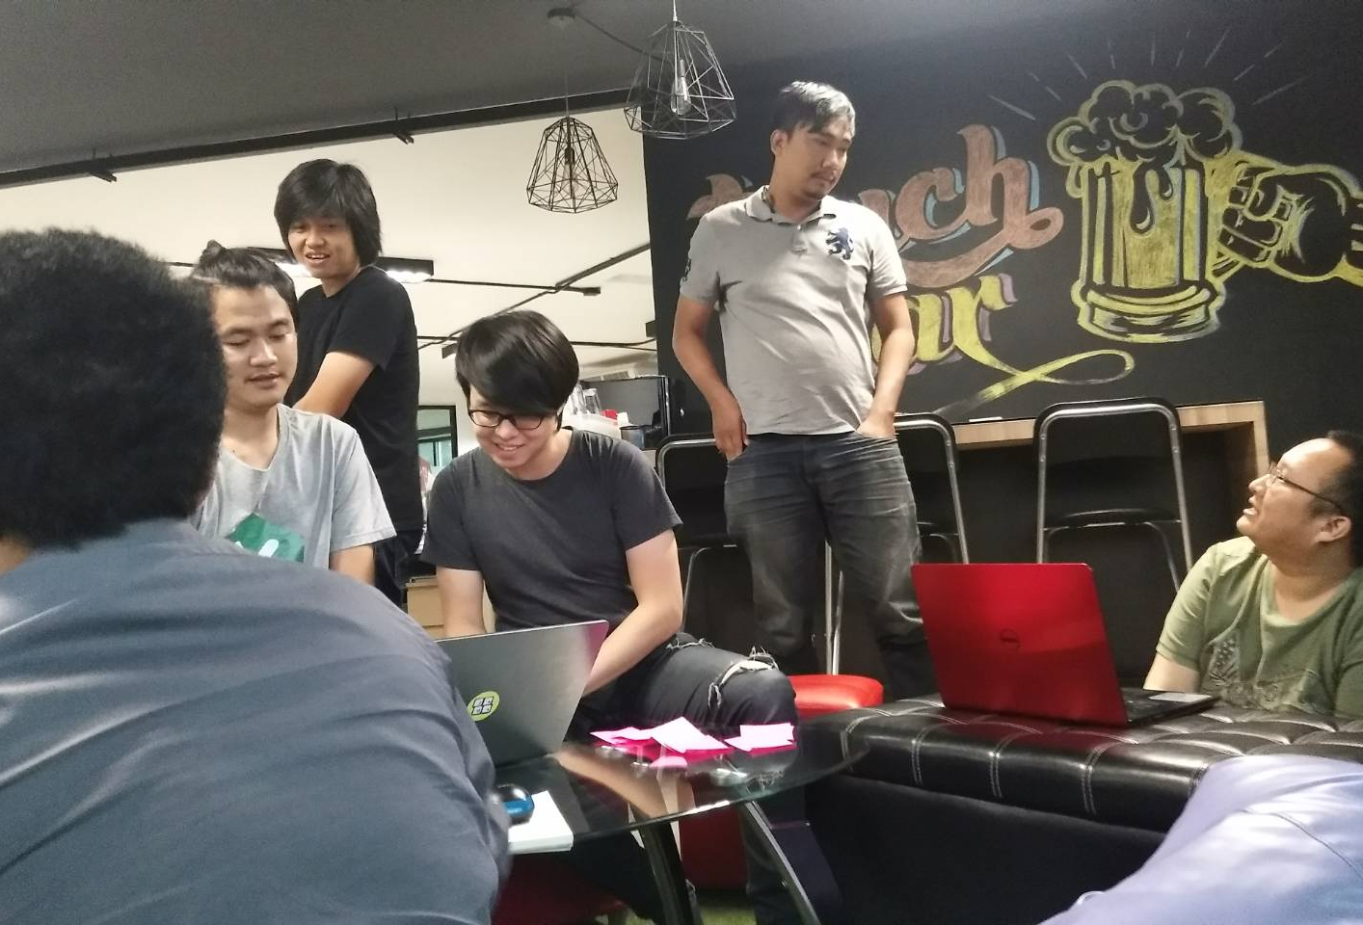

WHAT WE HAVE DONE ?
CCTV (Responsive)
AKROM
ASREE
User
Create
Read
Update
Delete
Login
Side bar
Cctvs
Create
Read
Update
Delete
Seeitlivethailand
Add menu(I like travel)

Slide 5





TOOLS
Visual Studio Code
CMD
Xampp
Git
SQLyog Community

Slide 6
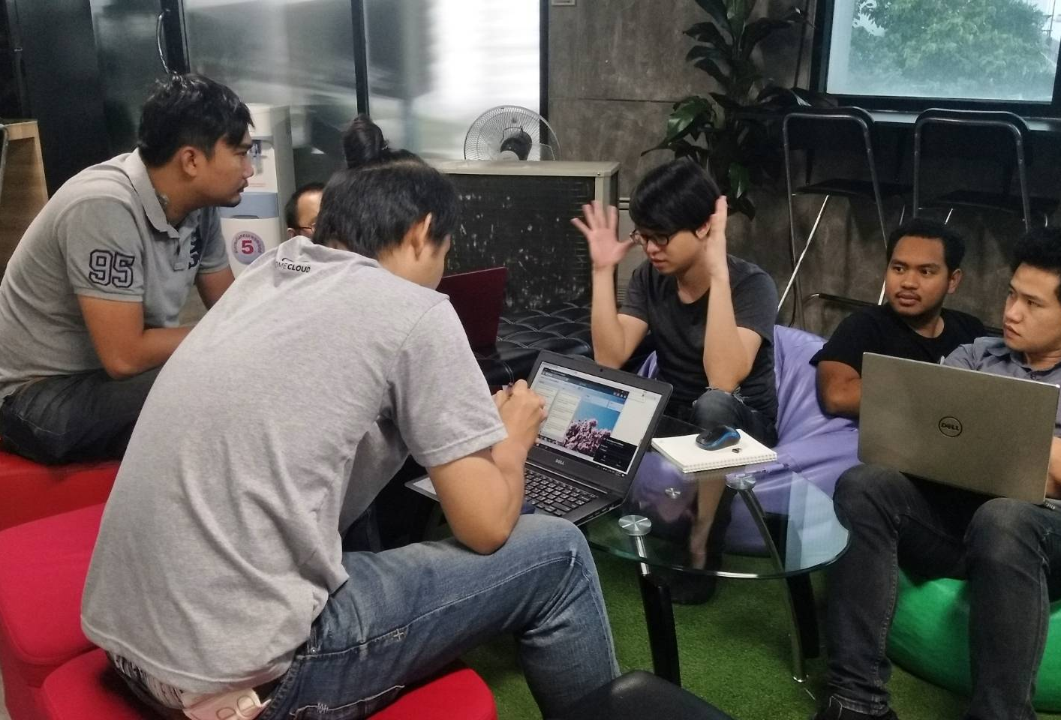
PROCESS DEV. TEAM
Meeting
Back log
Next
Current
Release

Slide 7
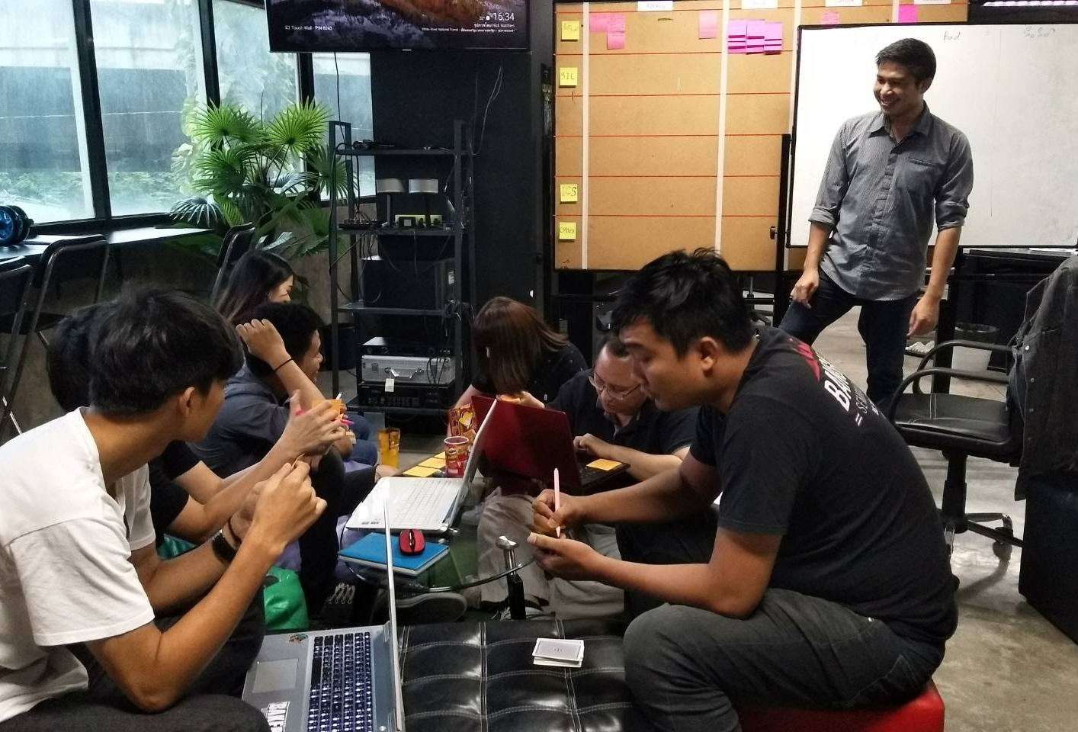
PROCESS DEV. TEAM
Project
Doing
To Test
Testing
Done

Slide 8
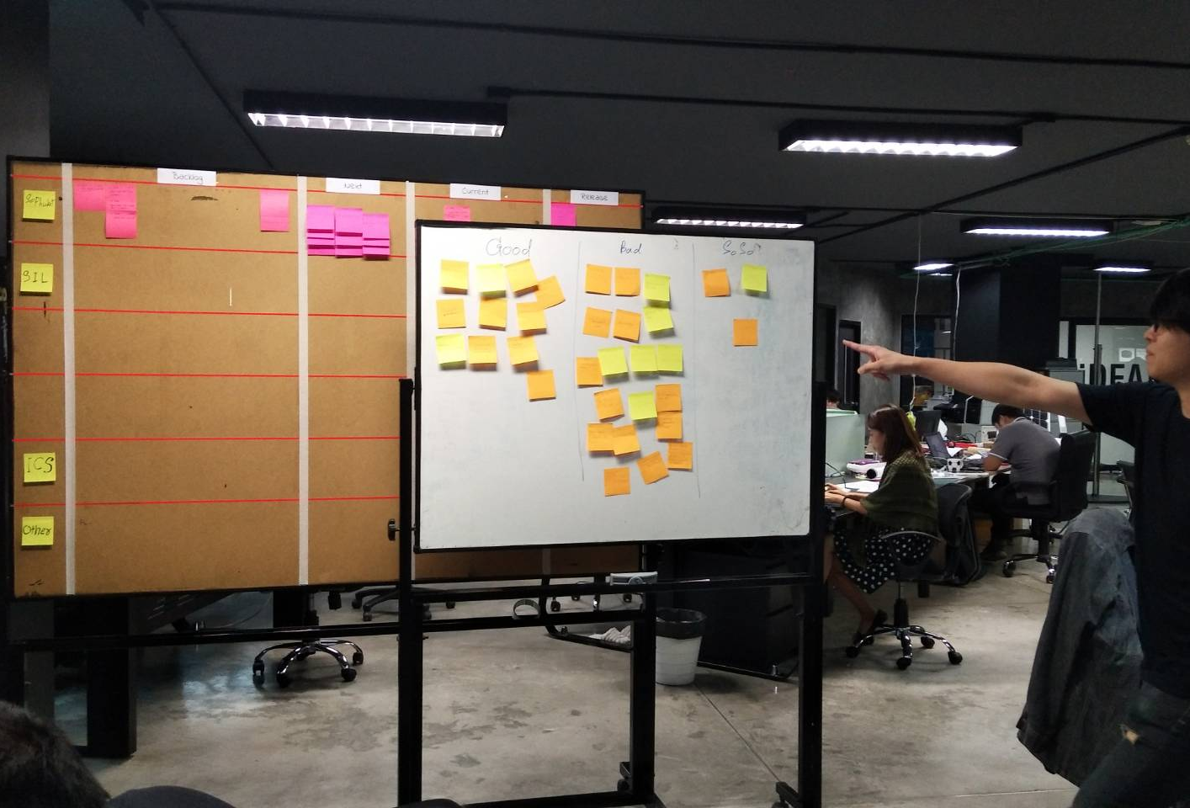
PROCESS DEV. TEAM
Done
(Repo)
Good
Bad
Soso

Slide 9
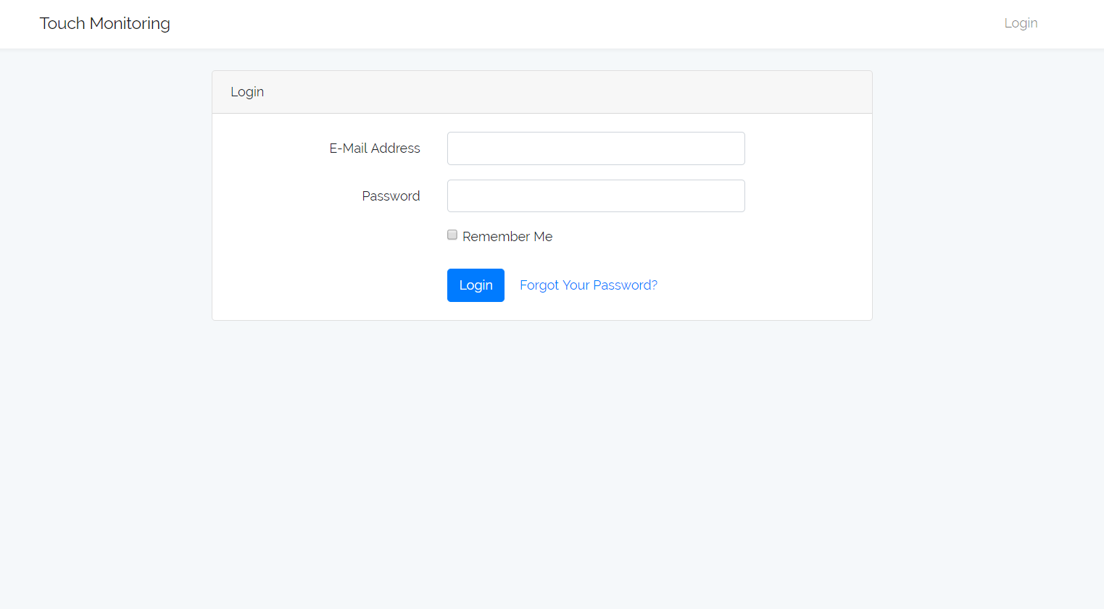
OUR PROJECT

Slide 10
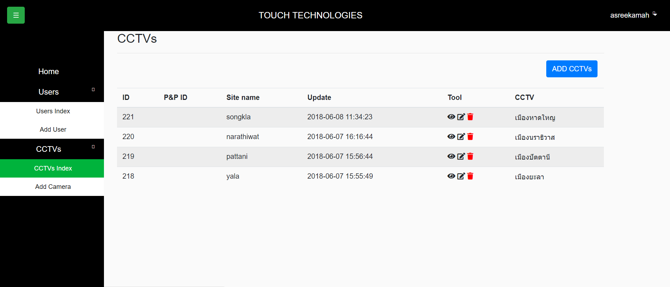
OUR PROJECT

Slide 11
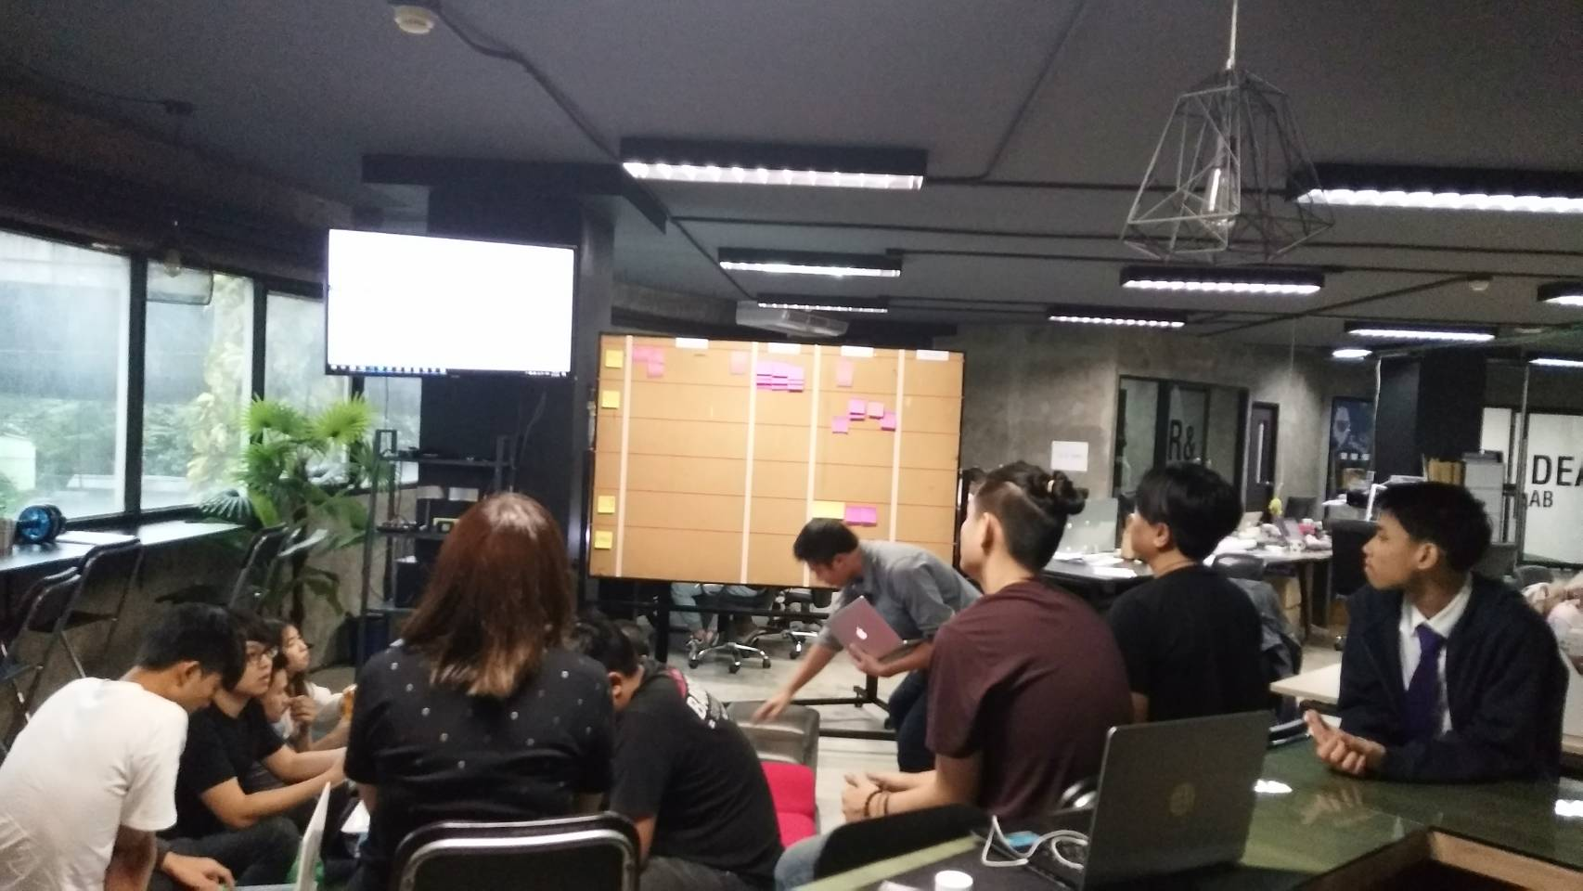
Section Divider
THANK YOU
F O R Y O U R A T T E N T I O N
A new way to engage with customers from across the globe.

