Slide 1
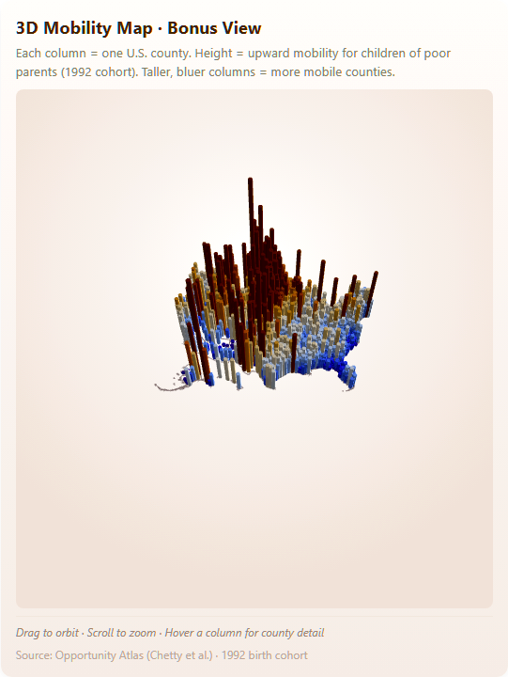
CSCI 5609 · Final Project · Spring 2026
The Geography of Opportunity
How birthplace shapes the chance of climbing — and how the U.S. compares globally.
Brandon Borzello · Harris Li · Qi Wu · Yiqi Huang
https://57777-bit.github.io/5609finalProject/
Notes:
We built an interactive scrollytelling piece asking two linked questions: how unequal is opportunity inside the U.S., and how does the U.S. compare against its wealthy peers? The argument is a local-to-global pivot. The 3D map on the right shows the full topography of opportunity — red peaks are counties where children of poor parents reach the highest adult incomes.

Slide 2
Our Framing
How much does where an American child grows up shape their adult economic outcomes — and how does the U.S. compare against its wealthy peers?
Two Acts
Part I — The American Problem
Within the U.S., mobility is sharply geographic.
Part II — The Global Perspective
The U.S. as a whole sits below most of its wealthy peers.
The Geography of Opportunity
02 / 17
Notes:
Local-to-global structure lets the audience internalize within-country spread before weighing the U.S. against peers. School funding (Step 3) is the bridge.

Slide 3
Data Sources
All Public, All Static — No Backend
Dataset
Attribution
Use
Opportunity Atlas
Chetty et al.
County-level adult outcomes by parent income
GDIM 2023
World Bank
Intergenerational immobility (IGE) by country
SWIID v9.6
Frederick Solt
Pre-/post-tax inequality (Gini)
OECD Educ. at a Glance
OECD
School funding centralization by country
US Census TopoJSON
Mike Bostock
County + state boundaries (10M vertices)
The Geography of Opportunity
03 / 17
Notes:
All loaded statically — no backend. Bridge: GDIM × SWIID inner-join on country name.

Slide 4
Tech Stack
Static Site, No Backend
Framework
Visualization
Build & Deploy
– SvelteKit
– Svelte 5 runes ($state, $bindable, $props, $effect)
– D3 v7 (scales, axes, projections)
– topojson-client
– deck.gl (3D bonus — lazy-loaded)
– Vite dev server
– GitHub Actions → GitHub Pages (auto-deploy on push)
Sticky right panel + scrollytelling left panel — the chart stays anchored as the prose advances, so each narrative beat resolves against a visible mark.
The Geography of Opportunity
04 / 17
Notes:
Deploy is fully automated via GitHub Actions on every push to main.

Slide 5
Since Last Milestone
What Changed After FP3
Three rounds of peer review pushed us toward simpler interaction, tighter narrative continuity, and a 3D bonus that earns its place.
01
Play button replaces scroll trigger on Step 0
Reviewers reported layout reflow races on fast scrolls — the map would re-mount mid-animation. We swapped the scroll trigger for an explicit Play / Replay button. Determinism over cleverness.
02
Morph animation between Step 4 and Step 6
The Gatsby Curve and the Mobility League ranking now share a transition: scatter dots morph into sorted bars (~1.2s, rect-with-rx interpolation). Same 20 countries, two views, one continuous argument.
03
3D bonus added at Step 7 (deck.gl)
A late addition. We held off until the 2D narrative was settled, then added the extruded county map as a 'magnitude reveal' — height = mobility, color = mobility — so the headline argument never depended on 3D for accessibility.
The Geography of Opportunity
05 / 17
Notes:
Highlight the Play button change first — it's the most visible UX change from FP3. The morph animation is the engineering centrepiece. The 3D was intentionally held back to ensure it didn't undermine the accessible 2D narrative.

Slide 6
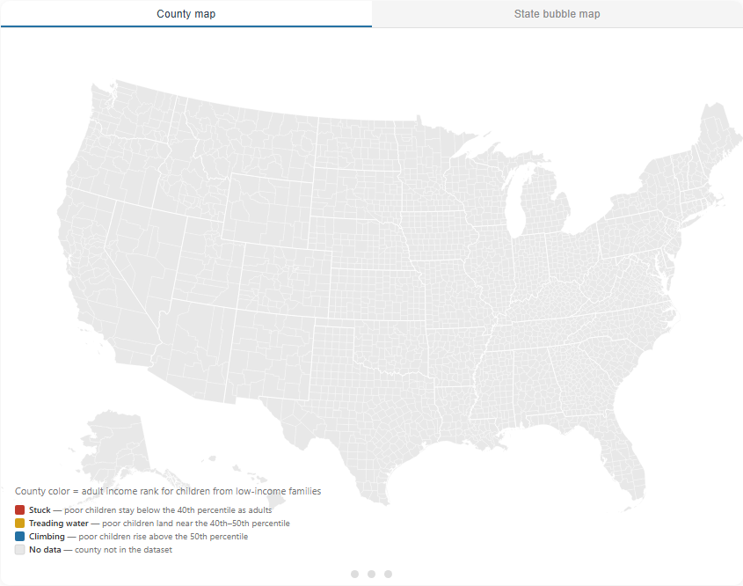
→ live demo
Step 0 · Part I — American Problem
Scrollymap · The American Problem at a Glance
County-level mobility map with button-triggered animation through three tiers.
– Stuck (red) → Treading water (amber) → Climbing (blue)
– Toggleable to state-bubble (Dorling) view
– Click a state → zoom to its counties
TAKEAWAY
Play button replaces scroll trigger — fixes layout reflow races on fast scrolls.
The Geography of Opportunity
06 / 17
Notes:
The opening uses a Play button instead of scroll trigger because scroll triggers were producing layout reflow races on fast scrolls.

Slide 7
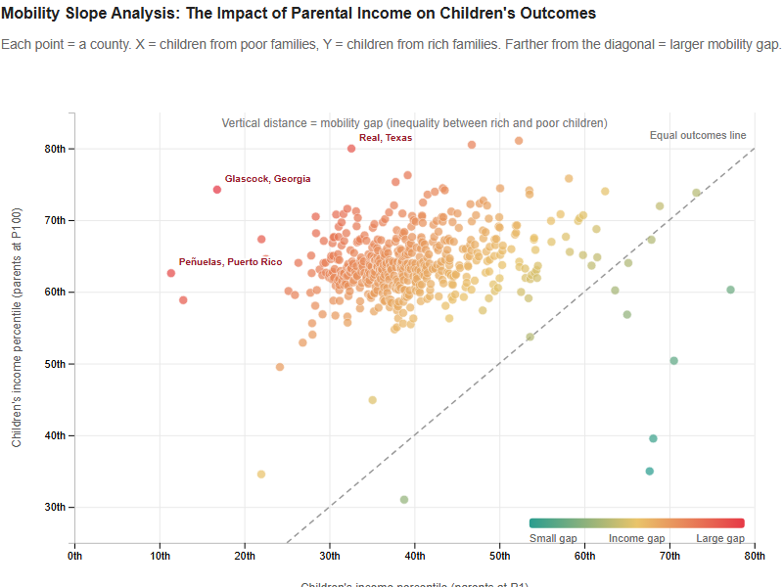
→ live demo
Step 1 · Part I — American Problem
ScatterPlot · Poor vs Rich Children
Adult-rank by county: children of poor vs. rich parents.
– Diagonal = perfect-mobility line
– Color encodes the gap (teal → yellow → red)
– Annotation: the three counties with the largest mobility gap are labeled by name.
TAKEAWAY
Distance from the diagonal is the mobility gap.
The Geography of Opportunity
07 / 17
Notes:
The reddest, most-distant points get named on the chart so the prose has a target.

Slide 8
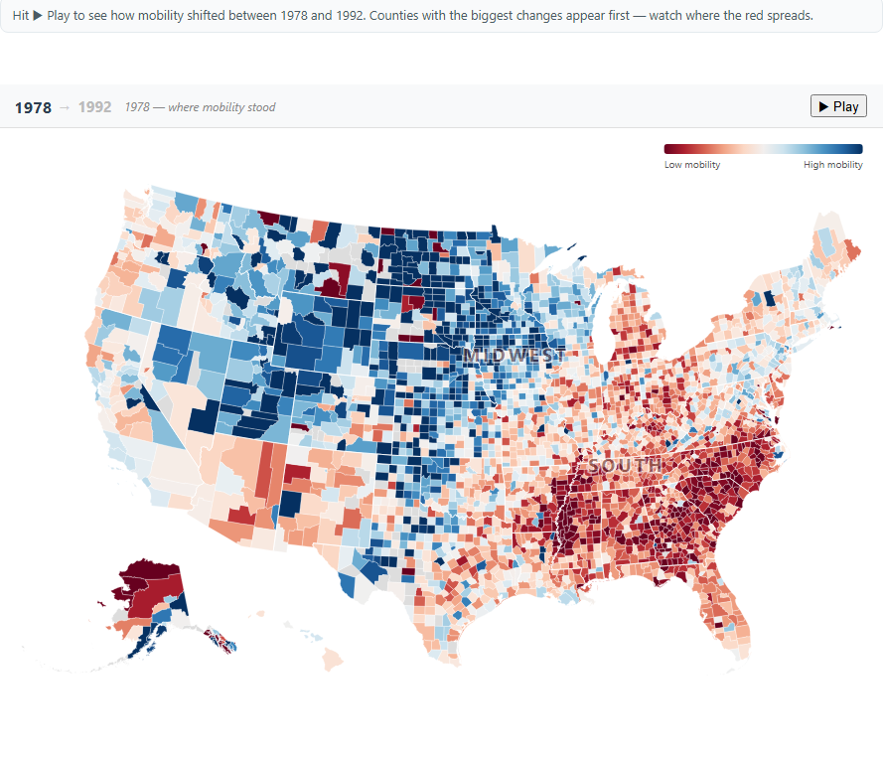
→ live demo
Step 2 · Part I — American Problem
ChangeMap · 1978 → 1992 Birth Cohorts
Animated transition from 1978 baseline to 1992 outcome.
– Counties reveal in order of largest absolute change
– Annotations: SOUTH / MIDWEST region tags anchor regional prose claims to the map.
– Eye is drawn first to where mobility moved most
TAKEAWAY
Reveal order is the magnitude of change, not alphabetical.
The Geography of Opportunity
08 / 17
Notes:
The animation reveals counties from the largest changes inward.

Slide 9
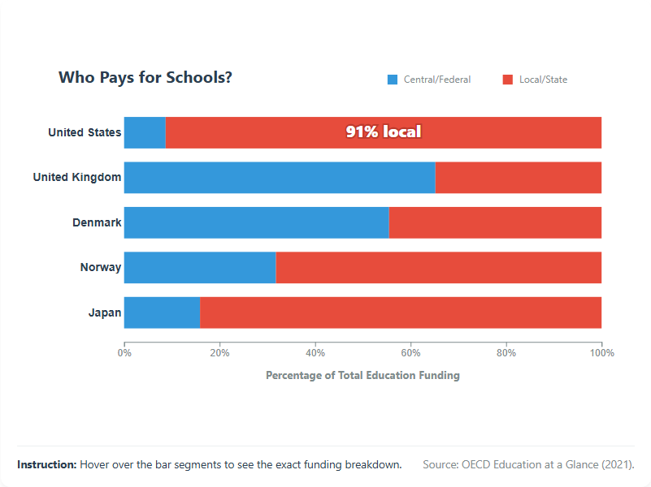
→ live demo
Step 3 · Part I — American Problem
SchoolFunding · The Bridge to Global
Stacked bar: Central/Federal vs. Local/State education funding share.
– U.S. vs. five wealthy peers
– Annotation: big '91% local' headline centered in the U.S. red segment.
– Bridge from the American problem to the global perspective
TAKEAWAY
The U.S. funds schools through local property tax — geography of opportunity is geography of the tax base.
The Geography of Opportunity
09 / 17
Notes:
This is the pivot slide from the American problem to the global perspective.

Slide 10
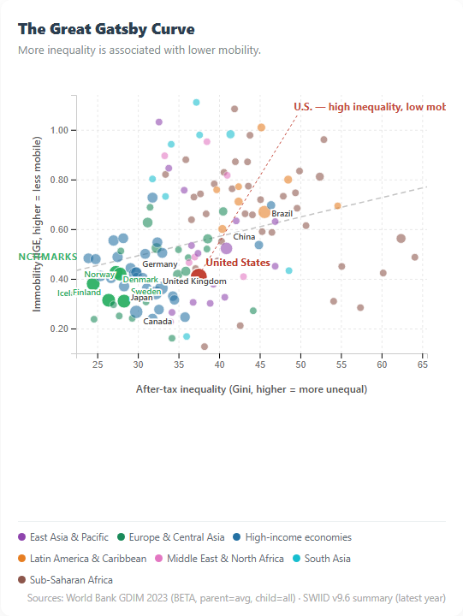
→ live demo
Step 4 · Part II — Global Perspective
The Great Gatsby Curve
Cross-country scatter: after-tax Gini vs. intergenerational immobility (IGE).
– Trend line: more inequality ↔ less mobility
– Country labels: U.S. in terracotta, NORDIC BENCHMARKS caption in sage.
– Takeaway callout: 'U.S. — high inequality, low mobility' with dashed leader.
TAKEAWAY
The U.S. sits up and to the right — the worst quadrant on both axes.
The Geography of Opportunity
10 / 17
Notes:
The canonical Great Gatsby curve. The U.S. sits in the worst quadrant on both axes.

Slide 11
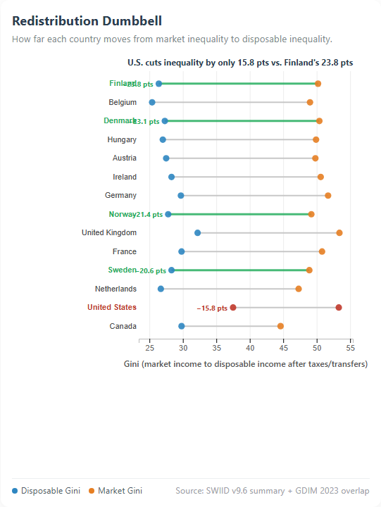
→ live demo
Step 5 · Part II — Global Perspective
Redistribution Dumbbell
For 14 countries: market Gini → disposable Gini after taxes/transfers.
– Each row's Δ is labeled in points
– Nordic accent: sage color + thicker line for visual binding to prose claims.
– Headline contrasts U.S. redistribution against the strongest Nordic redistributor
TAKEAWAY
Denmark cuts ~25 points; the U.S. cuts under 10. The institutional choice matters.
The Geography of Opportunity
11 / 17
Notes:
Same starting market inequality can land at very different places.

Slide 12
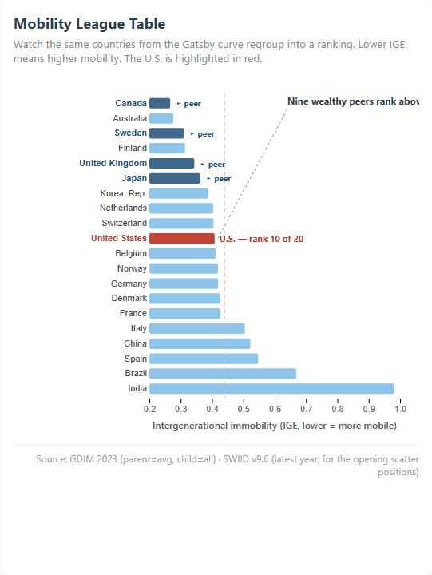
→ live demo
Step 6 · Part II — Global Perspective
Mobility League · The Closing Frame
Ranking of 20 major economies by intergenerational immobility (IGE).
– Morph animation: scatter dots morph into sorted bar ranking (~1.2s, rect-with-rx interpolation).
– U.S. callout: 'rank 10 of 20' with dashed leader line.
– ▸ peer tags on Canada, Sweden, U.K., Japan
TAKEAWAY
Continuity from Step 4 to Step 6 is the whole argument: same world, viewed two ways.
The Geography of Opportunity
12 / 17
Notes:
The morph makes visible that the SAME 20 countries are now ranked. Continuity is the argument.

Slide 13
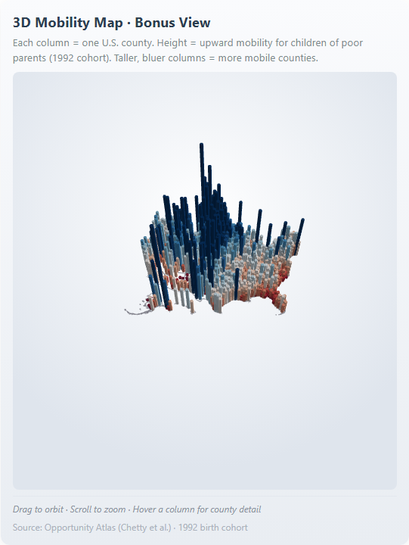
→ live demo
Bonus Step 7 · deck.gl
Bonus · A Topography of Opportunity
3D extruded county map — height = mobility for poor-parent children (1992 cohort).
– Tech: deck.gl OrbitView + ColumnLayer + PathLayer, lazy-loaded.
– Drag to orbit · Scroll to zoom · Hover for county detail
– 2D answers WHICH counties are stuck. 3D answers HOW DRAMATIC.
TAKEAWAY
2D answers which counties are stuck. 3D makes the magnitude visceral.
The Geography of Opportunity
13 / 17
Notes:
Kept as bonus rather than opener — color encoding is more accessible for the headline argument.

Slide 14
Design Decisions
What Mattered — and Why
1.
2.
Two-act structure
Sticky right panel
Local → global lets the reader internalize within-country spread before weighing the U.S. against peers.
Chart stays anchored; prose advances on the left. Each narrative beat resolves against a visible mark.
3.
4.
Word–image binding
Curated league of 20
When prose names a country, that row is visibly distinguished — deep-blue label, peer tag, leader line.
Restricted to major economies. Low-IGE outliers (Mauritius, Maldives) muddied the rich-peer framing.
5.
6.
Button trigger over scroll trigger
3D as bonus, not opener
Step 0 uses a Play button — fixes layout reflow races on fast scrolls. Determinism over cleverness.
Color encoding is more accessible for the headline argument. 3D is for magnitude impact at the end.
The Geography of Opportunity
14 / 17
Notes:
Most of these decisions came from things that broke. The button trigger replaced a scroll trigger that raced. The curated league replaced an 'all countries' view that buried the U.S. in noise.

Slide 15
Animation & Interaction
What Moves, What the Reader Can Do
1
Morph animation
scatter → bar ranking on Step 6 (~1.2s, rect-with-rx interpolation)
2
Animated reveal
county-by-county fill transition on Step 2
3
Button-triggered play
Step 0 with Replay — deterministic, no scroll races
4
Hover tooltips
every chart — country / county / value detail
5
State drill-down
Dorling bubble view → click state → zoom to counties
6
3D orbit + zoom
bonus Step 7 (deck.gl OrbitView, lazy-loaded)
7
In-chart annotations
every step — prose references resolve to specific marks
The Geography of Opportunity
15 / 17
Notes:
Step 6's morph is the visual climax — the same 20 countries from Step 4's scatter literally flow into a sorted ranking. Step 7's 3D adds a magnitude dimension.

Slide 16
Reflection
What Worked · What We'd Redo
What worked
What we'd redo
Hardest part
Scrollytelling kept the argument sequenced. Sticky charts gave each prose beat a visual anchor. The 3D bonus at the end gave a magnitude reveal without competing with the 2D choropleth's accessibility.
Invest more in keyboard-only interaction for the 3D scene — orbit/zoom currently rely on mouse gestures. Add an elevation slider for non-mouse users.
Keeping the same 20-country roster visually consistent across Steps 4, 5, 6. The morph animation is what makes the roster legible — the eye carries identity from one chart to the next.
The Geography of Opportunity
16 / 17
Notes:
If we had another week we'd add keyboard navigation to the 3D scene. The hardest engineering problem was keeping the 20-country roster consistent.

Slide 17


Q & A
Thank you.
We're happy to take questions.
LIVE DEMO
REPO
57777-bit.github.io/5609finalProject
github.com/57777-bit/5609finalProject
Acknowledgements
Chetty et al. · Opportunity Atlas · World Bank GDIM 2023 · Frederick Solt SWIID v9.6 · Mike Bostock TopoJSON Atlas · D3 · Svelte / SvelteKit · deck.gl · OECD Education at a Glance · Special thanks to Prof. Qianwen Wang and the CSCI 5609 TAs.
Notes:
Open the floor. Common questions: why 1992 specifically (earliest robust Opp Atlas cohort), why IGE not rank correlation (GDIM uses IGE, kept their measure), why 3D is bonus not opener.

