Slide 1
CSCI 5609 · FINAL PROJECT · SPRING 2026
The Geography of Opportunity
How birthplace shapes the chance of climbing —
and how the U.S. compares globally.
Brandon Borzello · Harris Li · Qi Wu · Yiqi Huang
https://57777-bit.github.io/5609finalProject/
Notes:
We built an interactive scrollytelling piece that asks two linked questions: how unequal is opportunity inside the U.S., and how does the U.S. as a whole stack up against its wealthy peers? The whole argument is a local-to-global pivot, and we kept it as a single scroll from a county map all the way out to a 20-country mobility ranking.

Slide 2
The Geography of Opportunity · CSCI 5609 Spring 2026
OUR FRAMING
The Question
How much does where an American child grows up shape their adult
economic outcomes — and how does the U.S. compare against
its wealthy peers?
Two acts
Part I — The American Problem
Part II — The Global Perspective
Within the U.S., mobility is sharply geographic.
The U.S. as a whole sits below most of its wealthy peers.
Brandon Borzello · Harris Li · Qi Wu · Yiqi Huang
2 / 16
Notes:
We deliberately structure as local→global so the audience first feels the within-country spread, then is asked to weigh the U.S. against peer economies. The pivot point is school funding — Step 3 is the bridge.

Slide 3
The Geography of Opportunity · CSCI 5609 Spring 2026
ALL PUBLIC, ALL STATIC
Data Sources
DATASET
ATTRIBUTION
USE
Opportunity Atlas
Chetty et al.
County-level adult outcomes by parent income
GDIM 2023
World Bank
Intergenerational immobility (IGE) by country
SWIID v9.6
Frederick Solt
Pre-/post-tax inequality (Gini)
OECD Education at a Glance
OECD
School funding centralization
US Census TopoJSON Atlas
Mike Bostock
County + state boundaries (10M vertices)
Brandon Borzello · Harris Li · Qi Wu · Yiqi Huang
3 / 16
Notes:
All public, all loaded statically — no backend. Counties at 10M-vertex Albers USA projection. We bridge GDIM and SWIID by inner-joining on country name; that's how Step 4 (Gatsby curve) and Step 5 (redistribution dumbbell) share the same 14-country roster.

Slide 4
The Geography of Opportunity · CSCI 5609 Spring 2026
STATIC SITE, NO BACKEND
Tech Stack
Framework
Visualization
Build & Deploy
• SvelteKit
• Svelte 5 runes ($state, $bindable, $props, $effect)
• D3 v7 (scales, axes, projections)
• topojson-client
• deck.gl (3D bonus)
• Vite dev server
• GitHub Actions → GitHub Pages
Sticky right panel + scrollytelling left panel:
the chart stays anchored as the prose advances, so each narrative beat resolves against a visible mark.
Brandon Borzello · Harris Li · Qi Wu · Yiqi Huang
4 / 16
Notes:
Static site — no backend. Sticky right panel with scrollytelling left panel. The chart stays anchored as the prose advances, so each narrative beat resolves against a visible mark. Deploy is fully automated via GitHub Actions on every push to main.

Slide 5
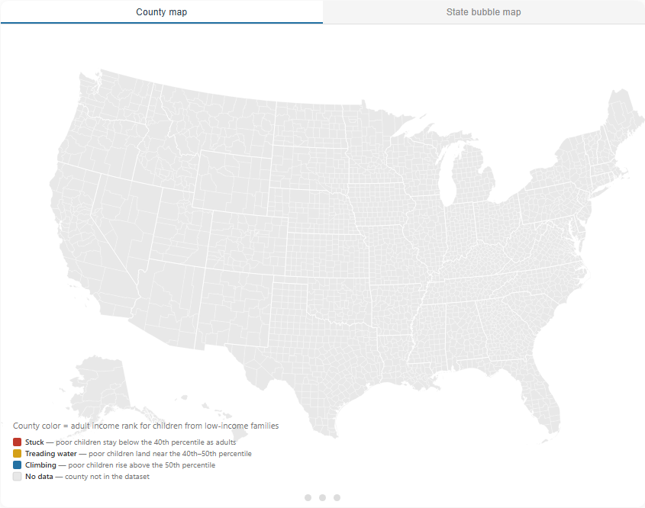
The Geography of Opportunity · CSCI 5609 Spring 2026
STEP 0 · PART I — AMERICAN PROBLEM
▶ LIVE DEMO
Scrollymap · The American Problem at a Glance
County-level mobility map with button-triggered animation through three tiers.
• Stuck (red) → Treading water (amber) → Climbing (blue)
• Toggleable to state-bubble (Dorling) view
• Click a state → zoom to its counties
TAKEAWAY
Play button instead of scroll trigger — fixes layout reflow races.
Brandon Borzello · Harris Li · Qi Wu · Yiqi Huang
5 / 16
Notes:
The opening uses a Play button instead of a scroll trigger because scroll triggers were producing layout reflow races on fast scrolls. The button locks the section to 100vh and removes that bug class.

Slide 6
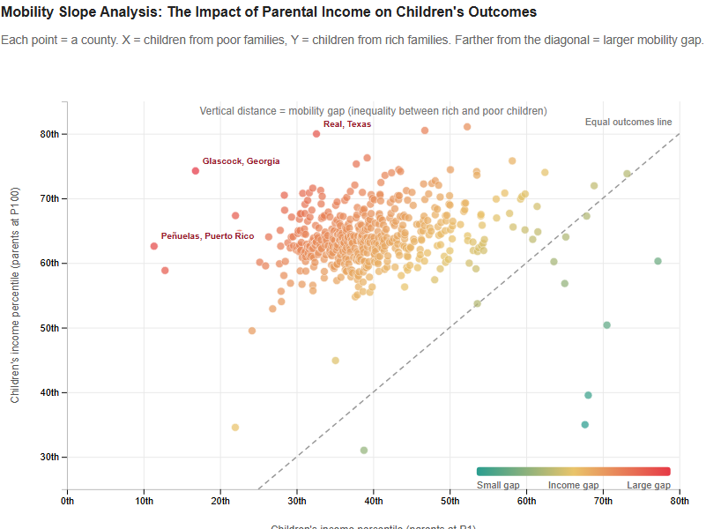
The Geography of Opportunity · CSCI 5609 Spring 2026
STEP 1 · PART I — AMERICAN PROBLEM
▶ LIVE DEMO
ScatterPlot · Poor vs Rich Children
Adult-rank by county for poor-children vs rich-children parents.
• Diagonal = perfect-mobility line
• Color encodes the gap (teal → yellow → red)
• Annotation: the three counties with the largest mobility gap are labeled.
TAKEAWAY
Distance from the diagonal is the mobility gap.
Brandon Borzello · Harris Li · Qi Wu · Yiqi Huang
6 / 16
Notes:
Distance from the diagonal is the mobility gap. The reddest, most-distant points get named on the chart so the prose has a target.

Slide 7
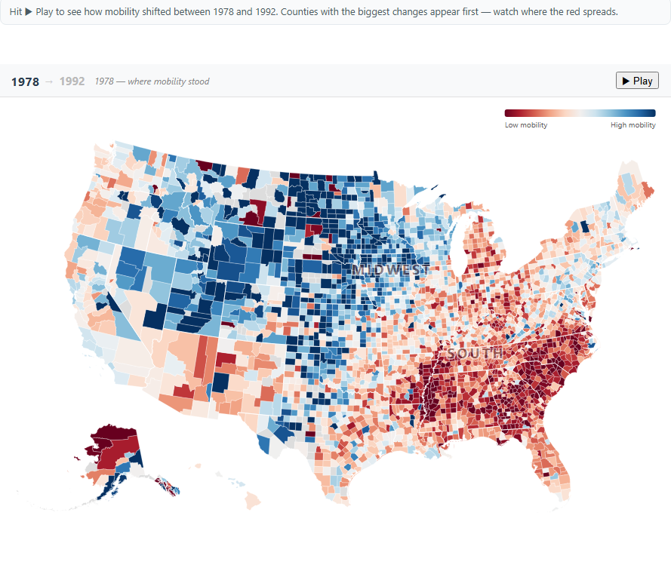
The Geography of Opportunity · CSCI 5609 Spring 2026
STEP 2 · PART I — AMERICAN PROBLEM
▶ LIVE DEMO
ChangeMap · 1978 → 1992 Birth Cohorts
Animated transition from the 1978 baseline to the 1992 outcome.
• Counties reveal in order of largest absolute change
• Annotations: SOUTH / MIDWEST region tags anchor regional prose claims.
• Eye is drawn first to where mobility moved most
TAKEAWAY
Reveal order is the magnitude of change, not alphabetical.
Brandon Borzello · Harris Li · Qi Wu · Yiqi Huang
7 / 16
Notes:
The animation reveals counties from the largest changes inward, so the eye is drawn first to where mobility moved most. The regional tags let us say 'the Mississippi Delta lost ground' and have a target to point at.

Slide 8
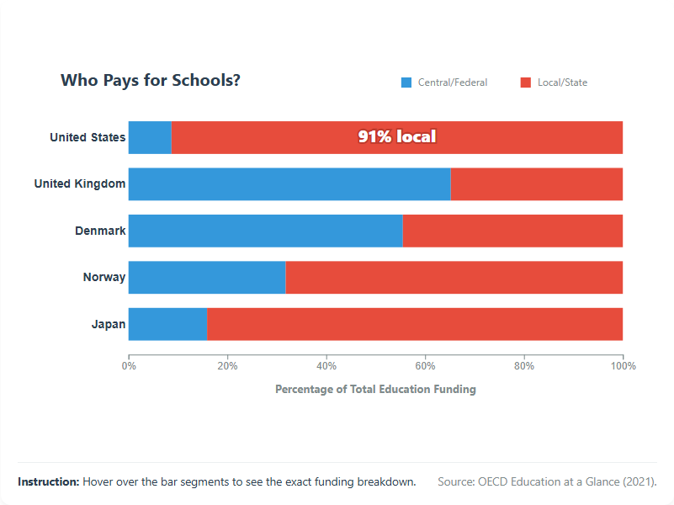
The Geography of Opportunity · CSCI 5609 Spring 2026
STEP 3 · PART I — AMERICAN PROBLEM
▶ LIVE DEMO
SchoolFunding · The Bridge to the Global View
Stacked bar: Central/Federal vs. Local/State education funding share.
• U.S. vs. five wealthy peers
• Annotation: big 'X% local' headline centered in the U.S. red segment.
• Pivot from the American problem to the global perspective
TAKEAWAY
The U.S. funds schools through local property tax — geography of opportunity is geography of the tax base.
Brandon Borzello · Harris Li · Qi Wu · Yiqi Huang
8 / 16
Notes:
This is the bridge from the American problem to the global perspective. The U.S. funds schools through local property tax — so the geography of opportunity is partly the geography of the tax base.

Slide 9
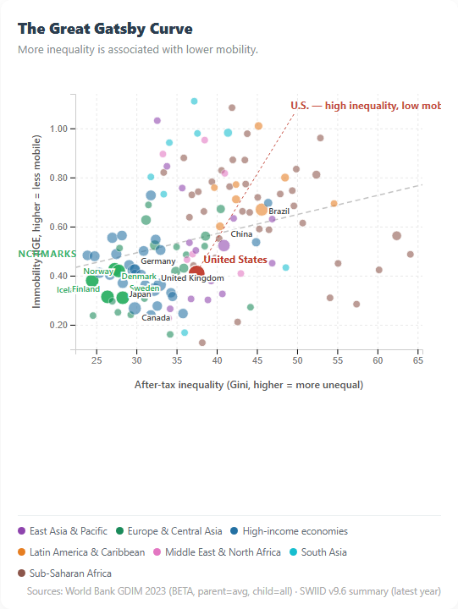
The Geography of Opportunity · CSCI 5609 Spring 2026
STEP 4 · PART II — GLOBAL PERSPECTIVE
▶ LIVE DEMO
The Great Gatsby Curve
Cross-country scatter: after-tax Gini vs. immobility (IGE).
• Trend line: more inequality ↔ less mobility
• Country labels: U.S. in red, NORDIC BENCHMARKS caption
• Takeaway callout: 'U.S. — high inequality, low mobility' with dashed leader.
TAKEAWAY
The U.S. sits up and to the right — the worst quadrant on both axes.
Brandon Borzello · Harris Li · Qi Wu · Yiqi Huang
9 / 16
Notes:
This is the canonical Great Gatsby curve. The U.S. sits up and to the right — the worst quadrant on both axes. The dashed leader line on the U.S. dot means the prose claim resolves to a specific mark.

Slide 10
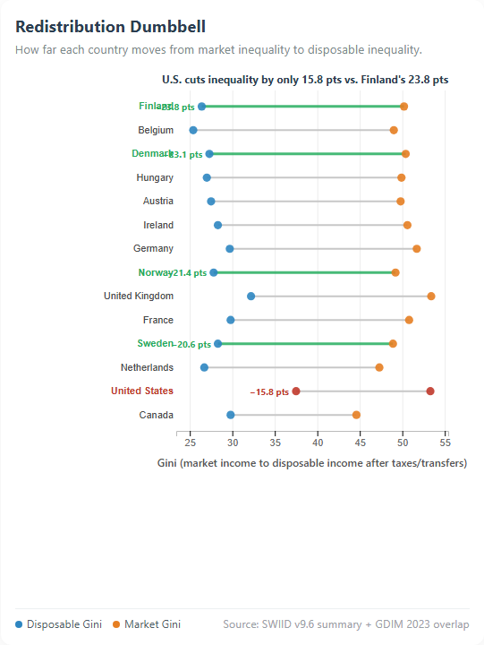
The Geography of Opportunity · CSCI 5609 Spring 2026
STEP 5 · PART II — GLOBAL PERSPECTIVE
▶ LIVE DEMO
Redistribution Dumbbell
For 14 countries: market Gini → disposable Gini after taxes/transfers.
• Each row's Δ is labeled in points
• Nordic accent: green color + thicker line for visual binding to prose
• Headline contrasts U.S. redistribution against the strongest Nordic redistributor
TAKEAWAY
Denmark cuts ~25 points; the U.S. cuts under 10. The institutional choice matters.
Brandon Borzello · Harris Li · Qi Wu · Yiqi Huang
10 / 16
Notes:
Same starting market inequality can land at very different places. Denmark cuts roughly 25 points; the U.S. cuts under 10. The institutional choice matters more than the starting condition.

Slide 11
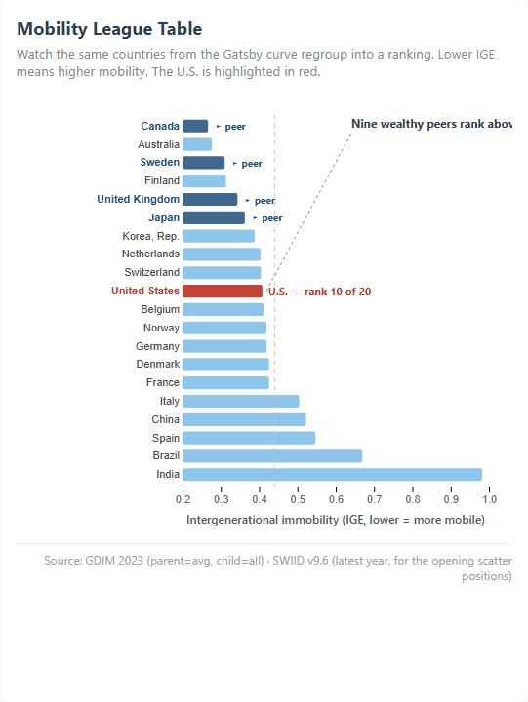
The Geography of Opportunity · CSCI 5609 Spring 2026
STEP 6 · PART II — GLOBAL PERSPECTIVE
▶ LIVE DEMO
Mobility League · The Closing Frame
Ranking of 20 major economies by intergenerational immobility (IGE).
• Animation: scatter dots morph into sorted bar ranking (~1.2s, rect-with-rx interpolation)
• U.S. callout: 'rank N of 20' with leader line
• ▸ peer tags on Canada, Sweden, U.K., Japan
• Takeaway: 'Nine wealthy peers rank above the U.S.'
TAKEAWAY
Continuity from Step 4 to Step 6 is the whole argument: same world, viewed two ways.
Brandon Borzello · Harris Li · Qi Wu · Yiqi Huang
11 / 16
Notes:
This is the closing chart, and the morph is intentional — it makes visible that the SAME 20 countries we just showed scattered against inequality are now ranked. The continuity from Step 4 to Step 6 is the whole argument: same world, viewed two ways.

Slide 12
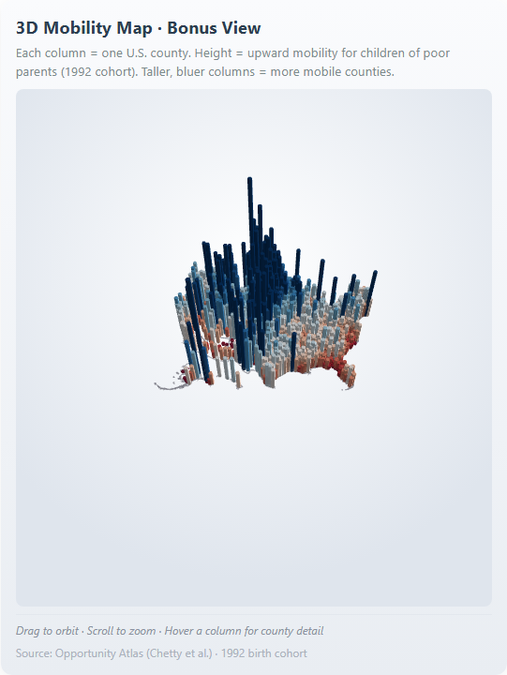
The Geography of Opportunity · CSCI 5609 Spring 2026
BONUS · STEP 7
▶ LIVE DEMO
Bonus · A Topography of Opportunity
3D extruded county map (deck.gl) — height = mobility for poor-parent children, 1992.
• Tech: deck.gl OrbitView + ColumnLayer + PathLayer (state borders)
• Lazy-loaded — only downloads when the user scrolls into Step 7
• Drag to orbit · Scroll to zoom · Hover for county detail
• Mountains and valleys aren't even on the same scale
TAKEAWAY
2D answers WHICH counties are stuck. 3D answers HOW DRAMATIC the difference is.
Brandon Borzello · Harris Li · Qi Wu · Yiqi Huang
12 / 16
Notes:
The 2D choropleth answers which counties are stuck. The 3D extrusion answers how dramatic the difference is between neighbors — the mountains and the valleys aren't even on the same scale. We kept it as a bonus rather than the opener because color encoding remains more accessible for the headline argument; the 3D is here to make the magnitude visceral.

Slide 13
The Geography of Opportunity · CSCI 5609 Spring 2026
WHAT WE LEARNED THE HARD WAY
Design Decisions That Mattered
1. Two-act structure
2. Sticky right panel
Local → global lets the reader internalize within-country spread before weighing the U.S. against peers.
Chart stays anchored; prose advances on the left. Each narrative beat resolves against a visible mark.
3. Word–image binding
4. Curated league of 20
When prose names a country, that row is visibly distinguished (deep-blue label, peer tag, leader line).
Restricted to major economies. Random low-IGE outliers (Mauritius, Maldives) muddied the rich-peer framing.
5. Button trigger over scroll trigger
6. 3D as bonus, not opener
Step 0 uses a Play button — fixes layout reflow on fast scrolls.
Color encoding is more accessible for the headline argument. The 3D is for magnitude impact at the end.
Brandon Borzello · Harris Li · Qi Wu · Yiqi Huang
13 / 16
Notes:
Most of these decisions came from things that broke. The button trigger replaced a scroll trigger that raced. The curated league replaced a naive 'all countries' view that buried the U.S. in noise. The 3D was deliberately kept as a bonus rather than competing with the 2D choropleth's accessibility for the headline argument.

Slide 14
The Geography of Opportunity · CSCI 5609 Spring 2026
WHAT MOVES, WHAT THE READER CAN DO
Animation & Interaction Highlights
1
Morph animation
scatter → bar ranking on Step 6
2
Animated reveal
county-by-county fill transition on Step 2
3
Button-triggered playback
Step 0 with Replay
4
Hover tooltips
every chart, with country / county / value detail
5
State drill-down
in the bubble (Dorling) view
6
3D orbit + zoom
bonus Step 7 (deck.gl OrbitView)
7
In-chart annotations
every step — prose references resolve to specific marks
Brandon Borzello · Harris Li · Qi Wu · Yiqi Huang
14 / 16
Notes:
Every chart has at least one motion or interaction. Step 6's morph is the visual climax — the same 20 countries from Step 4's scatter literally flow into a sorted ranking. Step 7's 3D adds a magnitude dimension that flat color can't carry.

Slide 15
The Geography of Opportunity · CSCI 5609 Spring 2026
WHAT WORKED · WHAT WE'D REDO
Reflection
What worked
What we'd redo
Hardest part
Scrollytelling kept the argument sequenced. Sticky charts gave each prose beat a visual anchor. Adding the deck.gl 3D bonus at the end gave a 'magnitude reveal' without competing with the 2D choropleth's accessibility for the headline argument.
Invest more in keyboard-only interaction for the 3D scene — orbit/zoom currently rely on mouse gestures. Add an elevation slider for non-mouse users.
Keeping the same 20-country roster visually consistent across Steps 4, 5, 6. The morph from scatter to ranking is what makes that roster legible — the eye carries identity from one chart to the next.
Brandon Borzello · Harris Li · Qi Wu · Yiqi Huang
15 / 16
Notes:
If we had another week we'd add keyboard navigation to the 3D scene and an elevation slider for non-mouse users. The hardest engineering problem was actually keeping the 20-country roster consistent across Steps 4, 5, and 6 — the morph animation is what carries identity through.

Slide 16


Q & A
Thank you.
We're happy to take questions.
LIVE DEMO
REPO
57777-bit.github.io/5609finalProject
github.com/57777-bit/5609finalProject
ACKNOWLEDGEMENTS
Chetty et al. · Opportunity Atlas · World Bank GDIM 2023 · Frederick Solt SWIID v9.6 · Mike Bostock TopoJSON Atlas · D3 · Svelte/SvelteKit
Notes:
Open the floor. The QR codes go to the live demo and the repo. Common questions to be ready for: data limitations, why we picked 1992 specifically (Opportunity Atlas's earliest robust cohort), why IGE not rank correlation (GDIM uses IGE; we kept their measure to avoid double conversion), and why the 3D is a bonus not the opener (color encoding is more accessible for the headline argument).

