Slide 1
Pneumonia Detection: A Neural Network Approach
HyangMok Baek
1/25/2025
NeurEx

Slide 2
Why Use Neural Networks in Pneumonia Detection?
Accuracy and Precision
Rapid Diagnosis
Handling Large Data Volumes
Reducing Human Error
Accessible Healthcare

Slide 3
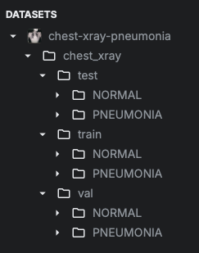
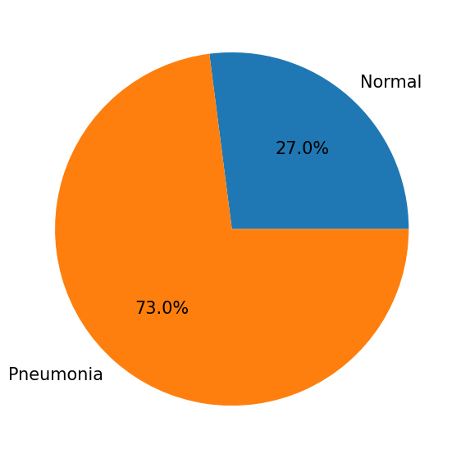
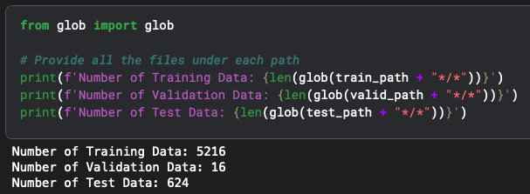
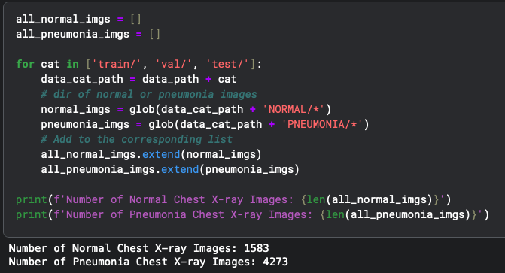
Let’s look at the dataset

Slide 4
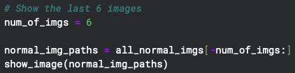
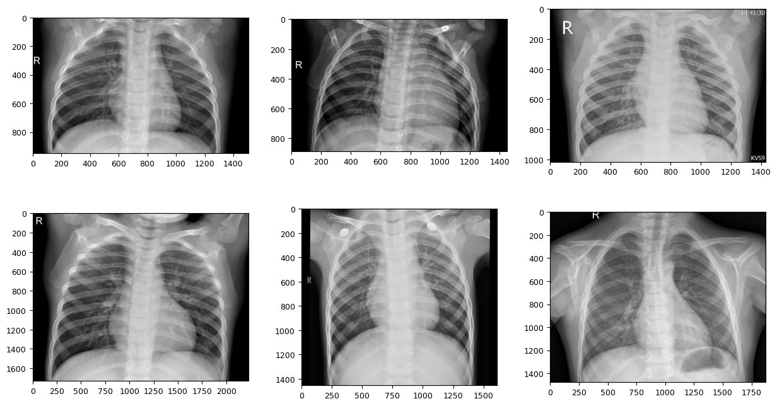

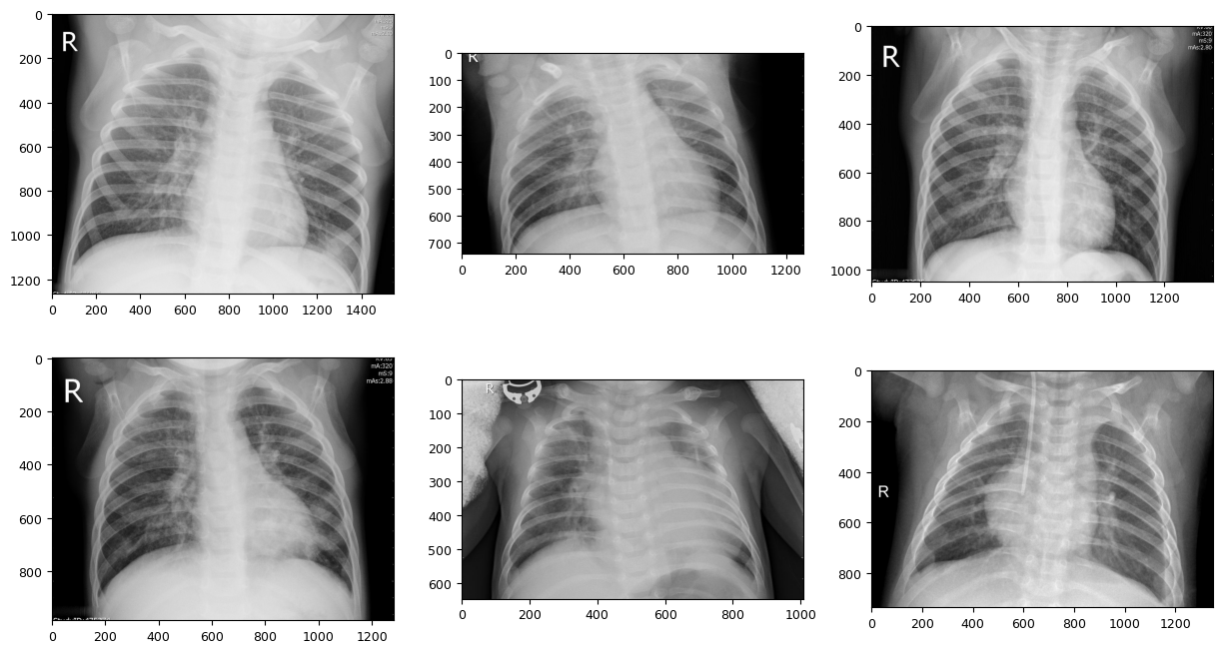

Slide 5
Modeling Strategy
Handling Different Image Sizes and Ratios: Images come in varying sizes and aspect ratios. To standardize them for the model, we will use transforms.Compose to resize and preprocess
Image File Format: The dataset consists of images in .jpeg format, not in a tabular .csv format. Therefore, we will process the images directly from their directories.
Validation Data: A separate validation dataset is provided, eliminating the need to split the training data for validation purposes.
Organized Target Values: Images are already categorized into directories based on their respective labels (e.g., “Normal” or “Pneumonia”).
Model Selection: To perform the binary classification task of detecting “Normal” or “Pneumonia,” we’ll leverage the EfficientNet architecture

Slide 6
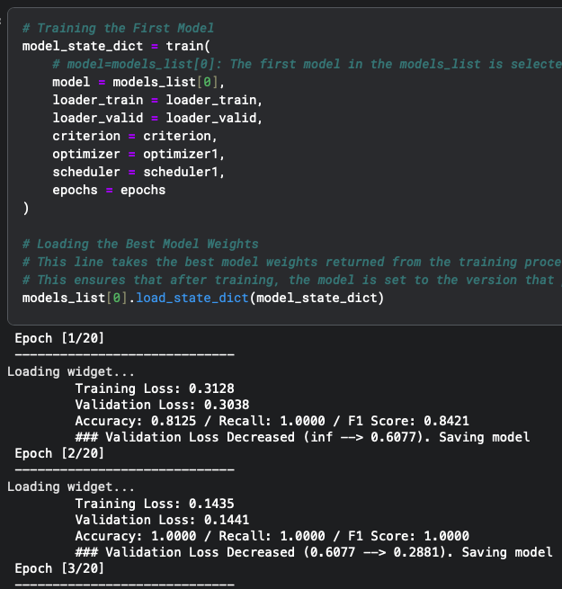
Big Picture: Training the Pneumonia Detection Project
1. Why EfficientNet Models? EfficientNet models (B1, B2, B3) were chosen for their advanced balance between accuracy and efficiency. These models use a compound scaling method that adjusts resolution, depth, and width systematically, making them highly suitable for image classification tasks while minimizing computational cost.

Slide 7
Big Picture: Training the Pneumonia Detection Project
1-1. Why Use Multiple EfficientNet Models?
Diverse Feature Extraction: Each model has different scaling factors (depth, width, resolution), meaning they may capture patterns in the data differently.
EfficientNet-B1: Optimized for speed with moderate accuracy.
EfficientNet-B2: Slightly larger and more accurate than B1.
EfficientNet-B3: Larger yet, with higher accuracy potential.
Performance Trade-offs: Using multiple models allows leveraging their strengths. For example, a smaller model may perform well on simpler patterns, while a larger one captures finer details.

Slide 8
Big Picture: Training the Pneumonia Detection Project
2. Data Preprocessing Challenges:
Images were of varying sizes and ratios.
The dataset was in .jpeg format, organized into directories by labels (Normal, Pneumonia).
Preprocessing Steps:
Used transforms.Compose to resize images to a uniform dimension required by EfficientNet.
Normalized pixel values to improve model performance and stability during training.
Applied transformations specifically designed for training, validation, and test datasets to avoid overfitting or data leakage.
Data Loading: Utilized PyTorch’s ImageFolder and DataLoader for structured dataset management and efficient data batching.

Slide 9
Big Picture: Training the Pneumonia Detection Project
3. Training and Validation
Integrated Training and Validation:
During each epoch, the model was trained on the training dataset and evaluated on the validation dataset.
Validation was used to monitor performance, ensuring the model wasn’t overfitting.
Training Components:
Optimizer: Used AdamW, which incorporates weight decay for better generalization.
Loss Function: Binary Cross-Entropy Loss (BCELoss) was chosen, ideal for binary classification tasks.
Learning Rate Scheduler: Applied CosineAnnealingLR to dynamically adjust the learning rate, improving convergence efficiency.

Slide 10
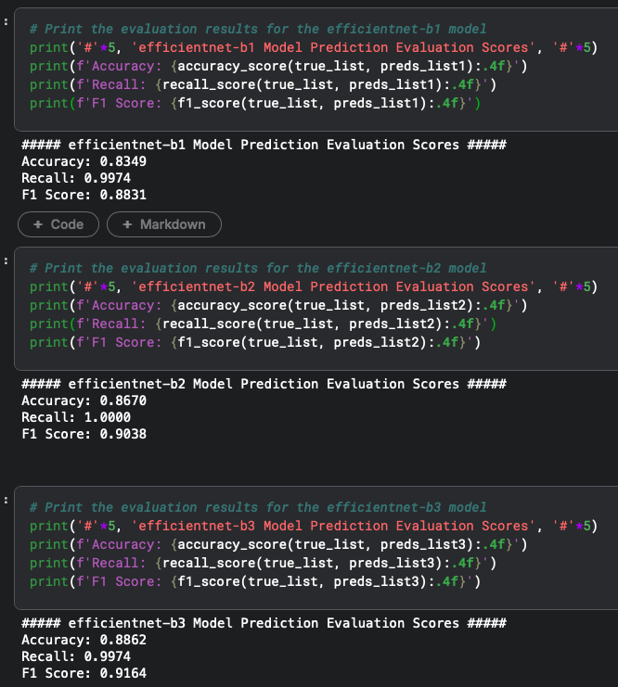
Big Picture: Training the Pneumonia Detection Project
4. Testing the Model
After training, the model’s performance was evaluated on a separate test dataset that it had never seen before.
Used the predict function to generate predictions and calculated metrics like accuracy, recall, and F1 score to assess the effectiveness of each model individually.

Slide 11
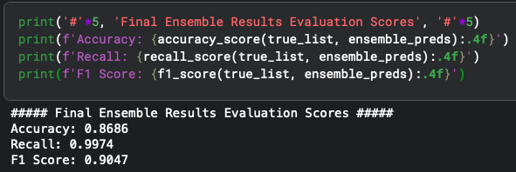
Big Picture: Training the Pneumonia Detection Project
5. Ensemble Method
Why Use an Ensemble?
Each EfficientNet variant (B1, B2, B3) captures slightly different patterns in the data due to its unique architecture. Combining their predictions helps leverage these diverse perspectives for a more robust and accurate outcome.
How It Worked:
Combined predictions from the three models by averaging their outputs.
Rounded the averaged predictions to the nearest integer to determine the final classification (Normal or Pneumonia).
Advantages:
Reduced variance and improved performance compared to individual models.
Achieved higher recall, minimizing the risk of missing pneumonia cases.

Slide 12
Big Picture: Training the Pneumonia Detection Project
5-1. Why Combine Them?
Increased Accuracy: Combining predictions reduces the chance of errors that a single model might make. If one model misclassifies an image, the others may correct it, leading to better overall results.
Reduced Variance: Individual models may perform inconsistently on different data subsets. An ensemble averages out these inconsistencies, producing more stable predictions.
Complementary Strengths: EfficientNet-B1, B2, and B3 may specialize in different aspects of the data. For example, one model might excel at detecting subtle features in pneumonia cases, while another might perform better on normal cases. Combining them ensures these complementary strengths are utilized.ble)?

