Slide 1
SyDEVS Library Framework Overview
Autodesk Research
April 2018

Slide 2
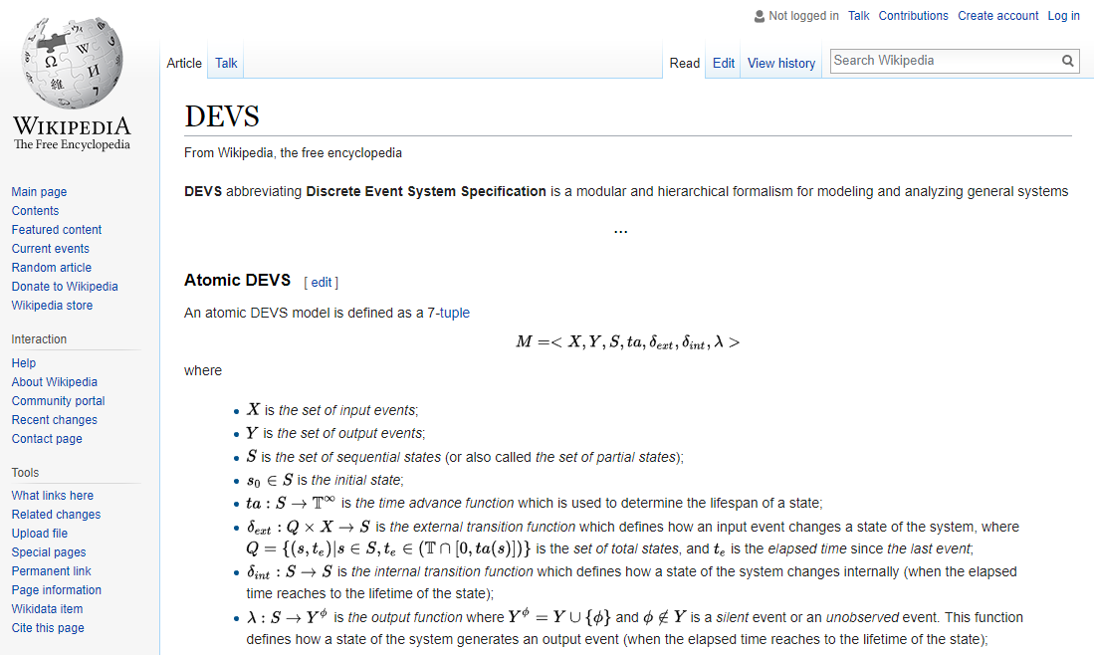
Classic Theory (1970s)

Slide 3
SyDEVS Approach
Simulation Node

Slide 4
SyDEVS Approach
Simulation Node

Slide 5
SyDEVS Approach
Simulation Node

Slide 6
SyDEVS Approach
Simulation Node

Slide 7
SyDEVS Approach
Message Passing
Simulation Node

Slide 8
SyDEVS Approach
Message Passing
Simulation Node
Data

Slide 9
SyDEVS Approach
Dataflow
Message Passing
Function
Node
Simulation Node
Data

Slide 10
SyDEVS Approach
Dataflow
Message Passing
Dataflow
Function
Node
Simulation Node
Data

Slide 11
SyDEVS Approach
Dataflow
Message Passing
Dataflow
Function
Node
Simulation Node
Data
Statistics
(for Discovery)
or
Performance Metrics
(for Design)

Slide 12
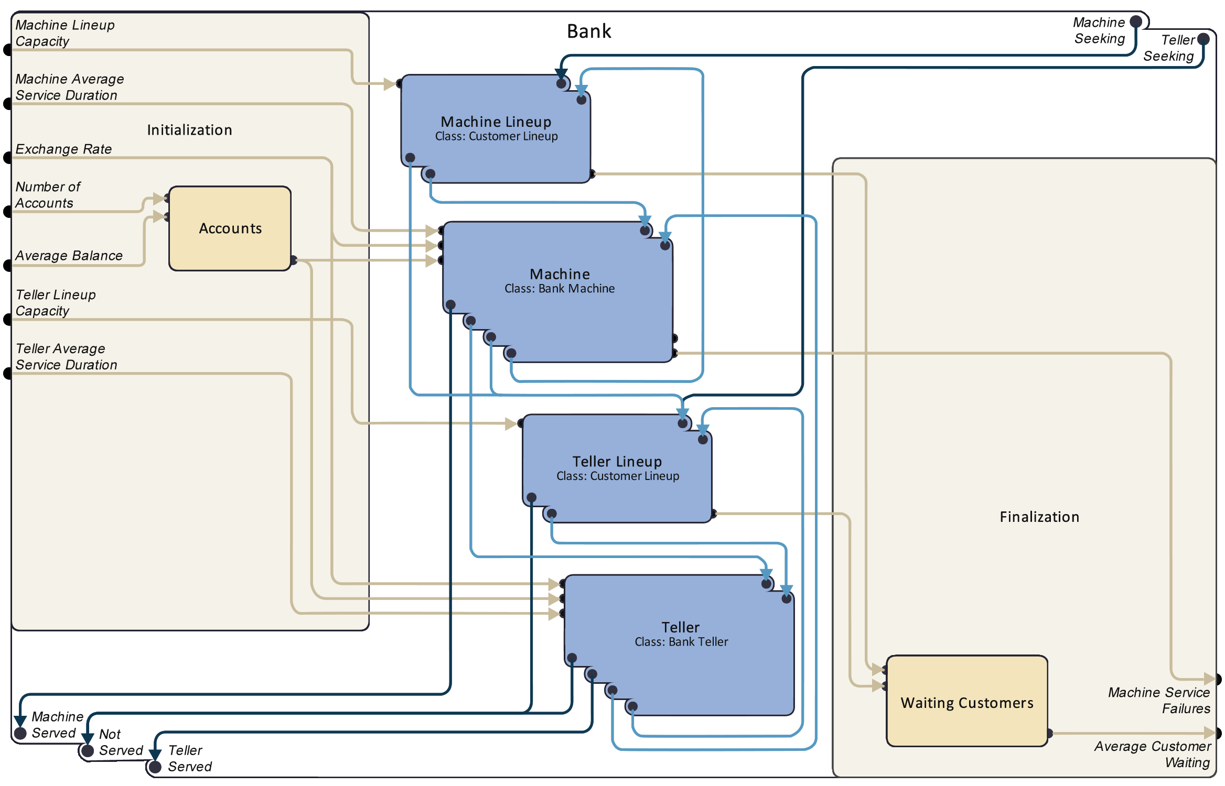
Proposed Visual Interface
https://autodeskresearch.com/publications/designingdevs

Slide 13
Proposed Visual Interface

Slide 14
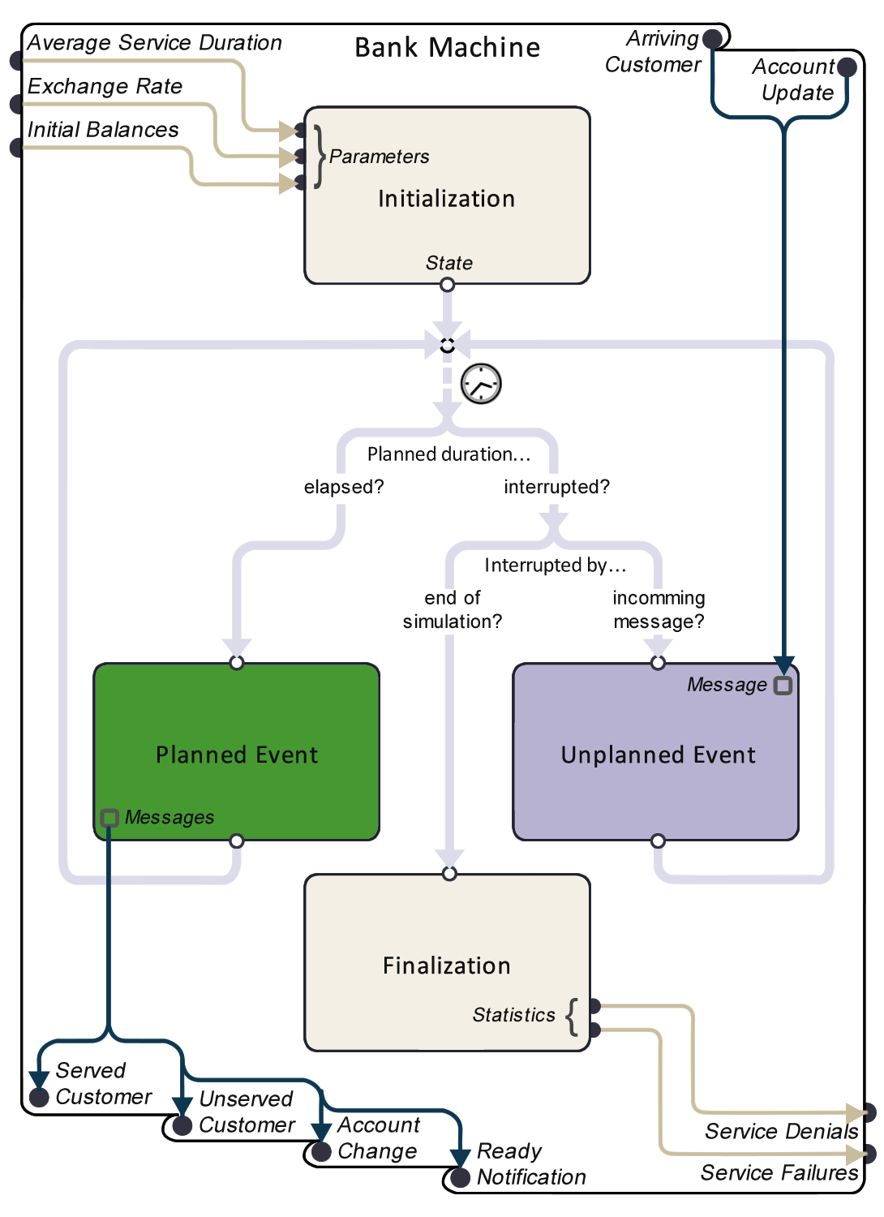
Proposed Visual Interface

Slide 15
Proposed Visual Interface

Slide 16
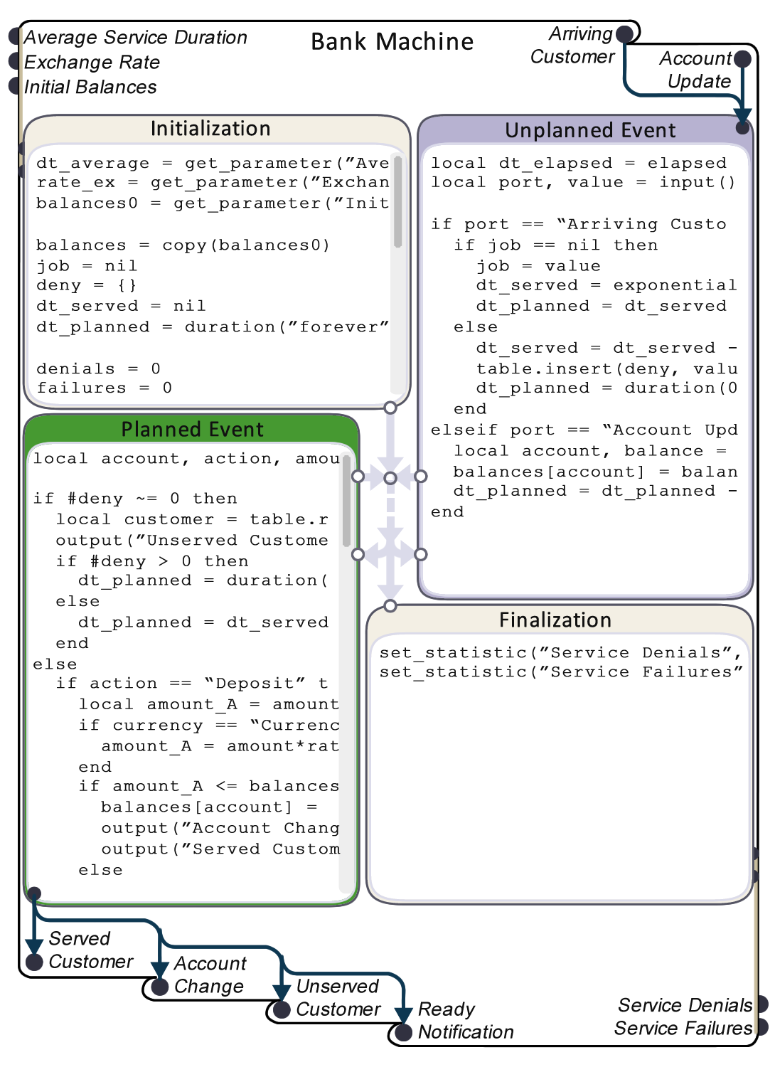
Proposed Visual Interface

Slide 17
Example
building_simulation
building_simulation_node
building_dynamics
building_dynamcs_node
initial_temperature
parameter_node
initial_temperature
weather
weather_node
outdoor_temperature
building_info
building_info_node
building_layout
thermodynamics
thermodynamics_node
wall_resistance
temperature_field
comfort
comfort_node
initial_position
initial_position_node
occupant_temperature
walking_speed
parameter_node
initial_position
occupant
occupant_node
walking_speed
average_temperature
average_temperature
statistic_node
occupant_position
frame_duration
parameter_node
frame_duration
building_vis
building_vis_node

Slide 18
Example – Function Nodes

Slide 19
Example – Function Nodes
Function
Node
Flow
Input
Flow
Output
(Inputs)
(Outputs)

Slide 20
Example
building_simulation
building_simulation_node
building_dynamics
building_dynamcs_node
initial_temperature
parameter_node
initial_temperature
weather
weather_node
outdoor_temperature
building_info
building_info_node
building_layout
thermodynamics
thermodynamics_node
wall_resistance
temperature_field
comfort
comfort_node
initial_position
initial_position_node
occupant_temperature
walking_speed
parameter_node
initial_position
occupant
occupant_node
walking_speed
average_temperature
average_temperature
statistic_node
occupant_position
frame_duration
parameter_node
frame_duration
building_vis
building_vis_node

Slide 21
Example – Simulation Nodes

Slide 22
Example – Simulation Nodes
(Inputs)
Message
Input
System
Node
Flow
Input
Flow
Output
(Parameters)
(Statistics)
Message
Output
(Outputs)

Slide 23
Example – Atomic Nodes

Slide 24
Example – Composite Nodes

Slide 25
Example – Flow Links

Slide 26
Example – Message Links

Slide 27
Example – Inward Links

Slide 28
Example – Inner Links

Slide 29
Example – Outward Links

Slide 30
Example
building_simulation
building_simulation_node
building_dynamics
building_dynamcs_node
initial_temperature
parameter_node
initial_temperature
weather
weather_node
outdoor_temperature
building_info
building_info_node
building_layout
thermodynamics
thermodynamics_node
wall_resistance
temperature_field
comfort
comfort_node
initial_position
initial_position_node
occupant_temperature
walking_speed
parameter_node
initial_position
occupant
occupant_node
walking_speed
average_temperature
average_temperature
statistic_node
occupant_position
frame_duration
parameter_node
frame_duration
building_vis
building_vis_node

Slide 31
Example
building_simulation
building_simulation_node
building_dynamics
building_dynamcs_node
initial_temperature
parameter_node
initial_temperature
weather
weather_node
outdoor_temperature
Node
building_info
building_info_node
building_layout
thermodynamics
thermodynamics_node
wall_resistance
temperature_field
comfort
comfort_node
initial_position
initial_position_node
occupant_temperature
walking_speed
parameter_node
initial_position
occupant
occupant_node
walking_speed
average_temperature
average_temperature
statistic_node
occupant_position
frame_duration
parameter_node
frame_duration
building_vis
building_vis_node

Slide 32
Example
Node
Example
class thermodynamics_node : public atomic_node
{
public:
port<flow, input, thermodynamic_temperature> initial_temperature_input;
port<flow, input, std::pair<array2d<int64>, distance>> building_layout_input;
port<flow, input, float64> wall_resistance_input;
port<message, input, thermodynamic_temperature> outdoor_temperature_input;
port<message, output, array2d<thermodynamic_temperature>> temperature_field_output;
protected:
array2d<int64> L; // building layout
int64 nx; // number of cells in the x dimension
int64 ny; // number of cells in the y dimension
float64 wall_R; // wall resistance
array2d<thermodynamic_temperature> TF; // temperature field
duration step_dt; // time step
duration planned_dt; // planned duration
virtual duration initialization_event();
virtual duration unplanned_event(duration elapsed_dt);
virtual duration planned_event(duration elapsed_dt);
virtual void finalization_event(duration elapsed_dt);
};

Slide 33
Example
Types of Nodes
Example
class thermodynamics_node : public atomic_node
{
public:
port<flow, input, thermodynamic_temperature> initial_temperature_input;
port<flow, input, std::pair<array2d<int64>, distance>> building_layout_input;
port<flow, input, float64> wall_resistance_input;
port<message, input, thermodynamic_temperature> outdoor_temperature_input;
port<message, output, array2d<thermodynamic_temperature>> temperature_field_output;
protected:
array2d<int64> L; // building layout
int64 nx; // number of cells in the x dimension
int64 ny; // number of cells in the y dimension
float64 wall_R; // wall resistance
array2d<thermodynamic_temperature> TF; // temperature field
duration step_dt; // time step
duration planned_dt; // planned duration
virtual duration initialization_event();
virtual duration unplanned_event(duration elapsed_dt);
virtual duration planned_event(duration elapsed_dt);
virtual void finalization_event(duration elapsed_dt);
};

Slide 34
class system_node
{
};
class atomic_node: public system_node
{
virtual duration initialization_event() = 0;
virtual duration unplanned_event(duration elapsed_dt) = 0;
virtual duration planned_event(duration elapsed_dt) = 0;
virtual void finalization_event(duration elapsed_dt) = 0;
};
class composite_node : public system_node
{
void inward_link(port<dmode, input, T>& src_port, port<dmode, input, T>& dst_port);
void inner_link(port<dmode, output, T>& src_port, port<dmode, input, T>& dst_port);
void outward_link(port<dmode, output, T>& src_port, port<dmode, output, T>& dst_port);
}
class function_node : public system_node
{
virtual void flow_event() = 0; // Also...
}; class collection_node ...
Types of Nodes

Slide 35
class system_node
{
};
class atomic_node: public system_node
{
virtual duration initialization_event() = 0;
virtual duration unplanned_event(duration elapsed_dt) = 0;
virtual duration planned_event(duration elapsed_dt) = 0;
virtual void finalization_event(duration elapsed_dt) = 0;
};
class composite_node : public system_node
{
void inward_link(port<dmode, input, T>& src_port, port<dmode, input, T>& dst_port);
void inner_link(port<dmode, output, T>& src_port, port<dmode, input, T>& dst_port);
void outward_link(port<dmode, output, T>& src_port, port<dmode, output, T>& dst_port);
}
class function_node : public system_node
{
virtual void flow_event() = 0; // Also...
}; class collection_node ...
Event Handlers

Slide 36
Visual Interface
Event Handlers

Slide 37
Example
building_simulation
building_simulation_node
building_dynamics
building_dynamcs_node
initial_temperature
parameter_node
initial_temperature
weather
weather_node
Ports
3
outdoor_temperature
1
building_info
building_info_node
building_layout
thermodynamics
thermodynamics_node
wall_resistance
1
temperature_field
comfort
comfort_node
initial_position
initial_position_node
occupant_temperature
walking_speed
parameter_node
initial_position
occupant
occupant_node
walking_speed
average_temperature
average_temperature
statistic_node
occupant_position
frame_duration
parameter_node
frame_duration
building_vis
building_vis_node

Slide 38
Example
Ports
Example
class thermodynamics_node : public atomic_node
{
public:
port<flow, input, thermodynamic_temperature> initial_temperature_input;
port<flow, input, std::pair<array2d<int64>, distance>> building_layout_input;
port<flow, input, float64> wall_resistance_input;
port<message, input, thermodynamic_temperature> outdoor_temperature_input;
port<message, output, array2d<thermodynamic_temperature>> temperature_field_output;
protected:
array2d<int64> L; // building layout
int64 nx; // number of cells in the x dimension
int64 ny; // number of cells in the y dimension
float64 wall_R; // wall resistance
array2d<thermodynamic_temperature> TF; // temperature field
duration step_dt; // time step
duration planned_dt; // planned duration
virtual duration initialization_event();
virtual duration unplanned_event(duration elapsed_dt);
virtual duration planned_event(duration elapsed_dt);
virtual void finalization_event(duration elapsed_dt);
};
3
1
1

Slide 39
Example
Example
Data types
class thermodynamics_node : public atomic_node
{
public:
port<flow, input, thermodynamic_temperature> initial_temperature_input;
port<flow, input, std::pair<array2d<int64>, distance>> building_layout_input;
port<flow, input, float64> wall_resistance_input;
port<message, input, thermodynamic_temperature> outdoor_temperature_input;
port<message, output, array2d<thermodynamic_temperature>> temperature_field_output;
protected:
array2d<int64> L; // building layout
int64 nx; // number of cells in the x dimension
int64 ny; // number of cells in the y dimension
float64 wall_R; // wall resistance
array2d<thermodynamic_temperature> TF; // temperature field
duration step_dt; // time step
duration planned_dt; // planned duration
virtual duration initialization_event();
virtual duration unplanned_event(duration elapsed_dt);
virtual duration planned_event(duration elapsed_dt);
virtual void finalization_event(duration elapsed_dt);
};

Slide 40
// Core Types
pointer // not sortable; encapsulates std::shared_ptr<void>
bool // sortable
int64 // sortable
float64 // sortable
std::string // sortable
quantity<U> // sortable; includes e.g. distance, duration, quantity<decltype(_kg*_m/_s/_s)>
arraynd<T, ndims> // valid if T is valid; not sortable
std::pair<T1, T2> // valid if T1, T2 are valid; sortable if T1, T2 are sortable
std::tuple<T> // valid if T is valid; sortable if T is sortable
std::tuple<T, Ts...> // valid if T, Ts... are valid; sortable if T, Ts... are sortable
std::vector<T> // valid if T is valid; sortable if T is sortable
std::set<T> // valid if T is valid; sortable if T is sortable
std::map<Key, T> // valid if T is valid and Key is valid and sortable;
// sortable if T is sortable
std::shared_ptr<T> // not sortable
T default_value<T>() // create a default value of core type T
tostring(const T&) // convert the value of core type T to a string
Data types

Slide 41
2nd
Example
#include <my_cpp_libraries/my_CFD_solver.h>
class CFD_node : public atomic_node
{
public:
port<message, output, array3d<float>> velocities;
protected:
my_CFD_solver_state CFD_state;
virtual duration initialization_event()
{
CFD_state = initialize_my_CFD_solver();
return 5_s; // planned_dt
}
virtual duration planned_event(duration elapsed_dt)
{
advance_one_time_step_using_my_CFD_solver(CFD_state);
velocities.send(CFD_state.get_velocities);
return 5_s; // planned_dt
}
};

Slide 42
2nd
Example
Possible to wrap existing simulation libraries (eg. CFD)
#include <my_cpp_libraries/my_CFD_solver.h>
class CFD_node : public atomic_node
{
public:
port<message, output, array3d<float>> velocities;
protected:
my_CFD_solver_state CFD_state;
virtual duration initialization_event()
{
CFD_state = initialize_my_CFD_solver();
return 5_s; // planned_dt
}
virtual duration planned_event(duration elapsed_dt)
{
advance_one_time_step_using_my_CFD_solver(CFD_state);
velocities.send(CFD_state.get_velocities);
return 5_s; // planned_dt
}
};

Slide 43
2nd
Example
The library includes multidimensional arrays
#include <my_cpp_libraries/my_CFD_solver.h>
class CFD_node : public atomic_node
{
public:
port<message, output, array3d<float>> velocities;
protected:
my_CFD_solver_state CFD_state;
virtual duration initialization_event()
{
CFD_state = initialize_my_CFD_solver();
return 5_s; // planned_dt
}
virtual duration planned_event(duration elapsed_dt)
{
advance_one_time_step_using_my_CFD_solver(CFD_state);
velocities.send(CFD_state.get_velocities);
return 5_s; // planned_dt
}
};

Slide 44
2nd
Example
#include <my_cpp_libraries/my_CFD_solver.h>
class CFD_node : public atomic_node
{
public:
port<message, output, array3d<float>> velocities;
protected:
my_CFD_solver_state CFD_state;
virtual duration initialization_event()
{
CFD_state = initialize_my_CFD_solver();
return 5_s; // planned_dt
}
virtual duration planned_event(duration elapsed_dt)
{
advance_one_time_step_using_my_CFD_solver(CFD_state);
velocities.send(CFD_state.get_velocities);
return 5_s; // planned_dt
}
};
Elapsed durations and planned durations are important concepts

Slide 45
2nd
Example
#include <my_cpp_libraries/my_CFD_solver.h>
class CFD_node : public atomic_node
{
public:
port<message, output, array3d<float>> velocities;
protected:
my_CFD_solver_state CFD_state;
virtual duration initialization_event()
{
CFD_state = initialize_my_CFD_solver();
return 5_s; // planned_dt
}
virtual duration planned_event(duration elapsed_dt)
{
advance_one_time_step_using_my_CFD_solver(CFD_state);
velocities.send(CFD_state.get_velocities);
return 5_s; // planned_dt
}
};
SI units are represented explicitly and checked at compile-time

Slide 46
Review

Slide 47
Review – ?

Slide 48
Review – Function Nodes

Slide 49
Review – Function Nodes
Function
Node
?
?

Slide 50
Review – Function Nodes
Function
Node
Flow
Input
Flow
Output
(Inputs)
(Outputs)

Slide 51
Review

Slide 52
Review – ?

Slide 53
Review – Simulation Nodes

Slide 54
Review – Simulation Nodes
?
System
Node
?
?
?

Slide 55
Review – Simulation Nodes
(Inputs)
Message
Input
System
Node
Flow
Input
Flow
Output
(Parameters)
(Statistics)
Message
Output
(Outputs)

Slide 56
Review – ?

Slide 57
Review – Atomic Nodes

Slide 58
Review – ?

Slide 59
Review – Composite Nodes

Slide 60
Review – ?

Slide 61
Review – Flow Links

Slide 62
Review – ?

Slide 63
Review – Message Links

Slide 64
Review – ?

Slide 65
Review – Inward Links

Slide 66
Review – ?

Slide 67
Review – Inner Links

Slide 68
Review – ?

Slide 69
Review – Outward Links

