Slide 1
SyDEVS Introduction Theory – Paradigm – Implementation
Autodesk Research
June 2018

Slide 2
SyDEVS is a framework supporting the development and integration of systems analysis and simulation code.
Decades of theory on the representation of systems forms a basis for the SyDEVS approach.
A paradigm has been developed that combines dataflow programming with discrete event simulation, and allows any simulation to be specified in the form of a node graph.
To implement a simulation using this approach, nodes are defined as C++ classes which inherit from classes in the SyDEVS open source library.

Slide 3
Theory

Slide 4
Theory
SyDEVS is based on theory that dates back to the late 1960s.
1970
1980
1990
2000
2010
2020

Slide 5
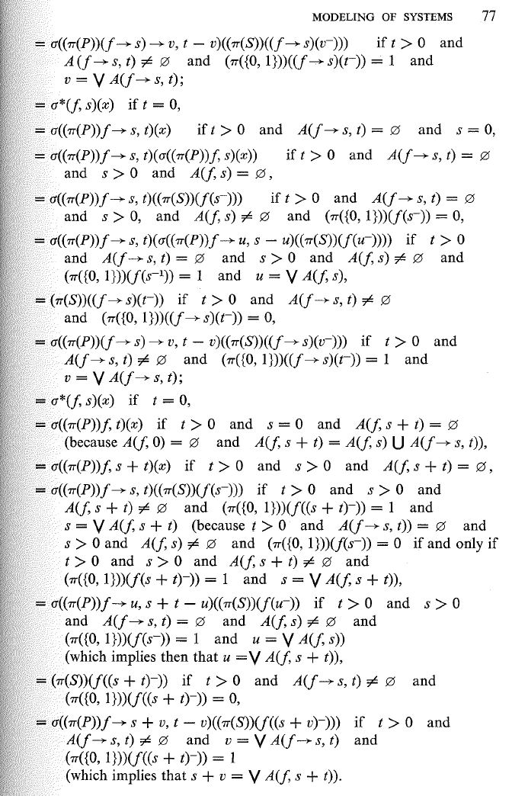
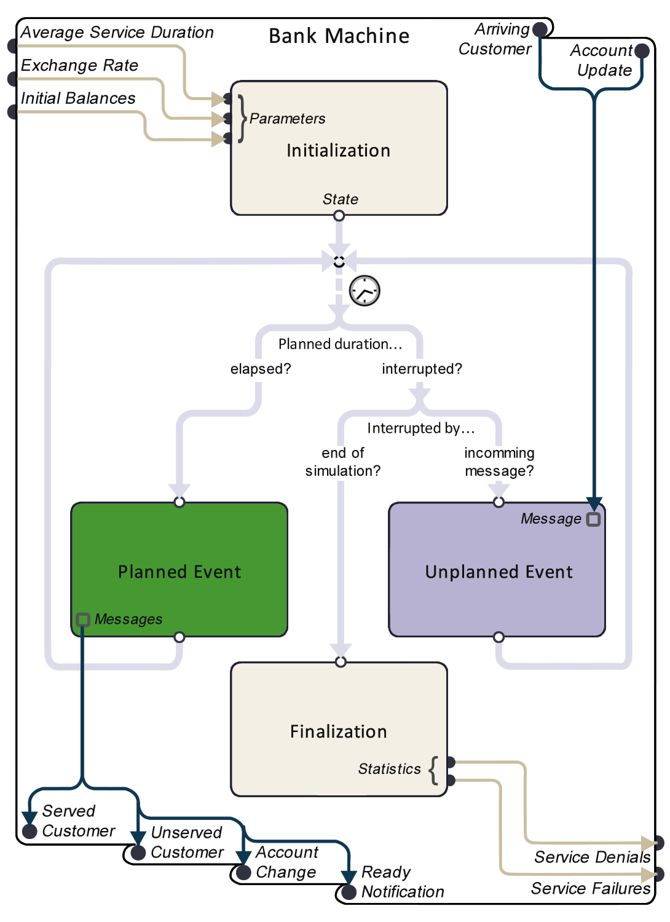
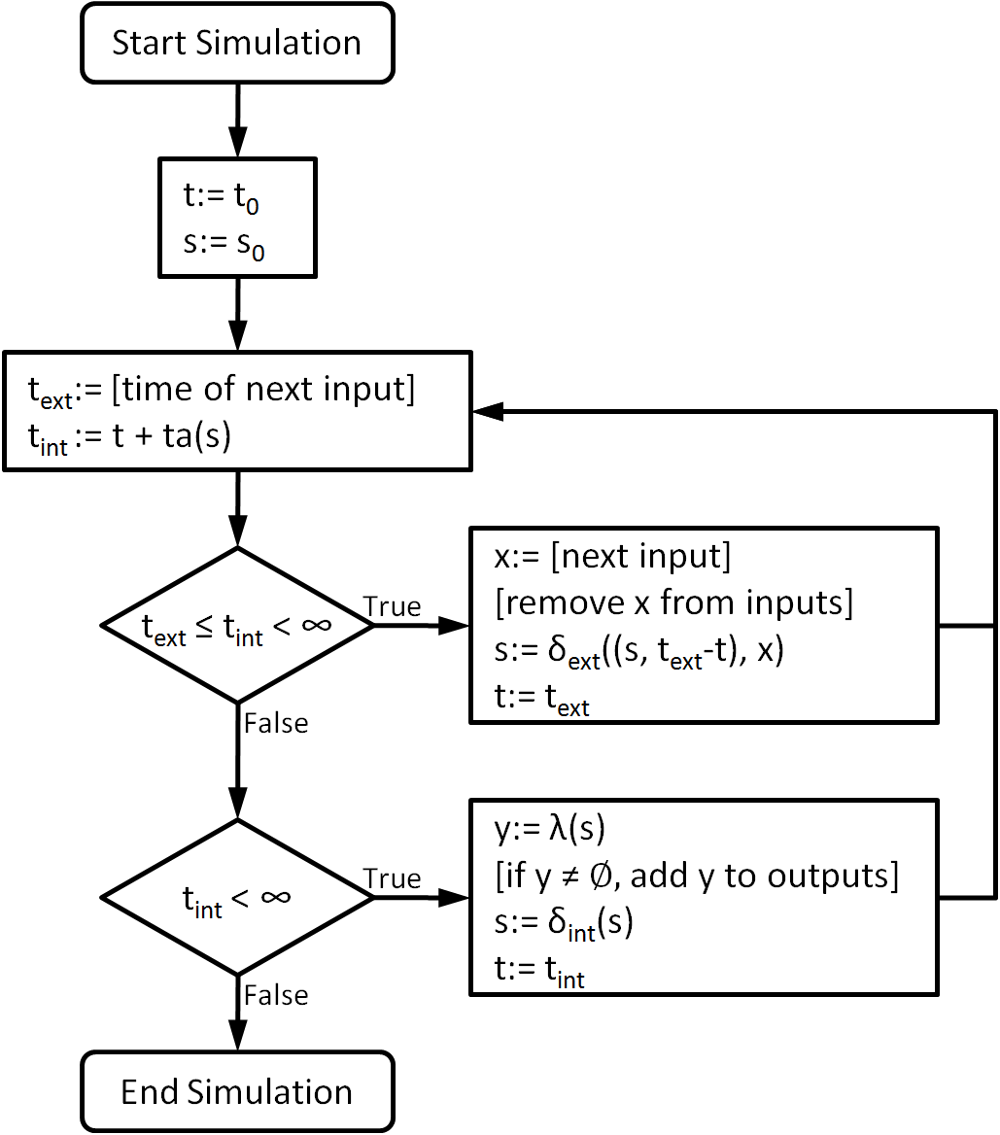
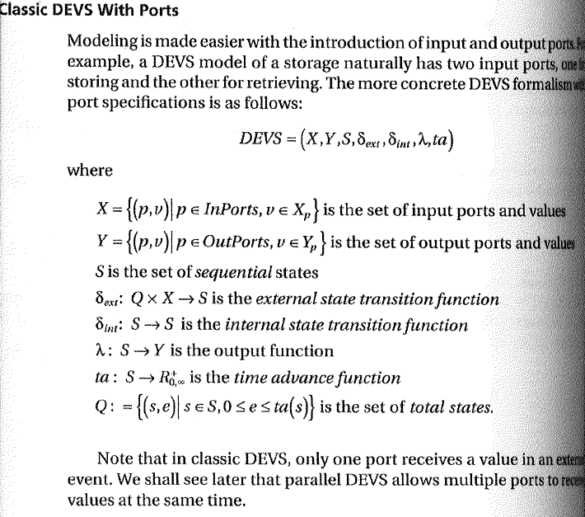
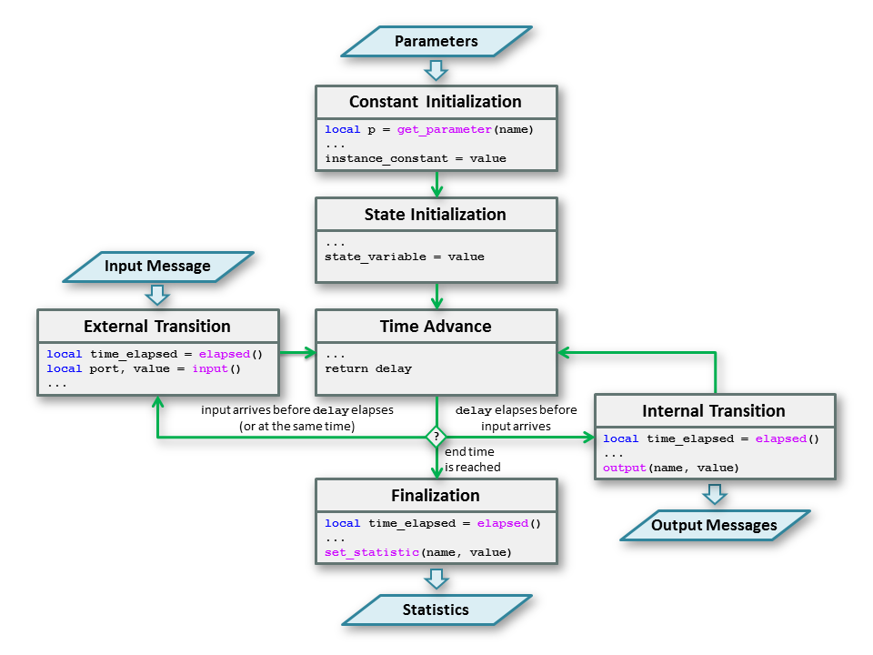
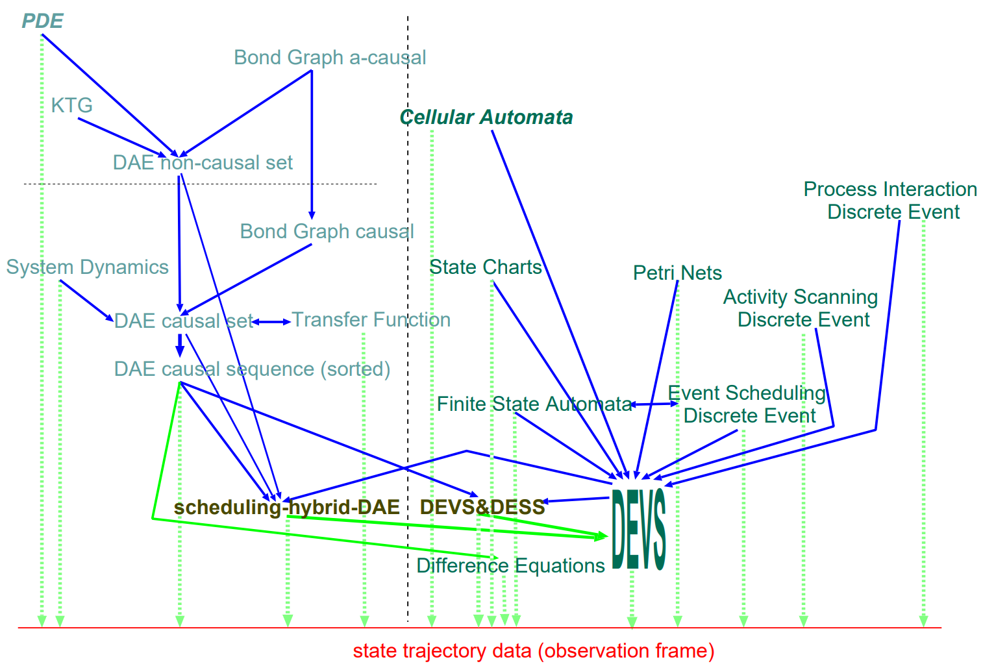
Theory
Here is a small sample of related publications from the last 50 years.
1970
1980
1990
2000
2010
2020

Slide 6
Theory
General methods to formally represent systems began with the work of Wayne Wymore.
A. Wayne Wymore
A Mathematical Theory of Systems Engineering
1967

Slide 7
Theory
Bernard Zeigler applied similar ideas to simulation.
Bernard P. Zeigler
Theory of Modeling and Simulation
1976

Slide 8
Theory
He found that essentially all simulations can be represented in a common form based on the discrete event simulation paradigm. Zeigler named this common form "DEVS".
Bernard P. Zeigler
Theory of Modeling and Simulation
1976

Slide 9
Theory
1970
1980
1990
2000
2010
2020

Slide 10
Theory
Over the years, the generality of DEVS was confirmed. It was found that for each of the most common modeling paradigms, any model expressed in that paradigm could also be represented using DEVS.
Hans L. M. Vangheluwe
DEVS as a Common Denominator…
2000

Slide 11
Theory
1970
1980
1990
2000
2010
2020

Slide 12
Theory
In 2011, researchers at Autodesk began exploring how to make DEVS more approachable to scientific and engineering communities.
Autodesk Research & Carleton University
Formal Languages for Computer Simulation
2011

Slide 13
Theory
The process involved several iterations.
Autodesk Research
DesignDEVS Help Graphic
2012

Slide 14
Theory
Eventually, a set of visual interfaces were designed along with a new way of expressing DEVS.
Autodesk Research & Simon Fraser University
Designing DEVS Visual Interfaces…
2015

Slide 15
Theory
1970
1980
1990
2000
2010
2020

Slide 16
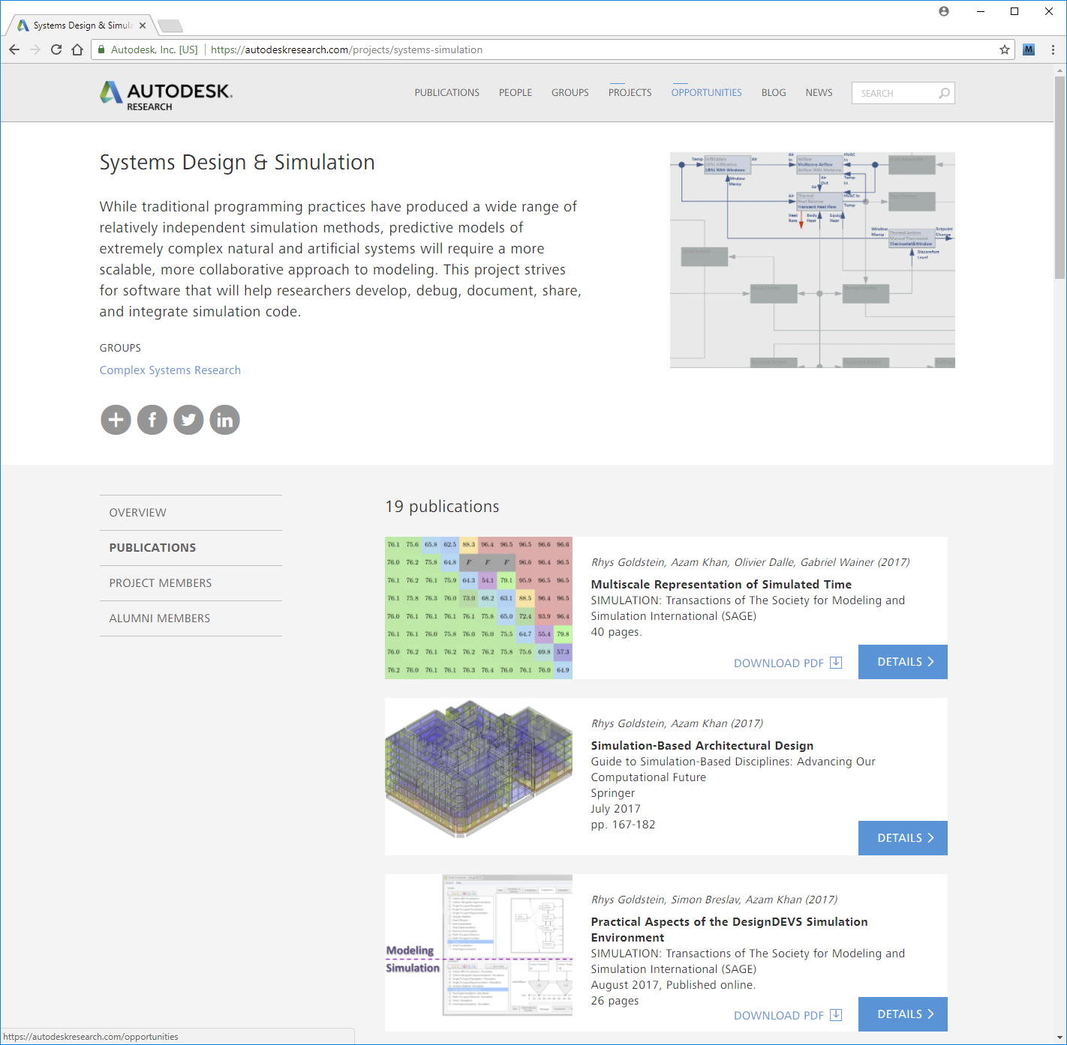
Theory
For more information on the theory underlying the SyDEVS framework, visit the Autodesk Research website and find the "Systems Design & Simulation" project.
www.autodeskresearch.com
Project: Systems Design & Simulation

Slide 17
Paradigm

Slide 18
Paradigm
SyDEVS supports a node-based modeling paradigm combining dataflow programming with DEVS.

Slide 19
Paradigm
Dataflow
Dataflow programming is a widely used paradigm in which the links between nodes form a directed acyclic graph.

Slide 20
Paradigm
Dataflow
A node is executed once it receives data on all of its input ports.

Slide 21
Paradigm
To introduce the notion of time into the paradigm, a column of discrete event simulation nodes is incorporated into the graph. Links between these nodes may form cycles.
DEVS

Slide 22
Paradigm
The execution of the entire graph is now partitioned into three phases.

Slide 23
Paradigm
The first phase is called "Initialization". A dataflow network collects data and converts it into a form suitable for simulation.
Initialization (Dataflow)

Slide 24
Paradigm
The second phase is the "Simulation" (or "DEVS") phase. Messages are passed from node to node as time advances.
Simulation
(DEVS)

Slide 25
Paradigm
The third phase is called "Finalization". Another dataflow network is executed to prepare statistics and metrics using data from the simulation nodes.
Finalization (Dataflow)

Slide 26
Paradigm
There are four types of nodes.

Slide 27
Paradigm
Function nodes are the basic type of dataflow node.
Atomic nodes are the basic type of simulation node.
Function
Node
Atomic
Node

Slide 28
Paradigm
Composite
Node
Composite nodes contain networks (dataflow + DEVS + dataflow) of other nodes. The contained nodes can themselves be composite nodes, forming a hierarchy.

Slide 29
Paradigm
Collection nodes contain any number of instances of a single type of node. The number of instances can change during a simulation. Collection nodes are useful for agent-based modeling, where each instance is an agent.
Collection
Node

Slide 30
Paradigm
Nodes
Function Node
Atomic Node
Composite Node
Collection Node
Here is a list of the four types of nodes.

Slide 31
Paradigm
Each type of node contains a particular set of elements.

Slide 32
Paradigm
For the purpose of understanding the paradigm, the elements of the atomic node are of key importance.
Atomic
Node

Slide 33
Paradigm
Atomic nodes contain functions for four types of events.
Unplanned
Event
Initialization
Event
Finalization
Event
Planned
Event

Slide 34
Paradigm
The Initialization Event is invoked once, at the beginning of the simulation or (if the node is an agent in a collection node) when the node is created.
Unplanned
Event
Initialization
Event
Finalization
Event
Planned
Event

Slide 35
Paradigm
An Unplanned Event is invoked every time a message is received. The node does not know when it will receive a message; hence these events are "unplanned". The fact a node must always be ready for an incoming message is one of the distinguishing characteristics of DEVS.
Unplanned
Event
Initialization
Event
Finalization
Event
Planned
Event

Slide 36
Paradigm
A Planned Event is essentially scheduled by the node, and hence "planned". It is only during one of these events that a message can be sent.
Unplanned
Event
Initialization
Event
Finalization
Event
Planned
Event

Slide 37
Paradigm
The Finalization Event is invoked once, at the end of the simulation or (if the node is an agent in a collection node) when the node is terminated.
Unplanned
Event
Initialization
Event
Finalization
Event
Planned
Event

Slide 38
Paradigm
The Elapsed Duration is the time elapsed since the previous event. It is available as a source of information for Unplanned, Planned, and Finalization events. For Initialization events, there is no previous event, and hence no Elapsed Duration.
Unplanned
Event
Elapsed
Duration
Initialization
Event
Elapsed
Duration
Finalization
Event
Planned
Event
Elapsed
Duration

Slide 39
Paradigm
The Planned Duration is the time before the next scheduled Planned Event. It is produced by every Initialization, Unplanned, and Planned event, overriding any previously scheduled Planned Event. For Finalization events, there is no next Planned Event, and hence no need to produce a Planned Duration.
Unplanned
Event
Planned
Duration
Initialization
Event
Planned
Duration
Finalization
Event
Planned
Event
Planned
Duration

Slide 40
Paradigm
Nodes
Function Node
Atomic Node
Composite Node
Collection Node
Events
Initialization Event
Unplanned Event
Planned Event
Finalization Event
Here are lists of the four types of nodes and four main types of events.

Slide 41
Implementation

Slide 42
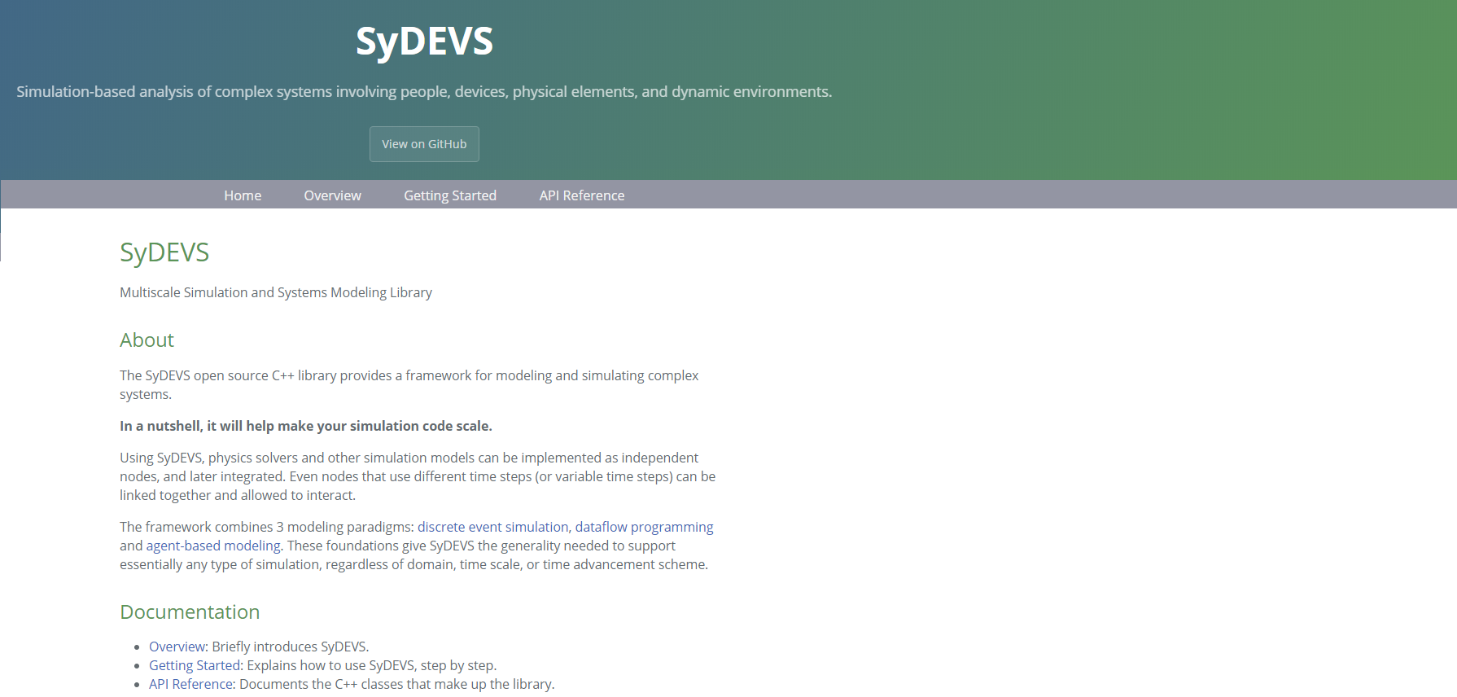
Implementation
SyDEVS is an open source C++ library that supports modeling and simulation using the previously described dataflow + DEVS + dataflow paradigm. The main SyDEVS website is at the following URL:
https://autodesk.github.io/sydevs

Slide 43
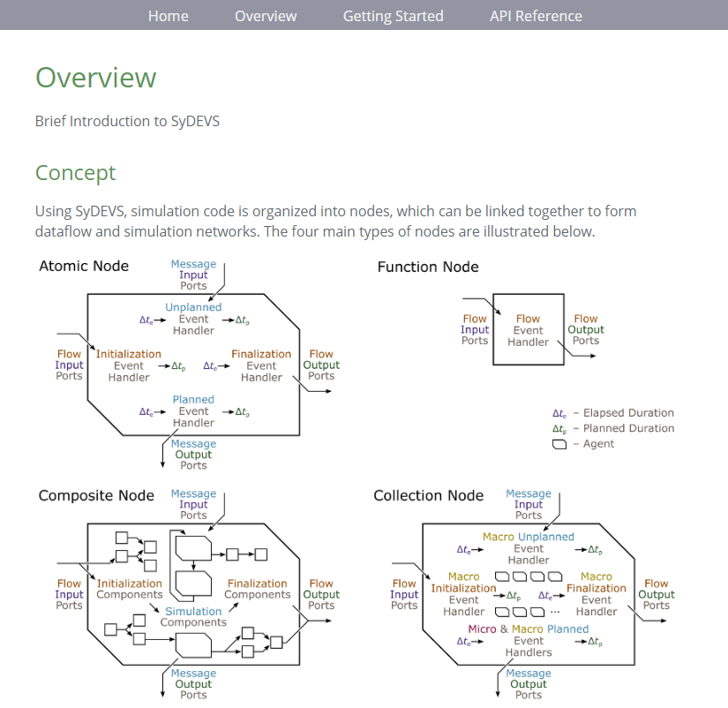
Implementation
The Overview page on the website illustrates the four types of nodes.

Slide 44
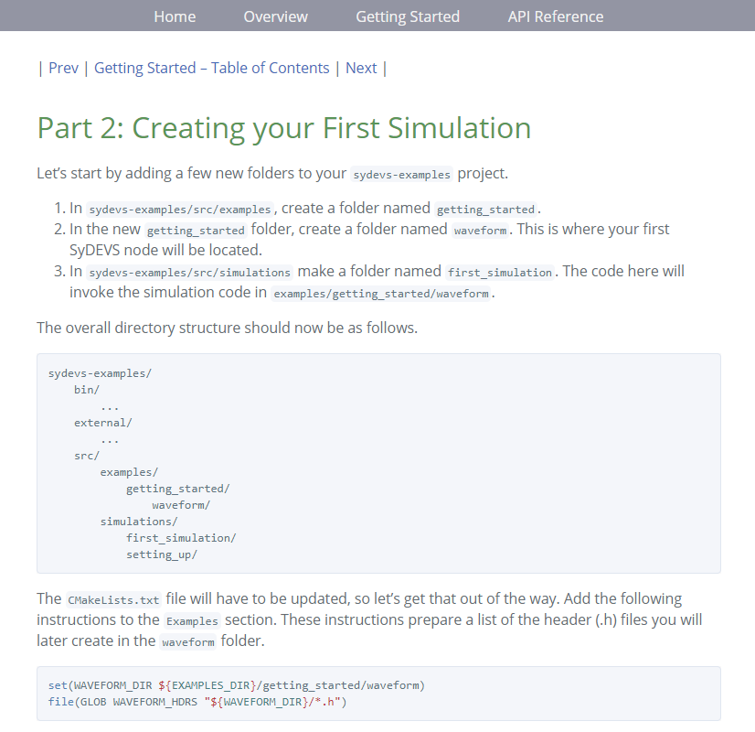
Implementation
The Getting Started tutorial guides users through the process of setting up a SyDEVS project and running simulations.

Slide 45
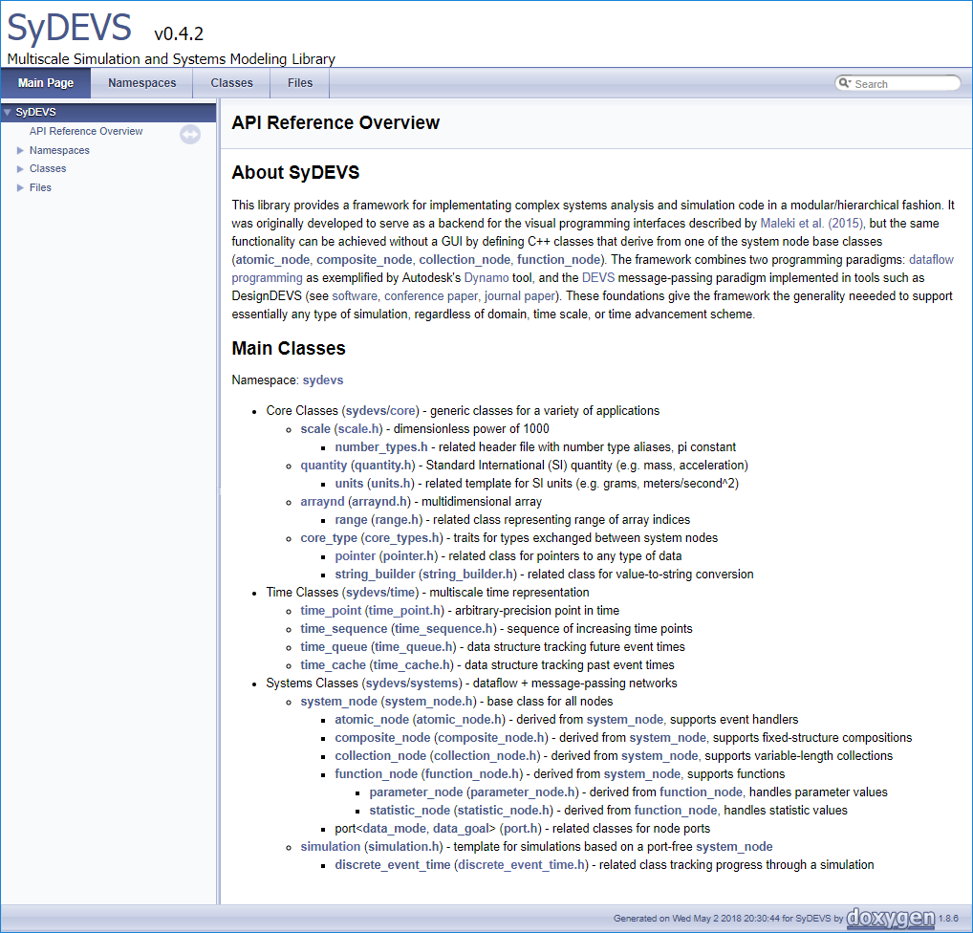
Implementation
There is also an API Reference.

Slide 46
Implementation
At present, there is no visual programming interface. Node graphs similar to the one shown must be defined in C++ using SyDEVS classes.

Slide 47
Implementation
Suppose one wishes to implement an atomic node.
Atomic
Node

Slide 48
Implementation
They would then write a C++ class that inherits from the atomic_node base class provided by the SyDEVS library.
class queueing_node : public atomic_node
{
public:
// Constructor/Destructor:
queueing_node(const std::string& node_name, const node_context& external_context);
virtual ~queueing_node() = default;
// Attributes:
virtual scale time_precision() const { return micro; }
// Ports:
port<flow, input, duration> serv_dt_input; // service duration
port<message, input, int64> job_id_input; // job ID (input)
port<message, output, int64> job_id_output; // job ID (output)
port<flow, output, duration> idle_dt_output; // idle duration
protected:
// State Variables:
duration serv_dt; // service duration (constant)
std::vector<int64> Q; // queue of IDs of jobs waiting to be processed
duration idle_dt; // idle duration (accumulating)
duration planned_dt; // planned duration
// Event Handlers:
virtual duration initialization_event();
virtual duration unplanned_event(duration elapsed_dt);
virtual duration planned_event(duration elapsed_dt);
virtual void finalization_event(duration elapsed_dt);
};

Slide 49
Implementation
class queueing_node : public atomic_node
{
public:
// Constructor/Destructor:
queueing_node(const std::string& node_name, const node_context& external_context);
virtual ~queueing_node() = default;
// Attributes:
virtual scale time_precision() const { return micro; }
// Ports:
port<flow, input, duration> serv_dt_input; // service duration
port<message, input, int64> job_id_input; // job ID (input)
port<message, output, int64> job_id_output; // job ID (output)
port<flow, output, duration> idle_dt_output; // idle duration
protected:
// State Variables:
duration serv_dt; // service duration (constant)
std::vector<int64> Q; // queue of IDs of jobs waiting to be processed
duration idle_dt; // idle duration (accumulating)
duration planned_dt; // planned duration
// Event Handlers:
virtual duration initialization_event();
virtual duration unplanned_event(duration elapsed_dt);
virtual duration planned_event(duration elapsed_dt);
virtual void finalization_event(duration elapsed_dt);
};
Observe there are four types of ports.

Slide 50
Implementation
Here they are in the diagram.
Atomic
Node

Slide 51
Implementation
Each type of port is associated with one of the four main types of events.
Unplanned
Event
Initialization
Event
Finalization
Event
Planned
Event

Slide 52
Implementation
class queueing_node : public atomic_node
{
public:
// Constructor/Destructor:
queueing_node(const std::string& node_name, const node_context& external_context);
virtual ~queueing_node() = default;
// Attributes:
virtual scale time_precision() const { return micro; }
// Ports:
port<flow, input, duration> serv_dt_input; // service duration
port<message, input, int64> job_id_input; // job ID (input)
port<message, output, int64> job_id_output; // job ID (output)
port<flow, output, duration> idle_dt_output; // idle duration
protected:
// State Variables:
duration serv_dt; // service duration (constant)
std::vector<int64> Q; // queue of IDs of jobs waiting to be processed
duration idle_dt; // idle duration (accumulating)
duration planned_dt; // planned duration
// Event Handlers:
virtual duration initialization_event();
virtual duration unplanned_event(duration elapsed_dt);
virtual duration planned_event(duration elapsed_dt);
virtual void finalization_event(duration elapsed_dt);
};
The code to be executed for each type of event is placed in these four member functions.

Slide 53
Implementation
class queueing_node : public atomic_node
{
public:
// Constructor/Destructor:
queueing_node(const std::string& node_name, const node_context& external_context);
virtual ~queueing_node() = default;
// Attributes:
virtual scale time_precision() const { return micro; }
// Ports:
port<flow, input, duration> serv_dt_input; // service duration
port<message, input, int64> job_id_input; // job ID (input)
port<message, output, int64> job_id_output; // job ID (output)
port<flow, output, duration> idle_dt_output; // idle duration
protected:
// State Variables:
duration serv_dt; // service duration (constant)
std::vector<int64> Q; // queue of IDs of jobs waiting to be processed
duration idle_dt; // idle duration (accumulating)
duration planned_dt; // planned duration
// Event Handlers:
virtual duration initialization_event();
virtual duration unplanned_event(duration elapsed_dt);
virtual duration planned_event(duration elapsed_dt);
virtual void finalization_event(duration elapsed_dt);
};
Observe that three of the functions have time duration arguments.

Slide 54
Implementation
These are the Elapsed Durations.
Unplanned
Event
Elapsed
Duration
Initialization
Event
Elapsed
Duration
Finalization
Event
Planned
Event
Elapsed
Duration

Slide 55
Implementation
As for the Planned Durations…
Unplanned
Event
Planned
Duration
Initialization
Event
Planned
Duration
Finalization
Event
Planned
Event
Planned
Duration

Slide 56
Implementation
class queueing_node : public atomic_node
{
public:
// Constructor/Destructor:
queueing_node(const std::string& node_name, const node_context& external_context);
virtual ~queueing_node() = default;
// Attributes:
virtual scale time_precision() const { return micro; }
// Ports:
port<flow, input, duration> serv_dt_input; // service duration
port<message, input, int64> job_id_input; // job ID (input)
port<message, output, int64> job_id_output; // job ID (output)
port<flow, output, duration> idle_dt_output; // idle duration
protected:
// State Variables:
duration serv_dt; // service duration (constant)
std::vector<int64> Q; // queue of IDs of jobs waiting to be processed
duration idle_dt; // idle duration (accumulating)
duration planned_dt; // planned duration
// Event Handlers:
virtual duration initialization_event();
virtual duration unplanned_event(duration elapsed_dt);
virtual duration planned_event(duration elapsed_dt);
virtual void finalization_event(duration elapsed_dt);
};
Planned Durations are produced by three of the functions as return values.

Slide 57
For more information, visit the SyDEVS website:
https://autodesk.github.io/sydevs

