Slide 1

For the financial conscious, want to be in control individual…… help is on its way!

Slide 2




Introducing
The
Control Tool
by
Team Control
Amina Aiman
Ebun David
Violetta Haveman
Ishita Nagar
Romi Oinam
April 12th, 2023

Slide 3
Table of Content
Objective
Analysis
Conclusion and Moving Forward
Appendix

Slide 4
Objective
The goal of our project is to perform market analysis to develop a personal budgeting tool that tracks and streamline discretionary spending.
This project idea is important to the team because in the past decade, Canadian consumer debt has been rising and we want to help Canadians resolve this issues.
Our inclination is that Canadians are unable to manage their spending because they cannot track where their money goes due to the intangible nature of debit and credit card payments.
Project 1 aims to determine if non-cash payments impact Canadian household debt levels, i.e. is our inclination correct or is just our opinion?

Slide 5
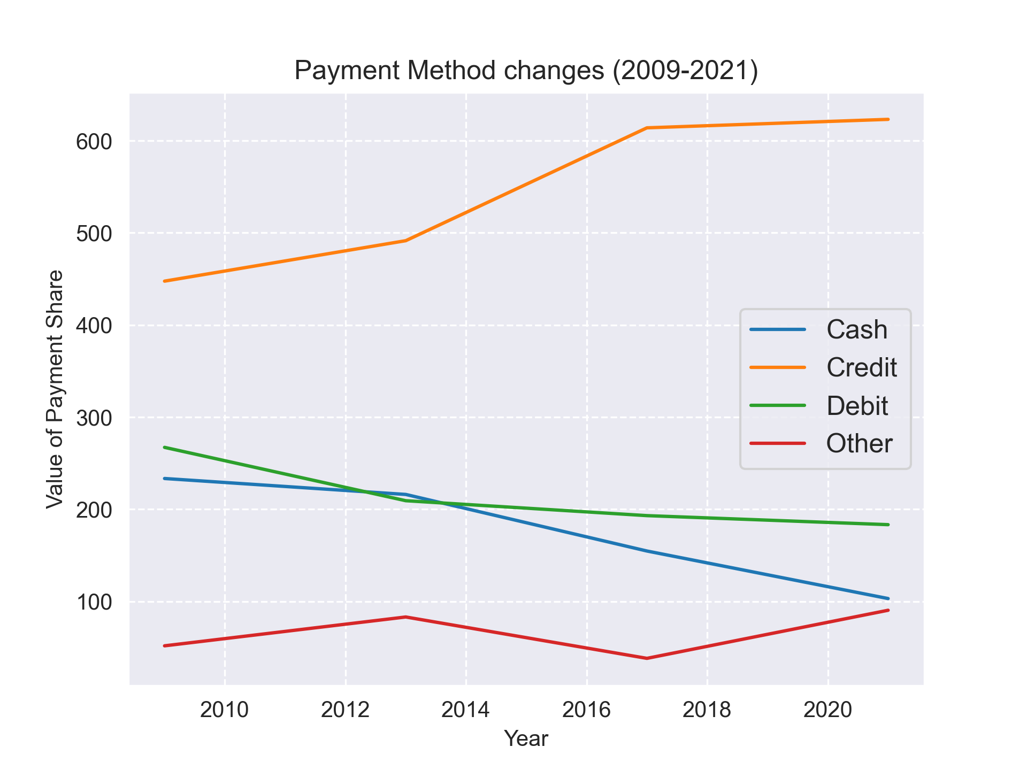
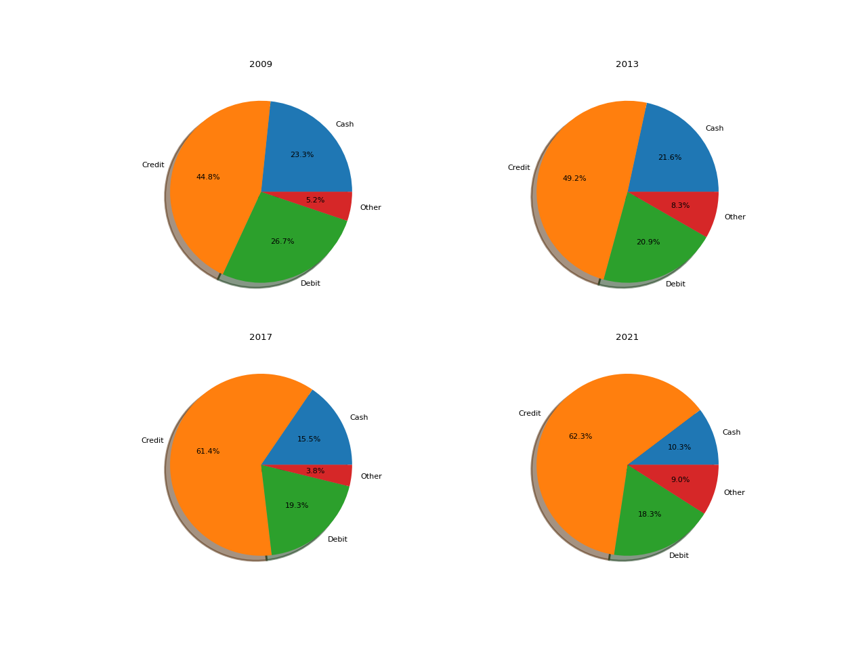
Payment Method Trends
Figure 2:
Pie Charts showing the proportional change in payment type (2009-2021)
Figure 1:
39%
56%
Over the past 14 years Credit Card Payment increasing became the preferred method of payment for goods and services.
Cash payment reduced by 56%
Credit card payments increased by 39 %
Source: 2013 – 2021 Bank of Canada Methods of Payment Survey Report: https://www.bankofcanada.ca/wp-content/uploads/2018/12/sdp2018-17.pdf

Slide 6
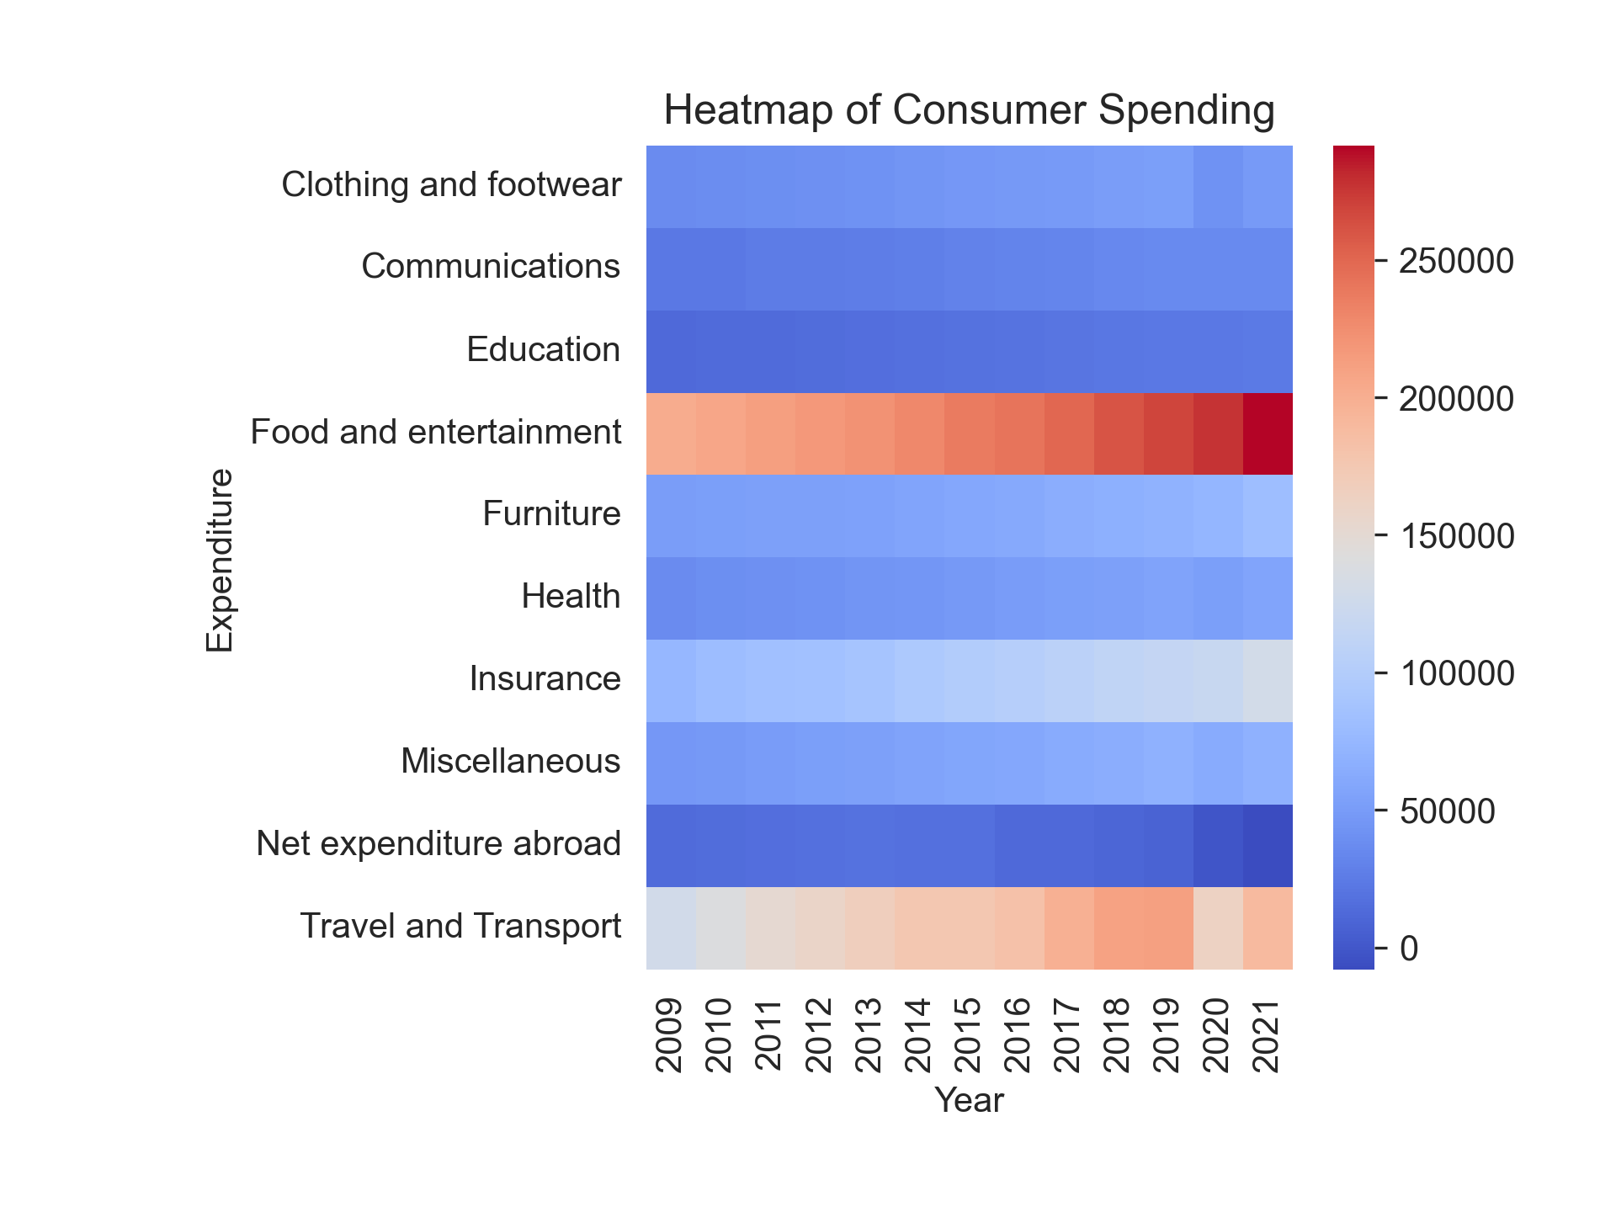
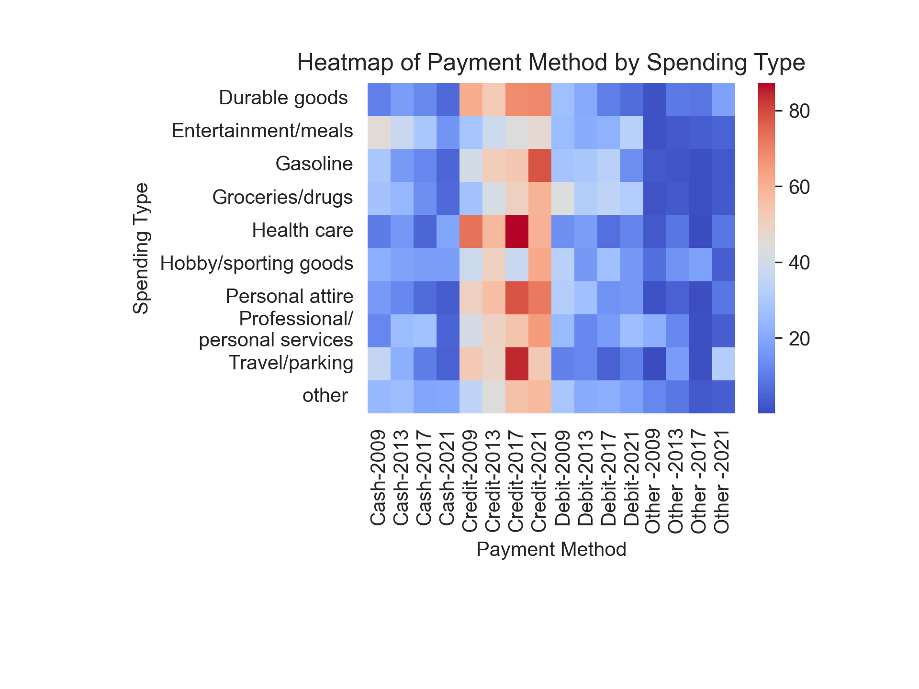
Spending and Payment
Figure 3:
Spending on discretionary spending such as food, entertainment and travel significantly increased from 2009 - 2021
Figure 4:
Credit card payment for those items also increase over the time period
Notes: Food does not include grocery
Sources: Bank of Canada Methods of Payment Survey Report 2013 – 2021 : https://www.bankofcanada.ca/wp-content/uploads/2018/12/sdp2018-17.pdf
Statistics Canada. Table 11-10-0222-01 Household spending, Canada, regions and provinces

Slide 7
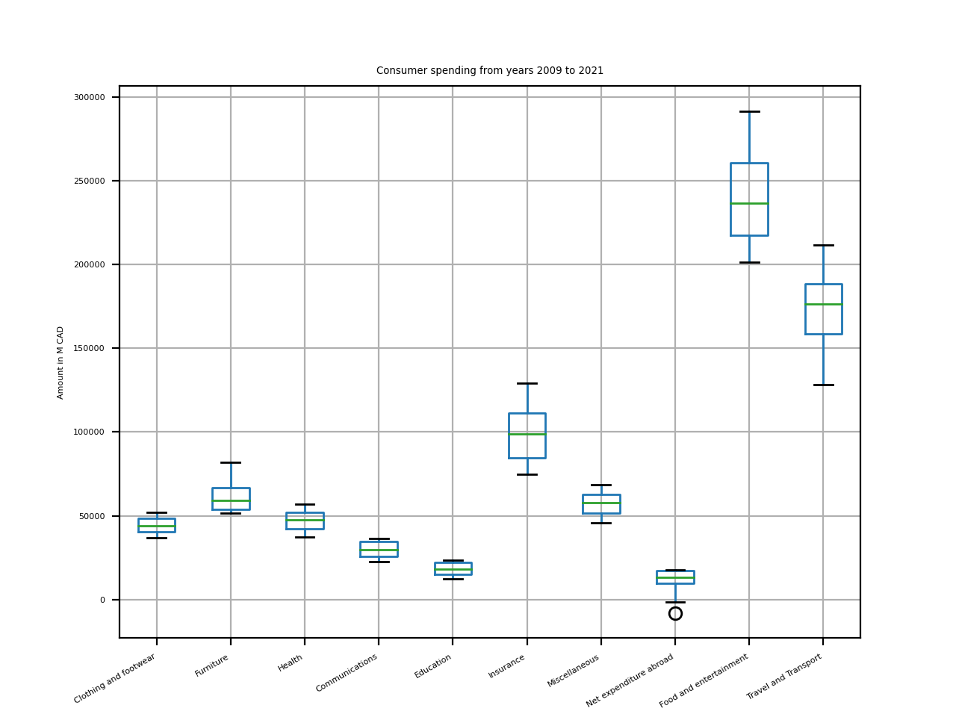
Spending Anomaly
Figure 5:
There are not noticeable outliers in consumer spending over the period except for expenditure abroad for 2020-2021 which is explained by the travel restrictions during the pandemic.
Source: Statistics Canada. Table 11-10-0222-01 Household spending, Canada, regions and provinces

Slide 8
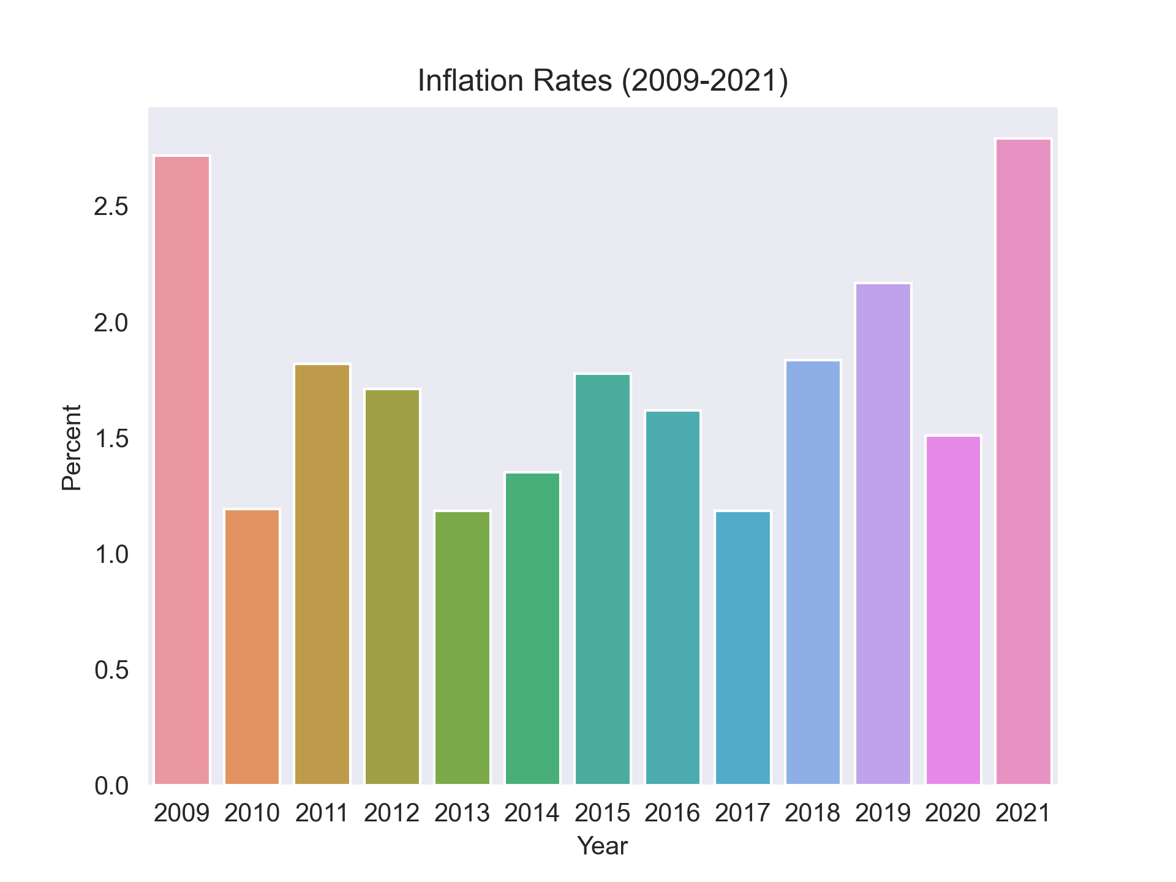
Inflation
Figure 6:
Inflation went down from 2009 to 2020 and rise again in 2021.
In some years we see a reduction of inflation by almost 60%
Source: Statistics Canada. Table 18-10-0256-01 Consumer Price Index (CPI) statistics, measures of core inflation and other related statistics - Bank of Canada definitions

Slide 9
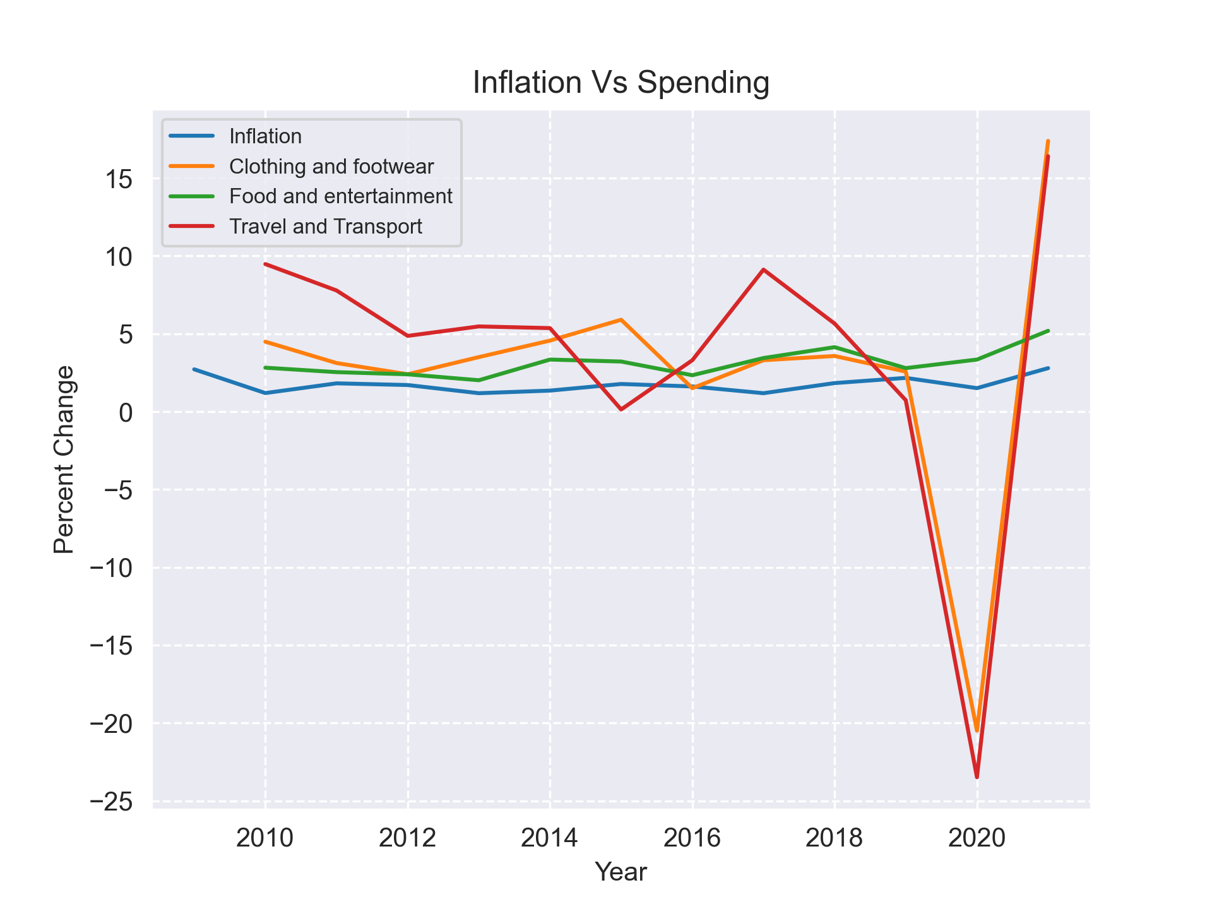
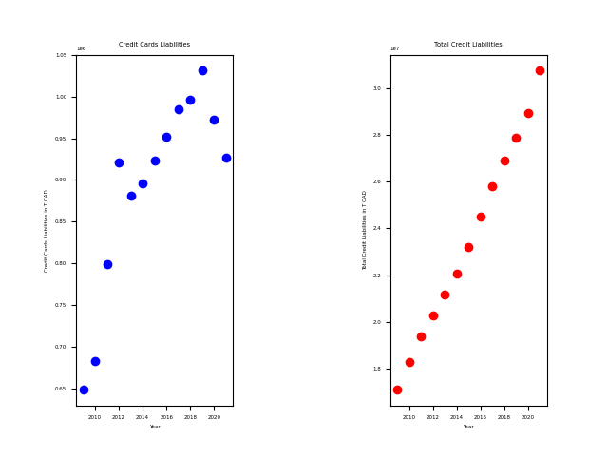
Inflation , Spending and Debt
Figure 7:
Pandemic
Total Debt showed a steady increased while credit card debt dropped in 2020 -2021
Credit card debt dropped as discretionary spending dropped.
Even though inflation dipped or remain static spending spending on food, clothing and travel increases
Sources: Statistics Canada. Table 18-10-0256-01 Consumer Price Index (CPI) statistics, measures of core inflation and other related statistics - Bank of Canada definitions
Statistics Canada. Table 11-10-0222-01 Household spending, Canada, regions and provinces
Statistics Canada. Table 36-10-0639-01 Credit liabilities of households (x 1,000,000)

Slide 10
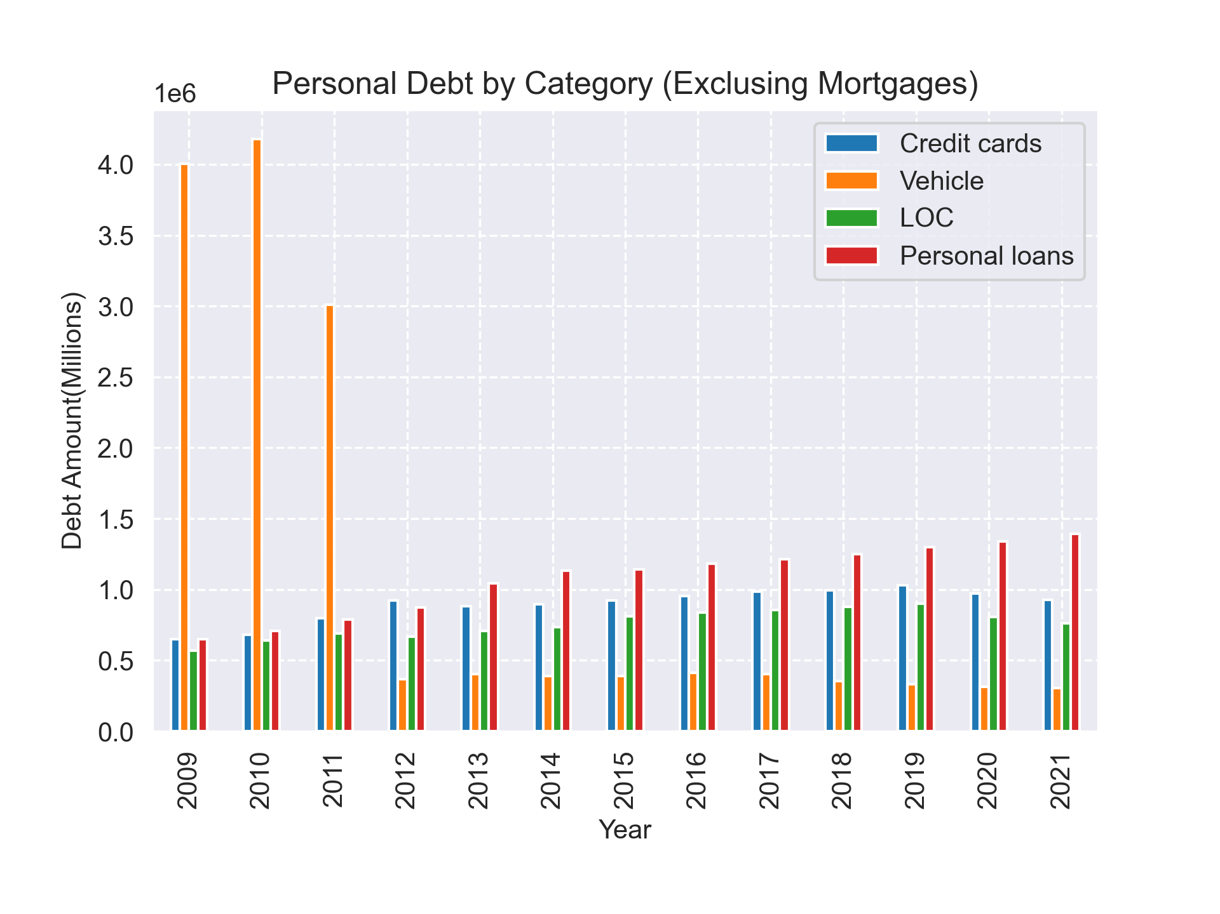
Debt Load
Figure 8:
Automotive debts reduce by almost 95% while personal loans and credit cards increased by the same amount.
95%
40%
Lines of Credit (LOC) increase by 40%
95%
Source: Statistics Canada. Table 36-10-0639-01 Credit liabilities of households (x 1,000,000)

Slide 11
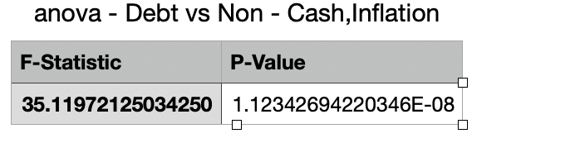
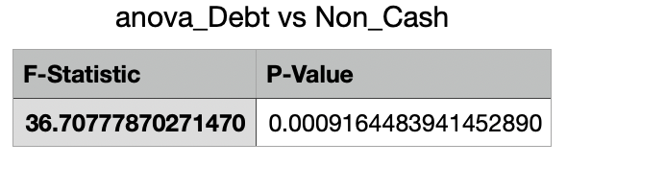
Relationship
Figure 9:
Anova testing shows a strong relationship between debt , discretionary spending, inflation and non-cash payment exist.
Further Anova testing indicates that non-cash payments and debts are strong related and affects each other. We reject the Null Hypothesis that Non-Cash payment does not affect debt levels.
Figure 10:
Sources: Statistics Canada. Table 18-10-0256-01 Consumer Price Index (CPI) statistics, measures of core inflation and other related statistics - Bank of Canada definitions
Statistics Canada. Table 11-10-0222-01 Household spending, Canada, regions and provinces
Statistics Canada. Table 36-10-0639-01 Credit liabilities of households (x 1,000,000)

Slide 12
Conclusion
For the period we tested inflation did not go up.
Evidence suggest that debt level, non-cash payment methods and inflation does go together.
Discretionary spending increased significantly over the period
Credit card and over debt levels are on an upward trend.
This evidence does suggest that it’s a casual event, therefore we’ve proved that our inclination is correct.
Payments by non-cash methods is the popular choice by consumers.

Slide 13
Next Steps
We would like to continue this project into Project 2, where we will conduct markets analysis for product features, barriers to entry and target audience

Slide 14
Appendix
For further details on our Analysis and the full dataset please visit our GitHub page here: https://github.com/585ishi/Project5.Bootcamp

Slide 15

Questions
Thank you we are happy to answer any questions you may have!

