Slide 1
KDD CUP 期末報告
M10715090 鄭思元
M10715067 林書宇
M10715086 鍾瑀芯

Slide 2
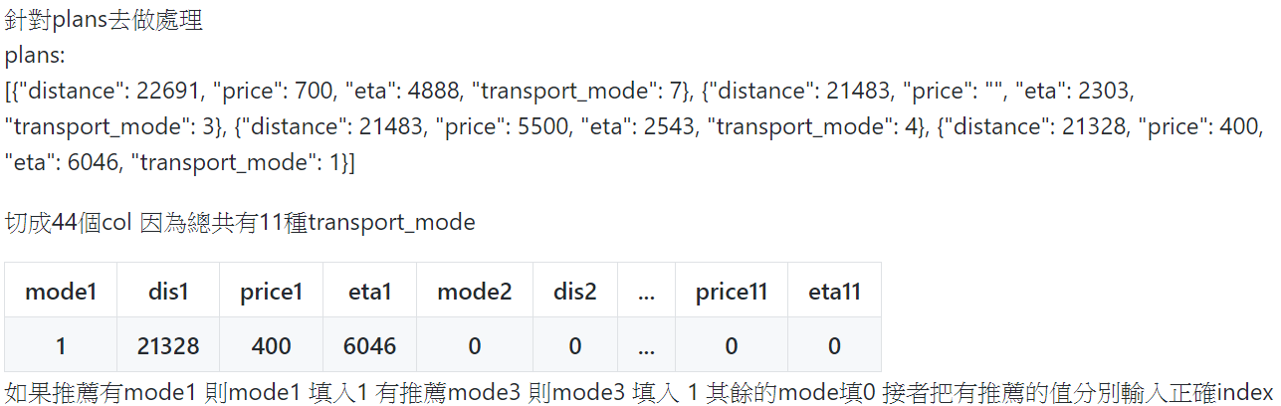
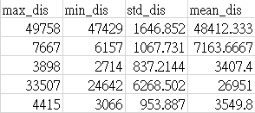
Preprocessing
How we deal with the features of plans :
我們把每一筆data的distance, price, eta
都計算出max, min, std, mean

Slide 3
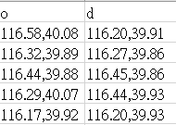
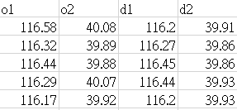
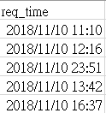
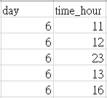
Preprocessing(cont’d)
Split [“o”, ”d”] to [“o1”, ”o2”, ”d1”, ”d2”]
Take the req_time’s hour and day as feature

Slide 4
How we predict
Like train_data we do the same preprocessing, but the final predict length is 94358 rows ( i.e. test_queries.csv ‘s length).
So we can know that there must have some “sid” didn’t have plans.
We give these rows answer : 0 (none_click class)

Slide 5
How we predict(cont’d)
Next, we can find out some “sid” didn’t have “pid”, so we give these rows the most recommended plan(because almost 70% people will choose the most recommended plan).
Final, we predict the remaining data.

Slide 6
model
We use Randomforest :
Use all the feature and the label is [click_mode]
Hyperparameter : n_estimators : 350, max_depth : 20

Slide 7
Rank

Slide 8
discussion
We have tried to add weather feature but it didn’t improve the score.
We think the profile is hard to analysis.

Slide 9
THANKS!
Q & A

