Slide 1
GearVR Framework Tutorial
Lesson 4: Components

Slide 2
Components Extend Your Application
Components attach to scene objects
Every GVRSceneObject has a list of components
Only one instance of each component type allowed
Components may be attached and detached at run-time
attachComponent attach component to scene object
getComponent get component of given type
GVRComponent
Base class for all components
Native components are managed by C++ code
Behavior components are completely in Java
getComponentType returns component type
setEnable enable / disable component
getObjectOwner get GVRSceneObject the component is attached to

Slide 3
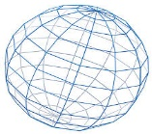
Native Components
Component | Description
GVRTransform | 4x4 matrix giving position and orientation of scene object
GVRRenderData | Contains mesh and material to render
GVRCamera | Single camera (for one eye)
GVRCameraRig | Camera rig with left, right and center cameras
GVRCollider | Collision geometry
GVRLightBase | Illumination source
GVRBone | Bone (transform) of skinned character
Scene Object
Transform
RenderData
SphereCollider
radius
Mesh
Native components are partially implemented in C++ and reference data structures in the C++ layer.

Slide 4
GVRBehavior
GVRBehavior is the base class for Java components
Subclasses must implement getComponentType() to return a unique type for the component
GVRBehavior.newComponentType will generate a unique type
GVRBehavior callbacks
onAttach called when attached to a scene object
onDetach called when detached from a scene object
onDrawFrame called once per frame
GVRPicker is a Java-only component derived from GVRBehavior

Slide 5
Particle Component (setup)
Component to move an object at constant velocity
Takes input velocity and direction
Overrides onDrawFrame to set the scene object translation
class Particle extends GVRBehavior
{
static private long TYPE_PARTICLE = newComponentType(org.gearvrf.balloons.Particle.class);
public float Velocity;
public Vector3f Direction;
public float Distance;
private Vector3f mStartPos = new Vector3f(0, 0, 0);
private Vector3f mCurPos = new Vector3f(0, 0, 0);
Particle(GVRContext ctx, float velocity, Vector3f direction)
{
super(ctx);
Velocity = velocity;
Direction = direction;
mType = TYPE_PARTICLE;
}
static public long getComponentType() { return TYPE_PARTICLE; }
Provide unique component type

Slide 6
Particle Component (position)
The Particle component updates the position of the GVRSceneObject it is attached to. This is done by setting the position of the GVRTransform component attached to that scene object.
public void setPosition(Vector3f pos)
{
GVRSceneObject owner = getOwnerObject();
Distance = 0;
mCurPos.x = mStartPos.x = pos.x;
mCurPos.y = mStartPos.y = pos.y;
mCurPos.z = mStartPos.z = pos.z;
if (owner != null)
{
owner.getTransform().setPosition(mCurPos.x, mCurPos.y, mCurPos.z);
}
}
public Vector3f getPosition()
{
Matrix4f localmtx = getOwnerObject().getTransform().getLocalModelMatrix4f();
localmtx.getTranslation(mCurPos);
return mCurPos;
}
public void onAttach(GVRSceneObject owner)
{
super.onAttach(owner);
getPosition();
mStartPos.x = mCurPos.x;
mStartPos.y = mCurPos.y;
mStartPos.z = mCurPos.z;
}
getOwnerObject gets the GVRSceneObject the component is attached to
mStartPos is the starting position of the particle.
When it is attached to the scene object the starting position is set.

Slide 7
Particle Component (movement)
Called each frame to move the particle based on its velocity and direction.
The time argument is the elapsed time since last frame.
public void move(float time)
{
GVRSceneObject owner = getOwnerObject();
if (owner == null)
{
return;
}
getPosition();
mCurPos.x += Direction.x * Velocity * time;
mCurPos.y += Direction.y * Velocity * time;
mCurPos.z += Direction.z * Velocity * time;
owner.getTransform().setPosition(mCurPos.x, mCurPos.y, mCurPos.z);
Distance = mCurPos.sub(mStartPos, mCurPos).length();
}

Slide 8
Particle Emitter Component (setup)
public int TotalParticles = 50;
public int MaxActiveParticles = 20;
public float EmissionRate = 2;
public float MaxDistance = 10;
public Range<Float> Velocity = new Range<Float>(1);
public Range<Vector3f> Direction = new Range<Vector3f>(new Vector3f(0, 0, 1));
public Range<Vector2f> EmitterArea = new Range<Vector2f>(new Vector2f(-5, -5), new Vector2f(5, 5));
private ArrayList<Particle> mFreeParticles; // list of free particles
private ArrayList<Particle> mActiveParticles; // list of active particles
private GVRScene mScene;
private Random mRandom = new Random(); // random number generator
private float mLastEmitTime; // last time particle was emitted
private int mNumParticles = 0; // number of particles created
private MakeParticle mMakeParticle; // new particle creator
static private long TYPE_PARTICLE_EMITTER = newComponentType(ParticleEmitter.class);
public ParticleEmitter(GVRContext ctx, GVRScene scene, MakeParticle newParticle)
{
super(ctx);
mFreeParticles = new ArrayList<Particle>();
mActiveParticles = new ArrayList<Particle>();
mMakeParticle = newParticle;
mScene = scene;
mType = TYPE_PARTICLE_EMITTER;
}
static public long getComponentType() { return TYPE_PARTICLE_EMITTER; }
Emits particles over time from a specified area. The velocity and direction of the particles are randomly generated and lie within the given range.
Particles are emitted from a rectangular area in the X, Y plane towards the negative Z axis. Transforming the scene object the particle emitter belongs to will transform the particles as well.
-z
Default particle direction 0,0,-1
+z
Emitter area

Slide 9
Particle Emitter (emission)
public interface MakeParticle
{
GVRSceneObject create(GVRContext ctx);
}
protected void emit() {
Particle particle = null;
GVRSceneObject sceneObj = null;
Vector3f direction = getNextDirection();
float velocity = getNextVelocity();
if (mFreeParticles.size() > 0) {
particle = mFreeParticles.get(mFreeParticles.size() - 1);
mFreeParticles.remove(last);
sceneObj = particle.getOwnerObject();
particle.Velocity = velocity;
particle.Direction = direction;
}
else {
if ((mNumParticles >= TotalParticles) ||
(mActiveParticles.size() >= MaxActiveParticles)) {
return; // cannot emit any more
}
sceneObj = mMakeParticle.create(getGVRContext());
sceneObj.setName(sceneObj.getName() + Integer.valueOf(mNumParticles).toString());
++mNumParticles;
particle = new Particle(getGVRContext(), velocity, direction);
sceneObj.attachComponent(particle);
getOwnerObject().addChildObject(sceneObj);
sceneObj.getRenderData().bindShader(mScene);
}
particle.setPosition(getNextPosition());
mActiveParticles.add(particle);
sceneObj.setEnable(true);
}
Emits the next particle. The particles are kept around and reused again and again.
A particle is a scene object constructed by the MakeParticle interface passed to the emitter on construction. Each time it is called, the MakeParticle.create function returns a new GVRSceneObject.

Slide 10
Particle Emission (flow control)
public void onDrawFrame(float elapsed)
{
if (isEnabled()) {
step(elapsed);
}
}
protected void step(float elapsed)
{
float emitTime = 1 / EmissionRate;
mLastEmitTime += elapsed;
synchronized (mActiveParticles)
{
for (Iterator<Particle> iter = mActiveParticles.iterator(); iter.hasNext(); )
{
Particle particle = iter.next();
particle.move(elapsed);
if (particle.Distance > MaxDistance)
{
iter.remove();
mFreeParticles.add(particle);
particle.getOwnerObject().setEnable(false);
}
}
if (mLastEmitTime >= emitTime)
{
emit();
mLastEmitTime = 0;
}
}
}
Each frame, move all the particles. Stop the particles which have gone out of range.
Emit another particle if it is time. This emitter will emit at most one particle per frame.

Slide 11
Adding the Emitter
emitter
Particle Emitter
particle0
particle1
private ParticleEmitter mParticleSystem;
private ArrayList<GVRMaterial> mMaterials;
private GVRMesh mSphereMesh;
private Random mRandom = new Random();
public void onInit(GVRContext context) {
. . .
GVRSceneObject particleRoot = new GVRSceneObject(context);
particleRoot.setName("ParticleSystem");
ParticleEmitter.MakeParticle particleCreator = new ParticleEmitter.MakeParticle()
{
public GVRSceneObject create(GVRContext context) { return makeBalloon(context); }
};
mParticleSystem = new ParticleEmitter(context, mScene, particleCreator);
mParticleSystem.MaxDistance = 10.0f;
mParticleSystem.TotalParticles = 10;
mParticleSystem.EmissionRate = 3;
mParticleSystem.Velocity = new ParticleEmitter.Range<Float>(2, 6);
mParticleSystem.EmitterArea = new ParticleEmitter.Range<Vector2f>(new Vector2f(-5, -2), new Vector2f(5, 2));
particleRoot.getTransform().setRotationByAxis(-90.0f, 1, 0, 0);
particleRoot.getTransform().setPosition(0, -3.0f, -3.0f);
particleRoot.attachComponent(mParticleSystem);
mScene.addSceneObject(particleRoot);
Particle
Particle
Define MakeParticle interface for making particles
Set up emitter properties
Rotate and position emitter to emit upwards in front of the viewer
Emitter starts when attached

Slide 12
Creating Particles
ArrayList<GVRMaterial> makeMaterials(GVRContext ctx)
{
float[][] colors = new float[][] {
{ 1.0f, 0.0f, 0.0f, 0.8f },
{ 0.0f, 1.0f, 0.0f, 0.8f },
{ 0.0f, 0.0f, 1.0f, 0.8f },
{ 1.0f, 0.0f, 1.0f, 0.8f },
{ 1.0f, 1.0f, 0.0f, 0.8f },
{ 0.0f, 1.0f, 1.0f, 0.8f }
};
ArrayList<GVRMaterial> materials = new ArrayList<GVRMaterial>();
for (int i = 0; i < 6; ++i)
{
GVRMaterial mtl = new GVRMaterial(ctx);
mtl.setDiffuseColor(colors[i][0], colors[i][1], colors[i][2], colors[i][3]);
materials.add(mtl);
}
return materials;
}
Create a table of materials with different colors
Modify makeBalloon to randomly select a material from the table
GVRSceneObject makeBalloon(GVRContext context)
{
GVRSceneObject balloon = new GVRSceneObject(context, mSphereMesh);
GVRRenderData rdata = balloon.getRenderData();
GVRSphereCollider collider = new GVRSphereCollider(context);
int mtlIndex = mRandom.nextInt(mMaterials.size() - 1);
balloon.setName("balloon");
rdata.setShaderTemplate(GVRPhongShader.class);
rdata.setAlphaBlend(true);
rdata.setMaterial(mMaterials.get(mtlIndex));
rdata.setRenderingOrder(GVRRenderingOrder.TRANSPARENT);
collider.setRadius(0.8f);
balloon.attachComponent(collider);
return balloon;
}

Slide 13
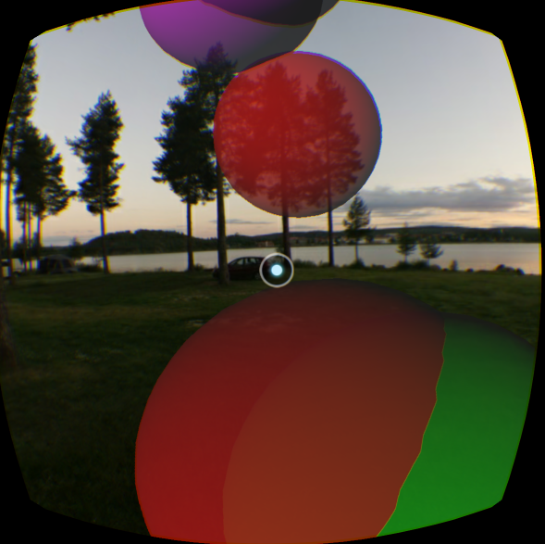

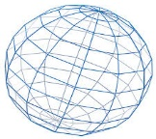

Lesson 4 Scene Graph
Transform
root
camera
rig
Transform
CameraRig
Picker
Mesh
headtracker
Transform
RenderData
Material
environment
Transform
RenderData
DirectLight
particleRoot
Transform
ParticleEmitter
Mesh
Material
balloon0
Transform
balloon1
Transform
SphereCollider
RenderData
SphereCollider
RenderData
Particle
Particle
Mesh
Material1
Mesh
Material0

