Slide 1
TEAM 4: CLINICAL TRIAL ENROLLMENT
LI SHI
KARAN HEGDE
ABHINAV MEDHEKAR
VENKATA SAIRAJ VURITI

Slide 2
INTRODUCTION
OBJECTIVE: Recommend the top medical institutions to pharma companies looking to conduct clinical trials
WHERE: Within the US
WHAT: Bronchogenic Carcinoma (Lung Cancer)
INPUT PARAMETERS:
Trial Phase
Location
Institution
OUTPUT:
Institution Ranking
Estimated Cost

Slide 3
CLINICAL TRIALS – PHASE OVERVIEW
Phase I: Researchers test a new drug or treatment in a small group of people for the first time to evaluate its safety, determine a safe dosage range, and identify side effects.
Phase II: The drug or treatment is given to a larger group of people to see if it is effective and to further evaluate its safety.
Phase III: The drug or treatment is given to large groups of people to confirm its effectiveness, monitor side effects, compare it to commonly used treatments, and collect information that will allow the drug or treatment to be used safely.
Phase IV: Studies are done after the drug or treatment has been marketed to gather information on the drug's effect in various populations and any side effects associated with long-term use.

Slide 4
METHODOLOGY
Determine the Reputation of an Institution based on:
Number of Trials
Number of Publications
Total Grants
Historical Trial Information:
Phase of the Trial
Number of people who attended trials in the past

Slide 5
CLINICAL TRIAL HISTORY
SOURCE: clinicaltrials.gov
Explain methods? Logic?

Slide 6
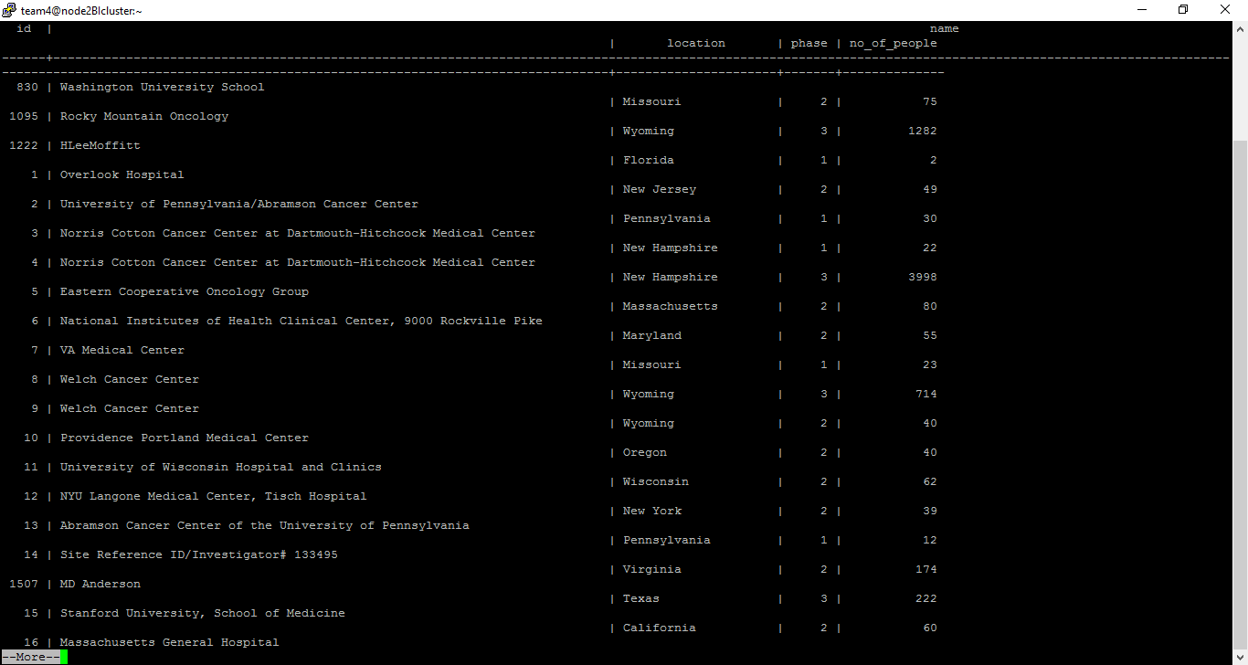
CLINICAL TRIAL HISTORY

Slide 7
REPUTATION
Explain weight order decision process for factors and how they’re calculated

Slide 8
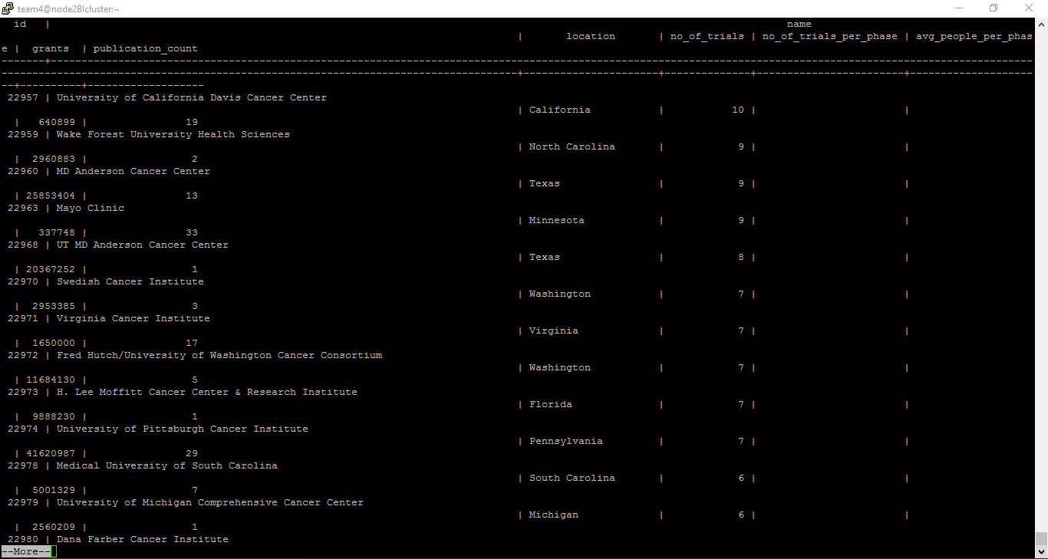
REPUTATION

Slide 9
ESTIMATED COST
Obtained average national costs and standard deviations of oncological clinical trials per phase
Average Health Expenditure for each state
Calculated the percentage difference from the national average expenditure for each state
Approximate cost per phase for every state obtained
SOURCES: U.S. Department of Health & Human Services
Kaiser Family Foundation (kff.org)

Slide 10
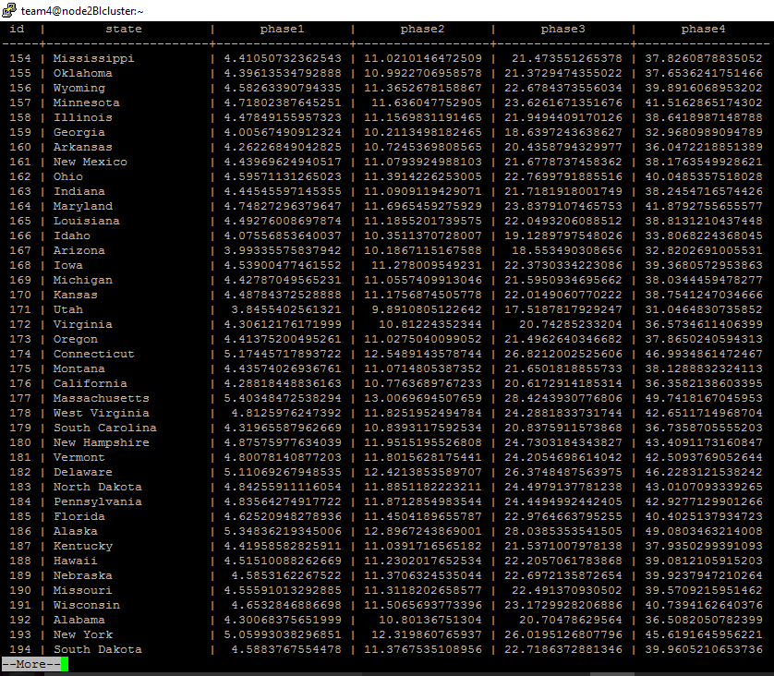
ESTIMATED COST

Slide 11
DEMO

Slide 12
SCOPE FOR IMPROVEMENT
Expand Geographic boundaries beyond the U.S.
Include multiple diseases and disease as a user-selected input
Currently limited to cost by location – if we can gain access to actual costs of each trial, will yield an improved and more accurate cost for each institution

