Slide 1


实验课：OpenGL Practice for Computer Graphics：OpenGL
李洋 副教授
计算机科学与技术学院
华东师范大学
yli@cs.ecnu.edu.cn

Slide 2
Outline
Introduction to OpenGL & GLFW
Exercise 3
Reference

Slide 3
Recall: Objects/Concepts in OpenGL
OpenGL Context: instance of OpenGL
State: the information used by OpenGL, stored in the context
Commands: some functions
Object Model: a group/aggregated of states with a certain id
Memory Model: synchronous model of how to read/write states
Rendering pipeline: the sequence of steps that are taken by the OpenGL rendering system

Slide 4
Recall: Objects/Concepts in OpenGL
Shaders: programs that run in certain programmable stages of the rendering pipeline. The term for a programmable stage of the pipeline is Shader.
Framebuffer: a memory place on which rendering pipeline are operated. The default one is a window on your display device.
Debugging: every functions check their parameters for mistakes or inconsistencies and emit errors if occur.
Implementation: Please remember OpenGL is an API (interface). There are a lot of implementations depend on hardwares.

Slide 5
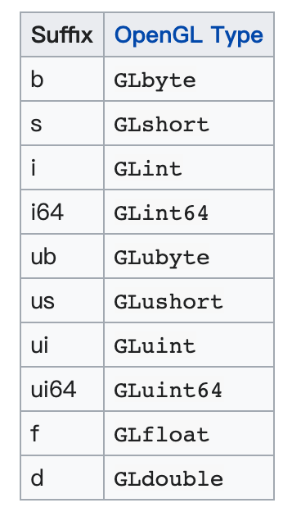
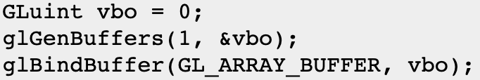
OpenGL
Remember OpenGL is implemented as a state machine
Nomenclature
Very OpenGL stuff is named with prefix: gl(func.)/GL(variable)
gl + FunctionName + {1234}{b s i i64 f d ub us ui ui64}{v}
Examples:

Slide 6
GLFW
GLFW is an Open Source, multi-platform library for OpenGL, OpenGL ES and Vulkan development on the desktop. It provides a simple API for creating windows, contexts and surfaces, receiving input and events.
GLFW is written in C and supports Windows, macOS, X11 and Wayland.

Slide 7
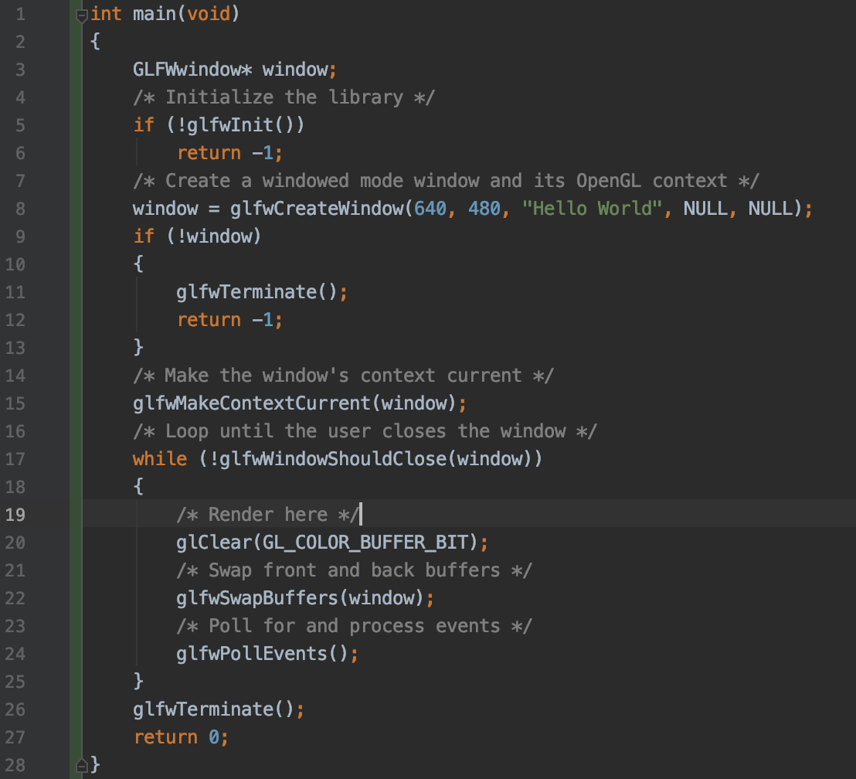
GLFW
Very similar to Win32 windows we have tried

Slide 8

Swap frame buffer
Usually, we will have two buffer frame. A front buffer and a back buffer. The front buffer is the one being displayed and the back buffer the one you render to.
When the entire frame has been rendered, the buffers need to be swapped with one another, so the back buffer becomes the front buffer and vice versa.

Slide 9
GLSL
After OpenGL 3.0, fixed-function render pipeline is no longer supported in OpenGL.
Instead, you need to write your own shaders to render.
OpenGL Shading Language (GLSL) is a high-level shading language with a syntax based on the C programming language.

Slide 10
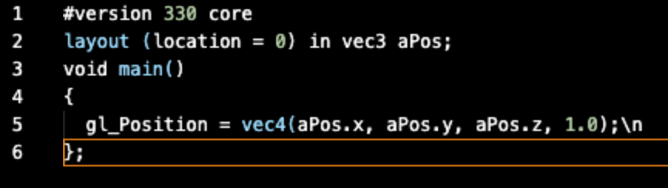
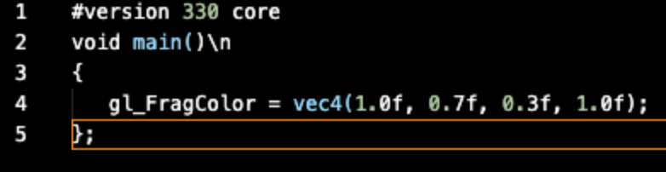
GLSL
We will use very simple shaders for now.
One is vertex shader
Another is fragment shader
They basically do nothing
for now.

Slide 11
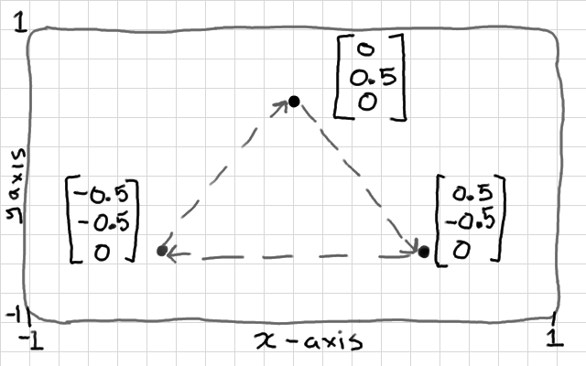
Task
draw a triangle with OpenGL!

Slide 12

Step by step 1
The first thing you need to do is to load shaders
Please use the helper.h to load our shaders
This constructs our render pipeline.
be careful about the path
Be aware of the GLuint which is the id of an OpenGL object

Slide 13
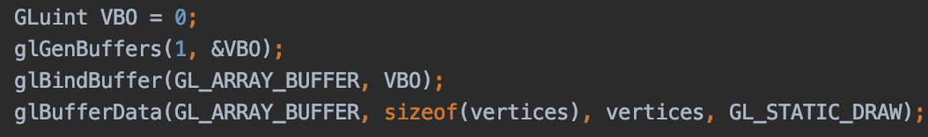
Step by step 2
The second thing is to prepare our data
please hardcode the coordinate of the triangle
And use memory model to let OpenGL know you have some data

Slide 14
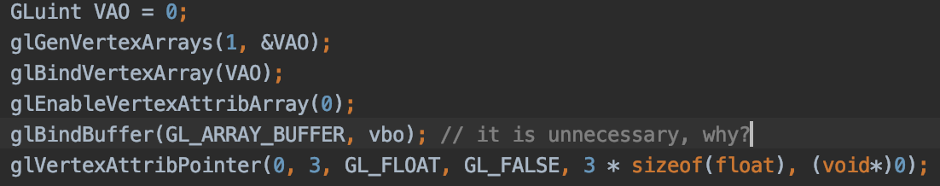
Step by step 3
The third thing is to construct our object model
please create vertex array and bind it (let the GL know)
attach your memory model and tell GL the data structure

Slide 15
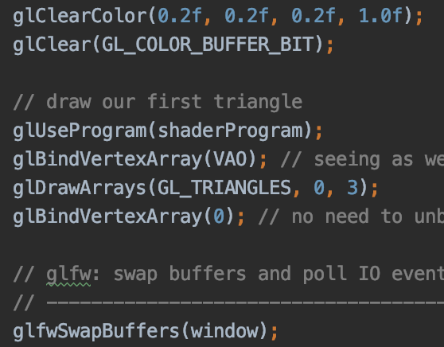
Render it!
now we have render pipeline(shaders) and object model.
let’s render it

Slide 16
实验练习
实验编号：3
实验名称：OpenGL可编程管线
实验目的：利用OpenGL API实现基本绘制功能。
实验环境：
Windows 10
Visual studio X

Slide 17
实验练习: 配置环境
实验内容与实验步骤：
使用课程网站上的代码
配置VS
使用glGetString(GL_VERSION)输出OpenGL版本
如有配置问题请举手
完成后举手

Slide 18
实验练习: 一个三角形
实验内容与实验步骤：
创建Vertex Shader
创建Fragment Shader
绑定一个可编程pipeline
创建Vertex Buffer
创建Vertex Array
绘制三角形
举手

Slide 19
附加题
Could you use OpenGL to implement the line drawing app last week?
Handle mouse input with GLFW
Use glDrawArrays(GL_LINES, …) to draw the lines

Slide 20
Reference
https://antongerdelan.net/opengl/hellotriangle.html
https://learnopengl.com/Getting-started/Hello-Triangle
https://www.glfw.org/documentation.html

