Slide 1


LEARNING SPARSE STRUCTURED ENSEMBLES WITH STOCASTIC
GTADIENT MCMC SAMPLING AND NETWORK PRUNING
Yichi Zhang, Zhijian Ou
Speech Processing and Machine Intelligence (SPMI) Lab
Department of Electronic Engineering, Tsinghua University
This work is accepted by IEEE International Workshop on Machine Learning and Signal Processing, 2018.
Notes:
Good afternoon everyone, my name is Yichi Zhang and I’m from Tsinghua University, today I’m glad to introduce our work, LEARNING SPARSE STRUCTURED ENSEMBLES WITH STOCASTIC GTADIENT MCMC SAMPLING AND NETWORK PRUNING.

Slide 2


目录 | CONTENT
1
Motivation & Problem
2
Related Work
3
Our solution: Mix of multiple ingredients
Learning ensembles via SG-MCMC sampling
Cost reduction via structured model compression
Experimental results
4
Conclusion & Future Work
Notes:
Our proposed method aims at efficiently learning ensemble for neural networks with low training and testing cost. This is the outline of my presentation, I will begin with our research motivation and the existing problem, then discuss some related work and come to our solution, and finally show the experimental results and conclude.

Slide 3
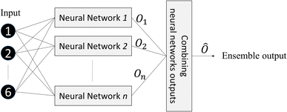
Ensemble of Neural Networks
Ensemble models are a group of models that work collectively to get the averaged prediction.
Figure from Effat Dehghanian et al. 2015
Notes:
As we know, an ensemble is a group of models to work together.

Slide 4
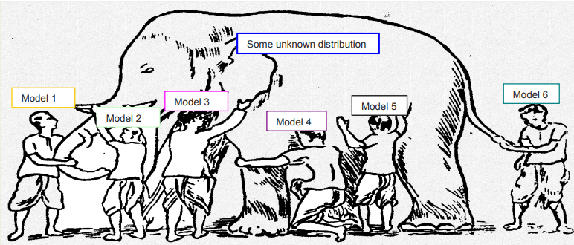
Ensemble of Neural Networks
Ensemble gives a great boost in accuracy because it does not rely on a single model for prediction.
Figure from Alejandro Correa et al. 2013
Notes:
We prefer ensembles, because they can greatly improve the prediction accuracy, since multiple models obtained from applying stochastic optimization training may converge to different local minimas, and tend to make different classification errors. This diversity makes an ensemble more robust and make less mistakes than individual model.

Slide 5
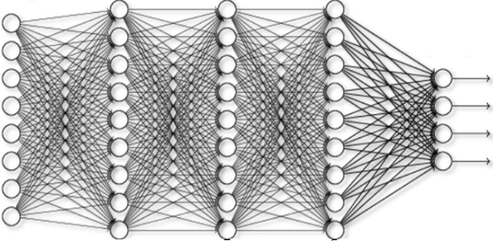
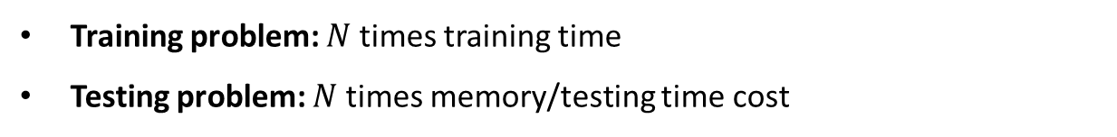

Problem
$N$ networks
Training problem: $N$ times training time
Testing problem: $N$ times memory/testing time cost
Notes:
However the problem is, when we train an ensemble of 𝑁 neural networks, the training time are also N times as large. While we need to store these networks and run all of them to do average, our memory and testing time cost are also N times. Therefore it is too costly to benefit from an ensemble.
These problems gives us the inspiration to study for a better way to learn ensembles for deep neural networks.

Slide 6
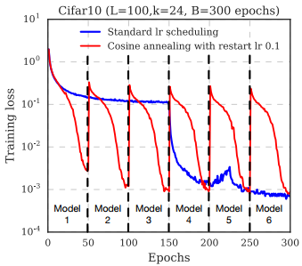
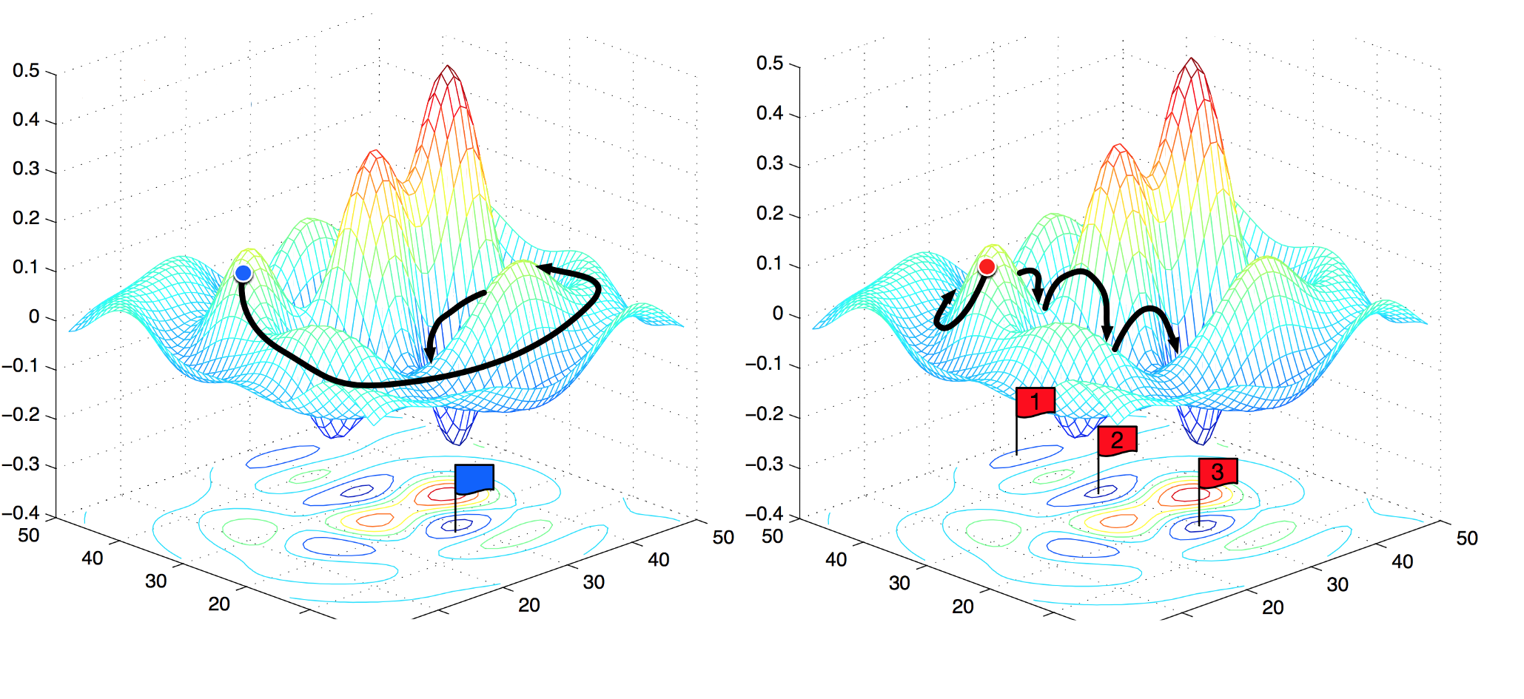
Related Work
Snapshot ensembles: Train 1, get m for free (Gao Huang et al. 2017)
Obtain multiple snapshot models within a single training process.
Empirical cyclic learning rate settings.
Notes:
For the training problem, the previous work of snapshot ensembles try to solve it by leveraging a special cyclic learning rate as shown in the figure to collect large diversity models within a single training process. So the training cost is reduced. However, we can see that the setting of the learning rate is very empirical and it is hard to scale to other tasks.

Slide 7
Related Work
The recent progress in Bayesian posterior sampling:
Stochastic Gradient Markov Chain Monte Carlo sampling algorithms
(Max Welling et al. 2011, Tianqi Chen et al. 2014, Zhe Gan et al. 2016)
SG-MCMC works by adding a scaled gradient noise to Stochastic optimization method which is proved to have the following benefits :
(i) Theoretically interpretable
(ii) Efficient exploration of the model parameter space
(iii) Scalable and simple
Notes:
In our work we also aim at learning an ensemble within a single training process, but from a different perspective, by leveraging the recent progress in Bayesian posterior sampling, namely the Stochastic Gradient MCMC (SG-MCMC) sampling.
We consider this since firstly, it is theoretically interpretable under the framework of Bayesian model averaging, secondly they are proved to take good exploration of the model parameter space to collect large diversity models, and what’s more, this sampling algorithms are scalable and simple for applying to deep learning. Therefore we choose SG-MCMC as our basic method to do ensemble learning, and I’ll talk about the details later.

Slide 8
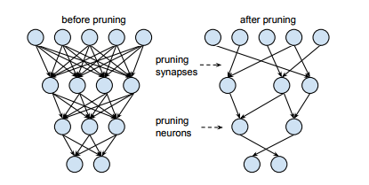
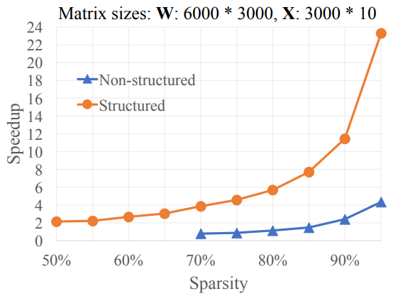
Related Work
Testing problem: $N$ times memory/testing time cost
Model compression via
Network pruning and retraining
(Song Han et al. 2015, 2017).
Sparse structure learning via
Group Lasso penalty (Ming Yuan et al. 2006) on deep models (Wei Wen et al. 2016, 2017).
Figure from Song Han et al. 2015
Figure from Wei Wen et al. 2017
Notes:
On the other hand, for the testing cost problem, we consider model compression and sparse structure learning. Song Han pointed out that the deep neural networks can be heavily pruned without losing prediction accuracy. While random pruned model with a non-structured pattern of non-zero weights are proved unfriendly to for speeding up computation as shown in this figure. So we want to learn sparse structured models by taking use of a specific group regularization, and together with the pruning technique, to obtain both memory and computation friendly models for the ensemble.

Slide 9
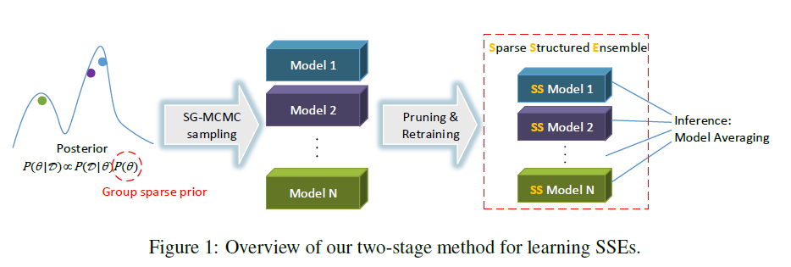
Our Work
SG-MCMC based
Bayesian learning
Network Pruning
& Retraining
Group Sparse Prior
Notes:
So our work is to put this things work together. This figure is a high level overview of our two-stage method, at first we sample models by SG-MCMC with group sparse prior, to obtain potentially sparse structured models. Then we prune them to get the real sparsity and retrain each model to maintain the accuracy. Finally for testing, we can just do average of all the network predictions from the ensemble.

Slide 10
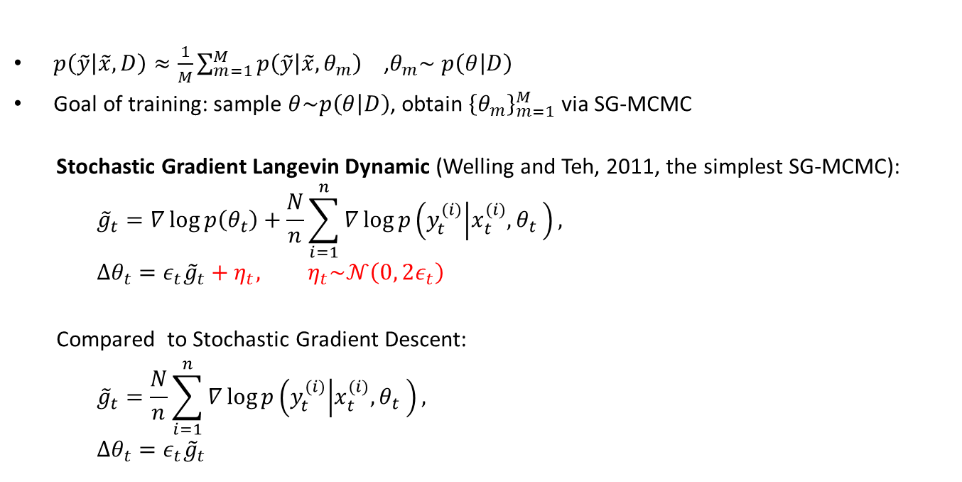
Training: SG-MCMC Sampling
$p\left(\tilde{y} | \tilde{x},D\right)≈\frac{1}{M}\sum_{m=1}^{M}{p\left(\tilde{y} | \tilde{x},θ_{m}\right)}$ ,$θ_{m}\sim$ $p\left(θ | D\right)$
Goal of training: sample $θ\sim p\left(θ | D\right)$, obtain ${\left\{θ_{m}\right\}}_{m=1}^{M}$ via SG-MCMC
Stochastic Gradient Langevin Dynamic (Welling and Teh, 2011, the simplest SG-MCMC):
$${\tilde{g}}_{t}=∇\log{p\left(θ_{t}\right)+\frac{N}{n}\sum_{i=1}^{n}{∇\log{p\left(y_{t}^{(i)} | x_{t}^{(i)}, θ_{t} \right)}}},$$
$$Δθ_{t}=ε_{t}{\tilde{g}}_{t}+η_{t}, η_{t}\sim 𝒩\left(0, 2ε_{t}\right)$$
Compared to Stochastic Gradient Descent:
$${\tilde{g}}_{t}=\frac{N}{n}\sum_{i=1}^{n}{∇\log{p\left(y_{t}^{(i)} | x_{t}^{(i)}, θ_{t} \right)}},$$
$$Δθ_{t}=ε_{t}{\tilde{g}}_{t}$$
Notes:
Ok and now we’ll go for some details. The framework of Bayesian neural network is to sample network weights from the posterior parameter space and do average of the sampled networks. Since neural network has hundreds of millions parameters, we need SG-MCMC algorithms to do efficiently sampling in the high dimensional parameter space. And they are easy to use, we can see that the simplest SG-MCMC algorithm is as simple as running a noisy SGD with Gaussian noise.
And the principle is, while the parameters are optimized follow the stochastic gradient, the extra noise can take the effect, to force the algorithm to do more efficiently explorations over the model parameter space, it is easier to collect large diversity models. This is exactly we need for a good ensemble.

Slide 11
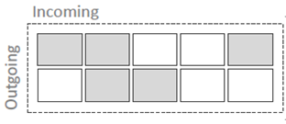
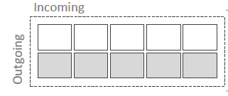

Sparse Structured FNN
Pruning of Fully-connected Neural Networks
Zero weight
Non-zero weight
Notes:
And, as mentioned before, we want our model to be structured sparse. Look at this fully-connected network. When we prune the small weights, the results of random sparsity is like the left figure.. And the weight matrix is a messy.
However, when we group the outgoing weights together for a neuron, and remove all the weights at the same time, it is equivalent to remove a row in the weight matrix. It is trivial that this kind of matrix size reduction can enjoy more speed up when taking matrix multiplications.

Slide 12
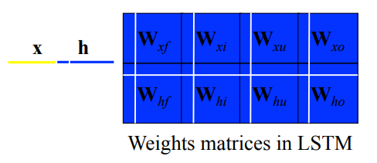
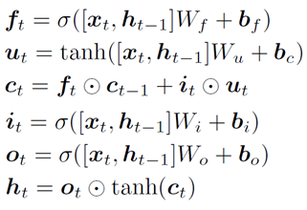
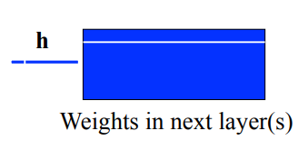
Sparse Structured LSTM
Pruning of LSTMs
Figure from Wei Wen et al. 2017
Notes:
We also try to prune the more complex recurrent neural network, the LSTM model. For LSTM, a neuron in the hidden state is connected in several different ways, as shown in the figure, all the write rows and columns are weights associated with a hidden unit, group them altogether and prune at the same time, the hidden unit can be removed thus we can reduce the dimension of hidden state.

Slide 13
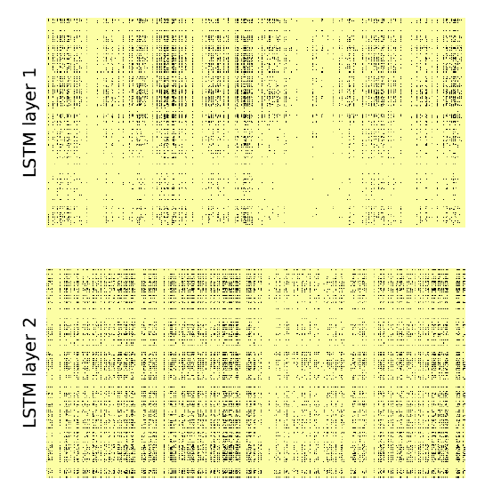
Sparse Structured LSTM
 | Structure | Params | FLOPs
Original model | 1500-1500-1500 | 51M | 100%
Pruned model | 533-425-533 | 9M(18%) | 18%
FLOPs for a matrix W is calculated as the size of the smallest sub-matrix formed by such rows and columns that contain all non-zero elements in W.
Notes:
And this figure is a real weight matrix pattern we obtained, the yellow area are all zero weights, we can see that the weights grouped together are successfully moved out to be structured sparse. The pruned models we obtained has only 18% parameters and FLOPs. While we consider the FLOPs as matrix-level instead of element-level, that’s to say only the all zero rows and columns take account for reducing FLOPs.

Slide 14
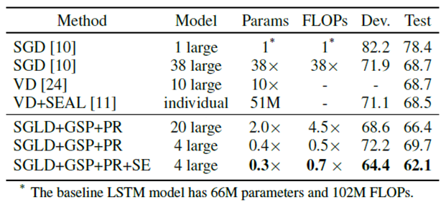
Language Modeling Experiment
Perplexity on PTB dataset
Ref： [10] Wojciech Zaremba et al. 2014; [11] Hakan Inan et al. 2017; [24] Yarin Gal et al. 2016
Notes:
And for experimental results, we test our method on language modeling task, to predict the next word in a sentence. The performance of measured by perplexity, and the lower the better. The baseline model is a 2-layer LSTM model with 1500 hidden units follow Zaremba.

Slide 15
Language Modeling Experiment
Perplexity on PTB dataset
Ref： [10] Wojciech Zaremba et al. 2014; [11] Hakan Inan et al. 2017; [24] Yarin Gal et al. 2016
Notes:
When compared to traditional ensemble method, that is, train with different initializations, they both gives the result of 68.7 perplexity, but with high cost. While our method can obtain a lower perplexity with 20 models, but far lower cost in both memory and computation than them.

Slide 16
Language Modeling Experiment
Perplexity on PTB dataset
Ref： [10] Wojciech Zaremba et al. 2014; [11] Hakan Inan et al. 2017; [24] Yarin Gal et al. 2016
Notes:
To go further on the trade-off between the cost and performance, we also run an experiment using only 4 models. This 4 model ensemble has less than half memory and computation cost in total than a single model, but gives a fairly good perplexity results.

Slide 17
Language Modeling Experiment
Perplexity on PTB dataset
Ref： [10] Wojciech Zaremba et al. 2014; [11] Hakan Inan et al. 2017; [24] Yarin Gal et al. 2016
Notes:
What’s more, our method has no requirement of the model used, which means it is easy to combine with some recent progress on more advanced models, such as the share embedding skill in Inan’s work, we can easily marry them up to further reduce the perplexity to 62.

Slide 18
Conclusion & Future Work
Conclusion:
Propose a novel approach for learning ensembles of neural networks.
Combination of SG-MCMC sampling, group sparse prior and network pruning.
Experimental verifications for sparse structure learning for LSTM models.
Future work:
Interleaving model sampling and model pruning.
Expand to more tasks.
Notes:
And I’ll conclude now. In this work, we propose a efficiently ensemble learning approach to deal with the cost problems and learn better ensembles. And to the best of our knowledge, we are the first to combine these things and verified their effectiveness via experiments.
Our future work may include interleaving model sampling and model pruning together in one process, and expand the proposed method to other tasks.

Slide 19
Thank you for your attention
Yichi Zhang
zhangyic17@mails.Tsinghua.edu.cn
Notes:
Thank you very much.

