Slide 1
Service Layer API for oneM2M
2018/6/5
Hiroyuki Maeomichi

Slide 2
AE
CSE
CSE
oneM2M view
Mca
Mcc
OSGi RFC237 View
AE Core
CSE Core
CSE Core
Protocol Binding
Protocol Binding
Protocol Binding
OSGi RFC237 View
(In case that all entities sit
in same framework)
Mca
Mcc
AE Core
CSE Core
CSE Core
Mca
Mcc

Slide 3
Service Layer IF
public interface ServiceLayer {
/**
* send a request.
*
* @param request request
* @return promise for ResponseDTO.
*/
Promise<ResponseDTO> request(RequestDTO request);
}

Slide 4
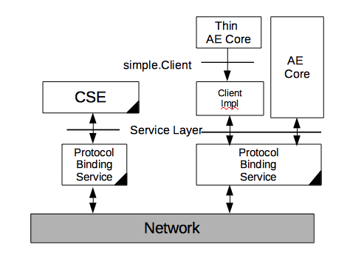
Client library
Client Interface provides higher level api to application for easier development. It
provids CRUD operations granularity and hides detail data structure of RequestPrimitive and ResponsePrimitive, and
automatically assigns some protocol parameters like request ids or from field.
It is assumed very small code around 100〜200 lines.
Usual Class
Not OSGi Service

Slide 5
Motivations
It is utility class, like Service Tracker.
It accommodates only set of standard API calls and simple operations.
It’s like syntax sugar. Provision of this prevents introduction of variations; Without this, people want to create their own one.
This also helps acceptance in oneM2M community.
In case that it should not be in regular specification, I would like to put 2nd candidates.
Reference Implementation
Util of Test Cases
Usage Example, like enRoute.
Other…

Slide 6
Overview of API
package org.osgi.service.onem2m.simple;
public interface Client {
public ResourceDTO create(String uri, ResourceDTO resource);
public ResourceDTO retrieve(String uri) ;
public ResourceDTO retrieve(String uri, String[] nesessaryAttributeNames);
public ResourceDTO update(String uri, ResourceDTO resource);
public void delete(String uri );
public List<String> discover(String uri, FilterCriteriaDTO fc);
public void notify(NotificationDTO notification);
}
package org.osgi.service.onem2m.simple.impl;
public class ClientImpl implements Client {
public ClientImpl(String appid, String aeid, NotificationListener listener) {}
public ClientImpl(String appid, String aeid, NotificationListener listener, Client customizer) {}
..
}

