Slide 1

Deep Graph Library Easy Deep Learning on Graphs
Minjie Wang & Lingfan Yu
With DGL Team
New York University, NYU Shanghai, AWS, AWS Shanghai AI Lab
GTC 2019 Instructor-led training (L9134)
https://github.com/dmlc/dgl

Slide 2
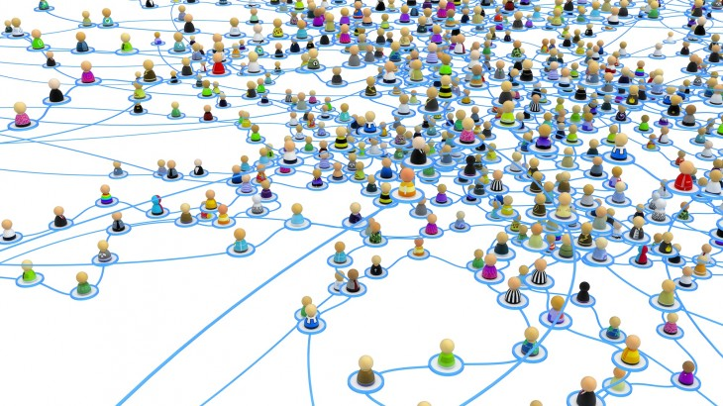
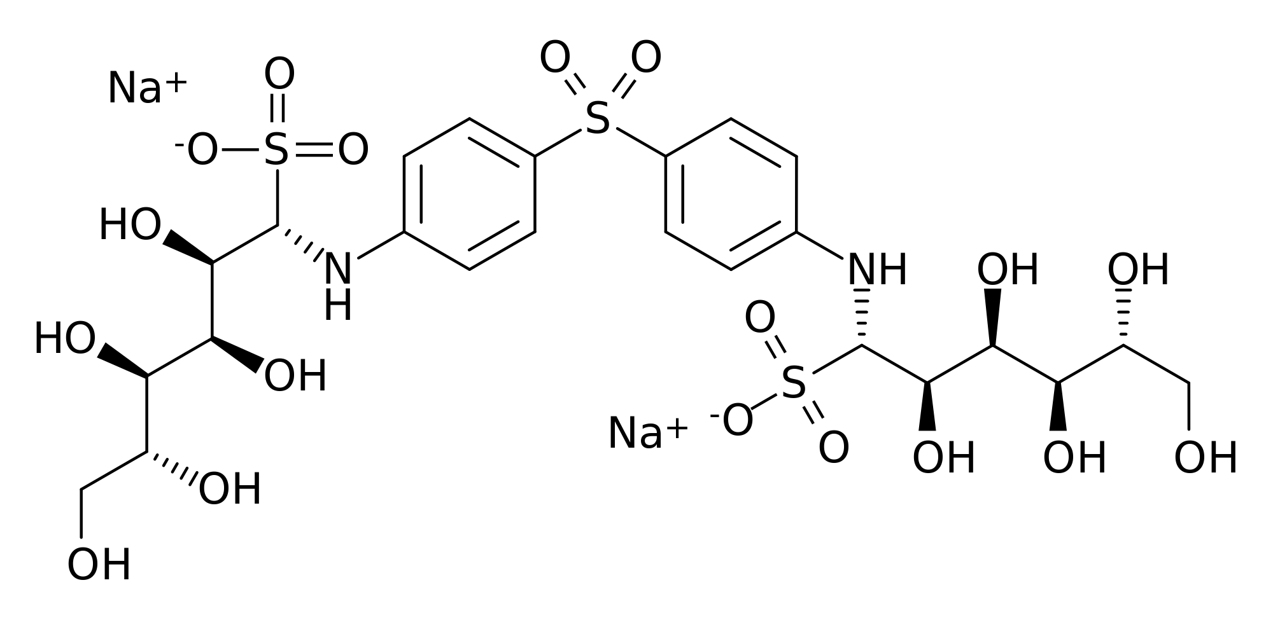
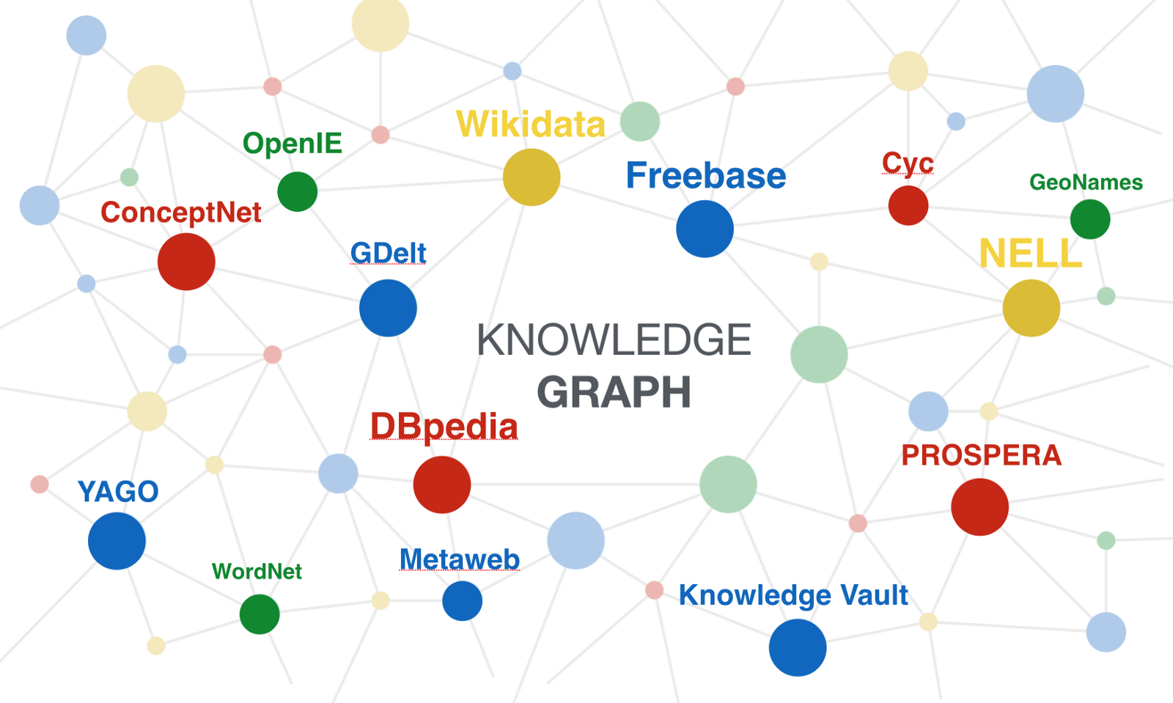
Why graph with deep learning?
Graphs are everywhere
Social network
Drugs and new materials
Knowledge graph

Slide 3
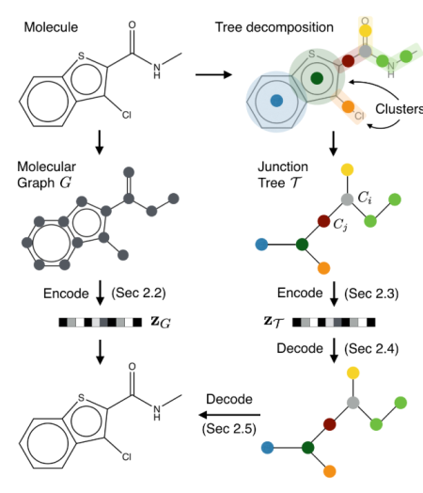
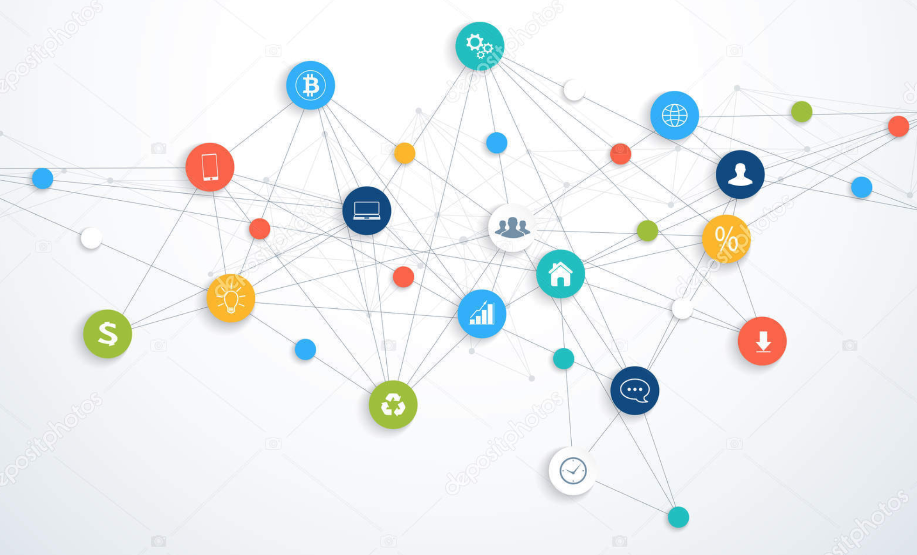
Popular Applications
Community detection
Find new molecules
Knowledge base completion
Social Network
[Chen et al. arxiv’18]
Molecule Graph
[Jin et al. ICML’18]
Knowledge Base
[Schlichtkrull et al. arxiv’17]

Slide 4
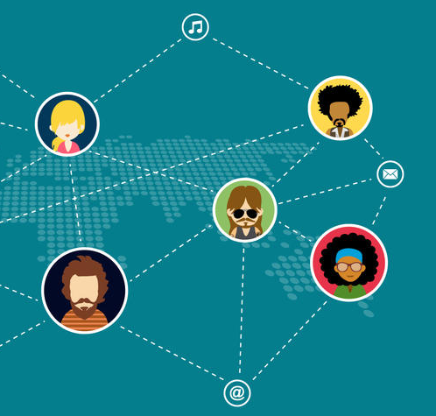
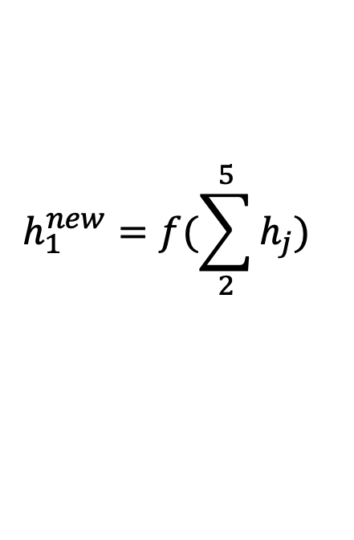
Representation Learning
Generating representation of nodes, which can later be used to predict node properties.
h₅
h₂
v₅
v₂
v₁
$$h_{1}^{new}=f(\sum_{2}^{5}{h_{j}})$$
v₃
v₄
h₄
h₃
Notes:
A new class of neural network has emerged and gained popularity recently
Incorporate relational information

Slide 5
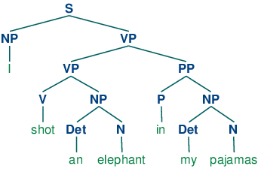
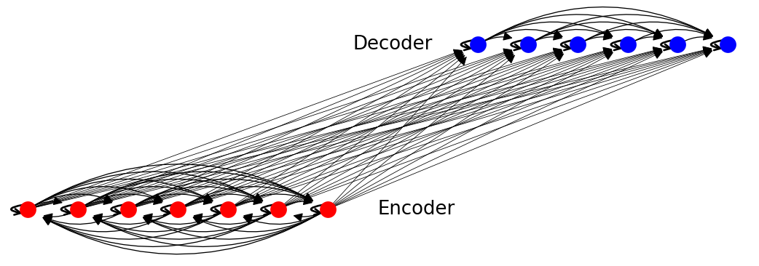
Traditional tasks can be modeled using graphs
Parse Tree
[Tai et al. ACL’15]
Transformer
[Vaswani et al. NIPS’17]

Slide 6
Implementing GNN is challenging with current frameworks
Graph can be giant and sparse
Naïve implementation may run out of memory
Graph has irregular structure, making it not trivial to
Batch nodes and edges of one graph
Batch multiple graphs together

Slide 7
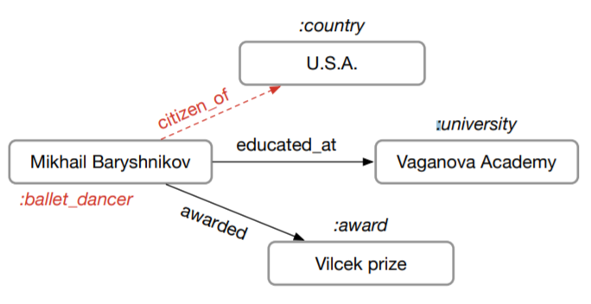
Training speed reality
Parse Tree
[Tai et al. ACL’15]
Molecule Graph
[Jin et al. ICML’18]
Knowledge Base
[Schlichtkrull et al. arxiv’17]
Training speed of one popular PyTorch version is only 23 trees/s
Author’s code in PyTorch: 8.25 graphs/s
Cannot run on GPU
due to OOM

Slide 8
Deep Graph Library (DGL)
A framework-agnostic library for graph neural networks.
User program
DGL automatically enables
Define models in their favorite DL frameworks (e.g. Pytorch, TF, MX, …).
Trigger graph computation using a narrow set of APIs.
Sparse operators
Auto-batching
Large graph storage

Slide 9
DGL Overview
Base APIs
- Create and change graphs
- Query graph structures
- Get/Set features
Message Passing APIs
- Compute and send messages along edges
- Reduce messages and update node representations
DGL Backend
- Graph Index
- Feature Storage
Batching APIs
- Batch and split graphs
- Efficient readout for a batch of graphs
Sampling & Subgraph APIs
- Create node/edge subgraphs
- Sampling utilities

Slide 10
Tutorial outline
Basics.ipynb
Create graph with DGL and associate features with nodes and edges
MessagePassing.ipynb
Perform message passing computation on a graph
GCN.ipynb
Implement Graph Convolutional Network
Speedup.ipynb
Speed up with sparse matrix multiplication kernels
BatchGraph.ipynb
Batch execution of multiple graphs, and perform efficient read-out on batch of graphs

Slide 11
DGL’s Message Passing Model
Message phase
V₁
E₁₃
V₃
M₁₃
message_func( , , ) =
V₂
E₂₃
V₃
M₂₃
V₁
1
E₁₃
3
V₃
E₂₃
2
V₂

Slide 12
DGL’s Message Passing Model
Reduce phase
M₁₃
reduce_func( ) =
M₃
M₂₃
V₁
1
E₁₃
3
V₃
E₂₃
2
M₁₃
V₂
M₂₃

Slide 13
DGL’s Message Passing Model
Apply phase
apply_func( , ) =
V₃
M₃
V₃
V₁
1
E₁₃
3
V₃
E₂₃
2
V₂

Slide 14
DGL’s Message Passing API
Define computations over batched of nodes / edges
Send(u, v, message_func)
Recv(v, reduce_func, apply_func)
A batch of edges
Source
Node
Destination
Node
<message>: edges
<apply>: nodes
edges.src
edges.data
edges.dst
<reduce>: nodes
A batch of source nodes
*Mailbox will be emptied after recv call triggers the node UDF.
Mailbox*

Slide 15

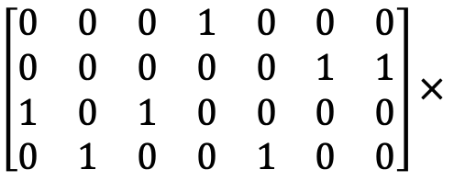

Fuse message passing
If reduce function is sum
Fuse reduce for all nodes into one sparse kernel
M₁₃
M₁₃
$$E$$
M₁₄
M₁₄
M₁
$\left[\begin{matrix}0 & 0 & 0 & 1 & 0 & 0 & 0 \\ 0 & 0 & 0 & 0 & 0 & 1 & 1 \\ 1 & 0 & 1 & 0 & 0 & 0 & 0 \\ 0 & 1 & 0 & 0 & 1 & 0 & 0\end{matrix}\right]×$
M₂₃
M₂₃
M₂
$$V_{dst}$$
M₂₁
M₂₁
M₃
M₃₄
M₃₄
M₄
M₃₂
M₃₂
M₄₂
M₄₂

Slide 16

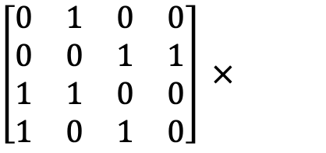

Fuse message passing
If message function copies source node data and reduce function is sum
Fuse message and reduce phase into one sparse kernel
Avoid materializing messages
$$V_{src}$$
V₁
M₁
$\left[\begin{matrix}0 & 1 & 0 & 0 \\ 0 & 0 & 1 & 1 \\ 1 & 1 & 0 & 0 \\ 1 & 0 & 1 & 0\end{matrix}\right] ×$
V₁
V₂
M₂
V₂
$$V_{dst}$$
V₃
M₃
V₃
V₄
M₄
V₄

Slide 17
Batch Multiple Graphs
Concatenate multiple graphs to be one graph with many disjoint connected components
Graph 1
[ ]
Graph 2
=
batch
Graph 1
Graph 2

Slide 18
Resources
DGL website: https://www.dgl.ai/
DGL GitHub Repository: https://github.com/dmlc/dgl
DGL discuss forum: https://discuss.dgl.ai/

Slide 19
Comparison with other systems
 | GraphNets | NGra | Euler | DGL
Active set | ❌ | ❌ | ❌ | ✅
Arbitrary reduce | ✅ | ❌ | ✅ | ✅
Auto-batching of reduce | ❌ | ❌ | ❌ | ✅
Batch multiple graphs | ✅ | ❌ | ❌ | ✅
Kernel fusion | ❌ | ❌ | ❌ | ✅

