Slide 1
DGL 101: Hello-World & Basic Operations
Jian Zhang
jamezhang@amazon.com

Slide 2
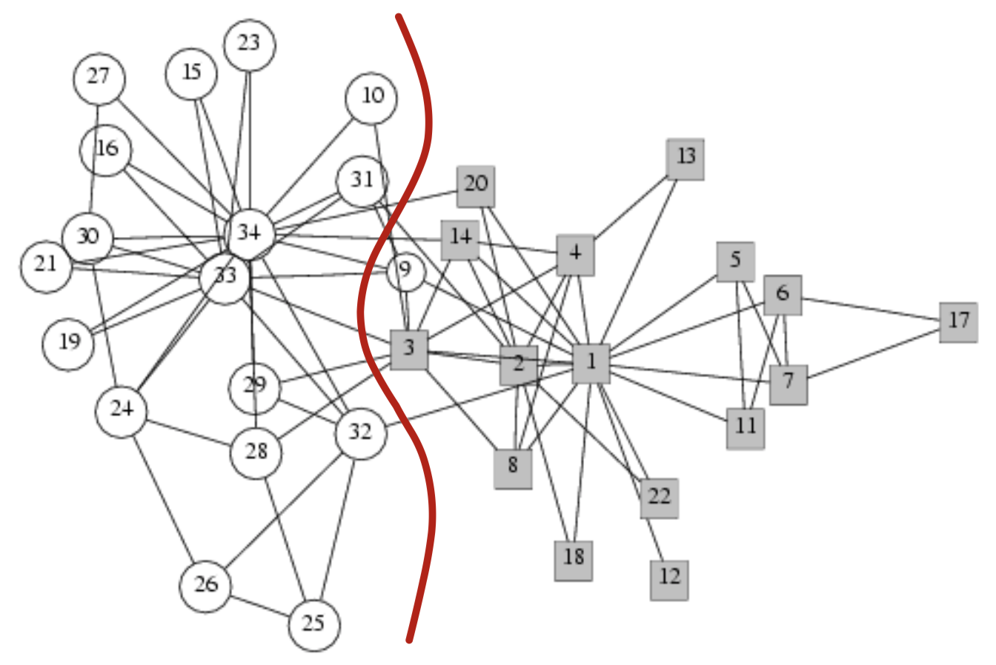
Hello-World Example
A semi-supervised Classification problem
Very few labeled data
Purely use graph structure information
In this DGL example, you will learn:
How to define a graph, adding nodes and edges;
How to setup features and labels for nodes;
How to define a GCN model using DGL's building modules;
How to train the GCN model, and
How to check the results

Slide 3
DGL basic operations
Read in edge file and create a DGL graph
Check graph information and structure
Assign features and check their data structure
Do message-passing and reduction

Slide 4
A Question for You
Print out each club member’s embedding (feature) during training

