Slide 1
DGL Tutorial: Node Classification
Jian Zhang
jamezhang@amazon.com

Slide 2
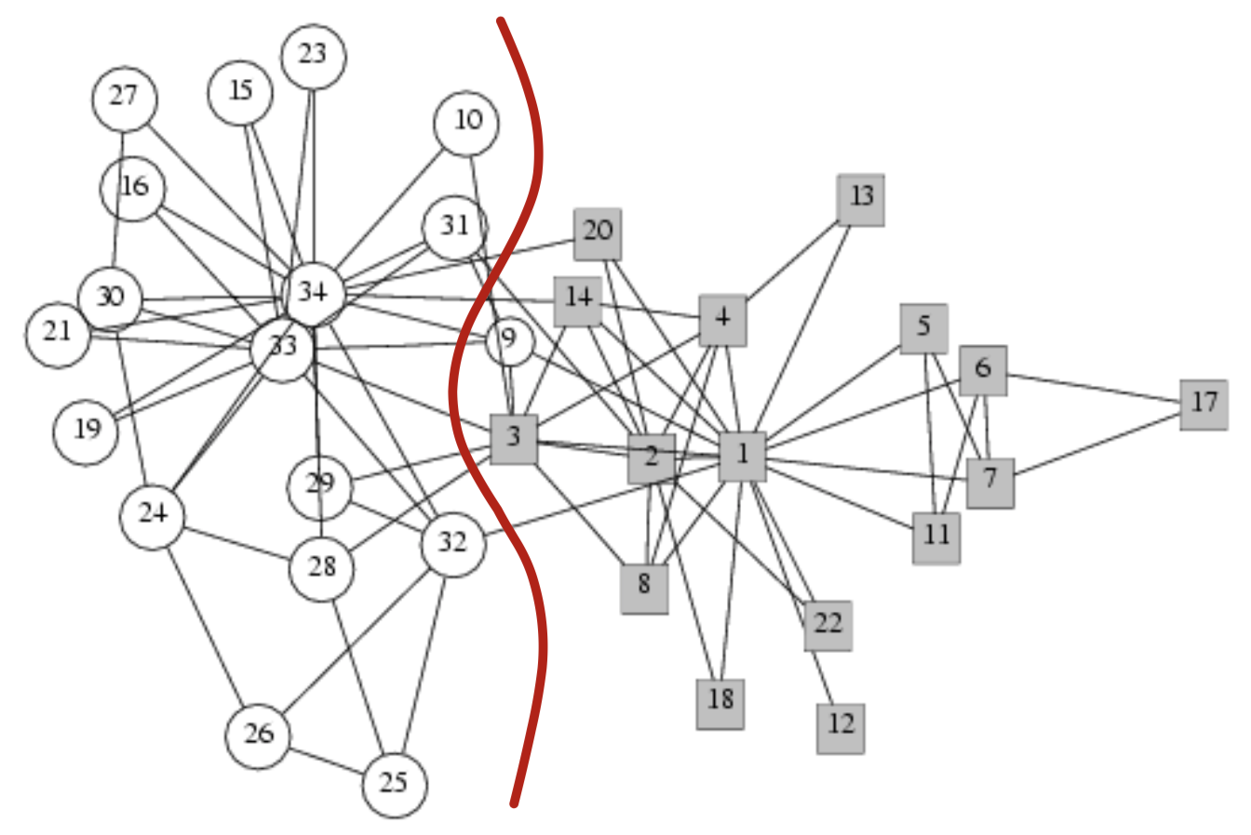
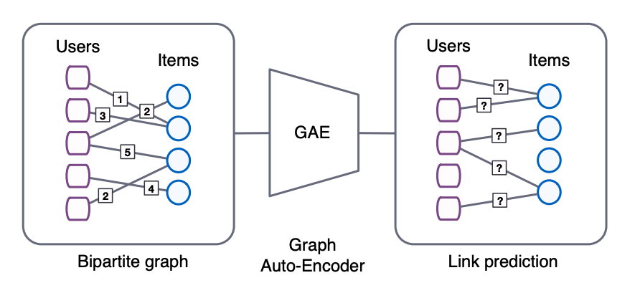
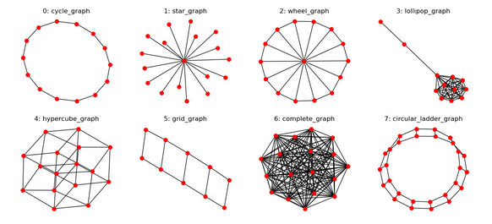
Graph Learning Tasks
Node Classification: assign a label to a node
Link Prediction: predict existence of an edge
Graph Classification: assign a label to a graph

Slide 3
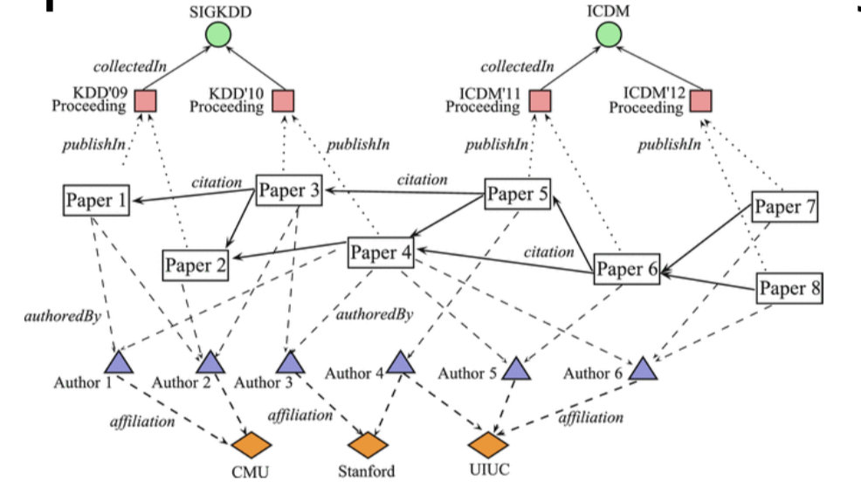
Node Classification Task
Semi-supervised learning
Pick a few labeled nodes
Train on the whole graph with features/structure
Validate and test on some known labels
Dataset
Node (paper): 19717
Edge (citation): 88651
Classes (diabetes type): 3, [0, 1, 2]
Features (TFIDF): 500-d
60 for training, 500 for validation, and 1000 for testing

Slide 4
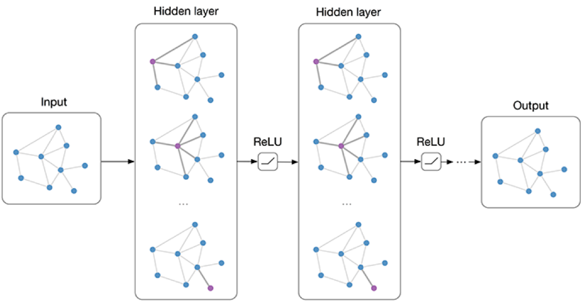

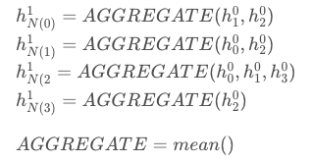
The Model - GraphSage
Nodes: 0,1,2,3
Edges: (0,1), (0,2), (1,2), (2,3)
Features: (3, 1), 3-d
0
1
2
3
1 | 1 | 1 | 1
1 | 1 | 1 | 1
1 | 1 | 1 | 1
1 | 1 | 1 | 1
1 | 1 | 1 | 1
1 | 1 | 1 | 1
0 | 0.1 | 0.1 | 0.1
1 | 0.2 | 0.2 | 0.2
2 | 0.4 | 0.4 | 0.4
3 | 0.8 | 0.8 | 0.8
0 | 0.3 | 0.3 | 0.3 | 0.1 | 0.1 | 0.1
1 | 0.25 | 0.25 | 0.25 | 0.2 | 0.2 | 0.2
2 | 0.37 | 0.37 | 0.37 | 0.4 | 0.4 | 0.4
3 | 0.4 | 0.4 | 0.4 | 0.8 | 0.8 | 0.8
0 | 1.2 | 1.2 | 1.2 | 1.2
1 | 1.35 | 1.35 | 1.35 | 1.35
2 | 2.2 | 2.2 | 2.2 | 2.2
3 | 3.6 | 3.6 | 3.6 | 3.6
ReLU
H⁰
W¹
H¹

Slide 5
A Question for You
Try out another GNN model for this task

