Slide 1
Introduction of the Graph World
April Workshop Serial 1

Slide 2
ToC
Success of DL and AI (1-2 slices)
The dark matter (1 slice)
What is graph, why we need it (1-2 slices)
Concepts and terms (1-2 slices)
Graph Neural Network (GNN) (2-3 slices)
DGL in GNN (2-3 slices)
Limitations of GNN
Wrap up (1 slice)
Q&A
9 ~ 14 slices
Target 15 slices

Slide 3
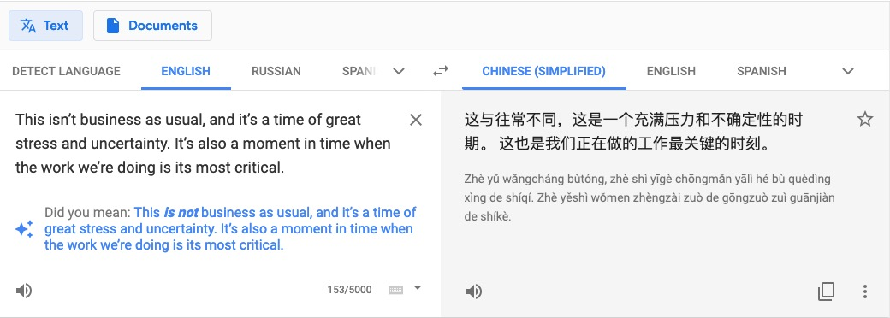
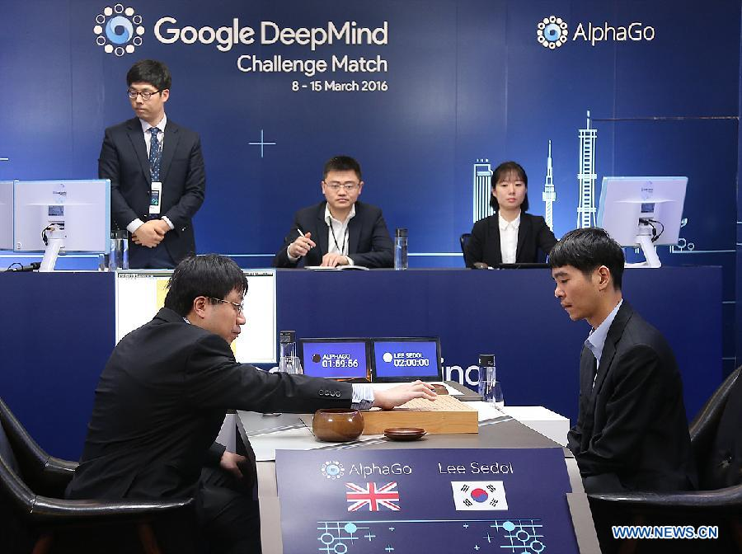
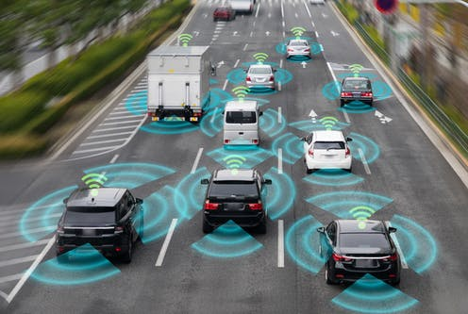
Booming of AI
General DL cases

Slide 4
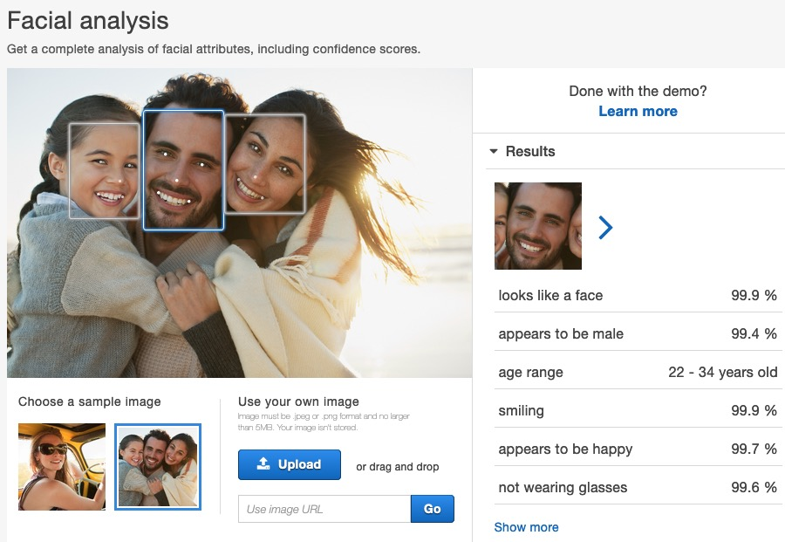
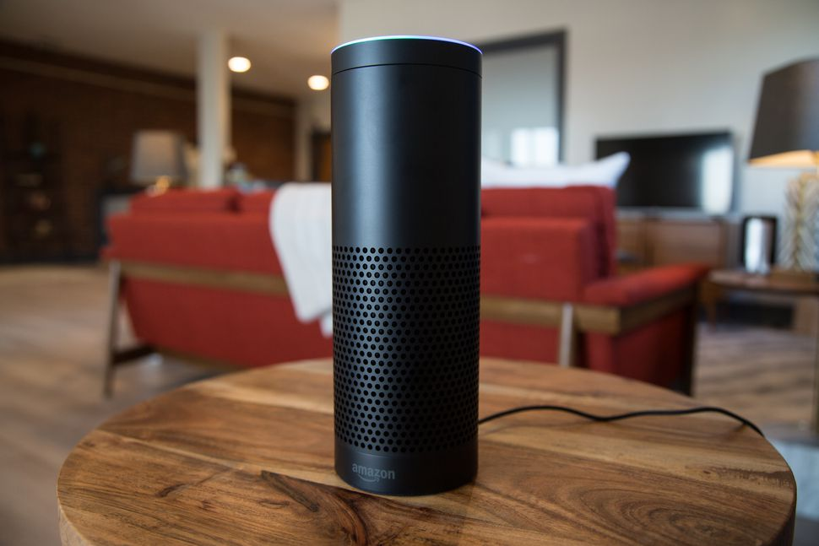
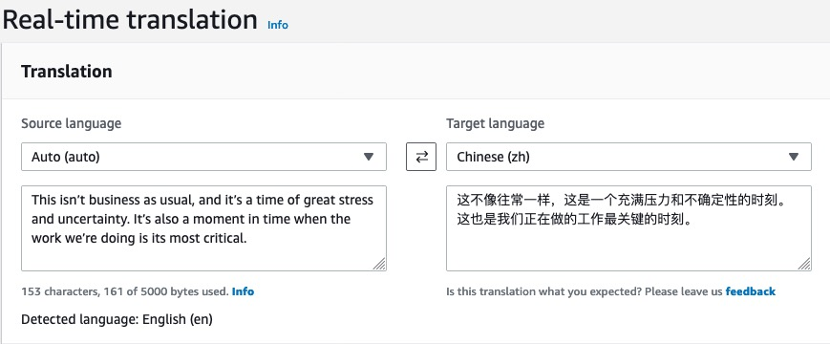
Booming of AI in Amazon

Slide 5
Some Obstacles of AI Adoption
Business Scenarios
Data, Data, Data – Labeled Data!
Have we been fully leveraging the existing data,
especially the rich relational information?

Slide 6
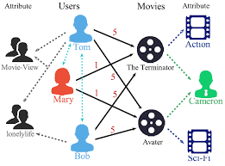
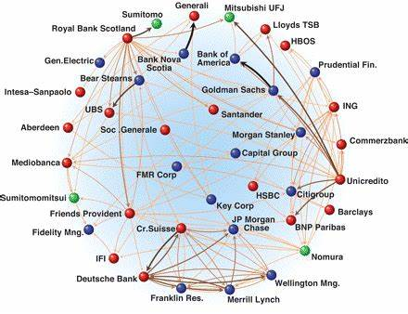
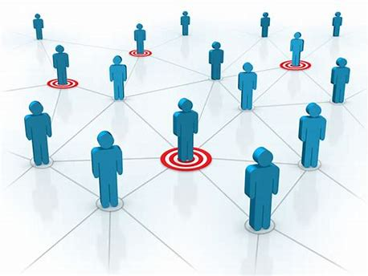
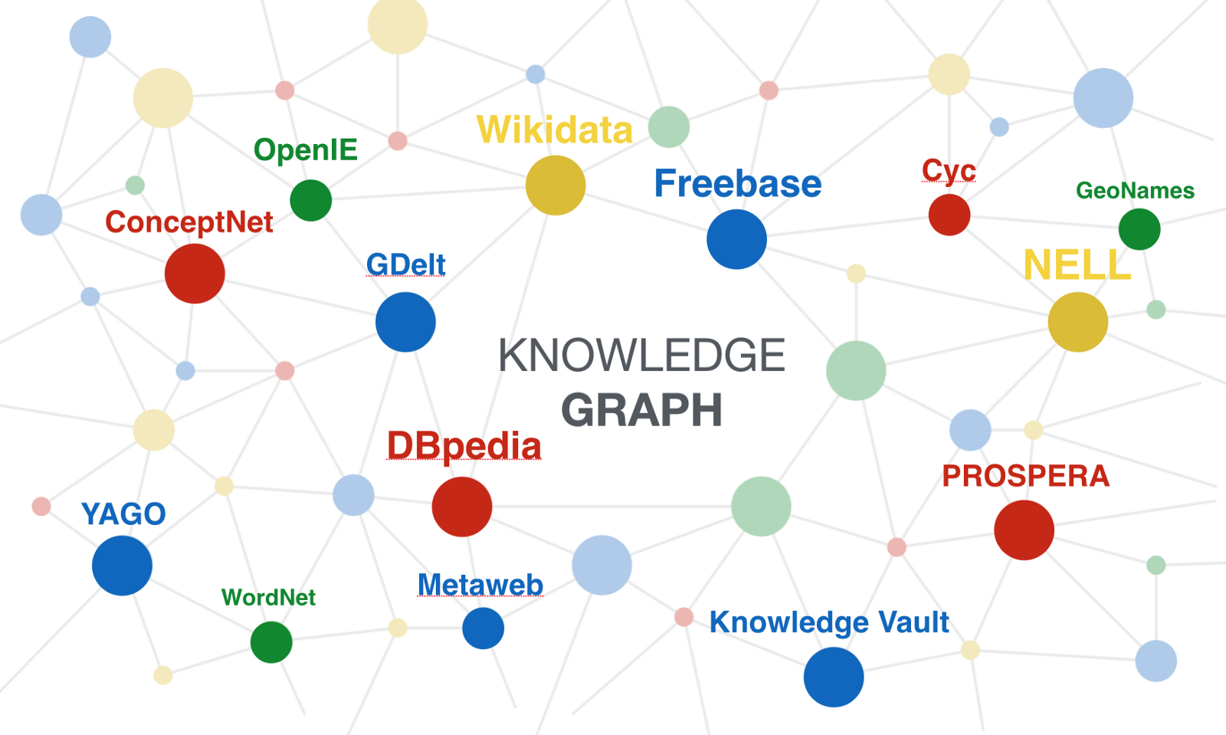
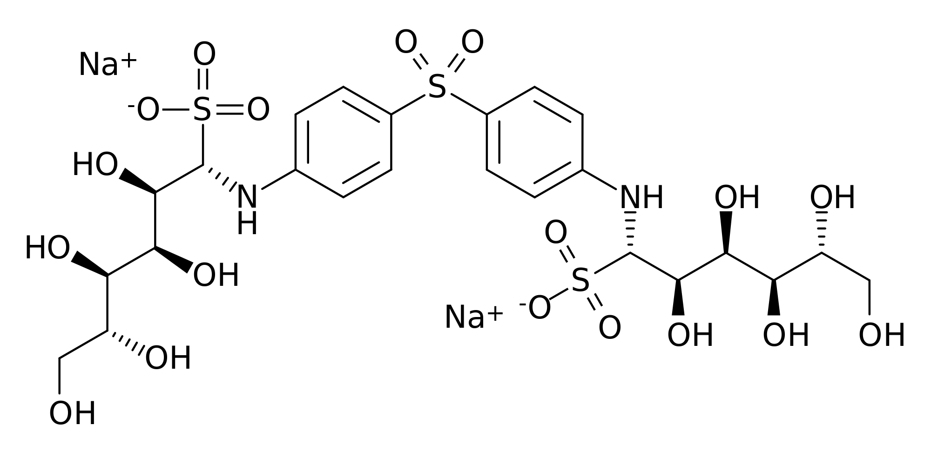
What is Graph
Graph is the language of complex interactions
Collaborative knowledge graph
Social network
Financial transactions network
Chemical molecule
Knowledge graph

Slide 7
Why do we need Graphs
Complex domains have rich relational structure, which can be represented as a relational graph
Recommender System
Fraud detection
Precision marketing
By explicitly modeling relationships we achieve better performance.
Data availability
Existing data have rich relational information
Some existing systems have implicitly use graph information
Collaborative knowledge graph
Social network
Financial transactions network

Slide 8
Concepts and terms
Graph vs Image
Node vs Vertex
Edge vs Link
Homograph vs Heterograph
Graph Learning vs Machine Learning

Slide 9
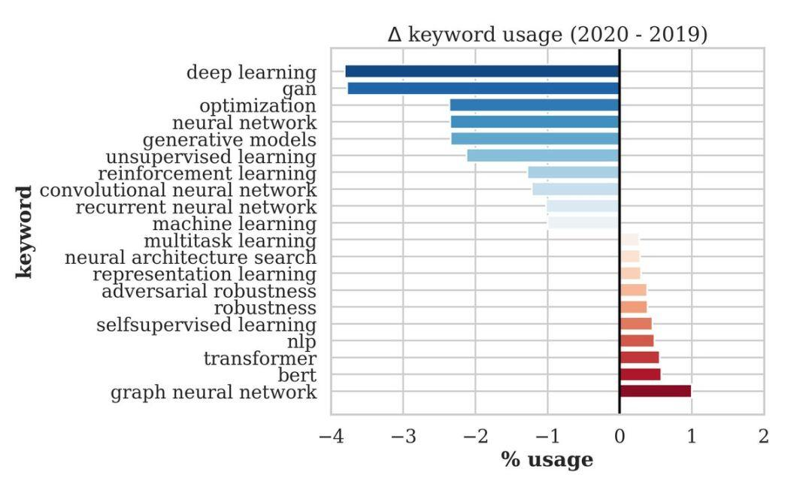
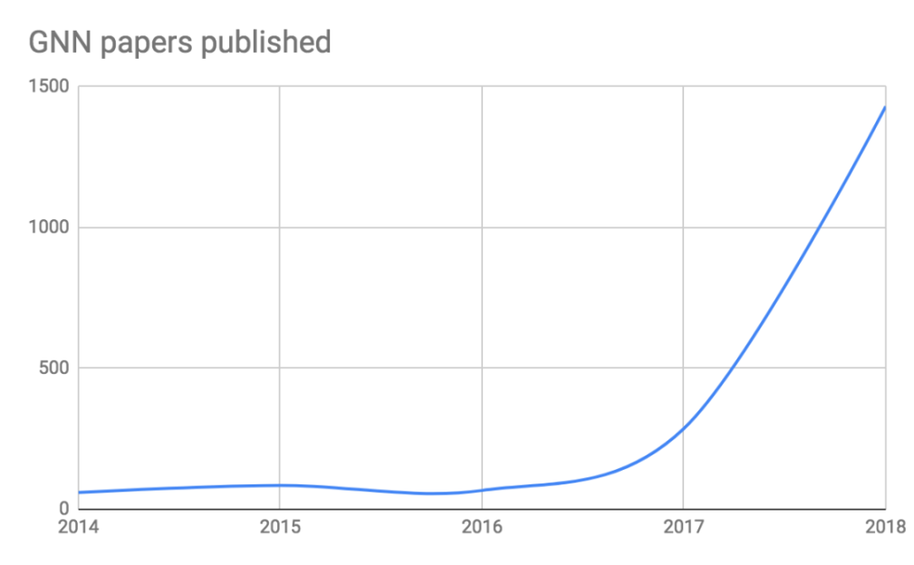
Graph Neural Network (GNN)
Graph analysis and learning has a long history
DL(NN) + Graph => GNN
A family of (deep) neural networks that learn node, edge, and graph features.

Slide 10


How does GNN work
Normal
GNN
Classifier
Fraudster

Slide 11
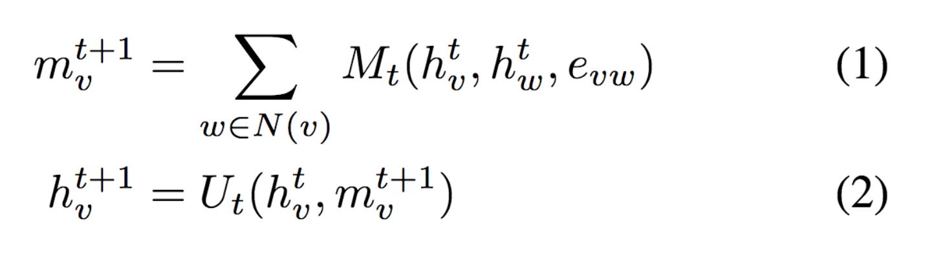
How does GNN work
Reduce function
Message function
Update function

Slide 12
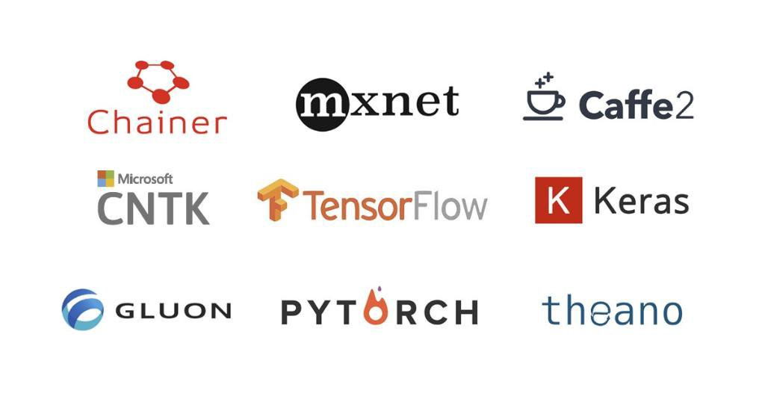
DGL in GNN
Industrial adoption of AI needs good ML and AI frameworks
It is very hard to implement GNN with TensorFlow/PyTorch/MXNet
(Our implementation) caused OOM … which is the reason for the lack of results on Pubmed.
-- from the authors of Graph Attention Network [ICLR’18]

Slide 13
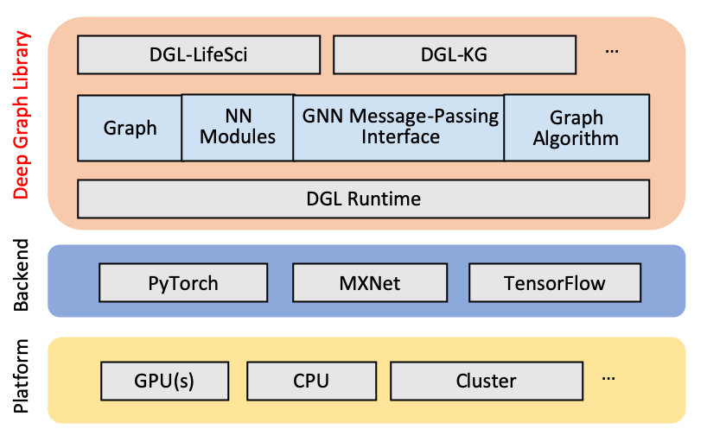
DGL in GNN

Slide 14
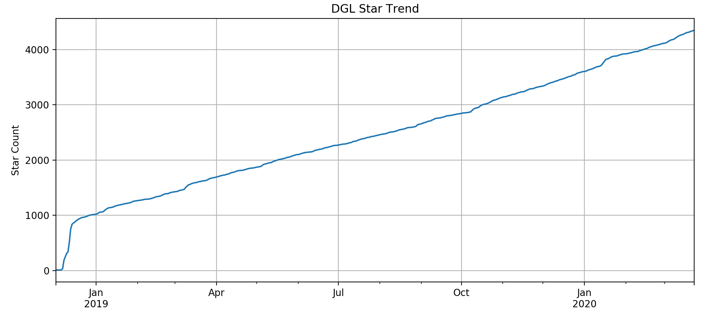
DGL in GNN
0.5 – May 202
??
0.3 release
19x Speed up
Distributed Training
0.4.2 release
TensorFlow support
MXNet Modules
0.1 release
Open Source release
0.4 release
Heterograph support
DGL Knowledge Graph
0.2 release
Multiple GPU support
Large graph sampling

Slide 15
Limitations of GNN
Graph brings information, but noise as well
GNN research is in a fast lane, but is still developing
GNN has proven its values in some scenarios, but need more cases

Slide 16
Wrap Up
Complex interactions are everywhere
Graph capture these relational information
Graph Neural Network is the new wave of AI
DGL make using GNN much easier and ready to engage customers
GNN needs more solid business cases

