Slide 1
Case Sharing
DGL in Fraud Detection
April Workshop Serial 3

Slide 2
ToC
What is fraud detection (2)
The business case (1)
Problem setting (2)
The data (1)
Solutions (2)
How DGL works for FD (2)
Wrap up (1)
Q&A
~ 10 slices
Target 10 slices

Slide 3
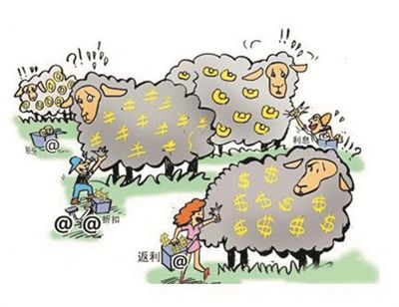
Fraud is everywhere
Finance/Heathcare/Social Security
  Fraud applications/claims
  Fraud accounts
  Account takeover
E-commerce
  Fraud transactions
  Unwelcome transactions
  Frequent cancelations/returns
Social-Media/Network
  Fraud contents
  Fraud behaviors

Slide 4
Fraud is everywhere
Social-Media/Network
  Fraud contents
  Fraud behaviors
  Malicious attacks
Finance, Healthcare, Social Security
  Fraud applications/claims
  Fraud accounts/Account takeover
  Money laundry
E-commerce
  Fraud transactions
  Unwelcome transactions
  Frequent cancelations/returns

Slide 5

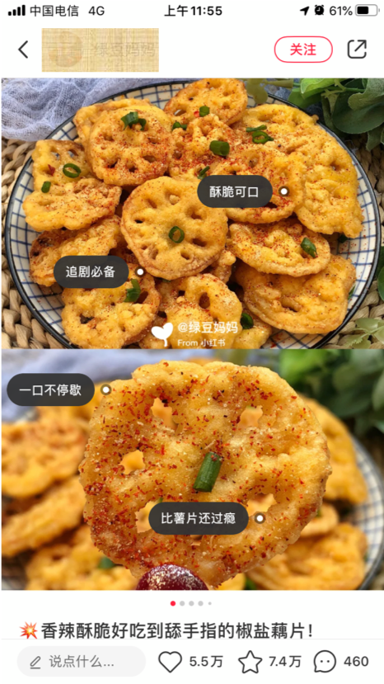
The Business Scenario
Background
  One of the largest social life platform
  User Generate Contents
  Social interactions on these UGC
  E-commerce channels
Potential fraudulent scenarios
  Fake/illegal/misleading contents
  Fake interactions
  Malicious interactions
  ……

Slide 6
Problem Setting
Identify Suspicious Interactions
Use their internal rules to find suspicious interactions
Use ML to identify these suspicious interactions
Users can “Like”, “Collect”, “Share”, “Comment” UGCs

Slide 7
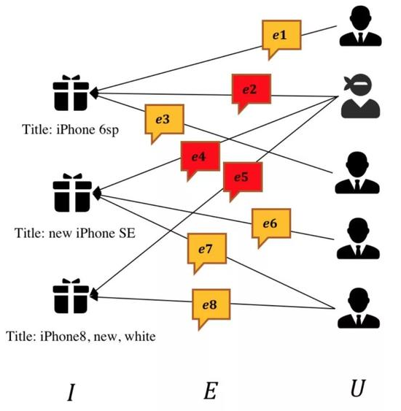
The Data
Raw Data
  Two days data of interactions (5M)
  User information (90K)
  UGC information (80K)
  Suspicious interactions (160K)
  Normal (White) User information (100K)
Labeled Data
  600 labeled white, 5k labeled black users
  16k labeled black interactions
UGC1
UGC2
UGC3

Slide 8
Solutions
User Classification – Node Classification
Interaction Classification – Edge Classification

Slide 9
How DGL works for fraud detection
Node classification – RGCN (Relational Graph Convolutional Network)
  dgl has existing RGCN modules and tutorials
Edge classification – GATN (Graph AttenTion Network)
  dgl has existing GATN modules and tutorial
  dgl has lower level APIs for module customization

Slide 10
Critical Issues in Fraud Detection
Evidence and Explanation
Feature Engineering vs Graph Information
Extremely skewed ground truth
data and characteristics determine the upper limit of machine learning, and models and algorithms just approach this upper limit.

Slide 11
Wrap Up
Fraud is everywhere
Social behavior create unique challenge
GNN is natural for social interaction
DGL can help with all levels

