Slide 1
Introduction to DGL
April Workshop Serial 2
Liu Xuefeng
liuxuefe@amazon.com

Slide 2
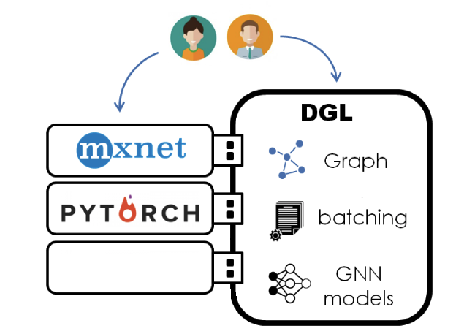
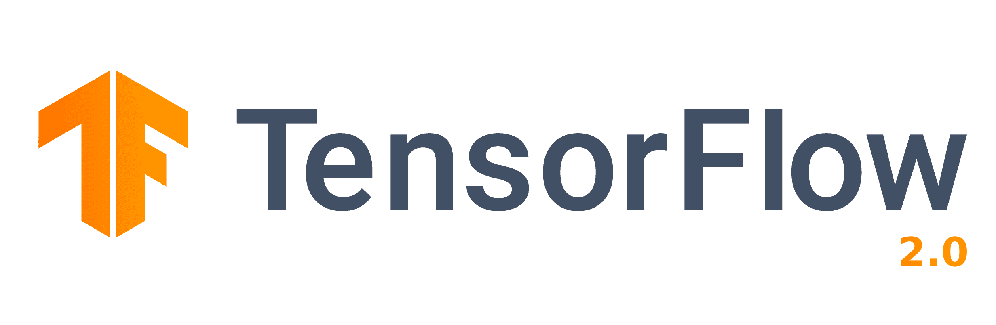
What is DGL
DGL (Deep Graph Library) is an easy-to-use, high performance and scalable Python package for deep learning on graphs.
It serves as a frontend for graph neural network algorithms and can leverage popular deep learning frameworks as backend.
It is open-source.
It runs on both CPU and GPU.
It supports major operating systems, including Linux, MacOS, Windows.

Slide 3
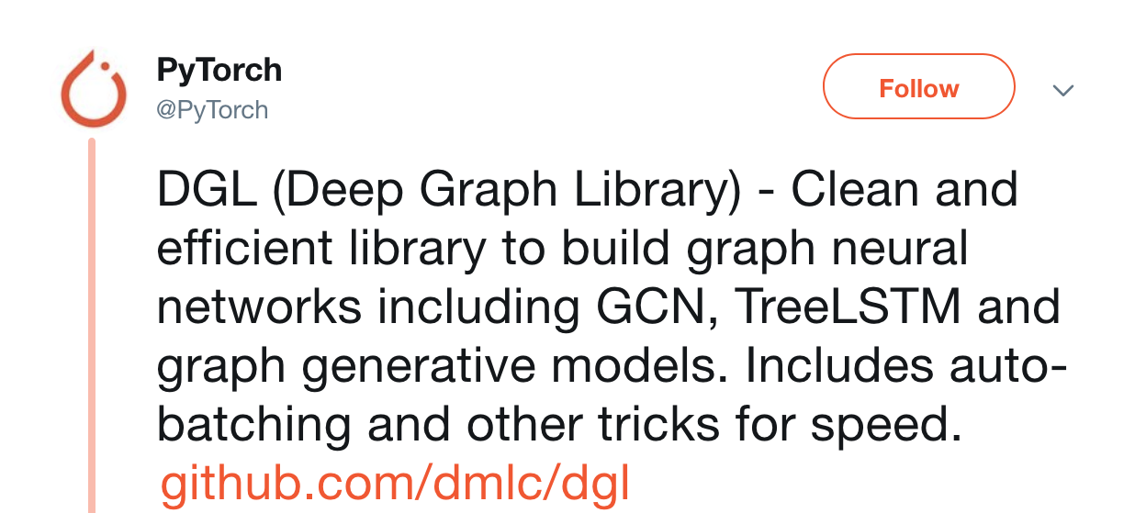
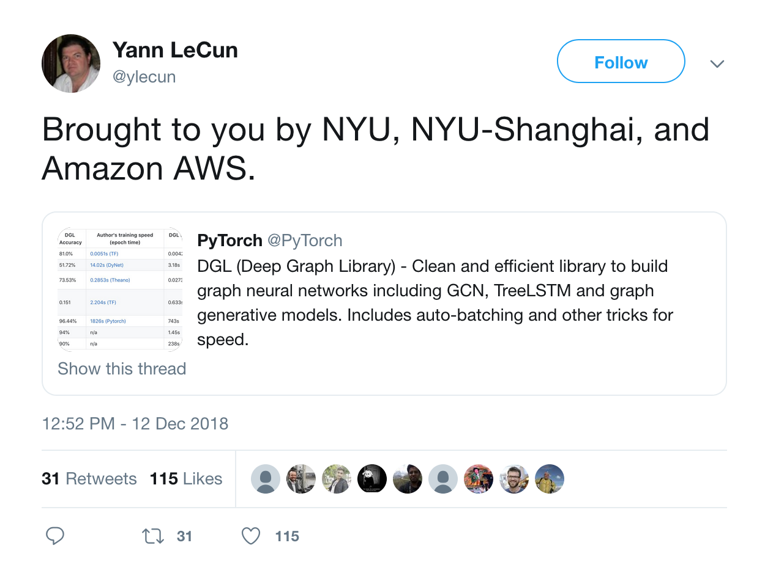
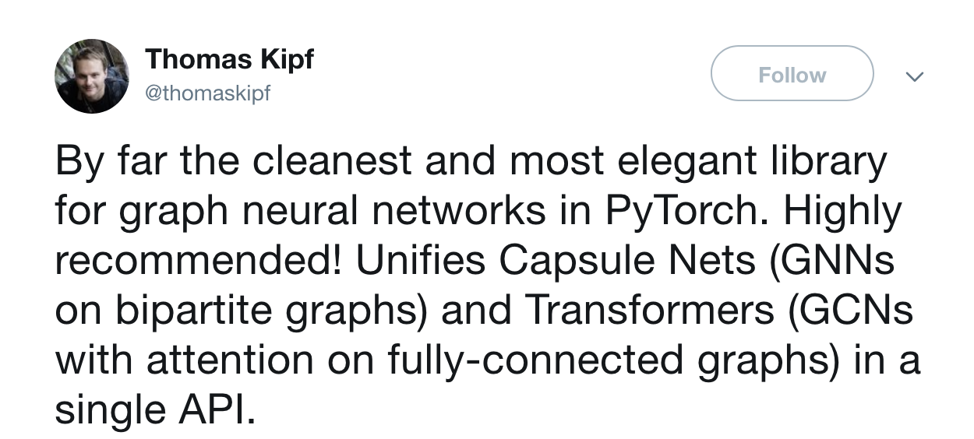
DGL is widely recognized

Slide 4
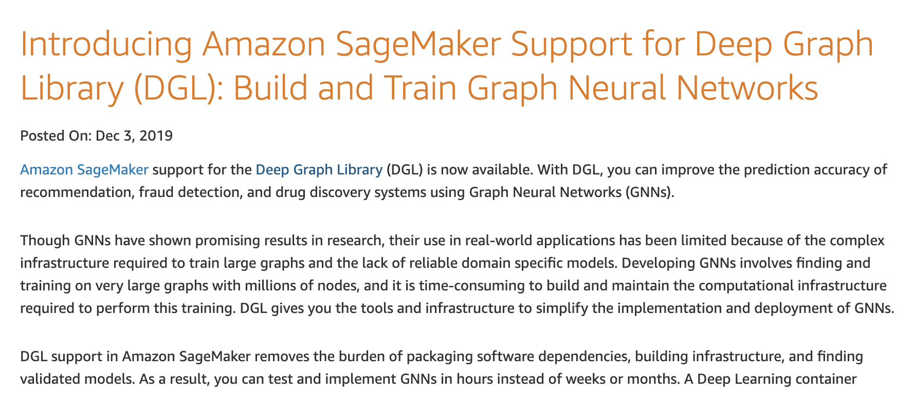
DGL is widely recognized

Slide 5
Why DGL is so popular?
In simple words, it solved all the major difficulties you might have when apply GNN algorithms.
Do not want to start all over and learn a new deep learning framework?
DGL can leverage multiple deep learning frameworks as backend, including PyTorch, Tensorflow, MXNet.
My graph is so complicated?
DGL graph API support all kinds of graphs.
Want to leverage existing GNN algorithms?
Try DGL built-in modules.
Want to try something innovative?
Try DGL message passing.
How about giant graph?
Try DGL sampling API.
I focuse on a domain area.
Try DGL domain apps.

Slide 6
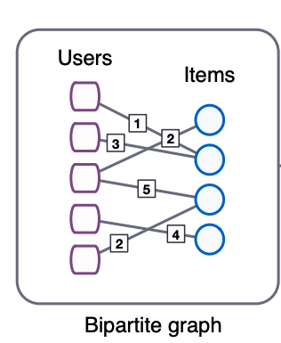
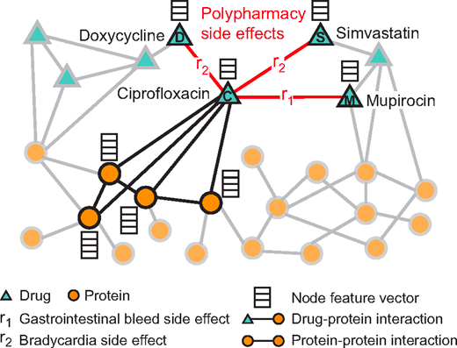
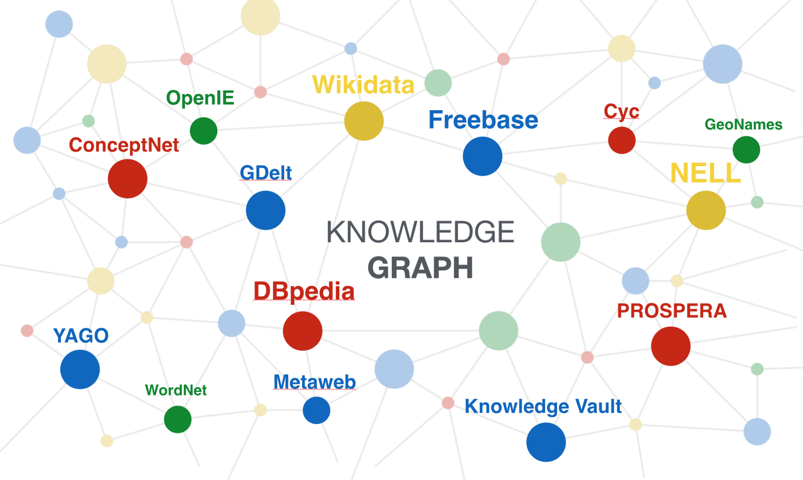
When your data structure is complicated
A lot dataset in real world is complicated and cannot be easily written as structure data.
In such cases, graph is a good choice for your data structure.
Graph is flexible and expressive.
It has node, edge, node label, edge label, node feature, edge feature.
DGL provides a scalable implementation of graph and supports all the attributes mentioned above.

Slide 7
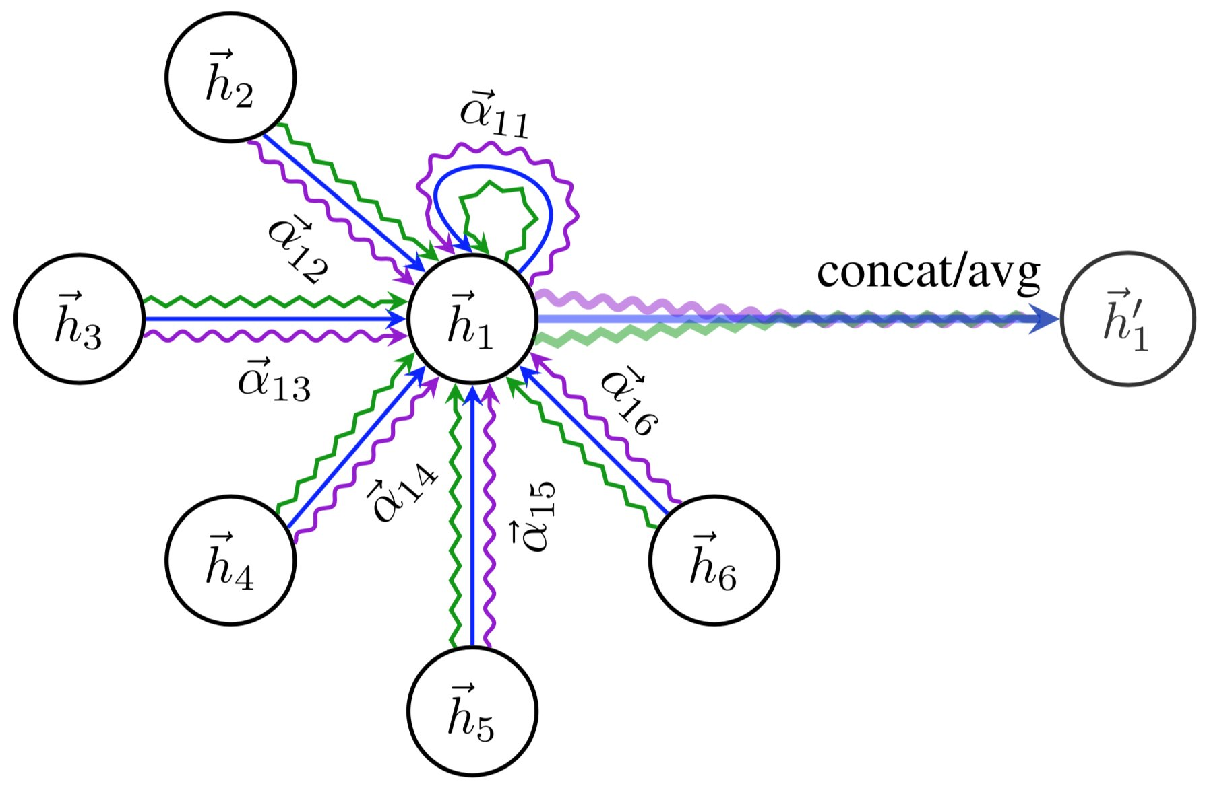
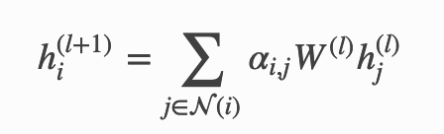
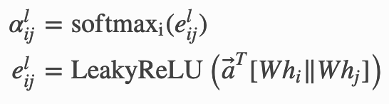
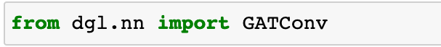
When you want to do fast prototyping with popular GNN algorithms
As GNN draws more attentions in recent years, a lot algorithms are proposed and some of them are proven to be effective in real world problem solving.
A lot of popular graph neural network modules are implement in and ready to use with DGL.
GraphConv, RelGraphConv, TAGConv, GATConv, EdgeConv, SAGEConv, APPNPConv, GINConv, GatedGraphConv, GMMConv, ChebConv, AGNNConv, NNConv, AtomicConv and so many more…
You can use them just other modules in PyTorch, Tensorflow, MXNet.

Slide 8
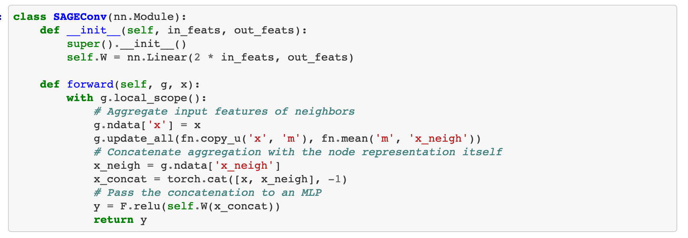
When you want to try your own graph algorithm
Have your own idea on graph analysis? Or want to try a graph algorithm just published?
DGL message passing API is an intuitive way to do it.
For example, the well known GraphSAGE model can be implemented with Message Passing in a few lines of code.

Slide 9
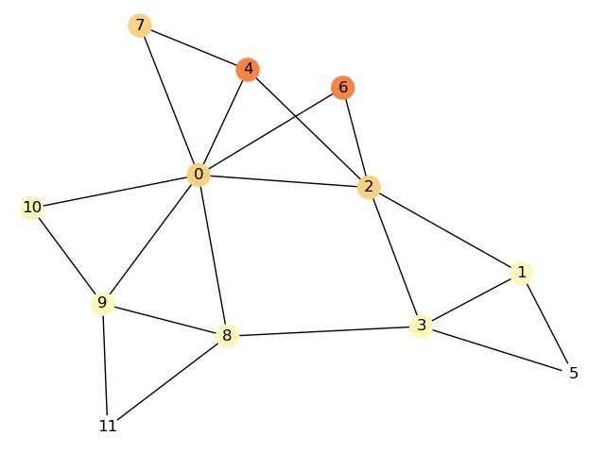
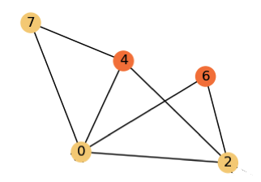
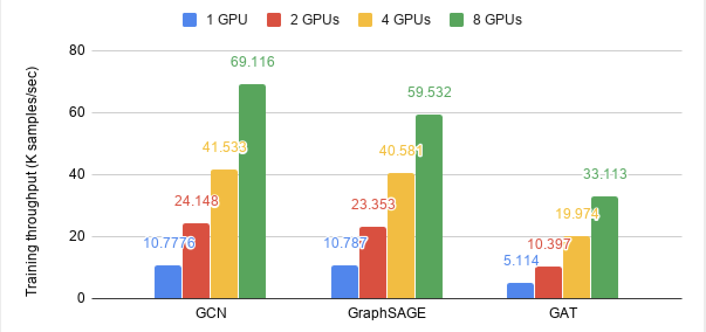
When you have a giant graph
Industrial graphs are always large by its nature.
Millions of nodes, billions of edges, thousands of features on every node and edge.
DGL supports training on giant graphs with
Sampling and batching API: focus only on part of a graph for each train step.
Multi GPU training: parallelly train the model with multiple GPUs.

Slide 10
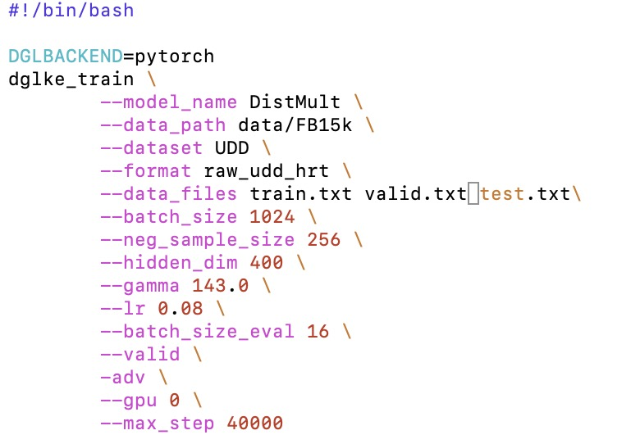
When you are a domain expert
DGL provides domain apps to ease its usage in some specific domains.
DGL-LifeSci for drug discovery, molecular representation..
DGL-KE for knowledge graph.
DGL-RecSys for recommend system (to come).
DGL-KE
Effortlessly generate knowledge graph embedding with one line of code.
Support for giant graphs with millions of nodes and edges.
Support distributed training on a GPU cluster.
It takes only 30 minutes to train a knowledge graph over 86M nodes and 338M edges on a 4-machine cluster.

Slide 11
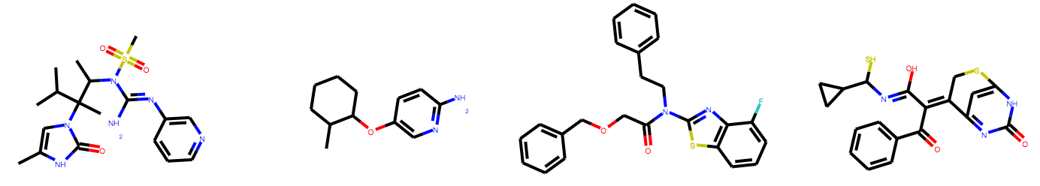
When you are a domain expert
DGL-LifeSci
Training scripts and pre-trained models for various applications — molecular property prediction, generative models, and reaction prediction.
Up to 5.5x model training speedup compared to previous implementations.
Well defined pipelines for data processing, model construction and evaluation.

