Slide 1
Sampling and batching in DGL

Slide 2
What is batching in deep learning
Recall what we do in CV
The whole dataset is split into small batches.
Each time the model is trained on one batch only.
We call a loop over all the batches an epoch.
The model is trained with one or more epochs.
Why we do batching generally?
Dataset is too big to fit into GPU memory.
What makes batching different in GNN?
In GNN, the observations are not independent with each other.
They can not be split to small batches directly.

Slide 3
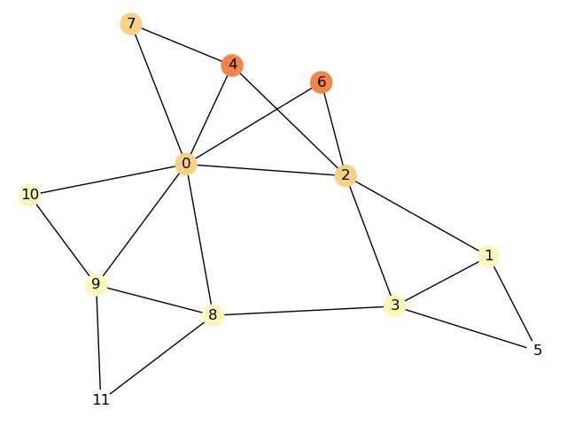
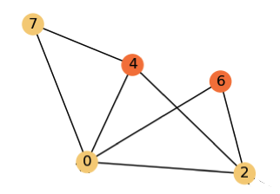
Batching in GNN
Batching in GNN is achieved by extracting sub graphs.
Split labels to small batches.
For each batch of labels, a sub graph is extracted based on which prediction of the labels can be generated.
Backpropagate based on the sub graph and update model.
Iterate over all the batches and complete an epoch.
An example of extracting sub graph when labeled nodes are 4 and 6.

Slide 4
Blocks
A block is a bipartite graph generated from a sub graph to separate input nodes and output nodes.
Output nodes are those nodes we want to calculate output.
Input nodes are those nodes based on which we can calculate the output of the output nodes.
4
4
6
6
0
2
7
Block 0

Slide 5
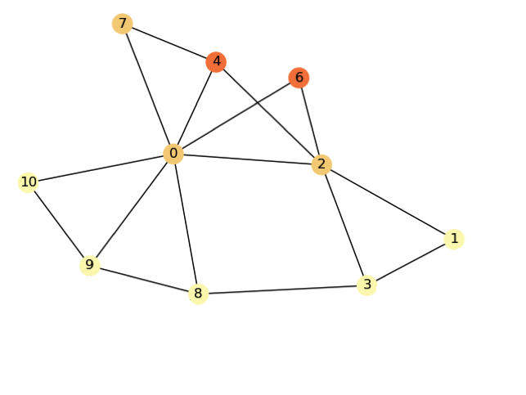
Blocks
Example of blocks for two layers.
Input nodes
Output nodes
Input nodes
Output nodes
4
4
4
4
6
6
6
6
0
0
0
2
2
2
7
7
7
1
3
8
9
Block 1
10
Block 0

Slide 6
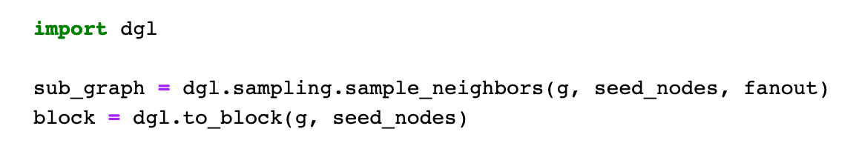
Node Sampling
Node sampling means for each output node we sample fixed number of neighbors instead of all of them.
It avoids oversized sub graph been extracted when there is a output node of very high degree.
It also serves as a kind of regularization.
Overall flow of generating a block in DGL

Slide 7
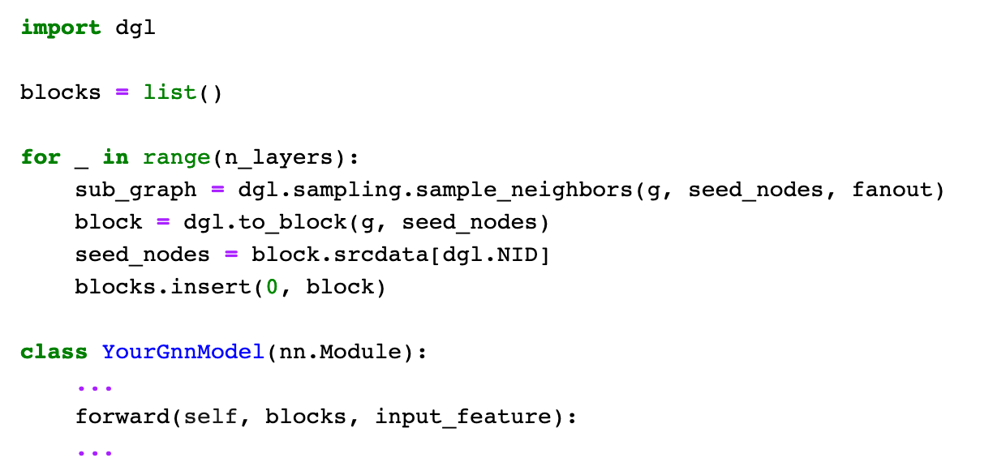
Overall flow of training based on blocks in DGL

