Slide 1
Recommender System with GNN
Da Zheng
AWS AI

Slide 2
Recommender system: Problem statement

Slide 3
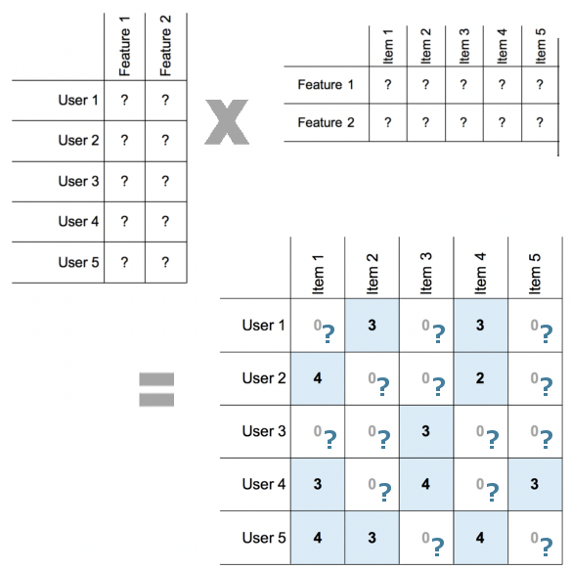
Latent User / Item Representation
An item can be described with a set of features (e.g. how sweet some food is).
A user can be described with preferences of the same set of features (e.g. how much a user likes sweet food).
The interaction is defined by how well the item features match the user preferences.

Slide 4
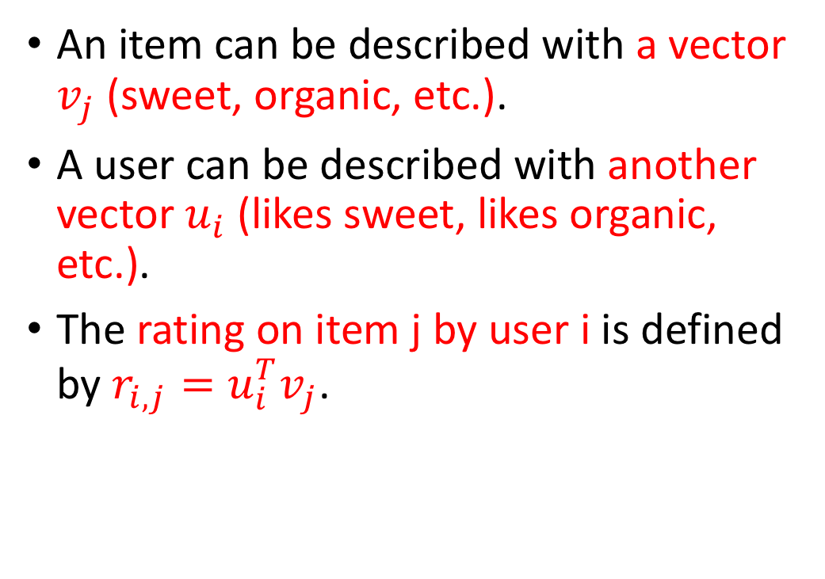
Latent User / Item Representation
An item can be described with a vector $v_{j}$ (sweet, organic, etc.).
A user can be described with another vector $u_{i}$ (likes sweet, likes organic, etc.).
The rating on item j by user i is defined by $r_{i,j}=u_{i}^{T}v_{j}$.

Slide 5
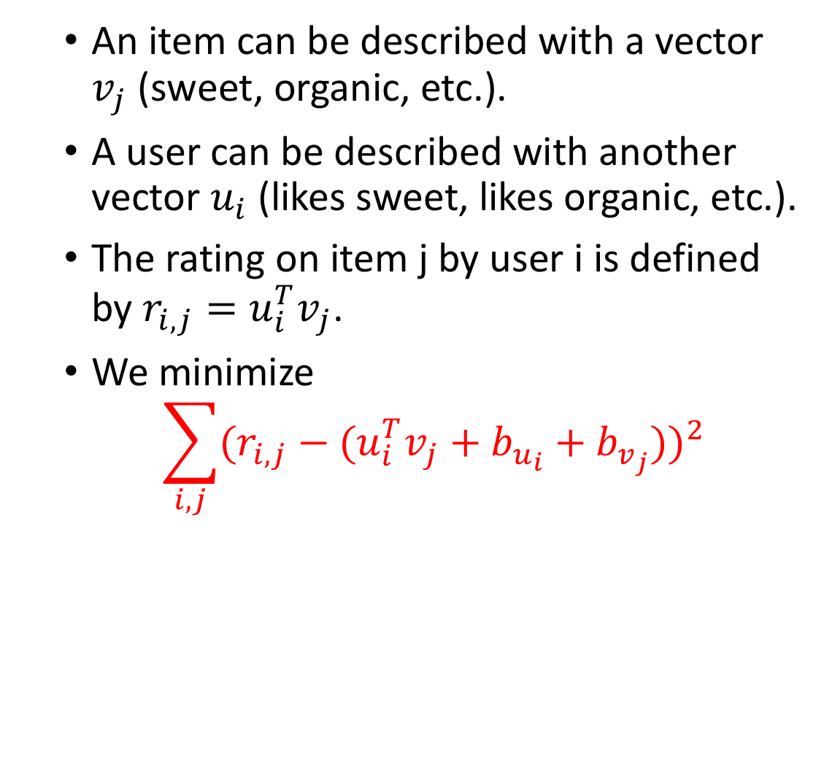
Latent User / Item Representation
An item can be described with a vector $v_{j}$ (sweet, organic, etc.).
A user can be described with another vector $u_{i}$ (likes sweet, likes organic, etc.).
The rating on item j by user i is defined by $r_{i,j}=u_{i}^{T}v_{j}$.
We minimize
$$\sum_{i,j}{{(r_{i,j}−(u_{i}^{T}v_{j}+b_{u_{i}}+b_{v_{j}}))}^{2}}$$

Slide 6
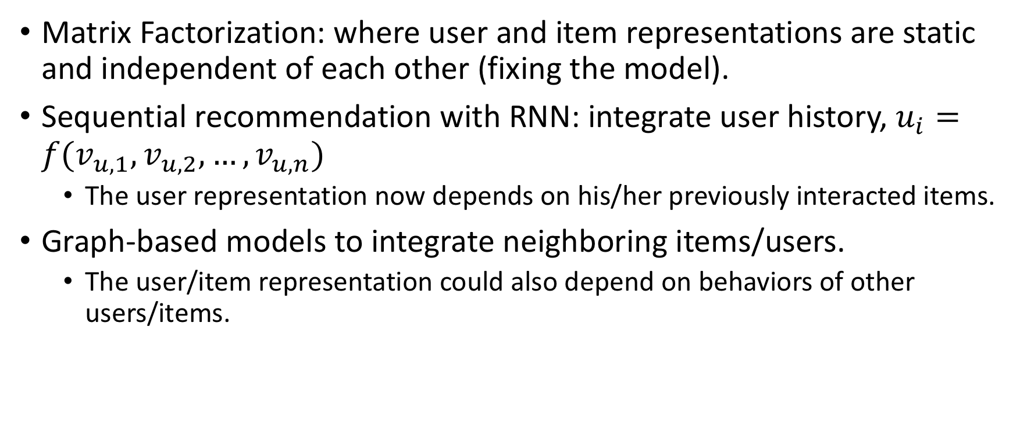
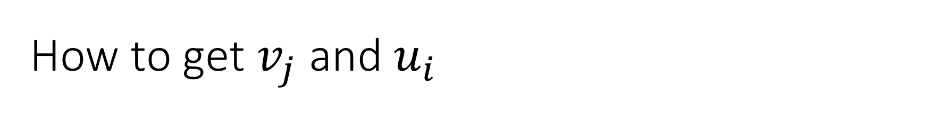
How to get $v_{j}$ and $u_{i}$
Matrix Factorization: where user and item representations are static and independent of each other (fixing the model).
Sequential recommendation with RNN: integrate user history, $u_{i}=f(v_{u,1},v_{u,2},…,v_{u,n})$
The user representation now depends on his/her previously interacted items.
Graph-based models to integrate neighboring items/users.
The user/item representation could also depend on behaviors of other users/items.

Slide 7
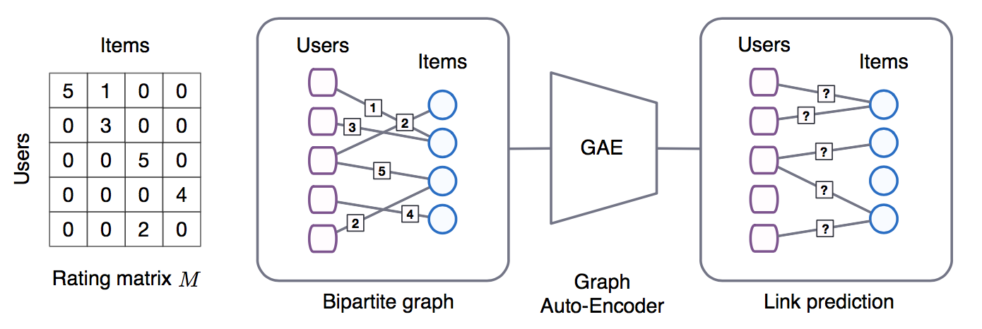
A graph view for recommendation
Source: Graph Convolutional Matrix Completion, van den Berg et al. 2017

Slide 8
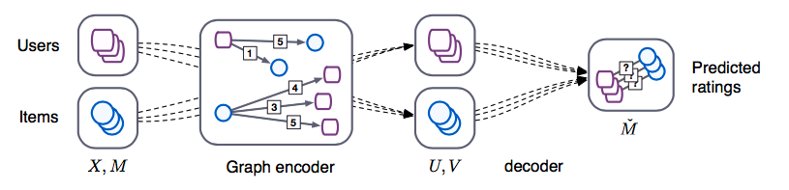

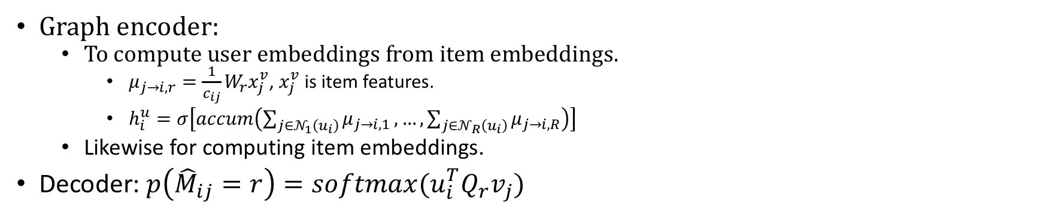
GCMC: Learning $v_{j}$ and $u_{i}$ from User-Item Graph
Source: Graph Convolutional Matrix Completion, van den Berg et al. 2017
Graph encoder:
To compute user embeddings from item embeddings.
$μ_{j→i,r}=\frac{1}{c_{ij}}W_{r}x_{j}^{v}$, $x_{j}^{v}$ is item features.
$h_{i}^{u}=σ\left[accum\left(\sum_{j∈𝒩_{1}\left(u_{i}\right)}{μ_{j→i,1}}, …,\sum_{j∈𝒩_{R}\left(u_{i}\right)}{μ_{j→i,R}}\right)\right]$
Likewise for computing item embeddings.
Decoder: $p\left({\hat{M}}_{ij}=r\right)=softmax(u_{i}^{T}Q_{r}v_{j})$

Slide 9
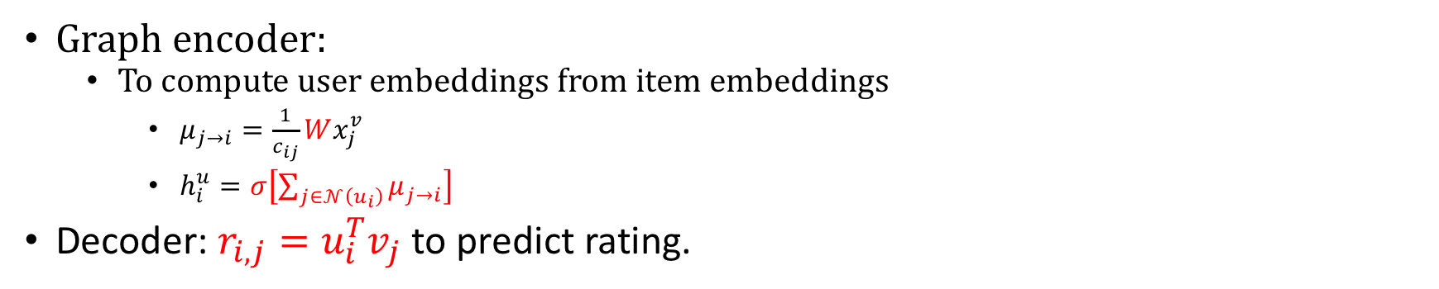
Simplifying GCMC to GraphSAGE
Source: Graph Convolutional Matrix Completion, van den Berg et al. 2017
Graph encoder:
To compute user embeddings from item embeddings
$μ_{j→i}=\frac{1}{c_{ij}}Wx_{j}^{v}$
$h_{i}^{u}=σ\left[\sum_{j∈𝒩\left(u_{i}\right)}{μ_{j→i}}\right]$
Decoder: $r_{i,j}=u_{i}^{T}v_{j}$ to predict rating.

Slide 10
Code session
GraphSAGE on bipartite user-item graph.

