Slide 1
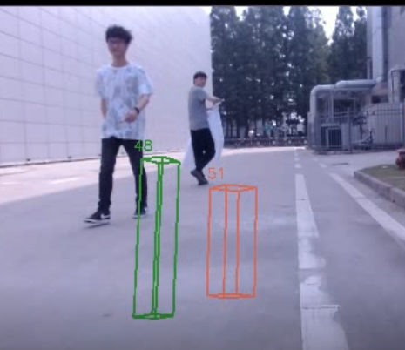
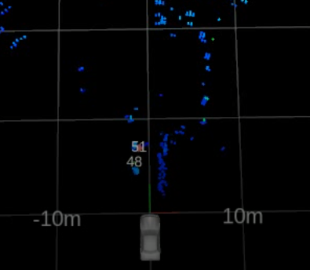
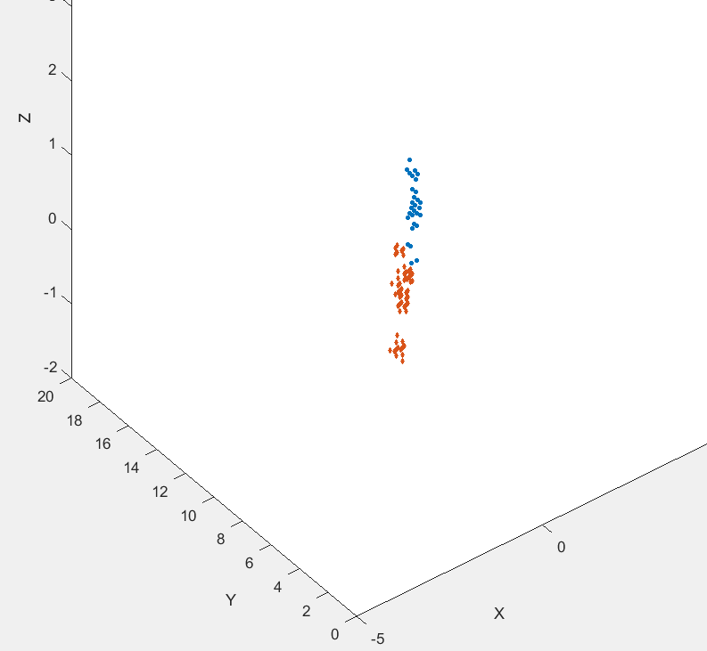
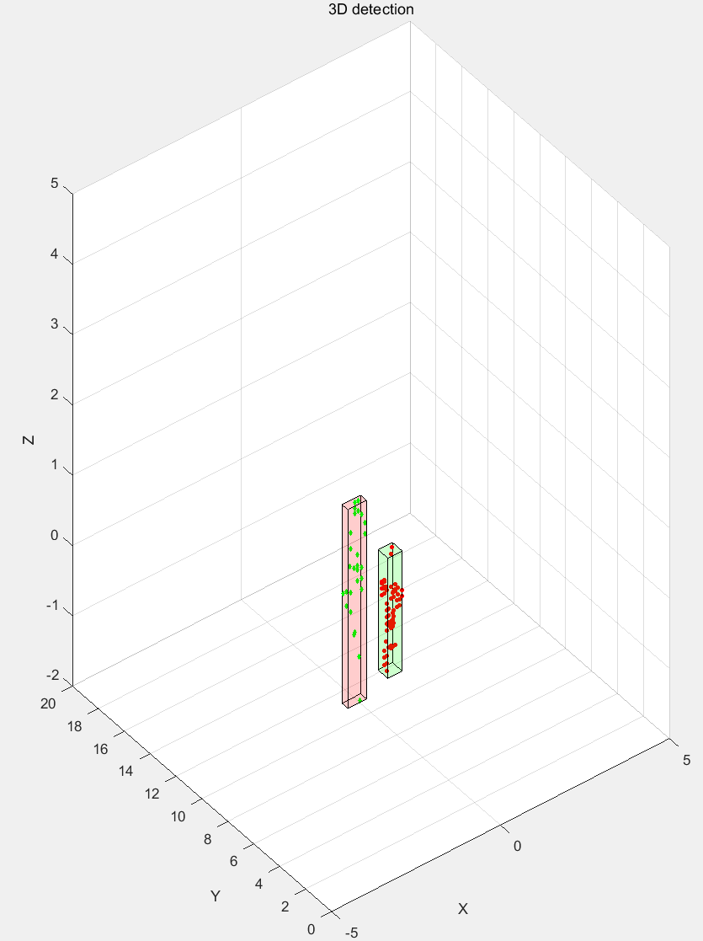
data collection
point cloud generation
denoising & clustering
tracking & identification
person1
person2

Slide 2
initialize tracks
get detections
Hungarian
algorithm
tracks assignment
correct
tracks
Kalman Filter
update
tracks
tracks
end

Slide 3
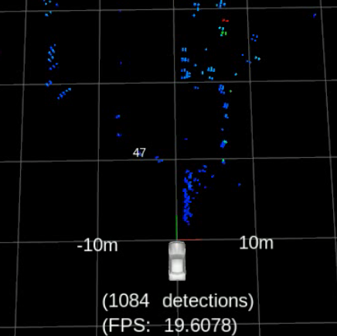
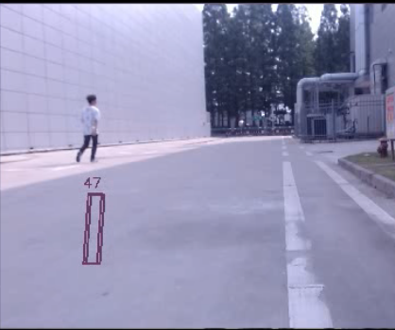
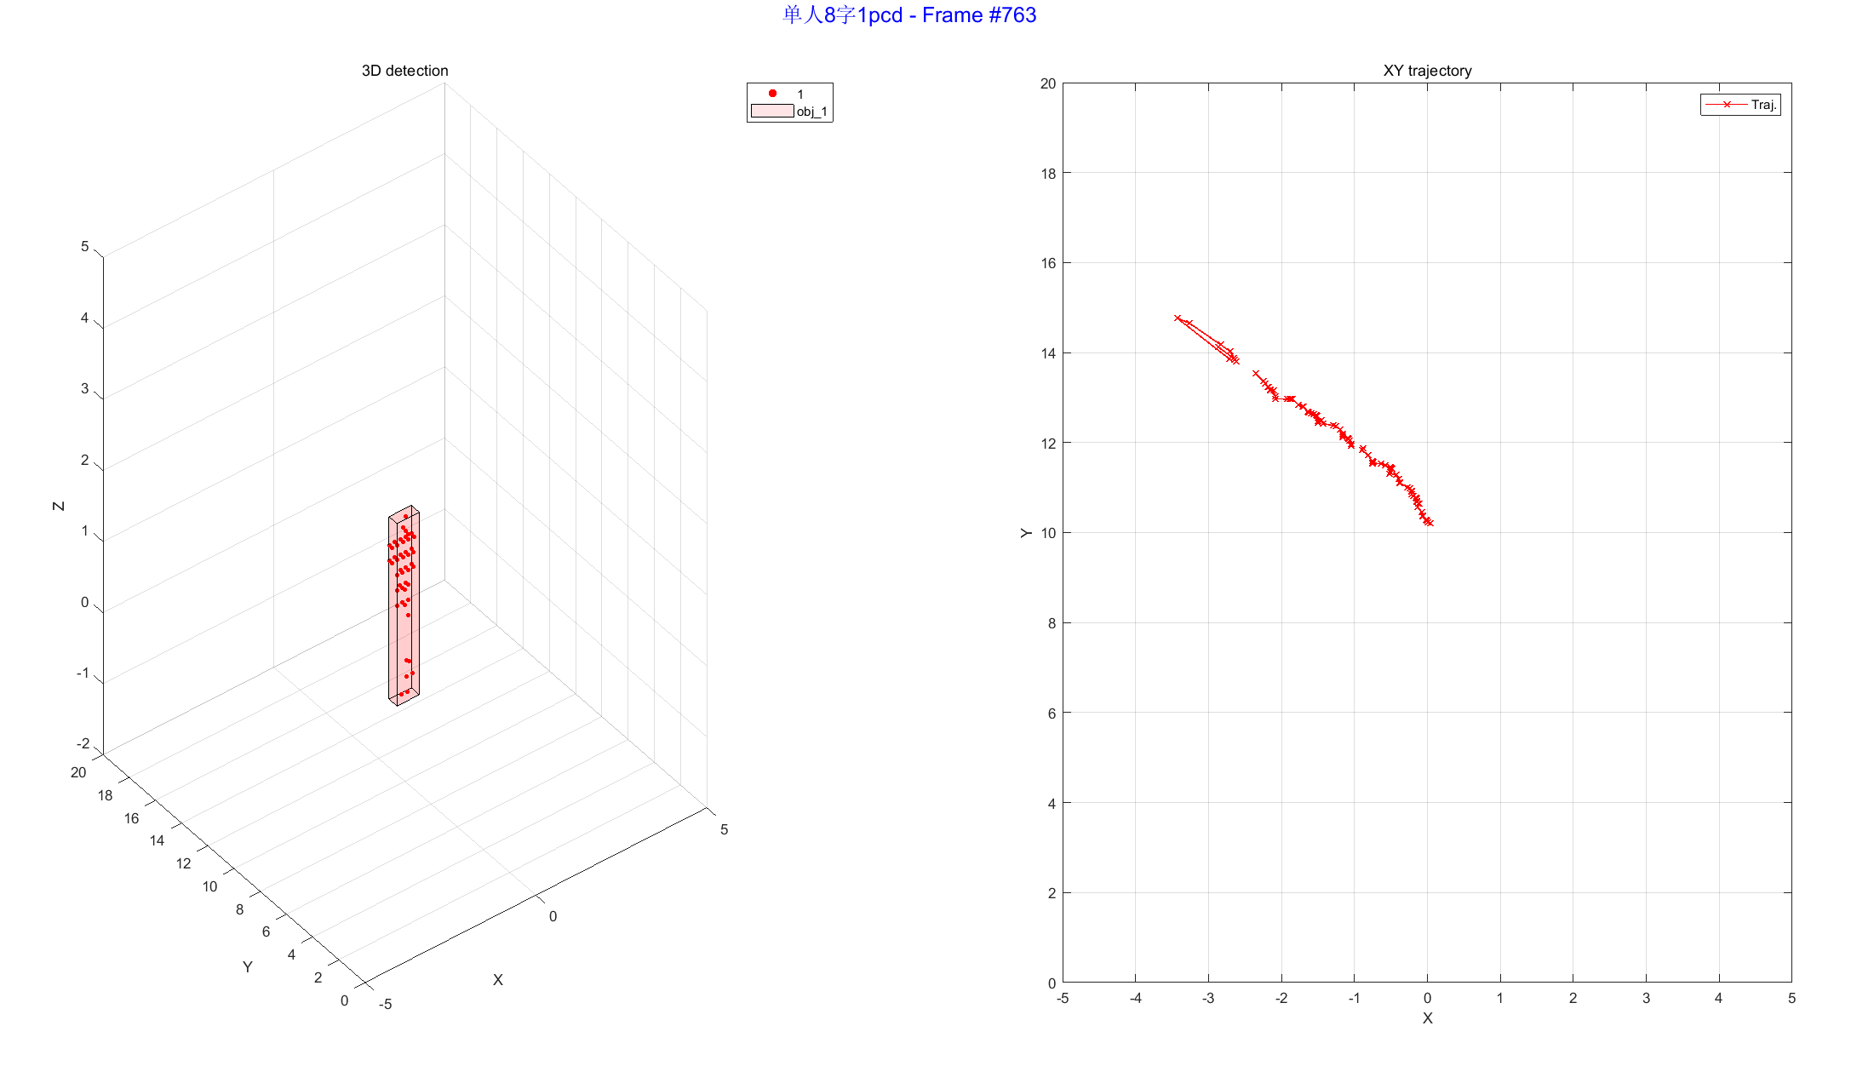

Slide 4
