Slide 1
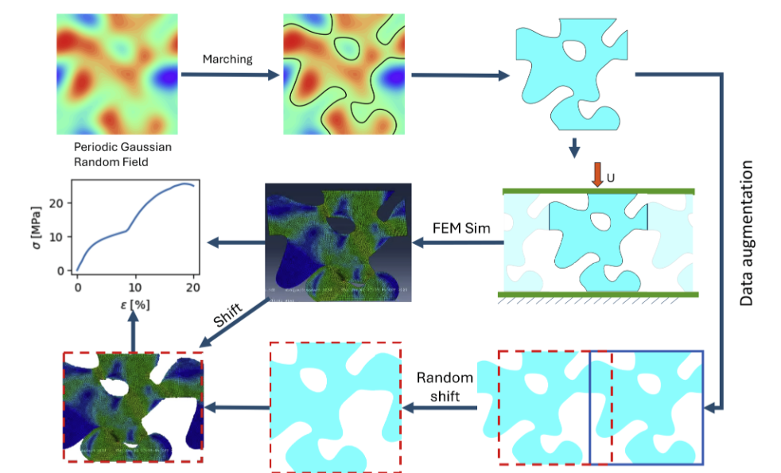
Visual Autoregressive Models for Inverse Design
1. Problem
The inverse design of metamaterial unit cells aims to generate geometries that achieve a target stress–strain response.
The current framework uses diffusion models to generate Signed Distance Function (SDF) representations of metamaterial geometries conditioned on the desired mechanical behavior.
However, diffusion models require many denoising steps during sampling, making generation relatively slow and computationally expensive.
2. Proposed Approach
Replace the diffusion model used for inverse design with a VAR generative model.
3. Evaluation Strategy
Generated designs will be evaluated using the same closed-loop framework used in the original paper:
Forward surrogate model (Neural Operator Transformer) predicts the stress–strain curve of generated geometries.
Compute L₂ relative error between the target stress–strain curve and predicted curve.
Validate top designs using finite element simulations (FEM).

Slide 2
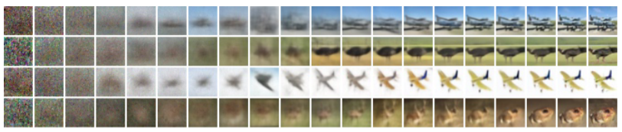
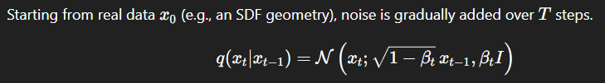
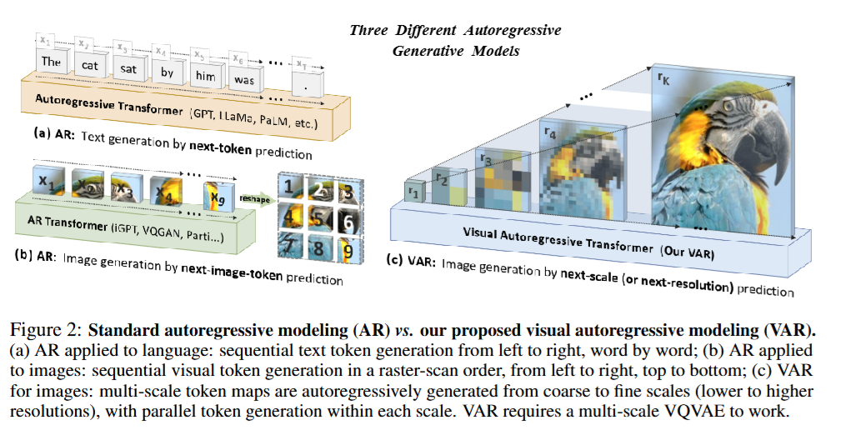
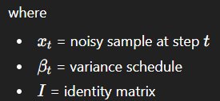
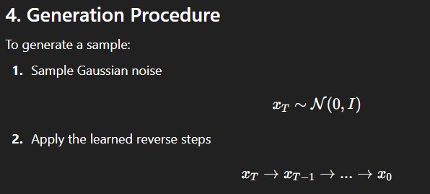
Visual Autoregressive Models for Inverse Design
Diffusion models are generative models that learn to generate data by reversing a gradual noise process.
Forward process: progressively corrupt data with Gaussian noise.
Reverse process: train a neural network to remove the noise step-by-step to reconstruct the data.

