Slide 1
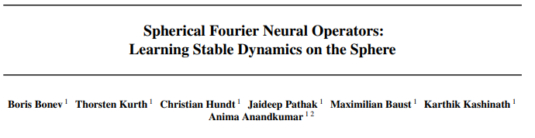
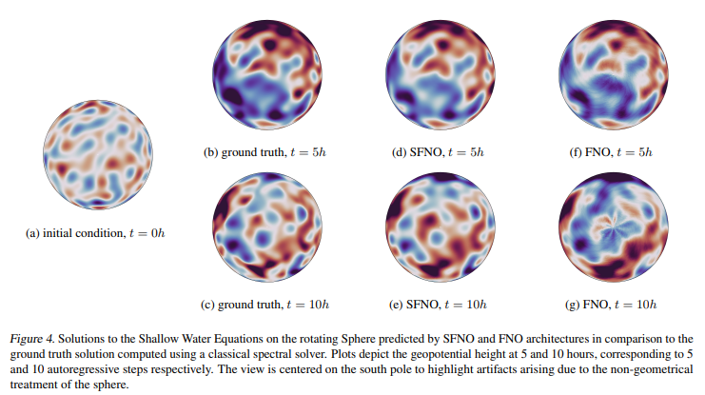
How to model planetary fluids with the use of ML: Spherical Fourier Neural Operators
what is the problem
What is SFNO and how does it work?
How does mapping work from regular FNO to SFNO?
How are temporal info stored at each grid point and across grid point?
To what point would SFNO break and no longer hold for SWE?
what approach do you plan to take
Use torch-harmonics code to implement a toy SFNO to solve Shallow Water Equation (representative of a majority of atmospheric and oceanic fluids - sea surface temperatures)
Evaluation
Reproduce Results from Bonev et al. 2023
Check outcome with changes to hyperparameters
reflection and stretch goals
Stretch Goals - compare with DeepONets

