Slide 1
059 CRAWL PSA Code Sprint 2023
Foo Chuan Shao, Sim Wang Lin, Raymond Harrison, Sean Ang

Slide 2
Executive Summary
Problem statement: How can digital solutions powered by data and AI optimize demand and supply to increase resilience of the port amidst global disruptions and risks?
In the face of increasing global disruptions and risks, leveraging machine learning and advanced algorithms presents a transformative opportunity to enhance the resilience of our port operations. By harnessing the power of data and AI, we can optimize demand and supply dynamics, ensuring efficient resource allocation, minimizing disruptions, and fortifying our ability to adapt in an ever-changing environment. This strategic approach promises to bolster the port's competitiveness, reliability, and sustainability, ultimately safeguarding its vital role in global trade.

Slide 3
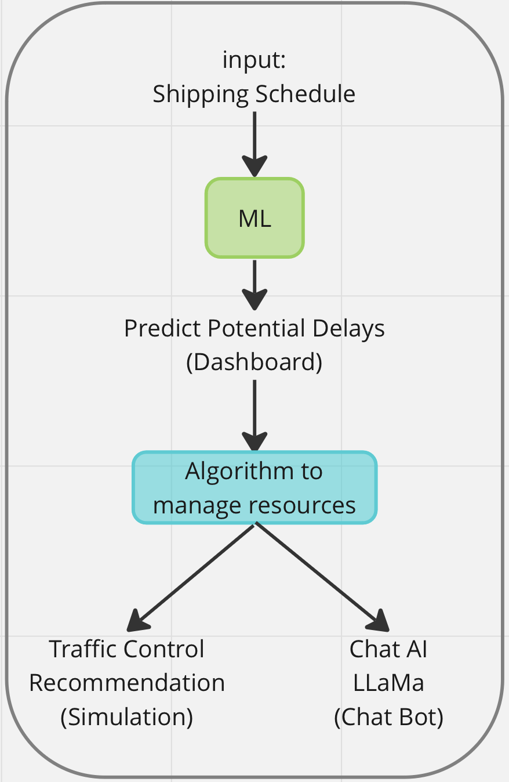
Our Product
We understand that demand-supply management within the port ecosystem of PSA is crucial for its efficiency; therefore we have come up with a solution that manages the sources of this problem
Container vessels get delayed, and berth timings get thrown off. To know the chances of these instances happening, we employ ML to determine when a ship is likely to be delayed
The algorithm developed also allows the plotting of ship routes when the ship gets delayed to maximise the efficiency of the port

Slide 4
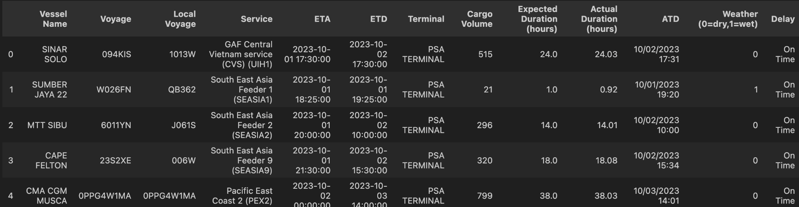
Data Collection for Training AI
Collected Data from CMA CGM
Mocked Data
Mocked Weather: 30% Wet, 70% Dry
Mocked Delay: 20% delay, 80% on time. Amongst all the delayed entry, 70% happens during wet weather
Mocked Cargo Volume/hour: Normal distribution. For on time: N(20, 1) for delayed: N(23, 1)
Mocked Duration: On Time: ± 5 minutes of Expected Duration. Delayed: + 30 to 120 minutes of Expected Duration

Slide 5
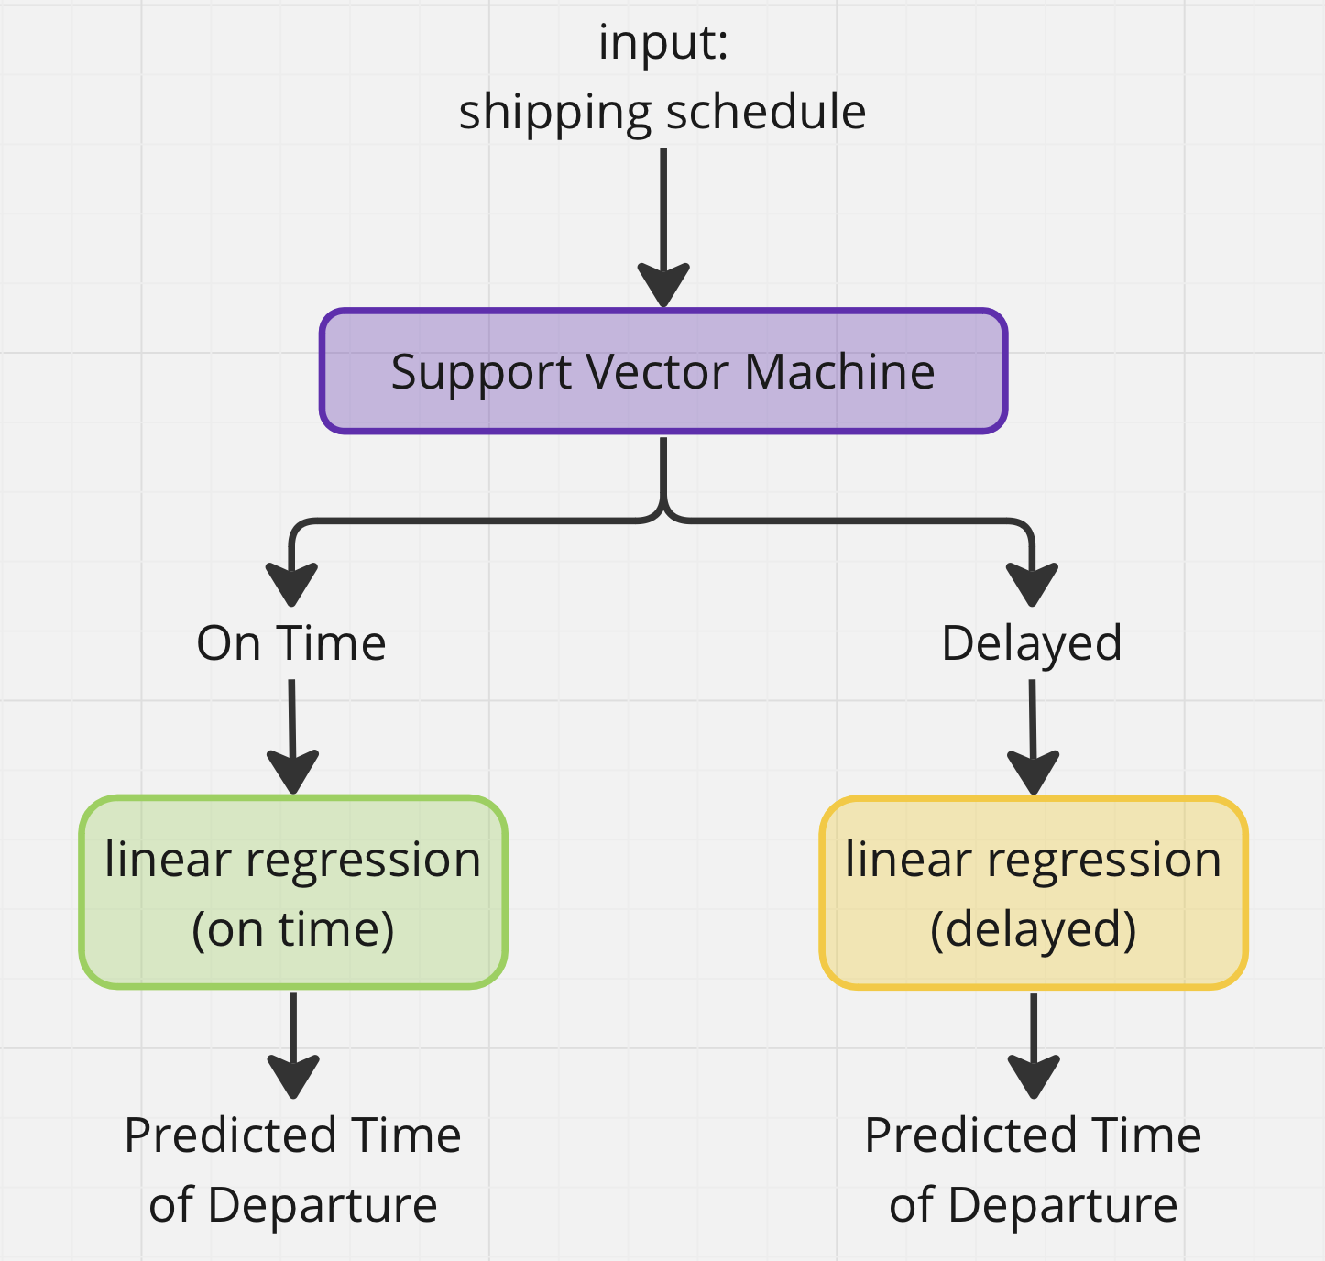
ML Model Architecture:
ML model performance
Support Vector Machine Confusion Matrix:
TP = 174 | FN = 4
FN = 12 | TN = 31
SVM able to Predict 31 Out of 43 Delayed Ships!
On Time Linear Regression:
RMSE = 0.048 hours
Model able to predict departure time of on time ships accurate to 2.9 minutes on average!
Delayed Linear Regression:
RMSE = 0.51hours
Model able to predict departure time of delayed ships accurate to 30.6 minutes on average!

Slide 6

ChatAI LLaMA
The AI space in today’s world largely revolves around increasing productivity of its users such as CoPilots
We have decided to also integrate this into our solution utilising ChatAI LLaMA

Slide 7

Algorithm
Given the timings and coordinates of shipping routes, optimization of these were also imperative to tackling the problem statement
Developed an algorithm to optimize the port efficiency taking delayed vessels into account

Slide 8

Backend
Backend was done using Python Flask
Accepts HTTP requests with CSV file and processes the data using ML model and Algorithm
Returns processed data in JSON format as HTTP response

Slide 9
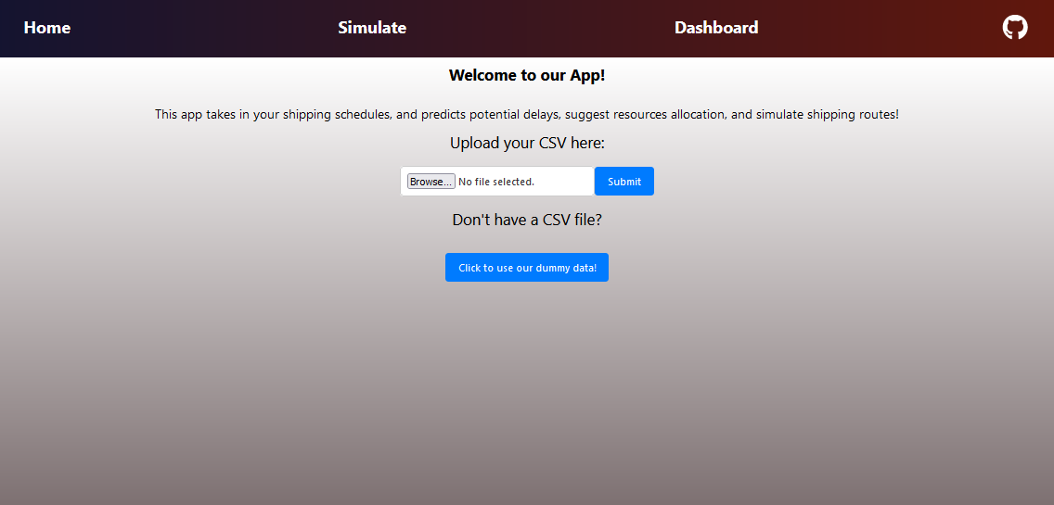
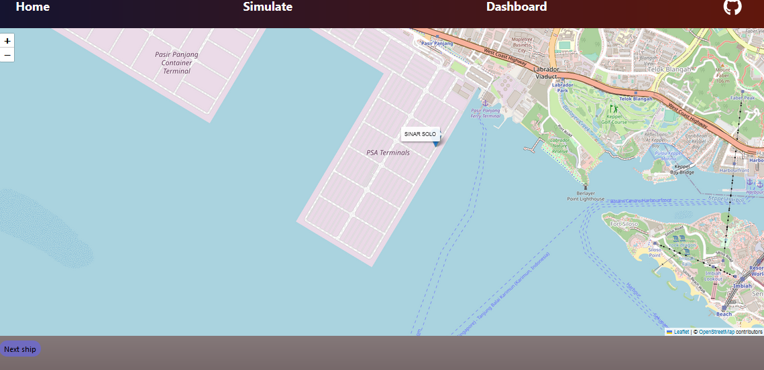
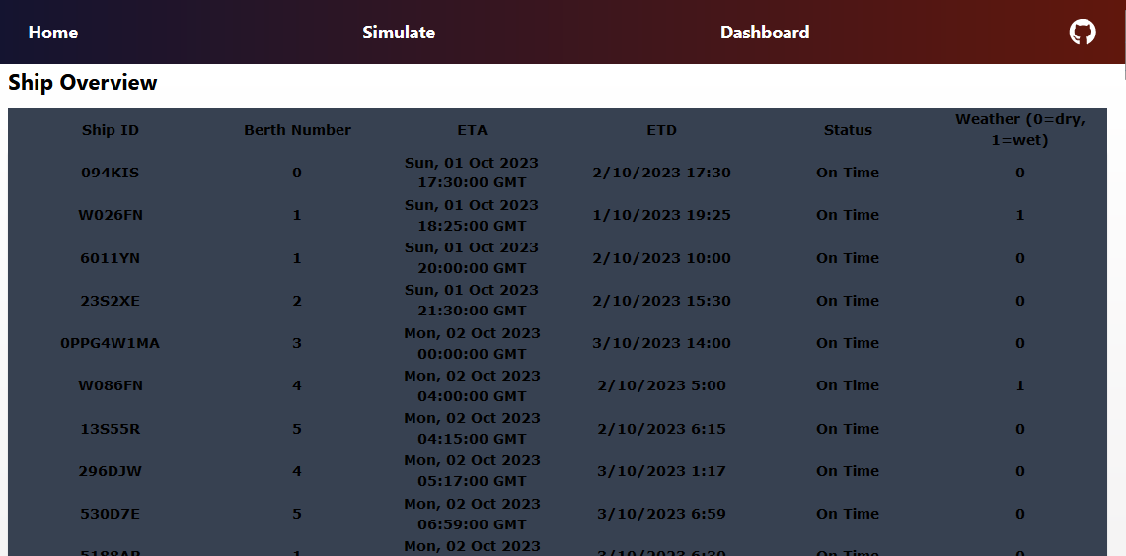
Frontend
Frontend was done using NextJS
Takes in a CSV file and allows the user to:
Simulate shipping routes off timestamps in the file uploaded
See an overview of all the ships

Slide 10
APP DEMO
Link to repo:
https://github.com/orgs/59CRAWL/repositories

