Slide 1
SQL Query Parser
Team 03
20175020 Doyoung Kim
20175068 Sejin Park
20185159 YunJae Heo

Slide 2
CONTENTS
01
02
03
04
Introduction
Implementation
Demonstration
Conclusion

Slide 3
CONTENTS
01
02
03
04
Introduction
Implementation
Demonstration
Conclusion
Project Scope
SQL SELECT
Example Statement
Limitation
How to?
SQL UPDATE
Demonstration
To-do list
Tools Used

Slide 4
01
Introduction of SQL query

Slide 5

01.
Introduction
What is SQL query?
SQL is shorten of ‘Structured Query Language’
Widely-used programming language for working with relational databases
Query is a request to access data from a database to manipulate it or retrieve it
To make a request, SQL provides keywords of statements such as select, update, insert, delete
Notes:
SQL is shorten of Structured Query Language
Which is the widely used programming language to control database.
In SQL we gives ‘query’ which is the request to of user to databse to access data that user wants
To make query sql offer some keywords such as select, update, insert, delete and etc

Slide 6
01.
Introduction
SELECT & UPDATE statement
Select
SELECT is the most common operation in SQL which retrieves data from one or more tables, or expressions.
SELECT queries allow the user to describe desired data, leaving the database management system (DBMS) to carry out planning, optimizing, and performing the physical operations necessary to produce that result as it chooses.
SQL has some optional keywords and clause to make right request to get data that user desired which are FROM, WHERE, GROUP BY, HAVING, ORDER BY, DISTINCT
UPDATE
UPDATE is used to modify the existing records in a table
UPDATE statement usually has the following form,
UPDATE table_name SET column_name = value [, column_name = value ...] [WHERE condition]
When using UPDATE, it is necessary to set the row you want to modify using keyword WHERE. Otherwise, the data for the entire column will be changed.
Notes:
Select is the most common operation in sql.
User can get certain datas in database using select
Select allow user to describe desired datas, with some keywords like FROM, WHERE, GROUP bY HAVING ORDER BY DISTINCT
Update is used to modify existing records
Normally UPDATE statement consists of UPDATE, SET, and WHERE.
When using UPDATE, it is necessary to set the row you want to modify using keyword WHERE. Otherwise, the data for the entire column will be changed.

Slide 7
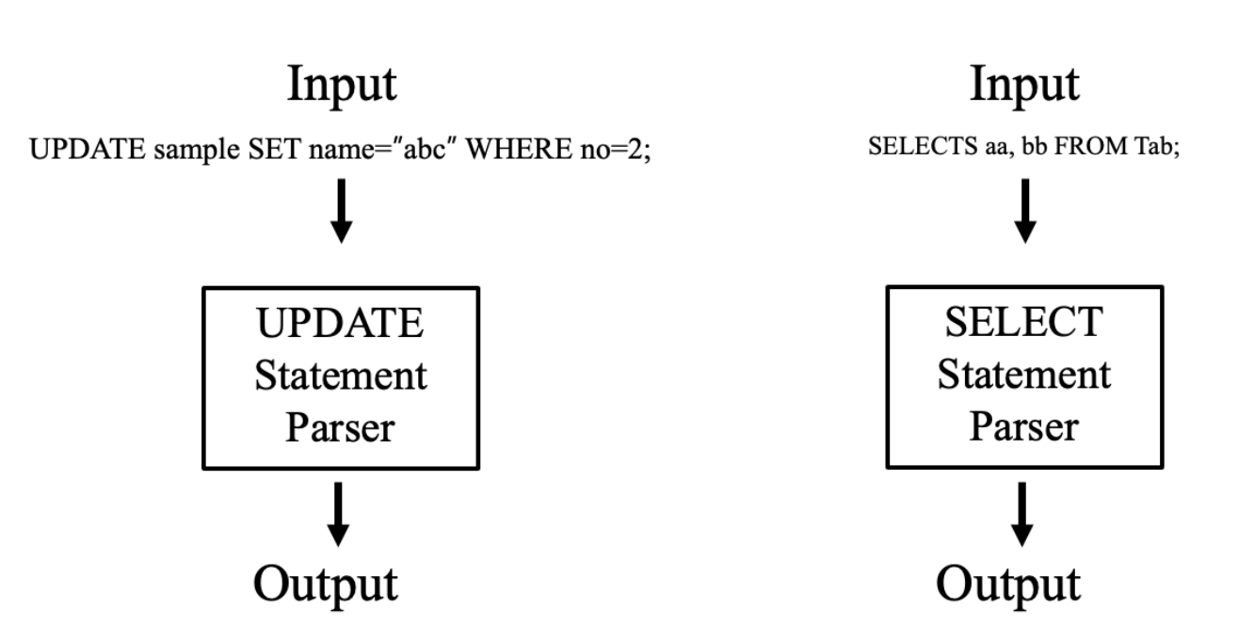
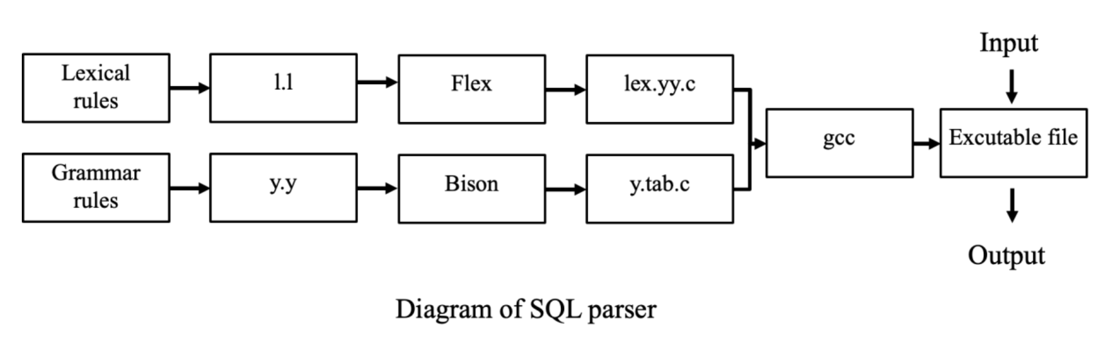
01.
Introduction
Scope of project
Make parser of SQL SELECT statement that can parse own conditions, group by, order by
Make parser of SQL UPDATE statement that can cover not only keyword UPDATE but also it's conditions
How to?
Diagrams of Our Project
Notes:
Our scope of this project is
Making parser of SQL SELECT and UPDATE parser that can understand with their whole keywords of conditions
To do,
We used bison and flex which is yacc and lex written in C language
And this is the diagrams of our project.

Slide 8
02
Implementation

Slide 9
02.
Implementation
Lex Basic Implement
Lex variables | Grammar
id | [A-Za-z_]+[A-Za-z0-9_]*
backticks_id | [`][A-Za-z_]+[A-Za-z0-9_ ]*[`]
digit | [0-9]
number | {digit}+(\.{digit}+)?
string_literal | (['](\\\'|[^'])*[‘]) | (["](\\\"|[^"])*["])
Notes:
First, before writing lex,
we wrote basic variables according to the rules.
In this way, identifier, digit, number and string
can be easily expressed in the lex grammar below.

Slide 10
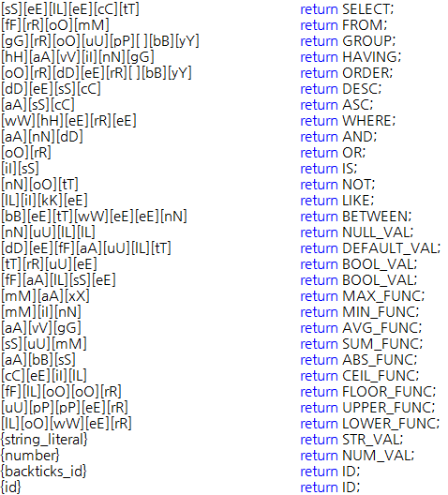
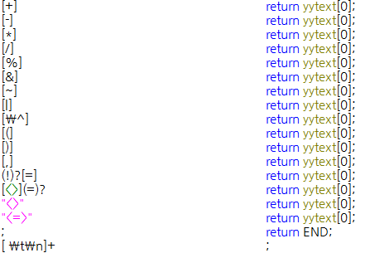
02.
Implementation
SELECT - Lex
Notes:
Commands that are basically used in queries are implemented as tokens one by one.
Of course, it is case insensitive.
Next, we pass both kinds of identifier as the same token to the parser.
Strings and numbers are also passed.
In the case of the operator, we decided to pass it as is and cover it with yacc.
Operators using in sql also added.
After checking all tokens, the last unclassified character will cause a lexical error.

Slide 11
02.
Implementation
SELECT - Yacc
start -> SELECT dist attributList FROM tableList clause group order END
dist -> DISTINCT | ε
attributList -> ID’,’ attributList | ‘*’ | ID
tableList -> ID’,’ tableList | ID
clause -> WHERE where_stmt | ε
where_stmt -> condition | condition AND condition | condition OR condition | ID BETWEEN value AND value
| ID BETWEEN value OR value | ID NOT BETWEEN value AND value
| ID NOT BETWEEN value OR value | ID LIKE STR_VAL | ID NOT LIKE STR_VAL
condition -> ‘(’ where_stmt ‘)’ | ID rel_op value | ID IS is_val | ID IS NOT is_val | NOT ID rel_op value
rel_op -> ‘=’ | ‘!’’=’ | ‘<’’>’ | ‘<’ | ‘>’ | ‘>’’=’ | ‘<’’=’ | ‘<’’=’’>’
Notes:
When a string is input to yacc, it moves to start.
It recognizes the SELECT command first.
Since then, it accepts various commands.
attributList and tableList are a series of identifiers.
clause expresses WHERE statement.
By writing the conditional statement as several separated rules,
various conditional statements can be recognized.

Slide 12
02.
Implementation
SELECT - Yacc
value -> NULL_VAL next_val | STR_VAL next_val | BOOL_VAL next_val | | MAX_FUNC '(' func_value ')' next_val
| MIN_FUNC '(' func_value ')' next_val | AVG_FUNC '(' func_value ')' next_val
| SUM_FUNC '(' func_value ')' next_val | ABS_FUNC '(' func_value ')' next_val
| CEIL_FUNC '(' func_value ')' next_val | FLOOR_FUNC '(' func_value ')' next_val
| UPPER_FUNC '(' func_value ')' next_val | LOWER_FUNC '(' func_value ')' next_val
next_val -> arith_op value | ε
is_val -> BOOL_VAL | NULL_VAL
func_value -> value | ID
pre_num -> ‘+’ pre_num | ‘-’ pre_num | ‘~’ pre_num | ε
arith_op -> ‘+’ | ‘-’ | ‘*’ | ‘/‘ | ‘%’ | ‘&’ | ‘|’ | ‘^’
group -> GROUP attributList having | ε
order -> ORDER attributList da | ε
having -> HAVING condition | ε
da -> DESC | ASC | ε
Notes:
Value consists of one or more connections between functions and various types of values.
value supports various expansions either internally or to the right.
It’s suitable for various conditional statements.
- Pre number means literaly a pre number operator. ~(Tilt) -> -(n+1) and ~~(double tilt) -> floor()

Slide 13
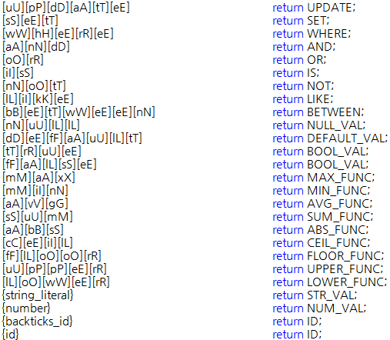
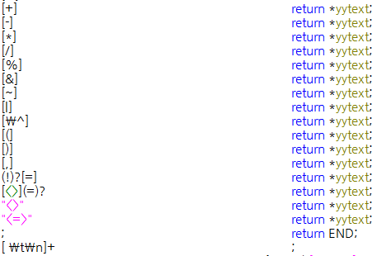
02.
Implementation
UPDATE - Lex
Notes:
The lex of update is similar to select.
However, some commands used only in select have been deleted
and update related commands have been added.

Slide 14
02.
Implementation
UPDATE - Yacc
start -> UPDATE ID SET columns clause END
columns -> ID ‘=’ col_val ‘,’ columns | ID ‘=’ col_val
col_val -> value | DEFAULT_VAL
value -> NULL_VAL next_val | STR_VAL next_val | BOOL_VAL next_val | pre_num NUM_VAL next_val
| MAX_FUNC '(' func_value ')' next_val | MIN_FUNC '(' func_value ')' next_val
| AVG_FUNC '(' func_value ')' next_val | SUM_FUNC '(' func_value ')' next_val
| ABS_FUNC '(' func_value ')' next_val | CEIL_FUNC '(' func_value ')' next_val
| FLOOR_FUNC '(' func_value ')' next_val | UPPER_FUNC '(' func_value ')' next_val
| LOWER_FUNC '(' func_value ')' next_val
pre_num -> '+' pre_num | '-' pre_num | '~' pre_num | ε
next_val -> arith_op value | ε
func_value -> value | ID
arith_op -> ‘+’ | ‘-’ | ‘*’ | ‘/‘ | ‘%’ | ‘&’ | ‘|’ | ‘^’
Notes:
When a string is input to yacc, it moves to start.
Than, UPDATE, ID, SET token will be accepted.
After that, update will recognize columns and clause value.
columns consist of a set of one or more ‘identifier equal column value' expressions.

Slide 15
02.
Implementation
UPDATE - Yacc
clause -> WHERE where_stmt | ε
where_stmt -> condition | condition AND condition | condition OR condition | ID BETWEEN value AND value
| ID BETWEEN value OR value | ID NOT BETWEEN value AND value
| ID NOT BETWEEN value OR value | ID LIKE STR_VAL | ID NOT LIKE STR_VAL
condition -> ‘(’ where_stmt ‘)’ | ID rel_op value | ID IS is_val | ID IS NOT is_val | NOT ID rel_op value
is_val -> BOOL_VAL | NULL_VAL
rel_op -> ‘=’ | ‘!’’=’ | ‘<’’>’ | ‘<’ | ‘>’ | ‘>’’=’ | ‘<’’=’ | ‘<’’=’’>’
Notes:
clause expresses WHERE statement.
This part is same with select yacc.

Slide 16
03
Demonstration
Notes:
Then I'll show you the demo.

Slide 17
03.
Demonstration
Diagram
Valid Query
Lexical Error
Lexical error occurred in SELECT
Notes:
The operation is performed as shown in the following diagram. First, we receive input from the user.
Outputs whether such inputs are valid or error. Our team made parsers for SELECT UPDATE, respectively.
As shown in the figure, when something like this enters to update parser as an input, it outputs a "Valid Query" message.
And, when something like this enters to Select parser as an input, it outputs a ”Lexical Error" message, Because input has a miss speling in the select.

Slide 18
03.
Demonstration
Example
Select
Select a from b;
Select * from b;
Select a from b where c=5;
Select a from b where c=5 group by d;
Select a from b where c=5 group by d having e=2;
Select a from b where c=5 group by d having e=2 order by * asc;
Select a from b where c=5 group by d having e=2 order by * desc;
Update
Update a set b=5;
Update a set b=5, c=6;
Update a set b=5 where b=0;
Update a set b=5 where b is null;
Update a set b=5 where b is not null;
Update a set b=5 where c=1 and d=2;
Update a set b=5 where c=1 or d=2;
Update a set b=lower(b), c=upper(c), d=min(d), e=max(e);
Notes:
This are an example for update, select query.
When the user inputs the following, the parser outputs whether the input is valid or if there is an error and where it is.

Slide 19
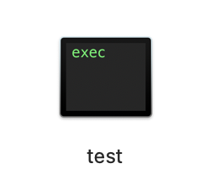
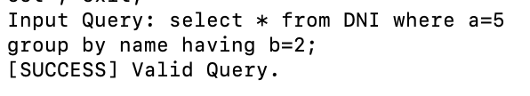
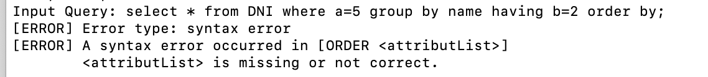
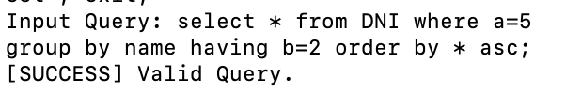
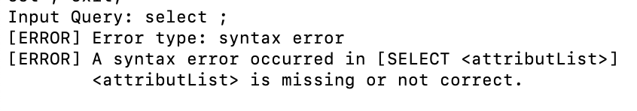
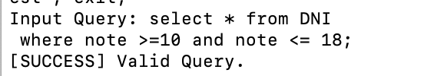

03.
Demonstration
SELECT
SELECT
Example of Demonstration SQL SELECT
Notes:
this are Demonstrations of SQL SELECT
The left side are valid cases, and the right side are error cases.
(Enter input has also been implemented effectively.)
The first error is a syntax error. The appropriate input was not entered after "order by".
Second case is syntax error case by no efficient token after select
And last one is a lexical error case by miss spelling in select.

Slide 20
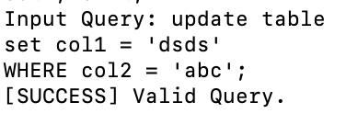
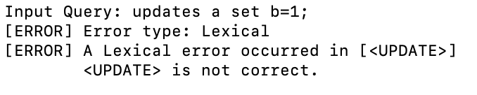
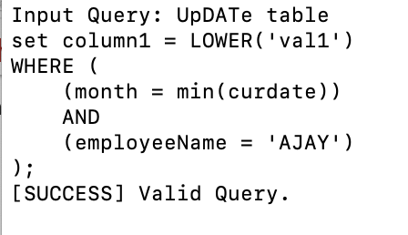
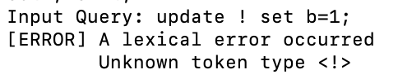
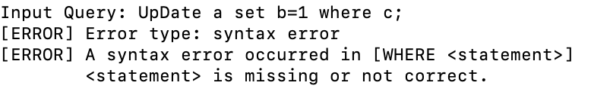
03.
Demonstration
UPDATE
UPDATE
Example of Demonstration SQL Update
Notes:
this are Demonstrations of SQL update
Like the previous slide, The left side are valid cases, and the right side are error cases too.
The first error case is lexical error by miss spelling in update
Second error case is syntax error by unexpected input ‘Exclamation mark’
Last case is syntax error by the wrong statement. After where, user must enter condition statement.
I will show you demonstration now.
이거 보여주고 바로 프로그램 실행으로 보여주기

Slide 21
04
Conclusion

Slide 22
04.
Conclusion
Limitation
SELECT parser and UPDATE parser are separated
Failed to resolve some errors related to epsilon transitions due to lack of understanding of the yyerror function
Failed to keep the program working even if an error occurred
Checked only the message that the program succeeded in parsing, but did not semantically check whether parsing was actually successful
To do
Concat SELECT parser and UPDATE parser
Understand yyerror function and do more elaborate error handling
Do semantic analysis for the parser
Notes:
We've almost successfully built SELECT and UPDATE parsers.
However, there are still some limitations.
Select parser and Update parser are separated
And also it is hard to understand yyerror function we failed to control error of epsilon transitions in some case
Also our program shut down if error occurred
and We didn’t check the result semantically, we just checked the validation messages and error message.
So for future works
We can concat select and update parser
And study about yyerror function and make error handling part more elaborated
lastly, Do semantical analysis for parser

Slide 23
Thank you
Thanks for attention

Slide 24
Reference
https://ko.wikipedia.org/wiki/SQL
https://namu.wiki/w/SQL?from=Structured%20Query%20Language
https://en.wikipedia.org/wiki/Select_(SQL)
https://en.wikipedia.org/wiki/Update_(SQL)

