Slide 1
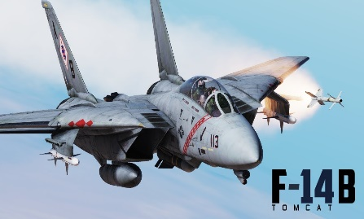
JTFF – VF84-203 Gemini
DCS F14-pilot mappings
Version 0.5.9-snapshot
HOOK BYPASS FIELD
up
MASTER ARM ON
HOOK BYPASS CARRIER
down
MASTER ARM OFF
TRIM DOWN
Push up
TRIM LEFT
TRIM RIGHT
Taxi lights On
center
STORE RELEASE
HCU Full Action
Taxi lights off
down
ACM JETT.
Push up
TRIM UP
ACM ON
center
DISPLAY MODE PREVIOUS
VSL HIGH
ILS ON
ACM OFF
down
CAGE SEAM
Toggle AFCS Pitch
FLAPS UP
up
ILS CHANEL DECREASE
TARGET DESIGNAT PAL
ILS CHANEL INCREASE
PLM BUTTON
UP
ILS OFF
down
DLC Axis
FLAPS DOWN
MR
DLC Axis
DISPLAY MODE NEXT
VSL LOW
Lantirn slew UP
WEAPON SELECTOR OFF
DN
MASTER RESET
MASTER CAUTION RESET
Lantirn slew LEFT
SPARROW/PHOENIX
Lantirn slew RIGHT
SIDEWINDER
GEARS UP
AUTOPILOT VEC/PCD
up
Lantirn slew DOWN
GUNS
GEARS DOWN
VECTOR OFF
center
STEER CMD DESTINATION
ACL
down
STEER CMD TACAN
STEER CMD AWL/PCD
HOOK UP
HOOK DOWN
AUTOPILOT TOGGLE
ICS PTT
STEER CMD VEC
STEER CMD MAN
KNEEBRD PREV PAGE
ALTITUDE HOLD ON
---
---
---
159 COMM MENU
A/G mode
A/G mode 2
KNEEBRD ON/OFF
182 COMM MENU
Normal mode
Normal mode 2
SRS 1 PTT
WING SWEEP AUTO
KNEEBRD NEXT PAGE
ALTITDUE HOLD OFF
VDI mode Norm/TV
AUTO THROTTLE
COMM MENU 182
WING SWEEP AFT
ICS PTT
WING SWEEP FWD
SRS 2 PTT
WING SWEEP BOMB
JESTER MENU
FIRE
forward
SPEED BRAKE EXTEND
back
SPEED BRAKE RETRACT
NWS ENGAGE/ AP REFERENCE
forward
SPOILER BOTH
HEADING HOLD ON
MASTER LIGHTS ON
center
SPOILER OFF
HEADING HOLD OFF
MASTER LIGHTS OFF
mode 2
back
SPOILER BK
TERRAIN HOLD
forward
DLC FORWARD
DLC TOGGLE
back
DLC AFT
DLC TOGGLE

