Slide 1
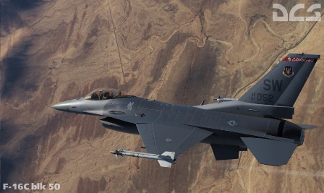
31st Gemini
DCS F16 mappings
Version 0.4,0-snapshot
---
up
CAT 1
---
down
CAT 3
TRIM DOWN
DED UP
A/G Mode
Push up
TRIM LEFT
DED RTN
TRIM RIGHT
DED SEQ
MMC-STSTA-MFD-UFC-GPS-DL-MIDS
ON
center
WPN REL
UNCAGE
MMC-STSTA-MFD-UFC-GPS-DL-MIDS
OFF
down
TRIM UP
DED DOWN
A/A Mode
Push up
HDPT-FCR-RDRALT
ON
center
TMS - UP
Zoom -
HDPT-FCR-RDRALT
OFF
down
NWS A/R DISC MSL STEP
PADLE DEPRESS
A/P ROLL – HDG SEL
UP
PROBE HEAT/OFF
TMS - LEFT
---
TMS - RIGHT
---
A/P ROLL – ATT HOLD
MR
RDR ELEVATION Axis
---
HMCS KNOB -
TMS - DOWN
Zoom +
---
HMCS KNOB +
A/P ROLL – STRG SEL
DN
DMS - UP
RDR CURSOR - UP
MASTER CAUTION RESET
BIT Switch
DMS - LEFT
RDR CURSOR - LEFT
DMS – RIGHT
RDR CURSOR - RIGHT
GEARS UP
A/P PITCH - ALT HOLD
up
DMS - DOWN
RDR CURSOR - DOWN
GEARS DOWN
A/P PITCH - A/P OFF
center
CMS FWD
Flood lights +
A/P PITCH - ATT HOLD
down
CMS LEFT
Panel lights -
CMS RIGHT
Panel lights +
RF NORM
RF QUIET
---
ICS PTT
CMS AFT
Flood lights -
---
---
KNEEBRD PREV PAGE
TRANSMIT IFF IN
AIR REFUEL – OPEN/CLOSE
START2
---
---
---
HDG KNOB CCW
LONG PRESS MODE 1
LONG PRESS MODE 2
KNEEBRD ON/OFF
HDG KNOB CW
Normal mode
Normal mode 2
SRS 1 PTT
ENABLE DEPRESS
KNEEBRD NEXT PAGE
TRANSMIT IFF OUT
MASTER ARM
LASER ARM/OFF
MASTER ARM OFF
FREE
COMM MENU VHF
NVG -
COMM MENU UHF
NVG +
SRS 2 PTT
NVG ON/OFF
ENABLE DEPRESS
---
GUN TRIGGER First Detent
AFTERBURNER DETENT ON/OFF
forward
SPEED BRAKE RETRACT
back
SPEED BRAKE EXTEND
GUN TRIGGER Second Detent
EXPEND/FOV
forward
MSL OVERRIDE
LIGHTS MASTER ALL
center
NEUTRAL
LIGHTS MASTER OFF
mode 2
back
DOGFIGHT
LIGHTS MASTER A-C
forward
MAN RNG - CW
CMS FWD
back
MAN RNG - CCW
CHAFF/FLARE DISPENSE

