Slide 1
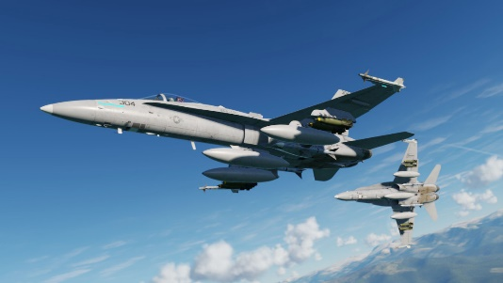
59th Gemini
DCS F/A 18C mappings
Version 1.9.3
Push up
center
down
Push up
center
down
UP
MR
DN
up
center
down
ICS PTT
---
---
A/G mode
A/G mode 2
Normal mode
Normal mode 2
forward
back
forward
---
---
center
Normal mode
Normal mode 2
mode 2
back
A/G mode
A/G mode 2
forward
back

