Slide 1
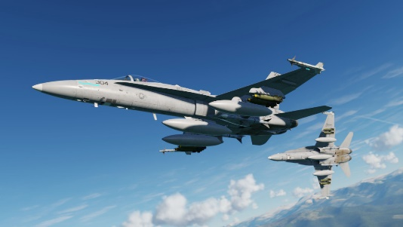
59th Gemini
DCS F/A 18C mappings
Version 1.9.3
External binding
DISPOSER ON/OFF
FUEL PROBE EXTEND/RETRACT
Long press
Long press + S4 (mode 2)
short press
Short press + S4 (mode 2)
TRIM NOSE DOWN
---
PUSH UP
FCS BIT
WINGS SWITCH LEFT
BATTERY
CENTER
BATTERY ON
LED 1
TRIM LEFT DOWN
---
TRIM RIGHT DOWN
---
GEAR
DOWN
BATTERY OFF
FIRE
CAGE/UNCAGE
FLAPS
PUSH UP
FCS RESET
WING SWITCH RIGHT
TRIM NOSE UP
---
TAIL HOOK
CENTER
LEFT-RIGHT MDI
DAY – OXYGEN ON
SENSOR SELECT DEPRESS
EXTERIOR LIGHTS
DOWN
LEFT-RIGHT MDI OFF
OXYGEN OFF
SENSOR FWD
ZOOM-
APU ON/OFF
SENSOR LEFT
RDR SWITCH LEFT
SENSOR RIGHT
RDR SWITCH RIGHT
MASTER ARM
RAID/FLIR FOV
CARRIER STARTUP
REFUEL & RELOAD
RADAR ELEVATION AXIS
---
HMD -
SENSOR AFT
ZOOM +
HMD +
FLAPS AUTO
UP
BACKLIGHT
BACKLIGHT
TDC UP
AMRAAM
PARKING BRAKE SWITCH STOW
LED 3
FLAPS HALF
MR
RESET MASTER WARNING
EMMERGENCY JETTISON
TDC LEFT
AIM7
TDC RIGHT
AIM9
LED 3
FLAPS FULL
DN
PARKING BRAKE SWITCH LEFT
PARKING BRAKE SWITCH RIGHT
CANOPY OPEN
VOICE TEST TAPE A
UP
TDC DOWN
GUNS
LED 2
GEAR UP/DOWN
CANOPY HOLD/OFF
CENTER
FLOOD-CHART LIGHT +
FORMATION LIGHTS +
PARKING BRAKE SWITCH PULL
CANOPY CLOSE
VOICE TEST TAPE B
DOWN
CONSOLE PANEL LIGHTS +
POSITION LIGHTS +
CONSOLE PANEL LIGHTS -
POSITION LIGHTS -
LED 4
TAIL HOOK UP/DOWN
LAUNCH BAR UP/DOWN
WING SWITCH PULL/STOW
ATC
MAP
STARTER RIGHT
STARTER LEFT
FLOOD-CHART LIGHT -
FORMATION LIGHTS -
PAUSE
MENU
SRS 1 PTT
TDC DOWN ACTION (LOCK)
EJECT (HOLD BUTTON)
Zoom on Y Axis
BACKLIGHT BLINK
COMM2
NVG +
COMM 1
NVG -
SRS 2 PTT
NVG ON/OFF
FOLLOW LAUNCHED
FINGER LIFT (BOTH)
FORWARD
RETRACT AIRBRAKE
JETTISON CTR/LIN/RIN
BACK
DEPLOY AIRBRAKE (HOLD)
AP/NWS OFF
FIRE
NWS/UNLOCK
TAKE OFF TRIM
FORWARD
STROBE BRIGHT
LANDING LIGHT ON
EXTERIOR LIGHTS ON
LED 5
CENTER
STROBE OFF
---
EXTERIOR LIGHTS OFF
mode 2
BACK
STROBE DIM
LANDING LIGHTS OFF
FORWARD
CHAFF
MODE AA
RECCE MARK
ALE 47 POWER
BACK
FLARE
MODE AG
NWS/AP/GLIMIT OFF
TORCH

