Slide 1



Mathias Cercelet
Florian Montels
Léo Maczyta
Coline Moinet
Julie Gonzalez
Lila Roig
PIR Presentation
Extraction of a flight behaviour from time series data
2022-2023
5Y - GMM
01.24.22
Notes:
Insa logo
company logo onera
Tutors
Author
Title
date
Yer of study + departtement
Pir presentation

Slide 2



Introduction
Flight simulator → artificially re-creates aircraft flights
Saving money & fuel
Reproduce flight scenarios
Aim: Classify time series data from flight simulators
The presence of a failure
The type of the failure
The type of flight scenario
Julie Gonzalez Lila Roig 2
Notes:
Savoir définir les keywords

Slide 3
2
2
Methods:
Data preprocessing
Dimension reduction
Classification
4
4
Conclusion and perspectives
1
1
3
3
Description of the data
Results
3
Julie Gonzalez Lila Roig 3

Slide 4


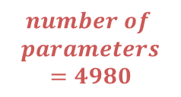

1
Description of the data
simulator X-plane
Each simulation = one Multivariate time series
sequence of data points indexed by time
several parameters that evolve in parallel
300 simulations
10 types of errors
5 types of scenarios
$$length of time series$$
$$number of$$
$$simulations$$
$$number of$$
$$parameters=4980$$
4980 parameters
Time step = 10 ms
Time series length = 40 seconds to 1 minute
Altitude, speed, amount of fuel…
Julie Gonzalez Lila Roig 4
Notes:
Savoir définir les keywords

Slide 5
2
Methods
Data Preprocessing
1. Identification of qualitative and quantitative variables
2. Separation training / test set
3. Feature selection
→ Processed differently by the algorithms
Separation 50/50:
Number of parameters >> number of observations
⇒ ill proportionned problem
4980 parameters
Deletion of constant parameters through time and between all multivariate time series
Not random, each failure scenarios in both sets but biased
Identification of the variable type based on the unit in the data
(ex : seconds, boolean…)
Separation 80/20:
Correlation matrix:
Identify groups of highly correlated variables
(correlation > 0.95)
Keep only one variable per group
Quantative variables
Qualitative variables
Random, no bias, more data for training
Selection of:
125 quantitative variables
79 qualitative variables
Julie Gonzalez Lila Roig 5
Notes:
Savoir définir les keywords

Slide 6
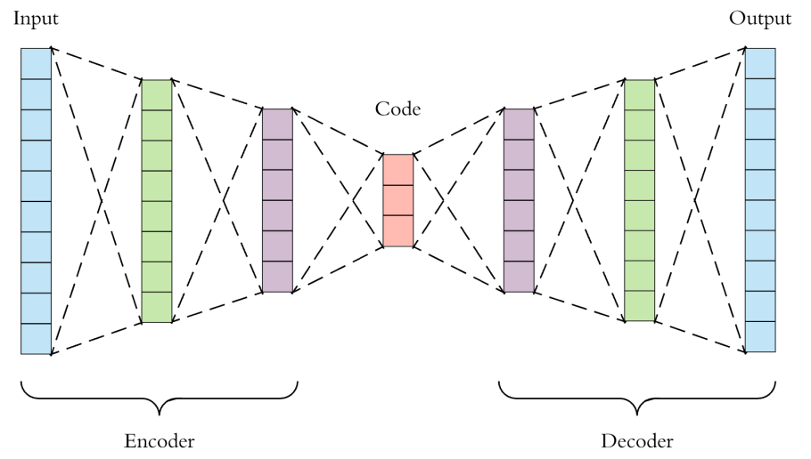

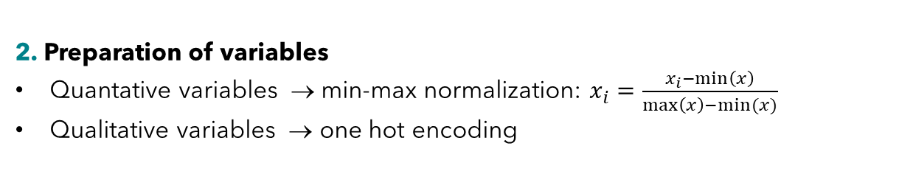




2
Dimension reduction with 1D-Deep Convolutional Autoencoder (1D-DCAE)
Methods
DCAE as a data preprocessing for time series classification to reduce the dimension
Autoencoder: neural network trained to compress the data in a short code and to decompress this code to reconstruct an output close to the initial data
Preprocessing steps:
1. Equalize length of all the multivariate time series
2. Preparation of variables
Quantative variables → min-max normalization: $x_{i}=\frac{x_{i}−min\left(x\right)}{\max\left(x\right)−min⁡(x)}$
Qualitative variables → one hot encoding
$$parameters$$
3. Resampling
→ reduce resolution up to 25 ms
$$w1$$
$$w2$$
4. Application of overlapping sliding windows
DCAE better at treating short sequences
preserve temporal characteristics:
$$time$$
⇒ Generalization of PCA in non-linear cases
$$stride=\frac{size window}{2}$$
time series
Julie Gonzalez Lila Roig 6
Notes:
Savoir définir les keywords

Slide 7
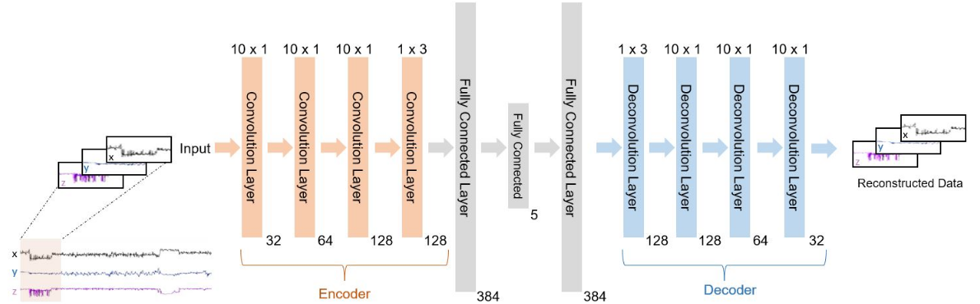

2
Dimension reduction with 1D-Deep Convolutional Autoencoder (1D-DCAE)
Methods
1D convolutions efficient to discover patterns and features from short sequences
Architecture 1
Time reduction only
Modifications architecture 2
→ Reduction of the time and the number of features
Addition of a:
a maxpooling layer in the encoder
an upsampling layer in the decoder
Adaptations
Number of slid windows
Architecture of the 1D-DCAE implemented by [Alqahtani et al., 2021]
Architecture inspired from [Salmina et al., 2021]
Julie Gonzalez Lila Roig 7
Notes:
Savoir définir les keywords

Slide 8

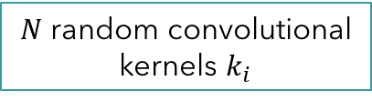

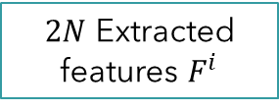












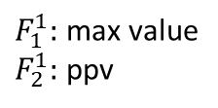





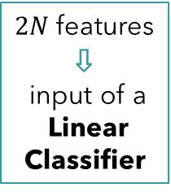
2
Multivariate time series classification
with Rocket & MiniRocket
Methods
Incentive: Rocket $≈$recent complex methods + much sorter training time.
Rocket Architecture:
CNN based on random convolutional kernels → detect complex patterns, shapes and frequencies.
$p$ variables
$N$random convolutional
kernels $k_{i}$
$N$ feature maps$f_{i}$
$2N$ Extracted
features $F^{i}$
$$l_{kernel}$$
$k_{1}$:
$$1$$
$$f_{1}:$$
$$+ b_{1}$$
$F_{1}^{1}:$max value
$F_{2}^{1}:$ ppv
$$w_{1}^{1}$$ | $$w_{2}^{1}$$ | $$w_{3}^{1}$$
$n$ time steps
...
...
$2N$features
⇩
input of a
Linear Classifier
$$f_{i}:$$
$$+ b_{i}$$
$$F_{1}^{i}$$
$$F_{2}^{i}$$
$k_{i}$:
$$w_{1}^{i}$$ | $$w_{2}^{i}$$ | $$w_{3}^{i}$$
...
...
$$f_{N}:$$
$$+ b_{N}$$
$$F_{1}^{N}$$
$$F_{2}^{N}$$
$k_{N}$:
$$w_{1}^{N}$$ | $$w_{2}^{N}$$ | $$w_{3}^{N}$$
Multivariate Time Serie
Weigths
Bias
Kernel parameters: size, weights, bias, dilation, padding.
Julie Gonzalez Lila Roig 8

Slide 9
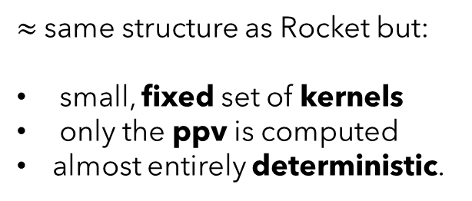
2
Multivariate time series classification
with Rocket & MiniRocket
Methods
Regular CNN:
Rocket:
weights + bias → learned during training
size, dilation, padding → fixed
VS
Random size, weights, bias, dilation and padding.
The combination of a massive variety of kernels can capture relevant features for classifying time series.
Parameters are not learned + calculations are // → low computational cost with makes Rocket fast.
MiniRocket Architecture:
Incentive: MiniRocket = reformulation of Rocket up to 75 times faster while maintaining the same accuracy.
Algorithm chosen for this project
MiniRocket:
$≈$same structure as Rocket but:
small, fixed set of kernels
only the ppv is computed
almost entirely deterministic.
Rocket:
VS
Allows to speed up the calculations making MiniRocket faster than Rocket
Julie Gonzalez Lila Roig 9

Slide 10
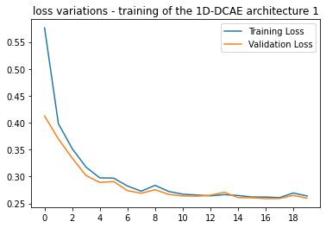
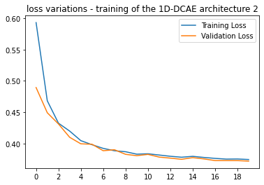
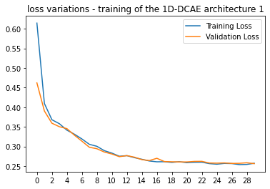
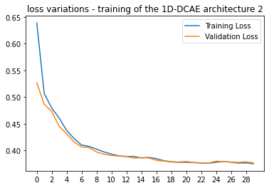
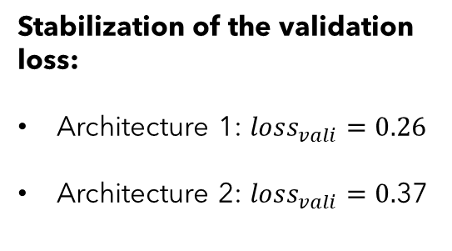
3
Dimension reduction with 1D-Deep Convolutional Autoencoder (1D-DCAE)
Results
Training of the DCAE
⇒ Plotting the training and validation loss of to make sure the algorithm converges
Stabilization of the validation loss:
Architecture 1: $loss_{vali}=0.26$
Architecture 2: $loss_{vali}=0.$37
Dataset
80/20
Architecture 1 fits the data better.
Coherent: architecture 1 reduces the data less
Dataset
50/50
Julie Gonzalez Lila Roig 10
Notes:
Savoir définir les keywords

Slide 11
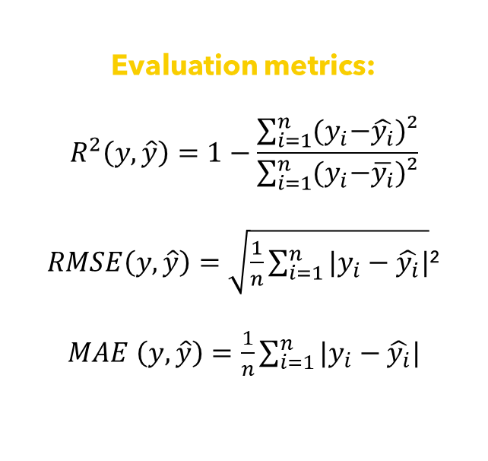
3
Dimension reduction with 1D-Deep Convolutional Autoencoder (1D-DCAE)
Results
Test of the DCAE
Evaluation metrics:
$$R^{2}\left(y,\hat{y}\right)=1−\frac{\sum_{i=1}^{n}{{(y}_{i}−\hat{y_{i}})²}}{\sum_{i=1}^{n}{{(y}_{i}−\overline{y_{i}}})²}$$
$RMSE\left(y,\hat{y}\right)=\sqrt{\frac{1}{n}\sum_{i=1}^{n}{{|y}_{i}−\hat{y_{i}}|}}$²
$MAE$ $\left(y,\hat{y}\right)=\frac{1}{n}\sum_{i=1}^{n}{{|y}_{i}−\hat{y_{i}}|}$
Dataset | Architecture | RMSE | MAE | R²
80/20 | 1 | 0.089 | 0.029 | 0.97
 | 2 | 0.22 | 0.14 | 0.68
50/50 | 1 | 0.072 | 0.027 | 0.97
 | 2 | 0.22 | 0.14 | 0.67
Conclusion
Architecture 1 provides a better reconstruction of the data
Architecture 2 reduces the dimension more, so the classification algorithm will be trained faster
Julie Gonzalez Lila Roig 11
Notes:
Savoir définir les keywords

Slide 12
3
Multivariate time series classification
with MiniRocket
Results
Training of MiniRocket
Separation:
Classification task:
Data:
50/50 & 80/20
1. Different configurations
error detection & type of error & type of scenario
reduced by DCAE & 'raw’ + preprocessed
2. Training & prediction
a. MiniRocket features are calculated on the train set.
b. A linear classifier head with a dropout layer is added.
c. Generate new features for the test set using the features of the train set → predictions on the test data
3. Parameter tuning
Tune 3 parameters: dropout + learning rate + number of epochs
1
Tune the parameters by hand
Implementation of our own grid search function.
The grid of possible input values is a
Latin Hypercube with low discrepancy
2
Optimize the tuning of parameters
Tuning on the raw dataset is too time consuming: we tune parameters with the reduced data from the DCAE and use the best parameters found to train other configurations.
Julie Gonzalez Lila Roig 12
Notes:
Savoir définir les keywords

Slide 13
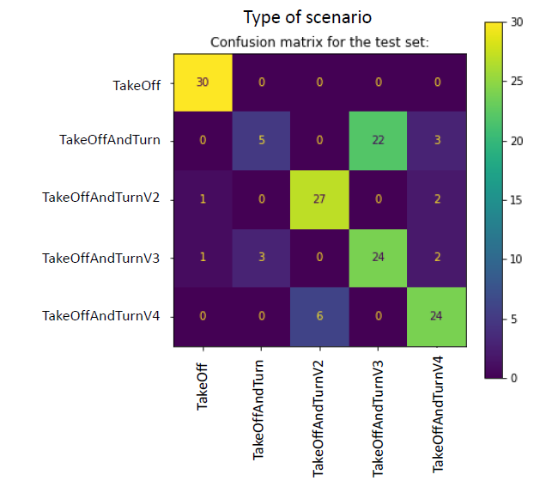
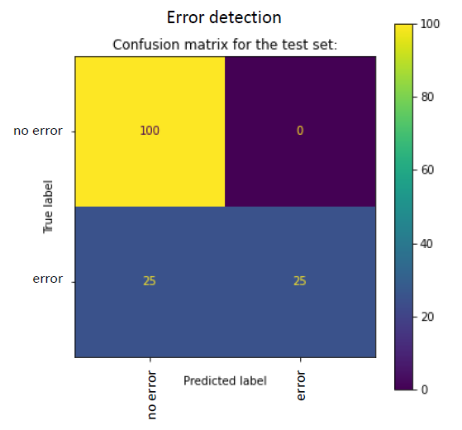
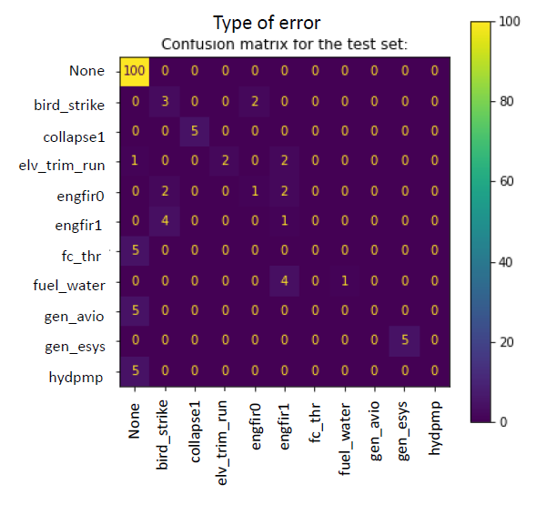




3
Multivariate time series classification
with MiniRocket
Results
Test of MiniRocket
Accuracy = $\frac{\text{nb} \text{of} \text{correct} \text{predictions}}{\text{nb} \text{of} \text{predictions}}$
Recall = $\frac{True positive }{True positive +false negative}$
Evaluation metrics:
F1-score = 2 $\frac{precision × recall }{precision + recall}$
Precision = $\frac{True positive }{True positive + false positive}$
Confusion matrices for the 3 classification tasks:
Julie Gonzalez Lila Roig 13
Notes:
Savoir définir les keywords

Slide 14
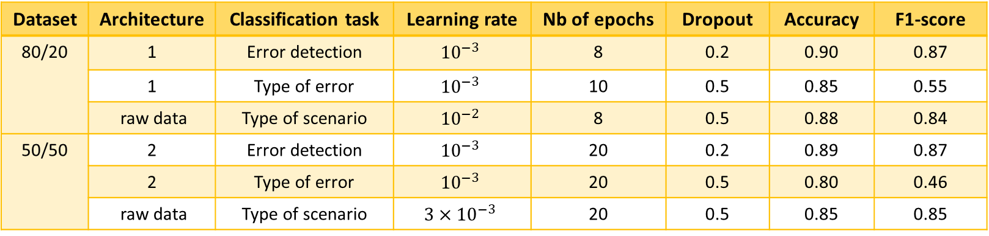
3
Multivariate time series classification
with MiniRocket
Results
Test of MiniRocket
Dataset | Architecture | Classification task | Learning rate | Nb of epochs | Dropout | Accuracy | F1-score
80/20 | 1 | Error detection | $${10}^{−3}$$ | 8 | 0.2 | 0.90 | 0.87
 | 1 | Type of error | $${10}^{−3}$$ | 10 | 0.5 | 0.85 | 0.55
 | raw data | Type of scenario | $${10}^{−2}$$ | 8 | 0.5 | 0.88 | 0.84
50/50 | 2 | Error detection | $${10}^{−3}$$ | 20 | 0.2 | 0.89 | 0.87
 | 2 | Type of error | $${10}^{−3}$$ | 20 | 0.5 | 0.80 | 0.46
 | raw data | Type of scenario | $${3×10}^{−3}$$ | 20 | 0.5 | 0.85 | 0.85
Table of
best results:
The DCAE improves the results for the tasks error detection and type of error.
Conclusion
The more classes to predict there are, the more the accuracy decreases.
Many tests by hand were performed.
Grid search tuning did not improve the results compared to hand tuning.
Grid of possible values for grid search not enough detailed.
More epochs are needed for the 50/50 dataset
The 50/50 dataset has less training data than the 80/20 dataset.
Worse results with the 50/50 dataset
The 50/50 dataset has larger and more diverse test set.
Julie Gonzalez Lila Roig 14
Notes:
Savoir définir les keywords

Slide 15
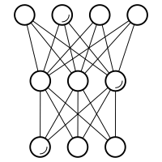


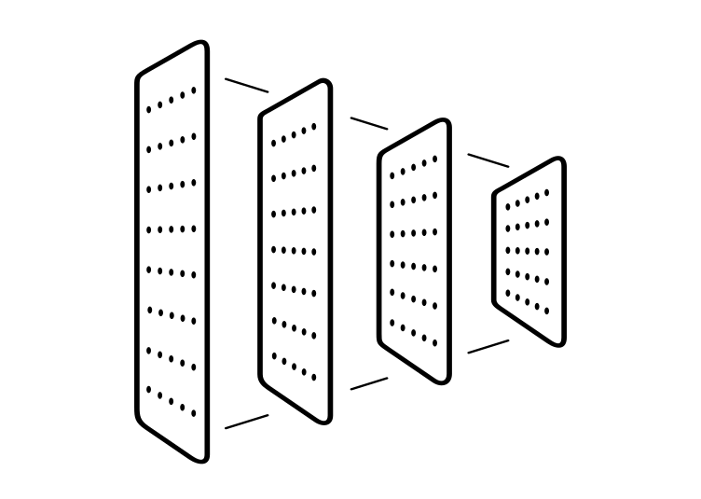


4
Conclusion and perspectives
Multivariate Time series data
Feature selection
Dimension reduction
Simulation
Classification
Accuracy
Failure detection: 90%
Type of failure: 89%
Objective: Detect failures, identify their type and the scenario
Constant and highly correlated variables
Type of scenario: 88%
DCAE: 2 architectures to reduce:
time
time + features
MiniRocket neural network
Advantages
Accurate classification with small computational costs
→ extraction of important information
→ fast classifier
1 algorithm for the 3 classification tasks
Limits
Deep learning methods would give better results if there would be more training data
How good is our algorithm on real data ?
Use by SII
Compare the results with the ones of the research unit to generate new tests
Application to real data to detect failures
Julie Gonzalez Lila Roig 15
Notes:
Savoir définir les keywords

Slide 16
References
[Alqahtani et al., 2021] Alqahtani, A., Ali, M., Xie, X., and Jones, M. (2021). Deep time-series clustering: A review. Electronics, 10:3001.
[Salmina et al., 2021] Salmina, L., Castello, R., Stoll, J., and Scartezzini, J.-L. (2021). Dimensionality reduction and clustering of time series for anomaly detection in a supermarket heating system. Journal of Physics: Conference Series, 2042(1):012027.
[Dempster et al., 2019] Dempster, A., Petitjean, F., and Webb, G. I. (2019). ROCKET: excep-
tionally fast and accurate time series classification using random convolutional kernels. CoRR,
abs/1910.13051.
[Dempster et al., 2021] Dempster, A., Schmidt, D. F., and Webb, G. I. (2021). MiniRocket.
In Proceedings of the 27th ACM SIGKDD Conference on Knowledge Discovery &amp Data
Mining. ACM.
Julie Gonzalez Lila Roig 16
Notes:
Savoir définir les keywords

Slide 17




CONTACTS
LinkedIn
JULIE GONZALEZ
jgonzale@etud.insa-toulouse.fr
+336 42 50 23 73
LinkedIn
LILA ROIG
lroig@etud.insa-toulouse.fr
+337 83 11 77 04
17

