Slide 1
第二章习题答案
王子康 2024.03.23

Slide 2
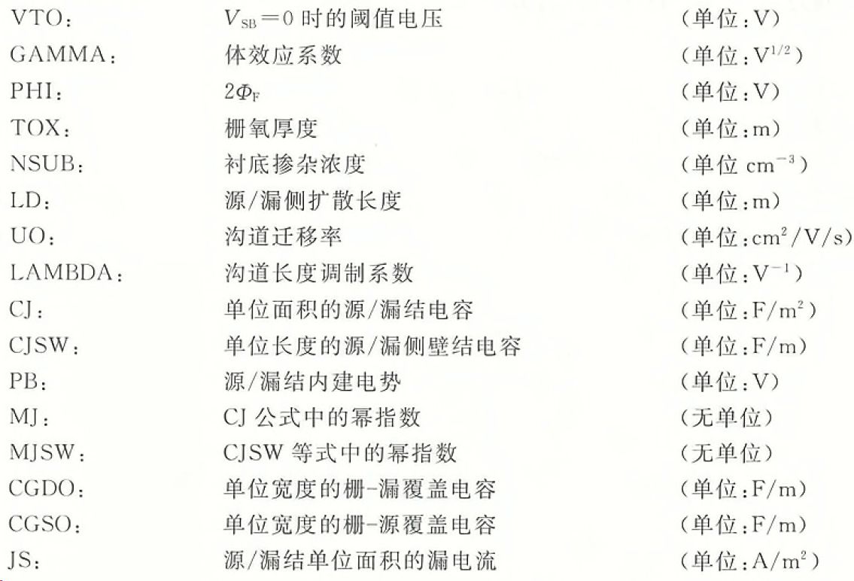
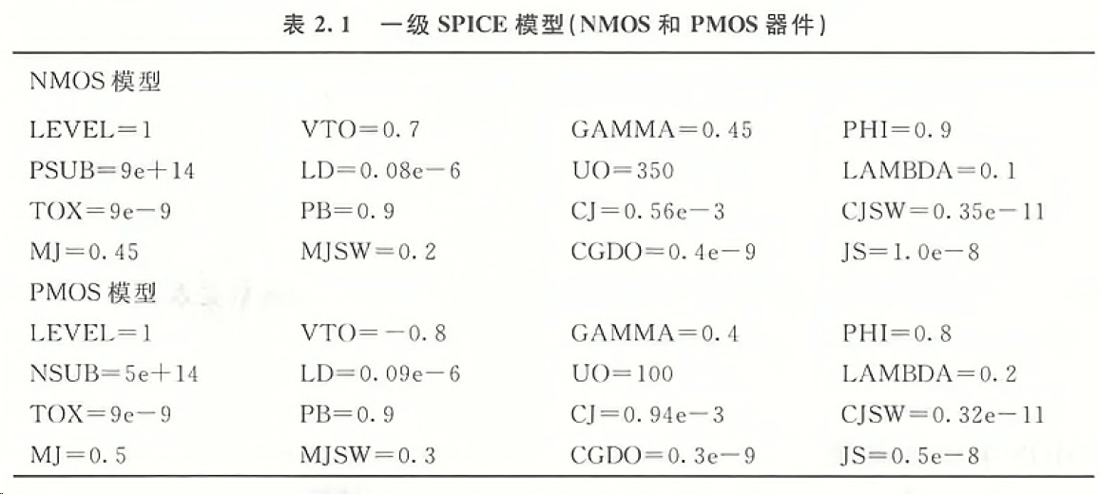

数据参考
$$L=0.5μm$$
P11

Slide 3
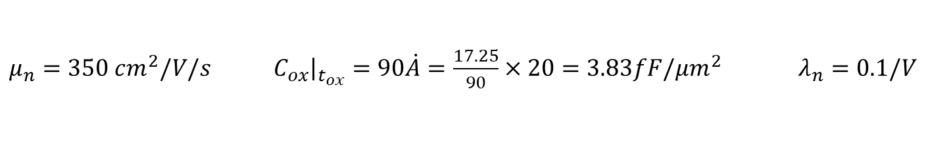
习题2.2
According to the Graphic 2.1 & Page 11
$μ_{n}=350 cm^{2}/V/s$ $C_{ox}{\left.​\right|}_{t_{ox}}=90\dot{A}=\frac{17.25}{90}×20=3.83fF/μm^{2}$ $λ_{n}=0.1/V$
$gm_{n}=\sqrt{2μ_{n}C_{ox}\frac{W}{L}I_{D}}=3.66mS$ $r_{o}=\frac{1}{λI_{D}}=20kΩ$ $Selfgain_{n}=gm_{n}r_{o}=73.6=37.3dB$
$μ_{p}=100 cm^{2}/V/s$ $λ_{n}=0.2/V$
$gm_{p}=\sqrt{2μ_{n}C_{ox}\frac{W}{L}I_{D}}=1.96mS$ $r_{o}=\frac{1}{λI_{D}}=10kΩ$ $Selfgain_{p}=gm_{p}r_{o}=19.6=25.8dB$

Slide 4
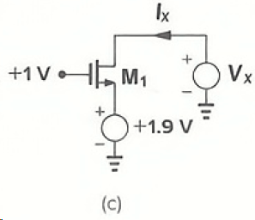

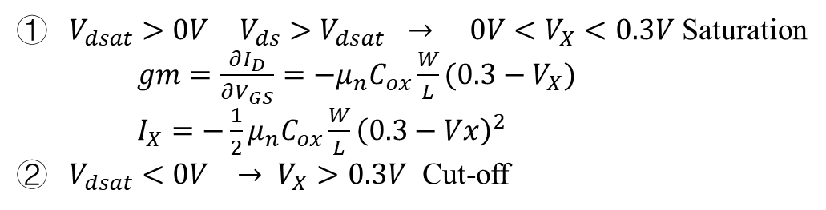


习题2.5c
$0V<V_{x}<1.9V$ Source-Drain reverse
$V_{dsat}=0.3−V_{x}$ $V_{DS}=1.9−V_{x}$
$V_{dsat}>0V$ $V_{ds}>V_{dsat}$ $→$ $0V<V_{X}<0.3V$ Saturation
$gm=\frac{∂I_{D}}{∂V_{GS}}=−μ_{n}C_{ox}\frac{W}{L}(0.3−V_{X})$
$I_{X}=−\frac{1}{2}μ_{n}C_{ox}\frac{W}{L}{\left(0.3−Vx\right)}^{2}$
$V_{dsat}<0V$ $→ V_{X}>0.3V$ Cut-off
The polarity/direction of ID and IX
$V_{x}>1.9V$ $V_{GS}=−0.9V$ Cut-off

Slide 5
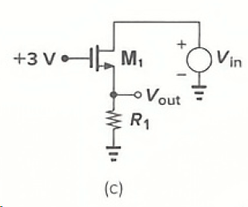
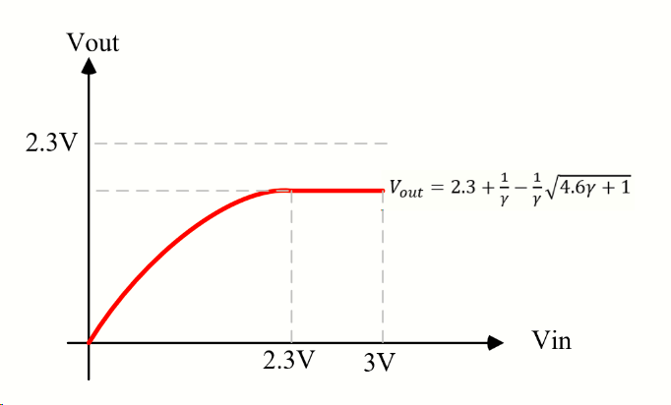
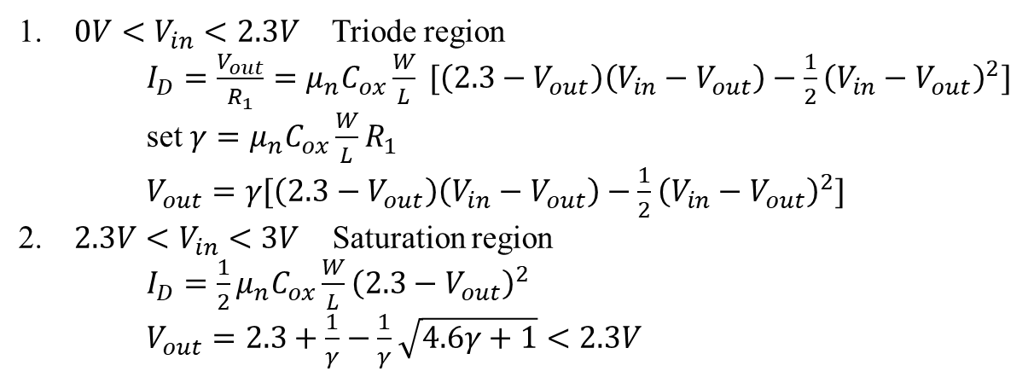
习题2.7c
$V_{GS}=3−V_{out}$ $V_{th}=0.7V$ $V_{DS}=V_{in}−V_{out}$
$0V<V_{in}<2.3V$ Triode region
$I_{D}=\frac{V_{out}}{R_{1}}=μ_{n}C_{ox}\frac{W}{L} [\left(2.3−V_{out}\right)\left(V_{in}−V_{out}\right)−\frac{1}{2}{\left(V_{in}−V_{out}\right)}^{2}]$
set $γ=μ_{n}C_{ox}\frac{W}{L}R_{1}$
$V_{out}=γ[\left(2.3−V_{out}\right)\left(V_{in}−V_{out}\right)−\frac{1}{2}{\left(V_{in}−V_{out}\right)}^{2}]$
$2.3V<V_{in}<3V$ Saturation region
$I_{D}=\frac{1}{2}μ_{n}C_{ox}\frac{W}{L}{\left(2.3−V_{out}\right)}^{2}$
$V_{out}=2.3+\frac{1}{γ}−\frac{1}{γ}\sqrt{4.6γ+1}<2.3V$

Slide 6
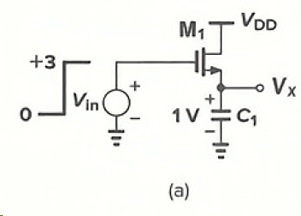
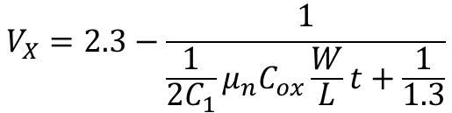
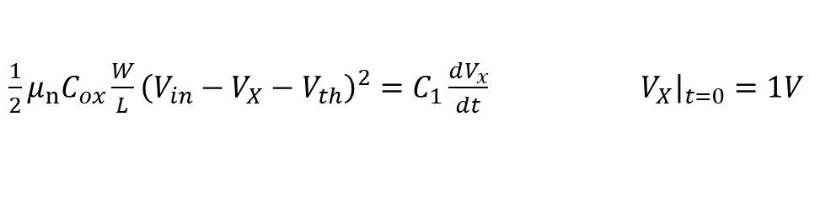
习题2.11a
$\frac{1}{2}μ_{n}C_{ox}\frac{W}{L}{\left(V_{in}−V_{X}−V_{th}\right)}^{2}=C_{1}\frac{dV_{x}}{dt}$ $V_{X}{\left.​\right|}_{t=0}=1V$
$$V_{X}=2.3−\frac{1}{\frac{1}{2C_{1}}μ_{n}C_{ox}\frac{W}{L}t+\frac{1}{1.3}}$$

Slide 7
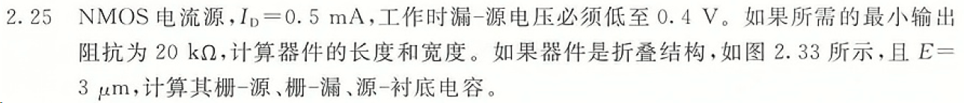

习题2.25
$r_{o}=20kΩ=\frac{1}{λΙ_{D}}$ & $λ∝\frac{1}{L}$ $→ L=0.5μm$
$V_{dsat}=V_{GS}−V_{th}=0.4V$ $I_{D}=\frac{1}{2}μ_{n}C_{ox}\frac{W}{L}{\left(V_{GS}−V_{th}\right)}^{2}$ $→W/L≈46.6$
The accurate value of W and L
$L=L_{eff}$ $W=23.3μm$
$L≠L_{eff}$ $\frac{W}{L_{eff}}=46.6$ $L_{eff}=L−2L_{D}=0.5−0.08×2=0.34μm$ $W=15.8μm$

