Slide 1



AI-First Technology Company for the
Digital, Cognitive & Industry 4.0 Era
Documentation Project Update
WE ACCELERATE JOURNEY TO FUTURE CONNECTIVITY
by offering the unique blend of next generation DIGITAL, COGNITIVE, and NETWORK technology services and solutions.

Slide 2
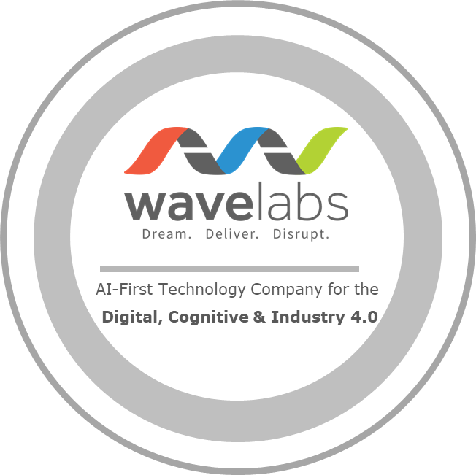
Documentation Project Update
© 2021-2025 Wavelabs Inc. All rights reserved.
2

Slide 3


Bi-Weekly Status Update (31/03/2022)
Ongoing Process
Cloud Native 5G Super Blueprint_Draft 0.2 is sent for review.
Cloud Native 5G Super Blueprint_Draft 0.3 is in progress.
Updating the information given by Rajat from Capgemini on how Altran 5GC works in Kaloom lab. (Related documents are also shared)
Had call with Sandeep & Josh from Turnium for SD-WAN on 9th Mar 2022 and explained about the inputs required for 5G Cloud Native Documentation. (Related documents are also shared)
Incorporating the content from the document provided by Capgemini into 5G Cloud Native Network document.
Hanen to provide the required information for Openshift. (Reminder mail is sent)
Next Step
Contact A10 for NGFW (Nextgen Firewall) (Introduction mail is sent, yet to get their response)
Contact Genxcomm for RAN (Introduction mail is sent, yet to get their response)
Contact UNH
Challenges in the Project
Getting interview slot & Response from the business owners.
© 2021-2025 Wavelabs Inc. All rights reserved.
3

Slide 4
Bi-Weekly Status Update (10/03/2022)
Ongoing Process
Cloud Native 5G Super Blueprint_Draft 0.2 is in progress.
Updating the information given by Ganesh & Copus from Kaloom on the fabrication. (Related documents are also shared)
Had call with Sandeep & Josh from Turnium for SD-WAN on 9th Mar 2022 and explained about the inputs required for 5G Cloud Native Documentation. Josh will prepare and share the related document in a week.
Incorporating the content from the document provided by Rebaca into 5G Cloud Native Network document.
Hanen to provide the required information for Openshift. (As Hanen Suggested reminder mail is sent)
Next Step
Contact A10 for NGFW (Nextgen Firewall) (Introduction mail is sent, yet to get their response)
Contact Genxcomm for RAN (Introduction mail is sent, yet to get their response)
Contact UNH
Ganesh from Kaloom has sent an introduction mail to Rajat from Altran to get information on the Altran 5G Core. (Waiting for the reply from Rajat)
Challenges in the Project
Getting interview slot & Response from the business owners.
© 2021-2025 Wavelabs Inc. All rights reserved.
4

Slide 5
Bi-Weekly Status Update (24/02/2022)
Ongoing Process
Cloud Native 5G Super Blueprint_Draft 0.1 is in review.
Scheduled call with Ganesh from Kaloom on 1st Mar 2022.
Updating the explanation given by Hana for the slides (5G Cloud Native Network) into main doc.
Hanen to provide the required information for Openshift. (As Hanen Suggested reminder mail is sent)
Next Step
Contact turnium for SDWAN (Interface between two labs) explanation.
Contact A10 for NGFW (Nextgen Firewall)
Contact Genxcomm for RAN
Contact Rebacaa for Gnb/UE Emulator
Challenges in the Project
Getting interview slots & Calls in late night IST.
Response from the business owners.
© 2021-2025 Wavelabs Inc. All rights reserved.
5

Slide 6

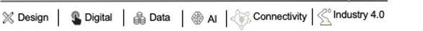


THANK YOU
https://www.wavelabs.ai/
info@wavelabs.ai
Parthiban Nalliamudali
Associate Director,
Solution Engineering, Connectivity.
parthiban@wavelabs.ai
+91-7022903371

