Slide 1
Cockpit dimensions
Width of cockpit leg room
  KH: 1.5 cm * 32 = 48 cm
  RK: 1.45 cm * 32 = 46.4 cm
  Ejection seat: https://www.britmodeller.com/forums/index.php?/topic/235109451-martin-baker-mk10-seat-dimensions/: 47 cm
  => chosen 48 cm to have a bit of margin between the seat and the cockpit (plus a nicer number)

Slide 2
Blender chunchunmarun
Factor to reduce dimensions is ca. 0,21 (most) - 0,23

Slide 3
VTH = HUD
Blender:
  The material for the VTH is canvas_transparent and has an alpha of 0.9. If you set it to a higher values, then the whole canvas gets green. The lower the value is set, the less visible the text/lines get.
The width of the inner side of the VTH:
  Blender file -5: 13.8 cm
  RK: 0.4*32 = 12.8 cm
  KH (glass): 0.4*32 = 12.8 cm
  From pictures it looks like the whole middle section is about 1/3 of cockpit leg-room – inluding outer stuff of hud -> 16 cm, maybe hud glass structure sides are 1 cm -> 14 cm
  Blender file chunchunmarun: 0.74 cm * 0,23 = 17 including out4er stuff of hud
  => stick with -5 blender file: 13,8 cm

Slide 4
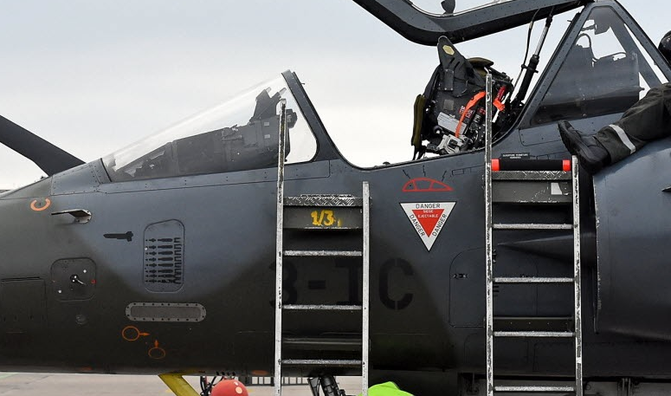
The average of the orange lines is 90 degs – i.e. the photo is representative for horizontal
The VTH glass has an angle of 45 deg respective to horizontal (green line)
The VTH body has an angle of 13 degs respective to horizontal (red line)
The lower part of the cockpit body has an angle of 28 degs (yellow line)

Slide 5
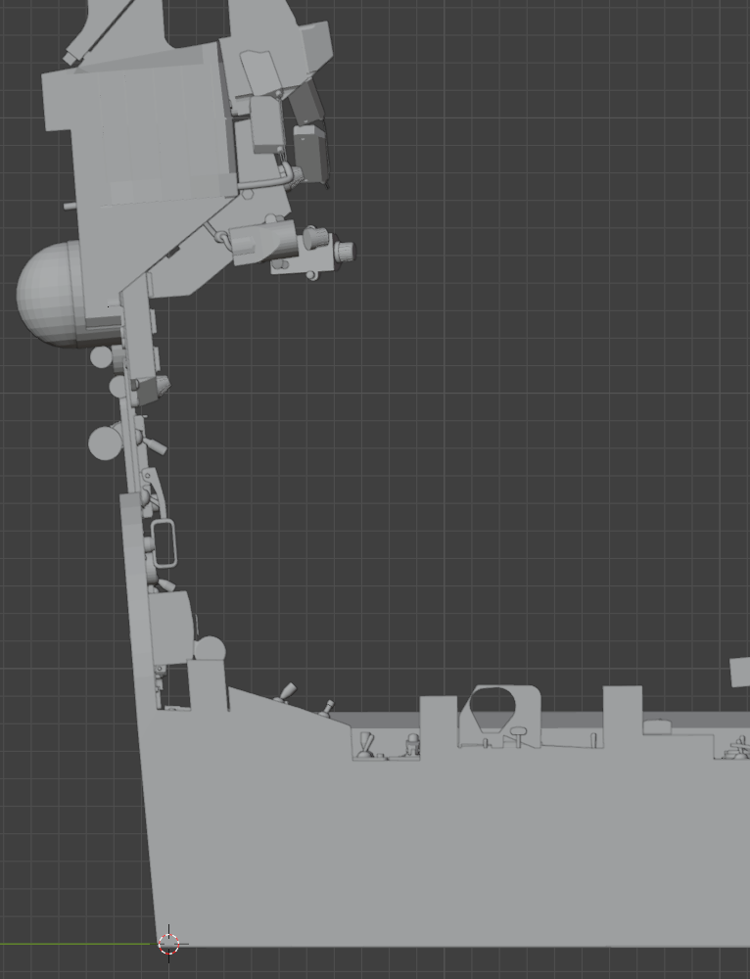
Inherited cockpit:
Green line ca. 11 deg
Amber line ca. 5 deg

Slide 6
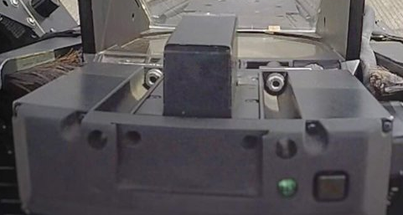
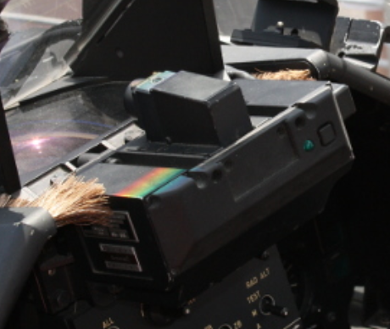
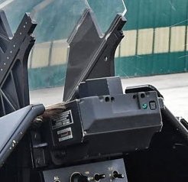
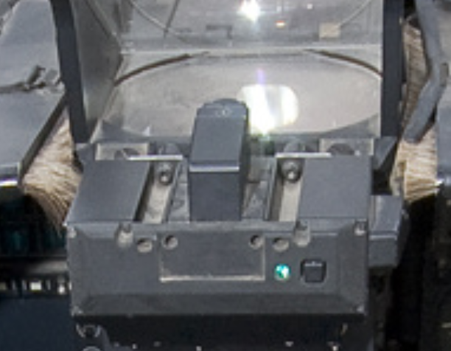
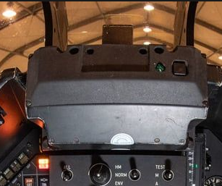
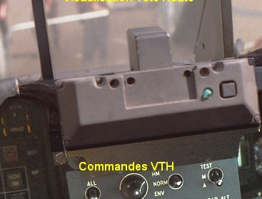
Camera+HUD
Camera body width: 11 cm/11.6 = 0,95*13,8 = 13,11 -> 13 cm

Slide 7
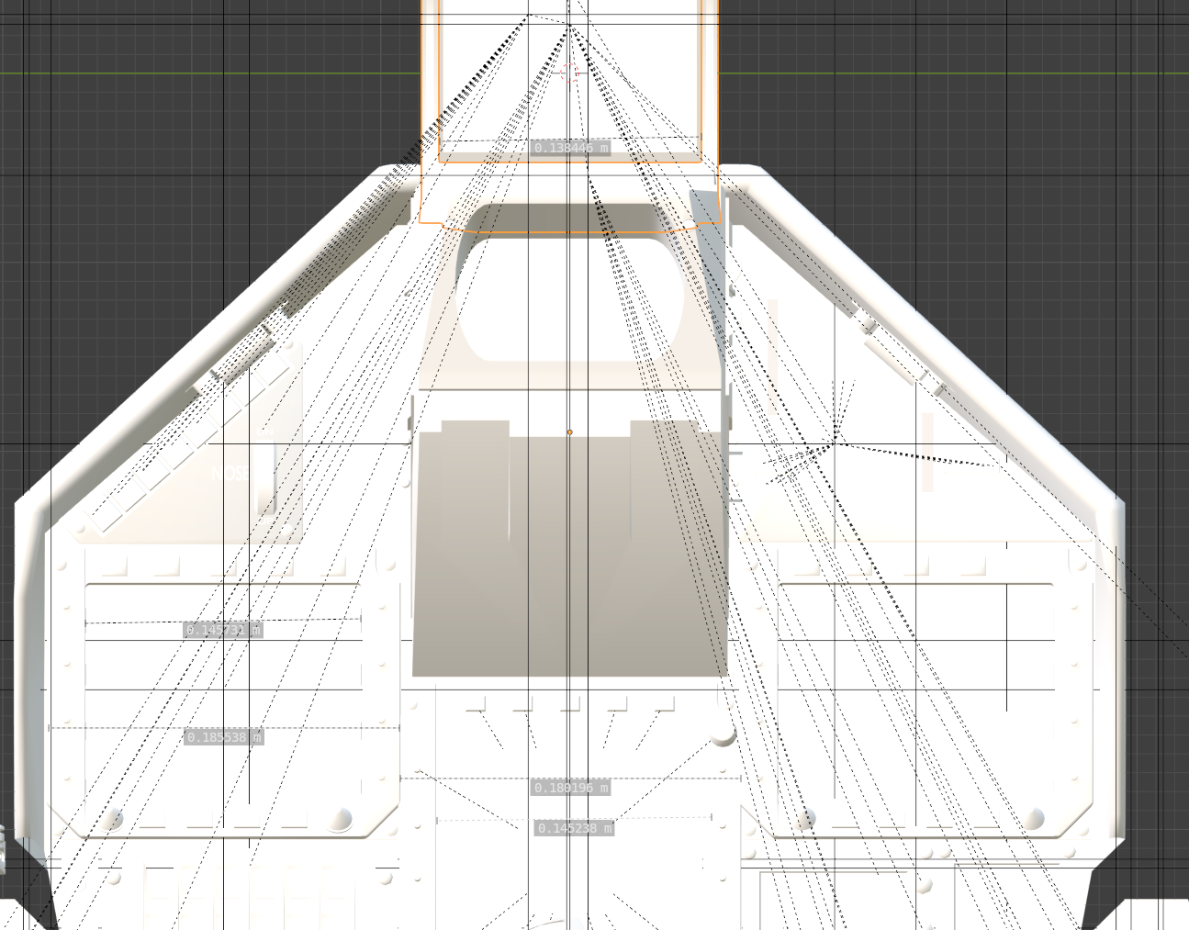
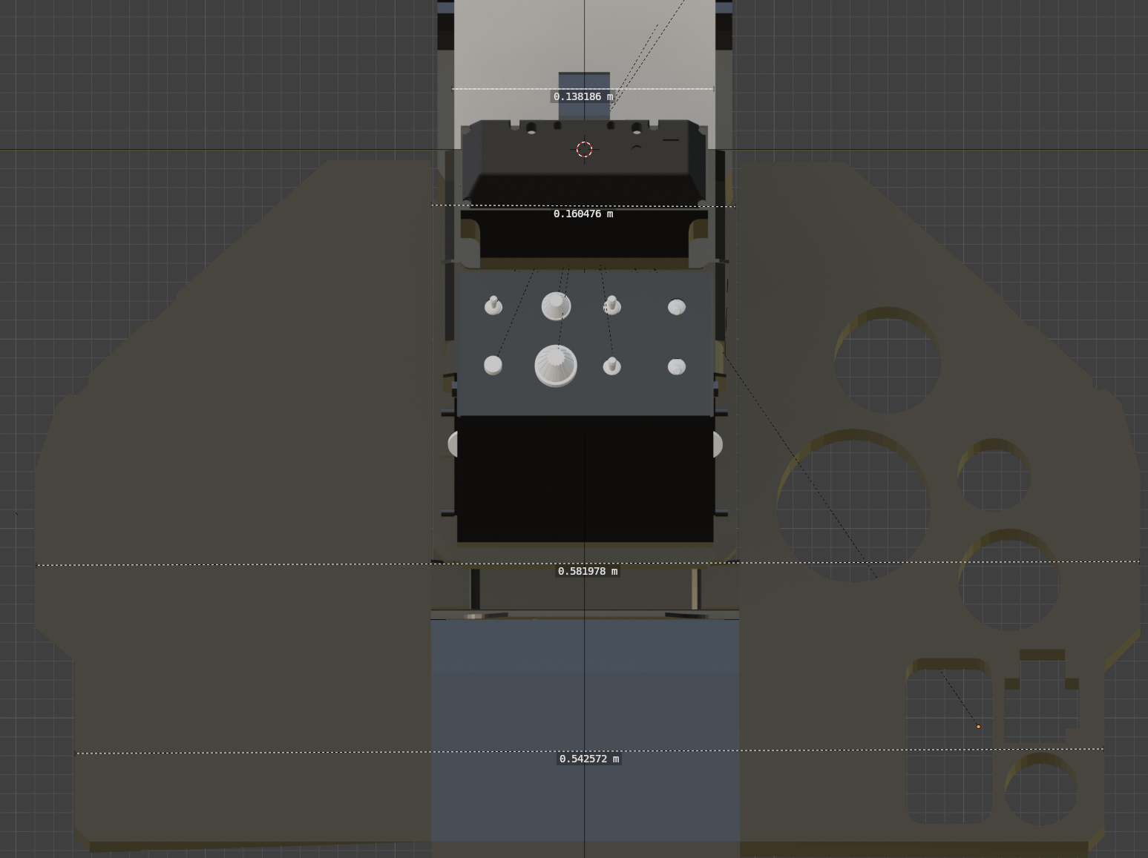
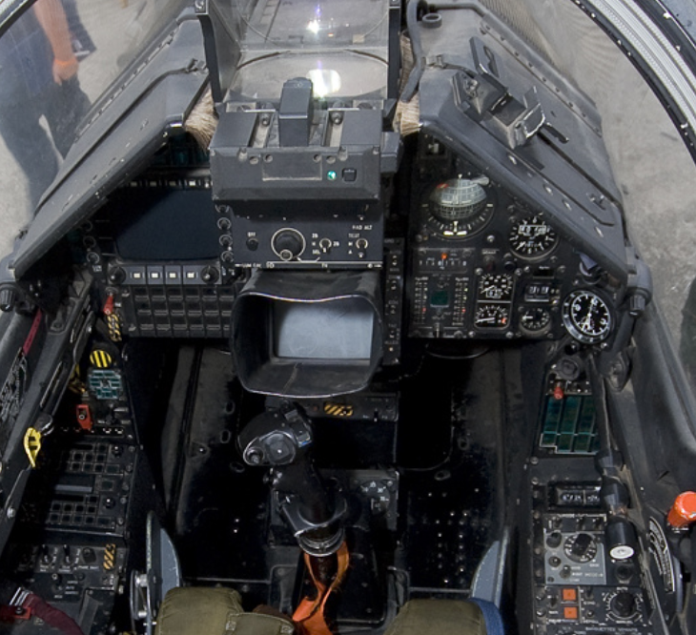
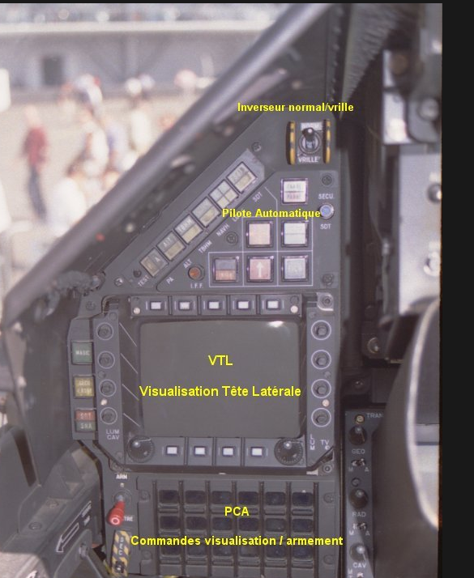
Reskit:
Centre part = 0,52 cm * 32 = 16,6 cm
Width at widest part: 1,6 cm * 32 = 51,2
-5 blender: 3*18cm = 54 cm (does not have the extra width for lights)

