Slide 1
Correlation study between traditional student feedback and a multimodal teacher evaluation system
Md Shafiqul Islam
Supervisor Dr Md. Mizanur Rahoman
26 May , 2025

Slide 2

Introduction
Importance of evaluating teacher performance in higher education
Traditional reliance on student feedback — subjective and limited
Emergence of multimodal systems using AI/ML
Objective: Compare reliability and validity between traditional and multimodal methods

Slide 3
Research problem and objectives
Problem
Objectives
Student feedback suffers from bias and lacks depth
Evaluate reliability and validity of both methods
Analyze correlation between student feedback and multimodal evaluation

Slide 4
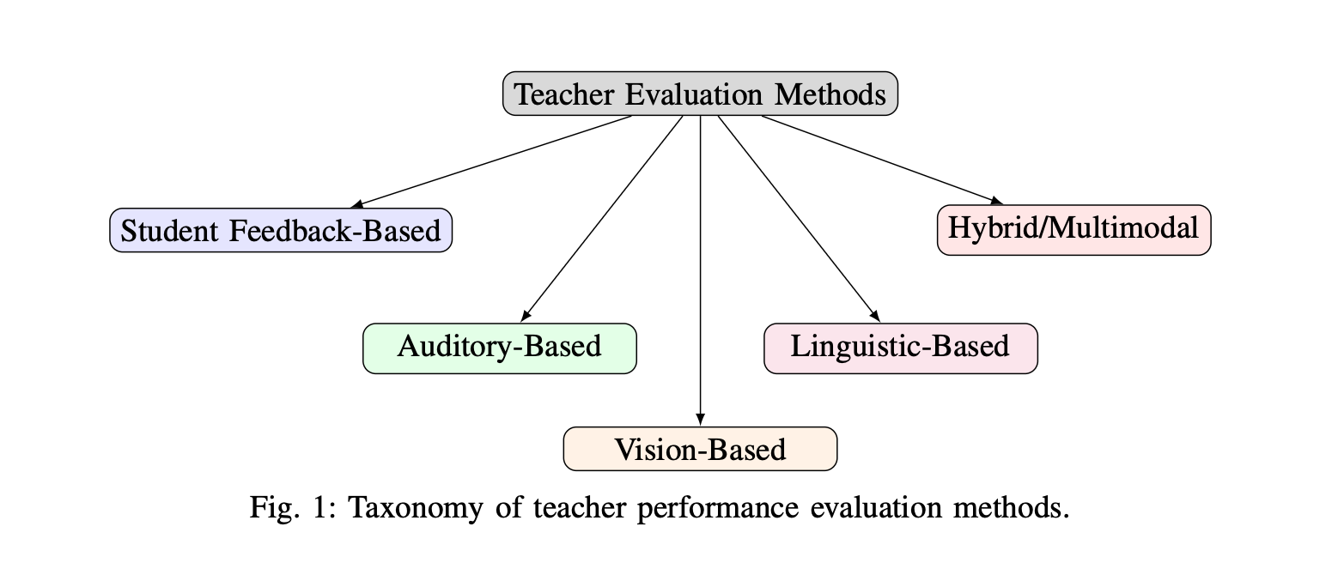
Literary review
Student feedback
Auditory Evaluation
Common but biased by non-academic factors
Captures vocal tone, emotion, prosody
Multimodal Systems
Vision-Based Systems
Linguistic/NLP
Combine all above for holistic analysis
Track movement, gestures, classroom interaction
Analyze instructional clarity, sentiment, question quality

Slide 5
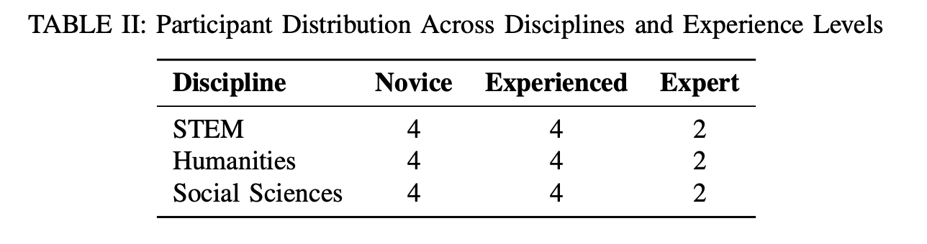
Methodology
Research design
This study employs a mixed-methods comparative design
Data collection methods
Student feedback Likert-scale (7 dimensions)
Multimodal system Audio, Video, Text

Slide 6
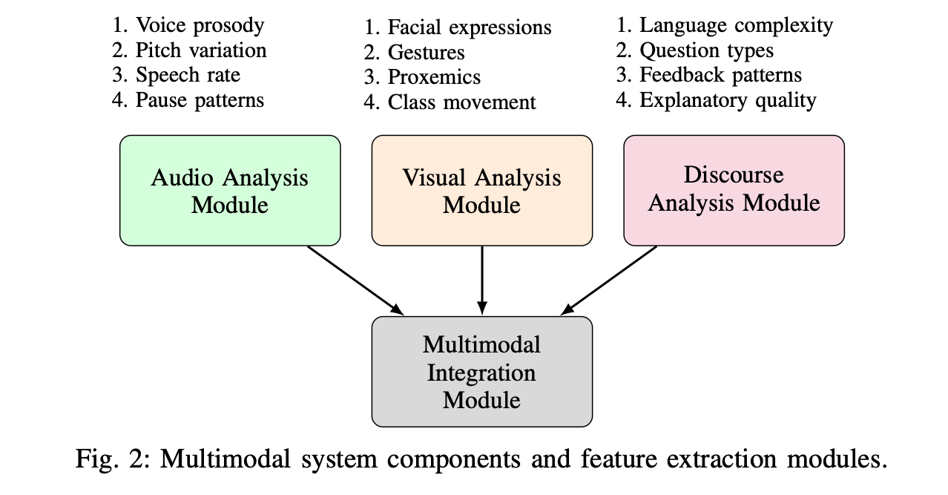
Methodology
Data processing
Visual YOLOv5 + HRNet
Audio PRAAT + emotion indicators
Text NLP + BERT embeddings
This study employs a mixed-methods comparative design

Slide 7
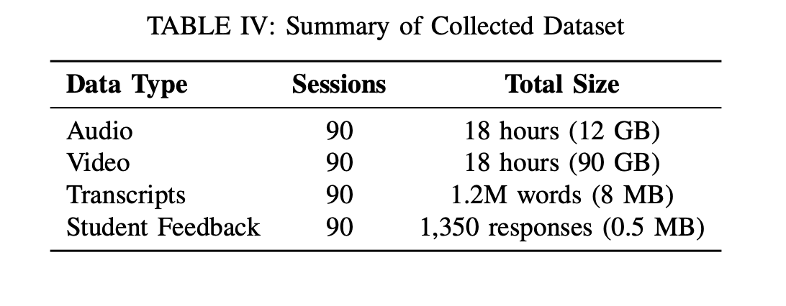
Data collection summery
Audio recordings WAV, 44.1Hz
Video recordings MP4, 1080p
Transcripts TXT
Student feedback CSV

Slide 8
Experimental setup
Hardwares
Softwares
RTX 3060 + 32 GB RAM For faster processing
PRAAT For audio processing
OpenPose/HRNet For pose estimation
Python + hugginface For analysis and modeling

Slide 9
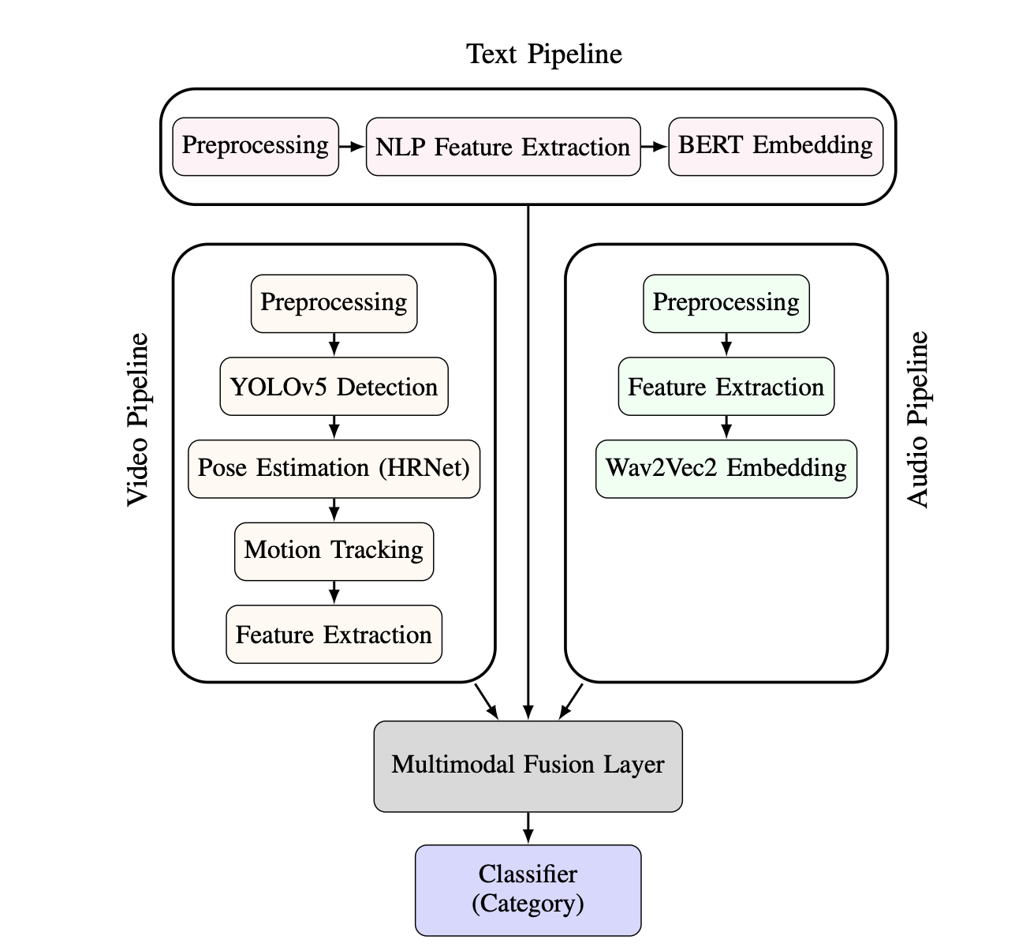
Multimodal evaluation system
Audio Speech rate, pitch, emotion using Wav2Vec2
Video Pose estimation, gesture tracking (YOLOv5, HRNet)
Text feedback Sentiment analysis, question type (BERT/DistilBERT)

Slide 10
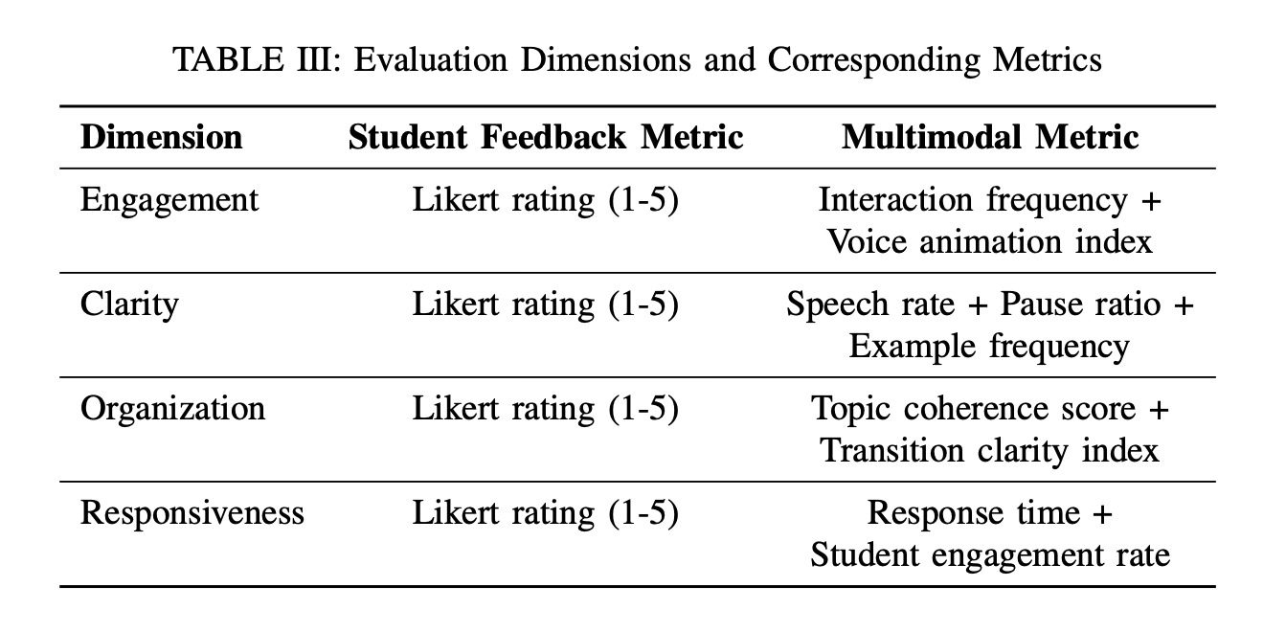
Evaluation metrics
We evaluated engagement, clarity, responsiveness, and overall effectiveness by comparing student feedback with multimodal features such as gestures, speech patterns, response timing, and combined audio-visual-text data.

Slide 11
THANK YOU

